Slide 1
Lecture — Telling a Story with ggplot
From a plot that shows everything to a figure that says one thing Bill Perry

Slide 2
Where we left off
Basic ggplot — geom_boxplot(), geom_point(), position_jitter()
Advanced plotting — facet_wrap(), stat_summary(), geom_smooth(), patchwork, log scales
You can now build almost any figure ggplot is capable of drawing
Note
✅ Key idea from Advanced Plotting
You now have the mechanics. Today is different: no new geoms. Today is about choosing which mechanics to use, and which to leave out, so your one figure makes one point.

Slide 3
Goals for Today
The problem this lecture solves:
Your final-project talk is 5 minutes and one figure
A technically-correct plot can still fail to communicate
“I made a boxplot” is not the same as “I told a story”
What we’ll practice:
Start from the question, not the geom
Cut everything that doesn’t serve the point
Direct labeling instead of a legend, when you can
Order categories to match the story, not the alphabet
Color with intent, and with accessibility in mind
A title that states the finding, not the variable names
annotate() to point at the one thing that matters
Tip
🖐 Try it yourself
By the end you will redesign a technically-correct-but-confusing plot into one that a stranger understands in five seconds.
Our tools today: mostly tools you already know, used differently.
References:
📖 R4DS Ch 9 — Layers
📖 R4DS Ch 11 — Communication
🌐 A Compendium of Clean Graphs in R
Naming conventions:
plots → _plot
a redesigned plot → _plot_v2

Slide 4
How to Use These Slides — Predict · Type · Run
Two chunks today. After each, switch to the activity and redesign a plot yourself.
Predict what’s wrong with a plot before I tell you
Type the redesign by hand
Compare your five-second read of the before vs. the after
Note
✅ Why this lecture matters
Every remaining lecture in this course ends with a plot. This is the only lecture that tells you how to judge whether that plot is any good — a skill no geom teaches by itself.

Slide 5
Load Libraries and Data
# Load all packages at the top of every script ---------- library(readxl) # reading Excel files library(tidyverse) # data wrangling + ggplot2 library(janitor) # cleans up messy column names
# Reuse our cleaned leaf data ---------------------------- tree_df <- read_excel("data/2026_06_25_tree_experiment_raw_data.xlsx") %>% clean_names()

Slide 6
🧩 Chunk 1 of 2 · The Rule — One Figure, One Point
We will cover: starting from the question, and the “five-second test.”
Tip
🖐 After this chunk: Activity Parts 1–3.

Slide 7
Start From the Question, Not the Geom
Before you write one line of ggplot(), answer this in a full sentence:
“This figure shows that ____.”
If you cannot finish that sentence, you are not ready to plot yet — you are still exploring. Exploring is fine, but exploratory plots and the final figure are not the same plot.
Our sentence today:
“Leaves on the shady side of the tree are heavier than leaves on the sunny side.”
Note
✅ Key idea
A dozen exploratory plots is normal and good. Your final talk gets one. Decide which one earns that slot by asking whether it finishes the sentence above.

Slide 8
The Five-Second Test
Show your plot to a labmate for five seconds, then hide it. Ask: “What did that plot say?”
If they repeat your sentence back — the plot works
If they describe the axes instead of the finding — it doesn’t yet
If they ask “wait, what am I looking at?” — start over
Tip
This is the same test we asked you to plan for in the final-project worksheet: “Slide 3 — the ONE figure that shows your result.” Today is where you learn to build that slide.

Slide 9
A Plot That Shows Everything (and Says Nothing)
Note
🔮 Predict first: Before you look at the code, predict what will be wrong with this plot even though every line of code is correct.

Slide 10
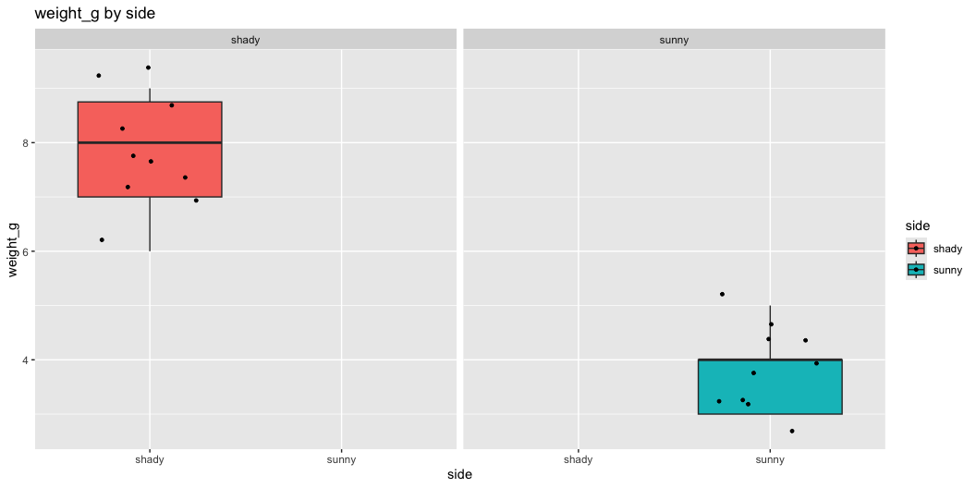
# Technically correct — but a poor final figure --------- tree_busy_plot <- tree_df %>% ggplot(aes(x = side, y = weight_g, fill = side)) + geom_boxplot() + geom_jitter(width = 0.3, size = 1) + facet_wrap(~ side) + labs(title = "weight_g by side", x = "side", y = "weight_g") + theme_gray() tree_busy_plot
Warning
⚠️ What’s wrong here
Faceting by the same variable that’s on the x-axis — pure redundancy
Legend repeats what the x-axis already says
Title is a variable name, not a finding
Axis labels are raw column names, not readable text
Default gray background adds visual noise

Slide 11
🧩 Chunk 2 of 2 · The Fixes
We will cover: cutting redundancy, direct labeling, deliberate ordering and color, and a finding-based title.
Tip
🖐 After this chunk: Activity Parts 4–7.

Slide 12
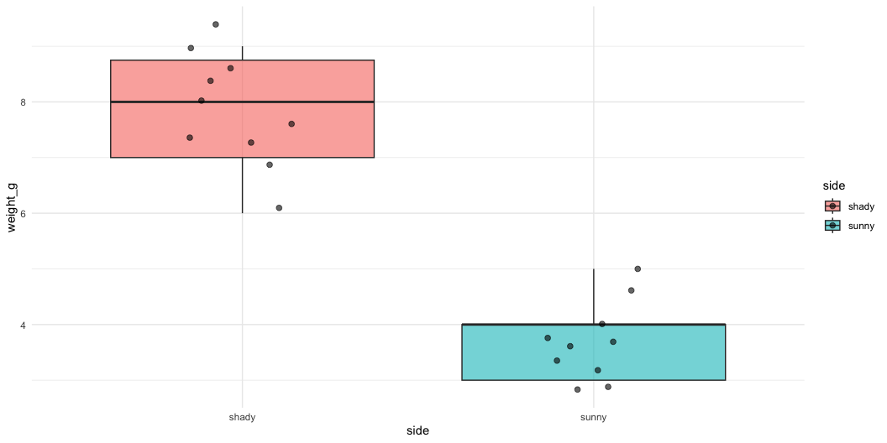
Fix #1 — Cut Anything That Repeats Itself
# Removed the redundant facet_wrap ---------------------- tree_plot_v2 <- tree_df %>% ggplot(aes(x = side, y = weight_g, fill = side)) + geom_boxplot(alpha = 0.6, outlier.shape = NA) + geom_jitter(width = 0.15, alpha = 0.6, size = 2) + theme_minimal() tree_plot_v2
Note
✅ Key idea
If two elements of your plot show the same information twice (facet + x-axis, legend + x-axis, title + axis label), delete one. Redundancy is not clarity — it’s clutter that looks like effort.

Slide 13
Fix #2 — Direct Labels Instead of a Legend
Note
🔮 Predict first: Our x-axis already says “sunny” and “shady.” Do we need the fill = side legend at all?

Slide 14
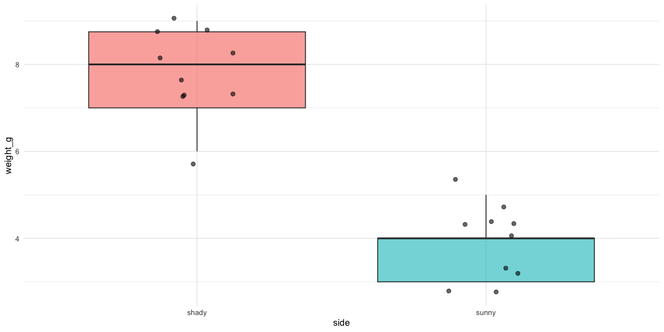
# Drop the legend — the x-axis already tells us the group tree_plot_v3 <- tree_df %>% ggplot(aes(x = side, y = weight_g, fill = side)) + geom_boxplot(alpha = 0.6, outlier.shape = NA) + geom_jitter(width = 0.15, alpha = 0.6, size = 2) + theme_minimal() + theme(legend.position = "none") tree_plot_v3
A legend forces the reader’s eye to travel back and forth
When the x-axis (or a direct label) already names the groups, the legend is dead weight
Rule of thumb: if removing the legend loses zero information, remove it

Slide 15
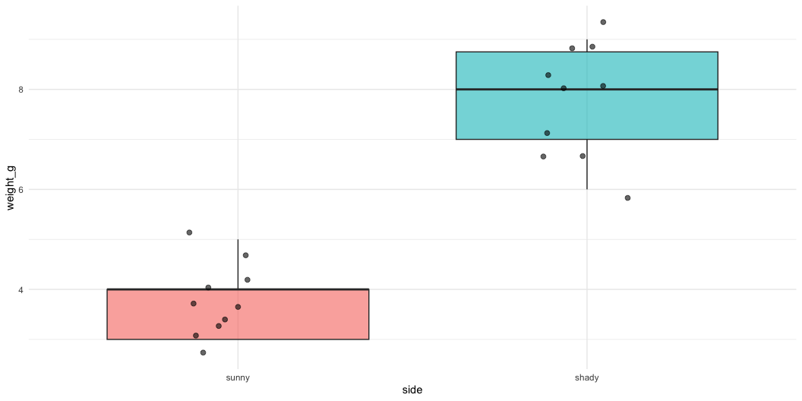
Fix #3 — Order With Intent, Not the Alphabet
# fct_relevel() puts categories in a meaningful order --- tree_plot_v4 <- tree_df %>% mutate(side = fct_relevel(side, "sunny", "shady")) %>% ggplot(aes(x = side, y = weight_g, fill = side)) + geom_boxplot(alpha = 0.6, outlier.shape = NA) + geom_jitter(width = 0.15, alpha = 0.6, size = 2) + theme_minimal() + theme(legend.position = "none") tree_plot_v4
Alphabetical order (shady before sunny) is an accident of spelling, not a decision
fct_relevel() lets you choose the order that matches your story: baseline first, then the comparison
Order becomes especially important with 3+ groups — put them in a logical sequence (low to high, control then treatments, etc.)
📖 R4DS Ch 17 — Factors

Slide 16
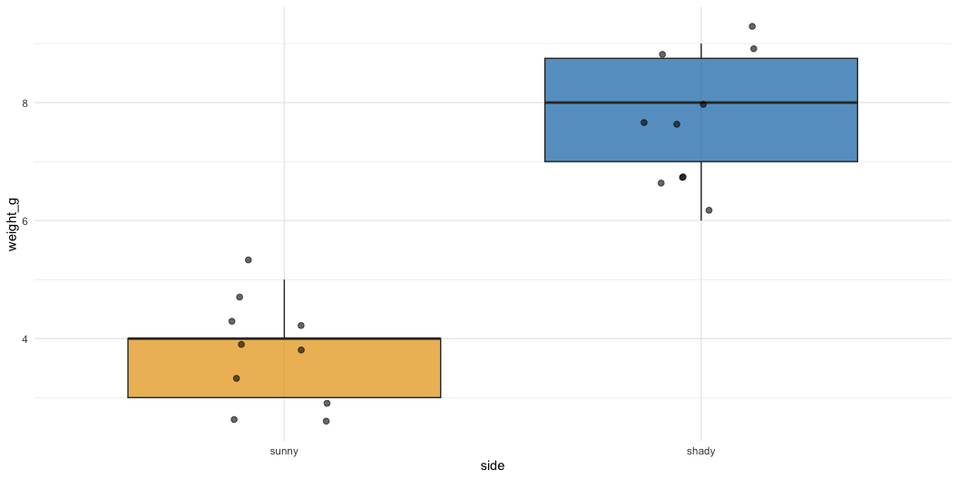
Fix #4 — Color With Intent (and Colorblind Safety)
# Choose two colors deliberately, not ggplot's defaults - tree_plot_v5 <- tree_df %>% mutate(side = fct_relevel(side, "sunny", "shady")) %>% ggplot(aes(x = side, y = weight_g, fill = side)) + geom_boxplot(alpha = 0.7, outlier.shape = NA) + geom_jitter(width = 0.15, alpha = 0.6, size = 2) + scale_fill_manual(values = c(sunny = "#E69F00", shady = "#0072B2")) + theme_minimal() + theme(legend.position = "none") tree_plot_v5
Warning
⚠️ Watch out!
Red/green combinations are unreadable to ~8% of men with red-green color blindness. #E69F00 (orange) and #0072B2 (blue) are from the Okabe-Ito palette, designed to stay distinguishable for colorblind readers.
Tip
Colour should encode the group your reader most needs to compare — not just “make it look nice.”

Slide 17
Fix #5 — A Title That States the Finding
Note
🔮 Predict first: Compare "weight_g by side" to "Shady leaves are heavier than sunny leaves". Which one lets someone understand the plot without ever looking at the axes?

Slide 18
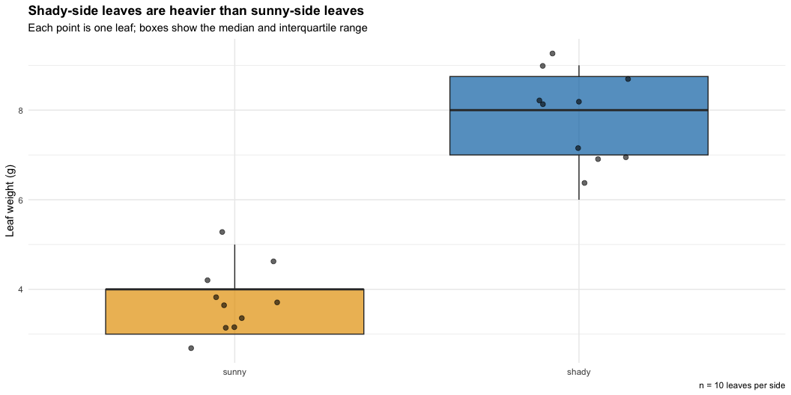
# The title states the finding; labs() explains the rest tree_final_plot <- tree_df %>% mutate(side = fct_relevel(side, "sunny", "shady")) %>% ggplot(aes(x = side, y = weight_g, fill = side)) + geom_boxplot(alpha = 0.7, outlier.shape = NA) + geom_jitter(width = 0.15, alpha = 0.6, size = 2) + scale_fill_manual(values = c(sunny = "#E69F00", shady = "#0072B2")) + labs( title = "Shady-side leaves are heavier than sunny-side leaves", subtitle = "Each point is one leaf; boxes show the median and interquartile range", x = NULL, y = "Leaf weight (g)", caption = "n = 10 leaves per side" ) + theme_minimal() + theme(legend.position = "none", plot.title = element_text(face = "bold")) tree_final_plot
Title = the finding, in plain English
Subtitle = one sentence of method/context
Caption = sample size or data source — small print, not the headline
x = NULL — when categories are self-explanatory, drop a redundant axis label
📖 R4DS Ch 11 — Communication

Slide 19
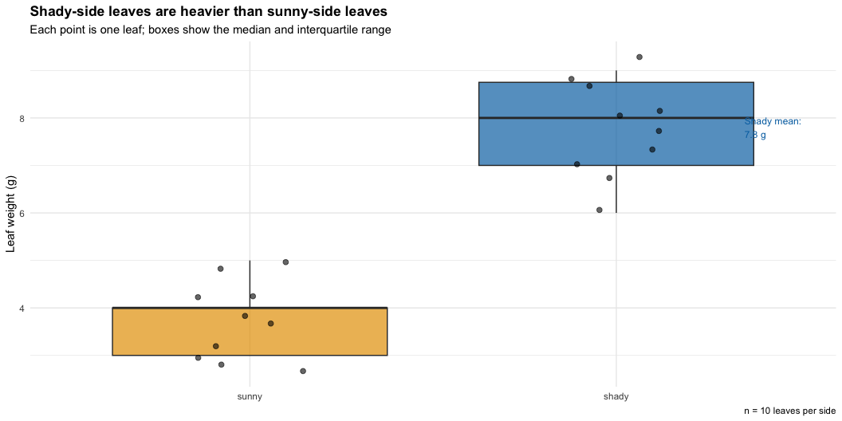
Fix #6 — annotate() to Point at the One Thing
# annotate() draws a fixed element, not tied to the data mean_shady <- tree_df %>% filter(side == "shady") %>% summarize(m = mean(weight_g, na.rm = TRUE)) %>% pull(m) tree_final_plot + annotate( "text", x = 2.35, y = mean_shady, label = paste0("Shady mean:\n", round(mean_shady, 1), " g"), size = 3.2, color = "#0072B2", hjust = 0 )
annotate() places a single fixed label — it does not come from a geom_*() mapped to data
Use it to call out the one number your audience should leave remembering
Do not over-annotate — one callout per figure is usually the right number

Slide 20
🛑 Pause — Do Activity Parts 1–7 Now
Take the “busy” plot all the way through every fix, and redesign a second plot on your own using height_cm or width_cm.

Slide 21
What We Learned Today
Start every final figure from a finished sentence, not a geom
The five-second test: does a stranger repeat your finding back?
Cut redundancy: repeated legends, facets, and titles are clutter
Direct-label when you can; drop the legend when the axis already says it
Order categories with intent (fct_relevel()), not alphabetically
Color with intent, and check colorblind safety (Okabe-Ito palette)
Title = finding. Subtitle = method. Caption = fine print.
annotate() to point at exactly one number or region that matters
References:
📖 R4DS Ch 9 — Layers
📖 R4DS Ch 11 — Communication
🌐 A Compendium of Clean Graphs in R
Up next:
Final Project Milestone work — you’ll use every fix from today on your own dataset’s take-home figure

