Slide 1
Lecture 12 — Real Climate Data in R
How fast is your city warming? (regression on time)
Bill Perry

Slide 2
Where we left off (Lecture 11 — Regression)
lm(Y ~ X, data = df) fits a straight line through a cloud of points
summary(model) gives you:
  the slope — how much Y changes per 1 unit of X
  its p-value — is that slope real, or could it be chance?
  R² — how tightly the points follow the line
geom_smooth(method = "lm") draws the line
plot(model) checks the residuals
Note
✅ Where today comes in
Last time X was paper mass and the slope converted grams into cm²
Today X is time
  the slope becomes a rate of change — degrees per year
  and that is exactly what a “warming rate” is

Slide 3
Goals for Today
Download real weather station data from inside R — no Excel, no copy-paste
Clean the names with janitor so the code stays easy to type
Summarize ~25,000 daily records into one mean per year
Fit lm(temp ~ year) and read the warming rate straight off summary()
Split by season — is winter warming faster than summer?
Find a station for a city you choose and run the whole thing again
Tip
🖐 Where this is going
The analysis is the same four lines every time
Change the station, and it is a new city
That is your out-of-class extension
Tools today:
GSODR — NOAA station data (Duluth)
nasapower — data by lat/long (your city)
janitor — clean_names()
tidyverse — summarize and plot
lm() — the slope is the answer
Reading:
📖 R for Data Science 2e
  Ch. 3 Data transformation
📖 Whitlock & Schluter Ch. 17 — Regression
Naming conventions:
data frames → _df
plots → _plot
models → _model

Slide 4
🧩 Chunk 1 of 3 · The Question
We will cover: where the data comes from, why the slope of a regression on time is a warming rate, and why you have to summarize before you can see it. No code in this chunk.

Slide 5
Where Does This Data Come From?
GSOD = Global Surface Summary of the Day, run by NOAA
  daily weather from thousands of stations worldwide
  many records reach back to the 1940s
  free, and no account needed
The GSODR package pulls it straight into R
  you give it a station ID and a range of years
  it hands back a data frame
  it warns GSOD retired in Aug 2025 — expected; the archive still works
Our station to start:
Duluth International Airport
Station ID 727450-14913
Daily records 1948–2024
  1965–1972 missing — a different station ID back then
Why this matters:
  this is the same messy, real-world data you will meet in your own project
  the workflow — download → summarize → model — is the one you will reuse all term
And it is yours to reuse:
  every city with a long station record can be run through the exact same code
  you will pick one later today

Slide 6
The Slope Is the Warming Rate
Last lecture:
$$\hat{\text{area}}=a+b×\text{mass}$$
b was cm² per gram — a conversion factor
Today:
$$\hat{\text{temp}}=a+b×\text{year}$$
b is °C per year — a rate of change
Nothing about the code changes. Only what X means.
Reading the slope:
  b positive → warming
  b negative → cooling
  b near 0 → no trend
Make it human: °C per year is a tiny number
  multiply it by 10 → °C per decade
  0.027 °C/year → about 0.27 °C per decade
The p-value still does the same job
  H₀: the slope is 0 — no trend at all
  small p → the trend is real, not chance

Slide 7
Why You Must Summarize First
A station reports one row per day
  69 years × 365 days ≈ 25,000 rows
Every one of those days carries the seasonal cycle
  January is 30 °C colder than July, every single year
  that swing is enormous compared with a few tenths of a degree of warming
So the trend you want is buried in the noise you don’t
Important
Summarizing is not throwing data away.
It is choosing which question you are answering
Want to study a heat wave? Use daily
Want to study climate? Use yearly
One group_by(year) %>% summarize() — the same two lines from Summary Statistics
That is the whole fix
Summary level | group_by() | Rows left
Daily (raw) | none | ~25,000
Yearly | year | 69

Slide 8
🧩 Chunk 2 of 3 · Duluth’s Warming Rate
We will cover: downloading the Duluth record, cleaning the names, summarizing to yearly means, and fitting lm(temp ~ year).
🛑 After this chunk: Activity Parts 1–5 (download, summarize, plot, fit, read the slope).

Slide 9
Load Libraries and Download the Data
# Load packages at the top -----------------------------
library(tidyverse) # dplyr + ggplot2
library(janitor) # clean_names()
library(GSODR) # NOAA station data - Duluth
library(nasapower) # NASA data by lat/long - your city
# Download daily Duluth weather, 1948-2024 -------------
# 1965-1972 are missing for this station, so skip them
gap_years <- 1965:1972
duluth_df <- get_GSOD(years = setdiff(1948:2024, gap_years),
station = "727450-14913") %>%
clean_names()
get_GSOD() takes years and a station and goes and gets the data
  1948:2024 is a vector — “every year in this range”
  setdiff() removes the 8 missing years from that vector
    ask for a year the station does not have and the whole download fails
  it takes a minute; 69 years of daily data is a lot
clean_names() is the important habit here
  NOAA ships columns as TEMP, YEARMODA, MXSPD
  R is case-sensitive, so temp would error
  clean_names() makes everything lower case and snake case, once, at the top
Tip
Clean the names as you load the data, and you never think about capitals again.

Slide 10
What Did We Get?
# How big is it, and what is in it? --------------------
dim(duluth_df)
[1] 25441 47
names(duluth_df)[13:18]
[1] "yearmoda" "year" "month" "day" "yday" "temp"
~25,000 rows — one per day
47 columns — temperature, dew point, wind, precipitation, flags…
The handful we care about:
  yearmoda — the date
  year, month, day
  temp — daily mean temperature in °C
Note
names(df) is how you find out what a downloaded data set actually calls things. Always look before you type.

Slide 11
Trim to What We Need
# Keep only the columns we actually use ----------------
dlh_df <- duluth_df %>%
select(name, yearmoda, year, month, temp)
head(dlh_df, 3)
name yearmoda year month temp
<char> <Date> <int> <int> <num>
1: DULUTH INTERNATIONAL AIRPORT 1948-01-01 1948 1 -8.2
2: DULUTH INTERNATIONAL AIRPORT 1948-01-02 1948 1 -4.1
3: DULUTH INTERNATIONAL AIRPORT 1948-01-03 1948 1 -8.4
47 columns is more than anyone needs to look at
select() keeps the five that answer our question
Same select() from the Wrangling lecture — just on a much wider real file
Tip
Trim early. Every later line is easier to read when the data frame has 5 columns instead of 47.

Slide 12
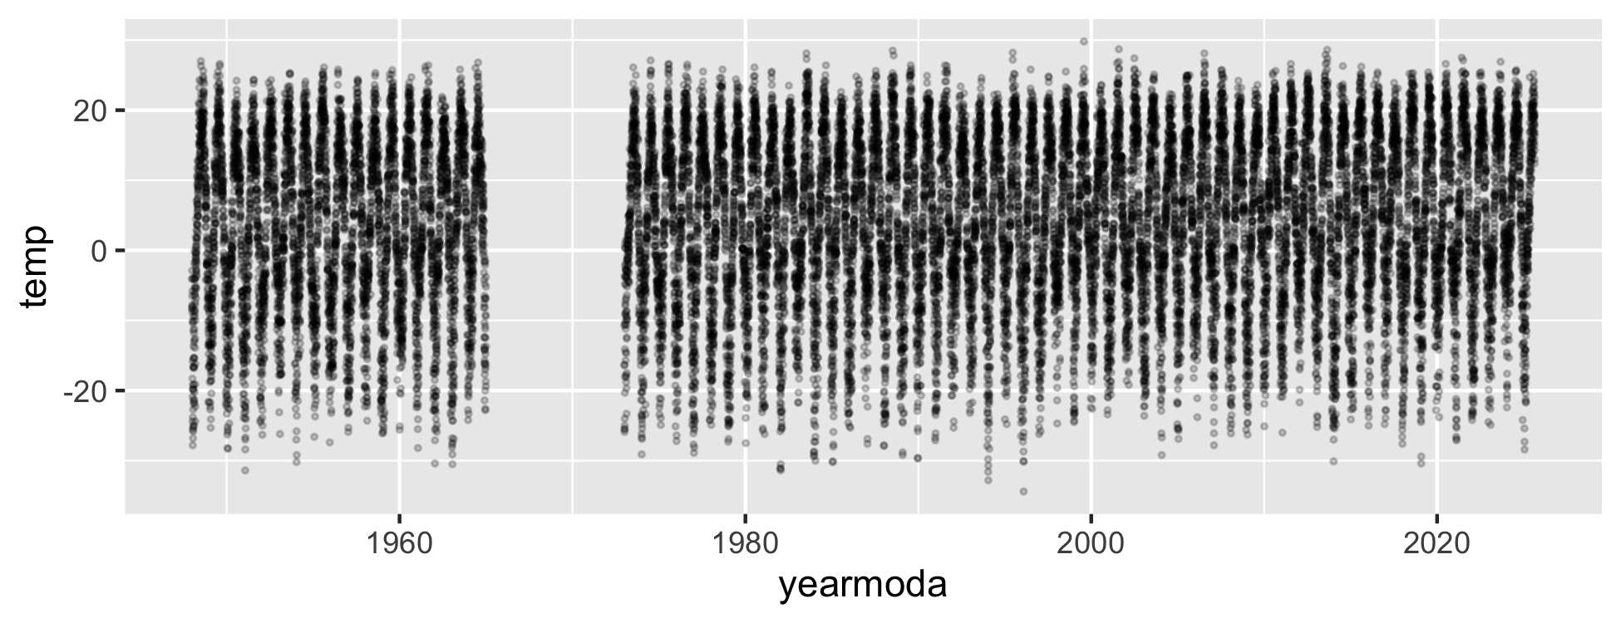
Look at the Raw Daily Data
# Every single daily temperature -----------------------
raw_temp_plot <- dlh_df %>%
ggplot(aes(x = yearmoda, y = temp)) +
geom_point(alpha = 0.2, size = 0.5)
raw_temp_plot
A solid band about 60 °C tall — that is summer vs winter, repeated 69 times
~25,000 points on top of each other
Any warming trend is in there, but it is a fraction of a degree against a 60 °C swing
So you cannot see it. That is not a plotting problem — it is a summarizing problem.

Slide 13
Summarize to One Mean per Year
# Mean temperature per year ----------------------------
dlh_year_df <- dlh_df %>%
group_by(year) %>%
summarize(temp = mean(temp, na.rm = TRUE))
head(dlh_year_df, 3)
# A tibble: 3 × 2
year temp
<int> <dbl>
1 1948 3.76
2 1949 4.10
3 1950 1.60
group_by(year) — one group per year
summarize(temp = mean(temp)) — one number per group
25,000 rows become 69
na.rm = TRUE ignores days the station missed
Note
Reusing the name temp on the left means every line below keeps working — the same trick from T-Tests II.

Slide 14
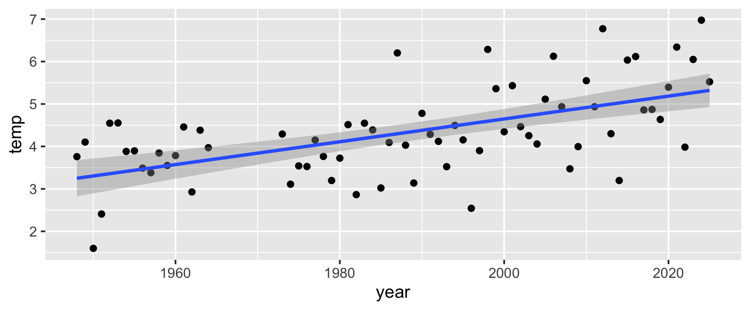
Plot the Yearly Means
# Yearly means with the regression line ----------------
yearly_temp_plot <- dlh_year_df %>%
ggplot(aes(x = year, y = temp)) +
geom_point() +
geom_smooth(method = "lm")
yearly_temp_plot
Now you can see it. The line clearly rises
69 points instead of 25,000 — and the story is clearer, not weaker
Still plenty of scatter: single years are weather, the line is climate
Exactly the same geom_smooth(method = "lm") as the Regression lecture
But “it looks like it goes up” is not a result. We need the number.

Slide 15
Fit the Trend
# Temperature predicted by year ------------------------
dlh_year_model <- lm(temp ~ year,
data = dlh_year_df)
summary(dlh_year_model)
Call:
lm(formula = temp ~ year, data = dlh_year_df)
Residuals:
Min 1Q Median 3Q Max
-1.99794 -0.51059 0.00688 0.49950 1.90458
Coefficients:
Estimate Std. Error t value Pr(>|t|)
(Intercept) -49.096842 9.119103 -5.384 9.77e-07 ***
year 0.026872 0.004585 5.860 1.49e-07 ***
---
Signif. codes: 0 '***' 0.001 '**' 0.01 '*' 0.05 '.' 0.1 ' ' 1
Residual standard error: 0.8774 on 68 degrees of freedom
Multiple R-squared: 0.3356, Adjusted R-squared: 0.3258
F-statistic: 34.34 on 1 and 68 DF, p-value: 1.489e-07
lm(temp ~ year) reads “temperature is predicted by year”
Y on the left, X on the right — same as always
The three numbers you want are all in this output:
  the slope (year → Estimate)
  its p-value (year → Pr(>|t|))
  R² (Multiple R-squared)

Slide 16
Reading the Warming Rate
Look at the year row of the Coefficients table.
Estimate ≈ 0.027 — that is the slope
  units: °C per year
  positive → Duluth is warming
  ×10 → about 0.27 °C per decade
  over ~77 years → roughly 2 °C
Pr(>|t|) is tiny (far below 0.001)
  the warming is real, not year-to-year luck
Multiple R-squared ≈ 0.32
  year explains about a third of the variation in annual temperature
  the other two thirds is weather — some years are just cold
  a modest R² next to a rock-solid p is completely normal in climate data
Important
The intercept looks absurd — about −49 °C.
That is the predicted temperature at “year 0”
Year 0 is 2,000 years outside the data
The intercept is bookkeeping; the slope is the science

Slide 17
→ ACTIVITY 12 Parts 1–5 now
🛑 Do Activity Parts 1–5 now
Download the Duluth record and clean_names() it
Trim the columns and plot the raw daily data
Summarize to one mean per year and plot it
Fit lm(temp ~ year) and read the slope, p, and R² off summary()

Slide 18
🧩 Chunk 3 of 3 · Seasons, and Your Own City
We will cover: labelling each day with a season, fitting a separate model for summer and winter, and finding the station ID for a city you choose.
🛑 After this chunk: Activity Parts 6–10 (seasons, two models, your own city).

Slide 19
A Better Question — Which Season Is Warming?
The annual mean says Duluth warmed about 0.27 °C per decade
But an annual mean hides which part of the year moved
That distinction is the biologically interesting one:
  ice-out dates and frozen soil depend on winter
  heat stress and drought depend on summer
  growing season length depends on the shoulders
The plan — three steps you already know:
mutate() + case_when() to label each day
group_by(year, season) + summarize()
One lm() per season
Important
⚠️ Seasons are not months — they are hemispheres.
June–August is summer north of the equator
June–August is winter south of it
If you pick Melbourne, Santiago or Cape Town later, you must swap the labels
A station’s latitude column tells you which hemisphere you are in
  positive → northern
  negative → southern

Slide 20
Label Each Day with a Season
# Northern hemisphere seasons --------------------------
# SOUTHERN hemisphere: swap summer and winter
dlh_season_df <- dlh_df %>%
mutate(season = case_when(
month %in% c(6, 7, 8) ~ "summer",
month %in% c(12, 1, 2) ~ "winter",
TRUE ~ "shoulder"
))
# Did it work? -----------------------------------------
dlh_season_df %>% count(season)
season n
<char> <int>
1: shoulder 12718
2: summer 6436
3: winter 6287
case_when() reads top to bottom: condition ~ answer
  the first matching line wins
month %in% c(6, 7, 8) = “is month 6, 7 or 8?”
TRUE ~ "shoulder" is the catch-all for everything left over — spring and fall
count() is the check: roughly a quarter of the days in each of summer and winter, half in the shoulder
📖 R4DS §3.4 — case_when()

Slide 21
Summarize by Year and Season
# Drop the shoulder, then one mean per year per season -
season_year_df <- dlh_season_df %>%
filter(season != "shoulder") %>%
group_by(year, season) %>%
summarize(temp = mean(temp, na.rm = TRUE),
.groups = "drop")
head(season_year_df, 4)
# A tibble: 4 × 3
year season temp
<int> <chr> <dbl>
1 1948 summer 17.4
2 1948 winter -12.6
3 1949 summer 18.4
4 1949 winter -11.4
filter(season != "shoulder") — != means “is not”
  keeps only the two extremes
group_by(year, season) — two grouping columns
  one row per year per season
  69 years × 2 seasons = 138 rows
.groups = "drop" tidies up afterwards
This is the same two-column group_by() from T-Tests II.

Slide 22
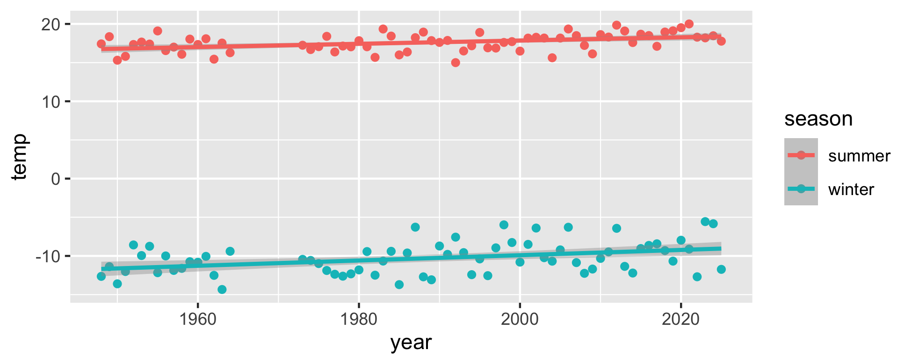
Plot Both Seasons
# One line per season ----------------------------------
season_temp_plot <- season_year_df %>%
ggplot(aes(x = year, y = temp, color = season)) +
geom_point() +
geom_smooth(method = "lm")
season_temp_plot
color = season inside aes() does two jobs at once:
  colors the points by season
  makes geom_smooth() fit a separate line per season
Two bands, far apart — winter near −11 °C, summer near 18 °C
Don’t compare the heights. Compare the steepness.
  the height is just “winter is cold”
  the slope is the warming rate
Winter’s line looks steeper — but we need the numbers

Slide 23
A Model for Summer
# Summer only ------------------------------------------
summer_df <- season_year_df %>%
filter(season == "summer")
summer_model <- lm(temp ~ year, data = summer_df)
summary(summer_model)
Call:
lm(formula = temp ~ year, data = summer_df)
Residuals:
Min 1Q Median 3Q Max
-2.6841 -0.7543 0.1585 0.6622 2.1918
Coefficients:
Estimate Std. Error t value Pr(>|t|)
(Intercept) -24.267149 10.815992 -2.244 0.028116 *
year 0.021059 0.005439 3.872 0.000245 ***
---
Signif. codes: 0 '***' 0.001 '**' 0.01 '*' 0.05 '.' 0.1 ' ' 1
Residual standard error: 1.041 on 68 degrees of freedom
Multiple R-squared: 0.1807, Adjusted R-squared: 0.1686
F-statistic: 14.99 on 1 and 68 DF, p-value: 0.0002448
filter() first, then the same lm() as before
Two small models are far easier to read than one complicated one
Summer slope ≈ 0.022 °C/year
×10 → about 0.22 °C per decade
p = 0.0002 → real
Now do exactly the same thing for winter.

Slide 24
A Model for Winter
# Winter only ------------------------------------------
winter_df <- season_year_df %>%
filter(season == "winter")
winter_model <- lm(temp ~ year, data = winter_df)
summary(winter_model)
Call:
lm(formula = temp ~ year, data = winter_df)
Residuals:
Min 1Q Median 3Q Max
-3.5398 -1.3901 0.0164 1.1662 4.0695
Coefficients:
Estimate Std. Error t value Pr(>|t|)
(Intercept) -78.24857 20.10231 -3.893 0.000229 ***
year 0.03417 0.01011 3.380 0.001202 **
---
Signif. codes: 0 '***' 0.001 '**' 0.01 '*' 0.05 '.' 0.1 ' ' 1
Residual standard error: 1.934 on 68 degrees of freedom
Multiple R-squared: 0.1439, Adjusted R-squared: 0.1313
F-statistic: 11.43 on 1 and 68 DF, p-value: 0.001202
Winter slope ≈ 0.037 °C/year
×10 → about 0.37 °C per decade
p = 0.0006 → real
Winter is warming about 1.7× as fast as summer.
This is the expected pattern across the northern continents
Fewer extreme-cold nights, shorter ice seasons, earlier thaw
The annual mean — 0.27 °C/decade — sat right between the two and told you neither

Slide 25
Reading Two Models Side by Side
Both slopes come straight off the year row of each summary():
How to write it up:
Mean annual temperature at Duluth rose significantly from 1948 to 2024 (linear regression: slope = 0.027 °C yr⁻¹, equivalent to 0.27 °C per decade; F(1, 67) = 32.1, p < 0.001, R² = 0.32). Winter warmed roughly 1.7 times faster than summer (0.37 vs 0.22 °C per decade).
Give the slope with units
Convert to per decade so a reader can feel it
Report p and R² the same way as any regression
Model | Slope (°C/yr) | ×10 (°C/decade) | p
Annual | 0.027 | 0.27 | 0.0000003
Summer | 0.022 | 0.22 | 0.0002
Winter | 0.037 | 0.37 | 0.0006
Winter’s slope has a bigger standard error too — winters are more variable than summers
A bigger p with a bigger slope is not a contradiction; it is noisier data

Slide 26
Now Do It for Your City
# NASA POWER - lon and lat, no station -----------------
city_df <- get_power(community = "ag",
lonlat = c(-0.13, 51.51),
pars = "T2M",
dates = c("1981-01-01",
"2024-12-31"),
temporal_api = "daily") %>%
clean_names() %>%
rename(month = mm, temp = t2m)
dim(city_df)
[1] 16071 8
Why switch packages?
  GSODR needs a station ID
  most stations outside the US have missing years
  Melbourne’s nearest long station is missing 48 of 59
nasapower needs only coordinates
  anywhere on Earth, 1981 to now, no gaps
  watch the order: longitude first
rename() makes the columns match Duluth’s

Slide 27
Swap Two Numbers, Get a New City
# The ONLY numbers that change ------------------
lonlat = c(-0.13, 51.51)
# Everything below is identical -----------------
city_year_df <- city_df %>%
group_by(year) %>%
summarize(temp = mean(temp, na.rm = TRUE))
city_model <- lm(temp ~ year, data = city_year_df)
summary(city_model)
That is the whole point of today
  two numbers name the place
  the rest of the analysis never changes
Look up lat/long in any search engine
  south of the equator → negative latitude
  west of Greenwich → negative longitude
Important
Southern hemisphere? Swap the season labels in case_when():
month %in% c(12, 1, 2) → summer
month %in% c(6, 7, 8) → winter

Slide 28
Are the Two Slopes Different?
# Stack the two yearly summaries ----------------
both_df <- bind_rows(duluth_year_df,
city_labeled_df)
# One slope per station -------------------------
slope_model <- lm(temp ~ year * station,
data = both_df)
summary(slope_model)
Your city and Duluth gave different numbers. Different-looking slopes are not always different slopes.
year * station fits a separate slope for each place
Read the year:stationmy_city row
  Estimate — how much your slope differs
  Pr(>|t|) — is that difference real?
This is a t-test on two slopes, in the same two columns you have read all class
  p < 0.05 → rates really differ
  p > 0.05 → cannot tell them apart
Important
Pull Duluth from the same source and years as your city — or you are comparing place plus source plus years.

Slide 29
→ ACTIVITY 12 Parts 6–10 now
🛑 Do Activity Parts 6–10 now
Label the seasons with case_when() and summarize by year and season
Plot both seasons, then fit a model for each
Write the warming rates in °C per decade
Get the coordinates for a city you choose — the analysis is your homework

Slide 30
What We Learned Today
The ideas:
A regression on time makes the slope a rate of change — ×10 per decade
Raw daily data hides the trend; group_by(year) %>% summarize() is the fix
An annual mean hides which season moved — Duluth’s winter warms ~1.7× faster
Seasons are set by hemisphere, not by month number
A modest R² with a tiny p is normal — real trend, weather scatter
The code:
get_GSOD() — Duluth, by station ID
get_power() — anywhere, by coordinates
clean_names() — lower-case names, once
group_by() + summarize() — the right level
case_when() — build the season
lm(temp ~ year), lm(temp ~ year * station)
Hand in: your finished activity script, plus the homework — your own city’s warming rate and how it compares with Duluth’s.
References:
📖 R4DS Ch. 3 — Data transformation
📖 W&S Ch. 17 — Regression
NOAA GSOD — ncei.noaa.gov
NASA POWER — power.larc.nasa.gov
Up next:
The final project — the same pipeline, on data you choose
Download → clean → summarize → plot → model → report

