Slide 1
Lecture 03 — Describing Our Data
Wrangling, summaries, statistics, and our first real comparisons Bill Perry

Slide 2
Where we left off (Lecture 02)
Setup — R and Positron installed; project folders created (data/, figures/, scripts/)
R as a calculator — arithmetic, order of operations, assignment with <-
Vectors — c(), data types (numeric, character, logical)
Functions — calling built-in functions, reading help with ?
Loading data — read_excel() and read_csv(); inspecting with glimpse(), head(), dim()
Pipe — %>% reads as “then”; chains steps together
First ggplot — boxplot + geom_jitter(), saved as PNG
Note
✅ Key idea from Lecture 02
You can get data into R and make a plot. Today we learn to wrangle and describe what we actually have.

Slide 3
Goals for Today
Part 1 — Tidyverse wrangling:
filter() — pick rows by a condition
select() — pick columns by name
mutate() — create new columns
arrange() — sort rows
Chain them all into a pipeline
Part 2 — Descriptive statistics:
mean, median, variance, SD, SE
NA handling — sum(!is.na())
group_by() + summarize()
skimr for a fast full overview
Boxplot + mean ± SE plots
Tip
🖐 Try it yourself
By the end you will wrangle and describe our leaf data in one connected pipeline.
Our tools today:
readxl
tidyverse
skimr
References:
📖 R4DS Ch 3 — Data Transformation
📖 R4DS Ch 13 — Numbers
📖 R4DS Ch 18 — Missing Values
🌐 Data Carpentry
Naming conventions:
data frames → _df
plots → _plot
models → _model

Slide 4
How to Use These Slides — Predict · Type · Run
This lecture runs in four short chunks. After each chunk you switch to the activity worksheet and type the code yourself.
For every code block, do three things:
Predict — before it runs, say what you think the output will be
Type it out by hand — do not copy-paste
Run it and compare to your prediction
Note
✅ Why bother? (the evidence)
Predicting first forces your brain to retrieve what it knows. The gap between your guess and the real answer is what makes the idea stick.
Typing by hand builds the finger-memory and error-spotting that copy-paste skips — including the typos R actually throws at you.
Chunk → immediate practice keeps a new idea in working memory long enough to form a lasting schema. A 90-minute lecture overloads it; an 8-minute chunk does not.

Slide 5
Load Libraries and Data
# Load all packages at the top of every script ---------- library(readxl) # reading Excel files library(tidyverse) # data wrangling + ggplot2 library(skimr) # fast descriptive summaries
# Read the leaf data from the data folder --------------- tree_df <- read_excel("data/2026_06_25_tree_experiment_raw_data.xlsx")
Note
Install once — load every session
Run in the Console one time only: install.packages("skimr")
Then every session: library(skimr) activates it.

Slide 6
Inspect the Data
# Preview the first rows ---------------------------- head(tree_df)
# A tibble: 6 × 5 index side weight_g width_cm height_cm <dbl> <chr> <dbl> <dbl> <dbl> 1 1 sunny 4 12 21 2 2 sunny 3 14 22 3 3 sunny 5 12 21 4 4 sunny 3 13 23 5 5 sunny 4 15 22 6 6 sunny 3 13 23
# Column names, types, first values ----------------- glimpse(tree_df)
Rows: 20 Columns: 5 $ index <dbl> 1, 2, 3, 4, 5, 6, 7, 8, 9, 10, 11, 12, 13, 14, 15, 16, 17, 1… $ side <chr> "sunny", "sunny", "sunny", "sunny", "sunny", "sunny", "sunny… $ weight_g <dbl> 4, 3, 5, 3, 4, 3, 5, 4, 3, 4, 7, 8, 6, 9, 8, 7, 8, 9, 9, 7 $ width_cm <dbl> 12, 14, 12, 13, 15, 13, 16, 13, 14, 15, 9, 18, 17, 18, 19, 1… $ height_cm <dbl> 21, 22, 21, 23, 22, 23, 21, 24, 23, 23, 28, 29, 27, 28, 27, …
# Rows × columns dim(tree_df)
[1] 20 5
<chr> = character
<dbl> = numeric

Slide 7
🧩 Chunk 1 of 4 · Wrangling Verbs
We will cover: filter(), select(), mutate(), arrange(), and chaining them into a pipeline.
Tip
🖐 After this chunk you will do Activity Parts 1–3. Keep the worksheet open beside you — you will type every verb yourself.

Slide 8
Part 1 · The Core Tidyverse Verbs
Five functions do most of the work in data wrangling:
Note
✅ Key idea
These five verbs are the tidyverse grammar for data. Learn them once and you can wrangle almost any dataset.
Think of them as building blocks:
filter() → rows you want select() → columns you want mutate() → new columns you need arrange() → order the rows summarize()→ collapse to summaries
Function | What it does
filter() | keep rows matching a condition
select() | keep columns by name
mutate() | add or change a column
arrange() | sort rows
summarize() | collapse rows to a summary
All take a data frame as first input (via %>%) and return a data frame.
📖 R4DS §3 — Data Transformation

Slide 9
filter() — Picking Rows
Note
🔮 Predict first: We have 20 leaves. Before you run it, guess how many rows filter(side == "sunny") returns. Write your number down, then run it and check.

Slide 10
# filter() keeps rows where the condition is TRUE ------- # Keep only sunny leaves tree_df %>% filter(side == "sunny") %>% head()
# A tibble: 6 × 5 index side weight_g width_cm height_cm <dbl> <chr> <dbl> <dbl> <dbl> 1 1 sunny 4 12 21 2 2 sunny 3 14 22 3 3 sunny 5 12 21 4 4 sunny 3 13 23 5 5 sunny 4 15 22 6 6 sunny 3 13 23
# Keep only leaves heavier than 5 g tree_df %>% filter(weight_g > 5) %>% head()
# A tibble: 6 × 5 index side weight_g width_cm height_cm <dbl> <chr> <dbl> <dbl> <dbl> 1 11 shady 7 9 28 2 12 shady 8 18 29 3 13 shady 6 17 27 4 14 shady 9 18 28 5 15 shady 8 19 27 6 16 shady 7 19 28
# Combine two conditions with & (AND) tree_df %>% filter(side == "shady", weight_g > 7) %>% head()
# A tibble: 6 × 5 index side weight_g width_cm height_cm <dbl> <chr> <dbl> <dbl> <dbl> 1 12 shady 8 18 29 2 14 shady 9 18 28 3 15 shady 8 19 27 4 17 shady 8 18 29 5 18 shady 9 17 27 6 19 shady 9 19 27
Common comparison operators:
Symbol | Meaning
== | exactly equal
!= | not equal
> < | greater / less than
>= <= | greater / less than or equal
is.na | return all NA rows
!is.na | return all rows that are NOT NA
Warning
⚠️ Watch out!
= assigns a value.
== tests equality.
filter(side = "sunny") → error.
filter(side == "sunny") → correct.

Slide 11
Live Demo — Watch It Break (on purpose)
I will type this wrong on purpose:
# One equals sign — a very common mistake tree_df %>% filter(side = "sunny")
R stops and tells us:
Error in `filter()`: ! We detected a named input. i This usually means that you've used `=` instead of `==`.
Now the fix — two equals signs:
tree_df %>% filter(side == "sunny")
Tip
✅ Why show a broken run?
Real coding is fixing errors. Watching me read the message, spot the =, and repair it teaches the debugging process that finished code samples always hide.
When you hit this exact error yourself, you will recognise it.

Slide 12
select() — Picking Columns
# select() keeps the columns you name ------------------ # Keep only side and weight tree_df %>% select(side, weight_g) %>% head()
# A tibble: 6 × 2 side weight_g <chr> <dbl> 1 sunny 4 2 sunny 3 3 sunny 5 4 sunny 3 5 sunny 4 6 sunny 3
# Drop the index column (use minus sign) tree_df %>% select(-index) %>% head()
# A tibble: 6 × 4 side weight_g width_cm height_cm <chr> <dbl> <dbl> <dbl> 1 sunny 4 12 21 2 sunny 3 14 22 3 sunny 5 12 21 4 sunny 3 13 23 5 sunny 4 15 22 6 sunny 3 13 23
# Keep columns that start with a word tree_df %>% select(starts_with("weight")) %>% head()
# A tibble: 6 × 1 weight_g <dbl> 1 4 2 3 3 5 4 3 5 4 6 3
Why select() matters:
Real datasets often have 50–100+ columns
You rarely need all of them
select() keeps your workspace clean
Useful helpers:
starts_with("x") — columns starting with “x”
ends_with("_g") — columns ending with “_g”
contains("cm") — columns containing “cm”
📖 R4DS §3.3

Slide 13
mutate() — Creating New Columns
Note
🔮 Predict first: weight_g * 1000 converts grams to milligrams. Before running: will mutate() replace weight_g or add a new column? How many columns will the result have?

Slide 14
# mutate() adds a new column to the data frame --------- # Convert grams to milligrams tree_df %>% mutate(weight_mg = weight_g * 1000) %>% head()
# A tibble: 6 × 6 index side weight_g width_cm height_cm weight_mg <dbl> <chr> <dbl> <dbl> <dbl> <dbl> 1 1 sunny 4 12 21 4000 2 2 sunny 3 14 22 3000 3 3 sunny 5 12 21 5000 4 4 sunny 3 13 23 3000 5 5 sunny 4 15 22 4000 6 6 sunny 3 13 23 3000
# Add a size category based on weight tree_df %>% mutate(size_class = if_else(weight_g > 5, "large", "small")) %>% head()
# A tibble: 6 × 6 index side weight_g width_cm height_cm size_class <dbl> <chr> <dbl> <dbl> <dbl> <chr> 1 1 sunny 4 12 21 small 2 2 sunny 3 14 22 small 3 3 sunny 5 12 21 small 4 4 sunny 3 13 23 small 5 5 sunny 4 15 22 small 6 6 sunny 3 13 23 small
# mutate() can reference multiple existing columns tree_df %>% mutate( weight_mg = weight_g * 1000, area_approx = width_cm * height_cm # rough area estimate ) %>% head()
# A tibble: 6 × 7 index side weight_g width_cm height_cm weight_mg area_approx <dbl> <chr> <dbl> <dbl> <dbl> <dbl> <dbl> 1 1 sunny 4 12 21 4000 252 2 2 sunny 3 14 22 3000 308 3 3 sunny 5 12 21 5000 252 4 4 sunny 3 13 23 3000 299 5 5 sunny 4 15 22 4000 330 6 6 sunny 3 13 23 3000 299
mutate() keeps all existing columns and adds new ones
Use if_else(condition, value_if_true, value_if_false) to create categories
Note
✅ Key idea
mutate() never removes columns — it adds to the right of your data frame.
To overwrite a column, just use the same name on the left: mutate(weight_g = round(weight_g, 1))
📖 R4DS §3.3

Slide 15
arrange() — Sorting Rows
# arrange() sorts rows by one or more columns ---------- # Lightest leaves first tree_df %>% arrange(weight_g)
# A tibble: 20 × 5 index side weight_g width_cm height_cm <dbl> <chr> <dbl> <dbl> <dbl> 1 2 sunny 3 14 22 2 4 sunny 3 13 23 3 6 sunny 3 13 23 4 9 sunny 3 14 23 5 1 sunny 4 12 21 6 5 sunny 4 15 22 7 8 sunny 4 13 24 8 10 sunny 4 15 23 9 3 sunny 5 12 21 10 7 sunny 5 16 21 11 13 shady 6 17 27 12 11 shady 7 9 28 13 16 shady 7 19 28 14 20 shady 7 19 29 15 12 shady 8 18 29 16 15 shady 8 19 27 17 17 shady 8 18 29 18 14 shady 9 18 28 19 18 shady 9 17 27 20 19 shady 9 19 27
# Heaviest leaves first (use desc() to reverse) tree_df %>% arrange(desc(weight_g))
# A tibble: 20 × 5 index side weight_g width_cm height_cm <dbl> <chr> <dbl> <dbl> <dbl> 1 14 shady 9 18 28 2 18 shady 9 17 27 3 19 shady 9 19 27 4 12 shady 8 18 29 5 15 shady 8 19 27 6 17 shady 8 18 29 7 11 shady 7 9 28 8 16 shady 7 19 28 9 20 shady 7 19 29 10 13 shady 6 17 27 11 3 sunny 5 12 21 12 7 sunny 5 16 21 13 1 sunny 4 12 21 14 5 sunny 4 15 22 15 8 sunny 4 13 24 16 10 sunny 4 15 23 17 2 sunny 3 14 22 18 4 sunny 3 13 23 19 6 sunny 3 13 23 20 9 sunny 3 14 23
# Sort by side, then by weight within each side tree_df %>% arrange(side, desc(weight_g))
# A tibble: 20 × 5 index side weight_g width_cm height_cm <dbl> <chr> <dbl> <dbl> <dbl> 1 14 shady 9 18 28 2 18 shady 9 17 27 3 19 shady 9 19 27 4 12 shady 8 18 29 5 15 shady 8 19 27 6 17 shady 8 18 29 7 11 shady 7 9 28 8 16 shady 7 19 28 9 20 shady 7 19 29 10 13 shady 6 17 27 11 3 sunny 5 12 21 12 7 sunny 5 16 21 13 1 sunny 4 12 21 14 5 sunny 4 15 22 15 8 sunny 4 13 24 16 10 sunny 4 15 23 17 2 sunny 3 14 22 18 4 sunny 3 13 23 19 6 sunny 3 13 23 20 9 sunny 3 14 23
Default: ascending order (smallest first)
desc(column) → descending order (largest first)
Very useful before printing a table or checking outliers
Tip
arrange() is rarely used in the middle of an analysis pipeline — it is most useful at the end when you want to inspect your results in a specific order.

Slide 16
The Full Pipeline
# Chain all the verbs together ------------------------- # Read it top to bottom like a recipe wrangled_df <- tree_df %>% filter(weight_g > 0) %>% # remove any zeros select(side, weight_g, height_cm) %>% # keep only needed cols mutate( weight_mg = weight_g * 1000, size_class = if_else(weight_g > 5, "large", "small") ) %>% arrange(side, desc(weight_g)) # sort by side, then weight head(wrangled_df)
# A tibble: 6 × 5 side weight_g height_cm weight_mg size_class <chr> <dbl> <dbl> <dbl> <chr> 1 shady 9 28 9000 large 2 shady 9 27 9000 large 3 shady 9 27 9000 large 4 shady 8 29 8000 large 5 shady 8 27 8000 large 6 shady 8 29 8000 large
Read the pipeline out loud:
Take tree_df,
then filter to non-zero weights,
then select three columns,
then add two new columns,
then sort by side and weight.
Note
✅ Key idea
The pipeline %>% is what makes tidyverse readable. You can see every step in order — unlike nested function calls that read inside-out.

Slide 17
🛑 Pause — Do Activity Parts 1–3 Now
Open the worksheet and work through filter, select, mutate, arrange, and the full pipeline. Type every line; predict before you run.
Note
Natural stopping point (optional two-session split)
Chunk 1 is all new code. Everything after this is new statistics. If class runs short, stop here and start next session at Chunk 2 — that keeps students from meeting new code and new statistics at the same moment, which is exactly what cognitive-load research warns against.

Slide 18
Part 2 · Our Scientific Question
Biological prediction: Leaves on the shady side of a tree will be larger and heavier to capture more of the limited light.
Plan for this unit:
Today — describe the data
Lecture 04 — formally test the hypotheses with a t-test
Statistics helps us decide which hypothesis is better supported by the data.
 | Hypothesis
H₀ — null | No difference in leaf size between sunny and shady sides
Hₐ — alternate | Leaf size differs between sunny and shady sides

Slide 19
🧩 Chunk 2 of 4 · Centre — Mean & Median
We will cover: the mean, extracting one group with filter() + pull(), and the median.
Tip
🖐 After this chunk: Activity Part 5 (mean & median).

Slide 20
What Is the Mean?
$$\overset{‾}{x}=\frac{\sum_{i=1}^{n}{x_{i}}}{n}$$
Add up all values, divide by n
The balance point of the distribution
Sensitive to outliers — one very large value pulls the mean up
Example:
Values: 5, 6, 7, 8, 50 → mean = 15.2
Is 15.2 a fair summary? Not really — the outlier dominates!
Why it matters:
The most commonly reported statistic
Used in every t-test, ANOVA, and regression
Always pair it with a measure of spread (SD or SE)
📖 R4DS §13 — Numbers

Slide 21
Calculating the Mean — filter() and pull()
# Use filter() + pull() to extract one group's values -- sunny_wt <- tree_df %>% filter(side == "sunny") %>% pull(weight_g) sunny_wt # look at the raw values
[1] 4 3 5 3 4 3 5 4 3 4
# Calculate the mean ----------------------------------- mean_sunny <- mean(sunny_wt, na.rm = TRUE) cat("Mean sunny weight:", round(mean_sunny, 2), "g\n")
Mean sunny weight: 3.8 g
filter(side == "sunny") — keeps only sunny rows
pull(weight_g) — extracts that column as a vector
na.rm = TRUE — removes any NA before computing
Key pattern:
filter() → picks rows
pull() → extracts a column as a vector
📖 R4DS §3 — Data Transformation

Slide 22
What Is the Median?
The middle value when data are sorted
# Median for each side --------------------------------- shady_wt <- tree_df %>% filter(side == "shady") %>% pull(weight_g) med_sunny <- median(sunny_wt, na.rm = TRUE) med_shady <- median(shady_wt, na.rm = TRUE) cat("Median sunny:", round(med_sunny, 2), "\n")
Median sunny: 4
cat("Median shady:", round(med_shady, 2), "\n")
Median shady: 8
Sorted data | Median
5, 6, 7, 8, 50 | 7
5, 6, 7, 8, 50, 51 | (7 + 8) / 2 = 7.5
Not pulled by outliers → robust
If mean ≫ median → right-skewed
If mean ≈ median → roughly symmetric

Slide 23
🧩 Chunk 3 of 4 · Spread & Counting Correctly
We will cover: variance, SD, SE, the trap in length(), and the fix sum(!is.na()).
Tip
🖐 After this chunk: Activity Part 4 (the NA problem) and the SD / SE steps of Part 5.

Slide 24
What Is Variance?
$$s^{2}=\frac{\sum_{i=1}^{n}{(}x_{i}−\overset{‾}{x})^{2}}{n−1}$$
For each value, compute distance from mean: $(x_{i}−\overset{‾}{x})$
Square those distances → all positive
Sum them up, divide by $n−1$
Dividing by $n−1$ gives an unbiased estimate of population variance.
Larger variance = more spread = more uncertainty
# Variance for each side ------------------------------ var_sunny <- var(sunny_wt, na.rm = TRUE) var_shady <- var(shady_wt, na.rm = TRUE) cat("Variance sunny:", round(var_sunny, 2), "\n")
Variance sunny: 0.62
cat("Variance shady:", round(var_shady, 2), "\n")
Variance shady: 1.07
Note
Variance is in squared units (g²) — hard to interpret. That is why we use SD.
📖 R4DS §13.3

Slide 25
What Is Standard Deviation?
$$s=\sqrt{s^{2}}=\sqrt{\frac{∑(x_{i}−\overset{‾}{x})^{2}}{n−1}}$$
The square root of variance → back in original units (g) ✓
For a normal distribution:
~68% of values fall within mean ± 1 SD
~95% fall within mean ± 2 SD
Reports how spread out individual data points are
# Standard deviation for each side ------------------- sd_sunny <- sd(sunny_wt, na.rm = TRUE) sd_shady <- sd(shady_wt, na.rm = TRUE) cat("SD sunny:", round(sd_sunny, 2), "g\n")
SD sunny: 0.79 g
cat("SD shady:", round(sd_shady, 2), "g\n")
SD shady: 1.03 g

Slide 26
What Is Standard Error?
$$SE=\frac{s}{\sqrt{n}}$$
Measures how precisely we know the mean
Not the spread of raw data — the uncertainty of the mean itself
Gets smaller as n increases → more data = more precise estimate
# SE = SD / sqrt(n) — need correct n ----------------- n_sunny <- sum(!is.na(sunny_wt)) n_shady <- sum(!is.na(shady_wt)) se_sunny <- sd_sunny / sqrt(n_sunny) se_shady <- sd_shady / sqrt(n_shady) cat("n sunny =", n_sunny, "\n")
n sunny = 10
cat("SE sunny =", round(se_sunny, 2), "g\n\n")
SE sunny = 0.25 g
cat("n shady =", n_shady, "\n")
n shady = 10
cat("SE shady =", round(se_shady, 2), "g\n")
SE shady = 0.33 g
 | Describes
SD | spread of individual data points
SE | precision of the sample mean
We report SE when making claims about group means.

Slide 27
The Problem with length()
# length() counts ALL positions — including NAs ------- x <- c(4, 3, NA, 7, NA) # a vector with missing values length(x) # returns 5 — but 2 are NA!
[1] 5
sum(is.na(x)) # how many NAs are there?
[1] 2
# Using length() in SE gives the WRONG answer --------- wrong_n <- length(x) wrong_se <- sd(x, na.rm = TRUE) / sqrt(wrong_n) cat("Wrong n =", wrong_n, "\n")
Wrong n = 5
cat("Wrong SE =", round(wrong_se, 3), "\n")
Wrong SE = 0.931
length(x) counts all positions in the vector — including NA
This is a silent error — R will not warn you!
Using n = 5 in SE = SD / √n when n should be 3 gives the wrong answer
📖 R4DS §18 — Missing Values

Slide 28
Fix — sum(!is.na())
# Break it down step by step ------------------------- x <- c(4, 3, NA, 7, NA) is.na(x) # TRUE where NA, FALSE where real
[1] FALSE FALSE TRUE FALSE TRUE
!is.na(x) # FLIP: TRUE where real, FALSE where NA
[1] TRUE TRUE FALSE TRUE FALSE
sum(!is.na(x)) # count the TRUEs = number of real values
[1] 3
# Apply to our real leaf data ------------------------ n_sun_check <- sum(!is.na(sunny_wt)) cat("Non-missing sunny weights =", n_sun_check, "\n")
Non-missing sunny weights = 10
How it works step by step:
is.na(x) → TRUE for each NA
!is.na(x) → flips it: TRUE for real values
sum(...) → counts TRUEs
Tip
Best practice: always use sum(!is.na(x)) when you need n — even when you think there are no NAs.

Slide 29
All Stats — Base R, One Group at a Time
# All stats for the sunny side ----------------------- n_s <- sum(!is.na(sunny_wt)) mean_s <- mean(sunny_wt, na.rm = TRUE) med_s <- median(sunny_wt, na.rm = TRUE) sd_s <- sd(sunny_wt, na.rm = TRUE) se_s <- sd_s / sqrt(n_s) cat("--- Sunny Leaves ---\n")
--- Sunny Leaves ---
cat("n =", n_s, "\n")
n = 10
cat("Mean =", round(mean_s, 2), "\n")
Mean = 3.8
cat("Median =", round(med_s, 2), "\n")
Median = 4
cat("SD =", round(sd_s, 2), "\n")
SD = 0.79
cat("SE =", round(se_s, 2), "\n")
SE = 0.25
Every function takes na.rm = TRUE
cat() prints clean labelled output
This is clear but repetitive for many groups → that is why we use group_by() next

Slide 30
🧩 Chunk 4 of 4 · Tidy Stats & Plots
We will cover: group_by() + summarize(), skimr, and the boxplot / mean ± SE plots.
Tip
🖐 After this chunk: Activity Parts 6–9.

Slide 31
Stats the Tidy Way — group_by() + summarize()
Note
🔮 Predict first: How many rows will stats_df have? (Hint: how many values does side take?) Predict the number before you run it.

Slide 32
# Calculate all stats for both sides at once ---------- stats_df <- tree_df %>% group_by(side) %>% summarize( n = sum(!is.na(weight_g)), mean_wt = round(mean(weight_g, na.rm = TRUE), 2), med_wt = round(median(weight_g, na.rm = TRUE), 2), sd_wt = round(sd(weight_g, na.rm = TRUE), 2), se_wt = round(sd_wt / sqrt(n), 2) ) stats_df
# A tibble: 2 × 6 side n mean_wt med_wt sd_wt se_wt <chr> <int> <dbl> <dbl> <dbl> <dbl> 1 shady 10 7.8 8 1.03 0.33 2 sunny 10 3.8 4 0.79 0.25
group_by(side) — splits the data by the side column
summarize() — collapses each group to one row of stats
You get both groups in one clean table
You can reference a column just created (sd_wt → se_wt)
📖 R4DS §3.5 — summarize()

Slide 33
Multiple Variables at Once
# One group_by() pipe summarizes all measurements ----- size_stats_df <- tree_df %>% group_by(side) %>% summarize( n = sum(!is.na(weight_g)), mean_wt = round(mean(weight_g, na.rm = TRUE), 2), mean_ht = round(mean(height_cm, na.rm = TRUE), 2), mean_wd = round(mean(width_cm, na.rm = TRUE), 2) ) size_stats_df
# A tibble: 2 × 5 side n mean_wt mean_ht mean_wd <chr> <int> <dbl> <dbl> <dbl> 1 shady 10 7.8 27.9 17.3 2 sunny 10 3.8 22.3 13.7
With one group_by() pipe you summarize all three measurements across both sides.
Do the numbers support our hypothesis?
Shady heavier? → check mean_wt
Shady taller? → check mean_ht
Shady wider? → check mean_wd

Slide 34
Fast Summaries with skimr
# skim() grouped by side — full column summaries ------ tree_df %>% group_by(side) %>% skim()
Name | Piped data
Number of rows | 20
Number of columns | 5
_______________________
Column type frequency:
numeric | 4
________________________
Group variables | side
Data summary

Slide 35
Variable type: numeric
skim_variable | side | n_missing | complete_rate | mean | sd | p0 | p25 | p50 | p75 | p100 | hist
index | shady | 0 | 1 | 15.5 | 3.03 | 11 | 13.25 | 15.5 | 17.75 | 20 | ▇▇▇▇▇
index | sunny | 0 | 1 | 5.5 | 3.03 | 1 | 3.25 | 5.5 | 7.75 | 10 | ▇▇▇▇▇
weight_g | shady | 0 | 1 | 7.8 | 1.03 | 6 | 7.00 | 8.0 | 8.75 | 9 | ▂▇▁▇▇
weight_g | sunny | 0 | 1 | 3.8 | 0.79 | 3 | 3.00 | 4.0 | 4.00 | 5 | ▇▁▇▁▃
width_cm | shady | 0 | 1 | 17.3 | 3.02 | 9 | 17.25 | 18.0 | 19.00 | 19 | ▁▁▁▂▇
width_cm | sunny | 0 | 1 | 13.7 | 1.34 | 12 | 13.00 | 13.5 | 14.75 | 16 | ▅▇▅▅▂
height_cm | shady | 0 | 1 | 27.9 | 0.88 | 27 | 27.00 | 28.0 | 28.75 | 29 | ▇▁▆▁▆
height_cm | sunny | 0 | 1 | 22.3 | 1.06 | 21 | 21.25 | 22.5 | 23.00 | 24 | ▆▃▁▇▂

Slide 36
Per column and per group: n_missing, mean, sd, percentiles (p0 to p100), and a mini histogram.
Tip
skim() is your fastest first look at any dataset. Pair it with group_by() to compare groups instantly.

Slide 37
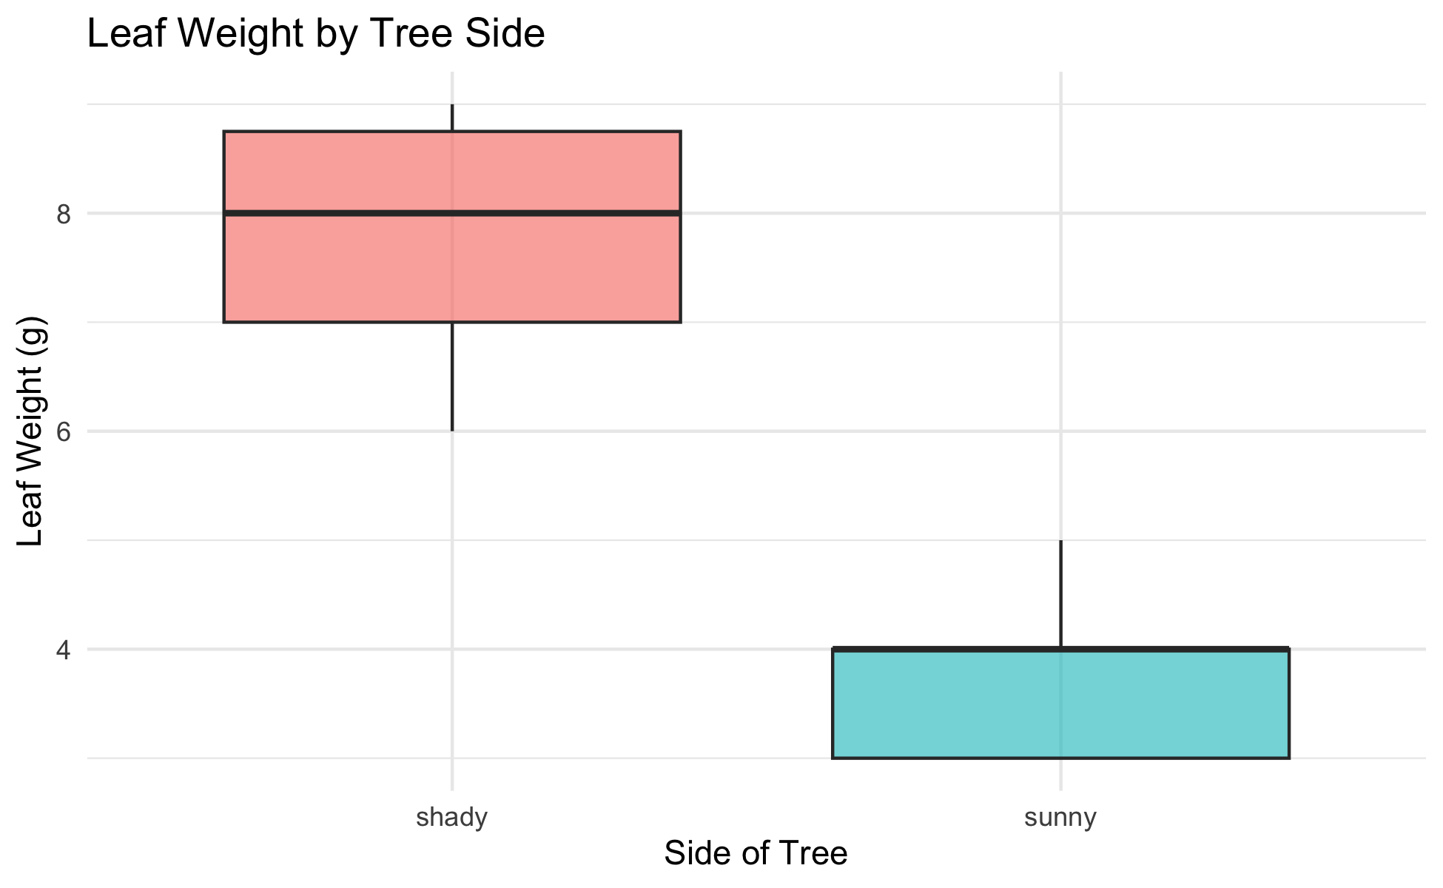
Boxplot — Basic Structure
# Basic boxplot — data is already long format --------- tree_box_plot <- tree_df %>% ggplot(aes(x = side, y = weight_g, fill = side)) + geom_boxplot(alpha = 0.6, outlier.shape = NA) + labs( title = "Leaf Weight by Tree Side", x = "Side of Tree", y = "Leaf Weight (g)", fill = "Side" ) + theme_minimal() + theme(legend.position = "none") tree_box_plot
Boxplot anatomy:
Middle line = median
Box edges = 25th and 75th percentile (IQR)
Whiskers = 1.5 × IQR
Dots beyond whiskers = outliers
Because our data is in long format, ggplot2 reads side straight off the x-axis — no reshaping needed.
📖 R4DS §9 — Layers

Slide 38
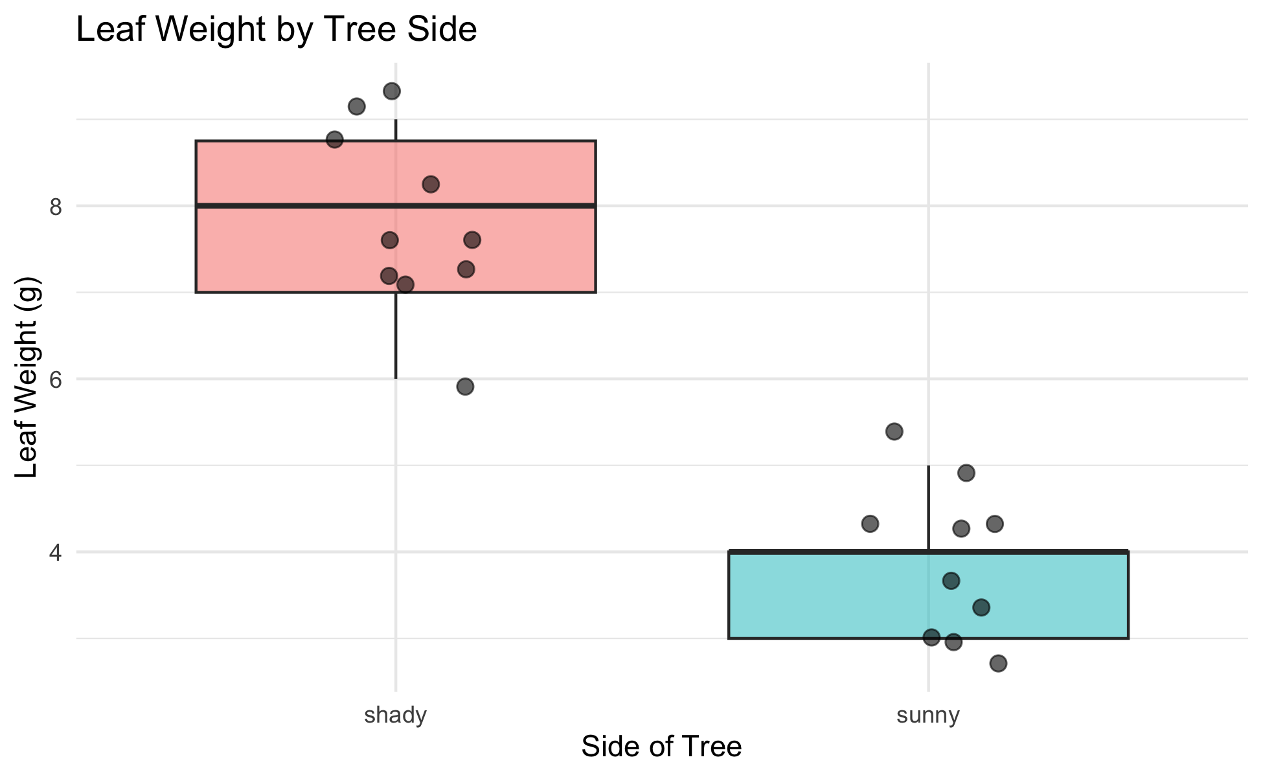
Boxplot — Overlay Individual Points
# Add raw data points over the boxplot ---------------- tree_jitter_plot <- tree_df %>% ggplot(aes(x = side, y = weight_g, fill = side)) + geom_boxplot(alpha = 0.5, outlier.shape = NA) + geom_point( position = position_jitter(width = 0.15, seed = 42), alpha = 0.6, size = 2.5 ) + labs( title = "Leaf Weight by Tree Side", x = "Side of Tree", y = "Leaf Weight (g)", fill = "Side" ) + theme_minimal() + theme(legend.position = "none") tree_jitter_plot
Key arguments:
position_jitter(width = 0.15) — spreads points left and right
seed = 42 — same jitter layout every render
alpha = 0.6 — semi-transparent to show overlap
size = 2.5 — point size
Tip
Always show raw points with a boxplot — with only 10 leaves per group, every point matters!

Slide 39
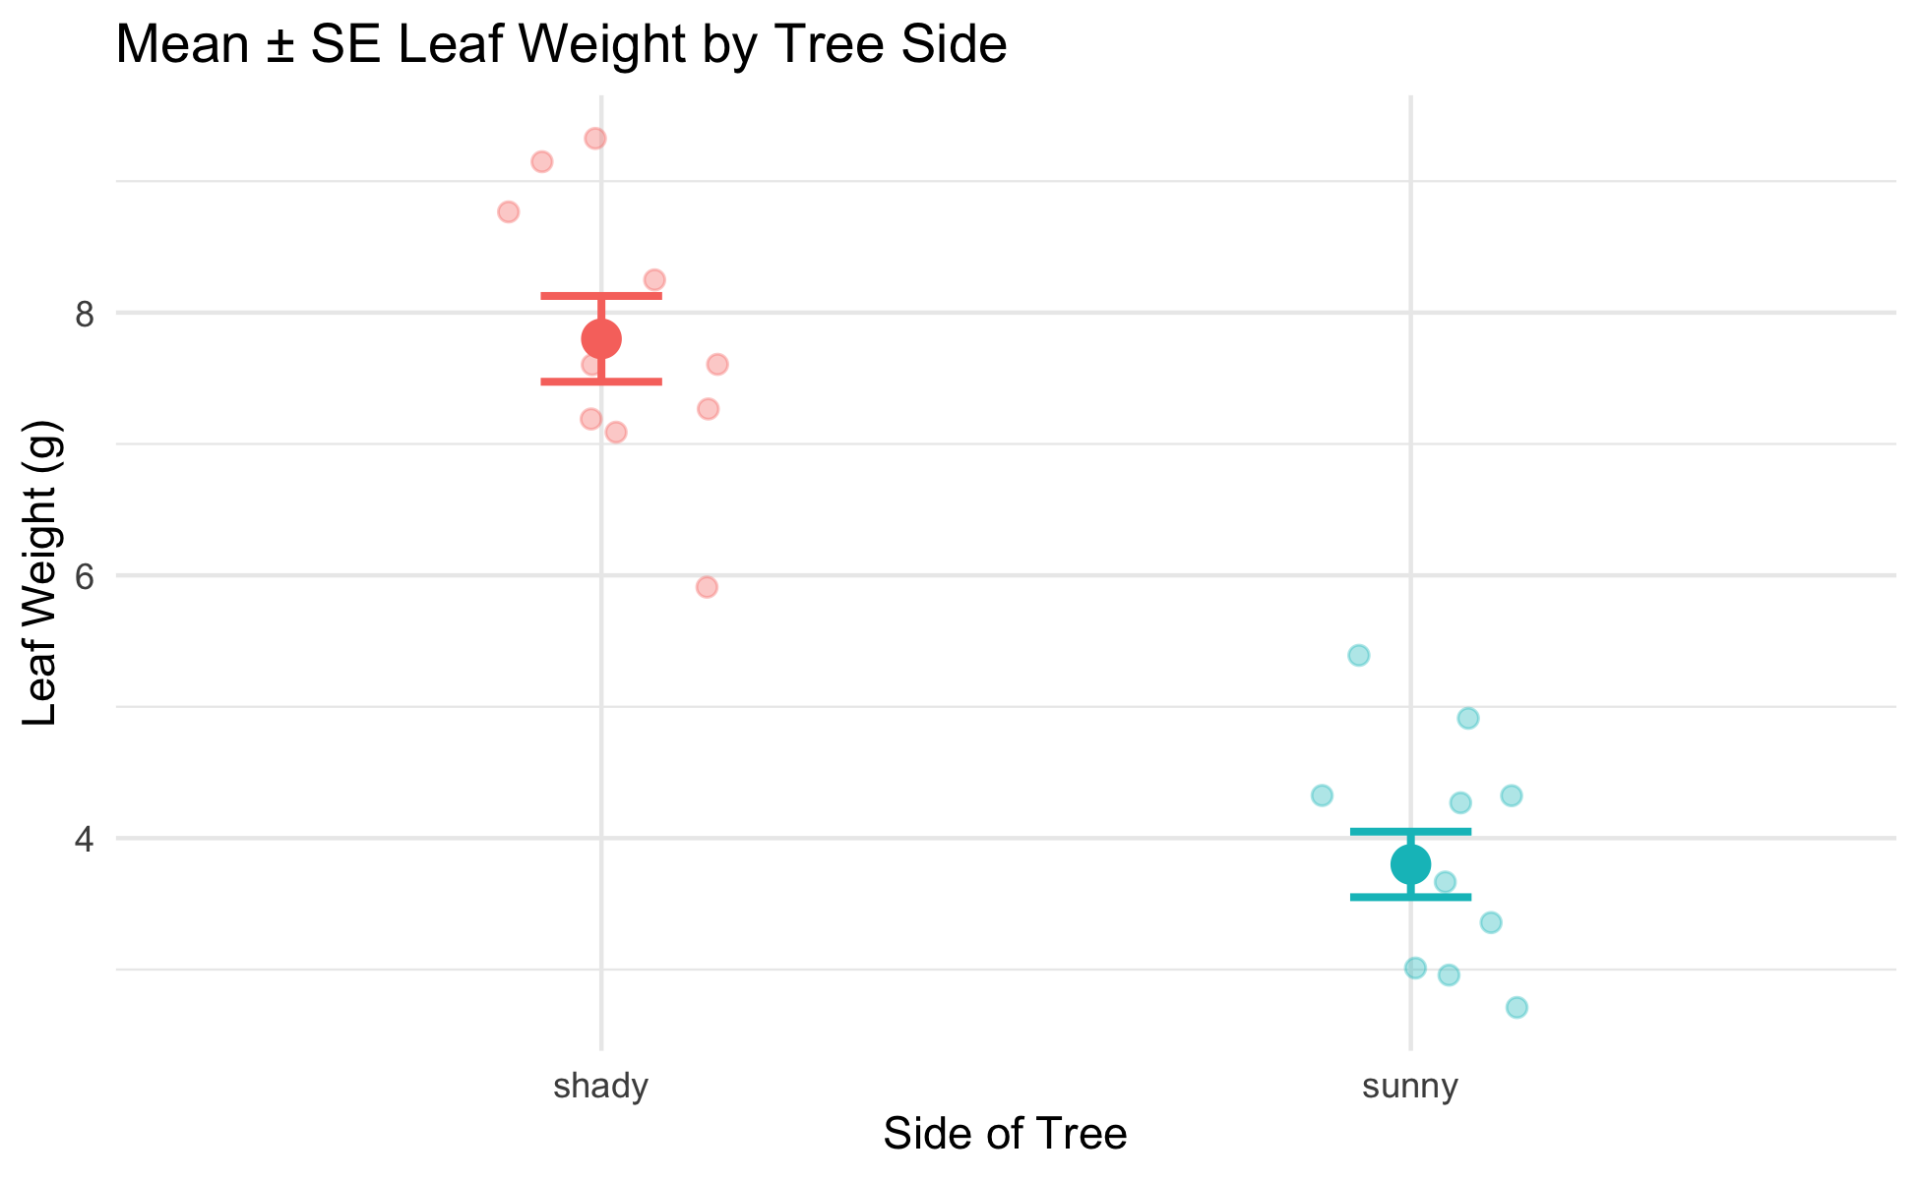
Mean ± SE Plot — stat_summary()
# stat_summary() computes and plots mean and SE ------- tree_mean_se_plot <- tree_df %>% ggplot(aes(x = side, y = weight_g, color = side)) + geom_point( position = position_jitter(width = 0.15, seed = 42), alpha = 0.35, size = 2 ) + stat_summary(fun = mean, geom = "point", size = 4) + stat_summary( fun.data = mean_se, geom = "errorbar", width = 0.15, linewidth = 0.9 ) + labs( title = "Mean ± SE Leaf Weight by Tree Side", x = "Side of Tree", y = "Leaf Weight (g)", color = "Side" ) + theme_minimal() + theme(legend.position = "none") tree_mean_se_plot
Two stat_summary() layers:
call | what it draws
fun = mean | large point at the mean
fun.data = mean_se | error bars for ± 1 SE
Individual points in the background (alpha = 0.35)
Mean shown as a larger foreground point
Error bars = ± 1 SE

Slide 40
🛑 Pause — Do Activity Parts 6–9 Now
Tidy stats with group_by(), a fast skim(), and both plots. Predict each output, type it, then run it.

Slide 41
What We Learned Today
R wrangling skills:
filter() — keep rows by condition
select() — keep columns by name
mutate() — add new calculated columns
arrange() — sort rows
Full pipeline: chain all verbs with %>%
Statistics concepts:
Mean — balance point; sensitive to outliers
Median — middle value; robust
Variance / SD — spread of individual data
SE — precision of the sample mean
More R skills:
group_by() + summarize() — all stats for all groups at once
sum(!is.na()) — the right way to count n
skim() — instant full dataset overview
geom_boxplot() + geom_point(), stat_summary()
References:
📖 R4DS §3 — Data Transformation
📖 R4DS §13 — Numbers
📖 R4DS §18 — Missing Values
🌐 Data Carpentry
Up next — Lecture 04:
Two-sample t-test
Checking assumptions (normality, equal variance)
Interpreting and reporting results

