Slide 1
Lecture 04 — Testing Our Hypothesis
The two-sample Welch’s t-test from assumptions to results Bill Perry

Slide 2
Where we left off (Lecture 03)
Wrangling — filter(), select(), mutate(), arrange() as the core tidyverse verbs
Descriptive stats — mean, median, SD, SE with group_by() + summarize()
NA handling — sum(!is.na()) is the safe way to count n
skimr — fast full-dataset overview in one line
Boxplot + jittered points; mean ± SE with stat_summary()
Finding: shady leaves appear heavier, taller, and wider than sunny leaves
Note
✅ Key idea from Lecture 03
We described the pattern in our data. Today we formally test whether that pattern is statistically significant.

Slide 3
Goals for Today
Understand why comparing means is not enough — we need a test
State null and alternate hypotheses formally
Check assumptions before running any test
normality: histogram, QQ plot, Shapiro-Wilk
variance: Levene’s test
Run Welch’s two-sample t-test in R
Read every line of the t.test() output
Report results in scientific writing format
Tip
🖐 Try it yourself
By the end you will run and interpret a complete t-test on our leaf data.
Tools added today:
car — Levene’s variance test
References:
📖 R4DS §3
🌐 Data Carpentry
Today’s naming:
test objects → _model
plots → _plot

Slide 4
Our Hypotheses — A Reminder
Biological prediction:
Shady-side leaves will be larger and heavier — they need more surface area to capture the limited light filtering through the canopy.
Why two-tailed?
We predicted shady > sunny
A one-tailed test would only reject H₀ in that direction
Two-tailed is more conservative and more broadly accepted
If the result is significant two-tailed, it is also significant one-tailed
α = 0.05 — our threshold for rejecting H₀
 | Formal statement
H₀ — null | $μ_{shady}=μ_{sunny}$ — no difference in mean leaf weight
Hₐ — alternate | $μ_{shady}≠μ_{sunny}$ — mean leaf weight differs by side
We use a two-tailed test — we will detect a difference in either direction.

Slide 5
How to Use These Slides — Predict · Type · Run
This lecture runs in four short chunks. After each chunk you switch to the activity worksheet and type the code yourself.
For every code block, do three things:
Predict — before it runs, say what you think the output will be
Type it out by hand — do not copy-paste
Run it and compare to your prediction
Note
✅ Why bother? (the evidence)
Predicting first forces your brain to retrieve what it knows. The gap between your guess and the real answer is what makes the idea stick — vital for slippery ideas like p-values.
Typing by hand builds the finger-memory and error-spotting that copy-paste skips.
Chunk → immediate practice keeps a new idea in working memory long enough to form a lasting schema.

Slide 6
Load Libraries and Data
# Load all packages at the top ---------------------------- library(readxl) # reading Excel files library(tidyverse) # data manipulation + ggplot2 library(skimr) # fast summaries library(car) # Levene's test for variance equality
# Load the leaf data from the data folder ----------------- tree_df <- read_excel("data/2026_06_25_tree_experiment_raw_data.xlsx")
Note
car is the Companion to Applied Regression package. It contains leveneTest(), which we use to check whether our two groups have similar variance.
Install once: install.packages("car")

Slide 7
What We Know So Far
Note
🔮 Predict first: The two group means differ by about 4 g. With only 10 leaves per side — commit now to a yes/no: is that gap big enough to be statistically significant? You’ll find out in Chunk 3.

Slide 8
# Quick recap from Lecture 03 ---------------------------- recap_df <- tree_df %>% group_by(side) %>% summarize( n = sum(!is.na(weight_g)), mean_wt = round(mean(weight_g, na.rm = TRUE), 2), sd_wt = round(sd(weight_g, na.rm = TRUE), 2), se_wt = round(sd_wt / sqrt(n), 2) ) recap_df
# A tibble: 2 × 5 side n mean_wt sd_wt se_wt <chr> <int> <dbl> <dbl> <dbl> 1 shady 10 7.8 1.03 0.33 2 sunny 10 3.8 0.79 0.25
RESULTS:
Shady mean: 7.80 g
Sunny mean: 3.80 g
Difference: 4.0 g — a big gap!
But is that gap real, or could it just be sampling noise?
With only n = 10 per group, random chance could produce apparent differences.
We need a formal test to quantify the probability.

Slide 9
🧩 Chunk 1 of 4 · Why We Test & the t-Statistic
We will cover: why comparing means isn’t enough, what a two-sample t-test is, why we default to Welch’s, and the formula in action.
Tip
🖐 After this chunk: Activity Parts 1–3 (load data, state hypotheses, recap the descriptive stats).

Slide 10
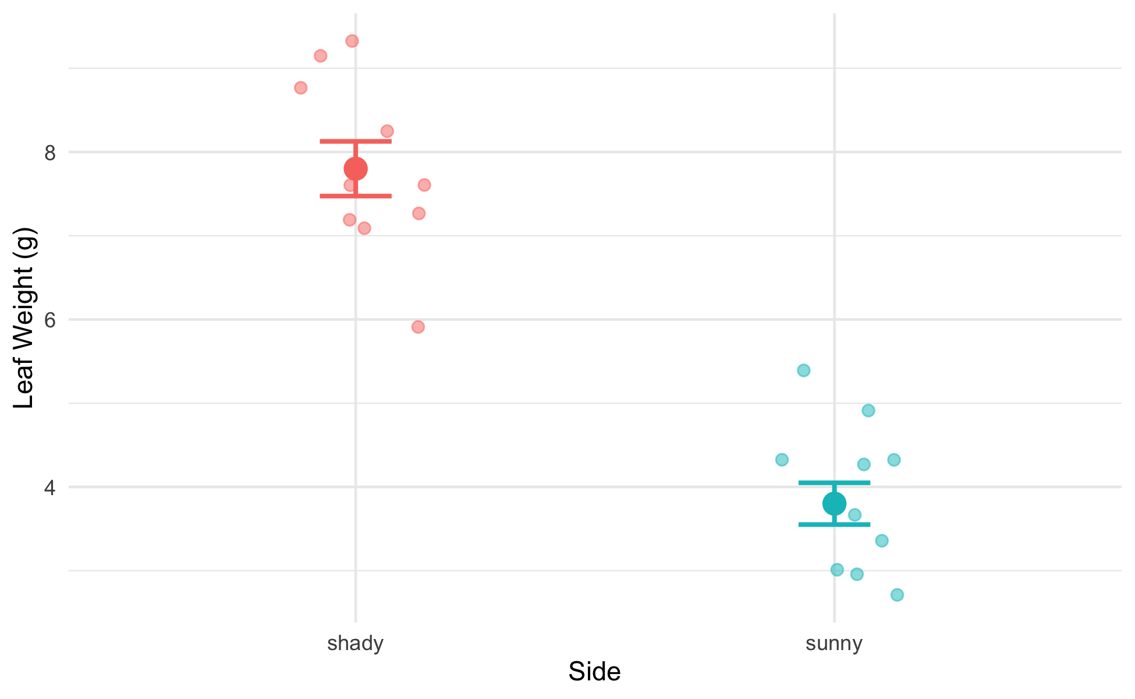
Why Comparing Means Is Not Enough
# Remind ourselves what the data look like --------------- recap_plot <- tree_df %>% ggplot(aes(x = side, y = weight_g, color = side)) + geom_point( position = position_jitter(width = 0.15, seed = 42), alpha = 0.5, size = 2 ) + stat_summary(fun = mean, geom = "point", size = 4) + stat_summary( fun.data = mean_se, geom = "errorbar", width = 0.15, linewidth = 0.9 ) + labs(x = "Side", y = "Leaf Weight (g)") + theme_minimal() + theme(legend.position = "none") recap_plot
The means look different — but:
We only have 10 leaves per group
There is natural variability within each group
The groups’ ranges overlap somewhat
A p-value tells us:
“If H₀ were true, how often would we see a gap this large just by chance?”
Small p → the gap is unlikely to be chance.

Slide 11
What Is a Two-Sample t-Test?
A two-sample t-test compares the means of two independent groups.
It asks: Could both groups plausibly be drawn from populations with the same mean?
The t-statistic is:
$$t=\frac{{\overset{‾}{x}}_{1}−{\overset{‾}{x}}_{2}}{{\text{SE}}_{\text{diff}}}$$
Numerator: the observed difference in means
Denominator: the uncertainty in that difference (SE of the difference)
Large |t| → the difference is large relative to the noise → small p-value
Component | Our context
Group 1 | Shady leaves
Group 2 | Sunny leaves
Measurement | weight_g
H₀ | $μ_{shady}=μ_{sunny}$
Hₐ | $μ_{shady}≠μ_{sunny}$

Slide 12
Why Welch’s? — Don’t Assume Equal Variance
Standard t-test — pools the two variances into one estimate. Requires both groups to have the same population variance.
Welch’s t-test — uses each group’s variance separately. Does not require equal variance.
$$t_{W}=\frac{{\overset{‾}{x}}_{1}−{\overset{‾}{x}}_{2}}{\sqrt{\frac{s_{1}^{2}}{n_{1}}+\frac{s_{2}^{2}}{n_{2}}}}$$
The denominator is the true SE of the difference — no pooling.
Why always use Welch’s?
When variances are equal: almost identical result — minimal loss of power
When variances are not equal: standard t-test gives inflated Type I error (false positives)
Welch’s protects you either way
Tip
Best practice: use Welch’s as your default for all two-group comparisons.
In R: var.equal = FALSE

Slide 13
The Welch’s Formula in Action
Note
🔮 Predict first: t = difference ÷ SE-of-the-difference, and the difference is 4 g. Do you expect |t| to land nearer 1, 5, or 10? Predict before the numbers appear.

Slide 14
# Pull stats and compute t by hand ---------------------- stats_df <- tree_df %>% group_by(side) %>% summarize( n = sum(!is.na(weight_g)), m = mean(weight_g, na.rm = TRUE), s = sd(weight_g, na.rm = TRUE) ) m_sha <- stats_df$m[stats_df$side == "shady"] m_sun <- stats_df$m[stats_df$side == "sunny"] s_sha <- stats_df$s[stats_df$side == "shady"] s_sun <- stats_df$s[stats_df$side == "sunny"] n_sha <- stats_df$n[stats_df$side == "shady"] n_sun <- stats_df$n[stats_df$side == "sunny"] se_diff <- sqrt((s_sha^2 / n_sha) + (s_sun^2 / n_sun)) t_manual <- (m_sha - m_sun) / se_diff cat("Difference in means:", round(m_sha - m_sun, 2), "g\n")
Difference in means: 4 g
cat("SE of difference: ", round(se_diff, 4), "\n")
SE of difference: 0.411
cat("t-statistic: ", round(t_manual, 3), "\n")
t-statistic: 9.733
Step by step:
Difference in means: 7.80 − 3.80 = 4.0 g
SE of the difference: $\sqrt{\frac{s_{shady}^{2}}{10}+\frac{s_{sunny}^{2}}{10}}$
t = difference / SE
The observed difference is ~10 standard errors above zero — very far from what we’d expect if H₀ were true.

Slide 15
🛑 Pause — Do Activity Parts 1–3 Now
Load the data, write your hypotheses before looking at any results, and recompute the group means / SD / SE. Predict each output, type it, run it.

Slide 16
🧩 Chunk 2 of 4 · Framework, Hypotheses & Assumptions
We will cover: the five-step framework, stating H₀ / Hₐ, and checking normality (histogram, QQ, Shapiro-Wilk) and equal variance (Levene’s).
Tip
🖐 After this chunk: Activity Parts 4–7 (histogram, QQ, Shapiro, Levene).

Slide 17
Five Steps to a Hypothesis Test
We will always follow this sequence:
Important
Check assumptions BEFORE running the test.
If your data seriously violate assumptions, the p-value from the t-test is unreliable.
With n = 10 per group, our main concern is gross non-normality. The t-test is quite robust to mild departures.
Step | Action
1 | State H₀ and Hₐ
2 | Check normality — histogram/box plot
3 | Check normality — QQ plot + Shapiro-Wilk
4 | Check variance — Levene’s test
5 | Run the test; interpret and report

Slide 18
Step 1 — Hypotheses (Formal)
Null hypothesis:
$$H_{0}:μ_{shady}=μ_{sunny}$$
Shady and sunny leaves have the same mean weight in the population.
Alternate hypothesis (two-tailed):
$$H_{A}:μ_{shady}≠μ_{sunny}$$
The mean leaf weights differ between sides — in either direction.
Significance level: α = 0.05
We will reject H₀ if p < 0.05.
Why state hypotheses first?
Keeps the analysis honest
Prevents “HARKing” (Hypothesizing After Results are Known)
Forces you to commit to a direction (one-tailed) or not (two-tailed) before seeing the data
Our commitment: two-tailed, α = 0.05, before running any test.

Slide 19
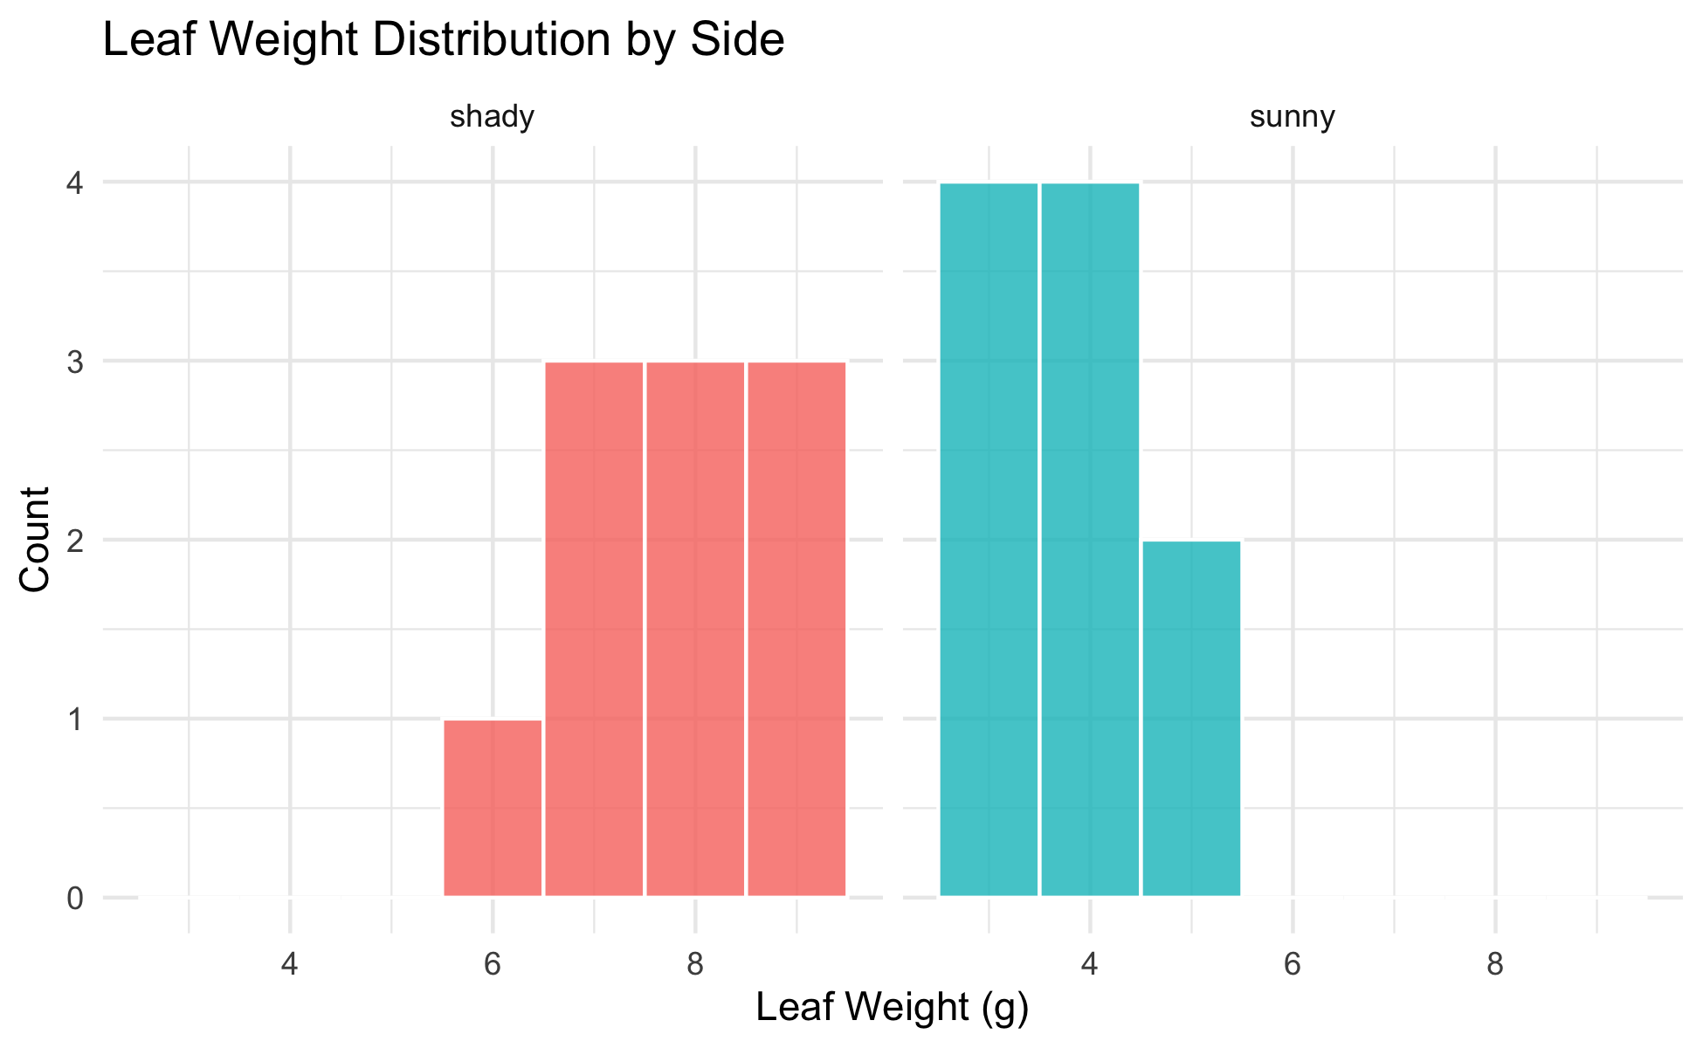
Step 2 — Check Normality: Histogram
# Histogram per group to visually check normality ------- hist_norm_plot <- tree_df %>% ggplot(aes(x = weight_g, fill = side)) + geom_histogram(binwidth = 1, color = "white", alpha = 0.8) + facet_wrap(~side, ncol = 2) + labs( title = "Leaf Weight Distribution by Side", x = "Leaf Weight (g)", y = "Count" ) + theme_minimal() + theme(legend.position = "none") hist_norm_plot
What to look for:
Roughly bell-shaped — not heavily skewed
No obvious bimodal peaks
No extreme outliers
With n = 10 per group, histograms look lumpy — that is normal for small samples.
Histograms are a visual check only. We also use QQ plots and Shapiro-Wilk.

Slide 20
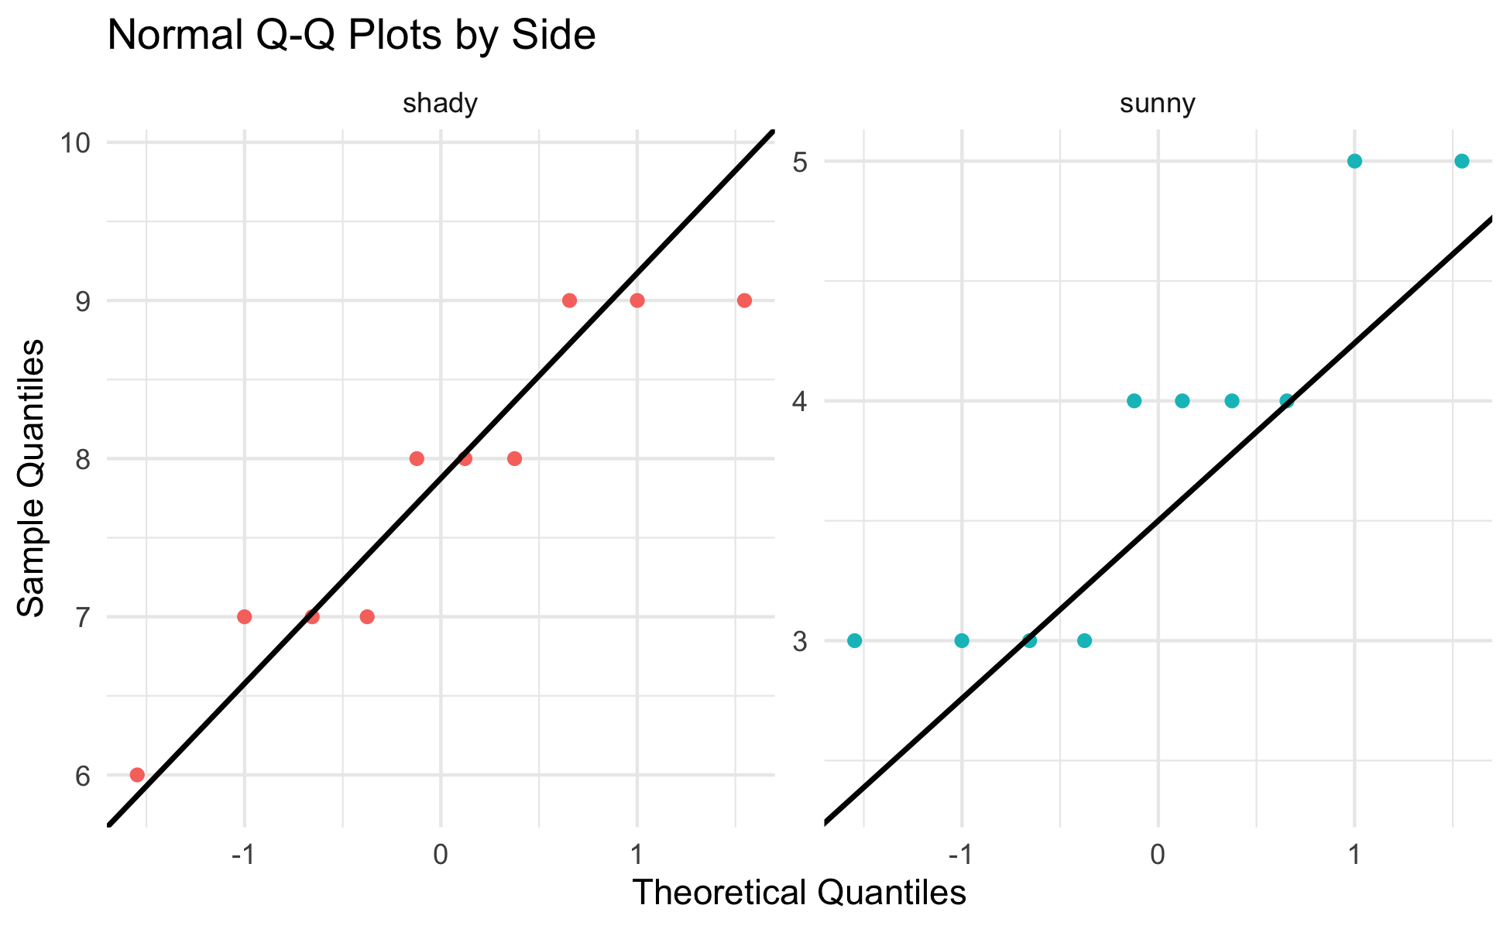
Step 3 — Check Normality: QQ Plot
# Q-Q plot — points should fall along the diagonal line -- qq_norm_plot <- tree_df %>% ggplot(aes(sample = weight_g, color = side)) + stat_qq() + stat_qq_line(color = "black", linewidth = 0.8) + facet_wrap(~side, scales = "free") + labs( title = "Normal Q-Q Plots by Side", x = "Theoretical Quantiles", y = "Sample Quantiles" ) + theme_minimal() + theme(legend.position = "none") qq_norm_plot
How to read a QQ plot:
Points on the line → data follow a normal distribution
Points curving away at ends → heavy tails or skew
With only n = 10, some deviation is expected and acceptable
If points follow the line roughly, we are comfortable proceeding with the t-test.

Slide 21
Step 3 — Check Normality: Shapiro-Wilk Test
Note
🔮 Predict first: Shapiro-Wilk’s H₀ is “the data are normal.” From the histogram and QQ plot you just saw, predict for each side: will p be above or below 0.05?

Slide 22
# Shapiro-Wilk test for the sunny side ----------------- tree_df %>% filter(side == "sunny") %>% pull(weight_g) %>% shapiro.test()
Shapiro-Wilk normality test data: . W = 0.8197, p-value = 0.02513
# Shapiro-Wilk test for the shady side ----------------- tree_df %>% filter(side == "shady") %>% pull(weight_g) %>% shapiro.test()
Shapiro-Wilk normality test data: . W = 0.89461, p-value = 0.191
Shapiro-Wilk H₀: the data are normally distributed.
p > 0.05 → fail to reject normality → proceed with t-test
p < 0.05 → evidence of non-normality → consider a non-parametric alternative
Important
Small-sample caution:
With n = 10, this test has low power — it rarely detects non-normality even when present. The QQ plot is equally important.

Slide 23
Step 4 — Check Variance: Levene’s Test
# Levene's test — are the variances similar? ----------- leveneTest(weight_g ~ side, data = tree_df)
Levene's Test for Homogeneity of Variance (center = median) Df F value Pr(>F) group 1 0.6 0.4486 18
Levene’s test H₀: the two groups have equal variance.
p > 0.05 → variances are not significantly different
p < 0.05 → variances are significantly different
Our response regardless of the result:
We will use Welch’s t-test (var.equal = FALSE).
Welch’s is valid whether or not the variances are equal. We run Levene’s to understand our data, not to choose our test.

Slide 24
Live Demo — Watch It Break (on purpose)
Suppose I forgot library(car) and run Levene’s:
leveneTest(weight_g ~ side, data = tree_df)
R stops with:
Error in leveneTest(weight_g ~ side, data = tree_df) : could not find function "leveneTest"
The fix — load the package that contains the function:
library(car) leveneTest(weight_g ~ side, data = tree_df)
Tip
✅ Why show a broken run?
“could not find function” almost always means a missing library() — not a typo. Watching me diagnose it here means you’ll fix it in seconds when it happens to you.

Slide 25
🛑 Pause — Do Activity Parts 4–7 Now
Check every assumption before you test: histogram, QQ plot, Shapiro-Wilk, and Levene’s. Predict each p-value before you run it.

Slide 26
🧩 Chunk 3 of 4 · Run & Interpret the Test
We will cover: running Welch’s t.test(), reading every line of the output, and making a formal reject / fail-to-reject decision.
Tip
🖐 After this chunk: Activity Parts 8–11 (run, decode, calculate t by hand, decide).

Slide 27
Step 5 — Run the Welch’s t-Test
Note
🔮 Predict first: Write down a guess for the p-value before you run t.test() — above or below 0.05? Then see how close you were.

Slide 28
# Welch's two-sample t-test — unequal variance --------- leaf_ttest_model <- t.test( weight_g ~ side, # formula: response ~ grouping variable data = tree_df, var.equal = FALSE, # Welch's — no pooled variance alternative = "two.sided" # two-tailed test ) leaf_ttest_model
Welch Two Sample t-test data: weight_g by side t = 9.7333, df = 16.834, p-value = 2.514e-08 alternative hypothesis: true difference in means between group shady and group sunny is not equal to 0 95 percent confidence interval: 3.132297 4.867703 sample estimates: mean in group shady mean in group sunny 7.8 3.8
Key arguments:
argument | what it does
weight_g ~ side | compare weight_g between levels of side
var.equal = FALSE | use Welch’s correction
alternative = "two.sided" | two-tailed test
The result is a model object. We decode each line of the output on the next slide.

Slide 29
Reading the t.test() Output
# Extract individual values from the model object ------ cat("t-statistic :", round(leaf_ttest_model$statistic, 3), "\n")
t-statistic : 9.733
cat("df (Welch) :", round(leaf_ttest_model$parameter, 2), "\n")
df (Welch) : 16.83
cat("p-value :", signif(leaf_ttest_model$p.value, 3), "\n")
p-value : 2.51e-08
cat( "95% CI :", round(leaf_ttest_model$conf.int[1], 2), "to", round(leaf_ttest_model$conf.int[2], 2), "g\n" )
95% CI : 3.13 to 4.87 g
cat("Mean shady :", round(leaf_ttest_model$estimate[1], 2), "g\n")
Mean shady : 7.8 g
cat("Mean sunny :", round(leaf_ttest_model$estimate[2], 2), "g\n")
Mean sunny : 3.8 g
Line by line:
output | meaning
t | our calculated t-statistic
df | Welch-Satterthwaite df (non-integer is normal!)
p-value | probability of this result if H₀ is true
95% CI | plausible range for the true difference in means
mean of shady/sunny | the two group means
The 95% CI is the range we could expect to see if we repeated this study many times.

Slide 30
Step 5 — Make a Decision
# State the decision formally -------------------------- # if/else: R checks the condition and runs one of two blocks # We will learn these formally in the functions lecture p_val <- leaf_ttest_model$p.value alpha <- 0.05 if (p_val < alpha) { cat("p =", signif(p_val, 3), "< α =", alpha, "\n") cat("Decision: REJECT H₀\n") cat("Conclusion: leaf weight differs between sides.\n") } else { cat("p =", signif(p_val, 3), ">= α =", alpha, "\n") cat("Decision: FAIL TO REJECT H₀\n") cat("Conclusion: insufficient evidence of a difference.\n") }
p = 2.51e-08 < α = 0.05 Decision: REJECT H₀ Conclusion: leaf weight differs between sides.
Important
What a small p-value means:
If H₀ were true (no real difference), we would get a t-statistic this large or larger less than p × 100% of the time just by chance.
We set α = 0.05 before the test. If p < α, we reject H₀.
What a small p-value does NOT mean:
It is not the probability that H₀ is true
Statistical significance ≠ biological importance
Report the effect size (difference in means) alongside p

Slide 31
🛑 Pause — Do Activity Parts 8–11 Now
Run the test, decode t / df / p / CI, reproduce t by hand, and state your decision in formal language. Predict the p-value first.

Slide 32
🧩 Chunk 4 of 4 · Visualize & Report
We will cover: embedding the test result in a boxplot and a mean ± SE plot, writing a scientific results sentence, and saving publication-quality figures.
Tip
🖐 After this chunk: Activity Parts 12–13 (plots and the results sentence).

Slide 33
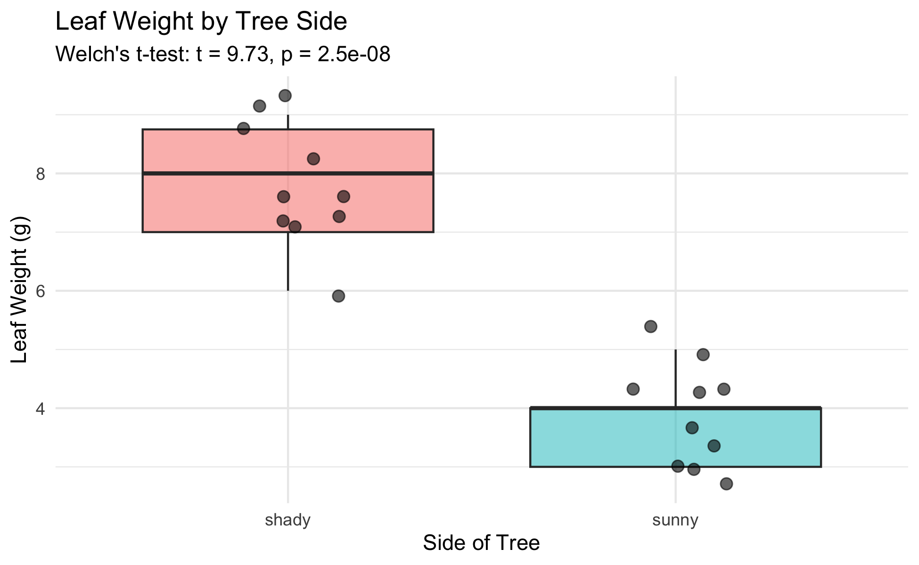
Visualize the Result — Boxplot
# Final boxplot with all points ----------------------- leaf_box_04_plot <- tree_df %>% ggplot(aes(x = side, y = weight_g, fill = side)) + geom_boxplot(alpha = 0.5, outlier.shape = NA) + geom_point( position = position_jitter(width = 0.15, seed = 42), alpha = 0.6, size = 2.5 ) + labs( title = "Leaf Weight by Tree Side", subtitle = paste0( "Welch's t-test: t = ", round(leaf_ttest_model$statistic, 2), ", p = ", signif(leaf_ttest_model$p.value, 2) ), x = "Side of Tree", y = "Leaf Weight (g)" ) + theme_minimal() + theme(legend.position = "none") leaf_box_04_plot
Including the test result in the figure:
subtitle pulls t and p directly from the model object
R fills in the actual numbers automatically
If you re-run with new data, the subtitle updates
Tip
Embedding test statistics in the plot subtitle saves you from copying numbers by hand — and avoids typos in your report.

Slide 34
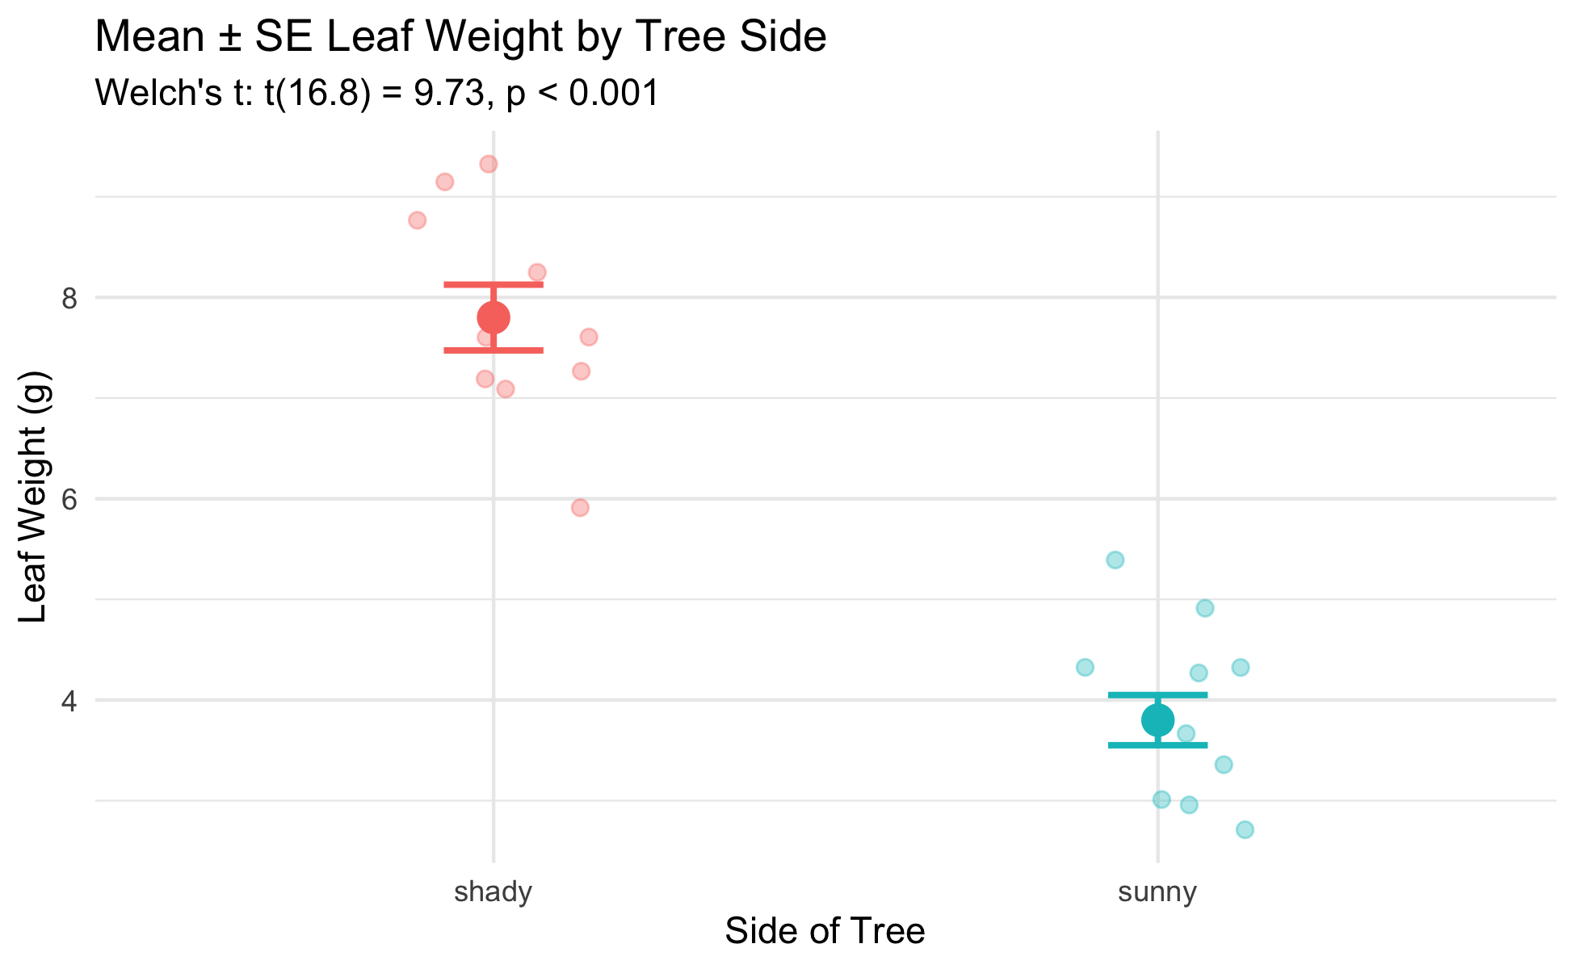
Visualize the Result — Mean ± SE
# Mean ± SE plot with individual points --------------- leaf_mean_se_04_plot <- tree_df %>% ggplot(aes(x = side, y = weight_g, color = side)) + geom_point( position = position_jitter(width = 0.15, seed = 42), alpha = 0.35, size = 2 ) + stat_summary(fun = mean, geom = "point", size = 4) + stat_summary( fun.data = mean_se, geom = "errorbar", width = 0.15, linewidth = 0.9 ) + labs( title = "Mean ± SE Leaf Weight by Tree Side", subtitle = paste0( "Welch's t: t(", round(leaf_ttest_model$parameter, 1), ") = ", round(leaf_ttest_model$statistic, 2), ", p < 0.001" ), x = "Side of Tree", y = "Leaf Weight (g)" ) + theme_minimal() + theme(legend.position = "none") leaf_mean_se_04_plot
What the error bars tell you:
Bars show ± 1 SE — precision of the mean estimate
Non-overlapping bars suggest a significant difference
Rule of thumb:
If error bars overlap by less than half the bar length, the difference is likely significant at α = 0.05. The p-value from the t-test is the definitive answer.

Slide 35
How to Report Results in Science
# Compute reporting values from the model object ------- t_val <- round(leaf_ttest_model$statistic, 2) df_val <- round(leaf_ttest_model$parameter, 1) p_val2 <- signif(leaf_ttest_model$p.value, 2) cat("--- Results sentence ---\n")
--- Results sentence ---
cat("Shady-side leaves were significantly heavier than\n")
Shady-side leaves were significantly heavier than
cat( "sunny-side leaves (Welch's t-test: t(", df_val, ") =", t_val, ", p =", p_val2, ").\n" )
sunny-side leaves (Welch's t-test: t( 16.8 ) = 9.73 , p = 2.5e-08 ).
cat( "Mean ± SE: shady =", round(leaf_ttest_model$estimate[1], 2), "±", round(recap_df$se_wt[recap_df$side == "shady"], 2), "g,\n" )
Mean ± SE: shady = 7.8 ± 0.33 g,
cat( " sunny =", round(leaf_ttest_model$estimate[2], 2), "±", round(recap_df$se_wt[recap_df$side == "sunny"], 2), "g.\n" )
sunny = 3.8 ± 0.25 g.
Standard format:
“[Finding] (Welch’s t-test: t(df) = X.XX, p = X.XXX; mean ± SE: group1 = X.X ± X.X units, group2 = X.X ± X.X units).”
Always include:
Test type (Welch’s t-test)
t-statistic and df
Exact p-value (or < 0.001)
Group means ± SE
Units
Never report “p = 0.000” — write “p < 0.001” instead.

Slide 36
Save Your Plots
# Save both plots to the figures folder ---------------- ggsave( "figures/leaf_weight_boxplot_ttest.png", plot = leaf_box_04_plot, width = 5, height = 5, units = "in", dpi = 300 ) ggsave( "figures/leaf_weight_mean_se_ttest.png", plot = leaf_mean_se_04_plot, width = 5, height = 5, units = "in", dpi = 300 )

Slide 37
Both plots are now in your figures/ folder with the test statistics embedded in the subtitle — ready for a lab report or paper.
Tip
dpi = 300 is publication quality. Use it for any figure that will appear in a paper, poster, or formal report.

Slide 38
🛑 Pause — Do Activity Parts 12–13 Now
Build both figures with the statistics embedded in the subtitle, then write your results sentence. Predict what the subtitle will say before you run it.

Slide 39
What We Learned Today
Concepts:
Why we need a hypothesis test — means alone are not enough
Welch’s t-test — use var.equal = FALSE as the safe default
Two-tailed test — detects differences in either direction
Five-step framework — hypotheses → normality → variance → test → report
Reading output — t, df, p, CI, group means
R skills:
library(car) + leveneTest(y ~ group, data) — variance check
filter() %>% pull() %>% shapiro.test() — normality per group
t.test(y ~ group, data, var.equal = FALSE, alternative = "two.sided")
model$statistic, model$p.value, model$conf.int — extract results
paste0(...) in subtitle — embed test statistics in figures
References:
📖 R4DS §3 — Data Transformation
📖 R4DS §13 — Numbers
🌐 Data Carpentry
Up next — Lecture 05:
Linear regression — predicting leaf area from paper tracing mass
Building a calibration curve with lm()
R², residuals, and assumption checking

