Slide 1
Lecture 05 — Linear Regression
Predicting leaf area from paper tracing mass (Whitlock & Schluter Ch. 17) Bill Perry

Slide 2
Where we left off (Lecture 4.5)
Quarto — one .qmd file holds your writing and your code, and renders to Word, HTML, or PowerPoint
Three ingredients — YAML front matter, Markdown text, and named code chunks
Reproducibility — numbers and figures are computed, never copied by hand; change the data, press Render
Inline code — drop a live result straight into a sentence with `r `
Word reports — format: docx with toc and number-sections gives a professional document
Carried forward (Lecture 04) — shady leaves were significantly heavier than sunny leaves (Welch’s t-test, p < 0.001)
Note
✅ Transition
You can now build a reproducible report. Today’s analysis — a calibration curve that converts leaf weight into a more meaningful measurement, leaf surface area (cm²) — is the perfect thing to write up in one. The activity gives you this same analysis as both a plain .R script and a Quarto report, so you can feel the difference.

Slide 3
Goals for Today
Understand what linear regression does and when to use it
Learn the equation: $\hat{Y}=a+bX$
slope b, intercept a, residuals, R²
Understand least squares — what the line minimizes
Fit a model in R with lm() and read every line of summary()
Apply it: build a calibration curve to predict leaf area from paper tracing mass
Check all four assumptions of regression
Use predict() to make predictions with intervals
Use mutate() to add model results to a data frame
Tip
🖐 Try it yourself
By the end you will predict leaf area from a tracing weight.
Tools today:
readxl, tidyverse
Textbook:
📖 Whitlock & Schluter Analysis of Biological Data 2nd ed.
Chapter 17 — Regression (pp. 539–575)
§17.1 Linear regression
§17.3 Testing slope hypotheses
§17.4 R²
§17.5 Assumptions
Naming conventions:
models → _model
plots → _plot

Slide 4
How to Use These Slides — Predict · Type · Run
This lecture runs in four short chunks. After each chunk you switch to the activity and type the code yourself.
For every code block, do three things:
Predict — before it runs, say what you think the output will be
Type it out by hand — do not copy-paste
Run it and compare to your prediction
Note
✅ Why bother? (the evidence)
Predicting first forces your brain to retrieve what it knows — the gap between guess and answer is what makes it stick.
Typing by hand builds the finger-memory and error-spotting that copy-paste skips.
Chunk → immediate practice keeps a new idea in working memory long enough to form a lasting schema.

Slide 5
🧩 Chunk 1 of 4 · What Regression Is
We will cover: the calibration idea, the equation $\hat{Y}=a+bX$, least squares, R², and the four assumptions.
Tip
🖐 After this chunk: Activity Parts 1–3 (load, inspect, and scatter-plot the paper data).

Slide 6
Our Calibration Idea
The problem: measuring leaf surface area without a leaf area meter.
The solution — a calibration curve:
Cut paper squares of known area (1, 4, 16 … 567 cm²)
Weigh each square on a precision balance
Fit a regression line: area ~ mass
Trace a leaf on the same paper, weigh the tracing
Plug the tracing mass into the equation → predicted leaf area
Why does this work?
Paper of uniform stock has constant area density (cm² per gram). Mass and area are therefore perfectly linearly related within a sheet.
Known area (cm²) | n replicates
1 | 25
4 | 32
16 | 24
36 | 3
64 | 7
100 | 14
225–567 | 12

Slide 7
What Is Linear Regression?
Linear regression draws the best straight line through a scatter of points to predict a response variable (Y) from an explanatory variable (X).
Two key roles:
When to use regression:
You have two numeric variables
One variable can reasonably predict or cause the other
You want an equation to make predictions for new observations
Regression vs. our t-test (Lecture 04):
Role | Variable | Our example
Explanatory (X) | on the x-axis; what you measure | mass_g
Response (Y) | on the y-axis; what you want to predict | area_cm2
X is often something easy to measure; Y is what you actually want to know. Regression gives you the equation to convert X → Y.
📖 W&S §17.1 p. 540–541
Test | Question
t-test | Do two group means differ?
Regression | Does X predict Y numerically?
Regression produces a predictive equation. The t-test produces a decision about group means.

Slide 8
The Regression Equation
Population model (W&S §17.1):
$$Y=α+βX+ε$$
Sample estimate (what R calculates):
$$\hat{Y}=a+bX$$
Interpreting the slope:
b = the change in area (cm²) for every additional 1 gram of paper
Since 1 g ≈ 130 cm² of paper, the slope is the area density of the paper stock.
Interpreting the intercept:
a = predicted area when mass = 0
Physically this should be 0 (no paper, no area). Small non-zero values reflect measurement error.
📖 W&S §17.1 pp. 543–545
Symbol | Name | Meaning
$\hat{Y}$ | predicted Y | estimated mean area at a given mass
a | intercept | predicted Y when X = 0
b | slope | change in Y per 1-unit increase in X
$ε$ | residual | observed − predicted
Our equation will be:
$$\hat{\text{area}}=a+b×\text{mass_g}$$

Slide 9
Residuals and Least Squares
Residual for observation i:
$$e_{i}=Y_{i}−{\hat{Y}}_{i}=\text{observed}−\text{predicted}$$
The least-squares line minimizes the sum of squared residuals:
$$\text{minimize}\sum_{i=1}^{n}{(}Y_{i}−{\hat{Y}}_{i})^{2}$$
Squaring serves two purposes:
- Makes all deviations positive (no cancellation)
- Penalizes large deviations more than small ones
There is only one line that achieves this minimum — it is unique.
📖 W&S §17.1 p. 542 (Figure 17.1-2)
Visual intuition:
Each data point has a vertical residual — the distance from the point to the regression line.
observed Y │ ● ← residual (positive) │ | predicted Ŷ│-----●--- regression line │ └──────────── X
A point above the line has a positive residual. A point below has a negative residual. The sum of all residuals = 0.

Slide 10
R² — How Much Does X Explain?
Note
🔮 Predict first: Paper of uniform stock has constant area-per-gram. Before you see any output, predict: will R² be near 0, 0.5, or 1?

Slide 11
$$R^{2}=\frac{SS_{\text{regression}}}{SS_{\text{total}}}=1−\frac{SS_{\text{residual}}}{SS_{\text{total}}}$$
SS_total = total variation in Y around its mean
SS_regression = variation explained by X
SS_residual = variation not explained (scatter around the line)
R² ranges from 0 to 1:
Our calibration data:
Because paper has uniform density, mass and area are nearly perfectly linearly related.
We expect R² ≈ 1.00.
Important: R² tells you how well the line fits the data you have. It does not by itself tell you whether the relationship is statistically significant — that requires a test of the slope.
A significant slope with a low R² is possible (weak but real relationship). In biology, R² values of 0.3–0.7 are common and meaningful.
R² | Interpretation
1.00 | X explains all variation in Y
0.85 | X explains 85% of variation
0.00 | X explains nothing
📖 W&S §17.4 p. 555

Slide 12
Assumptions of Regression
Four assumptions must hold for the p-value and confidence intervals to be valid (W&S §17.5):
Important
Check residuals, not raw data.
The normality assumption is about the residuals (observed − predicted), not the original Y values.
A well-fitted residual plot looks like a random horizontal cloud of points centered at zero — no curves, no funnel shapes.
📖 W&S §17.5 pp. 557–560 (Figures 17.5-1, 17.5-4)
# | Assumption | How to check
1 | Linearity — Y changes linearly with X | Residual vs. fitted plot
2 | Independence — observations are independent | Study design
3 | Equal variance — spread of residuals is constant | Residual vs. fitted plot
4 | Normality — residuals are normally distributed | QQ plot + Shapiro-Wilk

Slide 13
🛑 Pause — Do Activity Parts 1–3 Now
Load paper_area_weights.xlsx, inspect it with skim(), and make the scatter of area vs mass. Predict the shape before you plot it.

Slide 14
🧩 Chunk 2 of 4 · Fit the Model & Read It
We will cover: loading the data, lm(), and reading every line of summary() — slope, intercept, and R².
Tip
🖐 After this chunk: Activity Parts 4–7 (fit lm(), decode summary(), pull the equation and R²).

Slide 15
Load Libraries and Data
# Load packages at the top of the script --------------- library(readxl) # reading Excel files library(tidyverse) # data manipulation + ggplot2 library(skimr) # fast data overview
# Load the paper calibration data ---------------------- paper_df <- read_excel("data/paper_area_weights.xlsx")
Note
The file paper_area_weights.xlsx contains 118 paper squares of known area (1–567 cm²) with their measured masses. This is the calibration dataset we use to predict leaf area from a tracing weight.

Slide 16
Inspect the Data
# Quick overview of the calibration data --------------- skim(paper_df)
# How many squares per area group? -------------------- paper_df %>% group_by(area_cm2) %>% summarize( n = n(), mean_wt = round(mean(mass_g), 5) )
# A tibble: 10 × 3 area_cm2 n mean_wt <dbl> <int> <dbl> 1 1 25 0.00677 2 4 32 0.0299 3 16 24 0.121 4 36 3 0.269 5 64 7 0.484 6 100 14 0.760 7 225 1 1.74 8 400 6 3.07 9 500 1 3.77 10 567 5 4.35
Name | paper_df
Number of rows | 118
Number of columns | 2
_______________________
Column type frequency:
numeric | 2
________________________
Group variables | None
skim_variable | n_missing | complete_rate | mean | sd | p0 | p25 | p50 | p75 | p100 | hist
area_cm2 | 0 | 1 | 71.64 | 144.46 | 1 | 4.00 | 16.00 | 64.00 | 567.00 | ▇▁▁▁▁
mass_g | 0 | 1 | 0.55 | 1.11 | 0 | 0.03 | 0.12 | 0.48 | 4.39 | ▇▁▁▁▁
Variable type: numeric
Data summary

Slide 17
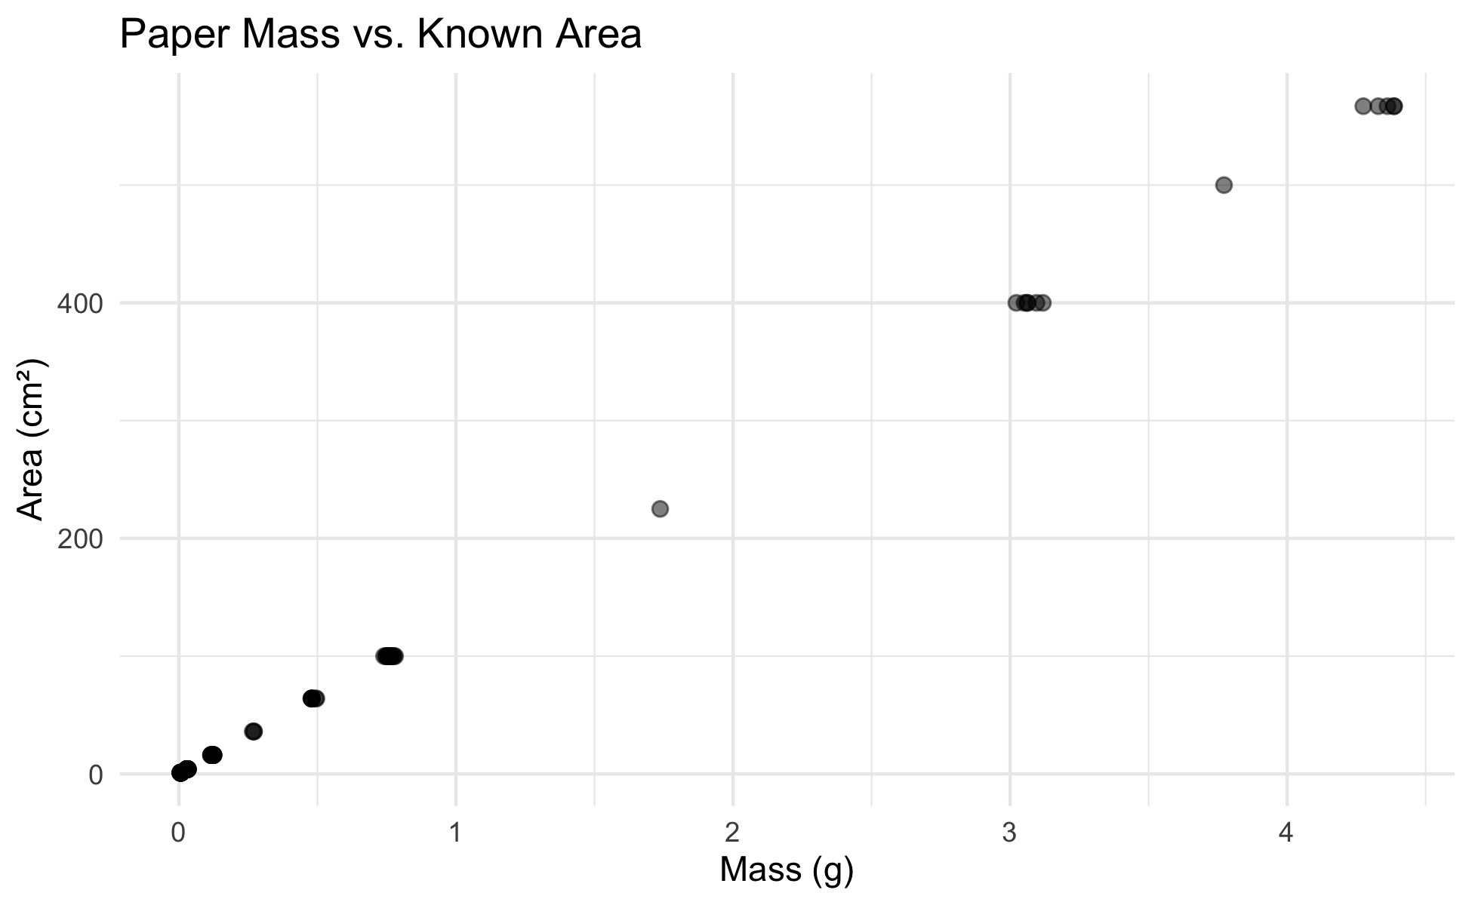
First Plot — Scatter
# Scatter plot of area vs mass to check linearity ----- scatter_05_plot <- paper_df %>% ggplot(aes(x = mass_g, y = area_cm2)) + geom_point(alpha = 0.5, size = 2) + labs( title = "Paper Mass vs. Known Area", x = "Mass (g)", y = "Area (cm²)" ) + theme_minimal() scatter_05_plot
What to look for before fitting:
Is the relationship linear? → points should follow a straight line
Is the variance constant? → spread around the trend should look similar at all X values
Any obvious outliers?
Both variables are continuous and numeric → linear regression is appropriate.
📖 W&S §17.1 p. 541

Slide 18
Fit the Model with lm() - Linear Model
Note
🔮 Predict first: area rises with mass. Before you read the output — will the slope be positive or negative? Roughly how many cm² per gram of paper?

Slide 19
# Fit the least-squares regression line --------------- # formula: response ~ predictor paper_lm_model <- lm(area_cm2 ~ mass_g, data = paper_df)
# Full model summary — every number matters ----------- summary(paper_lm_model)
Call: lm(formula = area_cm2 ~ mass_g, data = paper_df) Residuals: Min 1Q Median 3Q Max -7.2774 -0.3059 -0.1221 0.2264 8.7592 Coefficients: Estimate Std. Error t value Pr(>|t|) (Intercept) 0.2792 0.1812 1.541 0.126 mass_g 130.5234 0.1473 885.964 <2e-16 *** --- Signif. codes: 0 '***' 0.001 '**' 0.01 '*' 0.05 '.' 0.1 ' ' 1 Residual standard error: 1.764 on 116 degrees of freedom Multiple R-squared: 0.9999, Adjusted R-squared: 0.9999 F-statistic: 7.849e+05 on 1 and 116 DF, p-value: < 2.2e-16
The lm() formula syntax:
lm(Y ~ X, data = df)
Y goes on the left of ~
X goes on the right
~ reads as “is predicted by”
So area_cm2 ~ mass_g means: “area is predicted by mass”
The result is a model object — we can extract everything from it.
📖 W&S §17.1 p. 543

Slide 20
Reading the summary() Output
# Extract the key numbers from the model -------------- a_intercept <- coef(paper_lm_model)[1] # intercept b_slope <- coef(paper_lm_model)[2] # slope cat("Intercept (a) =", round(a_intercept, 4), "cm²\n")
Intercept (a) = 0.2792 cm²
cat("Slope (b) =", round(b_slope, 2), "cm²/g\n")
Slope (b) = 130.52 cm²/g
Decode the Coefficients table:
Row | What it is
(Intercept) | a — predicted area when mass = 0
mass_g | b — cm² per gram of paper
Std. Error | uncertainty in each estimate
t value | b / SE — tests if slope ≠ 0
Pr(>|t|) | p-value for that t-test
H₀: β = 0 (mass does not predict area)
Hₐ: β ≠ 0 — our slope tests this hypothesis
📖 W&S §17.3 p. 551–553

Slide 21
The Calibration Equation and R²
# Extract R-squared and build the equation label ------ r2_val <- summary(paper_lm_model)$r.squared cat("R² =", round(r2_val, 6), "\n\n")
R² = 0.999852
cat("Calibration equation:\n")
Calibration equation:
cat( " area (cm²) =", round(b_slope, 2), "× mass (g) +", round(a_intercept, 4), "\n\n" )
area (cm²) = 130.52 × mass (g) + 0.2792
cat("Interpretation of slope:\n")
Interpretation of slope:
cat(" Every 1 g of paper =", round(b_slope, 1), "cm² of area\n")
Every 1 g of paper = 130.5 cm² of area
What R² = 0.9999 means:
99.99% of the variation in paper area is explained by mass. The remaining 0.01% is measurement noise from the balance.
This is expected — the relationship between mass and area in uniform paper is essentially perfect.
In biological data, R² values of 0.3–0.7 are common and meaningful.
📖 W&S §17.4 p. 555

Slide 22
🛑 Pause — Do Activity Parts 4–7 Now
Fit lm(area_cm2 ~ mass_g), decode the summary() table, and pull the slope, intercept, and R². Predict each number before it prints.

Slide 23
🧩 Chunk 3 of 4 · Visualize & Check Assumptions
We will cover: the calibration curve with its CI band, the residuals-vs-fitted plot, and the QQ plot + Shapiro-Wilk on the residuals.
Tip
🖐 After this chunk: Activity Parts 8–10 (plot the curve; check the residual and QQ/Shapiro assumptions).

Slide 24
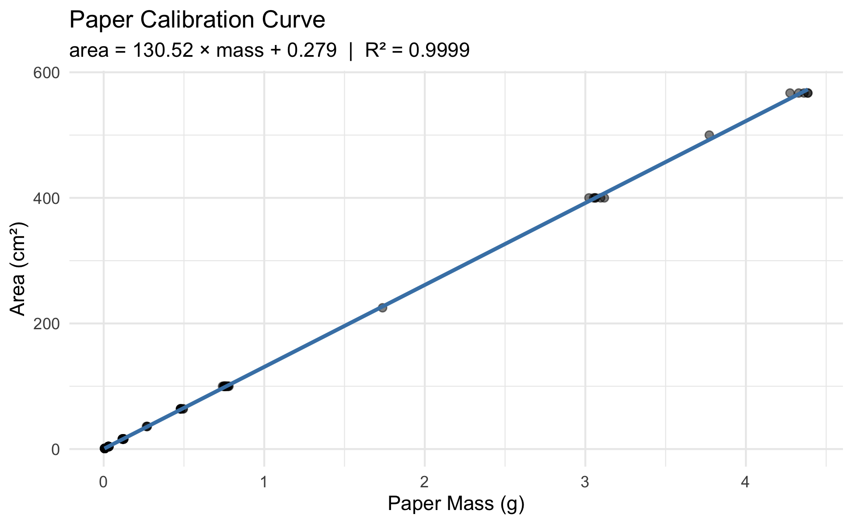
Plot the Calibration Curve
# Calibration curve with regression line + 95% CI band calibration_plot <- paper_df %>% ggplot(aes(x = mass_g, y = area_cm2)) + geom_point(alpha = 0.5, size = 1.8) + geom_smooth( method = "lm", se = TRUE, color = "steelblue", fill = "lightblue" ) + labs( title = "Paper Calibration Curve", subtitle = paste0( "area = ", round(b_slope, 2), " × mass + ", round(a_intercept, 3), " | R² = ", round(r2_val, 4) ), x = "Paper Mass (g)", y = "Area (cm²)" ) + theme_minimal() calibration_plot
The shaded band = 95% confidence band for the mean predicted area at each mass value.
Key observation: the band is narrowest in the middle of the data range and widens at the extremes — predictions are most precise near $\overset{‾}{X}$.
This is exactly Figure 17.2-1 from W&S (p. 549).
📖 W&S §17.2 p. 548–550

Slide 25
Check Assumptions — Residual Plot
Note
🔮 Predict first: If the line fits well, what should the residuals-vs-fitted plot look like — a random flat cloud, a curve, or a funnel? Predict, then look.

Slide 26
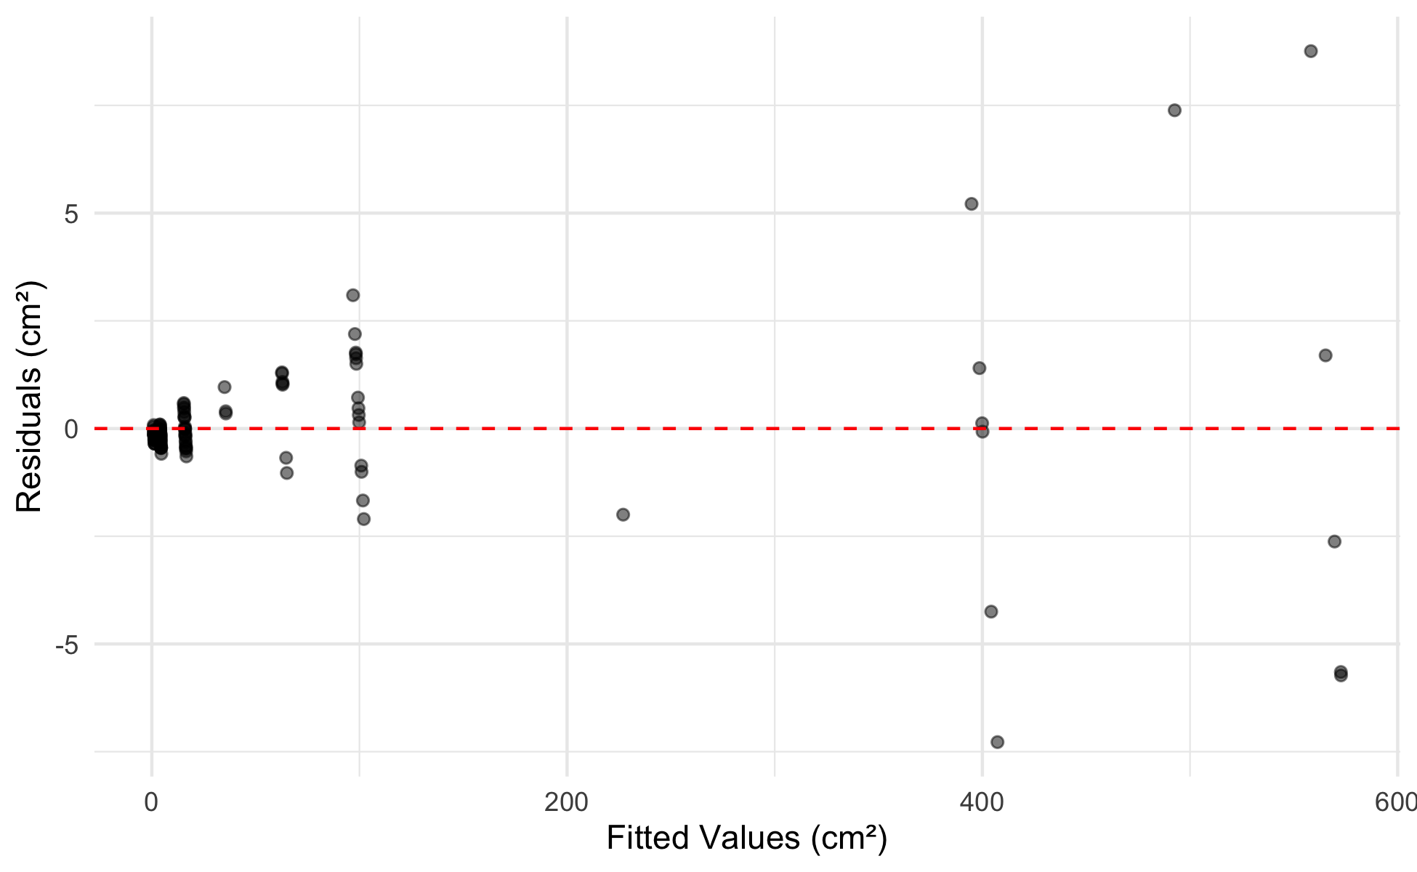
# mutate() adds new columns to the data frame ---------- # Here we add the model's fitted values and residuals # so we can plot them — recall mutate() from Lecture 03! paper_resid_df <- paper_df %>% mutate( fitted = fitted(paper_lm_model), residuals = residuals(paper_lm_model) )
# Residuals vs Fitted — checks linearity & equal variance resid_plot <- paper_resid_df %>% ggplot(aes(x = fitted, y = residuals)) + geom_point(alpha = 0.5) + geom_hline(yintercept = 0, linetype = "dashed", color = "red") + labs(x = "Fitted Values (cm²)", y = "Residuals (cm²)") + theme_minimal() resid_plot
What to look for:
✅ Good: random cloud of points centered at zero; constant spread across all fitted values
❌ Bad: - Curved pattern → linearity violated - Fan shape (funnel) → unequal variance
📖 W&S §17.5 p. 559 (Figure 17.5-4)
Tip
The residual plot is the most important diagnostic. Always check it before interpreting your results.

Slide 27
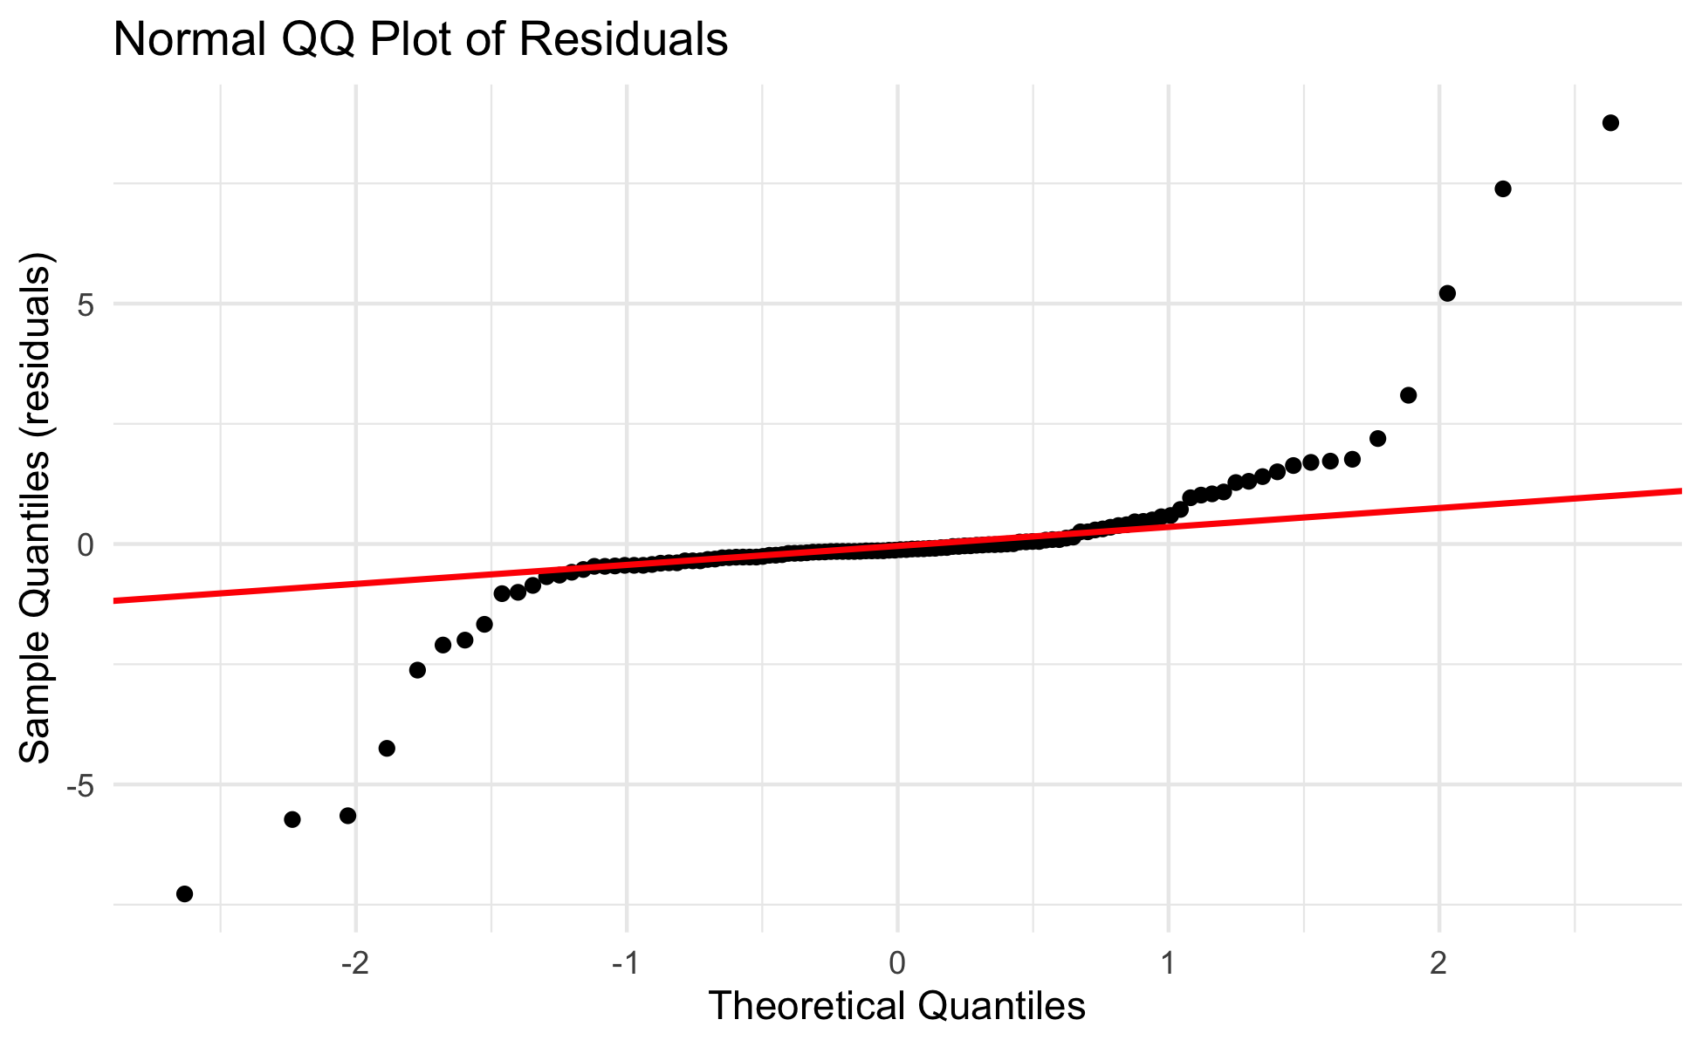
Check Assumptions — QQ Plot and Shapiro-Wilk
# QQ plot of residuals — checks normality assumption -- qq_resid_plot <- paper_resid_df %>% ggplot(aes(sample = residuals)) + stat_qq() + stat_qq_line(color = "red", linewidth = 0.8) + labs( title = "Normal QQ Plot of Residuals", x = "Theoretical Quantiles", y = "Sample Quantiles (residuals)" ) + theme_minimal() qq_resid_plot
# Shapiro-Wilk test on residuals — NOT on raw data --- shapiro.test(residuals(paper_lm_model))
Shapiro-Wilk normality test data: residuals(paper_lm_model) W = 0.67735, p-value = 9.425e-15
Remember:
The normality assumption is about residuals, not raw data
H₀ (Shapiro-Wilk): residuals are normally distributed
p > 0.05 → proceed with confidence intervals and p-values
📖 W&S §17.5 p. 559

Slide 28
🛑 Pause — Do Activity Parts 8–10 Now
Plot the calibration curve, then check the residual plot and the QQ/Shapiro test on the residuals. Predict each diagnostic before you run it.

Slide 29
🧩 Chunk 4 of 4 · Predict & Report
We will cover: turning a tracing mass into a predicted area, predict() with confidence vs prediction intervals, and writing the results paragraph.
Tip
🖐 After this chunk: Activity Parts 11–12 (predict leaf area; write the results paragraph).

Slide 30
Predict Leaf Area from Tracing Mass
Note
🔮 Predict first: The sunny tracing weighs 0.092 g, the shady 0.138 g. Before running — which predicts the larger area, and does that match “shady leaves are bigger”?

Slide 31
# Plug tracing masses into the calibration line ------- # Suppose sunny leaf tracing weighs 0.092 g # and shady leaf tracing weighs 0.138 g mass_sunny <- 0.092 mass_shady <- 0.138 area_sunny <- b_slope * mass_sunny + a_intercept area_shady <- b_slope * mass_shady + a_intercept cat("Sunny tracing mass:", mass_sunny, "g\n")
Sunny tracing mass: 0.092 g
cat("Predicted area: ", round(area_sunny, 2), "cm²\n\n")
Predicted area: 12.29 cm²
cat("Shady tracing mass:", mass_shady, "g\n")
Shady tracing mass: 0.138 g
cat("Predicted area: ", round(area_shady, 2), "cm²\n")
Predicted area: 18.29 cm²
The equation in action:
$$\hat{\text{area}}=130.5×\text{mass}+0.28$$
For a sunny tracing at 0.092 g:
$130.5×0.092+0.28=12.3$ cm²
For a shady tracing at 0.138 g:
$130.5×0.138+0.28=18.3$ cm²
This matches our observation from Lecture 03 — shady leaves are larger!

Slide 32
Live Demo — Watch It Break (on purpose)
predict() needs the exact predictor column name. I’ll get it wrong:
# The column is mass_g, but I typed mass new <- tibble(mass = 0.092) predict(paper_lm_model, newdata = new)
R errors:
Error in eval(predvars, data, env) : object 'mass_g' not found
The fix — match the model’s variable name exactly:
new <- tibble(mass_g = 0.092) predict(paper_lm_model, newdata = new)
Tip
✅ Why show a broken run?
predict() looks for the same column names the model was built on. “object ‘mass_g’ not found” means your newdata is missing that column — almost always a typo. This is the #1 predict() mistake.

Slide 33
Using predict() — with Prediction Intervals
# predict() gives uncertainty around predictions ------ new_masses <- tibble(mass_g = c(0.092, 0.138)) # Confidence interval: for the MEAN area at this mass predict(paper_lm_model, newdata = new_masses, interval = "confidence") %>% round(3)
fit lwr upr 1 12.287 11.940 12.635 2 18.291 17.948 18.634
# Prediction interval: for a SINGLE new observation predict(paper_lm_model, newdata = new_masses, interval = "prediction") %>% round(3)
fit lwr upr 1 12.287 8.777 15.798 2 18.291 14.782 21.801
Two types of interval (W&S §17.2 p. 549):
Type | Predicts | Width
Confidence | mean area for all leaves this mass | narrower
Prediction | area of one specific leaf | wider
For predicting a single leaf, use the prediction interval — it captures individual-to-individual variation within the same mass class.
📖 W&S §17.2 pp. 548–550

Slide 34
How to Report Regression Results
# Pull reporting values from the model ---------------- f_stat <- summary(paper_lm_model)$fstatistic f_val <- round(f_stat[1], 1) df1 <- f_stat[2] df2 <- f_stat[3] p_val <- pf(f_stat[1], df1, df2, lower.tail = FALSE) cat("--- Results paragraph ---\n")
--- Results paragraph ---
cat("Paper mass was a strong predictor of paper area\n")
Paper mass was a strong predictor of paper area
cat("(linear regression: F(", df1, ",", df2, ") =", f_val, ",\n")
(linear regression: F( 1 , 116 ) = 784932.9 ,
cat("p <", signif(p_val, 1), ", R² =", round(r2_val, 4), ").\n")
p < 5e-224 , R² = 0.9999 ).
cat("The calibration equation is:\n")
The calibration equation is:
cat(" area =", round(b_slope, 2), "× mass +", round(a_intercept, 3), "cm²\n")
area = 130.52 × mass + 0.279 cm²
cat( "(slope 95% CI:", round(confint(paper_lm_model)[2, 1], 2), "to", round(confint(paper_lm_model)[2, 2], 2), "cm²/g)\n" )
(slope 95% CI: 130.23 to 130.82 cm²/g)
Standard report format:
“Paper area was accurately predicted from paper mass (linear regression: F(df₁, df₂) = F, p < 0.001, R² = 0.9999). The regression equation was area = 130.5 × mass + 0.28 (slope 95% CI: X to Y cm²/g).”
Always include: - F-statistic and both df - p-value (never “p = 0.000” — write “p < 0.001”) - R² - The actual equation - 95% CI for the slope
📖 W&S §17.3 p. 553

Slide 35
🛑 Pause — Do Activity Parts 11–12 Now
Predict leaf area from tracing mass, compare confidence vs prediction intervals, and write your results paragraph. Predict the numbers before they print.

Slide 36
What We Learned Today
Concepts:
Regression predicts Y from X using a straight line equation
Equation: $\hat{Y}=a+bX$ — slope b, intercept a
Least squares — minimizes sum of squared residuals
R² — fraction of Y variation explained by X
Four assumptions — linearity, independence, equal variance, normality of residuals
Two prediction types — confidence vs. prediction intervals
R skills:
lm(Y ~ X, data) — fits the model
summary() — extracts slope, intercept, R², p-values
coef(), fitted(), residuals() — pull model components
mutate() with fitted() and residuals() — add model output to a data frame
predict(model, newdata, interval = "prediction") — predictions with uncertainty
geom_smooth(method = "lm", se = TRUE) — plot the line with CI band
Chapter references:
📖 W&S §17.1 — Linear regression
📖 W&S §17.2 — Confidence in predictions
📖 W&S §17.3 — Testing slope hypotheses
📖 W&S §17.4 — R²
📖 W&S §17.5 — Assumptions
Up next — Lecture 06:
Applying the calibration: predicting and comparing leaf area between sides
Revisiting the t-test on predicted area (cm²) rather than raw weight (g)
Discussion: which measurement is more biologically meaningful?

