Slide 1
Lecture 01 — Introduction to R and Positron
R, Positron and Projects Bill Perry

Slide 2
Where we left off (Lecture 01)
Science fundamentals — falsifiable predictions; null vs. alternate hypotheses
Our class project — leaf morphology: sunny vs. shady sides of trees
Design — randomization, replication (multiple trees), sampling limits
Variables — dependent (leaf mass/size) vs. independent (side of tree)
Spreadsheet hygiene — metadata, consistent column names, units, clean sheet design
Installed R and Positron before today
Note
✅ Key idea
Today we take that tidy spreadsheet and bring it to life in R.

Slide 3
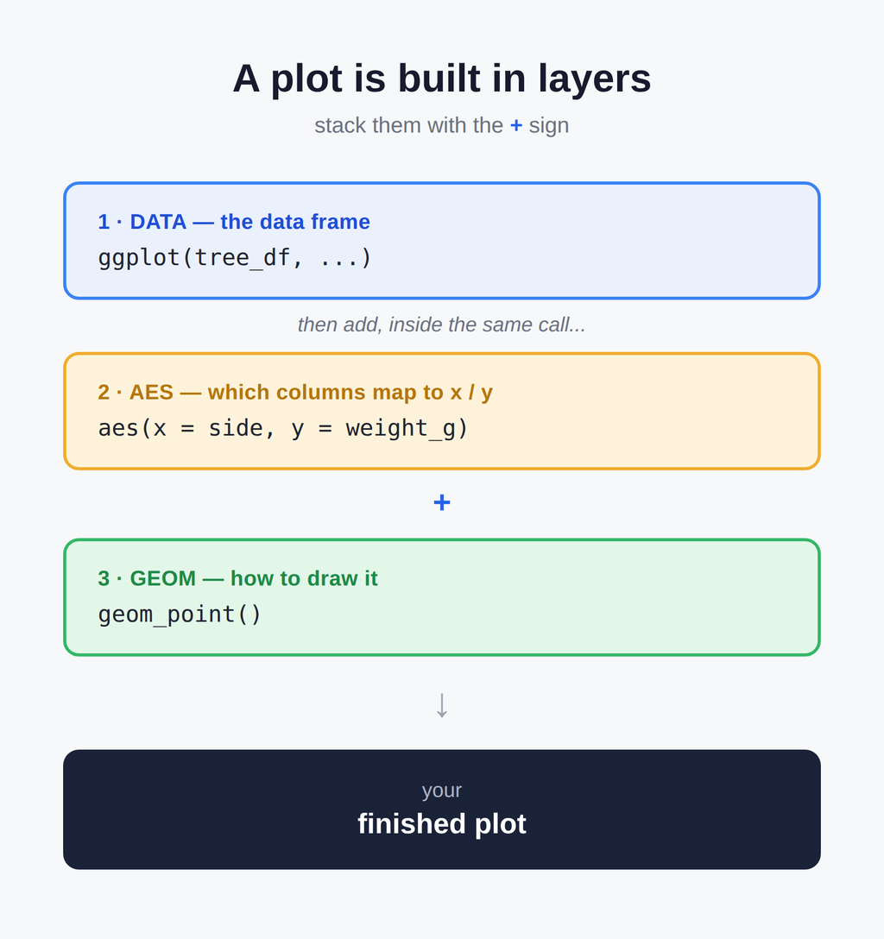
Goals for today
Get R and Positron oriented — the four panes
Organize a project so future-you can find things
Learn how R actually works:
using it as a calculator
storing things with <- the assignment operator - alligator eats the minus sign…
values, vectors, and data types
writing a script
Load our tree data and make a first plot
Tip
🖐 Try it yourself
By the end you will run real code on our leaf data — not a toy dataset.

Slide 4
Part 1 · Setting up
What is R, really?

Slide 5
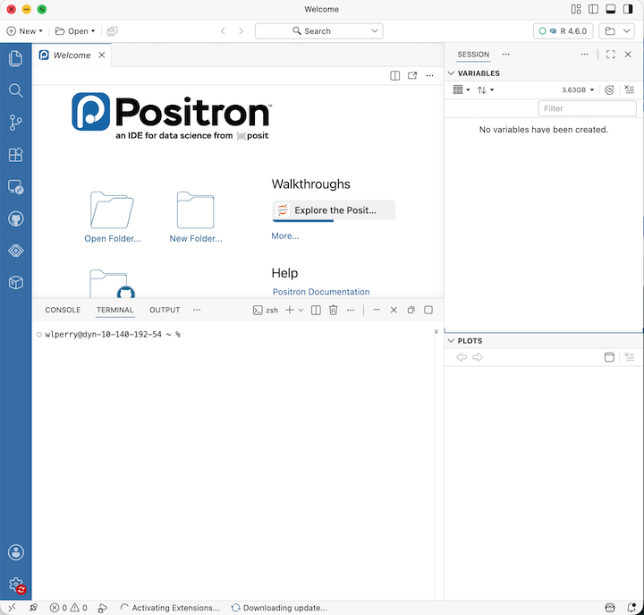
R is the engine — a free language for data and statistics
We drive that engine through an IDE (a code editor)
Two good IDEs — you may try both:
Positron — what we use (recommended)
RStudio — the long-time classic
Note
📖 New word
IDE = Integrated Development Environment. Think of R as the car engine and the IDE as the seat, wheel, and dashboard.

Slide 6
Organize the project before you code
Make one folder per project. Everything for the tree experiment lives together:
tree_project/ ├── data/ ← your Excel and CSV files ├── scripts/ ← your .R code files └── figures/ ← plots you save
In Positron: File → Open Folder… and pick this folder
Every path is then relative to the project — no more C:/Users/.../Desktop/... nightmares
Note
✅ Key idea
A tidy folder today saves an hour of “where did I put that file?” next week.
Note
📊 Coming from Excel?
In Excel you keep one big file and it can be hard to figure out what was done and how
In R we keep raw data untouched and
write new processed files
— so you can always trace your steps and never overwrite your original numbers

Slide 7
A quick tour of Positron
Four panes you will use constantly:
Editor (top-left) — your scripts live here when you have a script open
Console / Terminal (bottom) — where code runs
Variables / Session (right) — everything you have stored
Plots (right) — your figures appear here
Tip
🖐 Try it yourself
Find each pane on your screen now.
Click the Console tab — that is where we start next.

Slide 8
Part 2 · How R works
R is a calculator

Slide 9
Type math straight into the console and press Enter:
3 + 5 12 / 7 2 ^ 10
R answers immediately. The console is great for quick “what is the answer?” questions.
Warning
⚠️ Watch out!
A + at the start of the console line means R is still waiting for you to finish a command. Press Esc to start over.
Note
📊 Coming from Excel?
This is just like typing =3+5 into an Excel cell — except there are no cells, just a line you type and run.

Slide 10
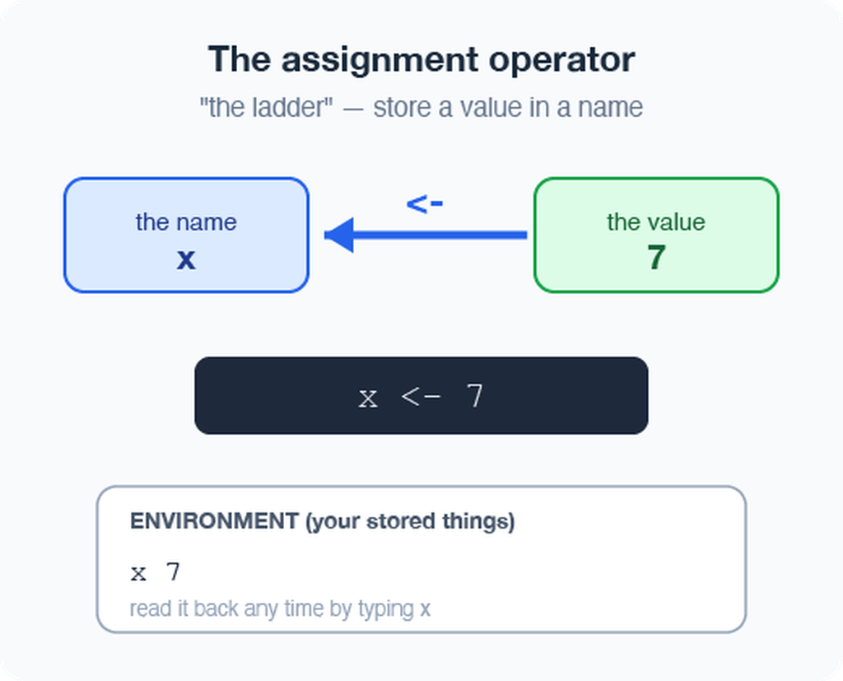
Storing values with <- assignment operator - alligators eats minus sign
To keep a value, give it a name with the assignment operator <-:
x <- 7 # store 7 under the name x x # type the name to read it back x * 2 # use it in math
<- puts the value into your environment (look in the Variables pane!)
Shortcut: Alt + - (Win) or Option + - (Mac) types <- for you
Note
📖 New word
Assignment operator <- “puts the thing on right and stores it in the name on left.” not always the same as =

Slide 11
Naming your objects well
Good names make code readable months later:
Be explicit, not too long: leaf_mass, not x2
Cannot start with a number — x2 ✅, 2x ❌
R is case-sensitive — weight_g ≠ Weight_g
Use lower_snake_case — words separated by underscores
leaf_mass <- c(4, 3, 5, 7) # good LeafMass <- c(4, 3, 5, 7) # works but avoid leaf.mass <- c(4, 3, 5, 7) # avoid dots
Warning
⚠️ Watch out!
weight_g and weight_G are two different objects. Pick one style and stick with it. I URGE you to use lower case and _
Note
📖 New word
Object (R) = variable (Excel/other languages). Same idea: a named container that holds something.
Our naming convention throughout this course:
- data frames → _df
- plots → _plot
- models → _model

Slide 12
Leave notes with comments #
Anything to the right of # is ignored by R — it is a note for humans:
# weights of four leaves, in grams leaf_mass <- c(4, 3, 5, 7) mean(leaf_mass) # average leaf mass
Comment generously — your future self will thank you
Shortcut to toggle: Ctrl/Cmd + Shift + C
Note
✅ Key idea
If a line confused you while writing it, comment why you did it.
Note
📊 Coming from Excel?
Comments are like the notes you scribble in a cell — but they never get in the way of the numbers or the code.

Slide 13
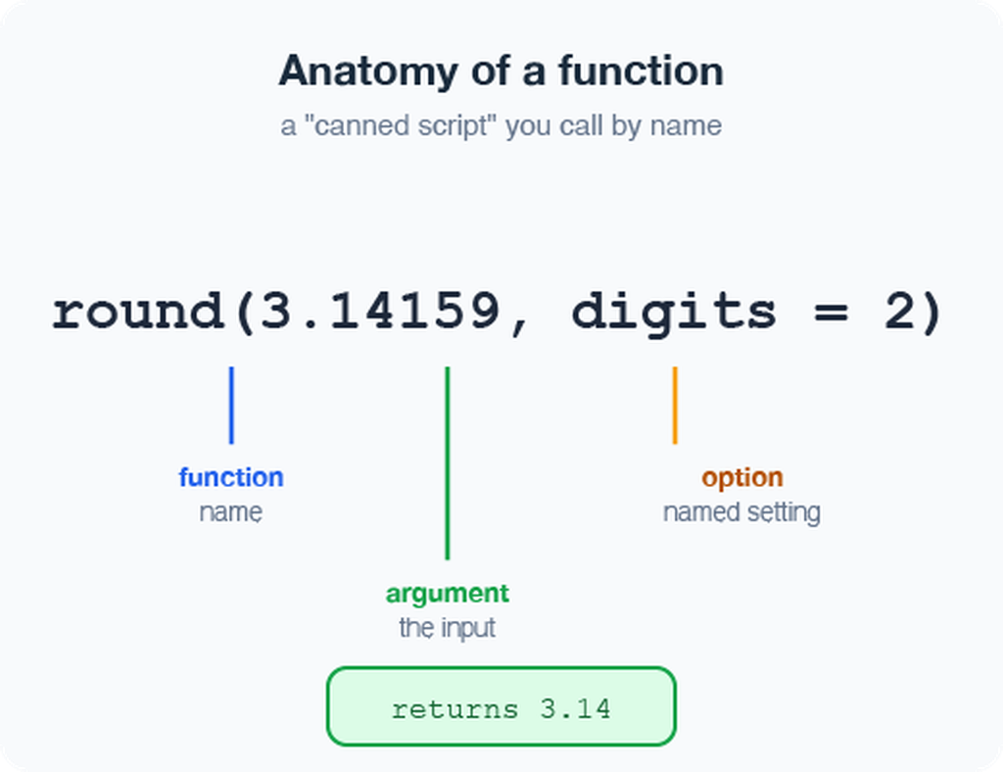
Functions and their arguments
A function is a canned script you call by name. You feed it arguments (inputs); it returns a result:
sqrt(10) # one argument round(3.14159) # default: 0 digits → 3 round(3.14159, 2) # two digits → 3.14 round(x = 3.14159, digits = 2) # named arguments
Stuck on a function?
?round # open the help page args(round) # what arguments does it take?
Note
📖 New word
Argument = an input you hand to a function inside its ( ).

Slide 14
Vectors — a row of values
A vector is a series of values built with c() (“combine”) or concatenated list:
weight_g <- c(4, 3, 5, 7) # numbers side <- c("sunny", "shady") # text needs quotes
Inspect any vector:
length(weight_g) # how many values? class(weight_g) # what type? str(weight_g) # quick structure overview
Warning
⚠️ Watch out!
Quotes matter: "sunny" is text. Without quotes, R hunts for an object named sunny and errors when it cannot find one.
Note
✅ Key idea
A vector is the workhorse of R. A spreadsheet column is really just a vector.

Slide 15
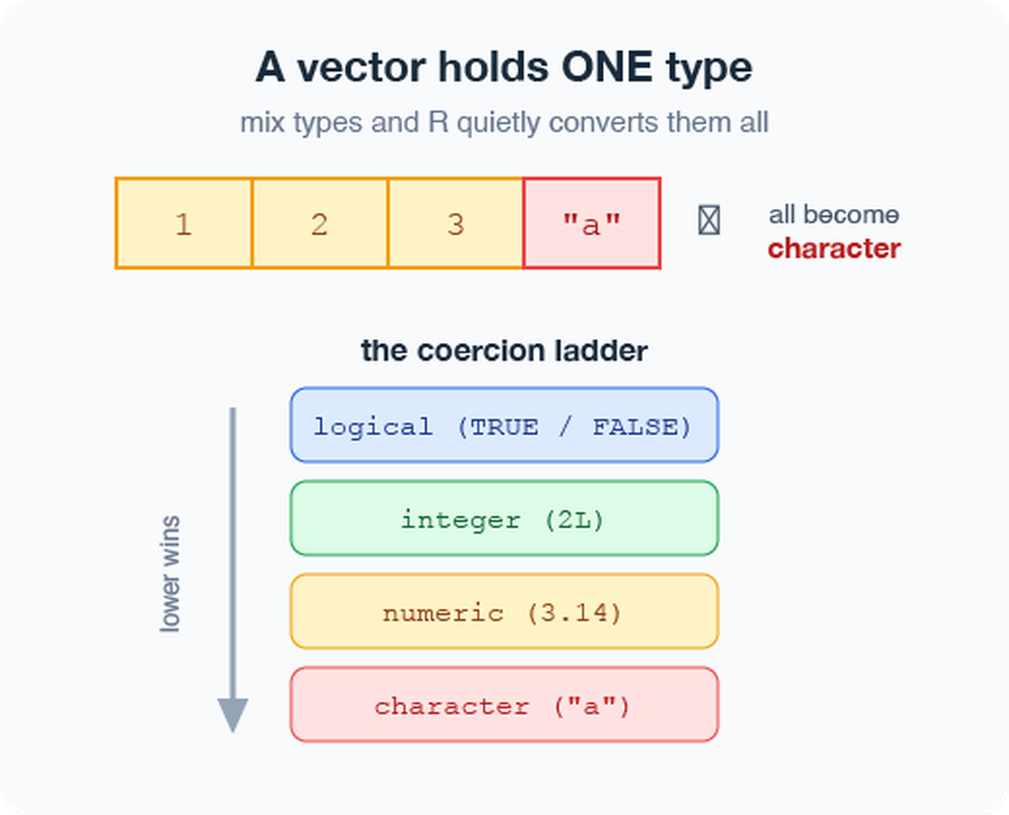
Data types live inside vectors
Every vector holds one type:
numeric — 4, 3.5
character — "sunny"
logical — TRUE / FALSE
Mix types and R quietly coerces them all to one:
c(1, 2, 3, "a") # all become character c(1, 2, 3, TRUE) # TRUE becomes 1 class(c(1, 2, 3, "a"))
Note
📖 New word
Coercion = R automatically converting everything in a vector to a single shared type.

Slide 16
Part 3 · From console to script
Do not retype — use a script

Slide 17
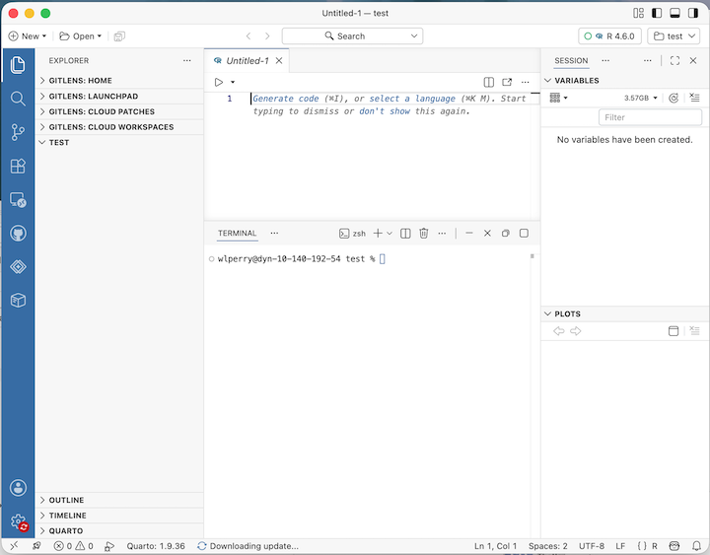
The console forgets.
A script (.R file) remembers and re-runs.
File → New File → R File opens a blank script
Type your commands, one per line
Put the cursor on a line and press Ctrl/Cmd + Enter to run it
Save with Ctrl/Cmd + S — reopen later and re-run everything
x <- 7 y <- 5 x + y
Note
✅ Key idea
Console = scratch paper.
Script = the lab notebook you keep.

Slide 18
Packages — extending what R can do
Like apps for your phone, packages add new abilities to R.
Install once — downloads to your computer (do this in the Console, not in your script):
install.packages("tidyverse") install.packages("readxl")
Load every session — activates it for today (put this at the top of every script):
library(tidyverse) # data wrangling + plotting library(readxl) # read Excel files
Warning
⚠️ Watch out!
If R says “could not find function read_excel”, you forgot the library(readxl) line.
Note
📖 New words
Package = the installed toolbox (install once).
Library = loading that toolbox into today’s session (every session).

Slide 19
Part 4 · Loading our data
Two functions for two file types

Slide 20
Put your files in the project’s data/ folder, then:
library(tidyverse) library(readxl) # Excel files (.xlsx) tree_df <- read_excel("data/2026_06_25_tree_experiment_raw_data.xlsx") # CSV files (.csv) — used by NOAA, iNaturalist, many databases noaa_df <- read_csv("data/noaa_global_yearly_temps.csv")
Note
✅ Key idea
read_excel() needs library(readxl). read_csv() comes with library(tidyverse) — no extra install needed.
Note
📊 Coming from Excel?
read_excel() and read_csv() are the bridge from your file into R. Your file’s first row becomes the column names in R.

Slide 21
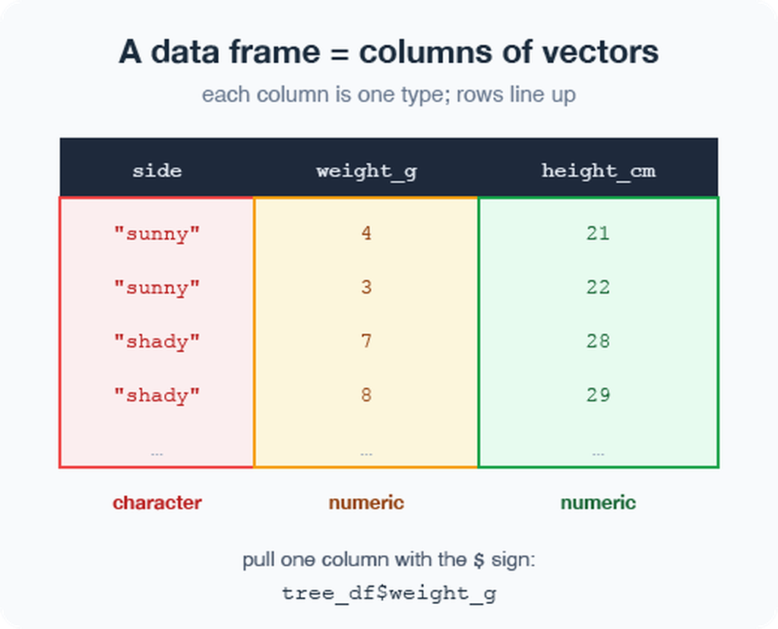
Meet the data frame
A data frame is a table: each column is a vector of one type, and the rows line up.
Our tree_df has five columns:
index — leaf number (numeric)
side — "sunny" / "shady" (character)
weight_g, width_cm, height_cm (numeric)
Pull a single column with $:
tree_df$weight_g # just the weights, as a vector
Note
📖 New word
Data frame = R’s word for a spreadsheet-style table.

Slide 22
Look at your data before trusting it
Always eyeball a new data frame:
head(tree_df) # first 6 rows tail(tree_df) # last 6 rows dim(tree_df) # rows, columns → 20 5 names(tree_df) # column names # Tidyverse-style structure check (prefer this over str): glimpse(tree_df) # one line per column: name, type, first values # Base R equivalent: str(tree_df) # same information, different layout
Tip
🖐 Try it yourself
Run glimpse(tree_df). How many rows? What type is side?
Note
✅ Key idea
Check dim() and glimpse() every single time you load data. Typos and wrong column types hide here.
Warning
⚠️ Watch out!
If a number column shows as <chr>, a stray letter or comma snuck into your spreadsheet.

Slide 23
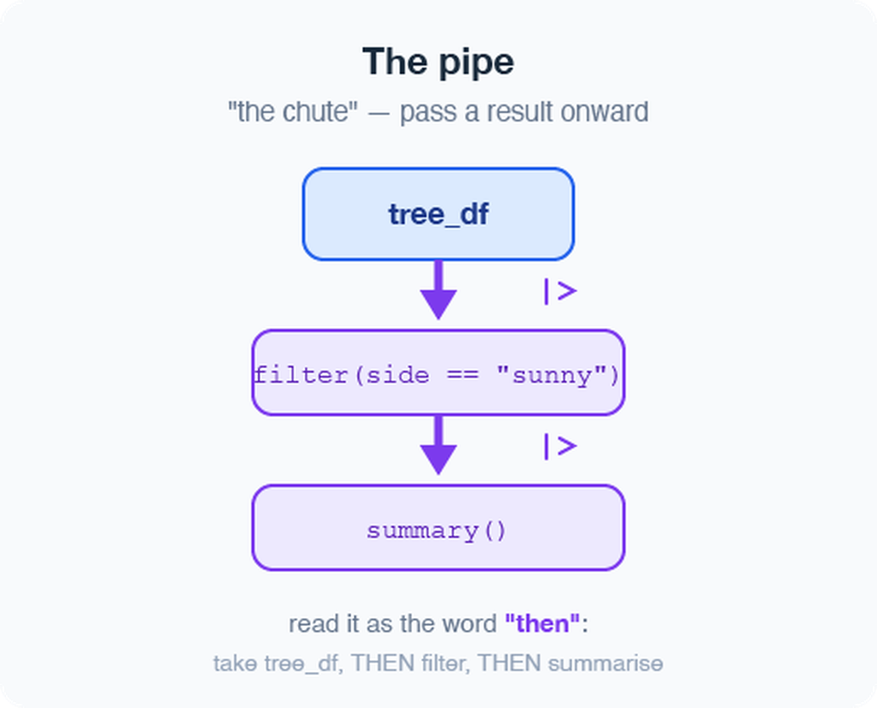
The pipe %>% — read it as “then”
The pipe sends a result straight into the next function. Read %>% as the word “then”:
# Start with simple examples: tree_df %>% nrow() # take tree_df, THEN count rows tree_df %>% names() # take tree_df, THEN list column names tree_df %>% summary() # take tree_df, THEN summarize # Chain two steps: tree_df %>% head(3) # take tree_df, THEN show first 3 rows
In Lecture 03 we will chain more steps together.
Note
📖 New word
Pipe %>% = “take what is on the left and feed it to the function on the right.”

Slide 24
Part 5 · Your first plot
ggplot: build a picture in layers

Slide 25
Plots are built from three core pieces, joined with +:
ggplot(tree_df, aes(x = side, y = weight_g))
data — which data frame (tree_df)
aes — which columns map to x and y
geom — how to draw it (add with +)
ggplot(tree_df, aes(x = side, y = weight_g)) + geom_point()
Warning
⚠️ Watch out!
The + must sit at the end of a line, never the start.
+ at the start = error
AND YES - Totally confusing to have %>% for code and + for plots - but its the way it is….

Slide 26
Improve it one layer at a time
Since side is a category, a boxplot with the raw points on top tells the story well:
ggplot(tree_df, aes(x = side, y = weight_g)) + geom_boxplot() + geom_jitter(width = 0.15, alpha = 0.6, color = "tomato") + labs(x = "Side of tree", y = "Leaf weight (g)", title = "Sunny vs. shady leaves")
Tip
🖐 Try it yourself
Swap weight_g for height_cm. What changes? Try geom_violin() instead of geom_boxplot().
CAN YOU DRAW A SKETCH OF WHAT THIS MIGHT LOOK LIKE???

Slide 27
Save your plot and your script
Store the plot in an object, then save it as a PNG:
leaf_plot <- ggplot(tree_df, aes(x = side, y = weight_g)) + geom_boxplot() # Save to the figures/ folder — always use PNG, dpi = 300 ggsave("figures/leaf_weight.png", plot = leaf_plot, width = 6, height = 6, units = "in", dpi = 300)
📖 File format tip
Save figures as PNG (.png) for reports and Canvas submissions.
dpi = 300 means 300 dots per inch — high enough for print and posters.
Warning
⚠️ Watch out!
ggsave() wants the filename first, then plot =. Also: dpi = 300 is publication quality — always use it.
Note

Slide 28
Wrap-up · What you can now do
Set up R + Positron and organize a project folder
Use R as a calculator and store values with <-
Write and run a script, with # comments
Call functions and read their help with ?
Build vectors, know their types
Load Excel and CSV data with read_excel() and read_csv()
Inspect a data frame with glimpse(), head(), dim()
Use the pipe %>% to chain steps
Make and save a first ggplot as a PNG
Tip
🖐 Before next class
Load tree_df, run glimpse(), and make one plot of width_cm by side. Save it to figures/.
Note
✅ Key idea
You went from a blank console to a saved figure of our data. That is the whole workflow in miniature.
Up next — Lecture 03:
filter() — pick rows
select() — pick columns
mutate() — create new columns
arrange() — sort rows
Then: descriptive statistics on our leaf data

Slide 29
Getting unstuck
When code breaks (it will — that is normal):
?function_name — the built-in help page
Read the error message out loud; it usually names the line
Check: did you load library(tidyverse) and library(readxl)?
Check: spelling? A missing ) or +?
The posit/tidyverse cheatsheets are excellent: posit.co/resources/cheatsheets
Bring the exact error (copy-paste it) to class or office hours
Note
✅ Key idea
Every coder googles error messages daily. Getting stuck is not failing — it is the job.
Note
📊 Coming from Excel?
In Excel you fix errors by clicking around. In R you fix them by reading the message and editing one line. Slower at first, far more powerful soon.

