Slide 1
Lecture 11 — Linear Regression
Using one measurement to predict another (Whitlock & Schluter Ch. 17)
Bill Perry

Slide 2
Where we left off (Lectures 09–10)
Five steps — hypotheses → check normality → check variance → run the test → interpret and report
Welch’s t-test compares the means of two groups
Pseudoreplication — average up to the thing you actually sampled before you test
Our leaves — mean leaf mass did not differ between the shady and sunny sides
Our sugar maples — shady-side leaves were significantly larger in area than sunny-side leaves on the same tree
Note
✅ Where today comes in
A t-test compares two groups.
Today we ask a different question:
  can one number predict another number?
  we weighed our leaf tracings, but what we actually want is leaf area in cm²

Slide 3
Goals for Today
Understand what a linear regression does: fit a straight line, $\hat{Y}=a+bX$
See what a residual is, in a real plot
Fit a model with lm()
Read and interpret the summary() output — slope, p-value, R²
Check the residuals the way R shows them to you
Use the slope to turn a tracing mass into a leaf area
Report the result in a standard sentence
Tools today:
  lm() — fit the line
  summary() — read the result
  plot(model) — check the residuals
  reading 7.660e-03 as 0.007660
  geom_smooth(method = "lm") — draw the line
Reading:
  📖 Whitlock & Schluter, Ch. 17 — Regression
    §17.1 Linear regression
    §17.3 Testing the slope
    §17.4 R²
    §17.5 Assumptions
Today’s naming:
  models → _model
  plots → _plot

Slide 4
🧩 Chunk 1 of 3 · What Regression Does
We will cover:
the question regression answers,
the equation $\hat{Y}=a+bX$,
what a residual is,
what R² tells you,
and the assumptions.
No code in this chunk — just the idea.

Slide 5
What Is Linear Regression?
Linear regression fits the best straight line through a cloud of points so you can predict one number (Y) from another number (X).
Regression vs. the t-test:
Role | Variable | On the plot
Explanatory (X) | what you can measure easily | x-axis
Response (Y) | what you actually want to know | y-axis
X is usually the easy measurement. Y is the expensive one. Regression gives you an equation that converts X into Y.
📖 W&S §17.1 p. 540–541
Test | The question
t-test | Do two groups have different means?
Regression | Does X predict Y?
Use regression when:
both variables are numeric
X could reasonably predict Y
you want an equation, not just a yes/no

Slide 6
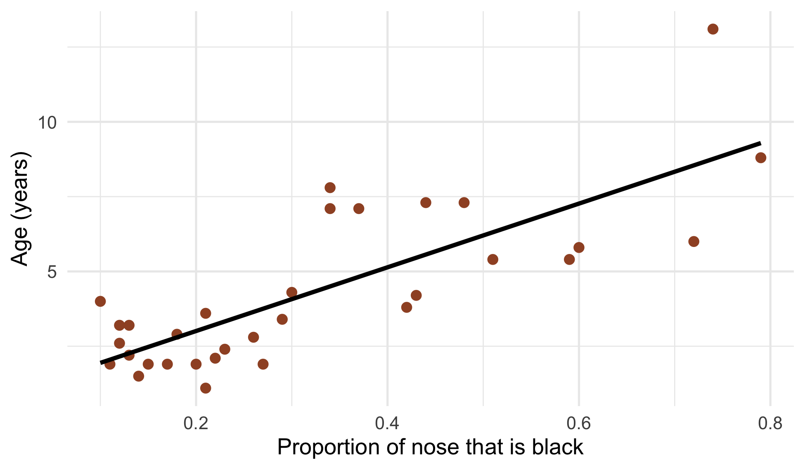
A Real Example from the Textbook
Aging a wild lion is hard — you have to have watched it since it was a cub.
But a male lion’s nose darkens as it ages, and you can photograph a nose from a truck.
X = proportion of the nose that is black — easy
Y = age in years — what you want
Fit the line once on lions of known age, and from then on you can estimate a lion’s age from a photograph.
📖 W&S §17.1, Example 17.1

Slide 7
Our Version of the Same Problem
The problem: we want leaf area in cm², but we don’t have a leaf-area meter. We have a balance.
The fix — a calibration curve:
Cut paper squares of known area (1, 4, 16 … 567 cm²)
Weigh each square
Fit the line: area ~ mass
Trace a leaf onto the same paper and weigh the tracing
Put the tracing mass into the equation → predicted leaf area
Why it works: paper from one stock has a constant area per gram, so mass and area move together almost perfectly.
Known area (cm²) | Squares weighed
1 | 25
4 | 32
16 | 24
36 | 3
64 | 7
100 | 14
225–567 | 13

Slide 8
The Regression Equation
$$\hat{Y}=a+bX$$
The slope is the useful one.
b = the extra cm² you get for each extra gram of paper
That is just the area density of the paper stock — and it is the number that does the converting.
The intercept is a bookkeeping number.
a = the predicted area of a piece of paper weighing nothing
Physically that should be 0. A small value near zero is fine; it is measurement noise, not biology.
Symbol | Name | What it means
$\hat{Y}$ | predicted Y | what the line says Y should be
a | intercept | Y when X = 0 — where the line crosses
b | slope | how much Y changes per 1 unit of X
Ours will read:
$$\hat{\text{area}}=a+b×\text{mass}$$
📖 W&S §17.1 pp. 543–545

Slide 9
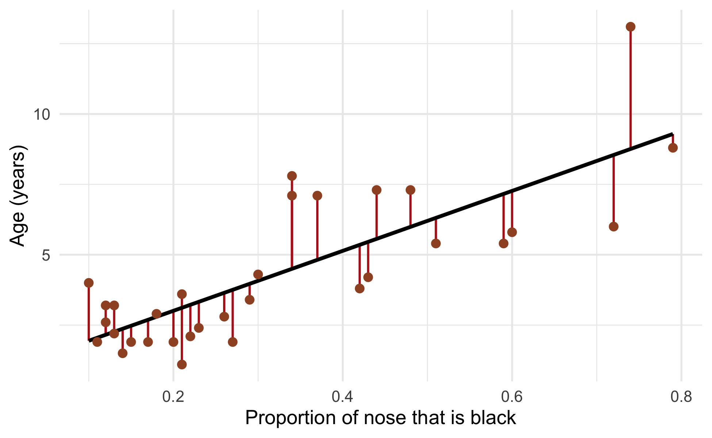
What Is a Residual?
A residual is one point’s miss:
$$\text{residual}=\text{observed}−\text{predicted}$$
A point above the line → positive residual (that lion was older than its nose suggested)
A point below the line → negative residual
A point on the line → residual of 0
The line R gives you is the one that makes those red segments as small as possible overall. That is all “least squares” means — and R does the work.
📖 W&S §17.1 p. 542

Slide 10
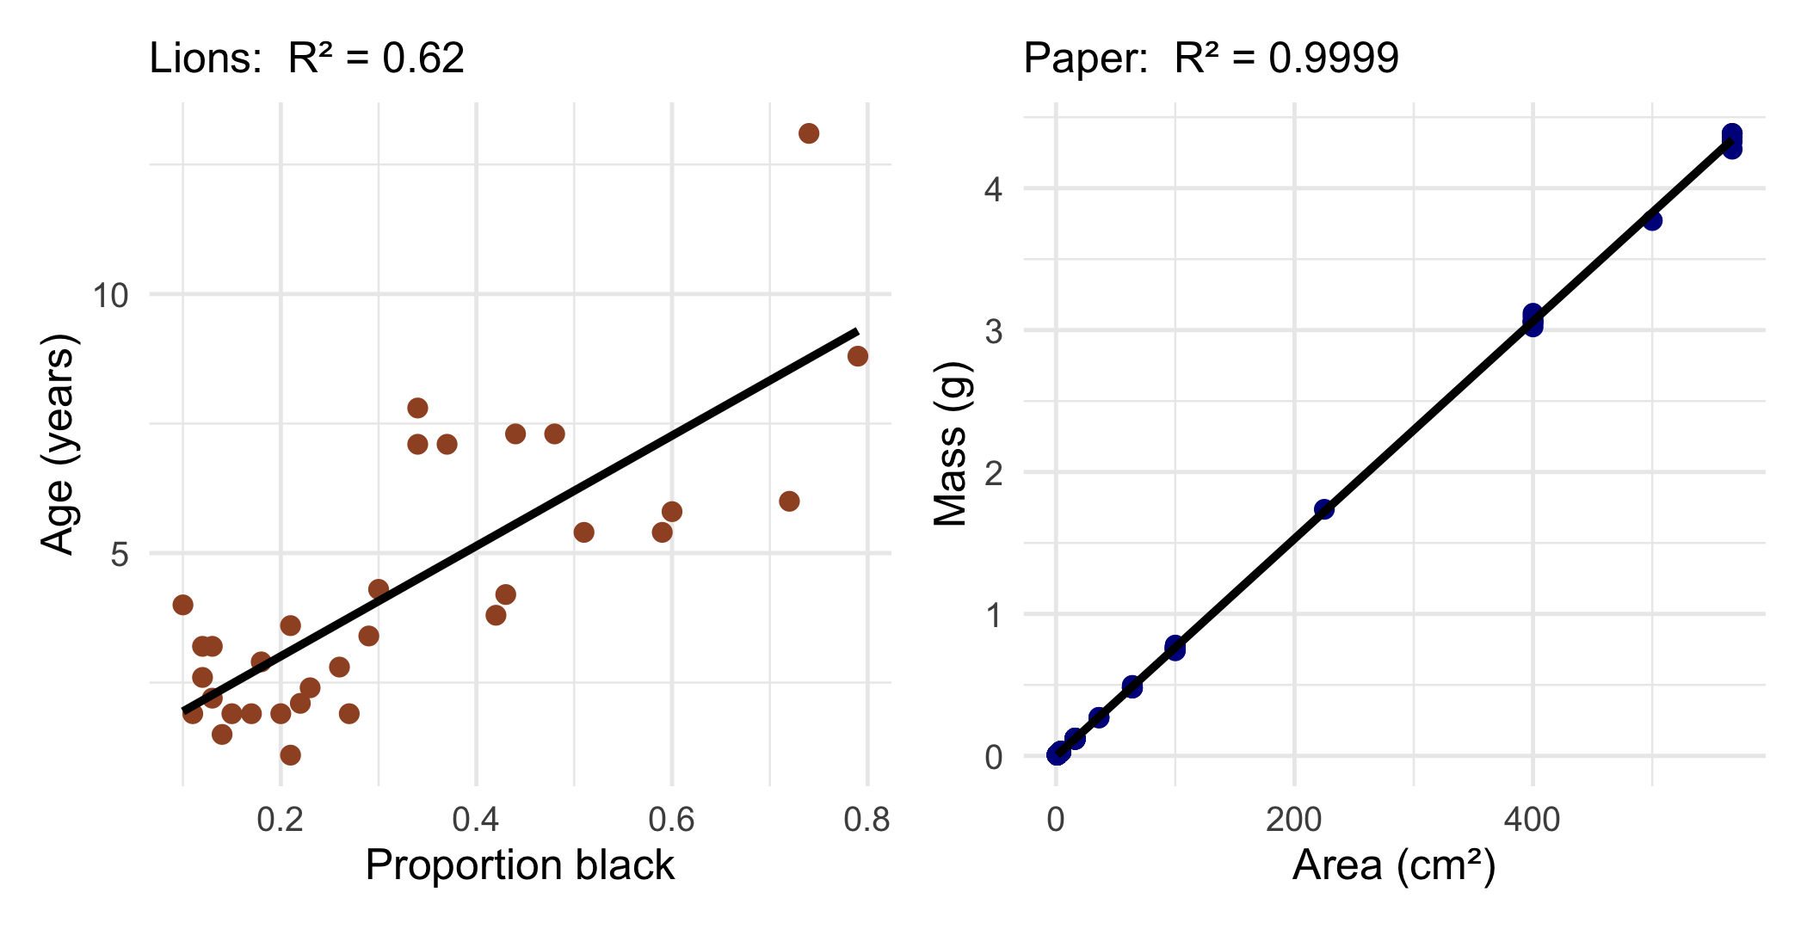
R² — How Tight Is the Fit?
R² runs from 0 to 1. It is the fraction of the variation in Y that the line accounts for.
R² | Reads as
1.00 | points sit on the line
0.62 | X explains 62% of the variation
0.00 | the line tells you nothing
Both of these are good regressions. Nose blackness really does predict a lion’s age — just with scatter, because lions vary. Paper is manufactured to be uniform, so it has almost none.
In biology, R² of 0.3–0.7 is normal and useful. Don’t expect 0.99.
📖 W&S §17.4 p. 555

Slide 11
R² and the p-value Answer Different Questions
 | The question it answers
p-value | Is there really a relationship, or could this slope be chance?
R² | How tightly do the points follow the line?
Important
The slope is the hypothesis test.
H₀: the slope is 0 — X does not predict Y
Hₐ: the slope is not 0 — X does predict Y
summary() gives you the p-value for exactly that test, and we will find it on the next few slides.
📖 W&S §17.3 pp. 551–553

Slide 12
Assumptions of Regression
Four things need to be roughly true for the p-value and the intervals to mean anything (W&S §17.5):
Important
Check the residuals, not the raw data.
Normality here is about the misses — the red segments — not about Y itself. Y is supposed to go up with X; of course it isn’t bell-shaped.
The good news: once you have a fitted model, plot() draws all of these for you. No extra code.
Same habit as the t-test: check → decide → report.
📖 W&S §17.5 pp. 557–560
# | Assumption | How you check it
1 | Linear — Y really does follow a straight line | the scatter plot, then plot(model) panel 1
2 | Independent — one observation doesn’t depend on another | your study design
3 | Equal variance — the scatter is about the same all the way along | plot(model) panels 1 and 3
4 | Normal residuals — the misses are bell-shaped | plot(model) panel 2

Slide 13
🧩 Chunk 2 of 3 · Fit It and Read It
We will cover: loading the paper data, the scatter plot, fitting with lm(), and reading the summary() output line by line.
🛑 After this chunk: Activity Parts 1–3 (the study, load, plot, fit, read the summary).

Slide 14
Load Libraries and Data
# Load packages at the top ------------------------------
library(readxl) # read Excel files
library(tidyverse) # dplyr + ggplot2
library(janitor) # clean_names()
# Load the paper calibration data ----------------------
paper_df <- read_excel("data/paper_area_weights.xlsx")
Two columns, 118 rows: area_cm2 is the known area of each square, mass_g is what it weighed.

Slide 15
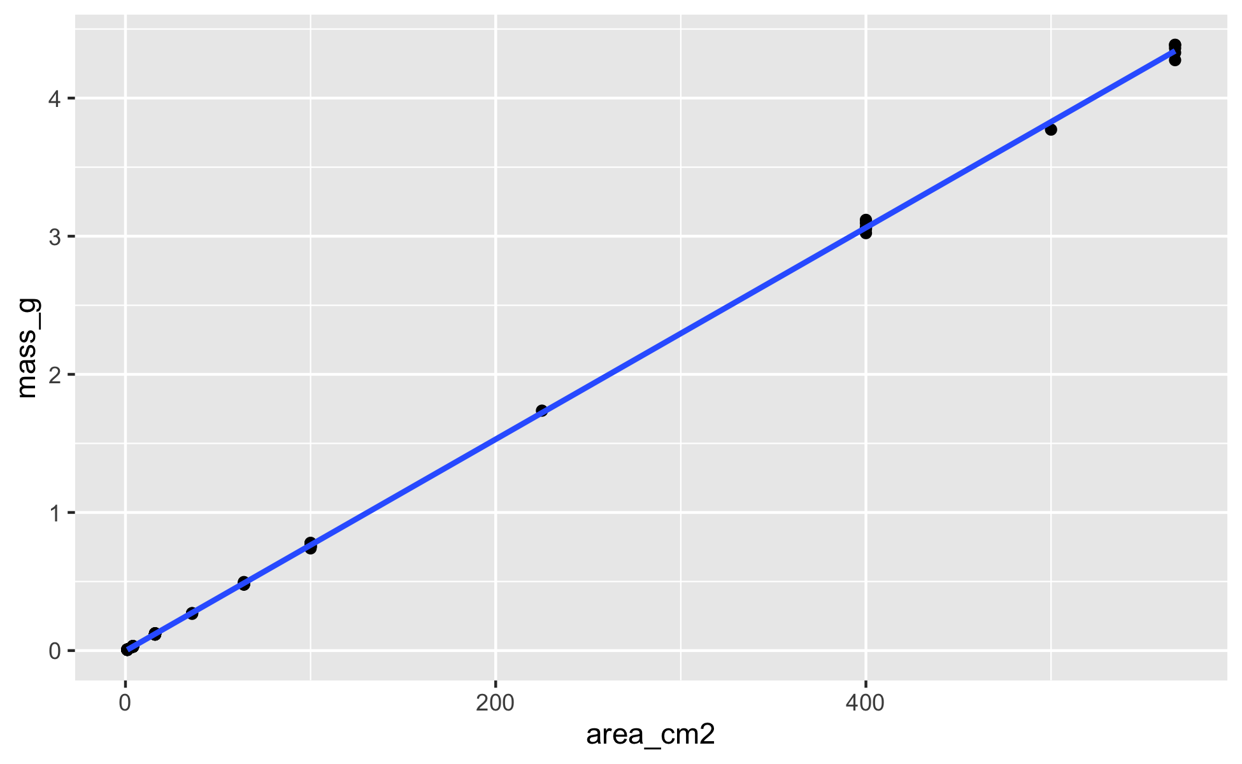
Always Plot It First
# Scatter plot of mass against known area --------------
scatter_plot <- paper_df %>%
ggplot(aes(x = area_cm2, y = mass_g)) +
geom_point() +
geom_smooth(method = "lm")
scatter_plot
Three plain lines. aes(x = , y = ) puts the variable you set on x and the one you measured on y, and geom_point() draws the dots.
What you are looking for:
Straight? → a line is the right tool
Scatter the same all the way along?
Any point way off on its own?
Here: straight, tight, nothing strange. Fit the line.
Note
Never fit a regression you haven’t looked at. A curve, a funnel, or one wild point all change what you should do next.

Slide 16
Fit the Model with lm()
# Fit the regression line ------------------------------
paper_model <- lm(mass_g ~ area_cm2, data = paper_df)
Nothing prints. lm() hands back a model object that is holding the answer — summary() is what shows it to you.
The formula is the whole trick:
lm(Y ~ X, data = df)
Y — the response — goes on the left of ~
X — the explanatory variable — goes on the right
~ reads as “is predicted by”
So mass_g ~ area_cm2 is “mass is predicted by area.”
Warning
⚠️ Which way round? We cut the areas and measured the masses, so mass is the response. lm(area_cm2 ~ mass_g) runs fine too — it just asks R to treat ten areas we chose on purpose as if they were the noisy measurement.

Slide 17
summary() — the Whole Output
# Read the model ---------------------------------------
summary(paper_model)
Call:
lm(formula = mass_g ~ area_cm2, data = paper_df)
Residuals:
Min 1Q Median 3Q Max
-0.066548 -0.001774 0.000907 0.002267 0.056127
Coefficients:
Estimate Std. Error t value Pr(>|t|)
(Intercept) -2.058e-03 1.389e-03 -1.481 0.141
area_cm2 7.660e-03 8.646e-06 885.964 <2e-16 ***
---
Signif. codes: 0 '***' 0.001 '**' 0.01 '*' 0.05 '.' 0.1 ' ' 1
Residual standard error: 0.01351 on 116 degrees of freedom
Multiple R-squared: 0.9999, Adjusted R-squared: 0.9999
F-statistic: 7.849e+05 on 1 and 116 DF, p-value: < 2.2e-16
There are only four numbers in here that you need, and we will take them one at a time:
the slope (area_cm2 → Estimate)
the intercept ((Intercept) → Estimate)
the slope’s p-value (area_cm2 → Pr(>|t|))
the R² (Multiple R-squared)

Slide 18
Reading It — 1. The Coefficients Table
Coefficients:
Estimate Std. Error t value Pr(>|t|)
(Intercept) -2.058e-03 1.389e-03 -1.481 0.141
area_cm2 7.660e-03 8.646e-06 885.964 <2e-16
The Estimate column is the equation.
(Intercept) = -0.002058 → that is a
area_cm2 = 0.007660 → that is b, the slope
7.660e-03 means 7.660 × 10⁻³ — move the decimal point three places left.
Tip
Prefer plain decimals? options(scipen = 999) turns scientific notation off and options(scipen = 0) turns it back on. We leave it on — with it off, p prints as <0.0000000000000002.
So the fitted line is:
$$\hat{\text{mass}}=−0.0021+0.00766×\text{area}$$
Say the slope out loud, with units:
Every extra 1 cm² of this paper weighs another 0.00766 g.
Note
×10,000 → 76.6 g/m² — the paper’s grammage, the number on the side of the ream. Copy paper is sold at 75–80 g/m², so the slope is a property you can go and check.
The other three columns, in one line each:
Column | What it is
Std. Error | how uncertain that estimate is
t value | Estimate ÷ Std. Error
Pr(>|t|) | the p-value for that row
📖 W&S §17.3 p. 551

Slide 19
Reading It — 2. The Two p-Values
(Intercept) -2.058e-03 ... 0.141
area_cm2 7.660e-03 ... <2e-16
The slope row is the one that matters. Pr(>|t|) for area_cm2 is <2e-16 — R’s way of writing “smaller than I can print.”
H₀: the slope is 0 → area tells you nothing about mass
p < 0.001 → reject H₀. Area predicts mass.
The intercept row: p = 0.141, so the intercept is not distinguishable from 0 — exactly what physics says it should be. A piece of paper with no area has no mass.
Tip
Which p-value do I report?
The slope’s. That is the biological question. Nobody reports the intercept’s p-value unless zero means something special.
Note
Never write p = 0. When R prints <2e-16, you write p < 0.001.

Slide 20
Reading It — 3. R² and the Bottom Line
Residual standard error: 0.01351 on 116 degrees of freedom
Multiple R-squared: 0.9999, Adjusted R-squared: 0.9999
F-statistic: 7.849e+05 on 1 and 116 DF, p-value: < 2.2e-16
Multiple R-squared = 0.9999 → area explains 99.99% of the variation in mass. That is manufactured paper, not biology.
F-statistic with 1 and 116 DF, p < 2.2e-16 → the overall test of the model. With one X it tells you the same thing as the slope’s p-value.
Residual standard error = 0.0135 g → a typical miss is about 13 mg.
Where the df come from:
1 = one explanatory variable
116 = 118 squares − 2 numbers we estimated (a and b)
Use Adjusted R-squared once you have more than one X; with a single X, report Multiple R-squared.
Important
R² = 0.9999 does not mean “everything is fine.” It means the points are close to the line. Whether the assumptions hold is a separate question — and we check it two slides from now.

Slide 21
→ ACTIVITY 11 Parts 1–3 now
🛑 Do Activity Parts 1–3 now
Load the paper data, make the scatter plot, fit lm(mass_g ~ area_cm2), and read the slope, the p-value and R² off the summary output.

Slide 22
🧩 Chunk 3 of 3 · Plot It, Check It, Use It
We will cover: drawing the fitted line, reading plot(model), converting the whole column of tracings, averaging away the pseudoreplication, and the paired t-tests.
🛑 After this chunk: Activity Parts 4–7 (check the residuals, convert, average, paired t-tests).

Slide 23
Draw the Line
# Scatter plot with the fitted line --------------------
calibration_plot <- paper_df %>%
ggplot(aes(x = area_cm2, y = mass_g)) +
geom_point() +
geom_smooth(method = "lm")
calibration_plot
One extra line. geom_smooth(method = "lm") fits the same regression again, just for drawing, and adds:
the fitted line
a grey 95% confidence band around it
The band is narrowest in the middle of the data and flares at the ends — the line is pinned down best where you have the most data. Here it is so narrow you can barely see it.
Note
geom_smooth() defaults to a wiggly curve. method = "lm" is what makes it a straight regression line.

Slide 24
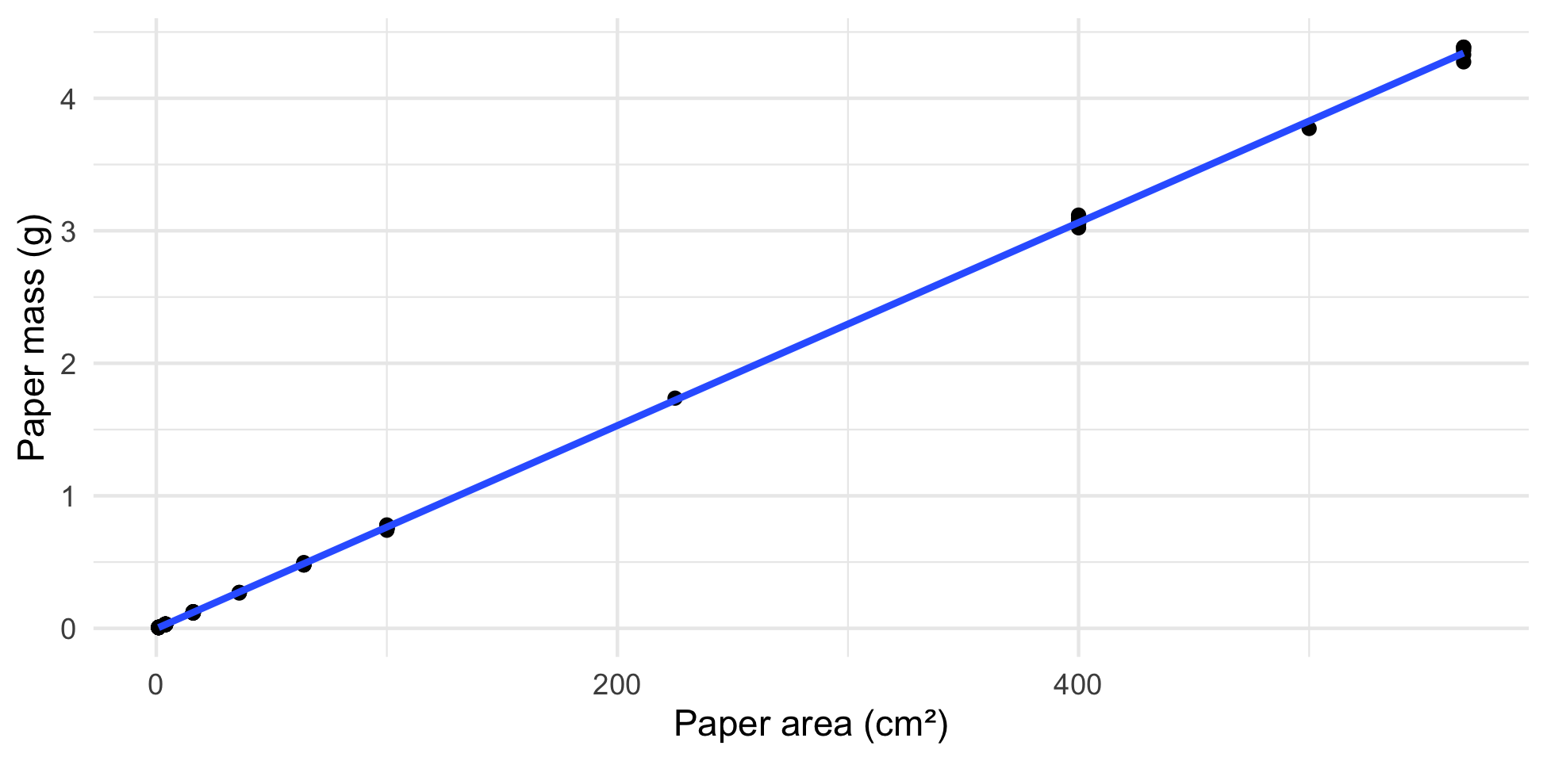
The Same Plot, Dressed Up
# The publication version — for reference ---------------
calibration_plot <- paper_df %>%
ggplot(aes(x = area_cm2, y = mass_g)) +
geom_point() +
geom_smooth(method = "lm") +
labs(x = "Paper area (cm²)",
y = "Paper mass (g)") +
theme_minimal()
calibration_plot
This is the version you’d put in a report — and it is only two additions to the plot you already made:
labs() — real axis labels with units
theme_minimal() — drop the grey background
Tip
Don’t type this today. Get the plain geom_point() + geom_smooth(method = "lm") working first. Labels and themes are the last thing you add, once you know the plot is right.

Slide 25
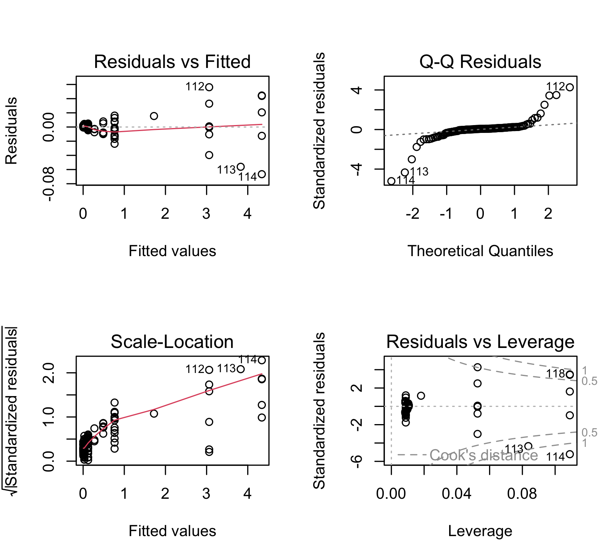
Check the Residuals — plot(model)
# All four residual plots in one call ------------------
par(mfrow = c(2, 2))
plot(paper_model)
par(mfrow = c(2, 2)) just says “put the next four plots in a 2×2 grid.”
Panel | Name | Checks
1 | Residuals vs Fitted | linear? equal scatter?
2 | Normal Q-Q | residuals bell-shaped?
3 | Scale-Location | equal scatter again
4 | Residuals vs Leverage | any one point running the show
Panel 1 is the one to look at first.
✅ Good: a flat, shapeless cloud around 0
❌ Curved: the relationship isn’t straight
❌ Funnel: the scatter grows as Y grows

Slide 26
What Our Residual Plot Is Telling Us
Look at panel 1 again. The points fan out — a 1 cm² square misses by hundredths of a cm², a 567 cm² square misses by several cm².
That is a funnel: assumption 3 (equal variance) does not hold.
# How big are the misses at each square size? ---------
paper_df %>%
mutate(residual = residuals(paper_model)) %>%
group_by(area_cm2) %>%
summarize(biggest_miss = round(max(abs(residual)), 2))
# A tibble: 10 × 2
area_cm2 biggest_miss
<dbl> <dbl>
1 1 0
2 4 0
3 16 0
4 36 0.01
5 64 0.01
6 100 0.02
7 225 0.02
8 400 0.06
9 500 0.06
10 567 0.07
Important
A great R² and a bad residual plot can live together. R² says the points are near the line. The residual plot says the size of the miss depends on how big the square is — which it does, because a balance has percentage error, not fixed error.
So what do we do?
For predicting a leaf tracing (0.1–0.4 g) we are down in the tight end of the line, where a typical miss is a fraction of a cm². The calibration is fine for the job.
The confidence intervals at the big-square end are the part you shouldn’t trust.
The proper fix — fitting on a log scale, or weighting the points — is a graduate topic. Knowing to look, and saying what you saw, is the undergraduate job.

Slide 27
From Tracing Mass to Leaf Area
The model says
$$\text{mass}=a+b×\text{area}$$
We have the mass and want the area, so rearrange:
$$\text{area}=\frac{\text{mass}−a}{b}$$
# Typed off the summary(), out of sci notation --------
intercept <- -0.002058 # from -2.058e-03
slope <- 0.007660 # from 7.660e-03
# 1 m2 = 10000 cm2
slope * 10000
[1] 76.6
Type the two numbers in. They are right there in the Coefficients table, and the arithmetic stays in plain sight
Rounding to six decimals changes nothing — same t, df and p at the end
Or let R hand them to you: coef(paper_model), then [1] and [2] — and it prints plain decimals
Note
×10,000 → 76.6 g/m² — the paper’s grammage, the number on the side of the ream. Copy paper is sold at 75–80 g/m², so the slope is a property you can check against the label.
A tracing weighing 0.138 g is
$$\frac{0.138−(−0.002058)}{0.007660}=18.3{\text{ cm}}^{2}$$

Slide 28
Convert a Whole Column of Tracings
# Load our leaf data ----------------------------------
leaf_df <-
read_excel("data/2026_09_03_data_sci_leaf_area.xlsx") %>%
clean_names()
# Every tracing mass becomes an area ------------------
leaf_df <- leaf_df %>%
mutate(area_cm2 = (paper_mass_g - intercept) / slope)
leaf_df %>%
select(teams, shade, mass_g, paper_mass_g, area_cm2)
# A tibble: 53 × 5
teams shade mass_g paper_mass_g area_cm2
<chr> <chr> <dbl> <dbl> <dbl>
1 12345 sunny 0.4 0.21 27.7
2 12345 sunny 0.48 0.21 27.7
3 12345 sunny 0.34 0.21 27.7
4 12345 sunny 0.65 0.24 31.6
5 12345 sunny 0.27 0.15 19.9
6 12345 sunny 0.43 0.34 44.7
7 12345 shady 0.39 0.29 38.1
8 12345 shady 0.45 0.25 32.9
9 12345 shady 0.6 0.23 30.3
10 12345 shady 0.57 0.28 36.8
# ℹ 43 more rows
This is the payoff. paper_mass_g was the mass of each leaf’s tracing — now every leaf has an area_cm2.
One line of arithmetic, all 53 rows at once
No new function to learn
Note
The NAs are honest. One team never weighed their tracings, so those leaves have no area. R keeps the gap instead of inventing a number.

Slide 29
One Value per Team per Side
# Average away the pseudoreplication ------------------
team_df <- leaf_df %>%
group_by(teams, shade) %>%
summarize(area_cm2 = mean(area_cm2, na.rm = TRUE),
mass_g = mean(mass_g, na.rm = TRUE),
.groups = "drop")
team_df
# A tibble: 10 × 4
teams shade area_cm2 mass_g
<chr> <chr> <dbl> <dbl>
1 12345 shady 34.0 0.448
2 12345 sunny 29.9 0.428
3 Oscar_Karl shady NaN 0.400
4 Oscar_Karl sunny NaN 0.339
5 fighting_mongooses shady 35.7 0.653
6 fighting_mongooses sunny 32.2 0.544
7 leaf_oglers shady 36.3 0.588
8 leaf_oglers sunny 37.4 0.599
9 still_loading shady 42.5 0.526
10 still_loading sunny 53.7 0.789
Six leaves off one branch are not six independent measurements
Using all 53 is pseudoreplication — it makes p look better than the study earned
Averaging gives each team one sunny and one shady value
Note
You met this in T-Tests II. Same tree, same pairing — now in cm² instead of grams.

Slide 30
Paired t-Tests on Area and Mass
# One row per team ------------------------------------
wide_df <- team_df %>%
pivot_wider(names_from = shade,
values_from = c(area_cm2, mass_g))
t.test(wide_df$area_cm2_shady,
wide_df$area_cm2_sunny, paired = TRUE)
t.test(wide_df$mass_g_shady,
wide_df$mass_g_sunny, paired = TRUE)
Each team measured both sides, so the team is the pair.
 | mean diff | t | df | p
area | −1.2 cm² | −0.34 | 3 | 0.76
mass | −0.016 g | −0.25 | 4 | 0.81
Neither is significant — with 5 teams there is not much power
The area test has df = 3: one team never traced their leaves
Note
A real answer of “we could not detect a difference” is still an answer.

Slide 31
How to Report a Regression
The template — fill in from your summary() output:
[What predicted what] (linear regression: F(df₁, df₂) = ___, p ___, R² = ___). The fitted equation was Y = ___ + ___ × X.
Ours:
Paper area was a very strong predictor of paper mass (linear regression: F(1, 116) = 784,900, p < 0.001, R² = 0.9999). The calibration equation was mass = −0.0021 + 0.00766 × area, equivalent to 76.6 g/m². Residual scatter increased with square size, so the largest squares are the least well described.
Where every number comes from:
In the sentence | In summary()
F and both df | the F-statistic: line
p | that same line
R² | Multiple R-squared
intercept | (Intercept) → Estimate
slope | area_cm2 → Estimate
Always include: the test name, F with both df, p, R², and the equation. Add a line about the assumptions you checked.
📖 W&S §17.3 p. 553

Slide 32
→ ACTIVITY 11 Parts 4–7 now
🛑 Do Activity Parts 4–7 now
Run plot(model) and say whether the assumptions are met
Convert the whole paper_mass_g column into areas
Average to one value per team per side, then run both paired t-tests
Your four answers in the script are what you hand in

Slide 33
What We Learned Today
The ideas:
Regression fits a line so you can predict Y from X
$\hat{Y}=a+bX$ — the slope converts X into Y
A residual is one point’s miss: observed − predicted
R² = how tight the fit is; p = whether the slope is real
Check the residuals — and say what you saw
The code:
lm(Y ~ X, data = df) — fit it
summary(model) — slope, intercept, p, R²
geom_smooth(method = "lm") — draw it
plot(model) — check it
7.660e-03 = 0.007660 — reading scientific notation
Hand in: your finished scripts/11_regression.R — the code is given; your answers are graded
📖 W&S Ch. 17:
§17.1 Linear regression · §17.2 Prediction
§17.3 Testing the slope · §17.4 R²
§17.5 Assumptions
Up next — Lecture 12:
Pulling real climate data into R with GSODR
Summarizing daily weather into yearly values
The same lm() — temperature predicted by date
  the slope becomes a rate of change per year
  and you write that regression yourself

