Slide 1
Lecture 03 — Describing Our Data
Wrangling, summaries, statistics, and our first real comparisons Bill Perry

Slide 2
Where we left off (Lecture 02)
Setup — R and Positron installed; project folders created (data/, figures/, scripts/)
R as a calculator — arithmetic, order of operations, assignment with <-
Vectors — c(), data types (numeric, character, logical)
Functions — calling built-in functions, reading help with ?
Loading data — read_excel() and read_csv(); inspecting with glimpse(), head(), dim()
Pipe — %>% reads as “then”; chains steps together
First ggplot — boxplot + geom_jitter(), saved as PNG
Note
✅ Key idea from Lecture 02
You can get data into R and make a plot. Today we learn to wrangle and describe what we actually have.

Slide 3
Goals for Today
Part 1 — Tidyverse wrangling:
filter() — pick rows by a condition
select() — pick columns by name
mutate() — create new columns
arrange() — sort rows
Chain them all into a pipeline
Part 2 — Descriptive statistics:
mean, median, variance, SD, SE
NA handling — sum(!is.na())
group_by() + summarize()
skimr for a fast full overview
Boxplot + mean ± SE plots
Tip
🖐 Try it yourself
By the end you will wrangle and describe our leaf data in one connected pipeline.
Our tools today:
readxl
tidyverse
skimr
References:
📖 R4DS Ch 3 — Data Transformation
📖 R4DS Ch 13 — Numbers
📖 R4DS Ch 18 — Missing Values
🌐 Data Carpentry
Naming conventions:
data frames → _df
plots → _plot
models → _model

Slide 4
Load Libraries and Data
# Load all packages at the top of every script ---------- library(readxl) # reading Excel files library(tidyverse) # data wrangling + ggplot2 library(skimr) # fast descriptive summaries
# Read the leaf data from the data folder --------------- tree_df <- read_excel("data/2026_06_25_tree_experiment_raw_data.xlsx")
Note
Install once — load every session
Run in the Console one time only: install.packages("skimr")
Then every session: library(skimr) activates it.

Slide 5
Inspect the Data
# Preview the first rows ---------------------------- head(tree_df)
# A tibble: 6 × 5 index side weight_g width_cm height_cm <dbl> <chr> <dbl> <dbl> <dbl> 1 1 sunny 4 12 21 2 2 sunny 3 14 22 3 3 sunny 5 12 21 4 4 sunny 3 13 23 5 5 sunny 4 15 22 6 6 sunny 3 13 23
# Column names, types, first values ----------------- glimpse(tree_df)
Rows: 20 Columns: 5 $ index <dbl> 1, 2, 3, 4, 5, 6, 7, 8, 9, 10, 11, 12, 13, 14, 15, 16, 17, 1… $ side <chr> "sunny", "sunny", "sunny", "sunny", "sunny", "sunny", "sunny… $ weight_g <dbl> 4, 3, 5, 3, 4, 3, 5, 4, 3, 4, 7, 8, 6, 9, 8, 7, 8, 9, 9, 7 $ width_cm <dbl> 12, 14, 12, 13, 15, 13, 16, 13, 14, 15, 9, 18, 17, 18, 19, 1… $ height_cm <dbl> 21, 22, 21, 23, 22, 23, 21, 24, 23, 23, 28, 29, 27, 28, 27, …
# Rows × columns dim(tree_df)
[1] 20 5
<chr> = character
<dbl> = numeric

Slide 6
Part 1 · The Core Tidyverse Verbs
Five functions do most of the work in data wrangling:
Note
✅ Key idea
These five verbs are the tidyverse grammar for data. Learn them once and you can wrangle almost any dataset.
Think of them as building blocks:
filter() → rows you want select() → columns you want mutate() → new columns you need arrange() → order the rows summarize()→ collapse to summaries
Function | What it does
filter() | keep rows matching a condition
select() | keep columns by name
mutate() | add or change a column
arrange() | sort rows
summarize() | collapse rows to a summary
All take a data frame as first input (via %>%) and return a data frame.
📖 R4DS §3 — Data Transformation

Slide 7
filter() — Picking Rows
# filter() keeps rows where the condition is TRUE ------- # Keep only sunny leaves tree_df %>% filter(side == "sunny") %>% head()
# A tibble: 6 × 5 index side weight_g width_cm height_cm <dbl> <chr> <dbl> <dbl> <dbl> 1 1 sunny 4 12 21 2 2 sunny 3 14 22 3 3 sunny 5 12 21 4 4 sunny 3 13 23 5 5 sunny 4 15 22 6 6 sunny 3 13 23
# Keep only leaves heavier than 5 g tree_df %>% filter(weight_g > 5) %>% head()
# A tibble: 6 × 5 index side weight_g width_cm height_cm <dbl> <chr> <dbl> <dbl> <dbl> 1 11 shady 7 9 28 2 12 shady 8 18 29 3 13 shady 6 17 27 4 14 shady 9 18 28 5 15 shady 8 19 27 6 16 shady 7 19 28
# Combine two conditions with & (AND) tree_df %>% filter(side == "shady", weight_g > 7) %>% head()
# A tibble: 6 × 5 index side weight_g width_cm height_cm <dbl> <chr> <dbl> <dbl> <dbl> 1 12 shady 8 18 29 2 14 shady 9 18 28 3 15 shady 8 19 27 4 17 shady 8 18 29 5 18 shady 9 17 27 6 19 shady 9 19 27
Common comparison operators:
Symbol | Meaning
== | exactly equal
!= | not equal
> < | greater / less than
>= <= | greater / less than or equal
is.na | return all NA rows
!is.na | return all rows that are NOT NA
Warning
⚠️ Watch out!
= assigns a value.
== tests equality.
filter(side = "sunny") → error.
filter(side == "sunny") → correct.

Slide 8
select() — Picking Columns
# select() keeps the columns you name ------------------ # Keep only side and weight tree_df %>% select(side, weight_g) %>% head()
# A tibble: 6 × 2 side weight_g <chr> <dbl> 1 sunny 4 2 sunny 3 3 sunny 5 4 sunny 3 5 sunny 4 6 sunny 3
# Drop the index column (use minus sign) tree_df %>% select(-index) %>% head()
# A tibble: 6 × 4 side weight_g width_cm height_cm <chr> <dbl> <dbl> <dbl> 1 sunny 4 12 21 2 sunny 3 14 22 3 sunny 5 12 21 4 sunny 3 13 23 5 sunny 4 15 22 6 sunny 3 13 23
# Keep columns that start with a word tree_df %>% select(starts_with("weight")) %>% head()
# A tibble: 6 × 1 weight_g <dbl> 1 4 2 3 3 5 4 3 5 4 6 3
Why select() matters:
Real datasets often have 50–100+ columns
You rarely need all of them
select() keeps your workspace clean
Useful helpers:
starts_with("x") — columns starting with “x”
ends_with("_g") — columns ending with “_g”
contains("cm") — columns containing “cm”
📖 R4DS §3.3

Slide 9
mutate() — Creating New Columns
# mutate() adds a new column to the data frame --------- # Convert grams to milligrams tree_df %>% mutate(weight_mg = weight_g * 1000) %>% head()
# A tibble: 6 × 6 index side weight_g width_cm height_cm weight_mg <dbl> <chr> <dbl> <dbl> <dbl> <dbl> 1 1 sunny 4 12 21 4000 2 2 sunny 3 14 22 3000 3 3 sunny 5 12 21 5000 4 4 sunny 3 13 23 3000 5 5 sunny 4 15 22 4000 6 6 sunny 3 13 23 3000
# Add a size category based on weight tree_df %>% mutate(size_class = if_else(weight_g > 5, "large", "small")) %>% head()
# A tibble: 6 × 6 index side weight_g width_cm height_cm size_class <dbl> <chr> <dbl> <dbl> <dbl> <chr> 1 1 sunny 4 12 21 small 2 2 sunny 3 14 22 small 3 3 sunny 5 12 21 small 4 4 sunny 3 13 23 small 5 5 sunny 4 15 22 small 6 6 sunny 3 13 23 small
# mutate() can reference multiple existing columns tree_df %>% mutate( weight_mg = weight_g * 1000, area_approx = width_cm * height_cm # rough area estimate ) %>% head()
# A tibble: 6 × 7 index side weight_g width_cm height_cm weight_mg area_approx <dbl> <chr> <dbl> <dbl> <dbl> <dbl> <dbl> 1 1 sunny 4 12 21 4000 252 2 2 sunny 3 14 22 3000 308 3 3 sunny 5 12 21 5000 252 4 4 sunny 3 13 23 3000 299 5 5 sunny 4 15 22 4000 330 6 6 sunny 3 13 23 3000 299
mutate() keeps all existing columns and adds new ones
Use if_else(condition, value_if_true, value_if_false) to create categories
Note
✅ Key idea
mutate() never removes columns — it adds to the right of your data frame.
To overwrite a column, just use the same name on the left: mutate(weight_g = round(weight_g, 1))
📖 R4DS §3.3

Slide 10
arrange() — Sorting Rows
# arrange() sorts rows by one or more columns ---------- # Lightest leaves first tree_df %>% arrange(weight_g)
# A tibble: 20 × 5 index side weight_g width_cm height_cm <dbl> <chr> <dbl> <dbl> <dbl> 1 2 sunny 3 14 22 2 4 sunny 3 13 23 3 6 sunny 3 13 23 4 9 sunny 3 14 23 5 1 sunny 4 12 21 6 5 sunny 4 15 22 7 8 sunny 4 13 24 8 10 sunny 4 15 23 9 3 sunny 5 12 21 10 7 sunny 5 16 21 11 13 shady 6 17 27 12 11 shady 7 9 28 13 16 shady 7 19 28 14 20 shady 7 19 29 15 12 shady 8 18 29 16 15 shady 8 19 27 17 17 shady 8 18 29 18 14 shady 9 18 28 19 18 shady 9 17 27 20 19 shady 9 19 27
# Heaviest leaves first (use desc() to reverse) tree_df %>% arrange(desc(weight_g))
# A tibble: 20 × 5 index side weight_g width_cm height_cm <dbl> <chr> <dbl> <dbl> <dbl> 1 14 shady 9 18 28 2 18 shady 9 17 27 3 19 shady 9 19 27 4 12 shady 8 18 29 5 15 shady 8 19 27 6 17 shady 8 18 29 7 11 shady 7 9 28 8 16 shady 7 19 28 9 20 shady 7 19 29 10 13 shady 6 17 27 11 3 sunny 5 12 21 12 7 sunny 5 16 21 13 1 sunny 4 12 21 14 5 sunny 4 15 22 15 8 sunny 4 13 24 16 10 sunny 4 15 23 17 2 sunny 3 14 22 18 4 sunny 3 13 23 19 6 sunny 3 13 23 20 9 sunny 3 14 23
# Sort by side, then by weight within each side tree_df %>% arrange(side, desc(weight_g))
# A tibble: 20 × 5 index side weight_g width_cm height_cm <dbl> <chr> <dbl> <dbl> <dbl> 1 14 shady 9 18 28 2 18 shady 9 17 27 3 19 shady 9 19 27 4 12 shady 8 18 29 5 15 shady 8 19 27 6 17 shady 8 18 29 7 11 shady 7 9 28 8 16 shady 7 19 28 9 20 shady 7 19 29 10 13 shady 6 17 27 11 3 sunny 5 12 21 12 7 sunny 5 16 21 13 1 sunny 4 12 21 14 5 sunny 4 15 22 15 8 sunny 4 13 24 16 10 sunny 4 15 23 17 2 sunny 3 14 22 18 4 sunny 3 13 23 19 6 sunny 3 13 23 20 9 sunny 3 14 23
Default: ascending order (smallest first)
desc(column) → descending order (largest first)
Very useful before printing a table or checking outliers
Tip
arrange() is rarely used in the middle of an analysis pipeline — it is most useful at the end when you want to inspect your results in a specific order.

Slide 11
The Full Pipeline
# Chain all the verbs together ------------------------- # Read it top to bottom like a recipe wrangled_df <- tree_df %>% filter(weight_g > 0) %>% # remove any zeros select(side, weight_g, height_cm) %>% # keep only needed cols mutate( weight_mg = weight_g * 1000, size_class = if_else(weight_g > 5, "large", "small") ) %>% arrange(side, desc(weight_g)) # sort by side, then weight head(wrangled_df)
# A tibble: 6 × 5 side weight_g height_cm weight_mg size_class <chr> <dbl> <dbl> <dbl> <chr> 1 shady 9 28 9000 large 2 shady 9 27 9000 large 3 shady 9 27 9000 large 4 shady 8 29 8000 large 5 shady 8 27 8000 large 6 shady 8 29 8000 large
Read the pipeline out loud:
Take tree_df,
then filter to non-zero weights,
then select three columns,
then add two new columns,
then sort by side and weight.
Note
✅ Key idea
The pipeline %>% is what makes tidyverse readable. You can see every step in order — unlike nested function calls that read inside-out.

Slide 12
Part 2 · Our Scientific Question
Biological prediction: Leaves on the shady side of a tree will be larger and heavier to capture more of the limited light.
Plan for this unit:
Today — describe the data
Lecture 04 — formally test the hypotheses with a t-test
Statistics helps us decide which hypothesis is better supported by the data.
 | Hypothesis
H₀ — null | No difference in leaf size between sunny and shady sides
Hₐ — alternate | Leaf size differs between sunny and shady sides

Slide 13
What Is the Mean?
$$\overset{‾}{x}=\frac{\sum_{i=1}^{n}{x_{i}}}{n}$$
Add up all values, divide by n
The balance point of the distribution
Sensitive to outliers — one very large value pulls the mean up
Example:
Values: 5, 6, 7, 8, 50 → mean = 15.2
Is 15.2 a fair summary? Not really — the outlier dominates!
Why it matters:
The most commonly reported statistic
Used in every t-test, ANOVA, and regression
Always pair it with a measure of spread (SD or SE)
📖 R4DS §13 — Numbers

Slide 14
Calculating the Mean — filter() and pull()
# Use filter() + pull() to extract one group's values -- sunny_wt <- tree_df %>% filter(side == "sunny") %>% pull(weight_g) sunny_wt # look at the raw values
[1] 4 3 5 3 4 3 5 4 3 4
# Calculate the mean ----------------------------------- mean_sunny <- mean(sunny_wt, na.rm = TRUE) cat("Mean sunny weight:", round(mean_sunny, 2), "g\n")
Mean sunny weight: 3.8 g
filter(side == "sunny") — keeps only sunny rows
pull(weight_g) — extracts that column as a vector
na.rm = TRUE — removes any NA before computing
Key pattern:
filter() → picks rows
pull() → extracts a column as a vector
📖 R4DS §3 — Data Transformation

Slide 15
What Is the Median?
The middle value when data are sorted
# Median for each side --------------------------------- shady_wt <- tree_df %>% filter(side == "shady") %>% pull(weight_g) med_sunny <- median(sunny_wt, na.rm = TRUE) med_shady <- median(shady_wt, na.rm = TRUE) cat("Median sunny:", round(med_sunny, 2), "\n")
Median sunny: 4
cat("Median shady:", round(med_shady, 2), "\n")
Median shady: 8
Sorted data | Median
5, 6, 7, 8, 50 | 7
5, 6, 7, 8, 50, 51 | (7 + 8) / 2 = 7.5
Not pulled by outliers → robust
If mean ≫ median → right-skewed
If mean ≈ median → roughly symmetric

Slide 16
What Is Variance?
$$s^{2}=\frac{\sum_{i=1}^{n}{(}x_{i}−\overset{‾}{x})^{2}}{n−1}$$
For each value, compute distance from mean: $(x_{i}−\overset{‾}{x})$
Square those distances → all positive
Sum them up, divide by $n−1$
Dividing by $n−1$ gives an unbiased estimate of population variance.
Larger variance = more spread = more uncertainty
# Variance for each side ------------------------------ var_sunny <- var(sunny_wt, na.rm = TRUE) var_shady <- var(shady_wt, na.rm = TRUE) cat("Variance sunny:", round(var_sunny, 2), "\n")
Variance sunny: 0.62
cat("Variance shady:", round(var_shady, 2), "\n")
Variance shady: 1.07
Note
Variance is in squared units (g²) — hard to interpret. That is why we use SD.
📖 R4DS §13.3

Slide 17
What Is Standard Deviation?
$$s=\sqrt{s^{2}}=\sqrt{\frac{∑(x_{i}−\overset{‾}{x})^{2}}{n−1}}$$
The square root of variance → back in original units (g) ✓
For a normal distribution:
~68% of values fall within mean ± 1 SD
~95% fall within mean ± 2 SD
Reports how spread out individual data points are
# Standard deviation for each side ------------------- sd_sunny <- sd(sunny_wt, na.rm = TRUE) sd_shady <- sd(shady_wt, na.rm = TRUE) cat("SD sunny:", round(sd_sunny, 2), "g\n")
SD sunny: 0.79 g
cat("SD shady:", round(sd_shady, 2), "g\n")
SD shady: 1.03 g

Slide 18
What Is Standard Error?
$$SE=\frac{s}{\sqrt{n}}$$
Measures how precisely we know the mean
Not the spread of raw data — the uncertainty of the mean itself
Gets smaller as n increases → more data = more precise estimate
# SE = SD / sqrt(n) — need correct n ----------------- n_sunny <- sum(!is.na(sunny_wt)) n_shady <- sum(!is.na(shady_wt)) se_sunny <- sd_sunny / sqrt(n_sunny) se_shady <- sd_shady / sqrt(n_shady) cat("n sunny =", n_sunny, "\n")
n sunny = 10
cat("SE sunny =", round(se_sunny, 2), "g\n\n")
SE sunny = 0.25 g
cat("n shady =", n_shady, "\n")
n shady = 10
cat("SE shady =", round(se_shady, 2), "g\n")
SE shady = 0.33 g
 | Describes
SD | spread of individual data points
SE | precision of the sample mean
We report SE when making claims about group means.

Slide 19
The Problem with length()
# length() counts ALL positions — including NAs ------- x <- c(4, 3, NA, 7, NA) # a vector with missing values length(x) # returns 5 — but 2 are NA!
[1] 5
sum(is.na(x)) # how many NAs are there?
[1] 2
# Using length() in SE gives the WRONG answer --------- wrong_n <- length(x) wrong_se <- sd(x, na.rm = TRUE) / sqrt(wrong_n) cat("Wrong n =", wrong_n, "\n")
Wrong n = 5
cat("Wrong SE =", round(wrong_se, 3), "\n")
Wrong SE = 0.931
length(x) counts all positions in the vector — including NA
This is a silent error — R will not warn you!
Using n = 5 in SE = SD / √n when n should be 3 gives the wrong answer
📖 R4DS §18 — Missing Values

Slide 20
Fix — sum(!is.na())
# Break it down step by step ------------------------- x <- c(4, 3, NA, 7, NA) is.na(x) # TRUE where NA, FALSE where real
[1] FALSE FALSE TRUE FALSE TRUE
!is.na(x) # FLIP: TRUE where real, FALSE where NA
[1] TRUE TRUE FALSE TRUE FALSE
sum(!is.na(x)) # count the TRUEs = number of real values
[1] 3
# Apply to our real leaf data ------------------------ n_sun_check <- sum(!is.na(sunny_wt)) cat("Non-missing sunny weights =", n_sun_check, "\n")
Non-missing sunny weights = 10
How it works step by step:
is.na(x) → TRUE for each NA
!is.na(x) → flips it: TRUE for real values
sum(...) → counts TRUEs
Tip
Best practice: always use sum(!is.na(x)) when you need n — even when you think there are no NAs.

Slide 21
All Stats — Base R, One Group at a Time
# All stats for the sunny side ----------------------- n_s <- sum(!is.na(sunny_wt)) mean_s <- mean(sunny_wt, na.rm = TRUE) med_s <- median(sunny_wt, na.rm = TRUE) sd_s <- sd(sunny_wt, na.rm = TRUE) se_s <- sd_s / sqrt(n_s) cat("--- Sunny Leaves ---\n")
--- Sunny Leaves ---
cat("n =", n_s, "\n")
n = 10
cat("Mean =", round(mean_s, 2), "\n")
Mean = 3.8
cat("Median =", round(med_s, 2), "\n")
Median = 4
cat("SD =", round(sd_s, 2), "\n")
SD = 0.79
cat("SE =", round(se_s, 2), "\n")
SE = 0.25
Every function takes na.rm = TRUE
cat() prints clean labelled output
This is clear but repetitive for many groups → that is why we use group_by() next

Slide 22
Stats the Tidy Way — group_by() + summarize()
# Calculate all stats for both sides at once ---------- stats_df <- tree_df %>% group_by(side) %>% summarize( n = sum(!is.na(weight_g)), mean_wt = round(mean(weight_g, na.rm = TRUE), 2), med_wt = round(median(weight_g, na.rm = TRUE), 2), sd_wt = round(sd(weight_g, na.rm = TRUE), 2), se_wt = round(sd_wt / sqrt(n), 2) ) stats_df
# A tibble: 2 × 6 side n mean_wt med_wt sd_wt se_wt <chr> <int> <dbl> <dbl> <dbl> <dbl> 1 shady 10 7.8 8 1.03 0.33 2 sunny 10 3.8 4 0.79 0.25
group_by(side) — splits the data by the side column
summarize() — collapses each group to one row of stats
You get both groups in one clean table
You can reference a column just created (sd_wt → se_wt)
📖 R4DS §3.5 — summarize()

Slide 23
Multiple Variables at Once
# One group_by() pipe summarizes all measurements ----- size_stats_df <- tree_df %>% group_by(side) %>% summarize( n = sum(!is.na(weight_g)), mean_wt = round(mean(weight_g, na.rm = TRUE), 2), mean_ht = round(mean(height_cm, na.rm = TRUE), 2), mean_wd = round(mean(width_cm, na.rm = TRUE), 2) ) size_stats_df
# A tibble: 2 × 5 side n mean_wt mean_ht mean_wd <chr> <int> <dbl> <dbl> <dbl> 1 shady 10 7.8 27.9 17.3 2 sunny 10 3.8 22.3 13.7
With one group_by() pipe you summarize all three measurements across both sides.
Do the numbers support our hypothesis?
Shady heavier? → check mean_wt
Shady taller? → check mean_ht
Shady wider? → check mean_wd

Slide 24
Fast Summaries with skimr
# skim() grouped by side — full column summaries ------ tree_df %>% group_by(side) %>% skim()
Name | Piped data
Number of rows | 20
Number of columns | 5
_______________________
Column type frequency:
numeric | 4
________________________
Group variables | side
Data summary

Slide 25
Variable type: numeric
skim_variable | side | n_missing | complete_rate | mean | sd | p0 | p25 | p50 | p75 | p100 | hist
index | shady | 0 | 1 | 15.5 | 3.03 | 11 | 13.25 | 15.5 | 17.75 | 20 | ▇▇▇▇▇
index | sunny | 0 | 1 | 5.5 | 3.03 | 1 | 3.25 | 5.5 | 7.75 | 10 | ▇▇▇▇▇
weight_g | shady | 0 | 1 | 7.8 | 1.03 | 6 | 7.00 | 8.0 | 8.75 | 9 | ▂▇▁▇▇
weight_g | sunny | 0 | 1 | 3.8 | 0.79 | 3 | 3.00 | 4.0 | 4.00 | 5 | ▇▁▇▁▃
width_cm | shady | 0 | 1 | 17.3 | 3.02 | 9 | 17.25 | 18.0 | 19.00 | 19 | ▁▁▁▂▇
width_cm | sunny | 0 | 1 | 13.7 | 1.34 | 12 | 13.00 | 13.5 | 14.75 | 16 | ▅▇▅▅▂
height_cm | shady | 0 | 1 | 27.9 | 0.88 | 27 | 27.00 | 28.0 | 28.75 | 29 | ▇▁▆▁▆
height_cm | sunny | 0 | 1 | 22.3 | 1.06 | 21 | 21.25 | 22.5 | 23.00 | 24 | ▆▃▁▇▂

Slide 26
Per column and per group: n_missing, mean, sd, percentiles (p0 to p100), and a mini histogram.
Tip
skim() is your fastest first look at any dataset. Pair it with group_by() to compare groups instantly.

Slide 27
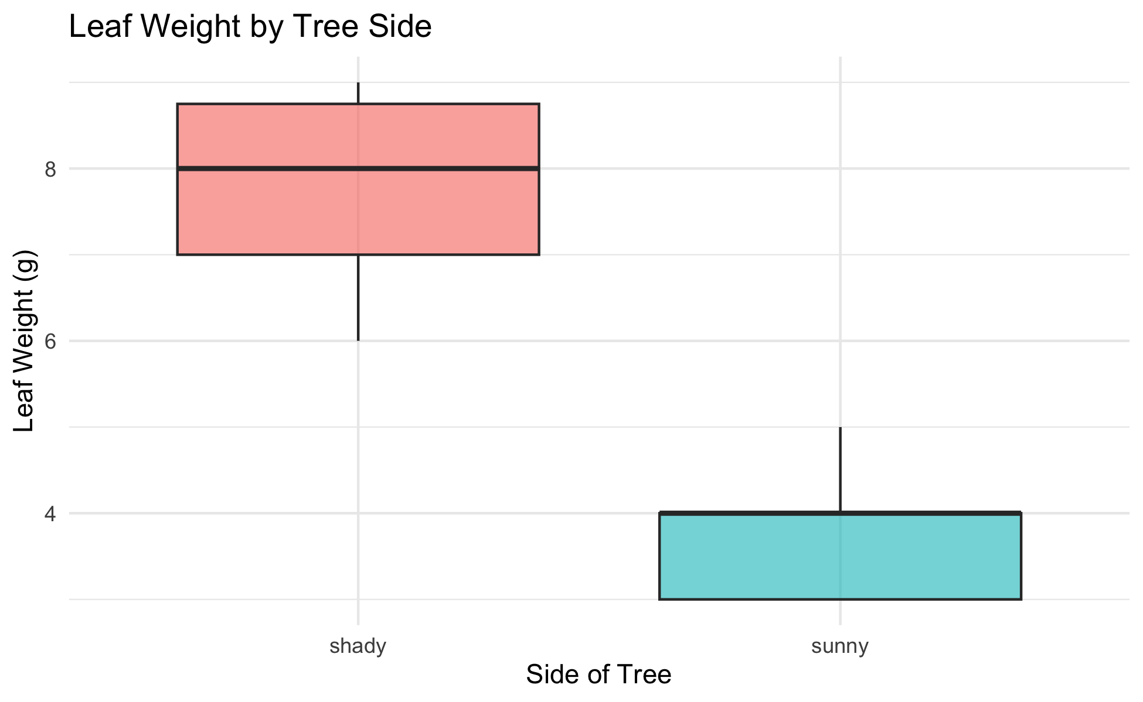
Boxplot — Basic Structure
# Basic boxplot — data is already long format --------- tree_box_plot <- tree_df %>% ggplot(aes(x = side, y = weight_g, fill = side)) + geom_boxplot(alpha = 0.6, outlier.shape = NA) + labs( title = "Leaf Weight by Tree Side", x = "Side of Tree", y = "Leaf Weight (g)", fill = "Side" ) + theme_minimal() + theme(legend.position = "none") tree_box_plot
Boxplot anatomy:
Middle line = median
Box edges = 25th and 75th percentile (IQR)
Whiskers = 1.5 × IQR
Dots beyond whiskers = outliers
Because our data is in long format, ggplot2 reads side straight off the x-axis — no reshaping needed.
📖 R4DS §9 — Layers

Slide 28
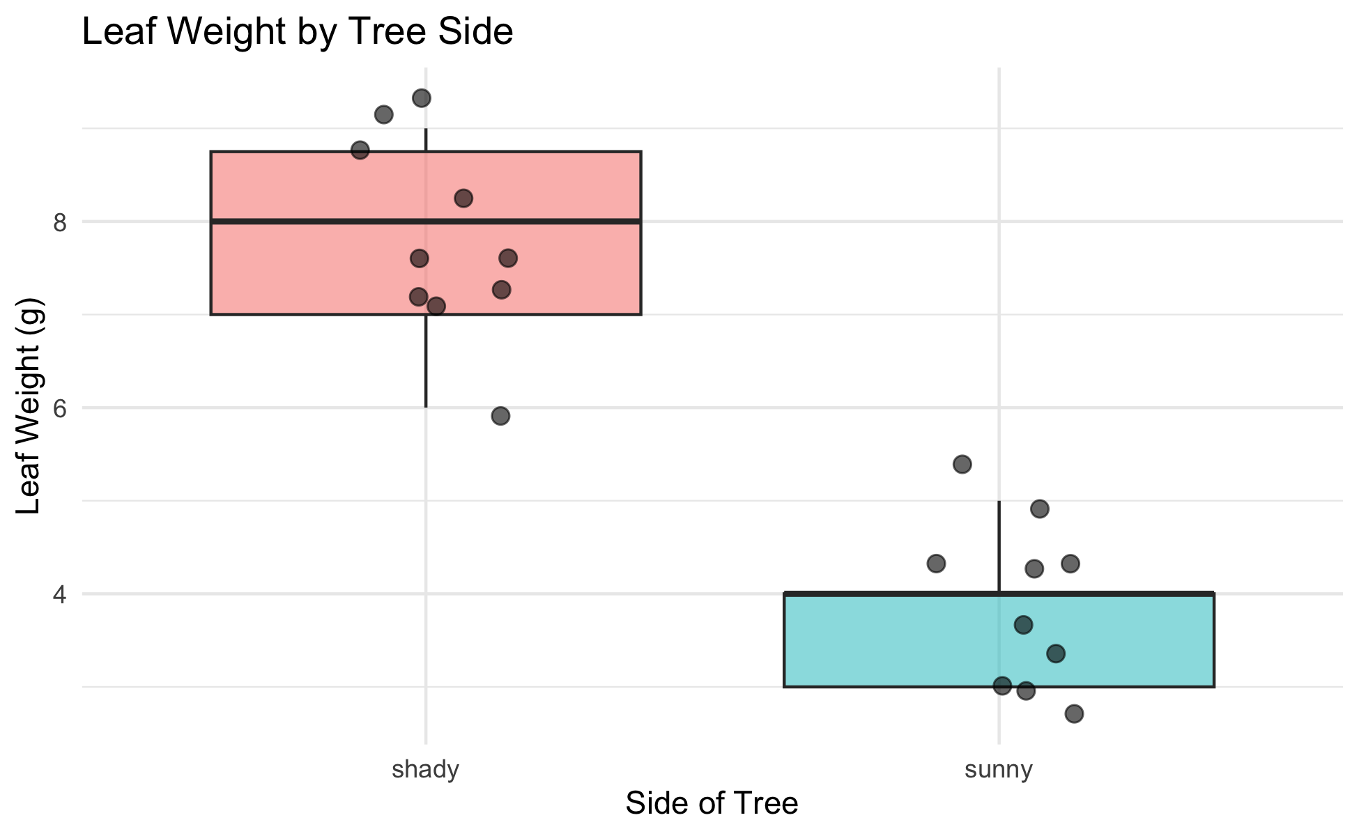
Boxplot — Overlay Individual Points
# Add raw data points over the boxplot ---------------- tree_jitter_plot <- tree_df %>% ggplot(aes(x = side, y = weight_g, fill = side)) + geom_boxplot(alpha = 0.5, outlier.shape = NA) + geom_point( position = position_jitter(width = 0.15, seed = 42), alpha = 0.6, size = 2.5 ) + labs( title = "Leaf Weight by Tree Side", x = "Side of Tree", y = "Leaf Weight (g)", fill = "Side" ) + theme_minimal() + theme(legend.position = "none") tree_jitter_plot
Key arguments:
position_jitter(width = 0.15) — spreads points left and right
seed = 42 — same jitter layout every render
alpha = 0.6 — semi-transparent to show overlap
size = 2.5 — point size
Tip
Always show raw points with a boxplot — with only 10 leaves per group, every point matters!

Slide 29
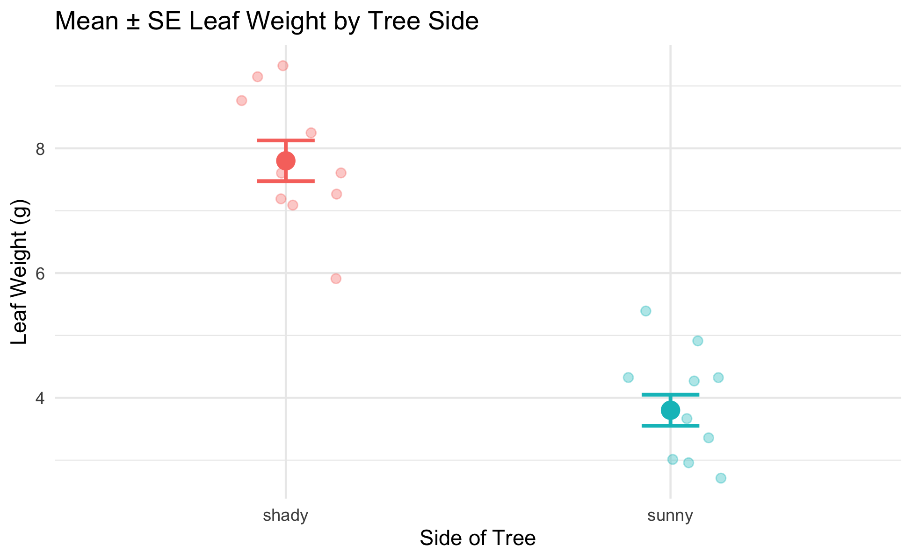
Mean ± SE Plot — stat_summary()
# stat_summary() computes and plots mean and SE ------- tree_mean_se_plot <- tree_df %>% ggplot(aes(x = side, y = weight_g, color = side)) + geom_point( position = position_jitter(width = 0.15, seed = 42), alpha = 0.35, size = 2 ) + stat_summary(fun = mean, geom = "point", size = 4) + stat_summary( fun.data = mean_se, geom = "errorbar", width = 0.15, linewidth = 0.9 ) + labs( title = "Mean ± SE Leaf Weight by Tree Side", x = "Side of Tree", y = "Leaf Weight (g)", color = "Side" ) + theme_minimal() + theme(legend.position = "none") tree_mean_se_plot
Two stat_summary() layers:
call | what it draws
fun = mean | large point at the mean
fun.data = mean_se | error bars for ± 1 SE
Individual points in the background (alpha = 0.35)
Mean shown as a larger foreground point
Error bars = ± 1 SE

Slide 30
What We Learned Today
R wrangling skills:
filter() — keep rows by condition
select() — keep columns by name
mutate() — add new calculated columns
arrange() — sort rows
Full pipeline: chain all verbs with %>%
Statistics concepts:
Mean — balance point; sensitive to outliers
Median — middle value; robust
Variance / SD — spread of individual data
SE — precision of the sample mean
More R skills:
group_by() + summarize() — all stats for all groups at once
sum(!is.na()) — the right way to count n
skim() — instant full dataset overview
geom_boxplot() + geom_point(), stat_summary()
References:
📖 R4DS §3 — Data Transformation
📖 R4DS §13 — Numbers
📖 R4DS §18 — Missing Values
🌐 Data Carpentry
Up next — Lecture 04:
Two-sample t-test
Checking assumptions (normality, equal variance)
Interpreting and reporting results

