Slide 1
Lecture 04 — GGPlot II
More geoms, zooming safely, and picking a theme Bill Perry

Slide 2
Where we left off (Lecture 03 — GGPlot I)
Piping straight into a plot: tree_df %>% ggplot(...)
scale_color_manual() / scale_fill_manual() — colors you choose
facet_wrap() and facet_grid() — one panel per group
stat_summary() — mean and mean ± SE, drawn from raw data
Note
✅ Key idea from Lecture 03
You can already build a grouped, colored, faceted figure. Today: one more geom, a safer way to zoom, and picking a theme that looks intentional instead of default.

Slide 3
Goals for Today
Map shape alongside color, and add a trend line with geom_smooth()
Zoom into a plot without silently dropping data — coord_cartesian()
Pick a built-in theme and adjust it with theme()
Save a figure in the right format for the job
Tip
🖐 Try it yourself
By the end you will recognize the single most common ggplot mistake — zooming with xlim()/ylim() — before you ever make it yourself.
References:
📖 Whitlock & Schluter, Ch. 2 — Displaying Data
📖 R4DS Ch 1 — Data Visualization
Both PDFs are in the course readings/ folder.

Slide 4
How to Use These Slides — Predict · Type · Run
This lecture runs in three short chunks. After each chunk you switch to the activity worksheet and type the code yourself.
Note
✅ Why bother?
xlim() and coord_cartesian() produce plots that look identical for simple scatter plots — the difference only shows up once you compute something (a smooth line, a boxplot). Typing both yourself and comparing outputs is the only way this sticks.

Slide 5
Load Libraries and Data
# Load all packages at the top of every script ---------- library(readxl) # reading Excel files library(tidyverse) # data wrangling + ggplot2 library(janitor) # cleans up messy column names
# Read the leaf data from the data folder --------------- tree_df <- read_excel("data/2026_06_25_tree_experiment_raw_data.xlsx") %>% clean_names()

Slide 6
🧩 Chunk 1 of 3 · Shape, Color, and a Trend Line
We will cover: mapping shape alongside color, and geom_smooth().
🛑 After this chunk you will do Activity Part 1.

Slide 7
Mapping Shape Alongside Color
Note
🔮 Predict first: We map both color = side and shape = side to the same variable. Will ggplot draw one legend or two?

Slide 8
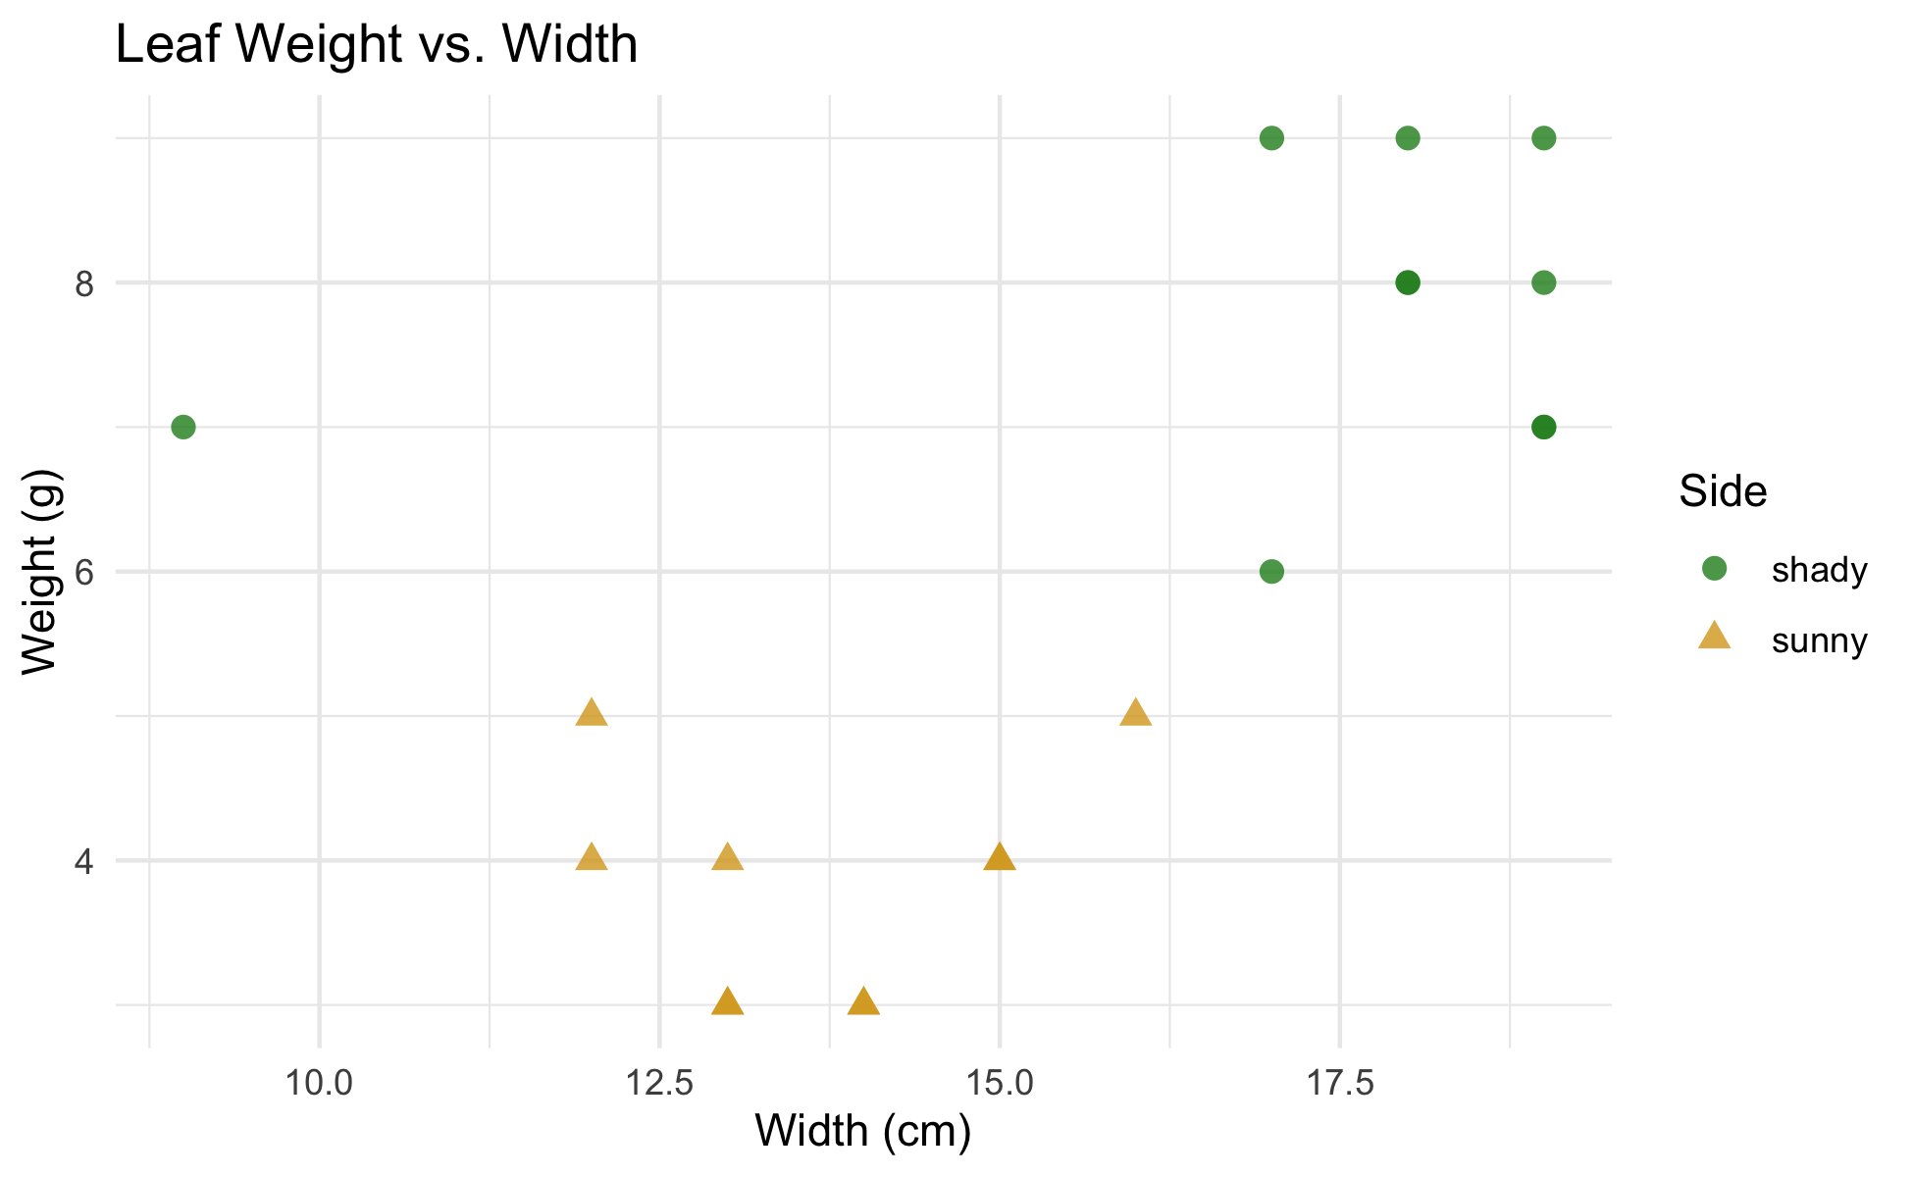
# Map color AND shape to the same variable ------------- tree_df %>% ggplot(aes(x = width_cm, y = weight_g, color = side, shape = side)) + geom_point(size = 2.5, alpha = 0.8) + scale_color_manual(values = c("sunny" = "goldenrod", "shady" = "forestgreen")) + labs( title = "Leaf Weight vs. Width", x = "Width (cm)", y = "Weight (g)", color = "Side", shape = "Side" ) + theme_minimal()
Mapping the same variable to both color and shape merges them into one legend
This makes the plot easier to read in black-and-white or for colorblind readers
If color and shape legend titles differ in labs(), you get two legends instead — usually not what you want
📖 R4DS §9 — Layers

Slide 9
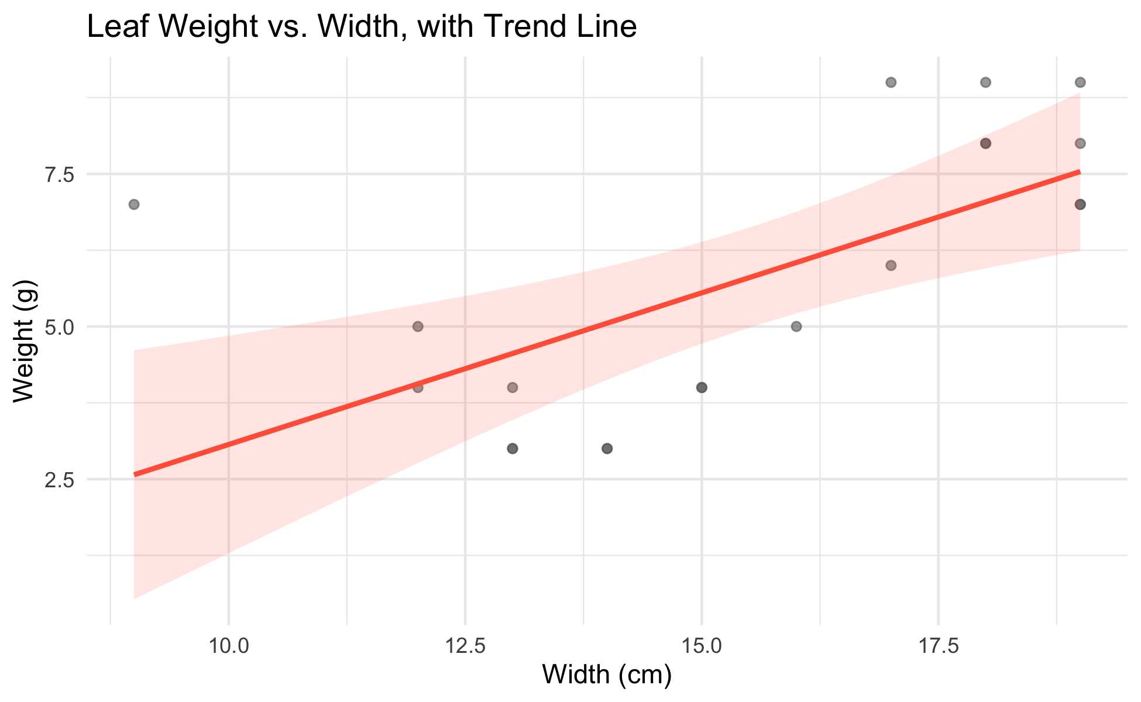
Adding a Trend Line — geom_smooth()
# geom_smooth() fits a line straight from the data ----- tree_df %>% ggplot(aes(x = width_cm, y = weight_g)) + geom_point(alpha = 0.6, color = "grey40") + geom_smooth(method = "lm", color = "tomato", fill = "tomato", alpha = 0.15) + labs( title = "Leaf Weight vs. Width, with Trend Line", x = "Width (cm)", y = "Weight (g)" ) + theme_minimal()
method = "lm" fits a straight line (linear model)
The shaded ribbon is the 95% confidence band around the line
We’ll fit this same relationship formally with lm() in the Regression unit later this semester
Tip
geom_smooth() is exploration, not a hypothesis test — it shows you whether a line is worth fitting formally before you commit to one.

Slide 10
→ ACTIVITY 4 Part 1 now
🛑 Do Activity Part 1 now
Map shape and color to side, then add a geom_smooth() trend line. Predict, type, run.

Slide 11
🧩 Chunk 2 of 3 · Zooming Without Losing Data
We will cover: coord_cartesian() vs. xlim()/ylim() — they look the same until they don’t.
🛑 After this chunk you will do Activity Part 2.

Slide 12
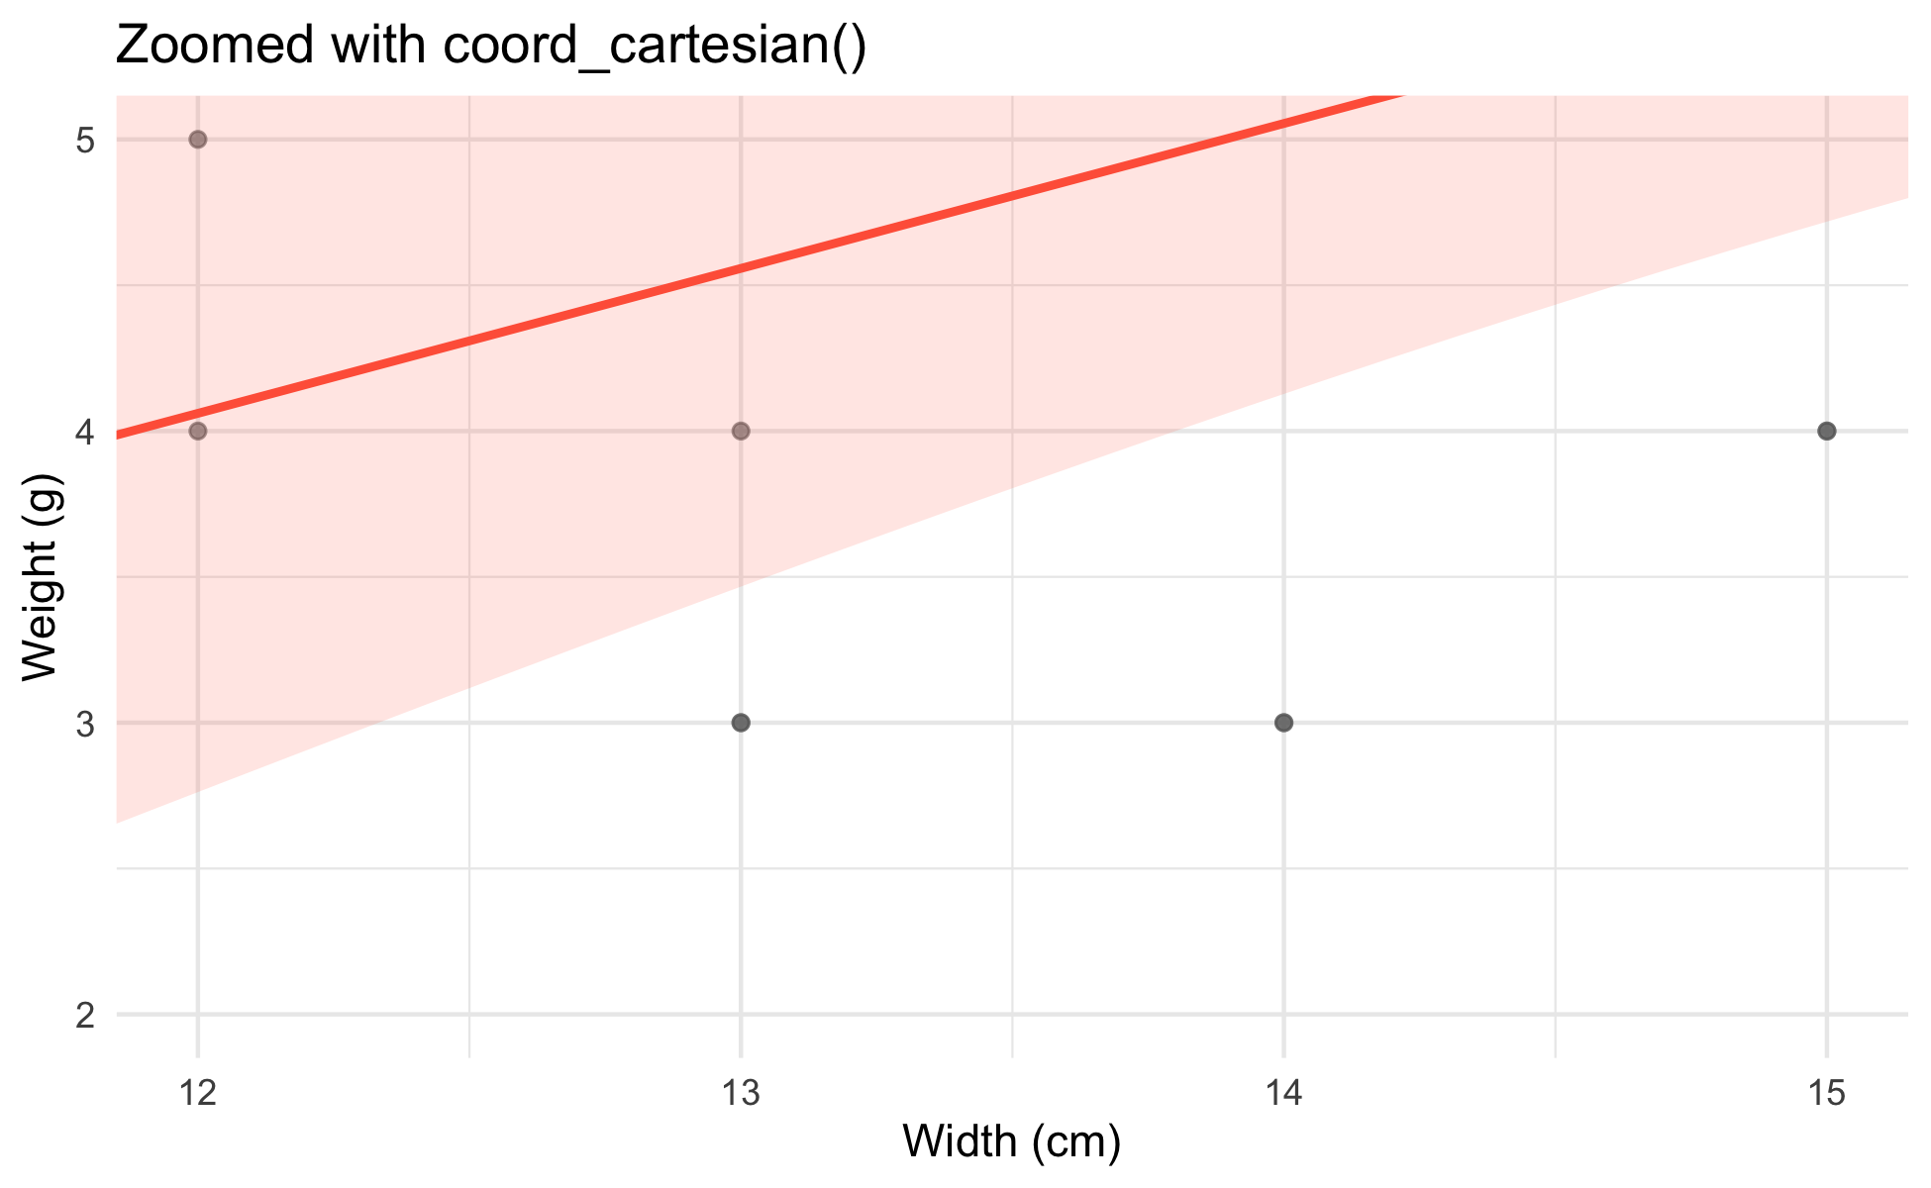
coord_cartesian() — Zoom Without Removing Data
# coord_cartesian() zooms the VIEW, keeps all the data - tree_df %>% ggplot(aes(x = width_cm, y = weight_g)) + geom_point(alpha = 0.6, color = "grey40") + geom_smooth(method = "lm", color = "tomato", fill = "tomato", alpha = 0.15) + coord_cartesian(xlim = c(12, 15), ylim = c(2, 5)) + labs( title = "Zoomed with coord_cartesian()", x = "Width (cm)", y = "Weight (g)" ) + theme_minimal()
Zooms the view — every point still contributes to the trend line
The trend line is fit on all 20 leaves, then the plot window is cropped afterward
Safe to use anytime you just want a closer look

Slide 13
xlim() / ylim() — Removes Data First
Note
🔮 Predict first: If we drop the leaves outside our zoom window before fitting the trend line, will the line look the same as before, or different?

Slide 14
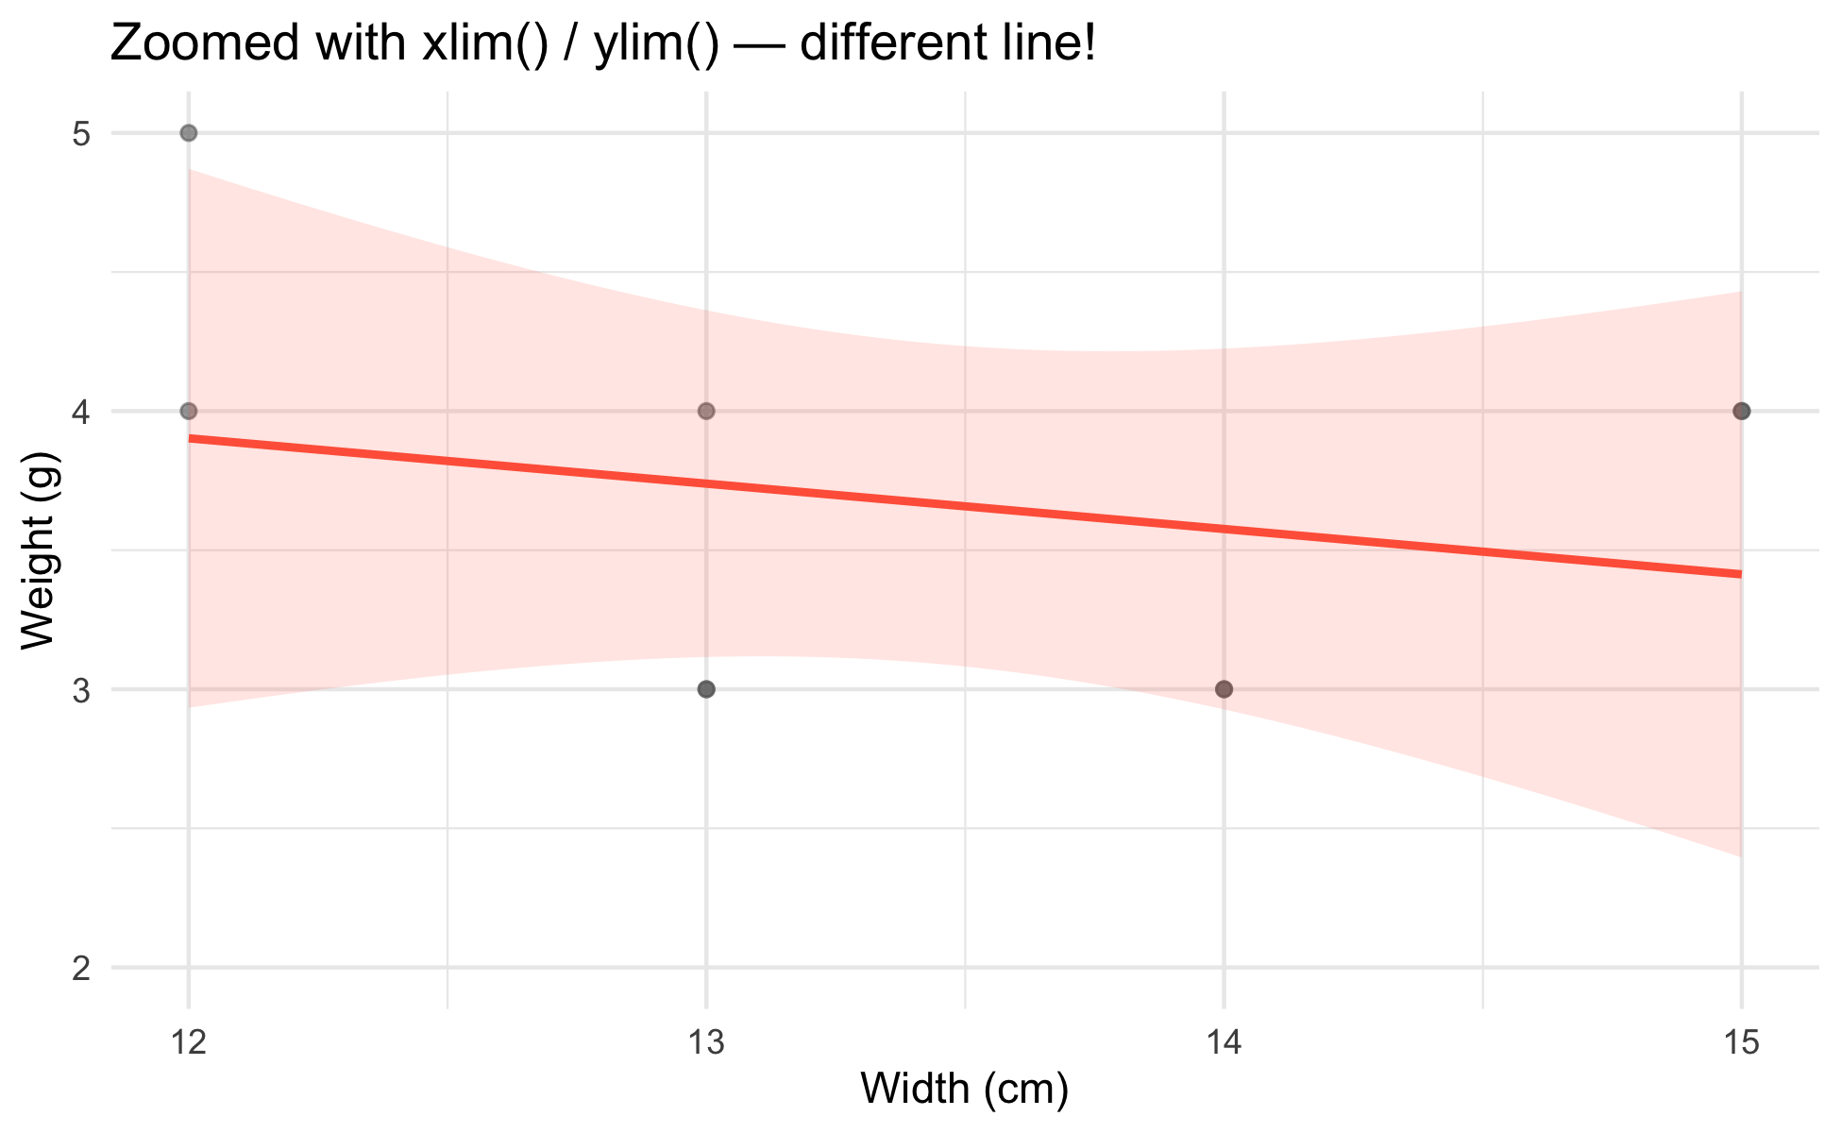
# xlim()/ylim() DELETE rows outside the range first ---- tree_df %>% ggplot(aes(x = width_cm, y = weight_g)) + geom_point(alpha = 0.6, color = "grey40") + geom_smooth(method = "lm", color = "tomato", fill = "tomato", alpha = 0.15) + xlim(12, 15) + ylim(2, 5) + labs( title = "Zoomed with xlim() / ylim() — different line!", x = "Width (cm)", y = "Weight (g)" ) + theme_minimal()
Warning
⚠️ Watch out!
xlim()/ylim() silently delete rows outside the range before anything is computed. The trend line above is fit only on the leaves that remain — a different line than coord_cartesian() produced, with no warning that data went missing.
Rule of thumb: use coord_cartesian() to zoom. Only use xlim()/ylim() when you actually want those rows excluded from the analysis, not just out of view.

Slide 15
→ ACTIVITY 4 Part 2 now
🛑 Do Activity Part 2 now
Zoom the same plot two ways and compare the trend lines. Predict, type, run.

Slide 16
🧩 Chunk 3 of 3 · Themes and Saving
We will cover: picking a built-in theme, theme() tweaks, and choosing a file format with ggsave().
🛑 After this chunk you will do Activity Parts 3–4.

Slide 17
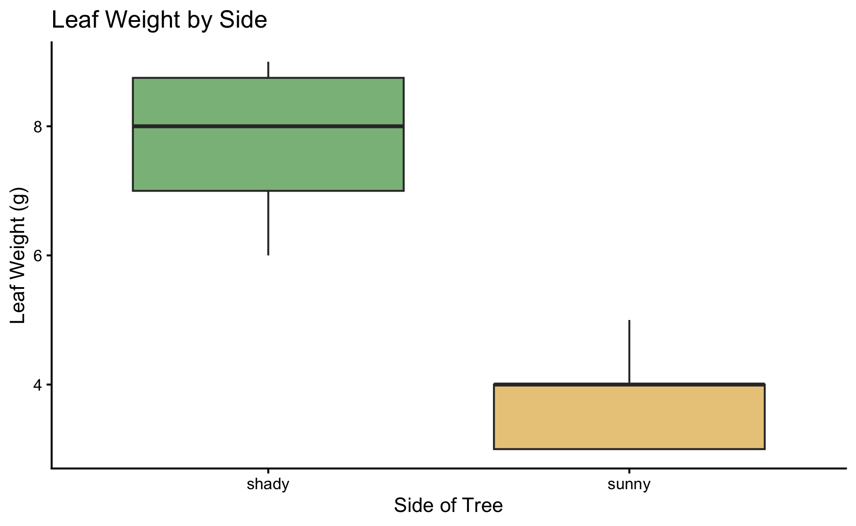
Picking a Theme
# theme_classic() — clean, close to journal defaults --- tree_df %>% ggplot(aes(x = side, y = weight_g, fill = side)) + geom_boxplot(alpha = 0.6, outlier.shape = NA) + scale_fill_manual(values = c("sunny" = "goldenrod", "shady" = "forestgreen")) + labs(x = "Side of Tree", y = "Leaf Weight (g)", title = "Leaf Weight by Side") + theme_classic() + theme(legend.position = "none")
Five built-in themes to try on the same plot:
Theme | Look
theme_grey() | default — grey background
theme_bw() | white background, grey gridlines
theme_minimal() | no background, subtle gridlines
theme_classic() | white background, axis lines only
theme_light() | light grey lines and border
Tip
theme_classic() is a safe default for scientific figures — clean, uncluttered, close to what most journals expect.

Slide 18
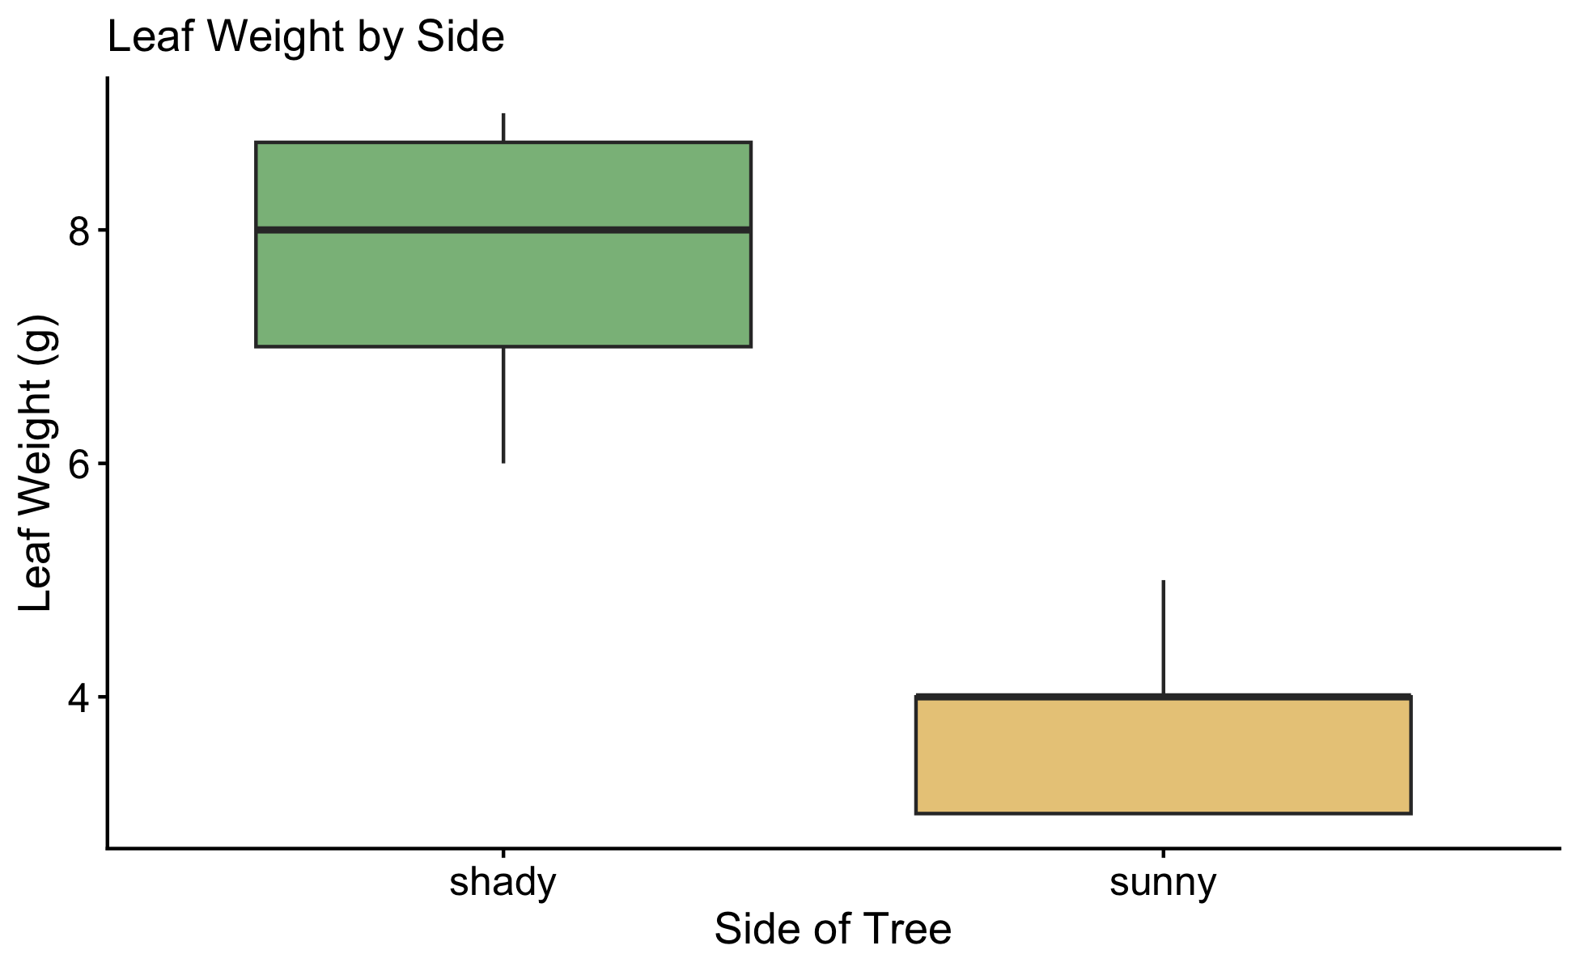
Adjusting a Theme with theme()
# theme() overrides individual elements afterward ----- tree_df %>% ggplot(aes(x = side, y = weight_g, fill = side)) + geom_boxplot(alpha = 0.6, outlier.shape = NA) + scale_fill_manual(values = c("sunny" = "goldenrod", "shady" = "forestgreen")) + labs(x = "Side of Tree", y = "Leaf Weight (g)", title = "Leaf Weight by Side") + theme_classic() + theme( legend.position = "none", axis.text = element_text(size = 12), axis.title = element_text(size = 13) )
Pick a built-in theme first (theme_classic()), then add theme() afterward to tweak individual pieces
legend.position = "none" — drop a redundant legend
axis.text / axis.title — control tick labels and axis titles separately
Note
✅ Key idea
You rarely need to build a theme from scratch. Start from a built-in theme and override only what looks wrong.

Slide 19
Saving in the Right Format
leaf_plot <- tree_df %>% ggplot(aes(x = side, y = weight_g, fill = side)) + geom_boxplot(alpha = 0.6, outlier.shape = NA) + scale_fill_manual(values = c("sunny" = "goldenrod", "shady" = "forestgreen")) + labs(x = "Side of Tree", y = "Leaf Weight (g)") + theme_classic() + theme(legend.position = "none") # PNG — good for Word docs, slides, web ggsave("figures/leaf_weight_theme.png", plot = leaf_plot, width = 5, height = 5, units = "in", dpi = 300) # PDF — vector, scales to any size, good for print ggsave("figures/leaf_weight_theme.pdf", plot = leaf_plot, width = 5, height = 5, units = "in")
Format | Best for | Scales?
.png | Word docs, slides, web | ❌ fixed pixels
.pdf | Print, journals | ✅ infinite
.tiff | Journal submission | ❌ fixed pixels

Slide 20
→ ACTIVITY 4 Parts 3–4 now
🛑 Go to Activity 4 — Parts 3–4
Close the slides. Pick a theme, tweak it, and save your plot as both PNG and PDF.

Slide 21
What We Learned Today
Map shape alongside color to merge legends
geom_smooth(method = "lm") — a quick trend line, not a hypothesis test
coord_cartesian() zooms safely; xlim()/ylim() silently deletes rows first
Built-in themes (theme_classic(), etc.) + theme() for small overrides
.png for documents/slides, .pdf for print/journals
References:
📖 Whitlock & Schluter, Ch. 2 — Displaying Data
📖 R4DS Ch 1 — Data Visualization
Up next — Lecture 05, Wrangling:
filter(), select(), mutate(), arrange()
Chaining verbs into one pipeline

