Slide 1
Lecture — One-Way ANOVA I: Setting Up the Test
Why not many t-tests, the F-statistic, ordering groups with factors, fitting the model, and checking assumptions Bill Perry

Slide 2
Where we left off (Lectures 09–11)
T-Tests I & II — comparing the means of two groups with Welch’s t-test
Regression (Lecture 11) — lm(Y ~ X) with a numeric predictor, checked with plot(model)
Both of those are, underneath, the same tool: a linear model
Note
✅ Transition
The t-test compared two groups. But biology is full of three-or-more group questions — three species, four sites, five treatments. Today’s twist: it’s still lm(Y ~ X) — just with a categorical X instead of a numeric one. That’s one-way ANOVA.

Slide 3
Goals for today
Understand why we don’t just run many t-tests
See how the F-statistic compares between- vs within-group variance
State ANOVA hypotheses (H₀: all means equal)
Use factors to order groups for a readable plot and set the reference level
Fit the model with lm()
Check assumptions — normality of residuals, equal variance
Tools today:
palmerpenguins, tidyverse (includes forcats)
car — Levene’s test
Textbook:
📖 Whitlock & Schluter, Ch. 15 — ANOVA
📖 R4DS Ch. 16 — Factors
📖 R4DS Ch. 9 — Layers
Naming: models → _model, plots → _plot

Slide 4
How to Use These Slides — Predict · Type · Run
This lecture runs in two short chunks. After each chunk you switch to the activity and type the code yourself.
For every code block, do three things:
Predict — before it runs, say what you think the output will be
Type it out by hand — do not copy-paste
Run it and compare to your prediction
Note
✅ Why bother? (the evidence)
With three groups instead of two, it is tempting to just read off which box in the plot looks tallest. Committing to a prediction about the F-statistic before you see it forces you to reason about between- vs. within-group variance instead of eyeballing a boxplot.
Typing type = "II" yourself in Anova() is what makes you notice it’s there — paste the line and you’ll never ask why it matters for unbalanced groups.
Practicing each assumption check right after it’s introduced keeps normality-of-residuals and Levene’s test tied to this penguin model instead of turning into two more disconnected rules to memorize.

Slide 5
🧩 Chunk 1 of 2 · Why ANOVA & the F-Statistic
We will cover: why not many t-tests, what ANOVA asks, how F partitions variance, and a first look at the penguin data.
Tip
🖐 After this chunk: Activity Parts 1–3 (load the penguins, explore, state hypotheses).

Slide 6
Why Not Just Run Many t-Tests?
With 3 groups you’d need 3 t-tests (A–B, A–C, B–C). With 4 groups, 6 tests.
Every test at α = 0.05 has a 5% chance of a false positive. Run several and those risks stack up:
3 tests → ~14% chance of at least one false positive
6 tests → ~26%
ANOVA asks the question once, holding the overall error rate at 0.05.
Important
The multiple-comparisons problem
More tests = more chances to be fooled by noise. ANOVA is the single, honest test for “do any of these groups differ?”
📖 W&S §15.1 — why a single test

Slide 7
What One-Way ANOVA Asks
One numeric response (Y) across the levels of one categorical predictor (X).
Our question today:
Do the three penguin species differ in body mass?
Y = body_mass_g
X = species (Adelie, Chinstrap, Gentoo)
 | Hypothesis
H₀ — null | all group means are equal ($μ_{1}=μ_{2}=μ_{3}$)
Hₐ — alternate | at least one group mean differs
Note what Hₐ does not say: it does not tell you which group differs — that comes later, from the post-hoc test.

Slide 8
The F-Statistic — Between vs. Within
$$F=\frac{\text{variance BETWEEN groups}}{\text{variance WITHIN groups}}$$
Between — how far apart the group means are
Within — how much the individuals scatter inside each group
Big F → the groups are far apart relative to their internal noise → small p-value.
F ≈ 1 → the spread between groups is no bigger than the spread within them → no real difference.
Note
✅ Key idea
ANOVA is a signal-to-noise ratio. The “signal” is the gap between group means; the “noise” is the within-group scatter.
📖 W&S §15.1–15.2

Slide 9
Meet the Data — Palmer Penguins
# Load packages at the top — always ------------------- library(tidyverse) # wrangling + ggplot2 library(palmerpenguins) # the penguins data library(car) # Levene's test, Anova() library(emmeans) # post-hoc pairwise tests
# Drop rows missing mass or species ------------------- penguins_df <- penguins %>% drop_na(body_mass_g, species) penguins_df %>% count(species)
# A tibble: 3 × 2 species n <fct> <int> 1 Adelie 151 2 Chinstrap 68 3 Gentoo 123
Three species, one lab: body mass (g) of penguins at Palmer Station, Antarctica.
drop_na() removes rows with missing mass
count(species) shows the sample size per group
Important
The groups are unbalanced (different n per species) — that matters when we pick our ANOVA type later.

Slide 10
Explore First — Boxplot by Species
Note
🔮 Predict first: Before the plot renders — do you expect all three species to differ, or just one? Which species do you think is heaviest?

Slide 11
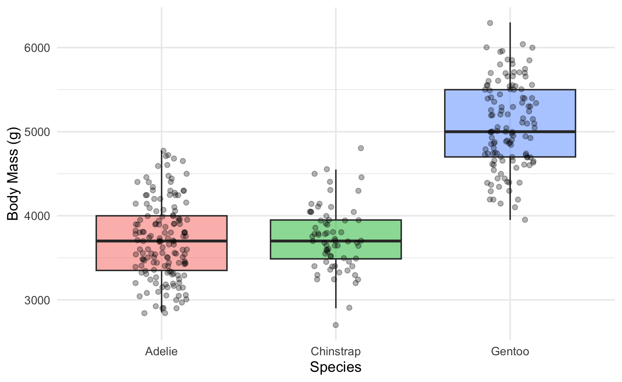
mass_box_plot <- penguins_df %>% ggplot(aes(x = species, y = body_mass_g, fill = species)) + geom_boxplot(alpha = 0.5, outlier.shape = NA) + geom_point( position = position_jitter(width = 0.15, seed = 42), alpha = 0.3, size = 1.5 ) + labs(x = "Species", y = "Body Mass (g)") + theme_minimal() + theme(legend.position = "none") mass_box_plot
Always plot before you test.
The picture usually tells the story before the p-value confirms it
Look for separation between boxes and roughly similar spread
But notice the order: Adelie, Chinstrap, Gentoo — that’s alphabetical, not by mass
📖 R4DS §9 — Layers

Slide 12
species Is a Factor — and Factors Have an Order
class(penguins_df$species) # "factor"
[1] "factor"
levels(penguins_df$species) # the stored order
[1] "Adelie" "Chinstrap" "Gentoo"
A factor is a categorical column with a fixed, ordered set of levels
ggplot (and lm) draw groups in level order
The default level order is alphabetical — almost never the order you want
Note
✅ Key idea
Alphabetical order hides the pattern. Ordering the groups by the thing you are testing — here, body mass — makes the boxplot tell the story at a glance.
forcats (the fct_* family) ships with library(tidyverse).

Slide 13
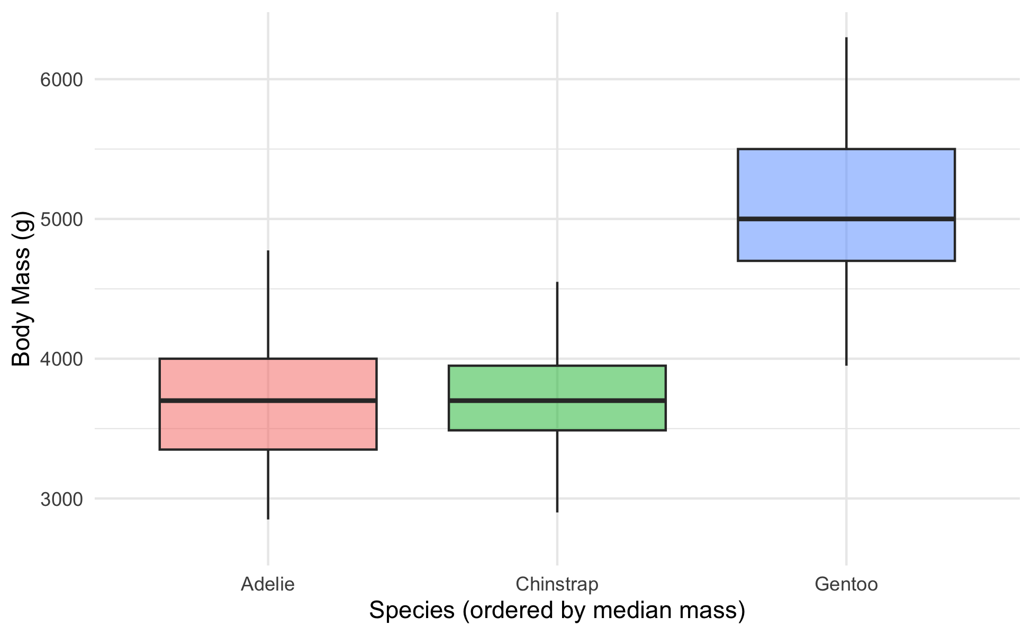
Order the Boxplot by Body Mass — fct_reorder()
penguins_df %>% mutate(species = fct_reorder(species, body_mass_g, .fun = median)) %>% ggplot(aes(x = species, y = body_mass_g, fill = species)) + geom_boxplot(alpha = 0.5, outlier.shape = NA) + labs(x = "Species (ordered by median mass)", y = "Body Mass (g)") + theme_minimal() + theme(legend.position = "none")
fct_reorder(f, x, .fun = median) — reorder factor f by a summary of x
Do it inside mutate(), then plot the result
One line; the plot now reads lightest → heaviest
Tip
The full forcats family — rename levels, merge them, lump rare ones — is in Common Code 15 · Factors. Today we only need ordering and, next, the reference level.

Slide 14
🛑 Pause — Do Activity Parts 1–4 Now
Load the penguins, plot body mass by species, reorder the boxplot with fct_reorder(), and write your hypotheses. Predict which species differ before you run anything.

Slide 15
🧩 Chunk 2 of 2 · Fit the Model & Check Assumptions
We will cover: fitting the model, then checking normality of the residuals and equal variance across groups.
Tip
🖐 After this chunk: Activity Parts 5–8 (fit, set the reference level, QQ + Shapiro on residuals, Levene’s test).

Slide 16
Fit the Model
# ANOVA is a linear model with a categorical X --------- mass_model <- lm(body_mass_g ~ species, data = penguins_df)
lm(Y ~ X) — the same syntax as regression (Lecture 11)
When X is categorical, that linear model is a one-way ANOVA
We check assumptions on this model before reading any p-value
Note
✅ Key idea
lm(body_mass_g ~ species) is the exact same function call you used for a numeric predictor in Lecture 11 — only species is categorical this time. R handles the encoding automatically; you don’t write anything differently to get an ANOVA instead of a regression.
📖 W&S §15.2

Slide 17
Which Group Is the Baseline? — fct_relevel()
# The (Intercept) is the FIRST level = Adelie --------- coef(mass_model)
(Intercept) speciesChinstrap speciesGentoo 3700.66225 32.42598 1375.35401
# Make Gentoo the reference instead -------------------- penguins_relevel <- penguins_df %>% mutate(species = fct_relevel(species, "Gentoo")) coef(lm(body_mass_g ~ species, data = penguins_relevel))
(Intercept) speciesAdelie speciesChinstrap 5076.016 -1375.354 -1342.928
lm picks the first factor level as the baseline; every coefficient is a difference from that group
fct_relevel(species, "Gentoo") moves Gentoo to the front → coefficients are now differences from Gentoo
Important
Releveling changes which comparisons the coefficients show. It does not change the overall F or p-value — the ANOVA question (“do any means differ?”) is the same no matter which group you call the baseline.

Slide 18
Assumption 1 — Normality of the Residuals
Note
🔮 Predict first: plot(mass_model) gives the same four panels you saw in the regression lecture. With ~340 penguins instead of 118 near-perfect paper squares, do you expect the Normal Q-Q panel to track the line as tightly?

Slide 19
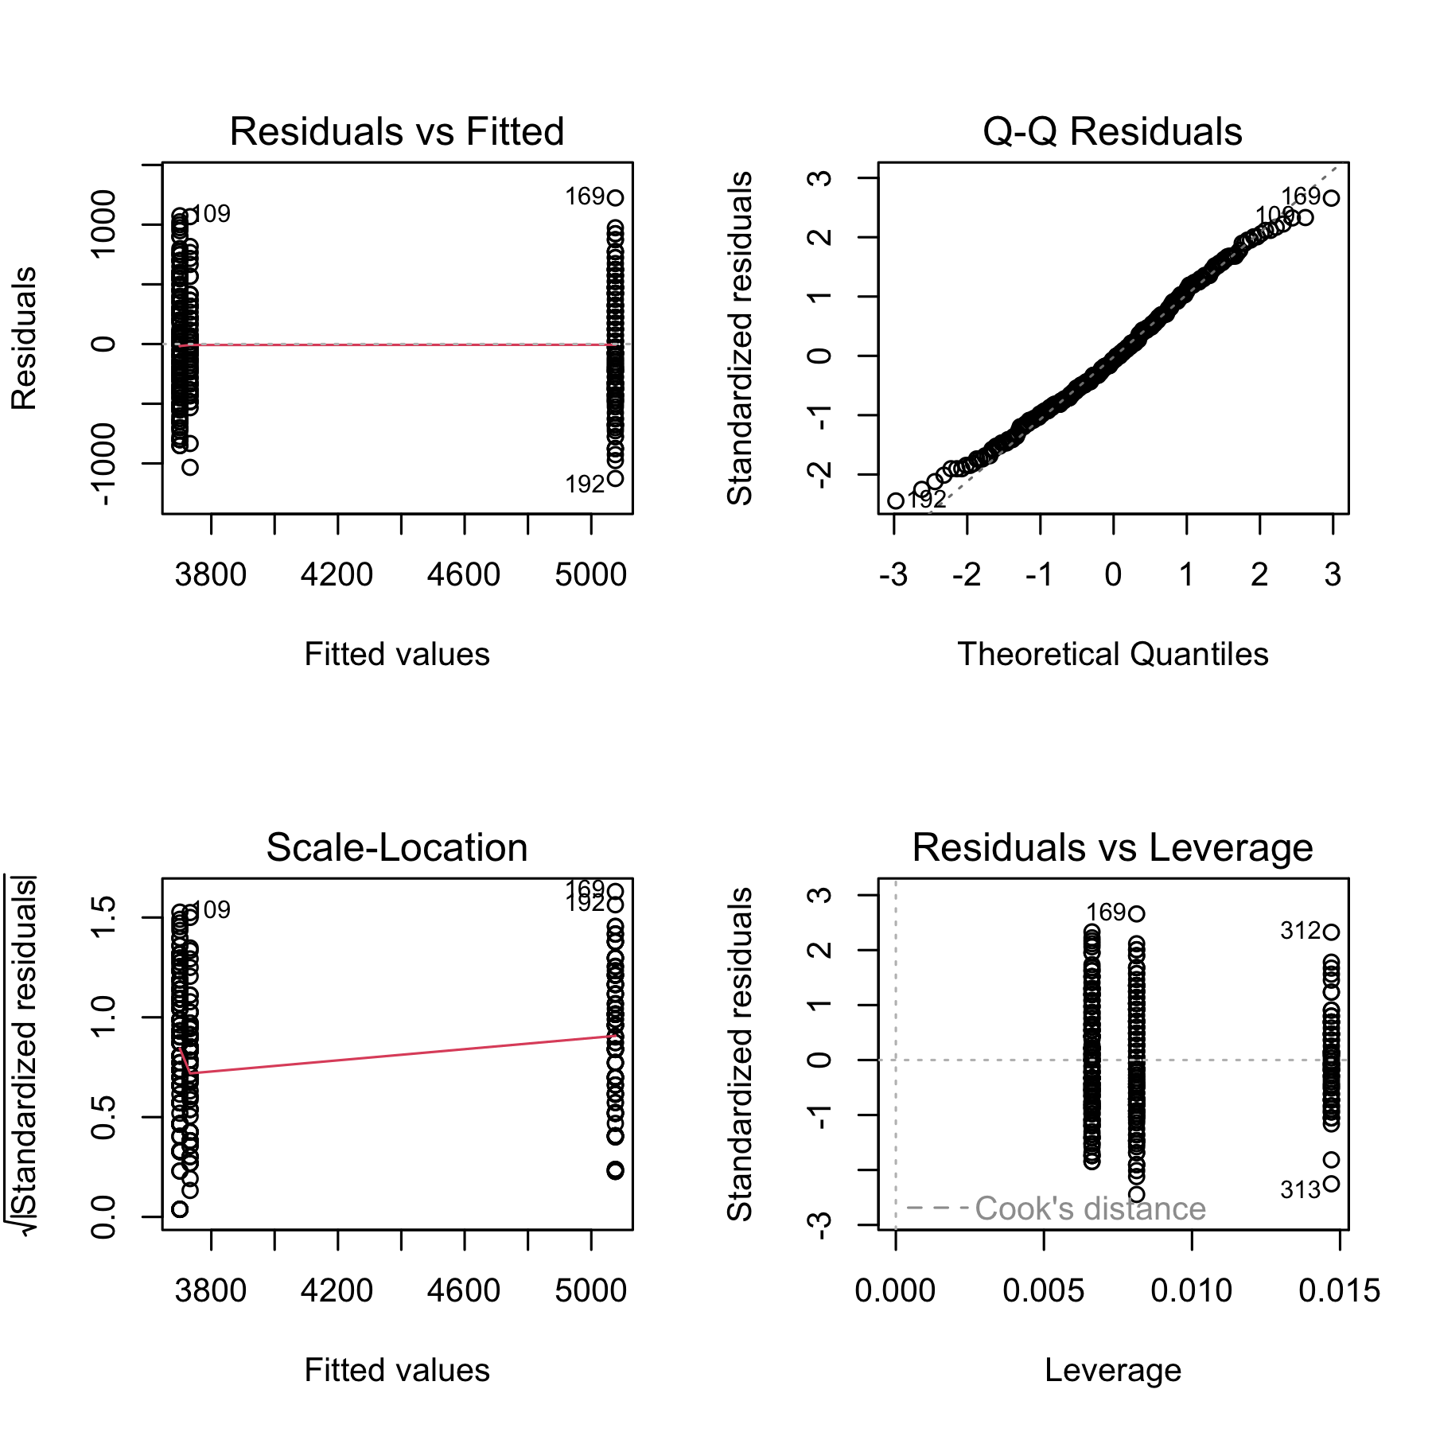
# Same plot(model) diagnostics as Lecture 11's regression par(mfrow = c(2, 2)) plot(mass_model)
Check normality of the residuals, not the raw masses
Panel 2 (Normal Q-Q) is the main visual tool; Shapiro-Wilk is a formal companion
Panels 1 & 3 double-check equal variance — the same job Levene’s does next, from a different angle
Important
Large-sample caution: with ~340 birds, Shapiro-Wilk flags tiny departures as “significant.” Trust the Q-Q panel — if points track the line, you’re fine.
shapiro.test(residuals(mass_model))
Shapiro-Wilk normality test data: residuals(mass_model) W = 0.99166, p-value = 0.05118

Slide 20
Assumption 2 — Equal Variance (Levene’s Test)
Note
🔮 Predict first: Look back at the boxplot spreads. Predict — will Levene’s test call the variances equal (p > 0.05) or unequal?

Slide 21
# Levene's test — H0: all groups have equal variance -- leveneTest(body_mass_g ~ species, data = penguins_df)
Levene's Test for Homogeneity of Variance (center = median) Df F value Pr(>F) group 2 5.1203 0.006445 ** 339 --- Signif. codes: 0 '***' 0.001 '**' 0.01 '*' 0.05 '.' 0.1 ' ' 1
p > 0.05 → variances similar → classic ANOVA is fine
p < 0.05 → variances differ → use Welch’s ANOVA:
oneway.test(body_mass_g ~ species, data = penguins_df, var.equal = FALSE)
Same spirit as Welch’s t-test — robust when spreads differ.

Slide 22
🛑 Pause — Do Activity Parts 5–8 Now
Fit lm(body_mass_g ~ species), set the reference level with fct_relevel(), check the residual QQ plot + Shapiro, and run Levene’s test. Predict each result before you run it.

Slide 23
What We Learned Today
Concepts:
Many t-tests inflate the false-positive rate — ANOVA asks once
F = between-group ÷ within-group variance (signal ÷ noise)
A factor’s level order sets the plot order and the model baseline
ANOVA is a linear model with a categorical predictor — same lm() as regression
Assumptions: normal residuals, equal variance (Levene)
R skills:
fct_reorder() to order groups by the response; fct_relevel() to set the baseline
lm(Y ~ group)
plot(model) diagnostics, shapiro.test(residuals())
leveneTest()
rest of the fct_* family → Common Code 15 · Factors
References:
📖 W&S Ch. 15 — ANOVA
📖 R4DS Ch. 16 — Factors
Up next — Lecture 14:
Assumptions are checked — now we run the test
aov() and car::Anova(), then emmeans post-hoc to find which species differ, and how to report it

