Slide 1
Lecture 09 — T-Tests I: Setting Up the Test
Hypotheses, the t-statistic, and checking assumptions before we test Bill Perry

Slide 2
Where we left off (Lectures 05–06)
Wrangling — filter(), select(), mutate(), arrange() as the core tidyverse verbs
Descriptive stats — mean, median, SD, SE with group_by() + summarize()
NA handling — sum(!is.na()) is the safe way to count n
Boxplot + jittered points; mean ± SE with stat_summary() (Lecture 03, GGPlot I)
Finding: shady leaves appear heavier, taller, and wider than sunny leaves
Note
✅ Key idea from Lecture 06
We described the pattern in our data. Over the next two lectures we formally test whether that pattern is statistically significant — today we set the test up, next time we run it.

Slide 3
Goals for Today
Understand why comparing means is not enough — we need a test
Meet the two-sample t-test and why we default to Welch’s
State null and alternate hypotheses formally
Check assumptions before running any test
normality: histogram + Shapiro-Wilk
variance: Levene’s test
Tip
🖐 Try it yourself
By the end of today your data will be fully checked and ready to test. Next lecture, we run it.
Tools added today:
car — Levene’s variance test
References:
📖 Whitlock & Schluter, Ch. 4 — Estimating with Uncertainty
📖 R4DS §3
Both are in the course readings/ folder.
Today’s naming:
test objects → _model
plots → _plot

Slide 4
Our Hypotheses — A Reminder
Biological prediction:
Shady-side leaves will be larger and heavier — they need more surface area to capture the limited light filtering through the canopy.
Why two-tailed?
We predicted shady > sunny
A one-tailed test would only reject H₀ in that direction
Two-tailed is more conservative and more broadly accepted
If the result is significant two-tailed, it is also significant one-tailed
α = 0.05 — our threshold for rejecting H₀
 | Formal statement
H₀ — null | $μ_{shady}=μ_{sunny}$ — no difference in mean leaf weight
Hₐ — alternate | $μ_{shady}≠μ_{sunny}$ — mean leaf weight differs by side
We use a two-tailed test — we will detect a difference in either direction.

Slide 5
How to Use These Slides — Predict · Type · Run
This lecture runs in two short chunks. After each chunk you switch to the activity worksheet and type the code yourself.
For every code block, do three things:
Predict — before it runs, say what you think the output will be
Type it out by hand — do not copy-paste
Run it and compare to your prediction
Note
✅ Why bother? (the evidence)
A p-value is easy to memorize and hard to actually understand. Guessing “above or below 0.05” before you see a test result forces you to reason about the test instead of just reading a number off the screen.
Typing var.equal = FALSE yourself — rather than pasting it — is what makes you notice it’s there at all, instead of skating past the one argument that separates Welch’s from the standard t-test.

Slide 6
Load Libraries and Data
# Load all packages at the top ---------------------------- library(readxl) # reading Excel files library(tidyverse) # data manipulation + ggplot2 library(car) # Levene's test for variance equality
# Load the leaf data from the data folder ----------------- tree_df <- read_excel("data/2026_06_25_tree_experiment_raw_data.xlsx")
Note
car is the Companion to Applied Regression package. It contains leveneTest(), which we use to check whether our two groups have similar variance.
Install once: install.packages("car")

Slide 7
🧩 Chunk 1 of 2 · Why We Test & the t-Statistic
We will cover: why comparing means isn’t enough, the five-step framework we’ll use for every test this semester, what a two-sample t-test is, and why we default to Welch’s.
🛑 After this chunk: Activity Parts 1–2 (load data, recap the descriptive stats).

Slide 8
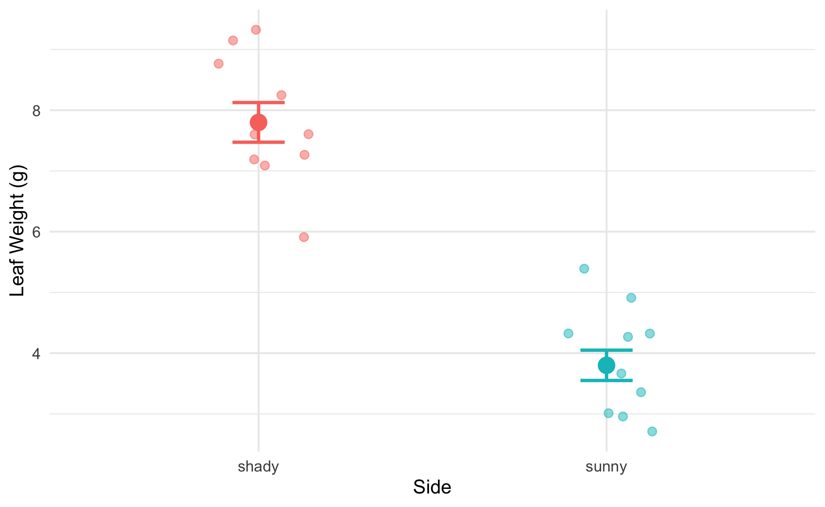
Why Comparing Means Is Not Enough
# Remind ourselves what the data look like --------------- recap_plot <- tree_df %>% ggplot(aes(x = side, y = weight_g, color = side)) + geom_point( position = position_jitter(width = 0.15, seed = 42), alpha = 0.5, size = 2 ) + stat_summary(fun = mean, geom = "point", size = 4) + stat_summary( fun.data = mean_se, geom = "errorbar", width = 0.15, linewidth = 0.9 ) + labs(x = "Side", y = "Leaf Weight (g)") + theme_minimal() + theme(legend.position = "none") recap_plot
The means look different — but:
We only have 10 leaves per group
There is natural variability within each group
The groups’ ranges overlap somewhat
A p-value tells us:
“If H₀ were true, how often would we see a gap this large just by chance?”
Small p → the gap is unlikely to be chance.

Slide 9
Five Steps to a Hypothesis Test
Every hypothesis test this semester — t-test, ANOVA, regression — follows the same sequence:
Important
Check assumptions BEFORE running the test.
If your data seriously violate assumptions, the p-value from the t-test is unreliable.
With n = 10 per group, our main concern is gross non-normality. The t-test is quite robust to mild departures.
Step | Action | When
1 | State H₀ and Hₐ | Today
2 | Check normality | Today
3 | Check variance | Today
4 | Run the test | Next lecture
5 | Interpret and report | Next lecture

Slide 10
What Is a Two-Sample t-Test?
A two-sample t-test compares the means of two independent groups.
It asks: Could both groups plausibly be drawn from populations with the same mean?
The t-statistic is:
$$t=\frac{{\overset{‾}{x}}_{1}−{\overset{‾}{x}}_{2}}{{\text{SE}}_{\text{diff}}}$$
Numerator: the observed difference in means
Denominator: the uncertainty in that difference (SE of the difference)
Large |t| → the difference is large relative to the noise → small p-value
Component | Our context
Group 1 | Shady leaves
Group 2 | Sunny leaves
Measurement | weight_g
H₀ | $μ_{shady}=μ_{sunny}$
Hₐ | $μ_{shady}≠μ_{sunny}$

Slide 11
Why Welch’s? — Don’t Assume Equal Variance
Standard t-test — pools the two variances into one estimate. Requires both groups to have the same population variance.
Welch’s t-test — uses each group’s variance separately. Does not require equal variance.
$$t_{W}=\frac{{\overset{‾}{x}}_{1}−{\overset{‾}{x}}_{2}}{\sqrt{\frac{s_{1}^{2}}{n_{1}}+\frac{s_{2}^{2}}{n_{2}}}}$$
The denominator is the true SE of the difference — no pooling.
Why always use Welch’s?
When variances are equal: almost identical result — minimal loss of power
When variances are not equal: standard t-test gives inflated Type I error (false positives)
Welch’s protects you either way
Tip
Best practice: use Welch’s as your default for all two-group comparisons.
In R: var.equal = FALSE

Slide 12
Seeing the Formula in Action
Note
🔮 Predict first: t = difference ÷ SE-of-the-difference, and the difference is 4 g. Do you expect |t| to land nearer 1, 5, or 10? Predict before the numbers appear.

Slide 13
# Watch the instructor plug numbers into the formula ---- stats_df <- tree_df %>% group_by(side) %>% summarize( n = sum(!is.na(weight_g)), m = mean(weight_g, na.rm = TRUE), s = sd(weight_g, na.rm = TRUE) ) m_sha <- stats_df$m[stats_df$side == "shady"] m_sun <- stats_df$m[stats_df$side == "sunny"] s_sha <- stats_df$s[stats_df$side == "shady"] s_sun <- stats_df$s[stats_df$side == "sunny"] n_sha <- stats_df$n[stats_df$side == "shady"] n_sun <- stats_df$n[stats_df$side == "sunny"] se_diff <- sqrt((s_sha^2 / n_sha) + (s_sun^2 / n_sun)) t_manual <- (m_sha - m_sun) / se_diff cat("Difference in means:", round(m_sha - m_sun, 2), "g\n")
Difference in means: 4 g
cat("SE of difference: ", round(se_diff, 4), "\n")
SE of difference: 0.411
cat("t-statistic: ", round(t_manual, 3), "\n")
t-statistic: 9.733
Step by step:
Difference in means: 7.80 − 3.80 = 4.0 g
SE of the difference: $\sqrt{\frac{s_{shady}^{2}}{10}+\frac{s_{sunny}^{2}}{10}}$
t = difference / SE
The observed difference is ~10 standard errors above zero — very far from what we’d expect if H₀ were true. You’ll try this yourself with a calculator in the activity’s optional section — today the goal is just to see where the number comes from.

Slide 14
→ ACTIVITY 9 Parts 1–2 now
🛑 Do Activity Parts 1–2 now
Load the data and recompute the group means, SD, and SE. Predict each output, type it, run it.

Slide 15
🧩 Chunk 2 of 2 · Steps 1–3: Hypotheses & Assumptions
We will cover: stating H₀ / Hₐ formally, checking normality (histogram + Shapiro-Wilk), and checking equal variance (Levene’s).
🛑 After this chunk: Activity Parts 3–6 (hypotheses, histogram, Shapiro-Wilk, Levene’s).

Slide 16
Step 1 — Hypotheses (Formal)
Null hypothesis:
$$H_{0}:μ_{shady}=μ_{sunny}$$
Shady and sunny leaves have the same mean weight in the population.
Alternate hypothesis (two-tailed):
$$H_{A}:μ_{shady}≠μ_{sunny}$$
The mean leaf weights differ between sides — in either direction.
Significance level: α = 0.05
We will reject H₀ if p < 0.05.
Why state hypotheses first?
Keeps the analysis honest
Prevents “HARKing” (Hypothesizing After Results are Known)
Forces you to commit to a direction (one-tailed) or not (two-tailed) before seeing the data
Our commitment: two-tailed, α = 0.05, before running any test.

Slide 17
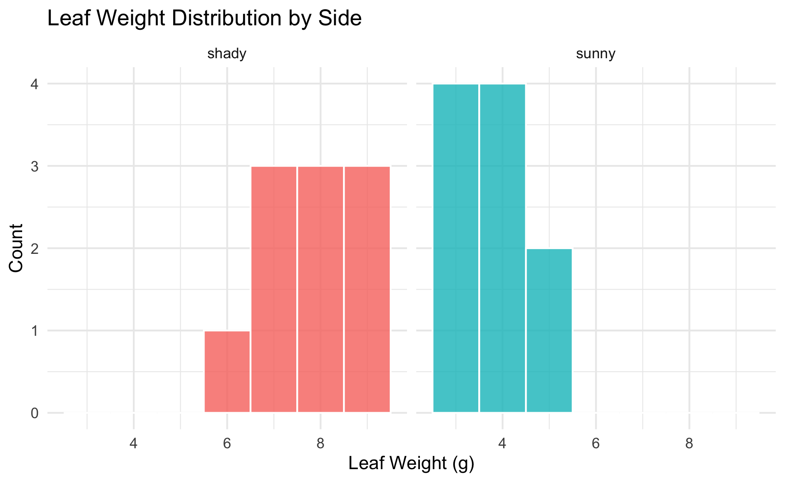
Step 2 — Check Normality: Histogram
# Histogram per group to visually check normality ------- hist_norm_plot <- tree_df %>% ggplot(aes(x = weight_g, fill = side)) + geom_histogram(binwidth = 1, color = "white", alpha = 0.8) + facet_wrap(~side, ncol = 2) + labs( title = "Leaf Weight Distribution by Side", x = "Leaf Weight (g)", y = "Count" ) + theme_minimal() + theme(legend.position = "none") hist_norm_plot
What to look for:
Roughly bell-shaped — not heavily skewed
No obvious bimodal peaks
No extreme outliers
With n = 10 per group, histograms look lumpy — that is normal for small samples.
Note
A QQ plot is another common visual check — same idea, different picture. You’ll find one in the activity’s optional section if you want to compare.

Slide 18
Step 2 — Check Normality: Shapiro-Wilk Test
Note
🔮 Predict first: Shapiro-Wilk’s H₀ is “the data are normal.” From the histogram you just saw, predict for each side: will p be above or below 0.05?

Slide 19
# Shapiro-Wilk test for the sunny side ----------------- tree_df %>% filter(side == "sunny") %>% pull(weight_g) %>% shapiro.test()
Shapiro-Wilk normality test data: . W = 0.8197, p-value = 0.02513
# Shapiro-Wilk test for the shady side ----------------- tree_df %>% filter(side == "shady") %>% pull(weight_g) %>% shapiro.test()
Shapiro-Wilk normality test data: . W = 0.89461, p-value = 0.191
Shapiro-Wilk H₀: the data are normally distributed.
p > 0.05 → fail to reject normality → proceed with t-test
p < 0.05 → evidence of non-normality → consider a non-parametric alternative
Important
Small-sample caution:
With n = 10, this test has low power — it rarely detects non-normality even when present. The histogram is equally important.

Slide 20
Step 3 — Check Variance: Levene’s Test
# Levene's test — are the variances similar? ----------- leveneTest(weight_g ~ side, data = tree_df)
Levene's Test for Homogeneity of Variance (center = median) Df F value Pr(>F) group 1 0.6 0.4486 18
Levene’s test H₀: the two groups have equal variance.
p > 0.05 → variances are not significantly different
p < 0.05 → variances are significantly different
Our response regardless of the result:
We will use Welch’s t-test (var.equal = FALSE).
Welch’s is valid whether or not the variances are equal. We run Levene’s to understand our data, not to choose our test.

Slide 21
Live Demo — Watch It Break (on purpose)
Suppose I forgot library(car) and run Levene’s:
leveneTest(weight_g ~ side, data = tree_df)
R stops with:
Error in leveneTest(weight_g ~ side, data = tree_df) : could not find function "leveneTest"
The fix — load the package that contains the function:
library(car) leveneTest(weight_g ~ side, data = tree_df)
Tip
✅ Why show a broken run?
leveneTest() lives inside car, not base R — so R has no idea what the function is until the package is loaded. Seeing that exact error message once, on purpose, means you won’t waste ten minutes hunting for a typo the next time it happens to you.

Slide 22
→ ACTIVITY 9 Parts 3–6 now
🛑 Go to Activity 9 — Parts 3–6
Close the slides. State your hypotheses, then check normality (histogram + Shapiro-Wilk) and variance (Levene’s). Predict every p-value before you run it.

Slide 23
What We Learned Today
Why we need a hypothesis test — means alone are not enough
The five-step framework we’ll reuse all semester
Welch’s t-test — use var.equal = FALSE as the safe default
Two-tailed test — detects differences in either direction
Checking assumptions before testing: normality (histogram + Shapiro-Wilk), variance (Levene’s)
References:
📖 Whitlock & Schluter, Ch. 4 — Estimating with Uncertainty
📖 R4DS §3
Up next — Lecture 10, T-Tests II:
Run Welch’s t.test()
Decode the output line by line
Make a formal decision and write a results sentence

