Slide 1
Lecture 16 — Factors: Taming Categorical Data
Ordering, renaming, and lumping categories with forcats — and cleaner ggplots Bill Perry

Slide 2
Where we left off — Pivoting real data
pivot_longer() / pivot_wider() — reshaped the messy Lake Superior ice data
group_by() + summarize() and lm() on the tidied result
But every plot still put categories in alphabetical order
Note
✅ Transition
Why alphabetical? Because a categorical column is a factor, and its levels default to alphabetical. Today we take control of that order — and of the labels — with the forcats package. You already used this kind of grouping variable back in the one-way ANOVA (Lecture 13) — today you learn to control how it displays.

Slide 3
Goals for today (a 2-day lecture)
What a factor is and why R uses them
Create & inspect — factor(), levels(), fct_count()
Reorder for plots — fct_reorder(), fct_infreq(), fct_rev()
Rename & simplify — fct_recode(), fct_collapse(), fct_lump()
Set a model’s reference level — fct_relevel()
Drop unused levels and dodge the classic traps
Tools today:
tidyverse (includes forcats)
palmerpenguins
Textbook:
📖 R4DS Ch. 16 — Factors
📖 R4DS Ch. 9 — Layers
Tip
Day 1: create, inspect, reorder. Day 2: rename, lump, model.

Slide 4
How to Use These Slides — Predict · Type · Run
This lecture runs in four short chunks over two days. After each chunk you switch to the activity and type the code yourself.
For every code block, do three things:
Predict — before it runs, say what the plot or output will look like
Type it out by hand — do not copy-paste
Run it and compare to your prediction
Note
✅ Why bother? (the evidence)
With factors, “predict the output” almost always means “predict the order the bars will appear in” — forcing that guess is what makes you actually think about levels instead of ggplot’s defaults.
The fct_ functions all take a similar shape (fct_something(factor, ...)), and typing them out enough times is what gets that shape into your fingers.
Two days of new fct_ verbs is a lot to hold onto — using each one in the activity right after you see it in lecture is what keeps Day 1’s functions available when Day 2 builds on them.

Slide 5
🧩 Chunk 1 of 4 · What a Factor Is (Day 1)
We will cover: what factors are, why alphabetical order is a problem, and how to create and inspect them.
Tip
🖐 After this chunk: Activity Parts 1–3 (inspect the penguin factors).

Slide 6
What Is a Factor?
A factor is a categorical variable with a fixed, known set of values — its levels — stored in a specific order.
Under the hood: integer codes (1, 2, 3…) plus a labels table
The order of the levels controls plot axes, legends, and model baselines
Different from a plain character string, which has no built-in order
Note
📖 New word
forcats = “for categorical variables” — the tidyverse package (loaded with library(tidyverse)) for working with factors. Every function starts with fct_.

Slide 7
The Problem Factors Solve — Alphabetical Order
Note
🔮 Predict first: If we make a bar chart of penguin species with no other instructions, in what order will the three bars appear?

Slide 8
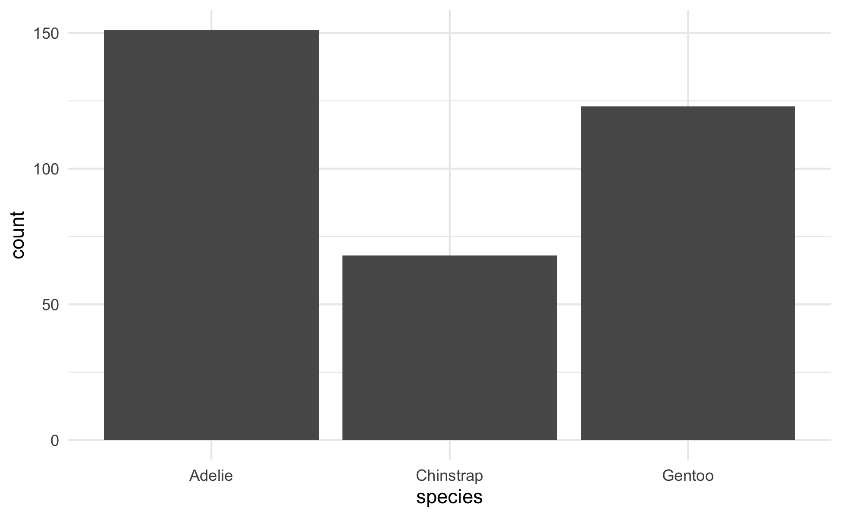
# Load packages + data -------------------------------- library(tidyverse) # includes forcats library(palmerpenguins) # Swap this one line to use your own data later ------- penguins_df <- penguins %>% drop_na(species, body_mass_g)
# ggplot uses the factor's level order = ALPHABETICAL - penguins_df %>% ggplot(aes(x = species)) + geom_bar() + theme_minimal()
Adelie, Chinstrap, Gentoo — alphabetical, because that is the default level order.
Alphabetical is almost never the order you want to show. Factors let you fix that in one line.
📖 R4DS §16.5 — modifying factor order

Slide 9
Create & Inspect Factors
# What type is species, and what are its levels? ------ class(penguins_df$species)
[1] "factor"
levels(penguins_df$species)
[1] "Adelie" "Chinstrap" "Gentoo"
# fct_count() = a factor-aware count ------------------- fct_count(penguins_df$species)
# A tibble: 3 × 2 f n <fct> <int> 1 Adelie 151 2 Chinstrap 68 3 Gentoo 123
class() — confirms it’s a factor
levels() — the ordered set of categories
fct_count() — how many rows per level (even levels with zero rows show up!)
Tip
Make a factor from a string with factor(x) or as_factor(x).

Slide 10
🛑 Pause — Do Activity Parts 1–3 Now
Load the penguins, confirm species and island are factors, list their levels, and make the default (alphabetical) bar chart. Predict the order before you run it.

Slide 11
🧩 Chunk 2 of 4 · Reorder for Readable Plots (Day 1)
We will cover: the payoff — reordering factor levels so plots tell the story, with fct_infreq(), fct_reorder(), and fct_rev().
Tip
🖐 After this chunk: Activity Parts 4–6 (reorder bars and boxplots).

Slide 12
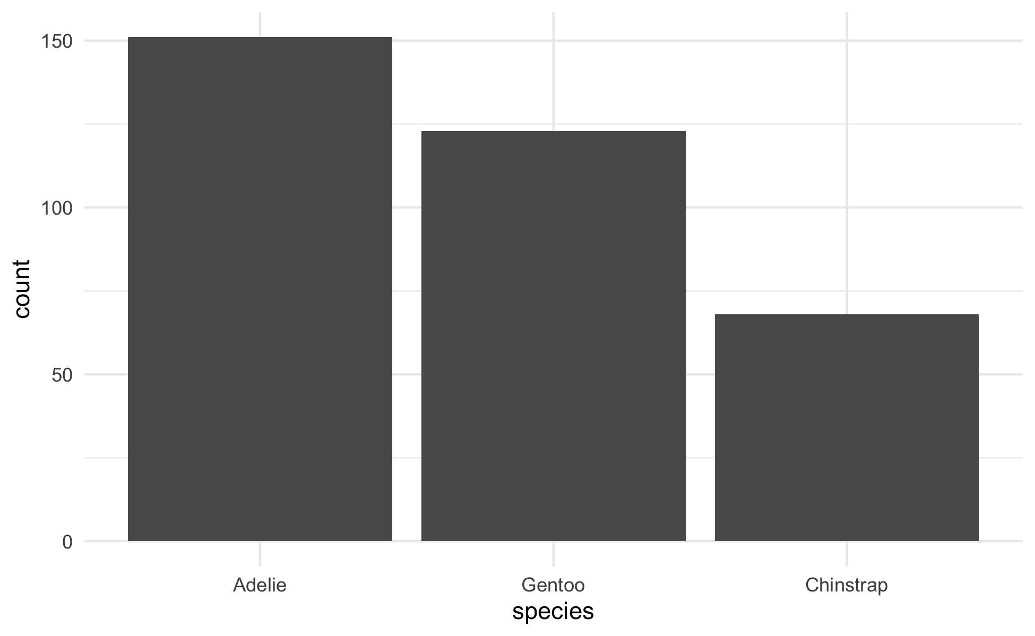
fct_infreq() — Order by Frequency
# Order bars from most to least common ---------------- penguins_df %>% mutate(species = fct_infreq(species)) %>% ggplot(aes(x = species)) + geom_bar() + theme_minimal()
fct_infreq() — biggest group first
Add fct_rev() to flip to smallest-first
Perfect for bar charts of counts — the reader sees the ranking instantly
Note
You reorder inside mutate(), then plot. The data itself is unchanged elsewhere.

Slide 13
fct_reorder() — Order by Another Variable
Note
🔮 Predict first: We’ll reorder species by their median body mass. Which species ends up last (heaviest)?

Slide 14
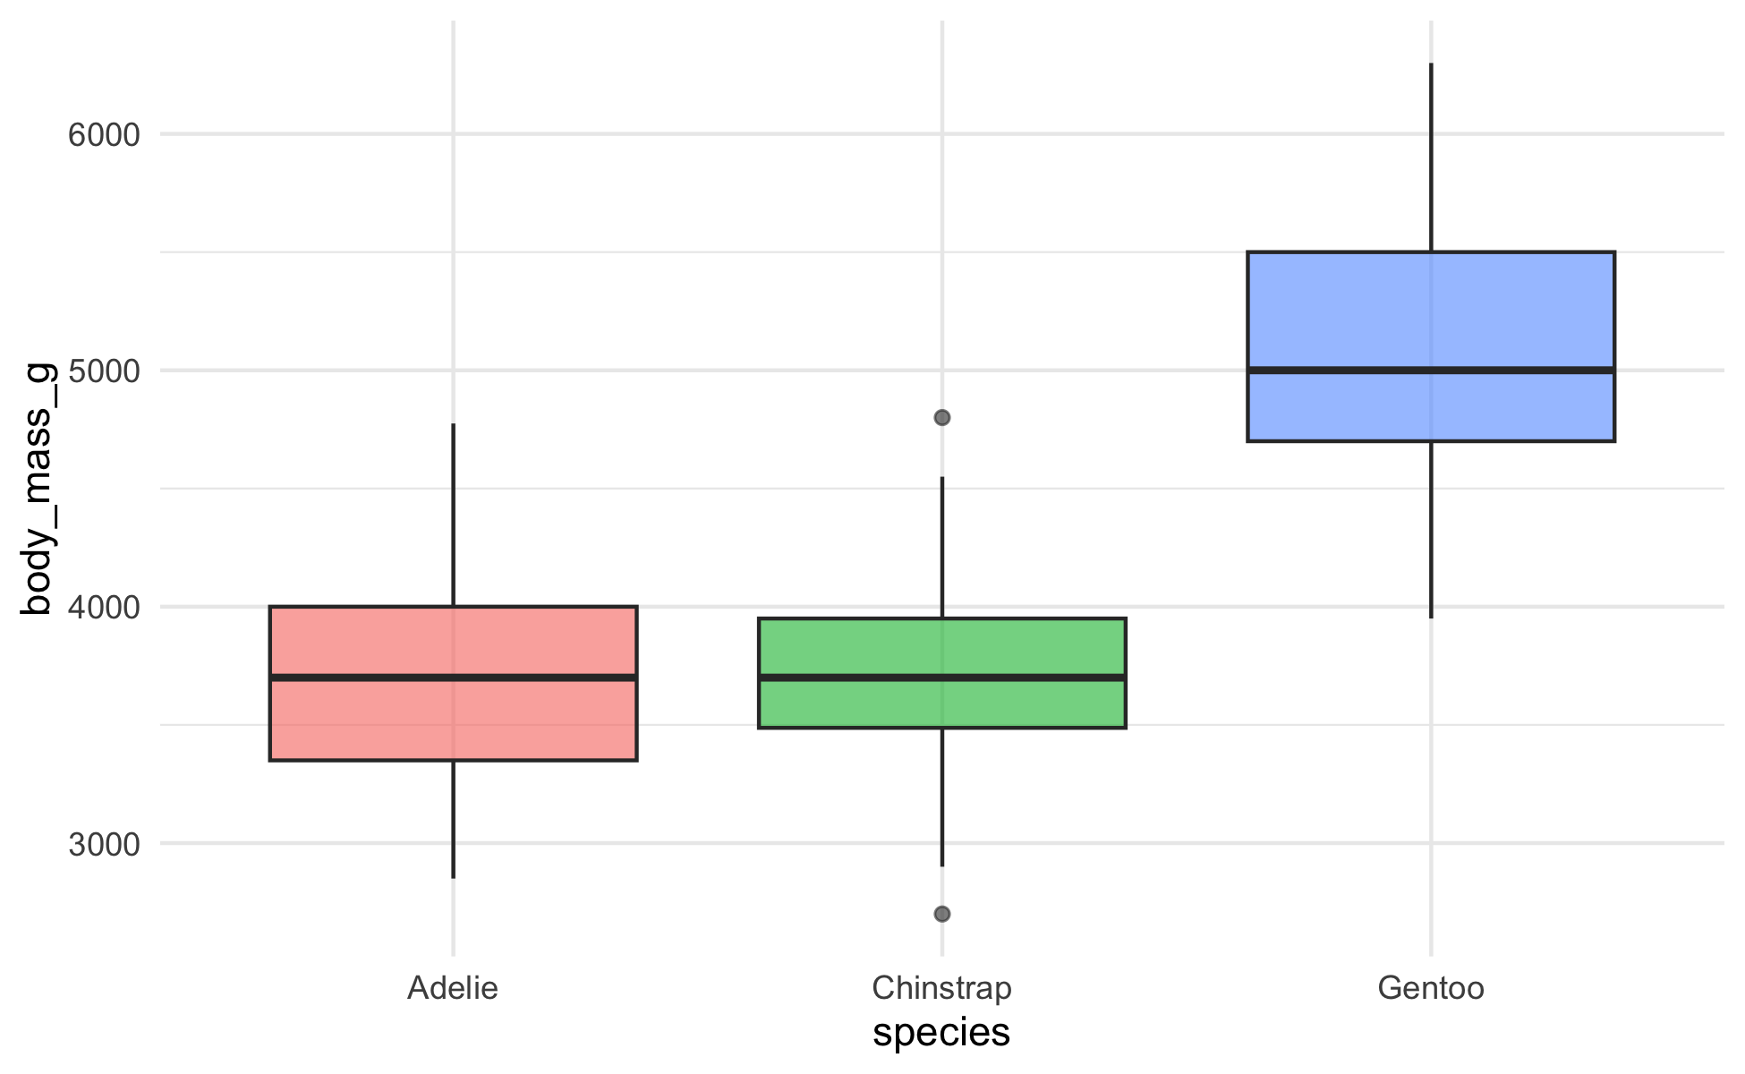
# Order species by MEDIAN body mass, low -> high ------ penguins_df %>% mutate(species = fct_reorder(species, body_mass_g, .fun = median)) %>% ggplot(aes(x = species, y = body_mass_g, fill = species)) + geom_boxplot(alpha = 0.6) + theme_minimal() + theme(legend.position = "none")
This is the one you’ll use constantly.
fct_reorder(f, x, .fun) — order the factor f by a summary of x
Boxplots, dot plots, lollipop charts all read better ordered by value, not alphabet
📖 R4DS §16.4 — fct_reorder()

Slide 15
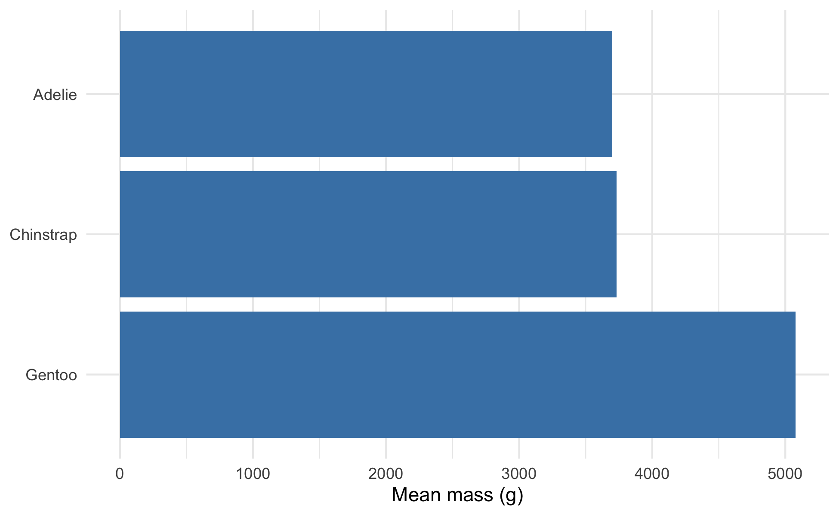
fct_rev() and Ordered Summary Plots
# Mean mass per species, ordered high -> low ---------- penguins_df %>% group_by(species) %>% summarize(mean_mass = mean(body_mass_g)) %>% mutate(species = fct_reorder(species, mean_mass) %>% fct_rev()) %>% ggplot(aes(x = mean_mass, y = species)) + geom_col(fill = "darkblue") + labs(x = "Mean mass (g)", y = NULL) + theme_minimal()
fct_rev() — reverse the current order
Horizontal bars ordered by value = the cleanest ranking plot there is
Chaining fct_reorder() %>% fct_rev() puts the biggest bar on top

Slide 16
🛑 End of Day 1 · Start Day 2 Here
Day 1 recap — you can now:
Say what a factor is and why level order matters
Inspect levels with levels() and fct_count()
Reorder for plots with fct_infreq(), fct_reorder(), fct_rev()
Day 2 — the deeper cuts:
Rename, collapse, and lump levels
Set the reference group for a model
Drop ghost levels, and dodge the classic traps

Slide 17
🧩 Chunk 3 of 4 · Rename, Collapse, Lump (Day 2)
We will cover: cleaning up messy level labels — fct_recode(), fct_collapse(), fct_lump().
Tip
🖐 After this chunk: Activity Parts 7–9 (rename and lump levels).

Slide 18
fct_recode() — Rename Levels
# Give levels cleaner display names ------------------- penguins_df %>% mutate(species = fct_recode(species, "Adélie penguin" = "Adelie", "Chinstrap penguin" = "Chinstrap", "Gentoo penguin" = "Gentoo" )) %>% count(species)
# A tibble: 3 × 2 species n <fct> <int> 1 Adélie penguin 151 2 Chinstrap penguin 68 3 Gentoo penguin 123
fct_recode(f, "new" = "old", ...) — rename one or more levels
New name on the left, old on the right
Great for turning codes or abbreviations into report-ready labels
Warning
⚠️ Watch out! A misspelled old name is silently ignored — check your levels after.

Slide 19
fct_collapse() — Merge Levels into Groups
# Combine several levels into one --------------------- penguins_df %>% mutate(size_group = fct_collapse(species, "smaller" = c("Adelie", "Chinstrap"), "larger" = "Gentoo" )) %>% count(size_group)
# A tibble: 2 × 2 size_group n <fct> <int> 1 smaller 219 2 larger 123
fct_collapse() — map many old levels onto a few new ones
Useful for turning fine categories into the groups your question needs
The reverse of splitting — you’re coarsening the variable

Slide 20
fct_lump() — Bundle Rare Levels into “Other”
# Keep the 2 most common islands, lump the rest ------- penguins %>% drop_na(island) %>% mutate(island = fct_lump_n(island, n = 2)) %>% count(island)
# A tibble: 3 × 2 island n <fct> <int> 1 Biscoe 168 2 Dream 124 3 Other 52
fct_lump_n(f, n) — keep the top n, everything else → “Other”
fct_lump_min(f, min) — lump any level with fewer than min rows
Essential when a variable has a long tail of rare categories
📖 R4DS §16.6 — lumping

Slide 21
Live Demo — Watch It Break (quietly)
Factors look like their labels, but underneath they’re integer codes. So this quietly gives the wrong answer:
years <- factor(c("2010", "2011", "2012")) as.numeric(years) #> [1] 1 2 3 # the level CODES, not the years!
The fix — go through character first:
as.numeric(as.character(years)) #> [1] 2010 2011 2012
Important
✅ Why show a quiet break?
No error, just wrong numbers. as.numeric() on a factor returns the 1, 2, 3 level codes, not the labels. Any time a factor holds numbers you need to compute with, convert to character first.

Slide 22
🛑 Pause — Do Activity Parts 7–9 Now
Rename the species to full names, collapse them into size groups, lump the islands, and try the as.numeric() trap yourself. Predict each output before you run it.

Slide 23
🧩 Chunk 4 of 4 · Factors in Models & Cleanup (Day 2)
We will cover: how level order sets the model baseline (fct_relevel), dropping unused levels, and one clean final figure.
Tip
🖐 After this chunk: Activity Parts 10–12 (relevel a model, drop levels, build the final plot).

Slide 24
fct_relevel() — Set the Reference Level
Note
🔮 Predict first: When you fit a model — the regression from Lecture 11, or the ANOVA from Lecture 13 — R compares everything to the first level (Adelie here). If we make Gentoo the reference, what changes — the overall test, or the coefficients?

Slide 25
# Default reference = Adelie (alphabetical first) ----- coef(lm(body_mass_g ~ species, data = penguins_df))
(Intercept) speciesChinstrap speciesGentoo 3700.66225 32.42598 1375.35401
# Make Gentoo the reference group --------------------- penguins_relevel <- penguins_df %>% mutate(species = fct_relevel(species, "Gentoo")) coef(lm(body_mass_g ~ species, data = penguins_relevel))
(Intercept) speciesAdelie speciesChinstrap 5076.016 -1375.354 -1342.928
fct_relevel(f, "x") — move level x to the front (the reference)
The (Intercept) becomes that group’s mean; other coefficients are differences from it
The overall F-test and p-value don’t change — only the baseline you compare to
📖 R4DS §16.5

Slide 26
Drop Unused Levels After Filtering
# Filter out Gentoo... but the level lingers ---------- two_species <- penguins_df %>% filter(species != "Gentoo") levels(two_species$species) # Gentoo is STILL a level!
[1] "Adelie" "Chinstrap" "Gentoo"
# Remove empty levels --------------------------------- two_species <- two_species %>% mutate(species = fct_drop(species)) levels(two_species$species)
[1] "Adelie" "Chinstrap"
filter() removes rows, not levels — a “ghost” level remains
Ghost levels leave empty gaps in plots and empty groups in models
fct_drop() (or droplevels()) clears them out
Warning
⚠️ Watch out! An empty factor level is the #1 cause of a stray blank space on a boxplot axis.

Slide 27
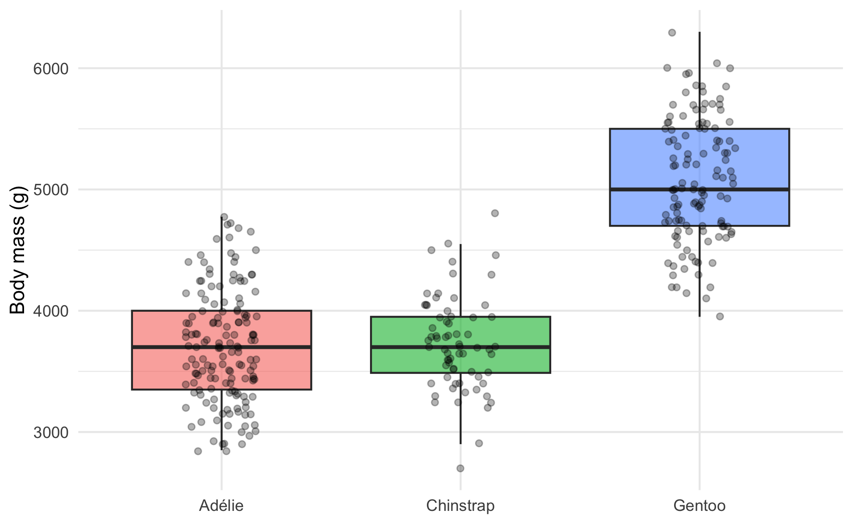
Put It All Together — One Clean Figure
# Reordered + relabeled in one pipeline --------------- penguins_df %>% mutate( species = fct_recode(species, "Adélie" = "Adelie"), species = fct_reorder(species, body_mass_g, .fun = median) ) %>% ggplot(aes(x = species, y = body_mass_g, fill = species)) + geom_boxplot(alpha = 0.6, outlier.shape = NA) + geom_point(position = position_jitter(width = 0.15, seed = 42), alpha = 0.3, size = 1.4) + labs(x = NULL, y = "Body mass (g)") + theme_minimal() + theme(legend.position = "none")
Ordered by mass, relabeled, publication-ready — and the code that made it is three fct_ calls inside one mutate().
Notice nothing here required touching the underlying data frame outside the pipe — fct_recode() and fct_reorder() did all the work on the fly, right where the plot is built.

Slide 28
🛑 Pause — Do Activity Parts 10–12 Now
Relevel a model to a new reference, drop an unused level, and build your own reordered + relabeled figure. Predict the reference change before you run it.

Slide 29
What We Learned Today
Concepts:
A factor = categories + a stored order of levels
Level order drives plot axes, legends, and model baselines
Reorder for readable plots: fct_reorder(), fct_infreq(), fct_rev()
Tidy the labels: fct_recode(), fct_collapse(), fct_lump()
Set the model reference with fct_relevel(); clear ghosts with fct_drop()
as.numeric() on a factor returns codes — convert to character first
References:
📖 R4DS Ch. 16 — Factors
📖 common_code/15_factors
Up next — Lecture 17:
Joins — combine two tables on a shared key
The prerequisite for bigger datasets — and for maps

