Slide 1
MCSL2018
Lab3

Slide 2
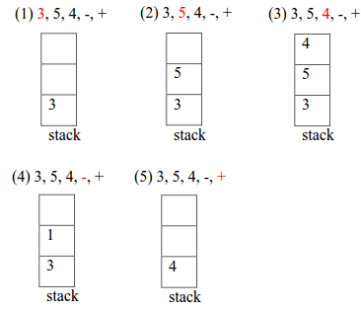
Lab 3.1 Postfix arithmetic
Setup stack pointer
Calculate postfix expression with stack
0x20000078
3
PUSH
0x20000074
5
SP
0x20000070
0x2000006C
0x20000068
The processor uses a full descending stack.

Slide 3
Lab 3.2 Calculating Greatest Common Divisor
Use Stein‘s algorithm to find GCD
Calculate the maximum stack size used in program

