Slide 1
Introduction of Network Simulator 3 (NS-3)
Wei-Lun

Slide 2
Agenda
NS-3 features
Basic conceptions
Development Environment

Slide 3
NS-3 Features
NS-3 is not an evolution of ns-2
  NS-3 is not backwards-compatible with ns-2
Programming languages
  Everything designed for C++
  Optional Python scripting
Use waf build system
NS-3 is a GNU GPLv2-licensed project

Slide 4
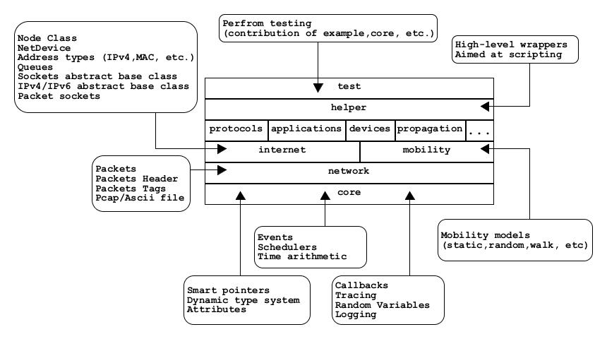
Software Organization
Notes:
Protocols: routing protocols
Device : wifi, lte, p2p, …etc

Slide 5
Fundamental Objects
Node
  Basic computing device abstraction
Application
  Acquires and uses the resources controlled
  Run on ns-3 Nodes to drive simulations
Channel
  Provides methods for managing communication sub-network objects and connecting nodes
Net Device
  Provides methods for managing connections to Node and Channel objects
  Net Device are strongly bound to Channels of a matching type
Topology Helpers
  It provides a set of classes and methods that make common operations easier than using the low-level API

Slide 6
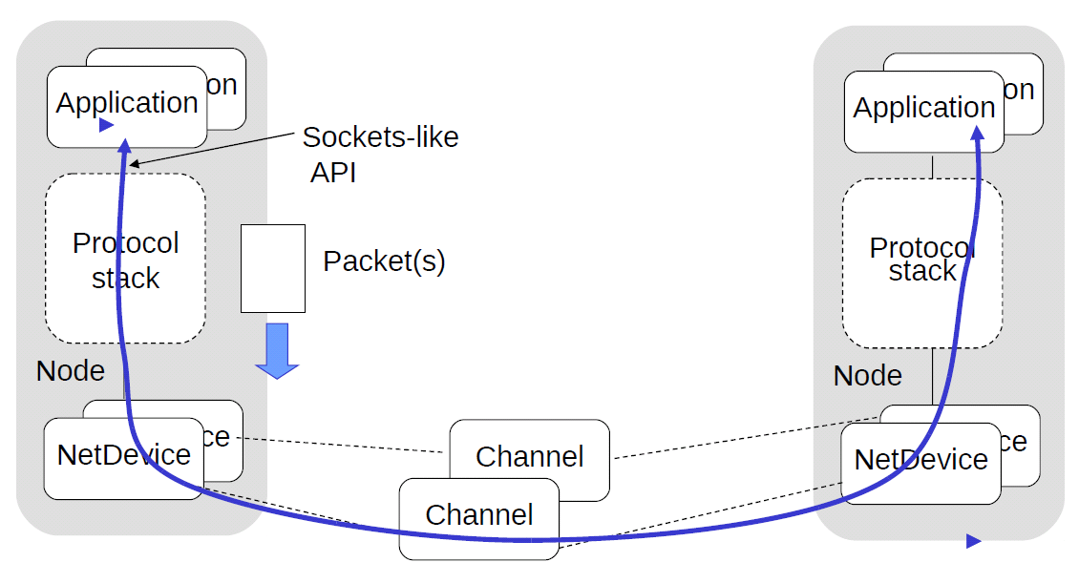
Conceptual Architecture

Slide 7
Net Device and Channel
Point-to-Point (PPP links)
CSMA (Ethernet links)
Wifi (802.11 links)
  Both infrastructure (with Beacons), and Ad-Hoc modes
Wimax (802.16 links)

Slide 8
Net Device and Channel (cont.)
LTE
Low-Rate Wireless Personal Area Network (LR-WPAN)
6LoWPAN (IEEE 802.15.4)
Wireless Access in the Vehicular Environment (WAVE)
  IEEE 802.11p
  IEEE 1069 set

Slide 9
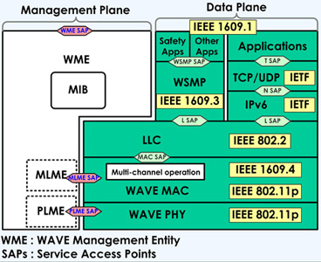
WAVE Module
Stack of WAVE/IEEE1069 set

Slide 10
Routing Models
Ad-Hoc
  OLSR (RFC 3626)
  AODV (RFC 3561)
Destination-Sequenced Distance Vector (DSDV)
Dynamic Source Routing (DSR)
Nix-vector Routing
  Limited but high performance static routing
  For simulations with thousands of wired nodes

Slide 11
Application Models
OnOff
  Generates streams, alternating on-and-off periods
  Generate many types of traffic with configurations
  Works with either UDP or TCP
Packet sink
  Receives packets or TCP connections
Ping6/v4ping
  Send ICMP ECHO request
UDP-client/server
  Send UDP packet sequence number
UDP-echo
  UDP packet, no sequence number

Slide 12
Folder structure
Directory (~/ns-allinone-3.28/ns-3.28)
  src folder
    Source code of all modules
  examples folder
    Example program
  scratch folder
    Every file/folder within scratch will be compiled (configure by waf)
  build folder
    Share libraries and object files

Slide 13
Folder structure (cont.)
Directory of a module (…/ns-3.28/src)
  model
    Contains source code for main part of module
  helper
    Contains code for helper classes
  examples
    Contains topology example related to module
  bindings
    Files related to python
  wscript
    The Makefile equivalent
  doc
    Document API of the module

Slide 14
Getting Started: Linux
Linux version
  ubuntu 14.04
Install ns-3
  Install dependency libraries
  Download NS-3.28 source code
  Pre-build models
  Use ns3_install-ns3.28.sh to cover above steps

Slide 15
Getting Started: Linux (cont.)
Configure environment
Run example program
Debug
$ cd ~/ns-allinone-3.2x/ns-3.2x
$ ./waf clean
$ ./waf configure --enable-sudo --build-profile=debug \
--enable-examples --enable-test
$ cd ~/ns-allinone-3.2x/ns-3.2x
$ cp ./examples/tutorial/first.cc ./scratch
$ ./waf --run ./scratch/first
$ ./waf --command-template="gdb -tui %s" --run <program-name>

Slide 16
Getting Started: Linux (cont.)
Logger
  Environment variable: NS_LOG
  Level flag
    level_error, level_warn, level_debug, level_info, level_function, level_logic, level_all
  Prefix flag
    prefix_func, prefix_time, prefix_node, prefix_level, prefix_all
NS_LOG=“NameOfComponentA=level_flag|prefix_flag: NameOfComponentB=level_flag|prefix_flag”
ps. Don’t use a newline here!

Slide 17
Getting Started: Linux (cont.)
Logger
$ NS_LOG= “UdpEchoClientApplication=level_all|prefix_func:
UdpEchoServerApplication=level_all|prefix_func”
./waf –run scratch/first
UdpEchoServerApplication:UdpEchoServer()
UdpEchoClientApplication:UdpEchoClient()
UdpEchoClientApplication:SetDataSize(1024)
UdpEchoServerApplication:StartApplication()
UdpEchoClientApplication:StartApplication()
UdpEchoClientApplication:ScheduleTransmit()
UdpEchoClientApplication:Send()
UdpEchoClientApplication:Send(): Sent 1024 bytes to 10.1.1.2
UdpEchoServerApplication:HandleRead(): Received 1024 bytes from 10.1.1.1
UdpEchoServerApplication:HandleRead(): Echoing packet
UdpEchoClientApplication:HandleRead(0x683d50, 0x6845d0)
UdpEchoClientApplication:HandleRead(): Received 1024 bytes from 10.1.1.2
UdpEchoClientApplication:StopApplication()
UdpEchoServerApplication:StopApplication()
…

Slide 18
Getting Started: Linux (cont.)
Logger
$ NS_LOG= “UdpEchoClientApplication=level_all|prefix_func|prefix_time:
UdpEchoServerApplication=level_all|prefix_func|prefix_time”
./waf –run scratch/first
0s UdpEchoServerApplication:UdpEchoServer()
0s UdpEchoClientApplication:UdpEchoClient()
0s UdpEchoClientApplication:SetDataSize(1024)
1s UdpEchoServerApplication:StartApplication()
2s UdpEchoClientApplication:StartApplication()
2s UdpEchoClientApplication:ScheduleTransmit()
2s UdpEchoClientApplication:Send()
2s UdpEchoClientApplication:Send(): Sent 1024 bytes to 10.1.1.2
2.00369s UdpEchoServerApplication:HandleRead(): Received 1024 bytes from 10.1.1.1
2.00369s UdpEchoServerApplication:HandleRead(): Echoing packet
2.00737s UdpEchoClientApplication:HandleRead(0x6842a0, 0x684b20)
2.00737s UdpEchoClientApplication:HandleRead(): Received 1024 bytes from 10.1.1.2
10s UdpEchoClientApplication:StopApplication()
10s UdpEchoServerApplication:StopApplication()
…

Slide 19
Reference
NS-3 Official
  https://www.nsnam.org/
The NS-3 tutorial
  https://www.nsnam.org/docs/tutorial/html/index.html
Model library online
  https://www.nsnam.org/docs/models/html/index.html
https://www.nsnam.org/tutorials/ns-3-tutorial-Walid-Younes.pdf

Slide 20
Appendix: ns3_install-ns3.28.sh (1/2)
#!/bin/bash
set -e
version=3.28
sudo apt-get -y install software-properties-common
sudo add-apt-repository ppa:ubuntu-toolchain-r/test
sudo apt-get update
sudo apt-get -y install gcc-4.9 g++-4.9
sudo update-alternatives --install /usr/bin/gcc gcc /usr/bin/gcc-4.9 49 \
--slave /usr/bin/g++ g++ /usr/bin/g++-4.9 \
--slave /usr/bin/gcc-ar gcc-ar /usr/bin/gcc-ar-4.9 \
--slave /usr/bin/gcc-nm gcc-nm /usr/bin/gcc-nm-4.9 \
--slave /usr/bin/gcc-ranlib gcc-ranlib /usr/bin/gcc-ranlib-4.9
sudo apt-get -y install qt5-default
sudo apt-get -y install python python-dev
sudo apt-get -y install mercurial bzr
sudo apt-get -y install cmake libc6-dev libc6-dev-i386 g++-multilib
sudo apt-get -y install gdb valgrind
sudo apt-get -y install flex bison libfl-dev tcpdump
sudo apt-get -y install sqlite sqlite3 libsqlite3-dev
sudo apt-get -y install libxml2 libxml2-dev
sudo apt-get -y install libgtk2.0-0 libgtk2.0-dev
sudo apt-get -y install vtun lxc
sudo apt-get -y install uncrustify
sudo apt-get -y install python-sphinx dia
sudo apt-get -y install python-pygraphviz python-kiwi python-pygoocanvas libgoocanvas-dev
sudo apt-get -y install libboost-signals-dev libboost-filesystem-dev
sudo apt-get -y install openmpi-bin openmpi-common openmpi-doc libopenmpi-dev

Slide 21
Appendix: ns3_install-ns3.28.sh (2/2)
#!/bin/bash
set -e
version=3.28
wget https://www.nsnam.org/release/ns-allinone-${version}.tar.bz2
tar jxvf ns-allinone-${version}.tar.bz2
cd ns-allinone-${version}
./build.py
cd ns-${version}

Slide 22
Appendix: Sockets API
Plain C sockets
NS-3 sockets
int sd;
sd = socket(PF_INET, SOCK_DGRAM,0);
struct sockaddr_in src;
inet_pton(AF_INET, "0.0.0.0", &src.sin_addr);
src.sin_port = htons(80);
bind(sd, (struct sockaddr *)&src, sizeof(src));
struct sockaddr_in dest;
inet_pton(AF_INET, "10.0.0.1", &dest.sin_addr);
dest.sin_port = htons(80);
sendto(sd, "hello", 6, 0,
(struct sockaddr*)&dest, sizeof(dest));
char buf[6];
recv(sd, buf, 6, 0);
Ptr<Socket> sd =
udpFactory->CreateSocket();
sd->Bind(InetSocketAddress (80));
sd->SendTo(
InetSocketAddress(
Ipv4Address("10.0.0.1"), 80),
Create<Packet>("hello", 6));
sd->SetReceiveCallback(
MakeCallback(MySocketReceive));
...
void MySocketReceive(Ptr<Socket>sd, Ptr<Packet>packet)
{ ...}

Slide 23
Appendix: Thread API
SystemThread class
MyClass myObject;
Ptr<SystemThread> th = Create<SystemThread>(
MakeCallback(&MyRouting, &myObject));
th->Start (); // pthread_create()
Simulator::Run ();
th->Join (); // pthread_join()
Simulator::Destroy ();
void MyRouting(MyClass &myObject)
{...}

Slide 24
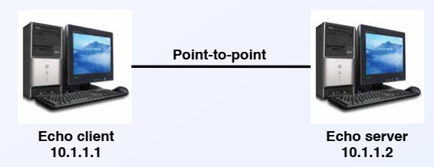
Appendix: example/tutorial/first.cc (1/12)
This is a script that will create a simple point-to-point link between two nodes and echo a single packet between the nodes.

Slide 25
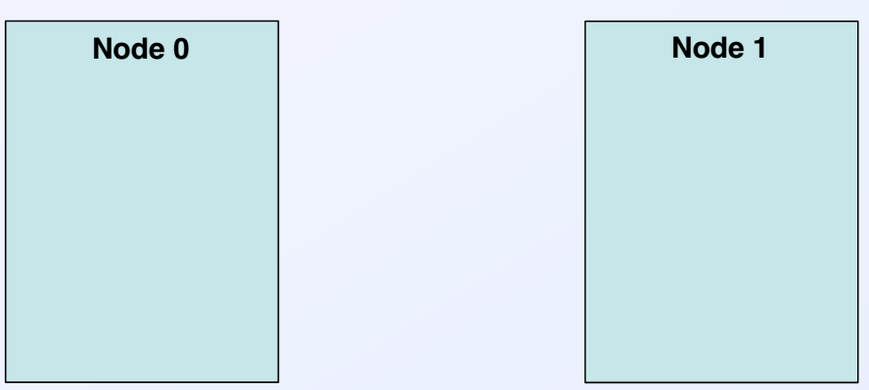
Appendix: example/tutorial/first.cc (2/12)
Create the network topology
NodeContainer nodes;
nodes.Create(2);

Slide 26
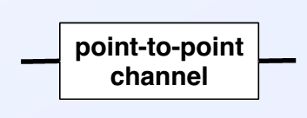
Appendix: example/tutorial/first.cc (3/12)
Configure the point-to-point channel
PointToPointHelper pointToPoint;
pointToPoint.SetDeviceAttribute(
"DataRate", StringValue("5Mbps"));
pointToPoint.SetChannelAttribute(
"Delay", StringValue("2ms"));

Slide 27
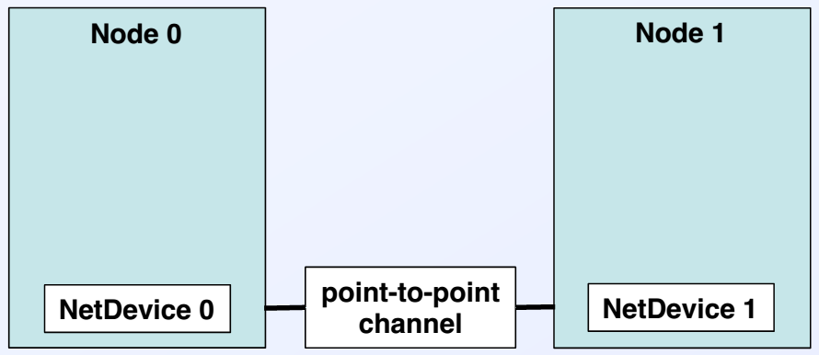
Appendix: example/tutorial/first.cc (4/12)
Install the point-to-point channel to the nodes
NetDeviceContainer devices;
devices = pointToPoint.Install(nodes);

Slide 28
Appendix: example/tutorial/first.cc (5/12)
Configure IP addresses
Ipv4AddressHelper address;
address.SetBase("10.1.1.0","255.255.255.0");
- Mask = 255.255.255.0
- 1st address = 10.1.1.1
2nd address = 10.1.1.2
…

Slide 29
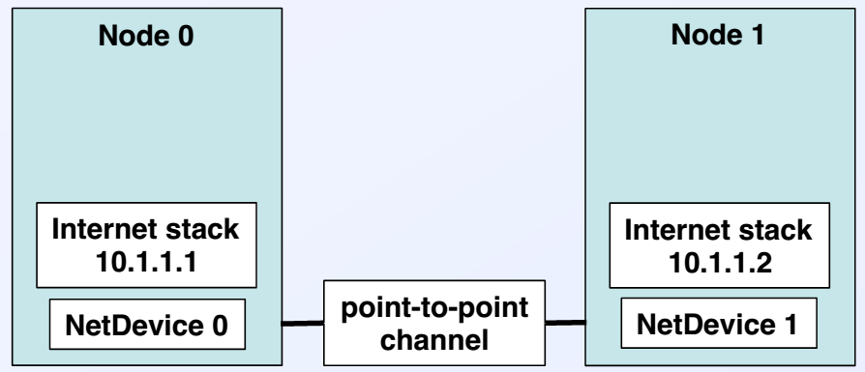
Appendix: example/tutorial/first.cc (6/12)
Assign the IP addresses to the nodes
Ipv4InterfaceContainer interfaces =
address.Assign(devices);

Slide 30
Appendix: example/tutorial/first.cc (7/12)
Set up the server application
UdpEchoServerHelper echoServer(9);
- Sets up User Datagram Protocol echo server
- Uses port 9
- Echo server just echoes back any packet it
receives

Slide 31
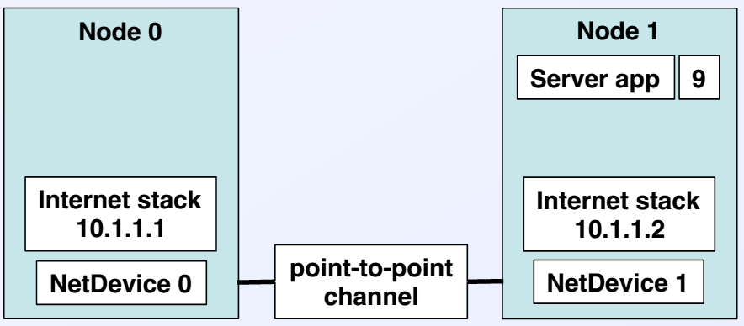
Appendix: example/tutorial/first.cc (8/12)
Install the server application to the node 1
ApplicationContainer serverApps =
echoServer.Install(nodes.Get(1));

Slide 32
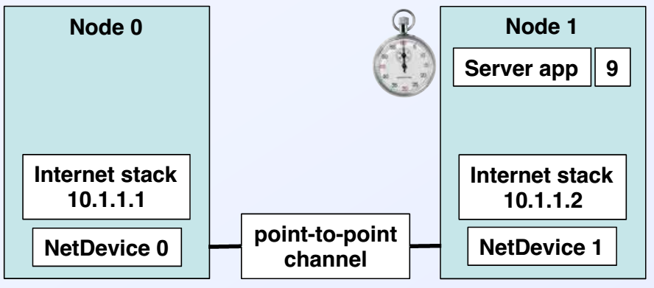
Appendix: example/tutorial/first.cc (9/12)
Schedule the server activity
serverApps.Start(Seconds(1.0));
serverApps.Stop(Seconds(10.0));
- Echo server enabled at t = 1s
- Echo server disabled at t = 10s

Slide 33
Appendix: example/tutorial/first.cc (10/12)
Configure the client application
UdpEchoClientHelper echoClient
(interfaces.GetAddress(1), 9);
- Remote address = server’s IP = 10.1.1.2
- Remote port = 9
echoClient.SetAttribute("MaxPackets", UintegerValue(1));
echoClient.SetAttribute("Interval", TimeValue(Seconds(1.0)));
echoClient.SetAttribute("PacketSize", UintegerValue(1024));
- MaxPackets = max number of packets to send
- Interval = time between sent packets
- PacketSize = size (1024 bytes in this case)

Slide 34
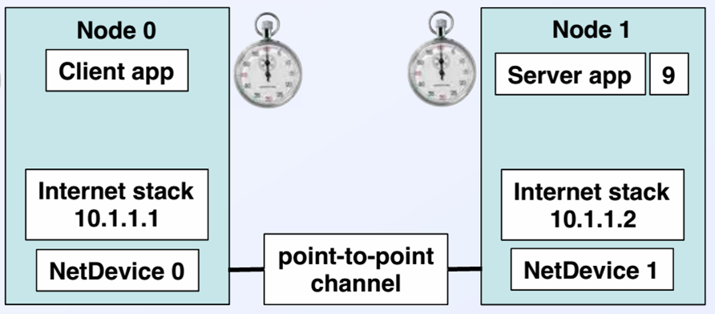
Appendix: example/tutorial/first.cc (11/12)
Install the client application to node 0
ApplicationContainer clientApps =
echoClient.Install(nodes.Get(0));
clientApps.Start(Seconds(2.0));
clientApps.Stop(Seconds(10.0));

Slide 35
Appendix: example/tutorial/first.cc (12/12)
Run the simulation and clean up
Simulator::Run();
Simulator::Destroy();
Run the simulation
Clean up when finish simulation

