Slide 1
Media playback basic flow

Slide 2
Agenda
Foundation component
StreamClass
Middle filter
NavigationFilter

Slide 3
Foundation component
Stream Class
CBasePin (Connect filter)
CBaseInputPin
CBaseOutputPin
CBaseFilter
Feature instance
CFlowManager
Event control

Slide 4
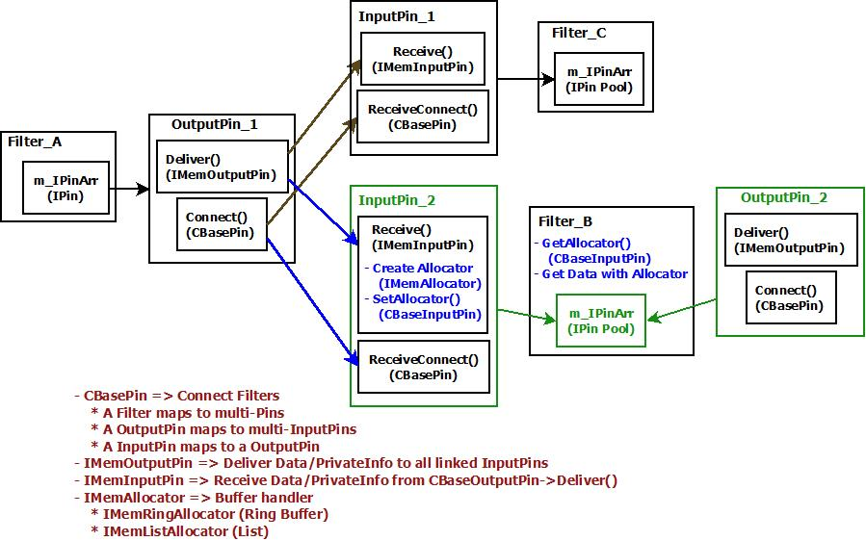
Pin and Filter
Notes:
One OutputPin -> N * InputPins and One InputPin -> One OutputPin
OutputPin broadcastData/Info and InputPin handle Data/Info (RingBuff or EnQueue)
InputPin create Allocator and share between filters (OutputPin ONLY get the 1st InputPin->Allocator)

Slide 5
Flow manager
Group filters
AddFilter()/RemoveFilter()
ConnectDirect()/Disconnect()
EnumFilters()
Flow control
Run()/Pause()/Stop()
Event handle
GetEvent()/FreeEventParams()
Notify()
Notes:
1. Assign pointer in AddXXX()

Slide 6
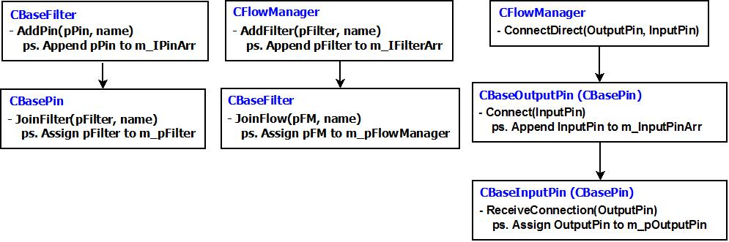
Flow manager (cont’d)

Slide 7
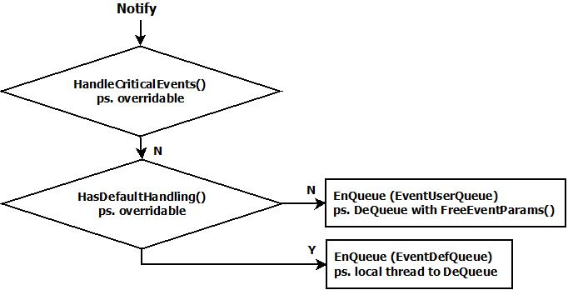
Flow manager (cont’d)
Event post/fetch between filters.
Enable local thread with StartDefaultHandlingThread()

Slide 8
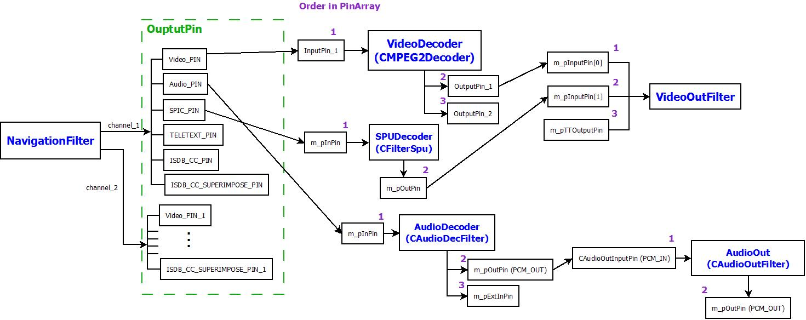
Playback basic architecture

Slide 9
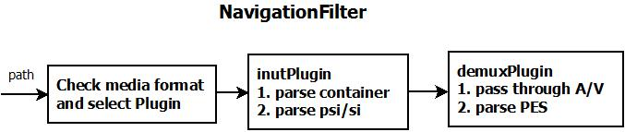
Navigation filter
Demux streams. e.g. audio, video, teletext, …etc.
Find the target demuxer
Follow file extension.
Simply parse the TAGs, which map to a container.

Slide 10
Navigation filter (cont’d)
Local thread
Enable with StartStreaming()
Handle user command (inherent INavControl, e.g. PlayXXX)
Read and Deliver stream data
Communicate Plugin with struct NAVBUF (like MsgBox)
Wrap UserCmd in NAVBUF format.
demuxPlugin.parse() output multiple NAVBUFs, which record data pointers/sizes.

