Slide 1
Agent-based Diamond–Dybvig with Cultural Heterogeneity
Markets and Society 2026
Walter Stover · George Mason University · 26 October
Notes:
~0.5 min.

Slide 2

The puzzle: who runs?
CryptoSlate, 12 October 2026, on the Financial Stability Board’s note to the G20. Screenshot, cryptoslate.com.
Notes:
~1.5 min. Raise the question only: who runs? Theory (Diamond–Dybvig) says runs can happen; it is silent on who runs first and how a run spreads. The screenshot: the FSB warned the G20 on 12 October 2026 that a fully reserved stablecoin can still face a redemption run. Even a regulator thinking about a modern run asks whether one happens, not who starts it. Alternative screenshot in figures/deck is not provided; the Nano Banc failure (25 September 2026, American Banker) was a capital failure, not a run.

Slide 3
Who runs? Luck of the draw, and location
Variation in the signal
Variation in location
Goldstein–Pauzner: every depositor gets a noisy draw of the same signal
The draw breaks common knowledge and selects the equilibrium
Who runs: whoever drew low
Everyone decides at once, so there is no first
Networks and media decide who hears what, from whom, when
Kelly–Ó Gráda, Iyer–Puri, Cookson et al.
Who runs first: whoever sits nearest the source
Notes:
~1 min. The two mechanisms the literature has used to answer who runs. Variation in the signal: Goldstein-Pauzner's noisy private draw (same technology, different draws), the device that gives Diamond-Dybvig an equilibrium-selection mechanism; depositors are ex ante identical, so who runs is luck. The model is static: for an intermediate fundamental a fraction runs (those below the threshold draw), not everyone or nobody; all-or-nothing is the zero-noise limit. Timing only enters with the network literature. Variation in location: networks and media; the order is position. Both are fruitful and both are consistent with identical processing: the same Bayesian, with the same prior, sits at every node. The third rung, variation in interpretation, is where this dissertation sits.

Slide 4

Who runs? Variation in interpretation
When there are two signals, which signal does a depositor act on, and in what proportion?
TechCrunch, 9 March 2023. Screenshot, techcrunch.com.
Notes:
~1.5 min. The question only becomes askable once a public signal sits next to the private one (Morris-Shin 2002, Hellwig 2002, Angeletos-Werning 2006); Diamond-Dybvig has no signal and Goldstein-Pauzner one. The screenshot is the question as a panic poses it: the public line (Becker: stay calm, that's my ask) against private evidence (VCs telling portfolio companies to move money out, the share price). Same shape at Celsius 2022 (Mashinsky on 11 June: do you know even one person who has a problem withdrawing? Why spread FUD and misinformation; withdrawals paused the next day) and Northern Rock 2007 (Bank of England support announced; queues outside the branches; a customer in the queue: we thought we would do what everyone else is doing). In each case depositors split on which to trust, and the interesting fact is who moved on which. If asked how the theory answers it: the Bayesian precision ratio, the weight on y is tau_y over tau_x plus tau_y, the same for everyone and vanishing as private information sharpens; so sorting is noise and official communication stops mattering just when depositors pay most attention.

Slide 5
Cultural economics: a source of stable weights
Transmitted weights. Cultural values pass largely unchanged from parents to children (Guiso, Sapienza, Zingales; Bazzi et al.).
Individualism as self-reliance against deference to the group (Hofstede) is the private-against-social weighting the model already contains (Gorodnichenko–Roland).
Measurable per depositor. Given names carry it (Twenge et al.), so we can observe the weight instead of assuming it.
Notes:
~1 min. Cultural economics gives a source of the weight that satisfies the three things the model needs: heterogeneity, positivity, and stability with respect to the information environment. Individualism is the dimension that maps onto the private-versus-social weighting, and names make it measurable at the individual level.

Slide 6
An agent-based bank run model with culturally heterogeneous signal interpretation
Notes:
Section card. ~0.2 min.

Slide 7
The model: one weight on two signals
ŝ_{i} = λ_{i} · y + (1 − λ_{i}) · x_{i}
Individualists λ_{I} < λ_{C} collectivists
ŝ_{I} − ŝ_{C} = (λ_{C} − λ_{I}) · (x − y)
Notes:
~1.5 min. The whole model in one line: a depositor blends what they are told with what they see, and the blend weight is a disposition, not a precision calculation (Chapter 1 writes it omega; the simulation writes it lambda). Subtracting the two types' estimates gives the wedge (lambda_C minus lambda_I)(x minus y): with the same pair of signals, the individualist's estimate is lower whenever private evidence is worse than the public line, so individualists run on a wider set of signals when the news is stale-optimistic, and the inclusion reverses when the news is stale-pessimistic. That is the sorting prediction the simulation tests. In the simulation, the public side is what neighbours do and what the news says, and lambda is drawn per agent in a cultural warm-up. Next: the simulation itself.

Slide 8
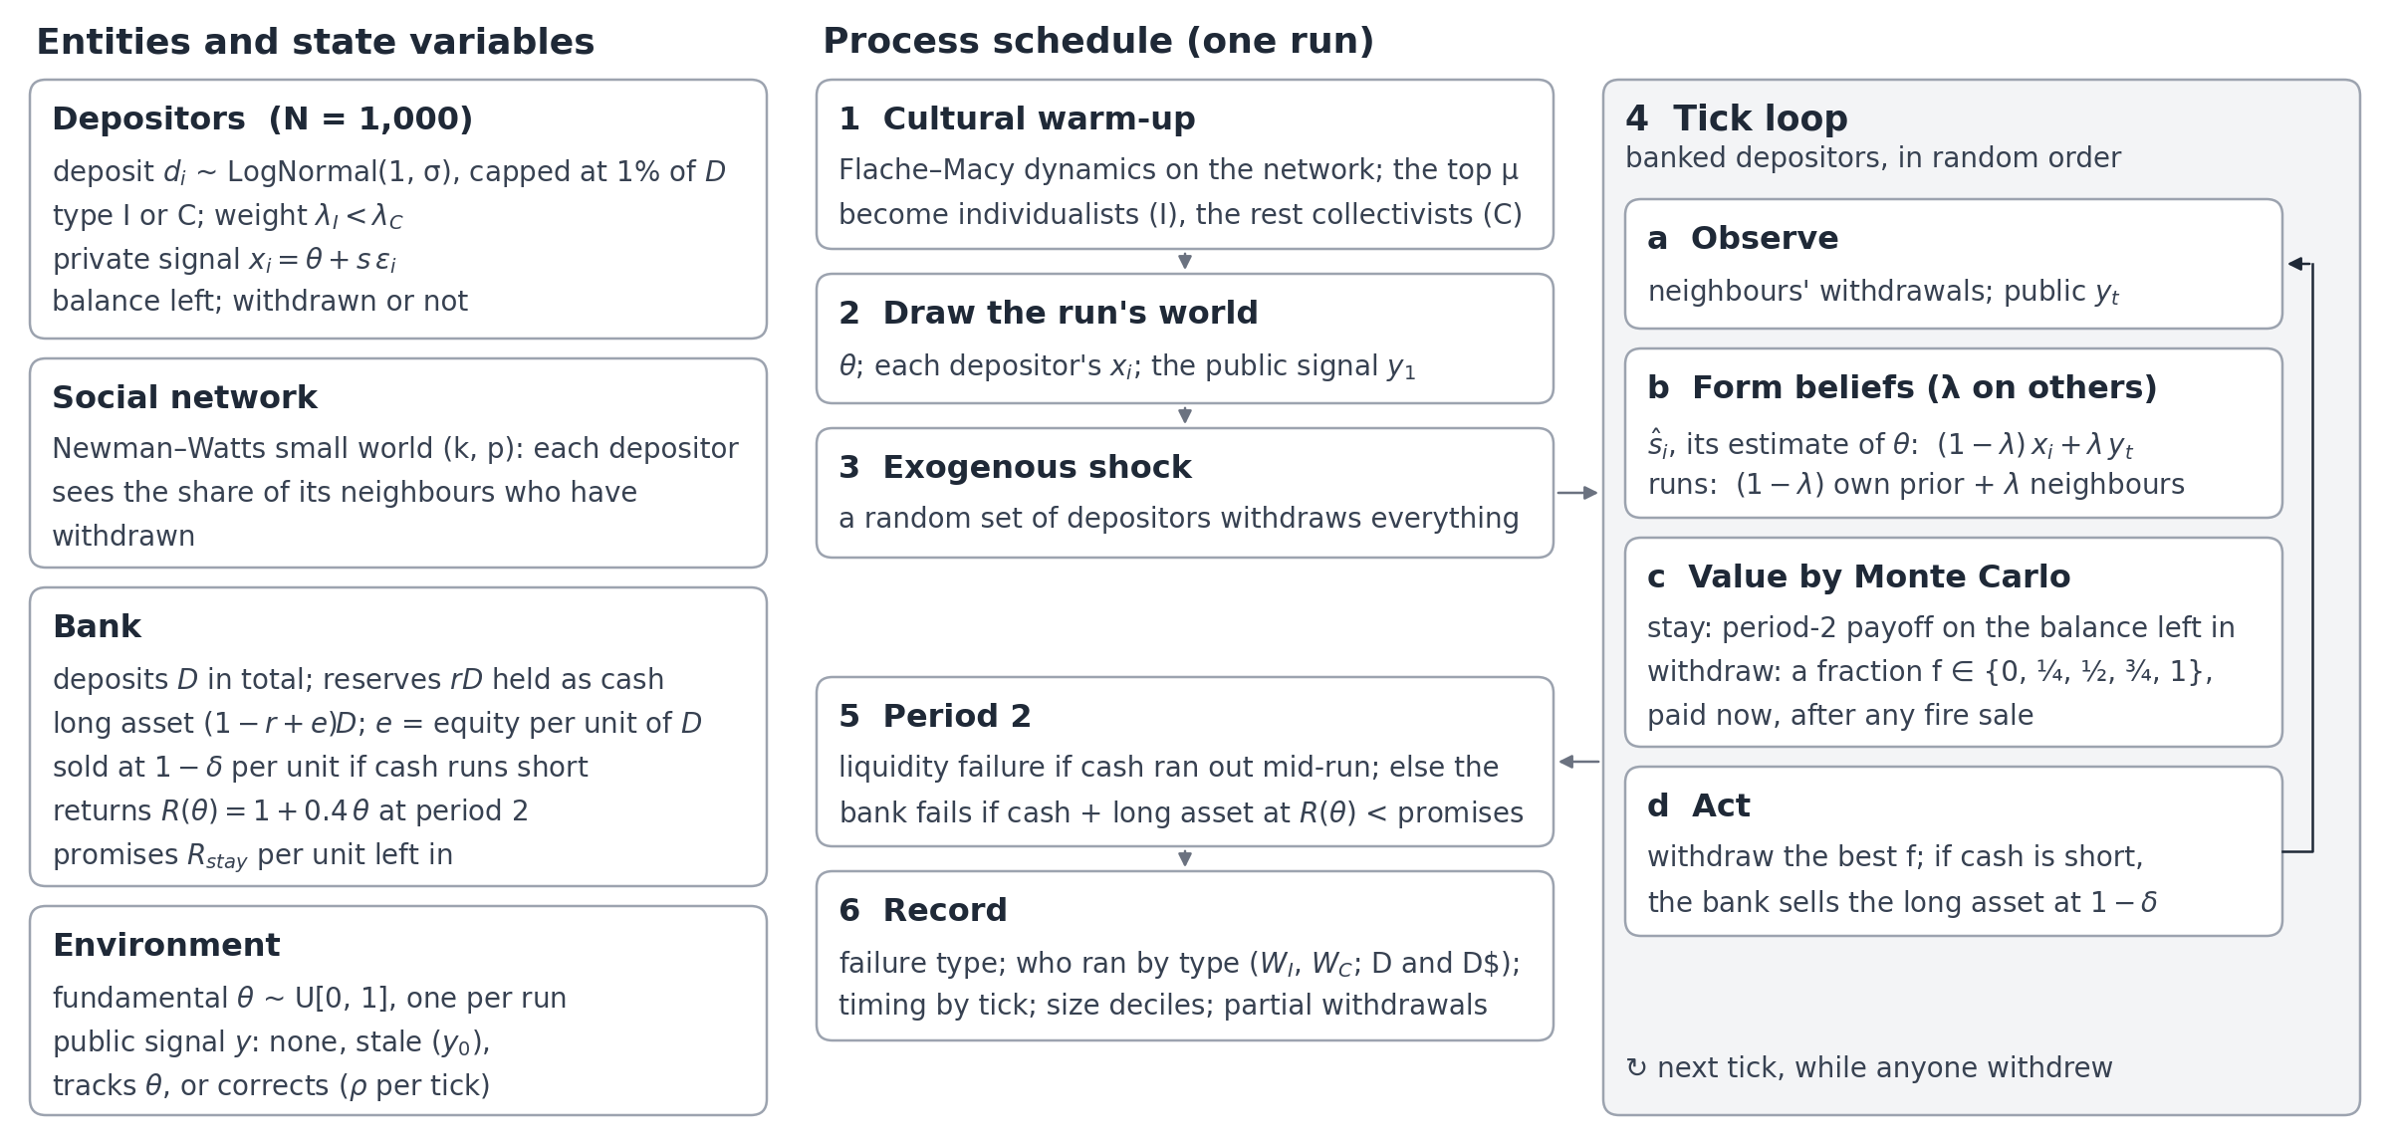
The model in one picture
Notes:
~2 min. Talk through the diagram. Left: N = 1,000 depositors, deposits log-normal (sigma 2.5) capped at 1% of the total (Celsius's largest account); types I and C from the warm-up; a Newman-Watts network; the fire-sale bank (reserves rD in cash, the rest plus equity in a long asset sold at a 60% haircut if cash runs short; it fails at period 2 if cash plus the asset at R(theta) is below its promises); theta uniform per run and a public signal that is absent, accurate or stale. Middle and right: warm-up, draw the world, shock, then the tick loop: observe neighbours and the news, blend each with your own information using lambda, value staying against withdrawing (a fraction, partial withdrawals allowed) by Monte Carlo, act. 25 initialisations x 10 draws per cell. Outcomes: D = individualists' minus collectivists' withdrawal share among those not hit by the shock; P(fail) = share of runs that fail. Risk aversion is in the model (CARA) but not on the slide.

Slide 9
Individualists and collectivists: who listens to whom
Individualists
Collectivists
Trust their own information about the bank
Put little weight on what neighbours do or on public news
Weight on the social side: λ = 0.1 to 0.3
Act on what they see themselves
Watch what neighbours do and what the public news says
Put little weight on their own information
Weight on the social side: λ = 0.5 to 0.9
Move when others move
(0.1, 0.9)
wide gap
(0.2, 0.8)
medium
(0.3, 0.5)
narrow
Signal interpretation gap
Notes:
~1 min. Individualists put little weight on others (neighbours and public news) and more on their own information; collectivists the reverse. In the model: weight on the social side lambda; pairs shown in the figures (I, C): (0.1, 0.9) = large difference, (0.2, 0.8) = medium, (0.3, 0.5) = small. Type comes from a cultural warm-up on the network: the top mu share become individualists. Colours used throughout: orange = individualists, blue = collectivists.

Slide 10
Results
Notes:
Section card. ~0.1 min.

Slide 11
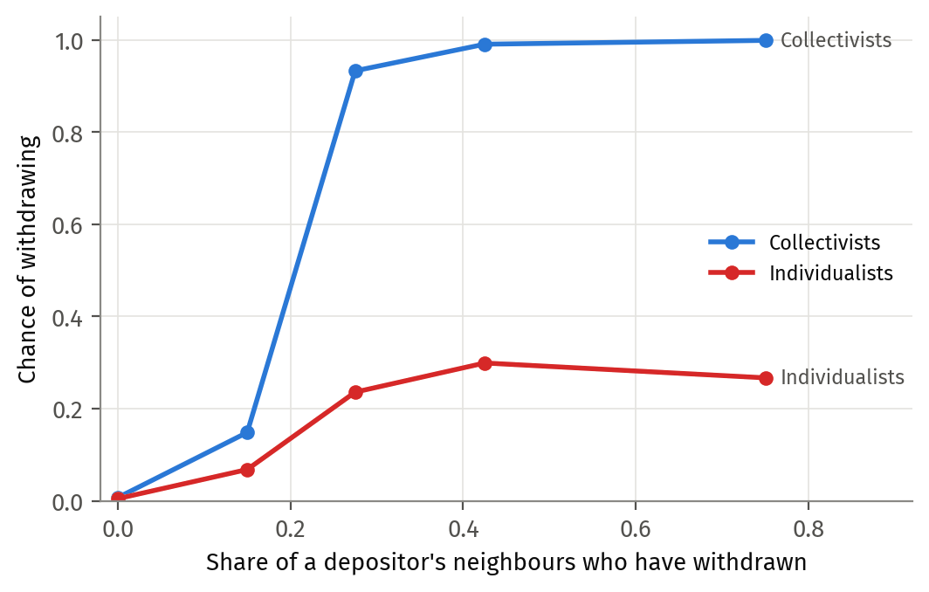
Collectivists herd
Notes:
~2 min. Collectivists jump from 0.15 to 0.93 once 20–35% of neighbours are out and reach 1.0; individualists plateau at ~0.25–0.30. Slopes: C 0.80, I 0.22 (difference +0.58, t 16.7). Lambda pairs pooled; reference bank.

Slide 12
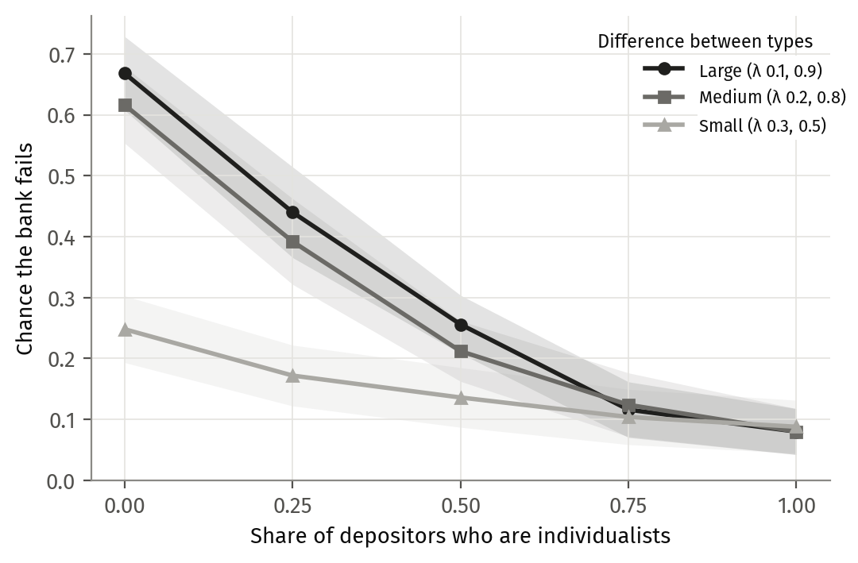
More individualists, fewer failures
Notes:
~2 min. Large difference (0.1, 0.9): 0.67 at mu 0 -> 0.08 at mu 1; medium (0.2, 0.8) similar; small (0.3, 0.5): 0.25 -> 0.09. Monotone, no interior peak. The difference between types matters most when collectivists dominate; lines converge at mu >= 0.75. Includes pure cells (mu 0 and 1). If asked about Ch 1's non-monotonic prediction (P6): see backup.

Slide 13
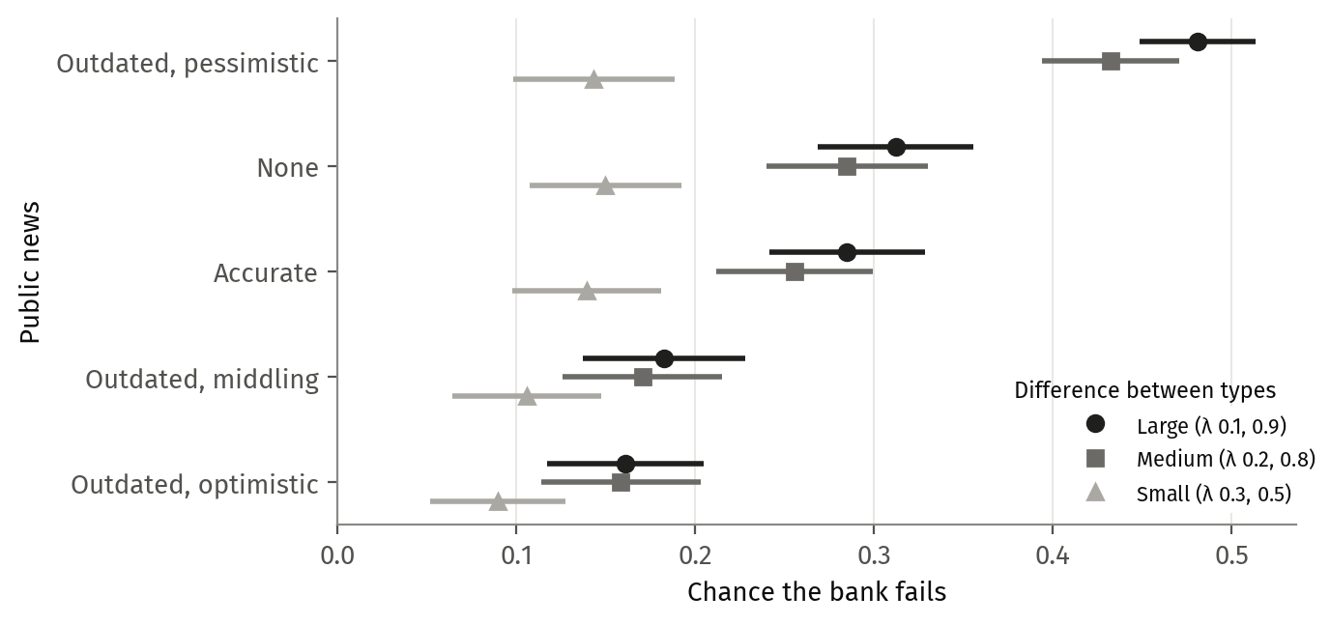
Outdated news cuts both ways
Notes:
~2.5 min. Large difference (0.1, 0.9): outdated pessimistic 0.48, none 0.31, accurate 0.29, outdated middling (y0 0.5) 0.18, outdated optimistic 0.16. Accurate news barely changes failure; stale optimistic halves it; stale pessimistic raises it by half. Small difference (0.3, 0.5) barely moves (0.09–0.15). All mu. Policy framing: the information environment (right to reassure), not sorting depositors by type.

Slide 14
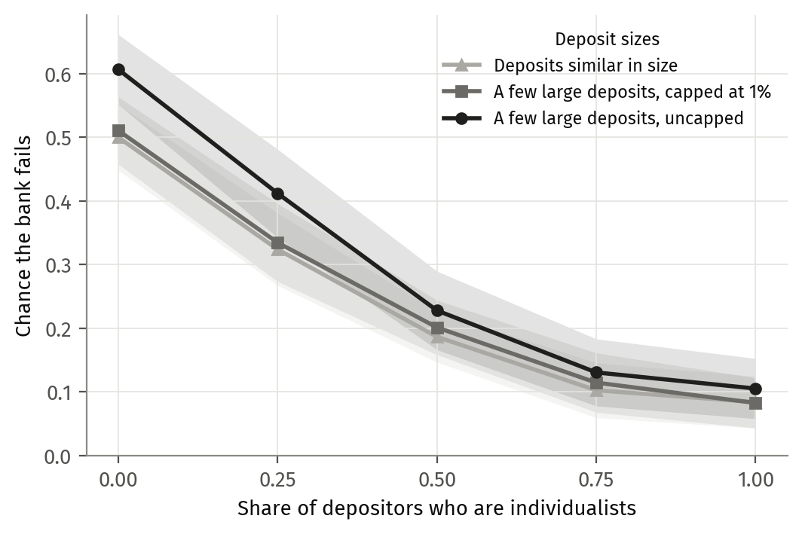
Varying the deposit-size distribution
Notes:
~2 min. Lambda pairs pooled. Uncapped (sigma 2.5) 0.61 -> 0.11; capped at 1% 0.51 -> 0.08; similar sizes (sigma 1) 0.50 -> 0.08. Capping brings failure down to the no-concentration level at every mu. The mu gradient is the same in all three: culture's effect does not depend on concentration. One spoken sentence on what 'capped at 1%' means (no single depositor holds more than 1% of the bank).

Slide 15
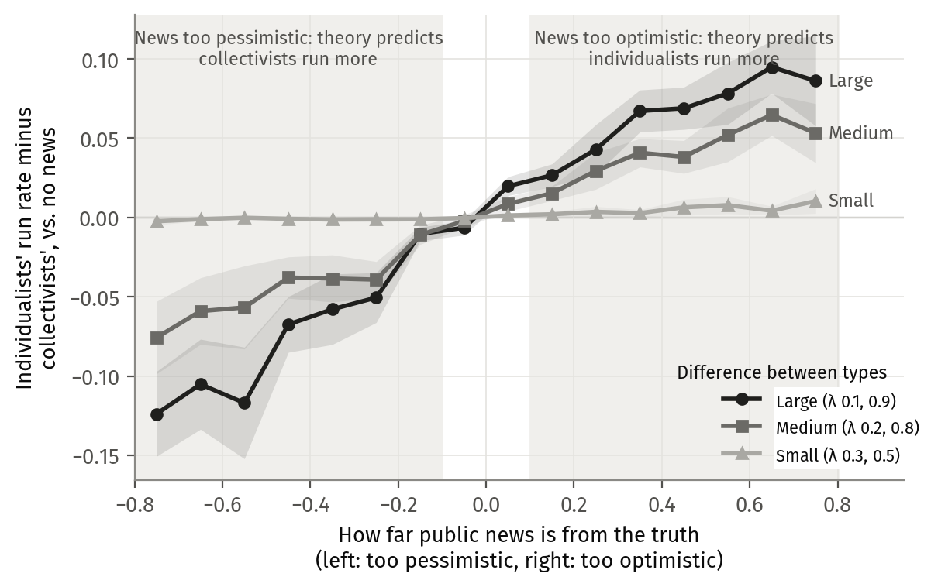
Does the model hold up?
Notes:
~1.5 min. Ch 1's theory predicts: optimistic news -> individualists run more than collectivists; pessimistic -> collectivists run more. The lines rise through zero as predicted. Large difference reaches about ±0.1; small stays flat. Pre-registered tests: 3 of 4 support, on all three versions of the bank (r1k pooled: G1' +0.033, G4' -0.031, G2a' +0.093, Holm-significant; G3 counts against). Option: make this one sentence and move the figure to backup.

Slide 16
Takeaways and next steps
1: Sorting follows the news
Optimistic public news makes individualists run relatively more; pessimistic news, collectivists.
2: Collectivists herd
Their chance of withdrawing jumps from 0.15 to 0.93 once 20–35% of neighbours are out; individualists level off near 0.3.
3: More individualists, fewer failures
P(fail) falls from 0.67 to 0.08 as the individualist share goes from 0 to 1.
4: Stale news cuts both ways
A stale optimistic signal halves failure, a stale pessimistic one raises it by half. Accurate news barely moves it.
5: Capping the largest deposits
A 1% cap brings failure down to the no-concentration bank’s level; the culture gradient is unchanged.
6: Not yet matched
How large depositors exit in real runs.
Notes:
~2 min. Next steps from the outline: super-individuals (match how Celsius's largest depositors exit), deposit insurance and the reserve ratio on the fire-sale bank, topology and learning, and the full parameter sweep (stale public signal + no-signal baseline; CARA 0.1; sigma reported).

