Slide 1

Beta distributions for communicating uncertainty in proportions

Slide 2
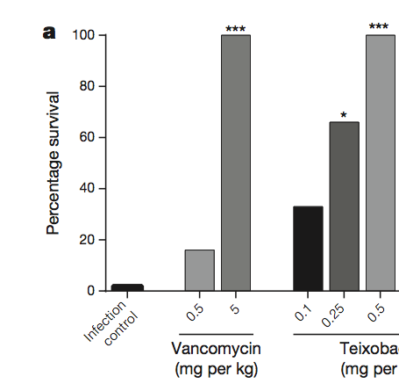
A new antibiotic
Ling et al. Nature 517:455 (2015)
The paper announced the discovery
of a new polypeptide antibiotic (tiexobactin).
Mice were given a lethal infection, and
then treated with two antibiotics at
different doses.
Something about the graph is funny.
Vancomycin
(mg per kg)
Teixobactin
(mg per kg)

Slide 3
A new antibiotic
Ling et al. Nature 517:455 (2015)
The paper announced the discovery
of a new polypeptide antibiotic (tiexobactin).
Mice were given a lethal infection, and
then treated with two antibiotics at
different doses.
Something about the graph is funny.
Vancomycin
(mg per kg)
Teixobactin
(mg per kg)

Slide 4
A new antibiotic
Ling et al. Nature 517:455 (2015)
The paper announced the discovery
of a new polypeptide antibiotic (tiexobactin).
Mice were given a lethal infection, and
then treated with two antibiotics at
different doses.
Something about the graph is funny.
All of the bars are multiples of 1/6.
Read the fine print..
Vancomycin
(mg per kg)
Teixobactin
(mg per kg)

Slide 5


This graph summarizes the fates of thirty-six mice, six cages of six mice each.

Slide 6

Binomial likelihood
P_{Binomial} (k; n, p) = _{𝑛}𝐶_{r} 𝑝^{k}(1−𝑝)^{𝑛−k}
P_{Binomial} (k; n, p) = $\left({n \atop k}\right)$𝑝^{k}(1−𝑝)^{𝑛−k}
P_{Binomial} (k; n, p) = $\frac{n!}{k!\left(n−k!\right) }$𝑝^{k}(1−𝑝)^{𝑛−k}

Slide 7

Binomial likelihood
P_{Binomial} (k; n, p) = _{𝑛}𝐶_{r} 𝑝^{k}(1−𝑝)^{𝑛−k}
P_{Binomial} (k; n, p) = $\left({n \atop k}\right)$𝑝^{k}(1−𝑝)^{𝑛−k}
P_{Binomial} (k; n, p) = $\frac{n!}{k!\left(n−k!\right) }$𝑝^{k}(1−𝑝)^{𝑛−k}

Slide 8
Binomial likelihood
P_{Binomial} (k; n, p) = _{𝑛}𝐶_{r} 𝑝^{k}(1−𝑝)^{𝑛−k}
P_{Binomial} (k; n, p) = $\left({n \atop k}\right)$𝑝^{k}(1−𝑝)^{𝑛−k}
P_{Binomial} (k; n, p) = $\frac{n!}{k!\left(n−k!\right) }$𝑝^{k}(1−𝑝)^{𝑛−k}
This is the number of outcomes
This is the probability of each outcome

Slide 9

Binomial likelihood
P_{Binomial} (p; n, k) = $f\left(n,k\right)$𝑝^{k}(1−𝑝)^{𝑛−k}
This is the number of outcomes
This is the probability of each outcome

Slide 10

Binomial log - likelihood
log P_{Binomial} (p; n, k) = log( $f\left(n,k\right) ) + k\log{(}$𝑝) + (n-k) log (1−𝑝)
Term that depends on n, k but
independent of p
Terms that depend on p

Slide 11
All Bayesian problems are the same.
Construct prior distribution consistent with ignorance of the parameters
Laplace (uniform) prior = beta(x;1,1) and
Jeffreys prior = beta(x;0.5,0.5)
are the only serious contenders
Evaluate posterior distribution in light of the data (joint binomial)
Integrate posterior distribution to get parameters of interest. (Beta inequality)

Slide 12
Binomial log - likelihood
log P_{Binomial} (p; n, k) = log( $f\left(n,k\right) ) + k\log{(}$𝑝) + (n-k) log (1−𝑝)
Term that depends on n, k but
independent of p
Terms that depend on p
Sometimes we use log-likelihood because it turns multiplication into addition and this makes some inferences easier.
Other times we use log-likelihood for numerical reasons; we may want to take the ratio of two likelihoods that are smaller than 10^{–16}

Slide 13
The Univariate Beta distribution
a and b are number
of successes and number
of failures (almost)
k, (n-k)
Two terms with powers of
x and 1-x
x is probability of success
This is a number

Slide 14
The Univariate Beta distribution
The late David MacKay pointed out that probability distributions are often named for their normalization constants.
“Normalization constant” – jargon for “the number you have to multiply the math by to make the probability sum to 1”
Two terms with powers of
x and 1-x
This is a number

Slide 15
The Univariate Beta distribution
You can think of this as the binomial probability
reorganized to add up to 1 when integrated over x
instead of summed over k.
Two terms with powers of
x and 1-x
This is a number

Slide 16
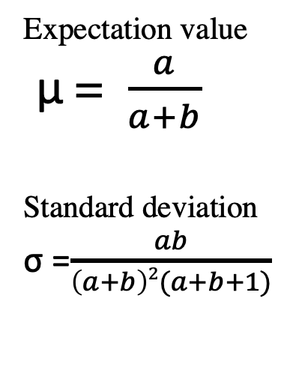
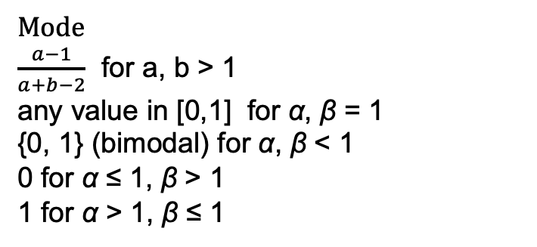
The Univariate Beta distribution
Expectation value
μ = $\frac{a}{a+b}$
Standard deviation
σ =$\frac{ab}{\left(a+b\right)2(a+b+1)}$
Mode
$\frac{a−1}{a+b−2}$ for a, b > 1
any value in [0,1] for α, β = 1
{0, 1} (bimodal) for α, β < 1
0 for α ≤ 1, β > 1
1 for α > 1, β ≤ 1

Slide 17
The math
Univariate Beta distribution:
The posterior distributions for
0, 1, 2, and 3 successes out of 3
are “polynomial functions”
known as middle- and high-
school torture instruments.

Slide 18
Bayesian inference
Event A: unknown state of nature
Event C: experiment
P(A | C ) = P(C|A) P(A) / P(C)
A
C
A∩C

Slide 19
Bayesian inference
Event A: am I infected?
Event C: experiment (test result)
P(A | C ) = P(C|A) P(A) / P(C)
The thing
I want to
know
The thing
the FDA wants
know
C
A
A∩C

Slide 20
Bayesian inference
Event A: unknown state of nature
Event C: experiment
P(A | C ) = P(C|A) P(A) / P(C)
Life’s persistent
question
“What is death
rate?”
A
C
Term that
depends on
experiment
in this case
binomial
likelihood
Term with
knowledge
and bias
about A
prior
Probability
for event that is no longer uncertain
evidence
A∩C

Slide 21
Bayesian inference
Event A: unknown state of nature
Event C: experiment
P(A | C ) = P(C|A) P(A) / P(C)
Population
prevalence
prior
A
C
Desired
probability
We know
this from
practice with
H₀
likelihood
Doesn’t
matter for
us
evidence
A∩C

Slide 22
Bayesian inference for proportions
Event A: unknown state of nature true proportion
Event C: experiment sample proportion
P(A | C ) = P(C|A) P(A) / P(C)
Prior dist.
for prop.
prior
A
C
Posterior
probability
density
for
proportion
Binomial
likelihood
Doesn’t
matter for
us
evidence
A∩C

Slide 23
posterior density = prior density * likelihood (function of the data)
Beta is a conjugate prior for the binomial distribution:
Beta priors * binomial likelihoods = Beta posteriors
Beta (α, α) prior
x Binomial likelihood with m successes and n failures
= Beta(α + m, α + n)
As long as we write a paragraph justifying our choice of prior,
we can easily get exact confidence intervals for parameters known
by binomial sampling.

Slide 24
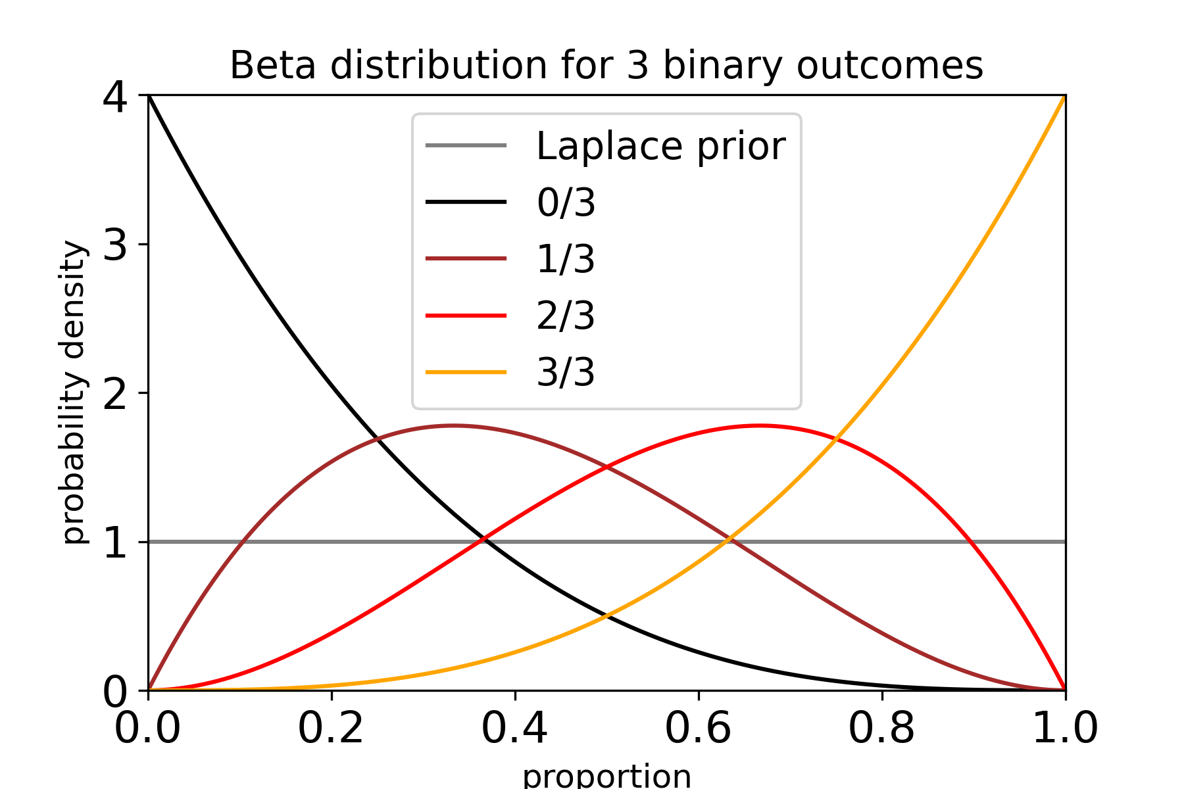
Beta distributions for all possible outcomes of an n=3 binomial experiment

Slide 25
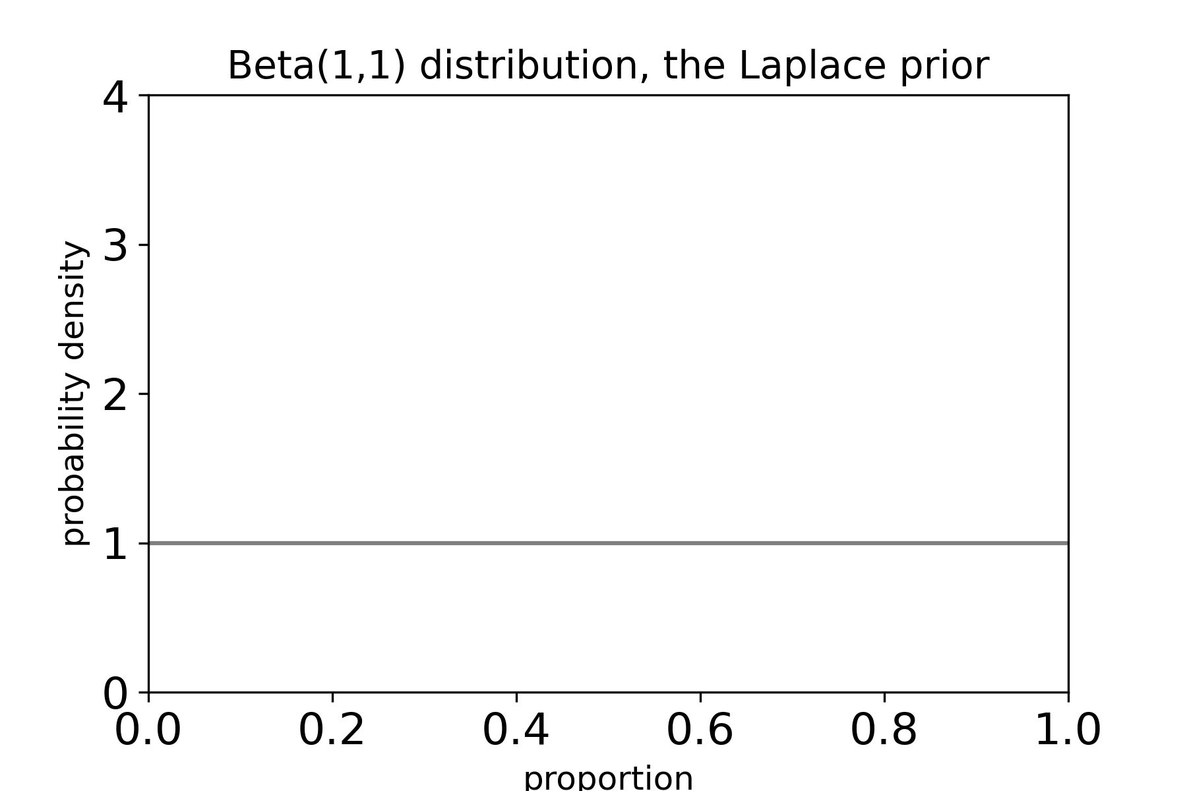
What does ignorance look like?
Before I do the experiment,
I don’t know much about
the proportion.
But we’re grownups, so I
have to put numbers on
my ignorance.
The oldest choice is the “flat” prior
Beta(a=1, b=1) = x⁰ (1-x)⁰ = 1
This prior introduces “bias” — it has an expectation value of 0.5 !!!

Slide 26
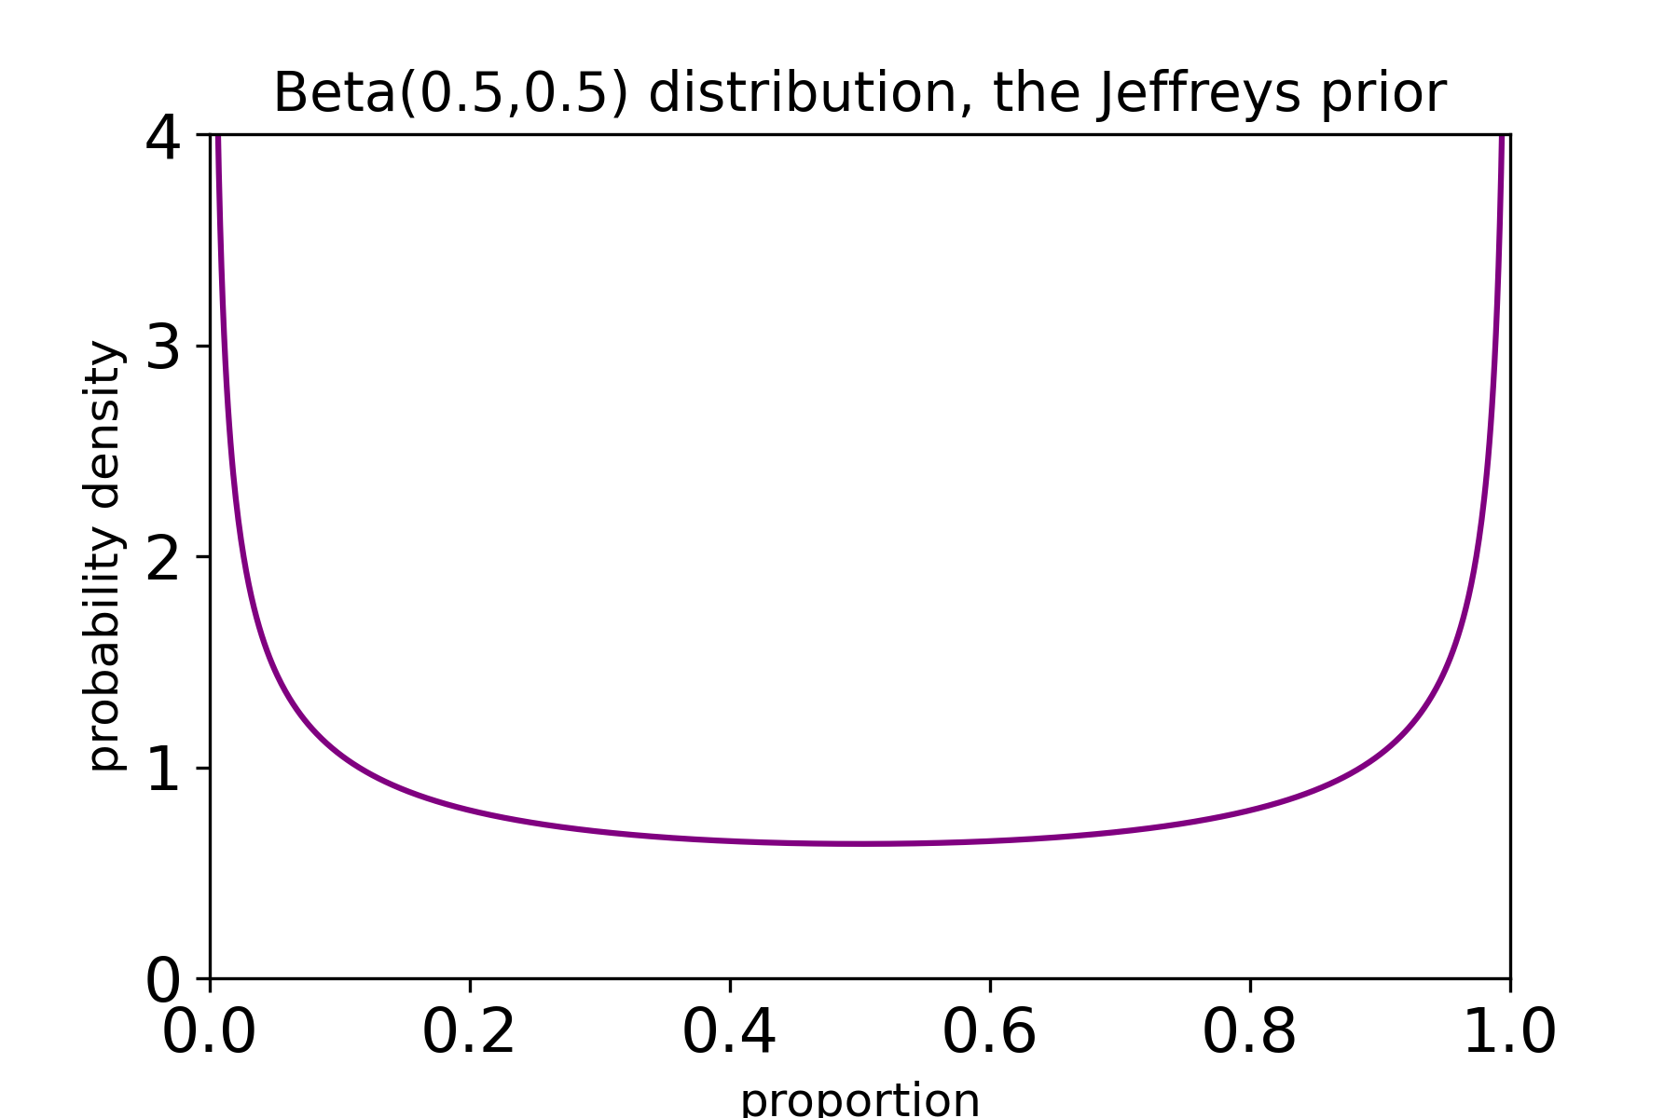
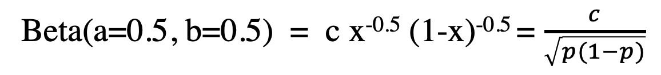
What does ignorance look like?
Perhaps there is reason to prefer
the extremes?
Jeffreys prior does that.
Note the symmetry: if a = b,
your prior does not prefer successes
or failures.
Beta(a=0.5, b=0.5) = c x^{-0.5} (1-x)^{-0.5} = $\frac{c}{\sqrt{p(1−p)}}$

Slide 27
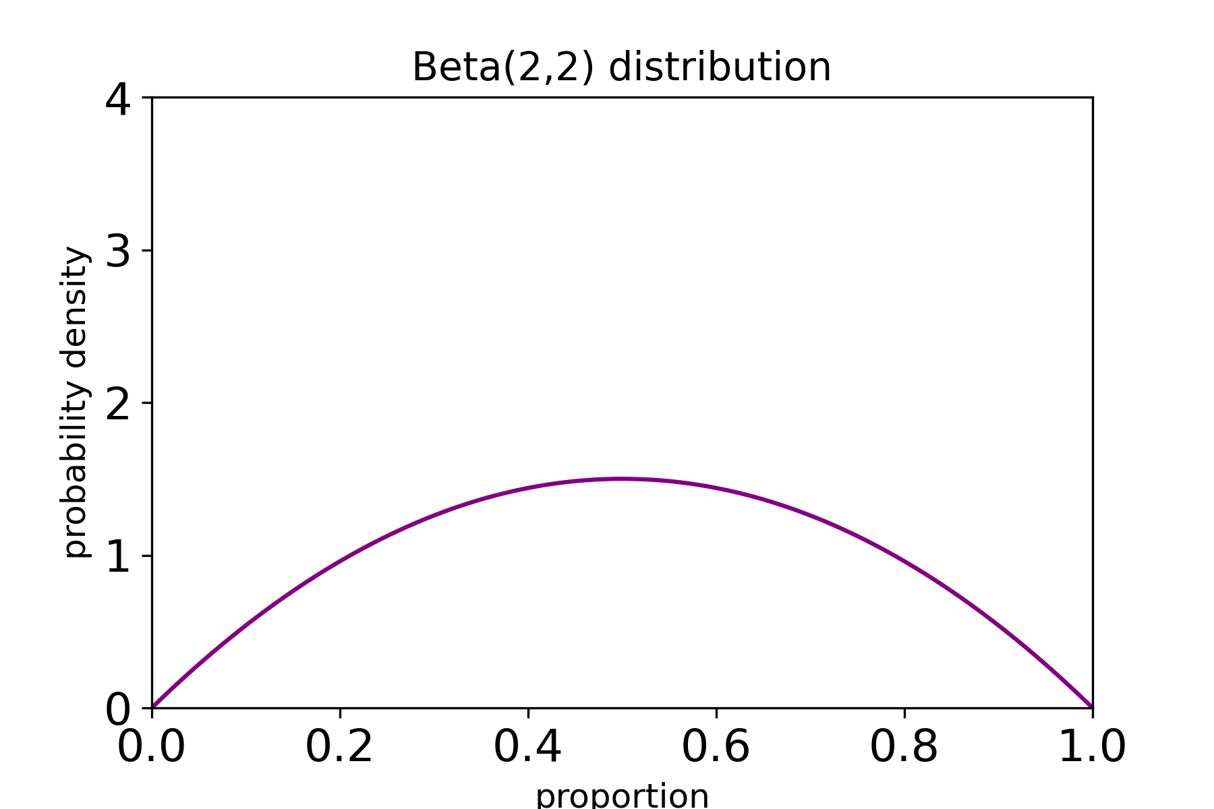
What does ignorance look like?
Note the symmetry: if a = b,
the prior does not prefer successes
or failures.
a = b = 2 is reasonable if we are certain
that both successes and failures
are possible (p cannot be exactly 0 or
exactly 1)
Beta(a=2, b=2) = c x (1-x)

Slide 28
Beta for n=3 binomial trial

Slide 29
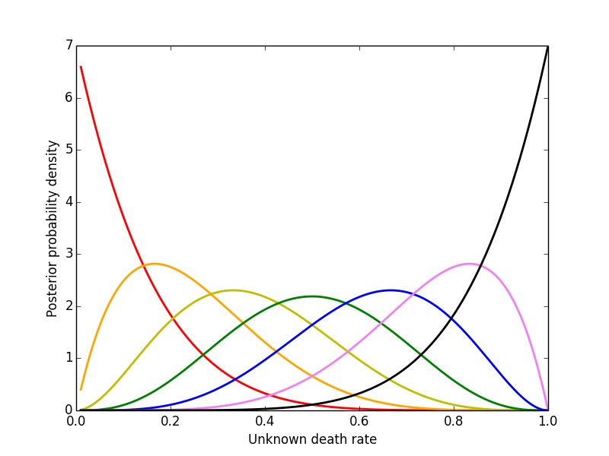
And these are their shapes for the
seven possible outcomes of an
experimental arm with six individuals:

Slide 30

The biased top
200 spins of a four-sided top.
Outcome A: 1
Outcome B: 34
Outcome C: 87
Outcome D: 78

Slide 31
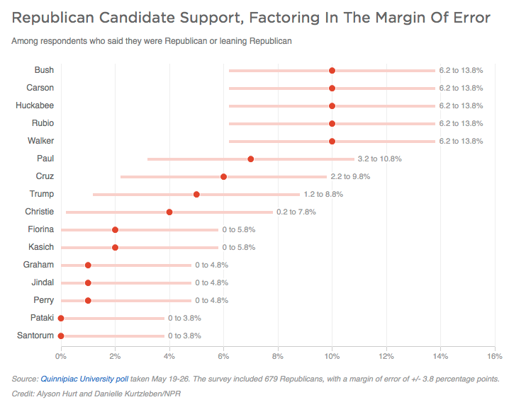
http://www.npr.org/sections/itsallpolitics/2015/05/29/410524780/the-gop-has-an-overcrowded-debate-problem

Slide 32
Proportions have been rounded.
Error bars are symmetrical, clipped at zero
Error bars are independent of point estimates!
In essence, the error bars are inappropriate.

Slide 33
The biased top
200 spins of a four-sided top.
Outcome A: 1 Here be dragons
Outcome B: 34 0.17± 1.96 * S.E.M.
Outcome C: 87 0.435 ±1.96 *S.E.M.
Outcome D: 78 0.39 ± 1.96*S.E.M.
Outcome NOT A : 199/200 ( can’t use Standard Error on the Mean!)

Slide 34
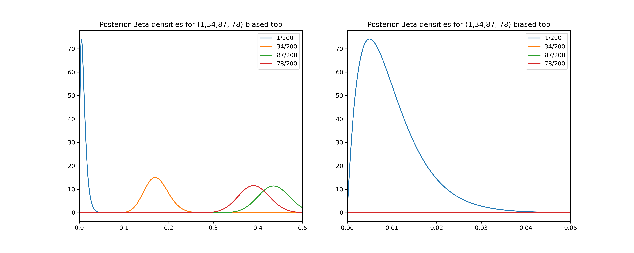
The biased top
200 spins of a four-sided top.
1
34
87
78

