Slide 1

Data 227
Autumn, 2023
Tidy data, spreadsheet tips

Slide 2
Week 2 readings
A Tour through the Visualization Zoo. Jeffrey Heer, Michael Bostock, and Vadim Ogievetsky. ACM Queue, 8(5). 2010.
Chapter 5: Chartjunk, In The Visual Display of Quantitative Information. Tufte.
(neither one is tough)

Slide 3
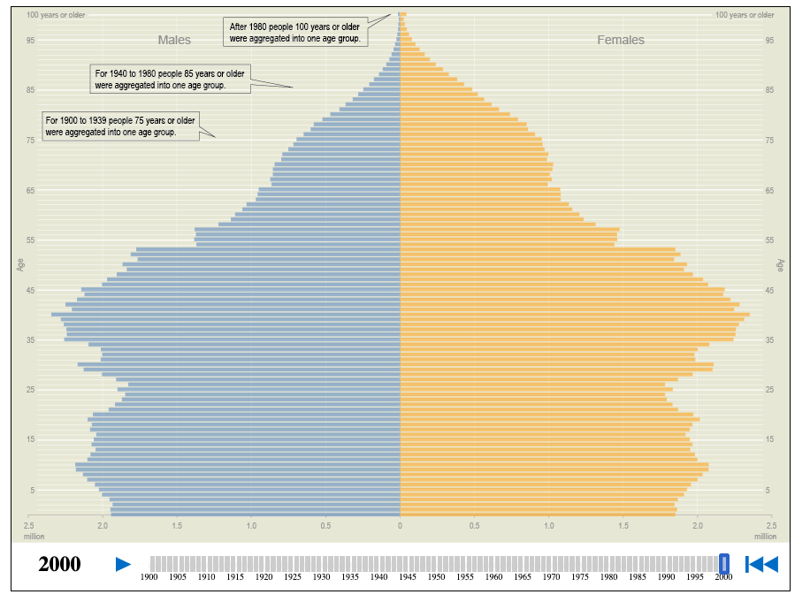
https://www.census.gov/dataviz/visualizations/055/

Slide 4
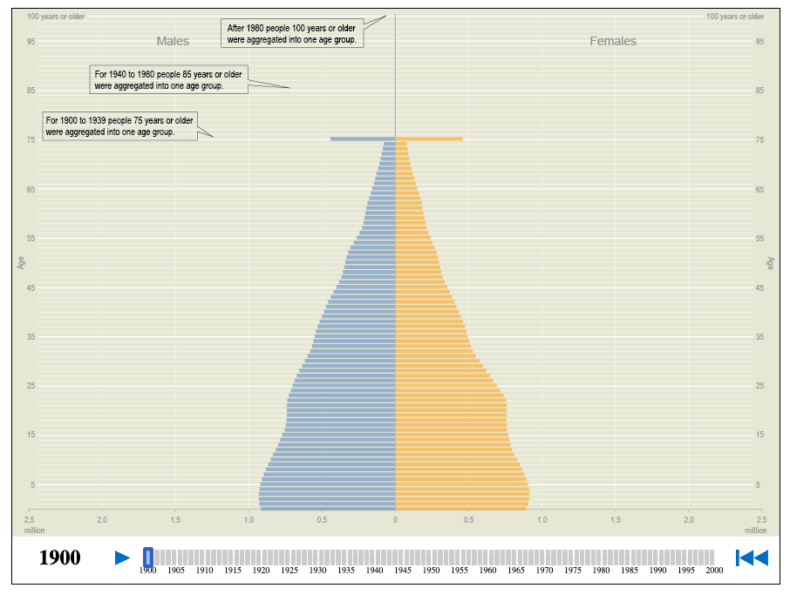
https://www.census.gov/dataviz/visualizations/055/

Slide 5
Tidy Data
“Tidy datasets provide a standardized way to link the structure of a dataset (its physical layout) with its semantics (its meaning).”
No one will demand that our data be tidy; they will demand that the analysis get done. Tidying data is not always necessary or useful, but this is a tool that may help us on the path to avoid suffering.

Slide 6
Data Semantics
A dataset is a collection of values, usually either numbers (if quantitative) or strings (if qualitative).
Values are organized in two ways. Every value belongs to a variable and an observation.
A variable contains all values that measure the same underlying attribute (like height, temperature, duration) across units.
An observation contains all values measured on the same unit (like a person, or a day, or a race) across attributes.
Wickham, H. . (2014).

Slide 7
Tidy Data principles
There are three interrelated rules which make a dataset tidy:
1 Each variable forms a column.
2 Each observation forms a row.
3 Each type of observational unit forms a table.
Wickham, H. . (2014).

Slide 8
Common problems 1
Column headers are values, not variable names (shows up frequently in tabular data).
## Row Col Hgt90 Hgt96 ... Deer97 Cover95 Fert Spacing
## 0 1 1 NaN NaN ... -2147483648 0 0 15
## 1 1 2 14.0 284.0... 12015
## 2 13 17.0 387.0... 01015
## 3 1 4 NaN NaN ... -2147483648 0 0 15
##4 1 5 24.0 294.0...
##5 1 6 22.0 310.0...
##6 1 7 18.0 318.0...

Slide 9
Common problems 2
## Name ... Value
## 0 ’C’ A CATERING AND EVENT COMPANY ... 4300-4304 N CENTRAL AVE
## 1 ’C’ A CATERING AND EVENT COMPANY ... 60634
## 2 ’C’ A CATERING AND EVENT COMPANY ... Restaurant
## 3 ’C’ A CATERING AND EVENT COMPANY ... No Entry
## 4 ’C’ A CATERING AND EVENT COMPANY ... 4300-4304 N CENTRAL AVE
## 5 ’C’ A CATERING AND EVENT COMPANY ... 60634
## 6 ’C’ A CATERING AND EVENT COMPANY ... Restaurant
## 7 ’C’ A CATERING AND EVENT COMPANY ... Pass

Slide 10
Common problems 3
## V1 V2 V3 V4 V5 ... V59 V60 V61
## 0 MX000017004195504TMAX 310 310 310 320 ... -214
## 1 MX000017004195504TMIN 150 150 160 150 ... -214
## 2 MX000017004195504PRCP 0 0 0 0 ... -214
## 3 MX000017004195505TMAX 310 310 310 300 ... -214
## 4 MX000017004195505TMIN 200 160 160 150 ... -214
## 5 MX000017004195505PRCP 0 0 0 0 ... -214
## 6 MX000017004195506TMAX 300 290 280 270 ... -214
## 7 MX000017004195506TMIN 160 160 150 140 ... -214

Slide 11
Common problems 4
## [’artist’, ’track’, ’date.entered’, ’wk1’, ’wk2’, ’wk3’, ’wk4’]
## [’wk6’, ’wk7’, ’wk8’, ’wk9’, ’wk10’, ’wk11’, ’wk12’, ’wk13’]
## [’wk14’, ’wk15’, ’wk16’, ’wk17’, ’wk18’, ’wk19’, ’wk20’, ’wk21’]
## [’wk22’, ’wk23’, ’wk24’, ’wk25’, ’wk26’, ’wk27’, ’wk28’, ’wk29’]
## [’wk30’, ’wk31’, ’wk32’, ’wk33’, ’wk34’, ’wk35’, ’wk36’, ’wk37’]
## [’wk38’, ’wk39’, ’wk40’, ’wk41’, ’wk42’, ’wk43’, ’wk44’, ’wk45’]
## [’wk46’, ’wk47’, ’wk48’, ’wk49’, ’wk50’, ’wk51’, ’wk52’, ’wk53’]
## [’wk54’, ’wk55’, ’wk56’, ’wk57’, ’wk58’, ’wk59’, ’wk60’, ’wk61’]

Slide 12
Common Problems...
A single observational unit is stored in multiple tables or files–these tables and files are often split up by another variable, so that each represents a single year, person, or location, etc.
As long as the format for individual records is consistent, this is an easy problem to fix.
For example, consider the Household Pulse Survey run by the US Census Bureau.
“Designed to quickly and efficiently deploy data collected on how people’s lives have been impacted by the coronavirus pandemic.”
You can visit the Household Pulse Survey website to download multiple files, one for every survey collection period, that could be combined to examine trends over time.

Slide 13
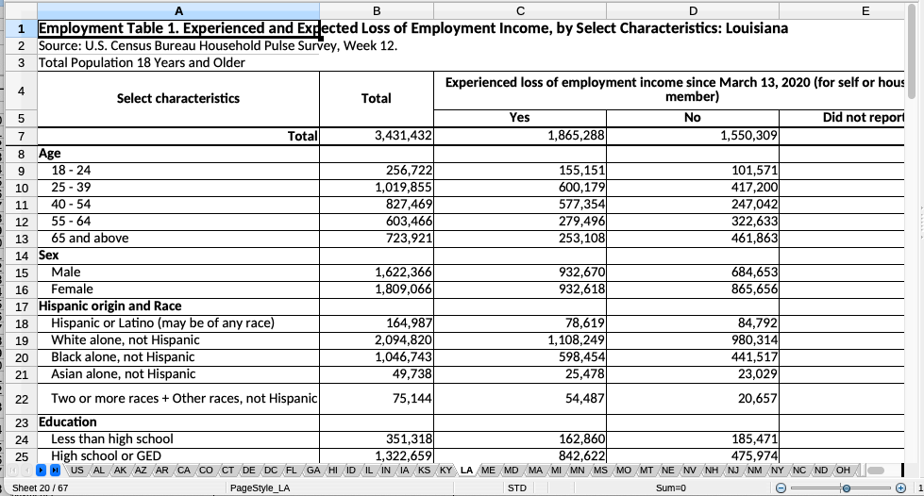
Household pulse survey reports

Slide 14
Data Cleaning
Familiarize yourself with the data set.
2 Check for structural errors (more on this in a bit).
3 Check for data irregularities (use plots, summary statistics, etc.).
4 Decide how to deal with missing values (beyond the scope of this class).
5 Document data versions and changes made.

Slide 15
Familiarize yourself with the dataset
Domain knowledge, domain knowledge, domain knowledge! Have a good grasp on what your variables mean, which are important, and which need cleaning.
Ask as many questions of your collaborator(s) as you need. Do this sooner, rather than later!
General steps:
Check the file size.
Check the dimensions of your dataset.
Check the first few rows of your dataset and the storage types of the variables to make sure you have read it in correctly.

Slide 16
Check for structural errors
Structural Errors: faulty data types, non-unique ID numbers, mislabeled variables, string inconsistencies, etc. It’s hard to give you a full list, since there are so many ways a dataset can be messy!
General steps
Check the names of the columns in your dataset and rename them if necessary.
Check the storage formats of the variables.
Look for duplicate rows.
Check variations in a column (e.g., "female", "Female", "F", etc.)

Slide 17
Check for data irregularities
Data Irregularities: accuracy concerns like invalid values and outliers. Invalid Values: Values that don’t make sense.
Individual Values: E.g., 19 pounds for a woman over 18, ages under 15 for a dataset of employees
Across Columns: E.g., Sexual orientation, gender, and household partners
Outliers:
Repeat analysis with and without the point, and see if the results change.

Slide 18
Missing Values
There are two types of missing values:
1 Explicitly, i.e. flagged with None, NaN, NA, etc. Strategizing about missing values is beyond the scope of this class.
2 Implicitly, i.e. simply not present in the data.
One bad habit is entering a year in an early row and leaving later rows empty because they should be filled with the value (and just are not, for some reason).
We like explicit values, a lot! It’s much more helpful to know if something was left missing intentionally.

Slide 19
Don't contaminate a stock solution
If you discover any of these errors in a data file, never modify it directly, but instead write code to correct the value and explain why you made the fix.
You will be forgiven for having two nearly-identical copies of the data.

Slide 20
Creating data
Be consistent.
Use a consistent data layout in multiple files (make it tidy!).
Use consistent codes for categorical variables.
Use a consistent fixed code for any missing values. Use consistent variable names.
Use consistent subject identifiers.
Use consistent file names.
Use a consistent format for all dates.
Use consistent phrases in your notes.
Be careful about extra spaces within cells.

Slide 21
Creating data
Choose good names for things.
As a general rule, don’t use spaces, either in variable names or file names
Where you might uses paces, use underscores or perhaps hyphens.
Be careful about extraneous spaces at the beginning or end of a variable name. Avoid special characters ($,@,%,#,&,*,(,),!,/, etc.), except for underscores and hyphens.
The main principle in choosing names, whether for variables or for file names, is short, but meaningful.
Finally, never include “final” in a file name.

Slide 22
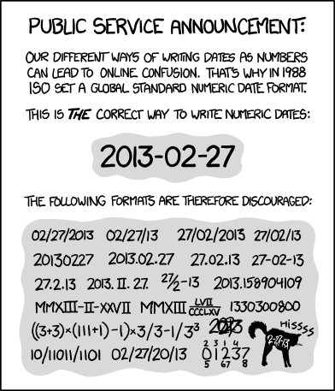
Shoutout to ISO-8601
Write dates like YYYY-MM-DD.
“When entering dates, we strongly recommend using the global ISO 8601 standard, YYYY-MM-DD, such as 2013-02-27.”
If you like, you can read about some horror stories coming from spreadsheet errors.(http://web.archive.org/web/20220810000430/www.eusprig.org/horror-stories.htm) Many of them involve incorrect date formatting.

Slide 23
Creating data 4
Create a data dictionary. It is helpful to have a separate file that explains what all of the variables are.
Such a “data dictionary” might contain:
The exact variable name as in the data file.
A version of the variable name that might be used in data visualizations.
A longer explanation of what the variable means.
The measurement units.
Expected minimum and maximum values (helpful for data cleaning or identifying outliers).
This is part of the metadata that you will want to prepare: information about the data.

Slide 24
Creating data 5
Don’t leave any cells empty, and use some common code for missing data. Don’t include calculations in the raw data.
Don’t use font color or highlighting as data.
Make backups.
Use data validation to avoid data entry errors. Save the data in plain text (usually, a .csv file).
These tips come from Broman, K. W., & Woo, K. H. (2018). Data organization in spreadsheets. The American Statistician, 72(1), 2-10.

