Slide 1

Data 227
Autumn, 2023
Encodings

Slide 2


Slide 3
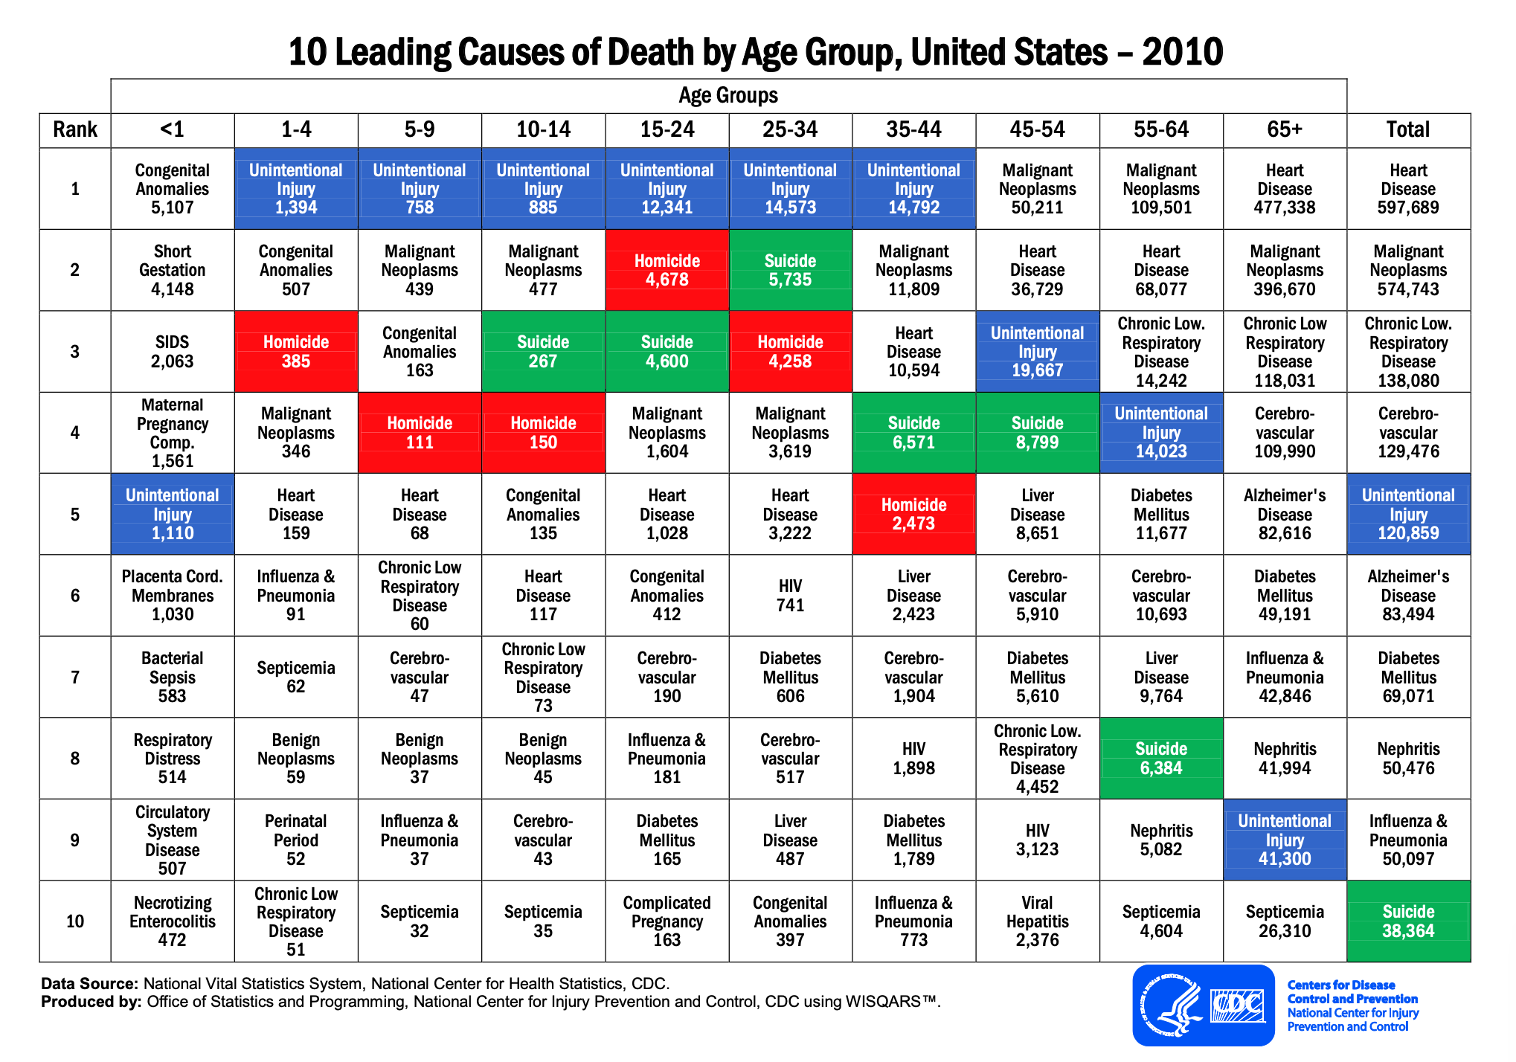

Slide 4
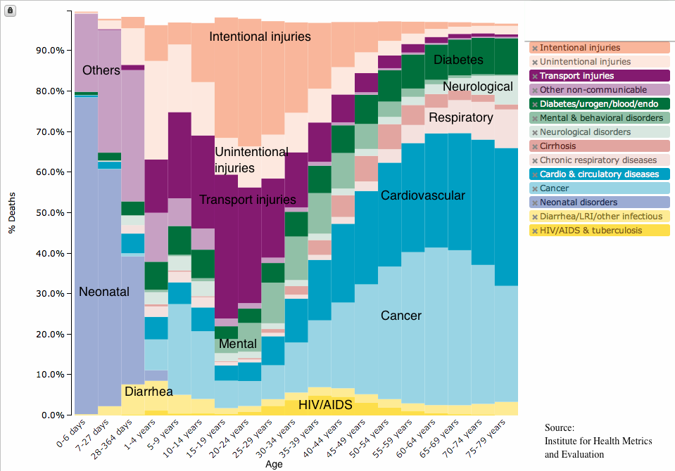
Unlike CDC data, suicide and homicide are combined here under Intentional Injuries.

Slide 5
Stacked bar graph--stairsteps bring group boundaries to mind
Order of stacking matches order in legend
On-data labels ease understanding
Uneven x-axis before age 5

Slide 6
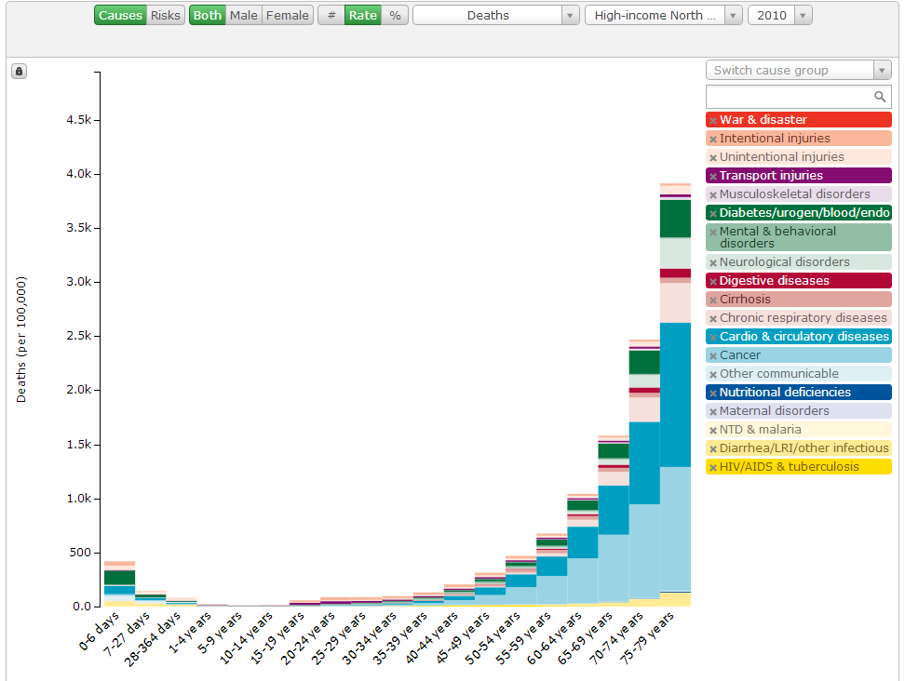
https://vizhub.healthdata.org/gbd-compare/

Slide 7
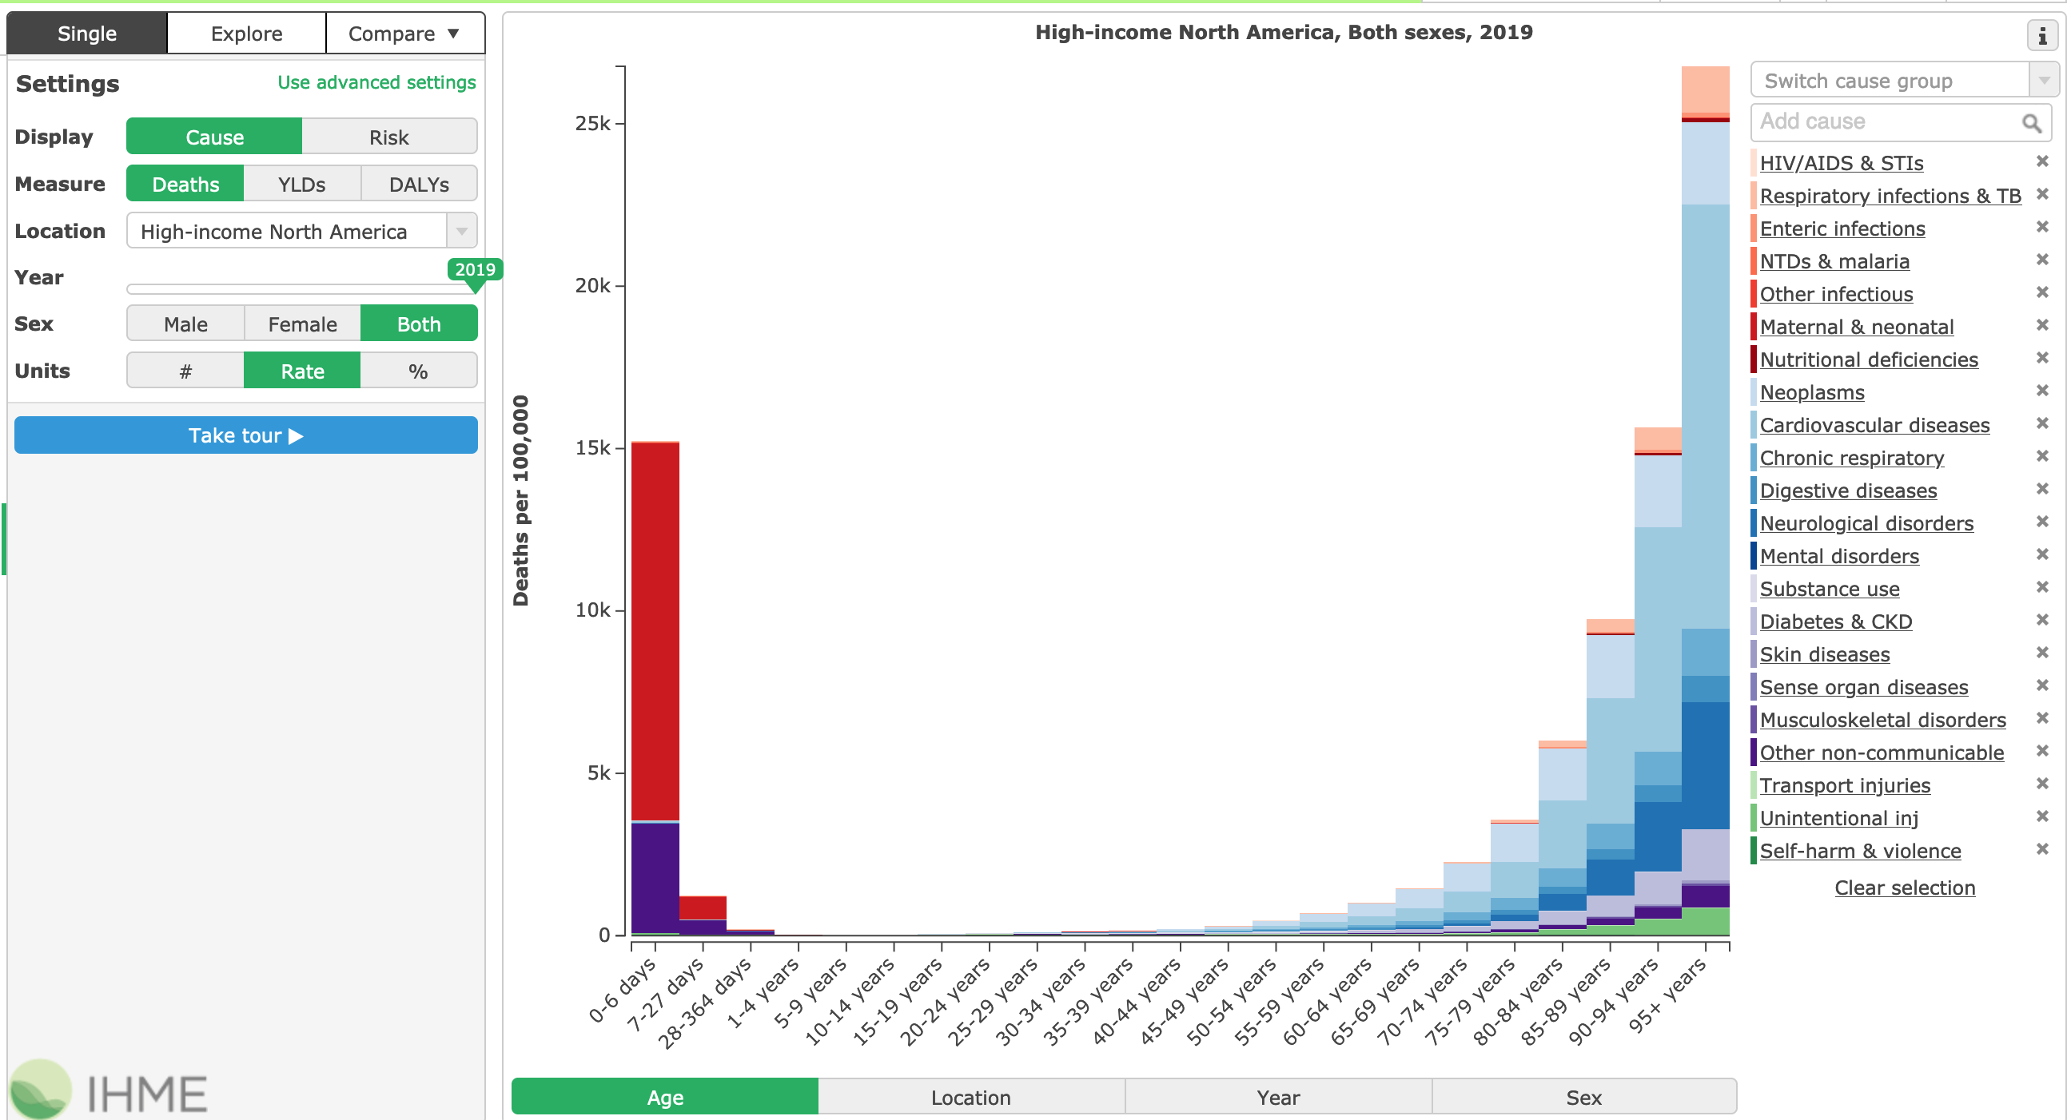
This graph shows the (browser) control panel
This graph goes out to age = 95
Note the colors for the categories --shades of red, blue, purple...

Slide 8
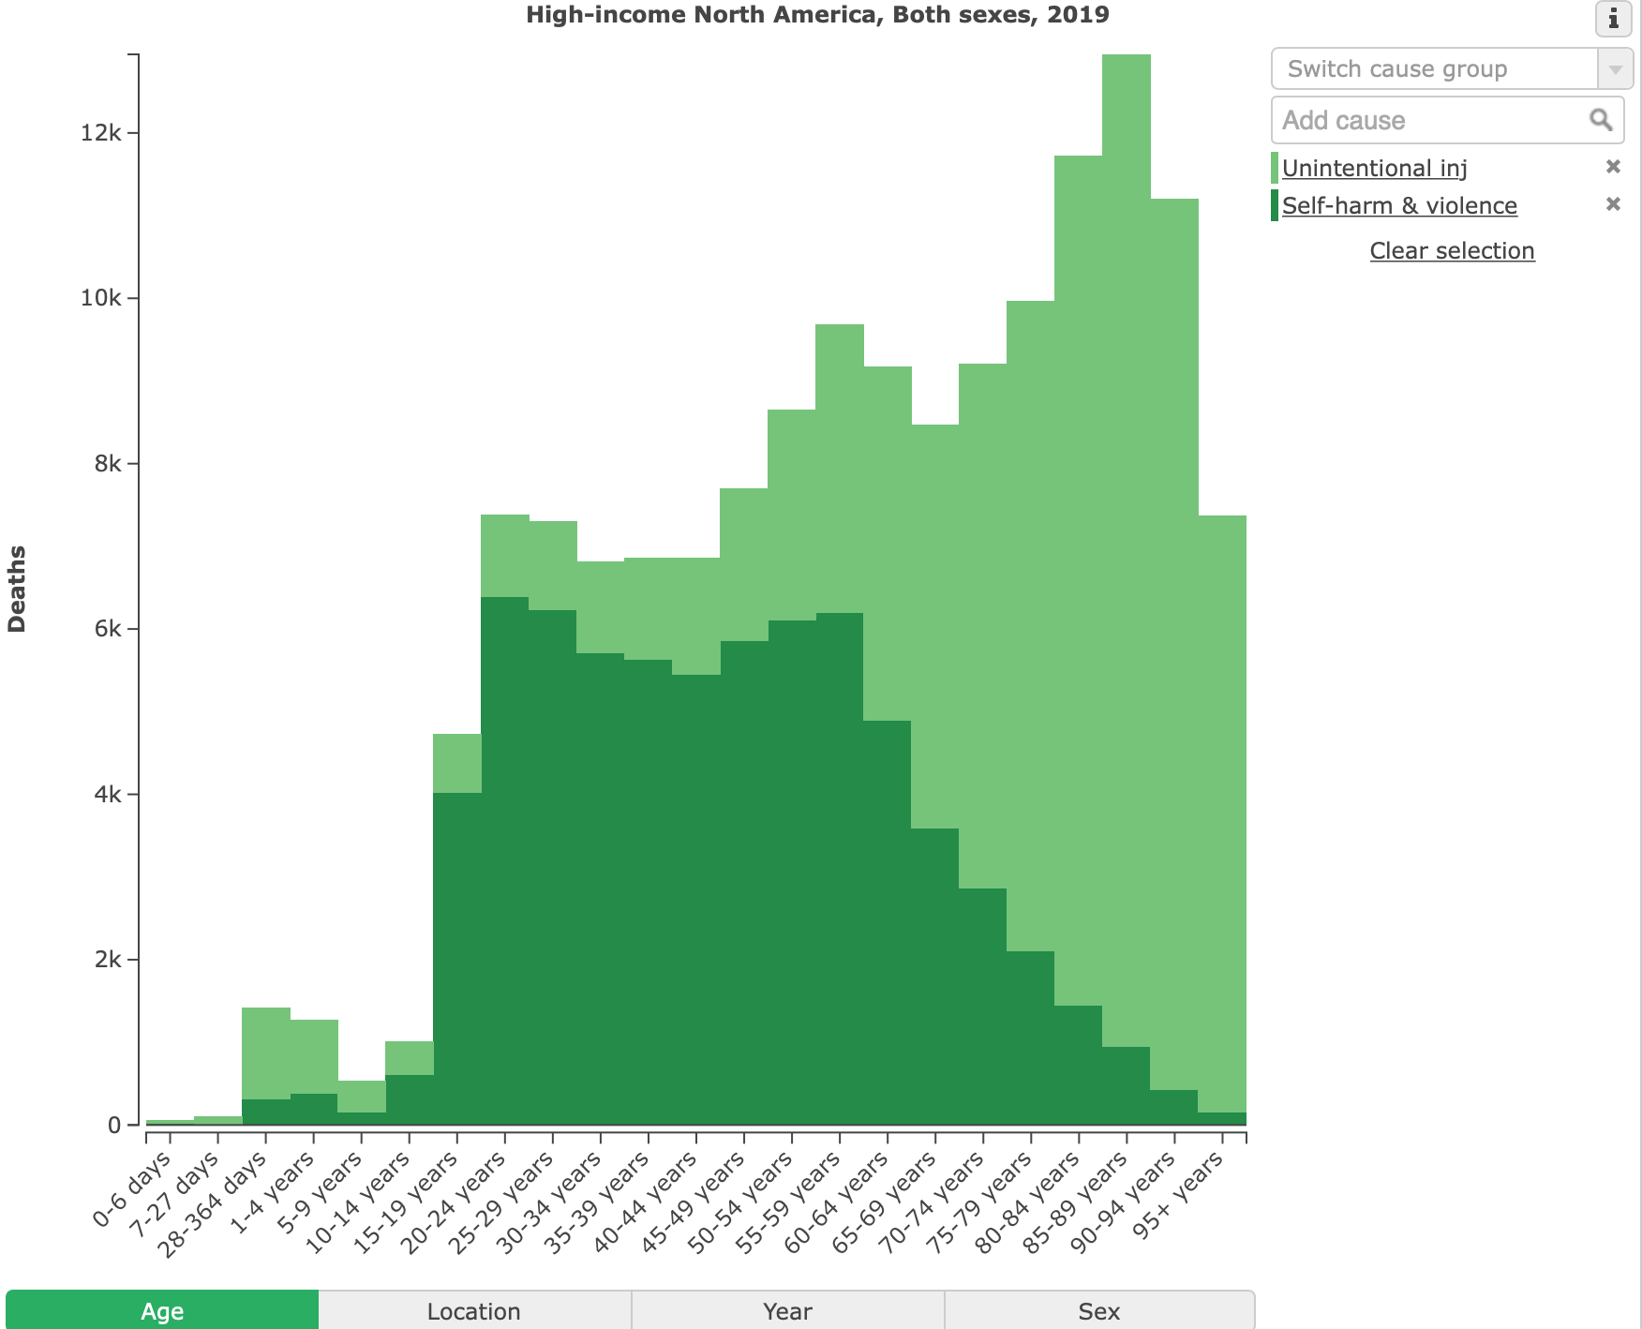
Units: #

Slide 9
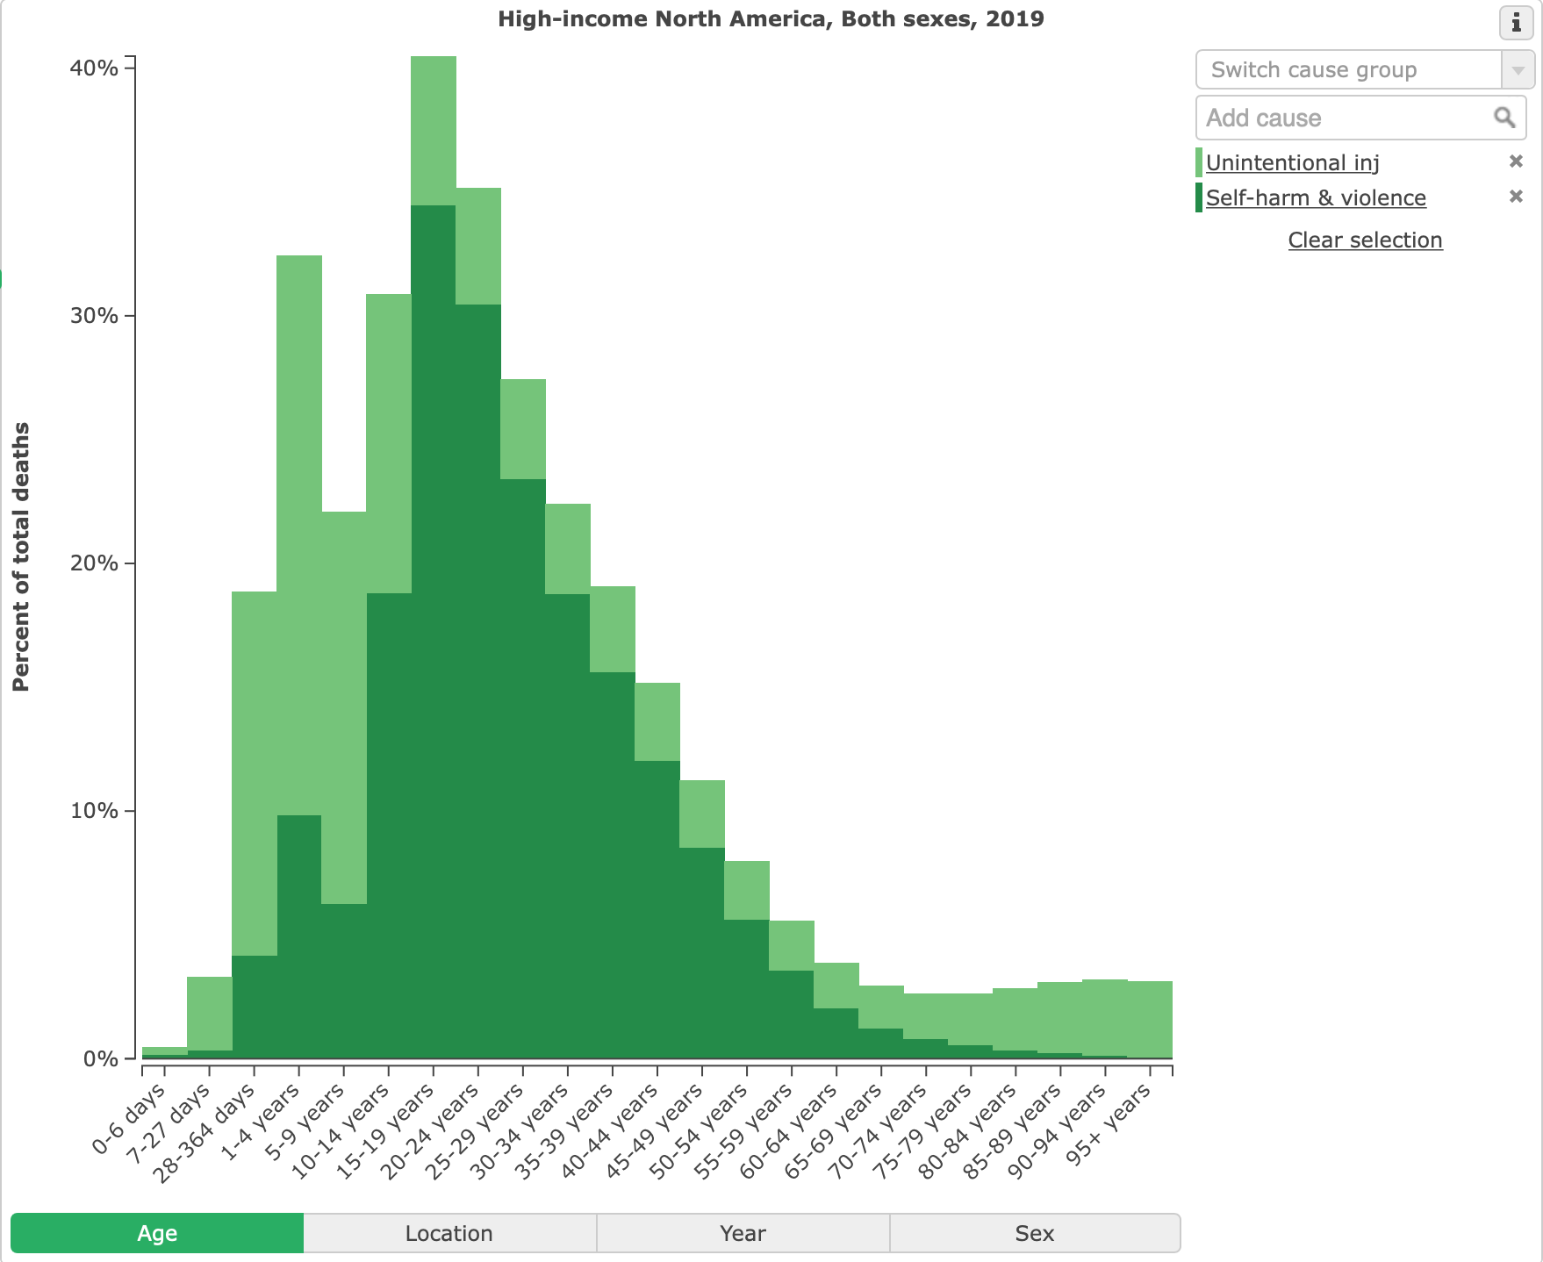
Units: %

Slide 10
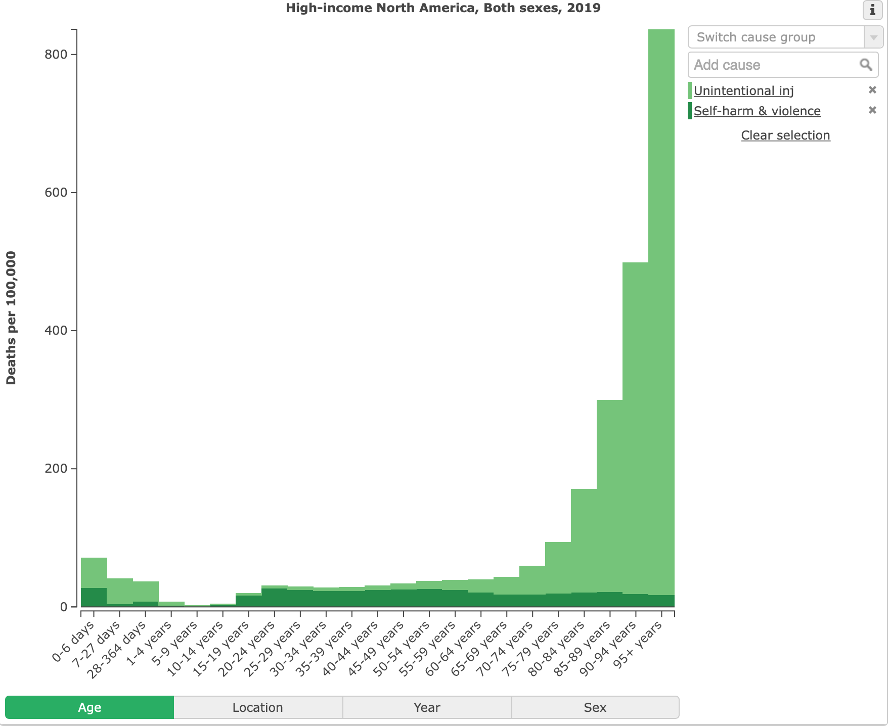
Units: per 100,000
We really do need different views of the data to understand it.

Slide 11
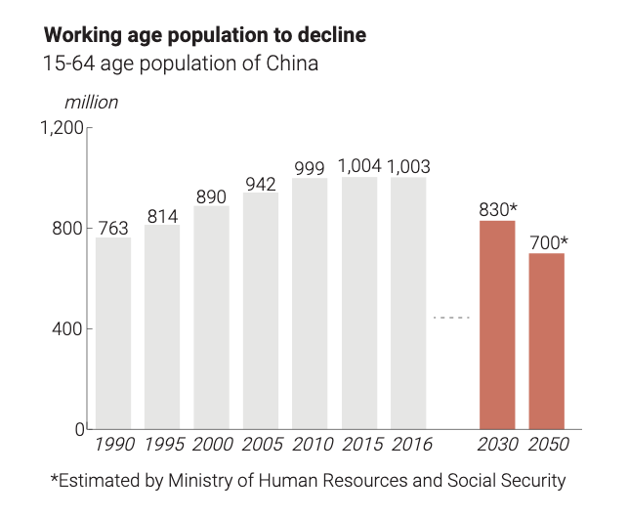
What's wrong here?
Why ‘Made in China 2025’ triggered the wrath of President Trump,
Alice Tse and Julianna Wu South China Morning Post 2018-09-11
https://multimedia.scmp.com/news/china/article/made-in-China-2025/index.html

Slide 12
What's wrong here?
Extremely irregular x-axis
Why ‘Made in China 2025’ triggered the wrath of President Trump,
Alice Tse and Julianna Wu South China Morning Post 2018-09-11
https://multimedia.scmp.com/news/china/article/made-in-China-2025/index.html

Slide 13
Activity: Representations
In one minute, how many ways you can write or draw
75 and 37

Slide 14
Activity: Representations
Written (Arabic, Roman, tally marks)
Length
Area
Arc, fraction
Counting objects

Slide 15
Activity: Representations
How can we generate more?
What strategies do we have to help generate new ideas?

Slide 16


Activity: Representations
Early exposure to examples
Rapid generation of low-value ideas (brainstorming)
Apply constraint (e.g. only use black-and-white; only use curved lines; only use vertical lines)

Slide 18
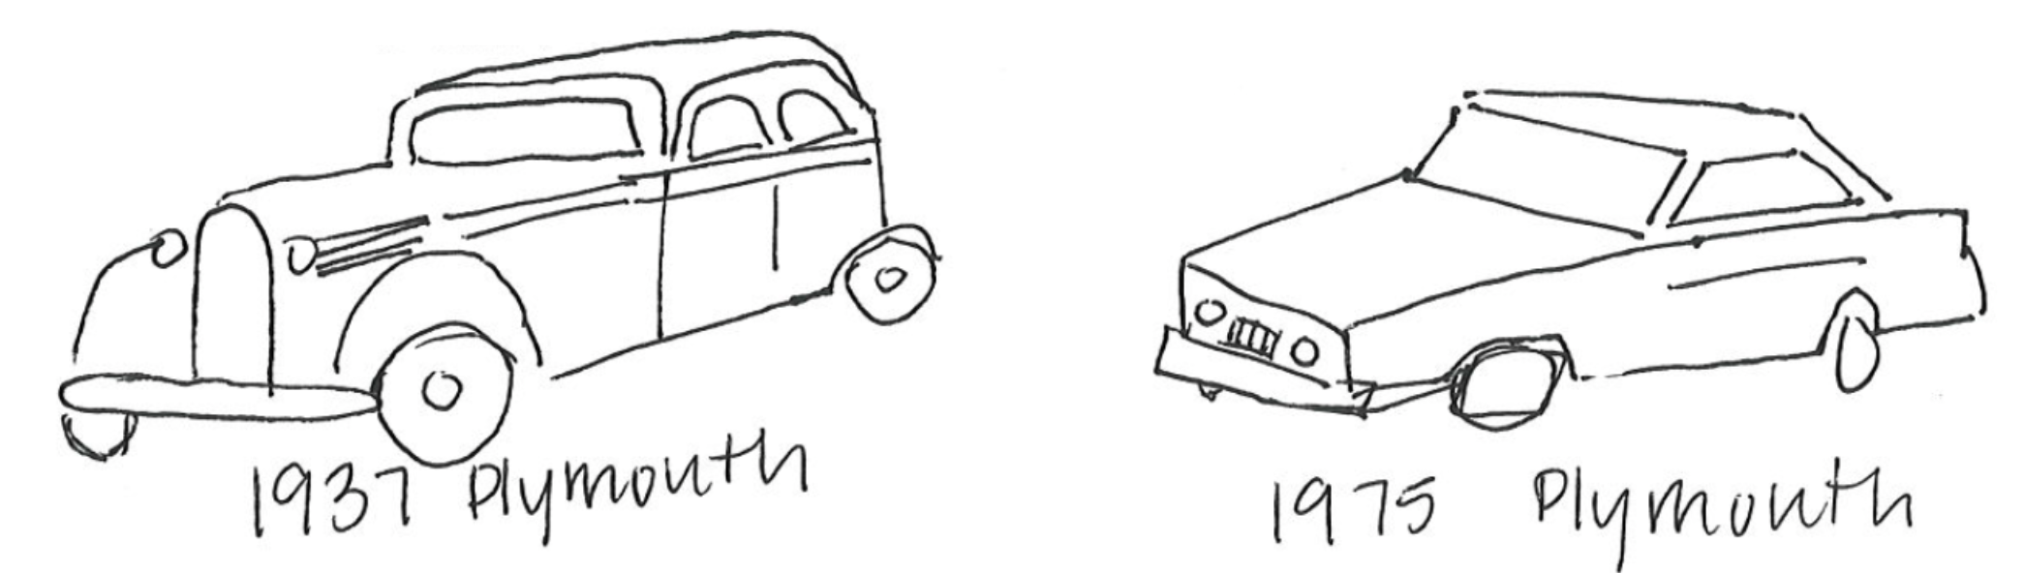
Time...
Image credit: Jon Schwabish.

Slide 19
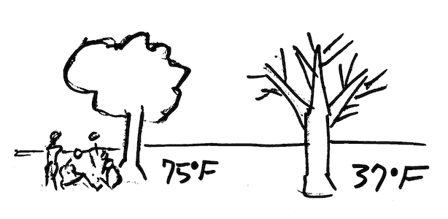
Temperature

Slide 20
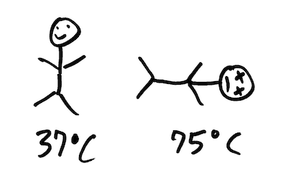
Temperature (civilized)

Slide 21

Arrow of time
37 75

Slide 22

37 75

Slide 23

Color?
https://rockcontent.com/blog/45-ways-to-communicate-two-quantities/
Santiago Ortiz
https://rockcontent.com/blog/45-ways-to-communicate-two-quantities/

Slide 24
Encoding
Data
Graphic
physical data types
(int, float, double, string)
conceptual data types
(date, temperature, price)
visual channels
(position, color, opacity)
visual marks
(line, point, rectangle, area)

Slide 25
Principles
“The expressiveness principle dictates that the visual encoding should express all of, and only, the information in the dataset attributes.”
Munzner, 2012

Slide 26
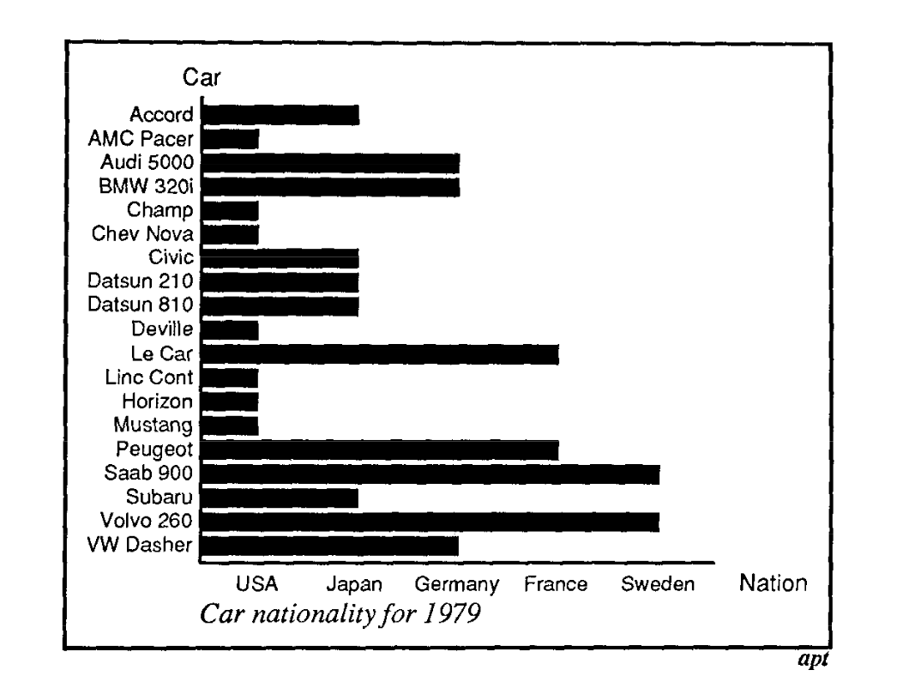
What's wrong here?
Mackinlay, 1986, Automating the Design of Graphical Presentations of Relational Information

Slide 27
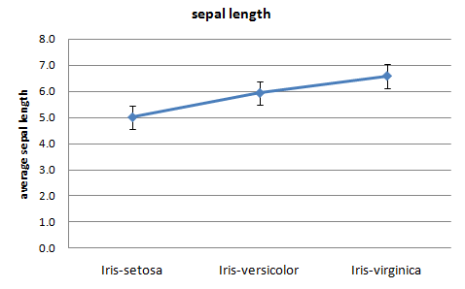
Don't do this!
Saed Sayad, https://www.saedsayad.com/categorical_numerical.htm

Slide 28
Principles
“The expressiveness principle dictates that the visual encoding should express all of, and only, the information in the dataset attributes.”
“The effectiveness principle dictates that the importance of the attribute should match the salience of the channel”
Munzner, 2012

Slide 29
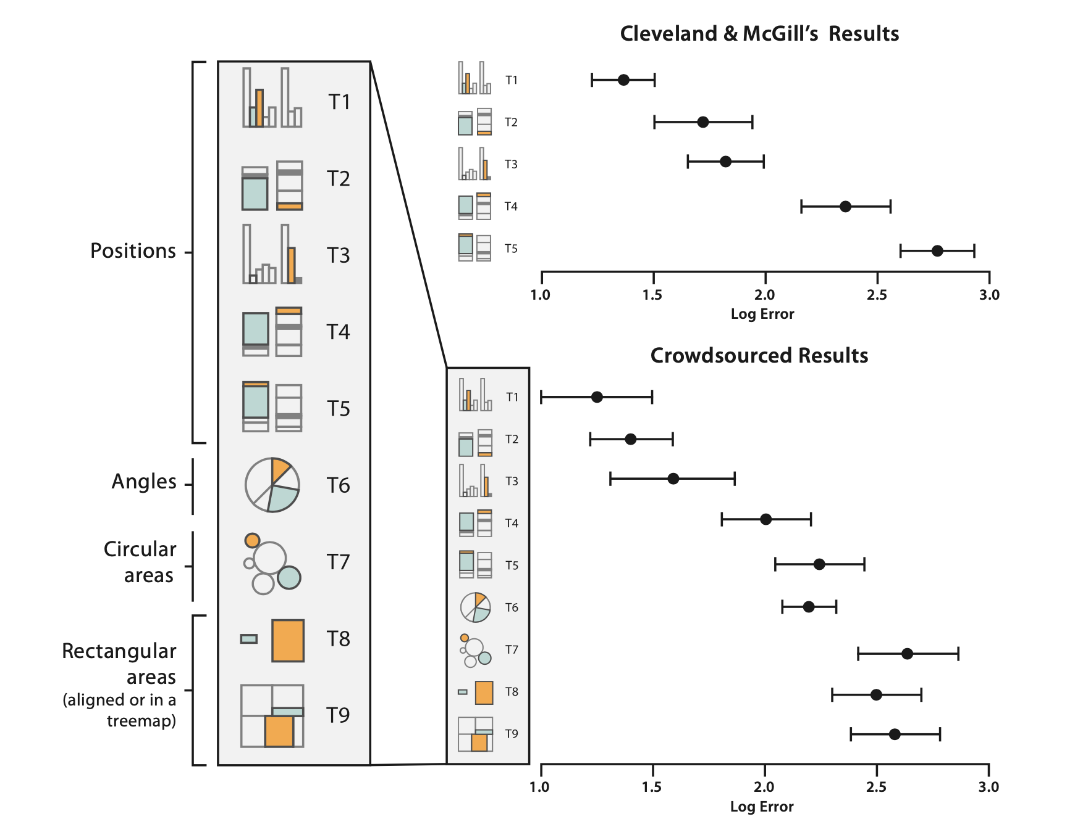
Encoding
Munzner, Visualization Analysis and Design, 2014, redrawn Heer and Bostock

Slide 30
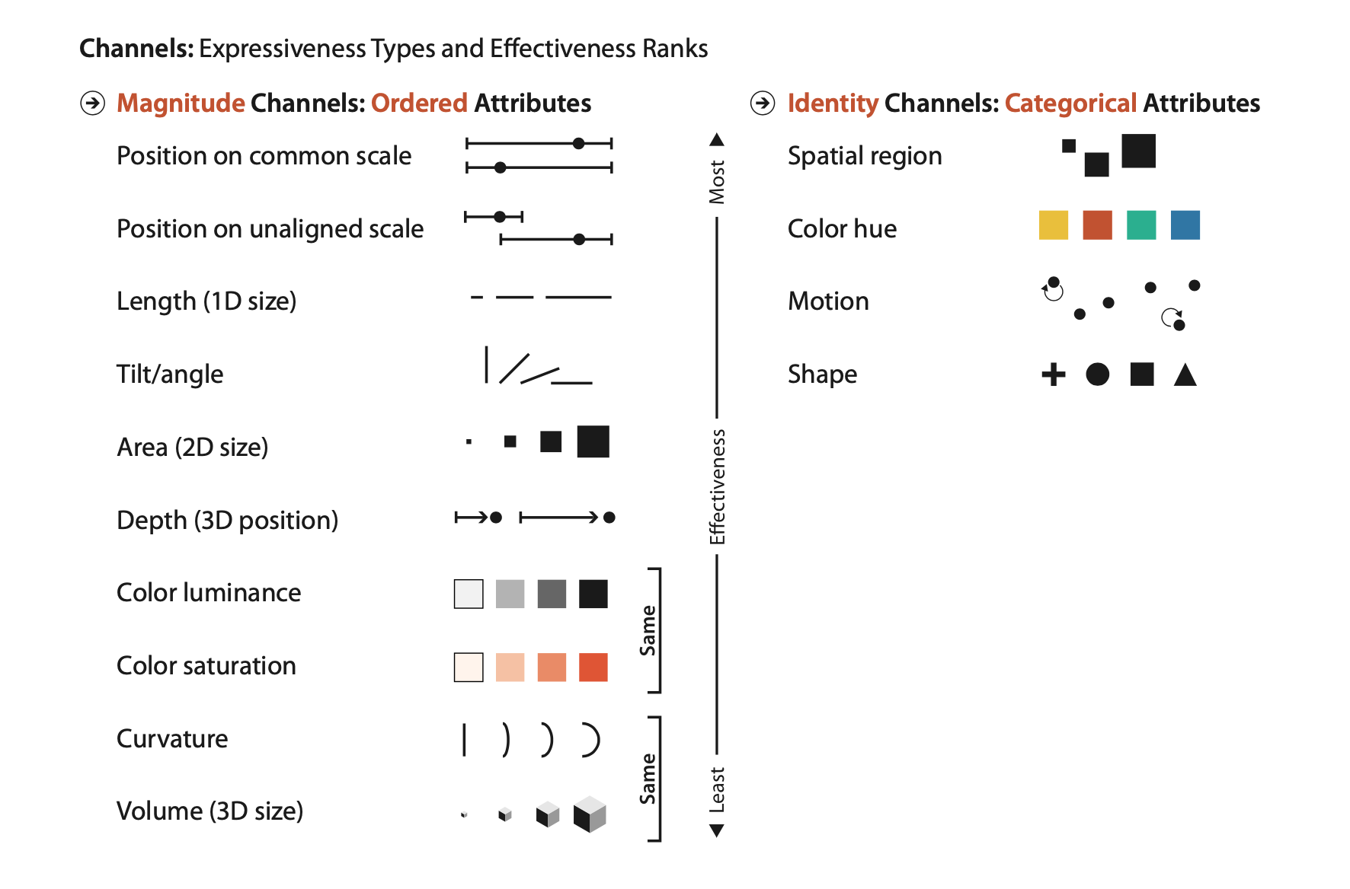
Encoding channels
Magnitude Channels: O and Q
Identity Channels : N
Graphical channel real estate is precious.
Munzner, Visualization Analysis and Design, 2014

Slide 31
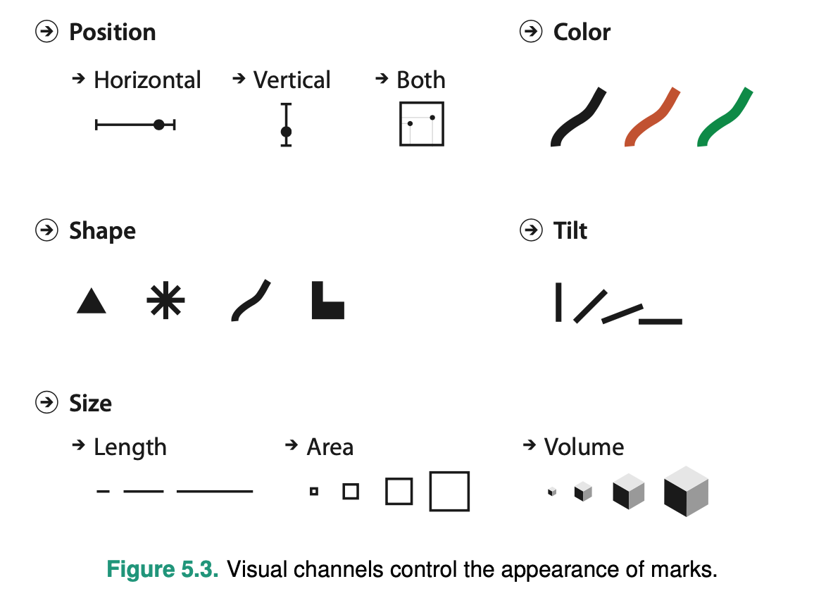
Encoding
A mark is a basic graphical element in an image.
A visual channel is a way to control the appearance of marks,

Slide 32
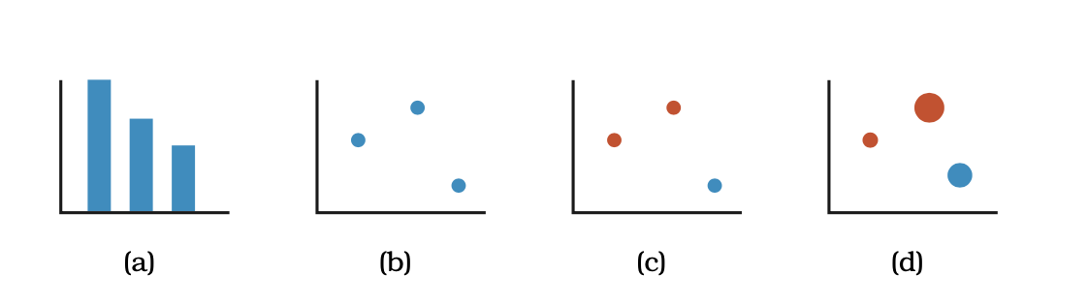
How many channels?

Slide 33
How many channels?
2
2
3
4
2

Slide 34
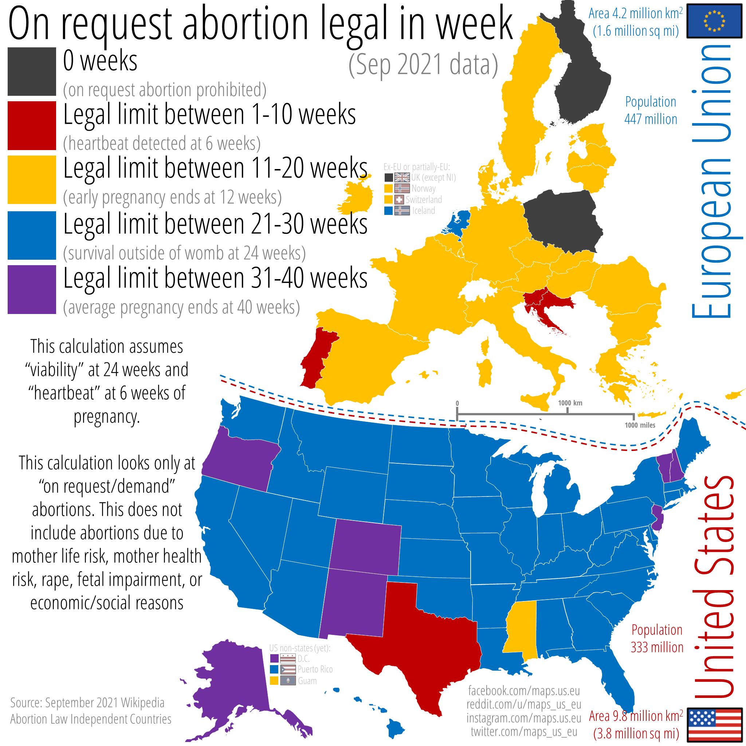

Slide 35
Where is Norway?
And the UK???

Slide 36
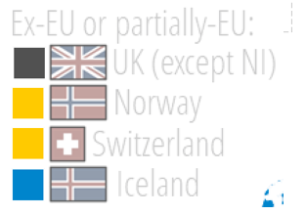
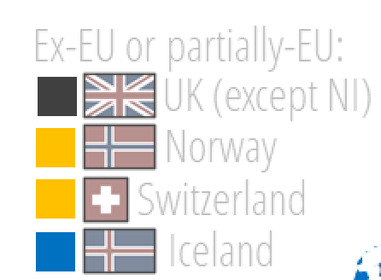

Slide 37
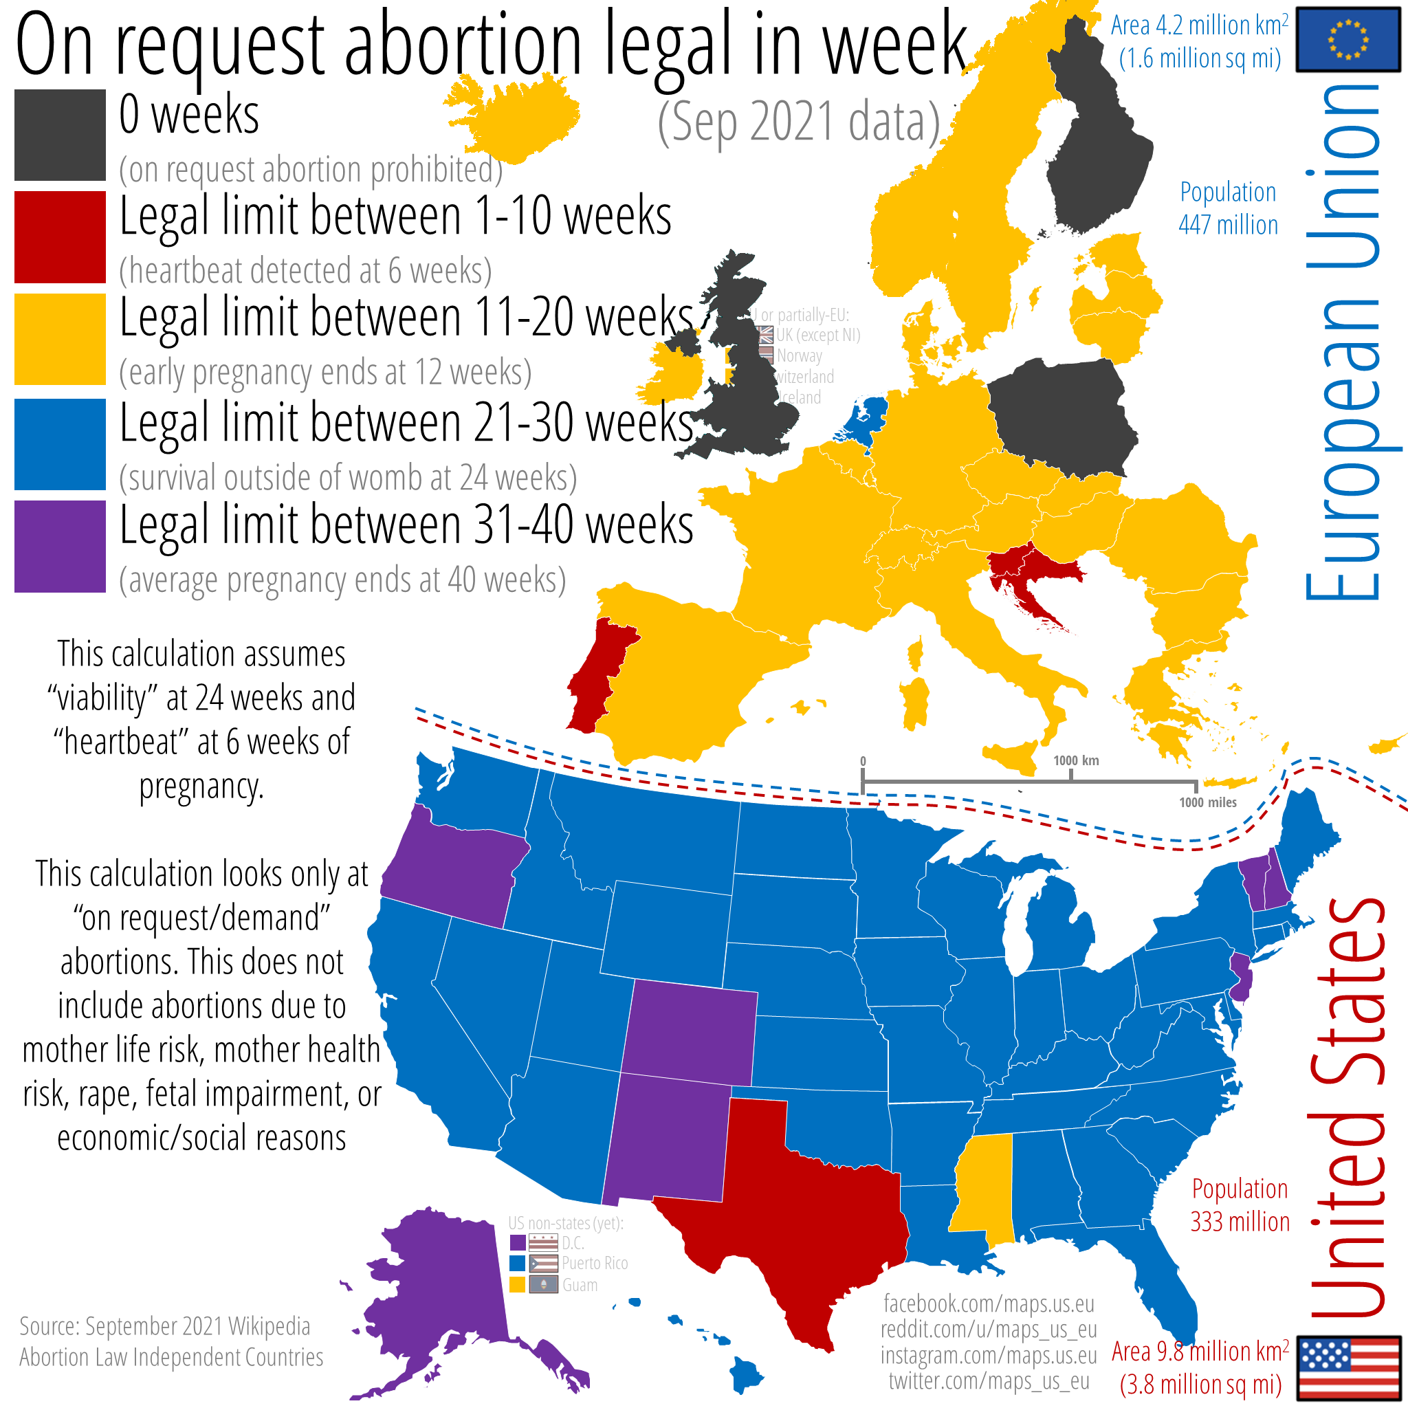

Slide 38
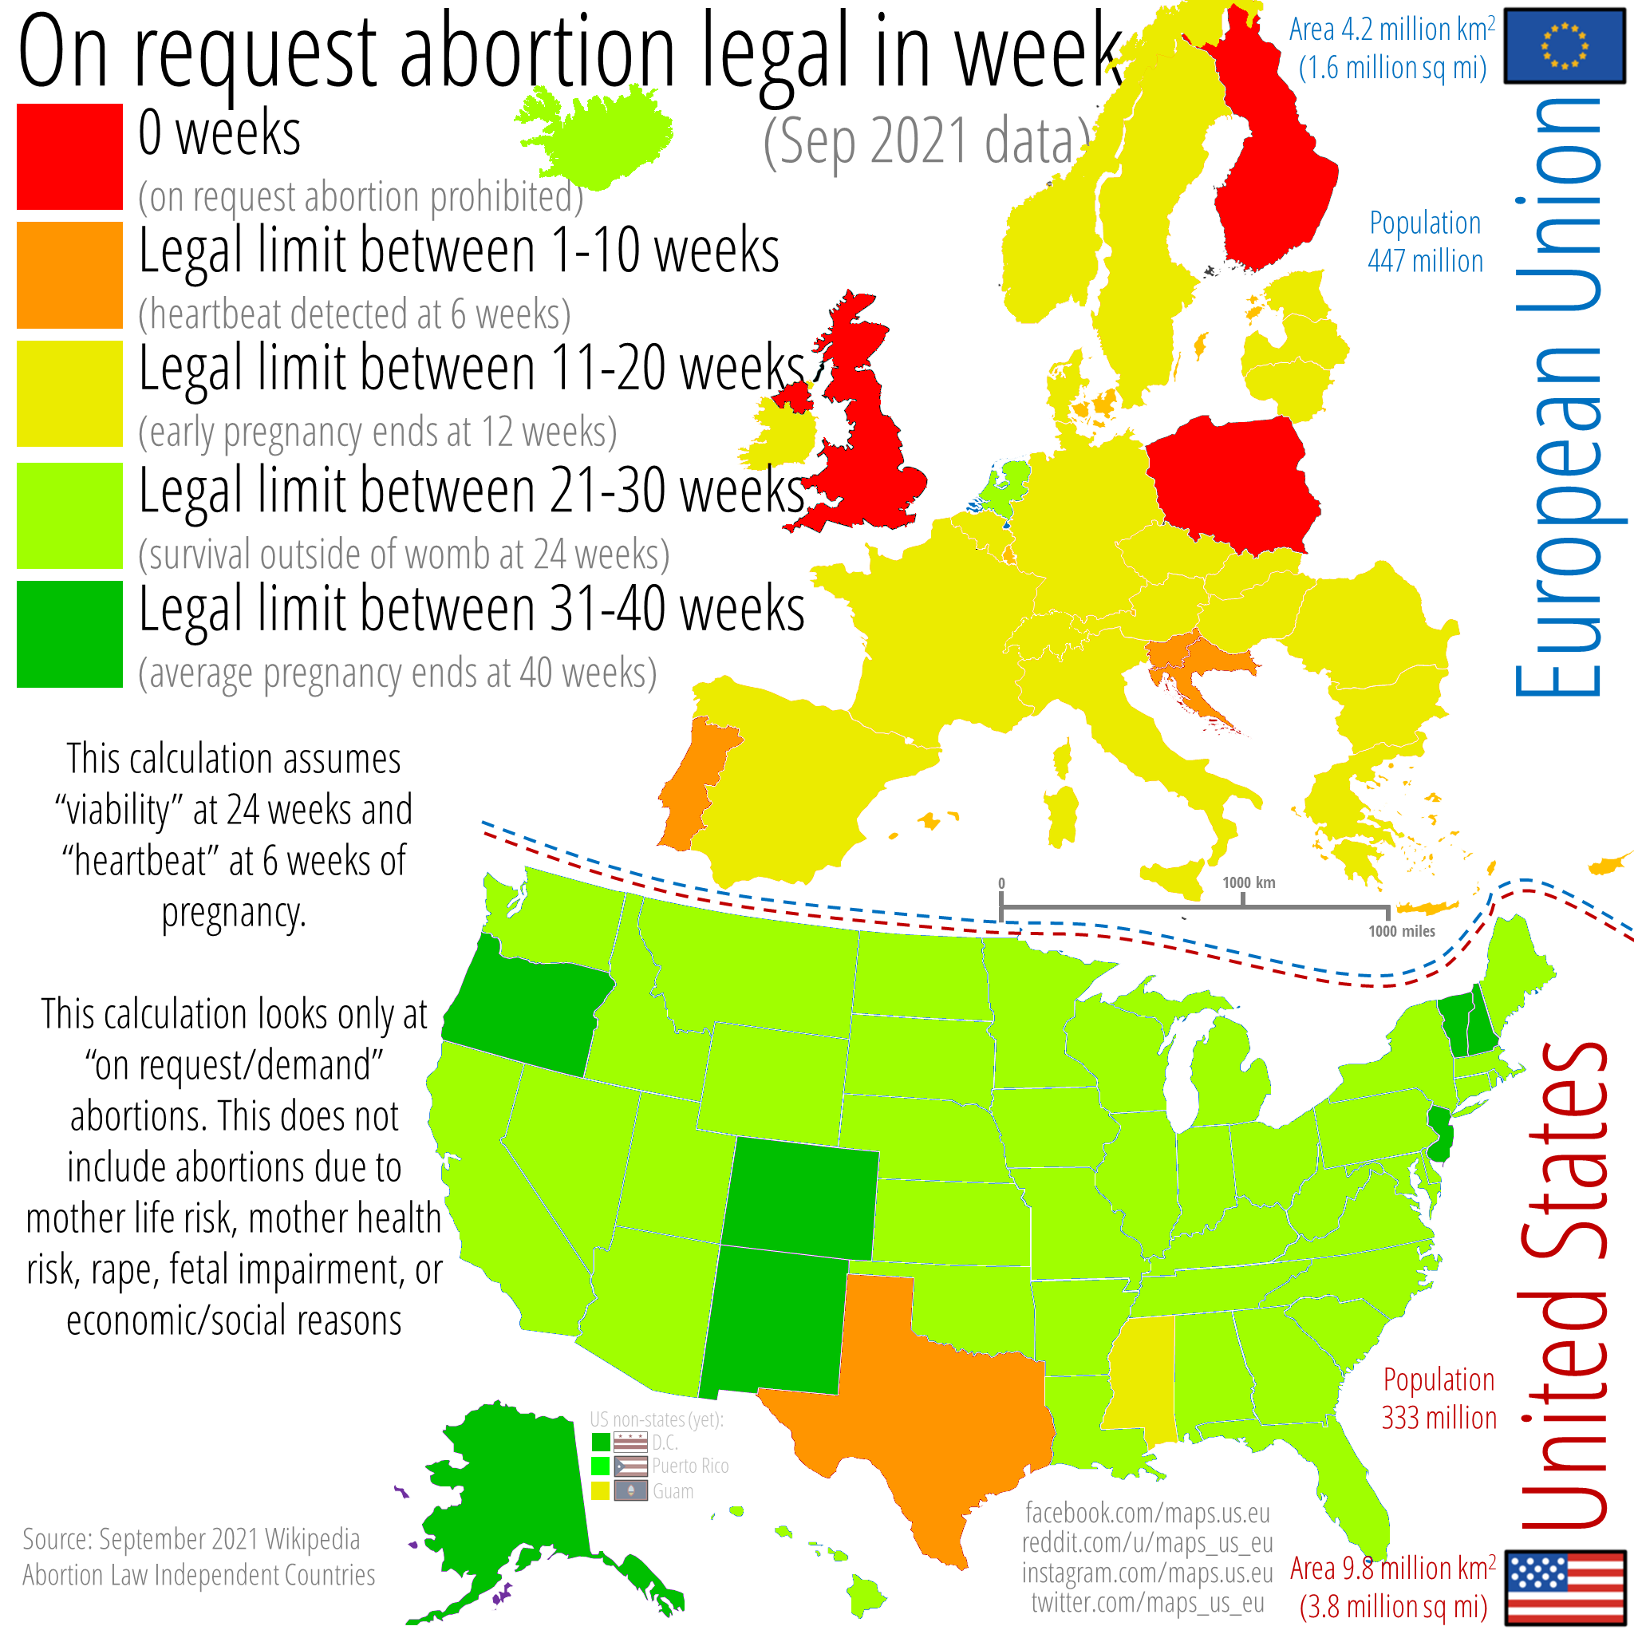

Slide 39
12
10
10
14
14
You can book an appointment with a gynecologist in PT, but not in TX.
Why 1-10 week boundaries?
6

Slide 40
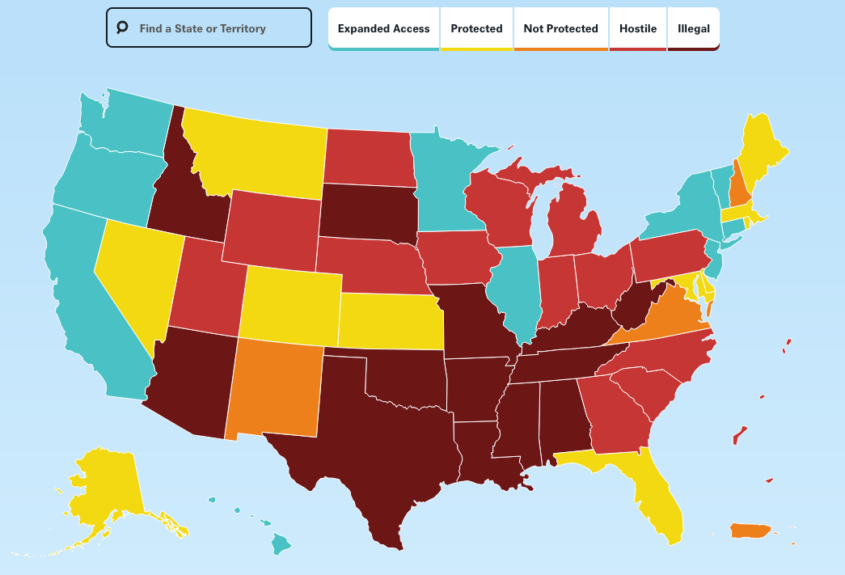
no byline, "After Roe Fell: Abortion Laws by State" Center for Reproductive Rights 2022 https://reproductiverights.org/maps/abortion-laws-by-state/

Slide 41
What did we see?
There were choices of how to present geography
Former EU / Schengen Area countries had data, but were in greyed-out text, not country outlines! (Don't do this to your audience, please)
Scale was ordinal, but color mapping black-red-yellow-blue-purple was hard to understand
Boundaries at 0, 1-10, 11-20, 21-30 are not without consequences: 6 is more like 0 than 10.
Maaybe making Texas stand out in red was purposeful.

Slide 42
...and on to hacking
Notebook on importing census data into pandas, making rudimentary bar graphs with matplotlib.
altair_introduction.ipynb
Population estimates with single-birth-year resolution:
https://www.census.gov/data/tables/time-series/demo/popest/pre-1980-national.html
https://www.census.gov/dataviz/visualizations/055/

Slide 43
Toy categorical data
Days City Inches Mm
113 Atlanta, Georgia 49.7 1263
88 Austin, Texas 34.2 870
116 Baltimore, Maryland 41.9 1064
117 Birmingham, Alabama 53.7 1364
126 Boston, Massachusetts 43.8 1112
167 Buffalo, New York 40.5 1028
110 Charlotte, North Carolina 41.6 1057
124 Chicago, Illinois 36.9 937
137 Cincinnati, Ohio 41.9 1065
155 Cleveland, Ohio 39.1 994
139 Columbus, Ohio 39.3 998
81 Dallas, Texas 37.6 954
87 Denver, Colorado 15.6 396
135 Detroit, Michigan 33.5 850
130 Hartford, Connecticut 45.9 1165
104 Houston, Texas 49.8 1264
129 Indianapolis, Indiana 42.4 1078

Slide 44
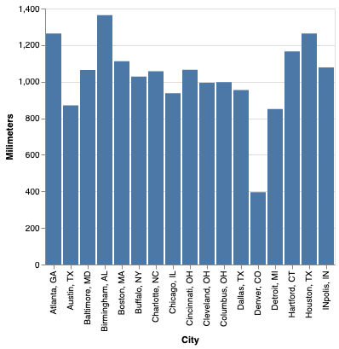
Toy data, bar charts
Nominal (city name) => x
Quantitative (Annual precipitation) => y
Mark: bar

Slide 45
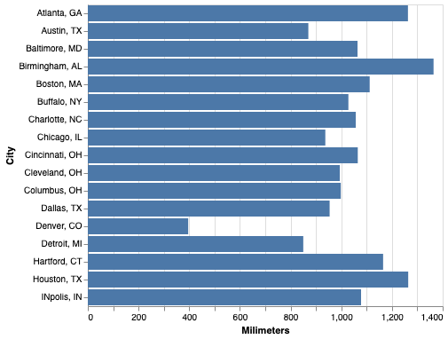
Toy data, bar charts
Mark: bar
Nominal (city name) => x
Quantitative (Annual precipitation) => y
Nominal (city name) => y
Quantitative (Annual precipitation) => x

Slide 46
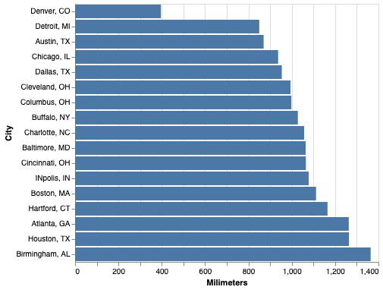
Toy data, bar charts
Nominal (city name) => y
Quantitative (Annual precipitation) => x
Mark: bar

Slide 47
Toy data, bar charts
Nominal (city name) => x
Quantitative (Annual precipitation) => y
Mark: bar

Slide 48
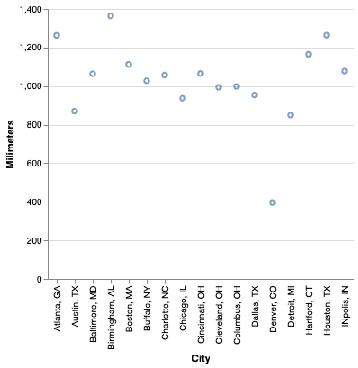
Mark types
Nominal (city name) => x
Quantitative (Annual precipitation) => y
Mark: bar
Mark: point

Slide 49
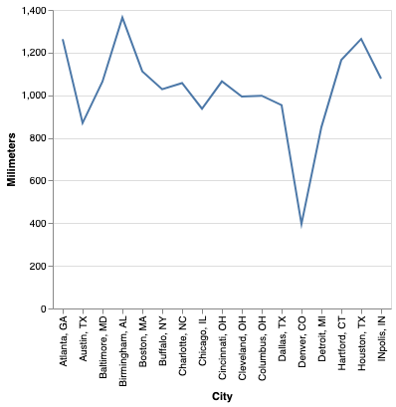
Mark types
Nominal (city name) => x
Quantitative (Annual precipitation) => y
Mark: bar
Mark: point
Mark: line

Slide 50
Mark types
Nominal (city name) => x
Quantitative (Annual precipitation) => y
Mark: bar
Mark: point
Mark: line

Slide 51
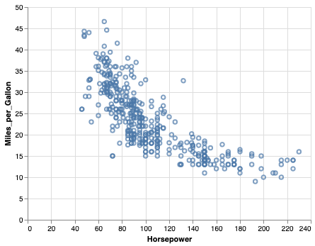
Scatterplot
Quantitative (Horsepower) => x
Quantitative (Miles_per_Gallon) => y

Slide 52
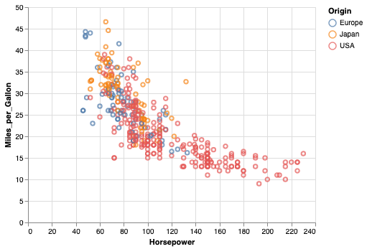
Scatterplot with nominal color
Nominal (city name) => x
Quantitative (Annual precipitation) => y
Nominal (Origin) => color

