Slide 1

Data 227
Data Visualization & Communication

Slide 2
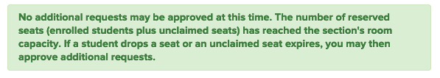

Slide 3
Week 3 readings
D3: Data-Driven Documents. Michael Bostock, Vadim Ogievetsky & Jeffrey Heer. InfoVis 2011.
Chapter 3: Sources of Graphical Integrity, In The Visual Display of Quantitative Information. Tufte. (easy)

Slide 4

Logarithmic scales: why?
Compress wide range of values onto one graph [Dynamic Range: the ratio of the largest to the smallest values a tool of yours can handle]
Convention (Earthquake, RF signal power, sound level, information theory)
When net effect is the result of small multiplicative effects (microbiology, finance) = sum of log-effects
Diligence: Log scales should usually be marked with the numbers, not their logarithms. Otherwise, base of logarithm must be specified (2, e, 10, and are common, field-specific choices)

Slide 5
The big picture
task
  find outliers, diagnose model fit, make decision
data
  physical type (int, float...)
  abstract type (nominal, ordinal, geographic, temporal...)
domain
  metadata
  semantics
  conceptual model
mapping
  visual encoding
  visual metaphor
image
  visual channels

Slide 6
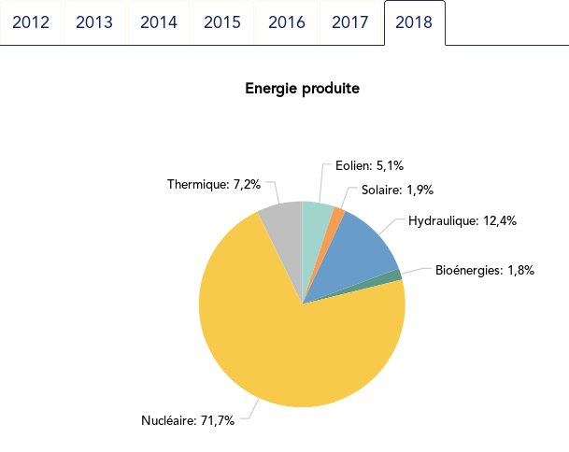
https://pierreh.eu/pie-vs-dots-powersystem/

Slide 7
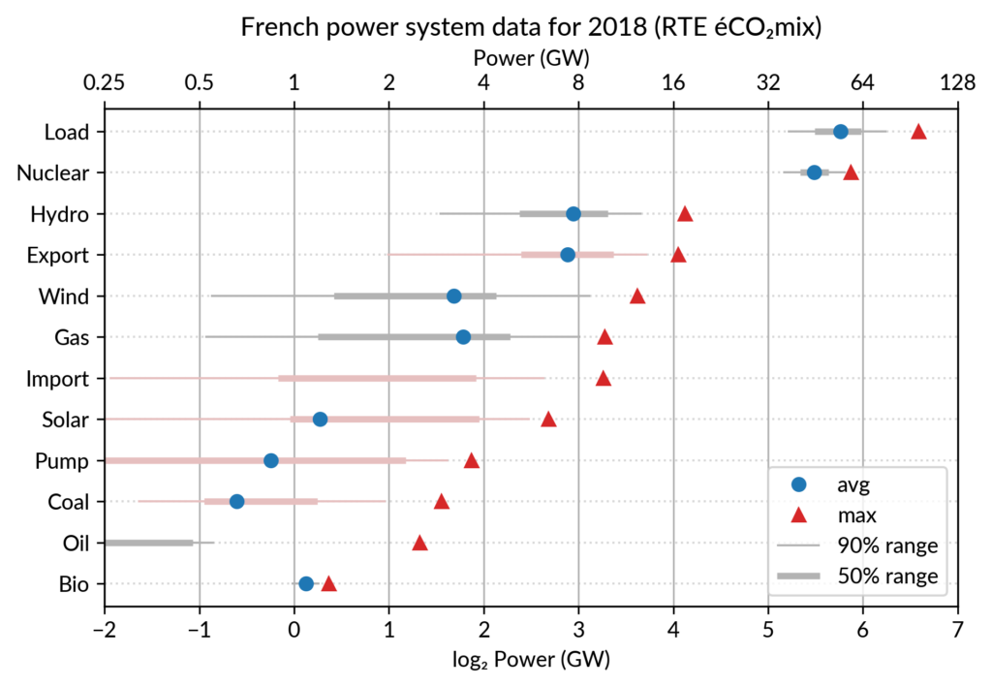
https://pierreh.eu/pie-vs-dots-powersystem/

Slide 8
But this visualization obscures the fact that the largest component is 71% of the total
https://pierreh.eu/pie-vs-dots-powersystem/

Slide 9
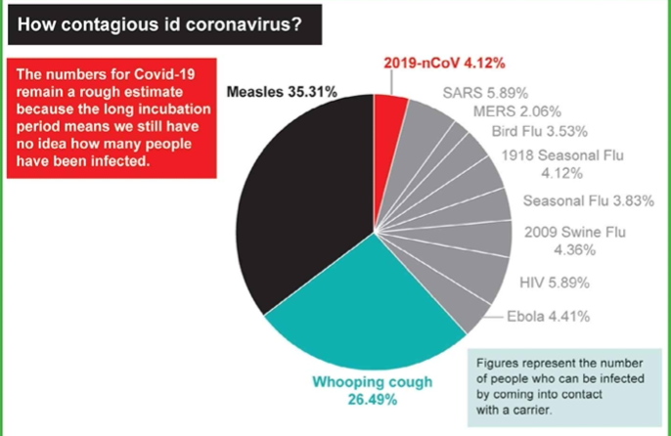
The Bad
Jonathan Schwabish, redrawn from The Australian March 2020

Slide 10
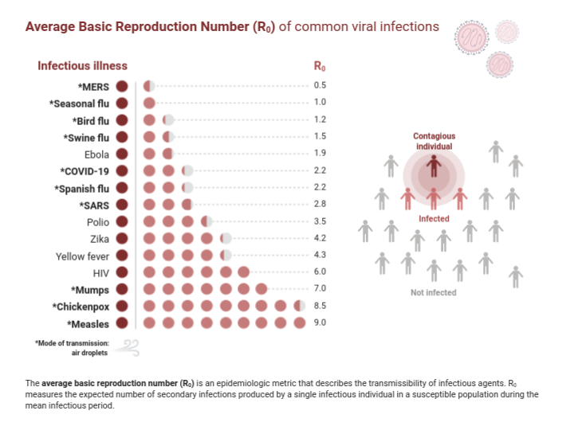
BioRender (2021). Average Basic Reproduction Number (R0) of Common Viral Infections. Retrieved from https://app.biorender.com/biorender-templates/t-5e820384a3f45b00ae3fd002-average-basic-reproduction-number-r0-of-common-viral-infecti

Slide 11
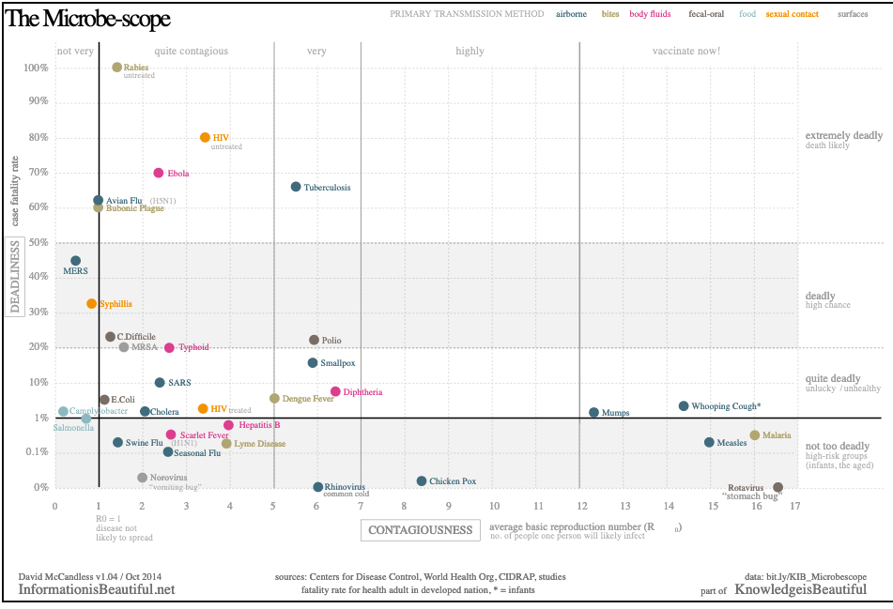
https://www.informationisbeautiful.net/visualizations/the-microbescope-infectious-diseases-in-context/

Slide 12
This is lovely! Descriptive labels on the right.
Unusual but effective mixture of logarithmic and linear scale for y.
This is actually interactive on the website.
https://www.informationisbeautiful.net/visualizations/the-microbescope-infectious-diseases-in-context/

Slide 13
Steven Few, Show me the Data

Slide 14
Playfair
Bretin
Tufte
Cleveland
Munzner
Playfair
Descartes
ISU
Tukey
Apple
Computer
Steven Few, Show me the Data

Slide 15

From a political/policy perspective, this is a pretty good nuts-and-bolts book on making pretty good graphs.

Slide 16
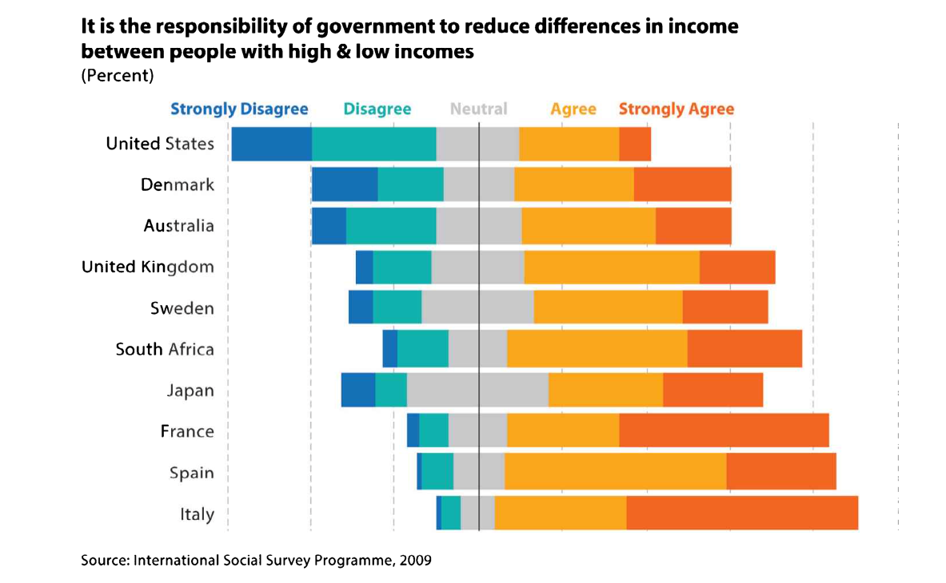
Likert scale -- diverging bar chart
Jonathan Schwabish, Better Data Visualizations

Slide 17
Likert scale -- diverging bar chart
Jonathan Schwabish, Better Data Visualizations

Slide 18
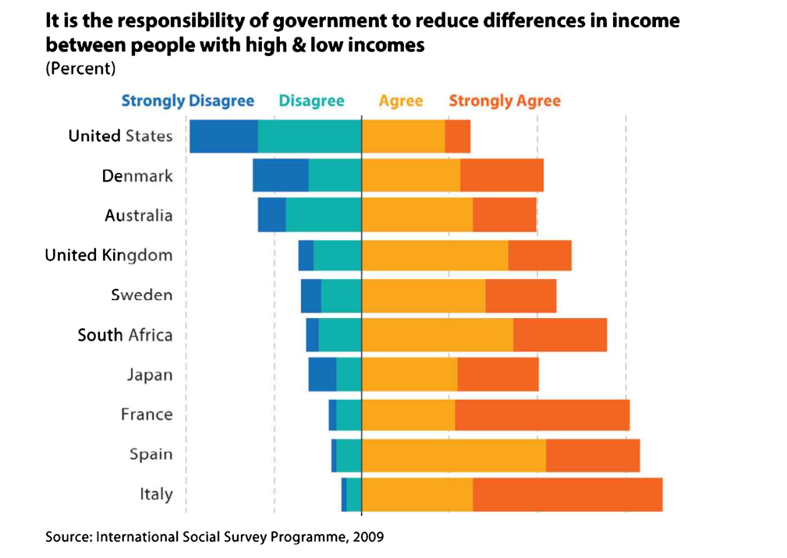
Likert scale -- diverging bar chart
Neutral has not been plotted.
Jonathan Schwabish, Better Data Visualizations

Slide 19
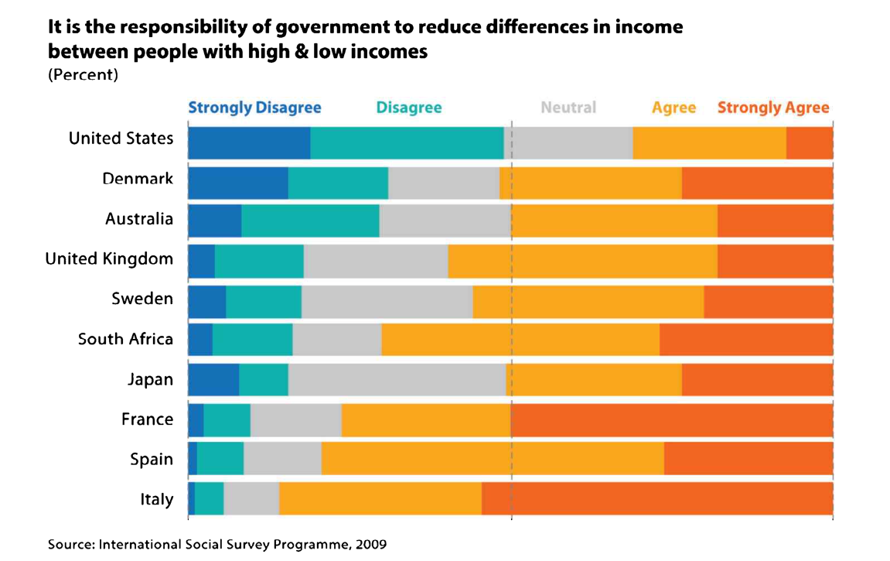
Likert scale -- stacked bar
Jonathan Schwabish, Better Data Visualizations

Slide 20
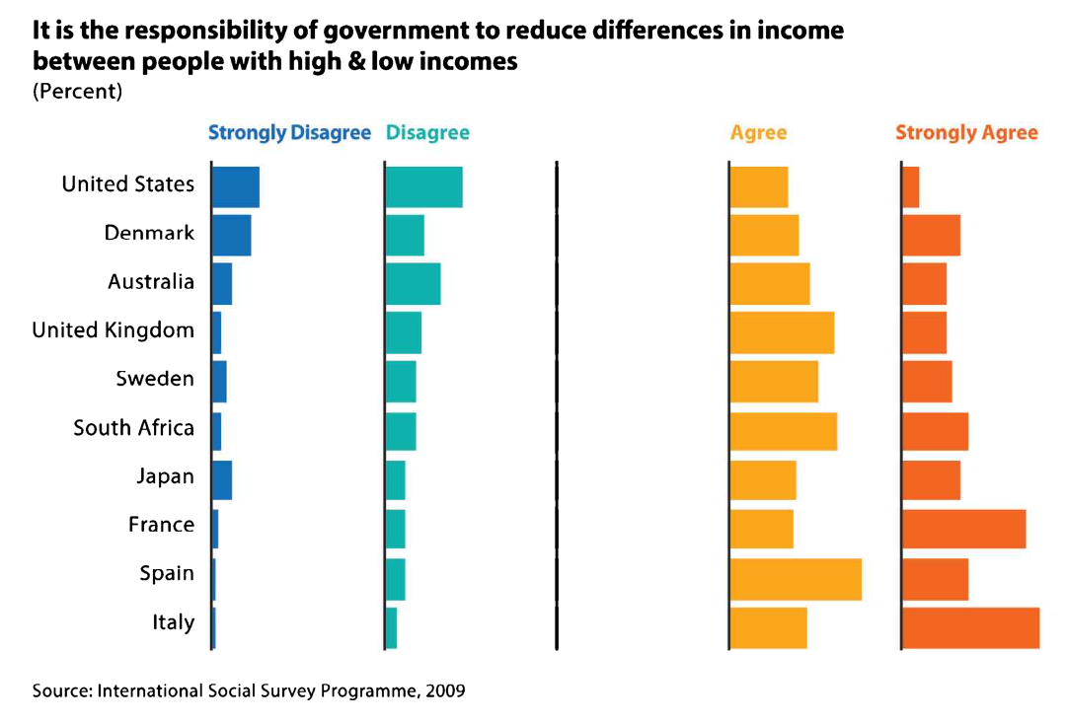
Likert scale - small multiples
Jonathan Schwabish, Better Data Visualizations

Slide 21
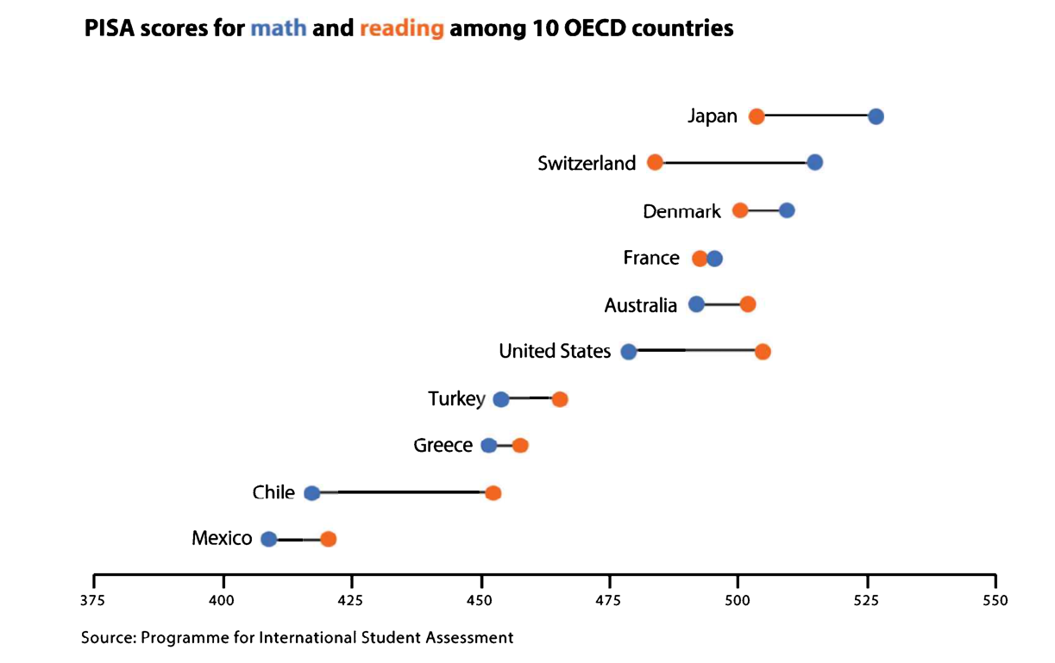
“Dot plot”

Slide 22
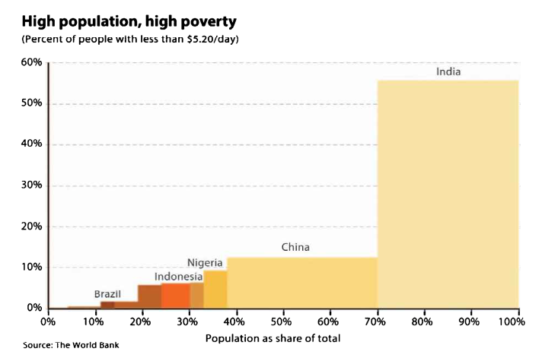
Marimekko graphs:
Bar Charts with more variables

Slide 23
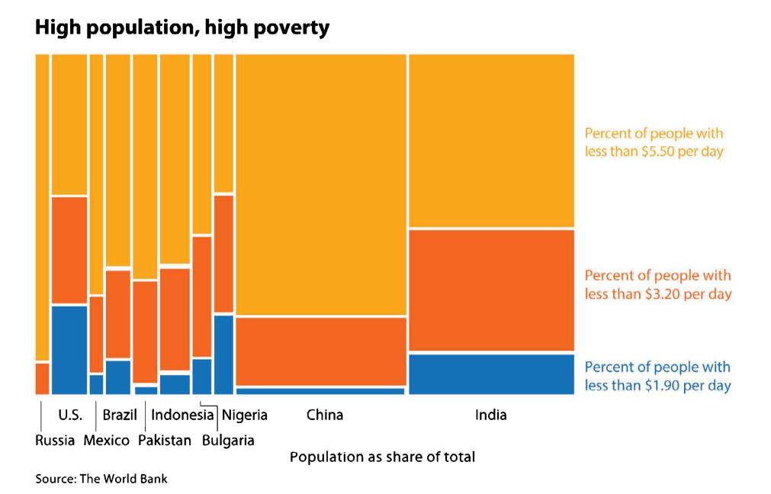
Marimekko graphs

Slide 24
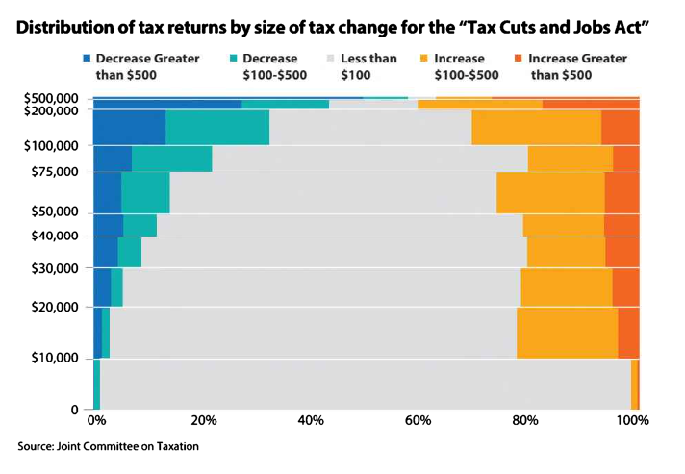
Marimekko graphs

Slide 25
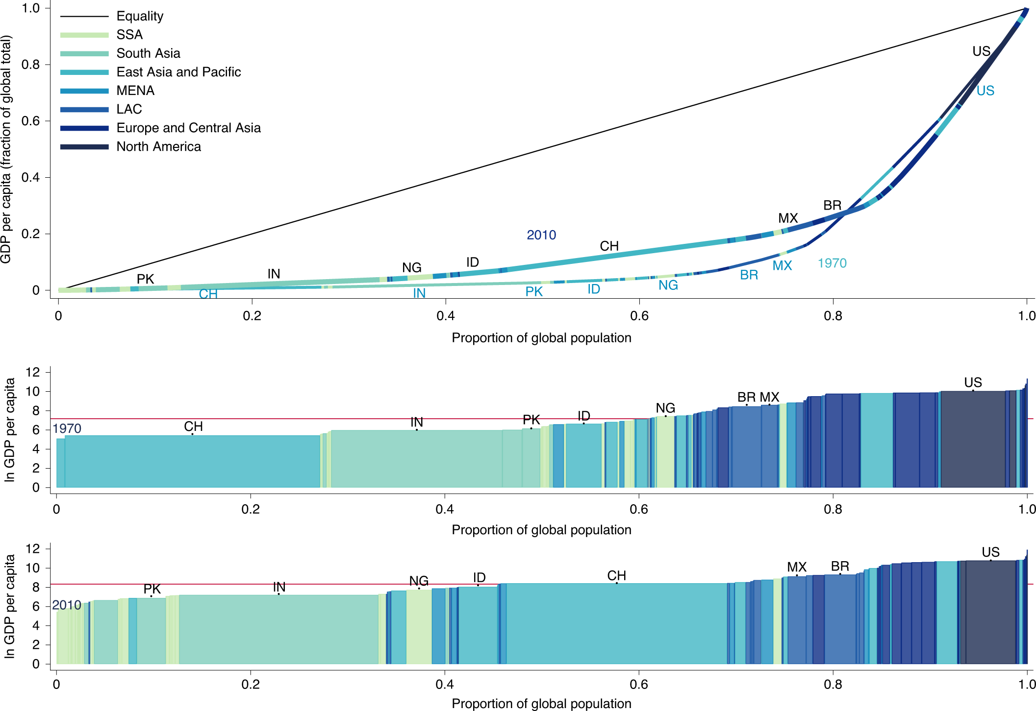
Bell, W., Lividini, K. & Masters, W.A. Global dietary convergence from 1970 to 2010 altered inequality in agriculture, nutrition and health. Nat Food 2, 156–165 (2021). doi: 10.1038/s43016-021-00241-9

Slide 26
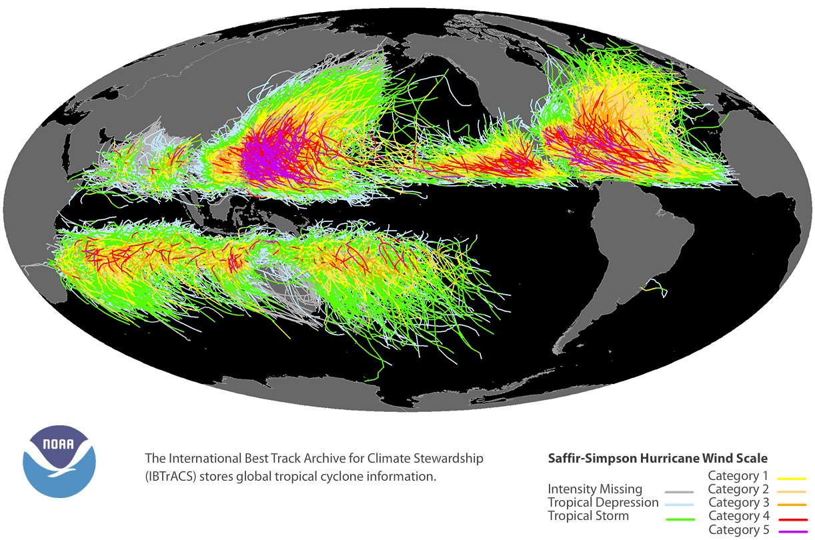

Slide 27
HW2: Hurricanes and lake temperature
Read the wikipedia page on tropical cylcones, ok?
You can just make a scatterplot for problem 1 BUT
  Map-like scatterplots can't be dramatically different from 1:1 scale. Do not make a square plot that covers 1 degree of latitude and 16 degrees of longitude.
  If you don't use a map projection, you need to label latitude and longitude
  If you use size-of-symbol to indicate diameter of sustained winds, you should make the diameter match the scale of the map.

Slide 28
HW2: Hurricanes and lake temperature
Play with the data, find something, and show it.
What can you do with weather data?
  When might one swim in the lake without pain?
  When does the lake produce heavy fog?
  Why does the water temperature sometimes drop suddenly in the summer?
  How long does it take the lake to heat up ? How much later does it heat up compared to the air?
  Why did my son get sunburn in October?

Slide 29
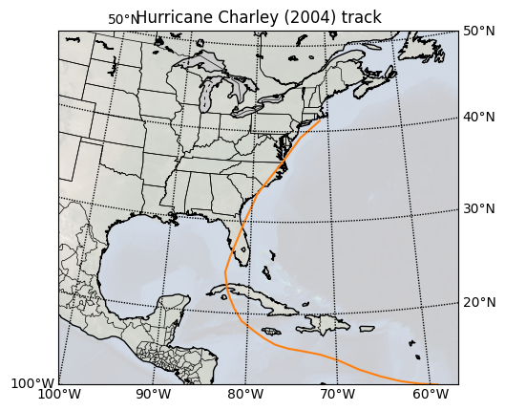
Back to the matrix
04-SALARY-OPEN.ipynb Loads in the Chicago salary database, makes a histogram with matplotlib, and makes a somewhat nicer-looking histogram with altair
altair_data_transformation.ipynb: math, log transforms, binning and aggregation in altair
Charley_track.ipynb Draws a map:

