Slide 1
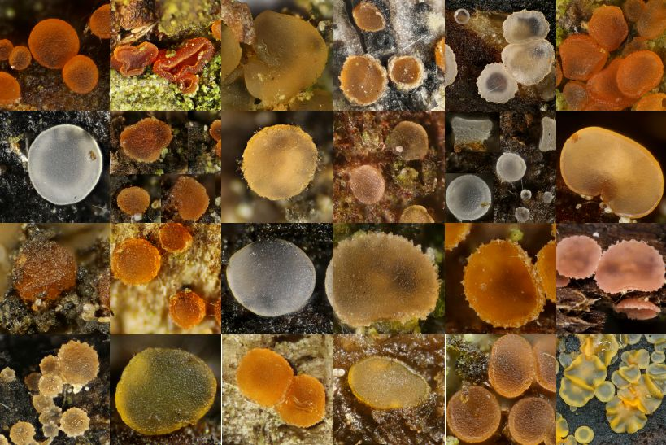
Data 227
Data Visualization & Communication
Autumn 2023

Slide 2

Data 227
Data Visualization & Communication
Autumn 2023
Just kidding.

Slide 3
Greetings
2023-09-26 Tuesday class
I am Will Trimble
  educated at University of Chicago and University of Washington (go Huskies)
You are ?

Slide 4
Greetings
I am Will Trimble
  educated at Univeristy of Chicago and University of Washington (go Huskies)
You are ?
  [Undergraduates, mostly 3rd and 4th year, mostly economics and social sciences]
Have you seen python? R?

Slide 5
Course Plan
Plan for the course
  Half slides/discussion, half interactive programming
  Five homeworks, two projects, no exams
  No particular technology required, but I can help you with python.
This class:
  Quick overview of topics
  Software choices for visualization
  jupyter notebook 10 minutes to pandas
  HW 1 due Friday Oct 6 - census visualization+ data cleaning

Slide 6
Week 1 readings
Hadley Wickham. Tidy Data. Journal of Statistical Software 2014
The Power of Representation, Chapter 3 in Things That Make Us Smart. Don Norman.
Chapter 1: Graphical Excellence, In The Visual Display of Quantitative Information. Tufte.

Slide 7
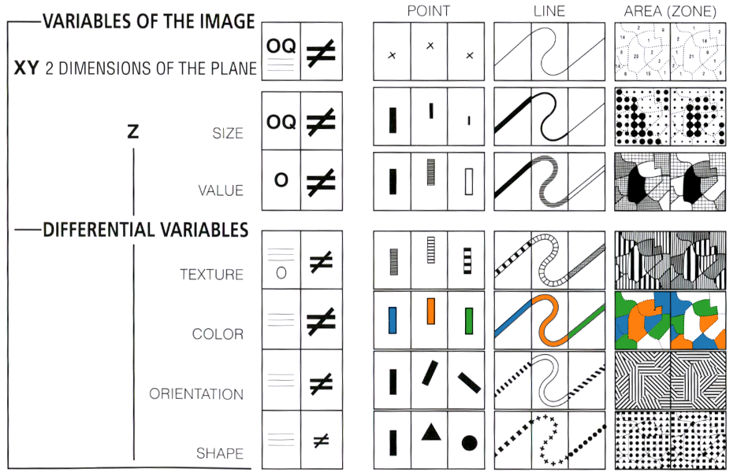
Encoding channels
Bertin's taxonomy of visual encodings from Sémiologie Graphique, as adapted by Mike Bostock.

Slide 8
Data types
integer : stored exactly, but with a limit, positive and negative
floating point: stored in scientific notation, not perfectly exact, positive and negative
dates: usually need to be handled separately from numbers and strings (can't add “2021-09-28” and 21:15 otherwise)
complex: encountered usually in physics and engineering; each point has two real numbers with a slightly different algebra
vectors and matrices: 1 x n or m x n objects, usually numbers
Shoutout to ISO-8601. There is a right way to write dates (for science). YYYY-MM-DD always. Why ?

Slide 9
More data types
character: single letter, number, or punctuation mark, conventionally set aside by quotation marks: “A” “8” 'j' '^M'
strings: sequences of ordered symbols (text)
“This course introduces best practices for presenting and communicating quantitative data.”
unicode: generalization of strings to every human alphabet and writing system “ٱلسَّلَامُ عَلَيْكُمْ” “A tsunami (from from Japanese: 津波, lit. 'harbour wave') is a series of waves”
Boolean: stores True or False, 0 or 1, “binary” data flag
When you import your data, if your computing environment does not guess the data types correctly, you will not be able to use the data.

Slide 10
Attribute types
Nominal : Labels or categories
=, ≠ ex: nationality, species, “type”, postal code (can be grouped)
Ordinal: Ordered
=,≠ <> ex: Likert scale (agree strongly, somewhat agree..) Grades A/B/C/D/F
Quantitative (interval):
=,≠ <> +- ex: dates, location
(ratios meaningless, differences meaningful)
Quantitative (ratio): physical measurement w/ meaningful zero
=,≠ <> + * / ex: mass, length, counts

Slide 11
Attribute types
Nominal : Labels or categories
=, ≠ ex: nationality, species, “type”, postal code (can be grouped)
Ordinal: Ordered
=,≠ <> ex: Likert scale (agree strongly, somewhat agree..) Grades A/B/C/D/F
Quantitative (interval):
=,≠ <> +- ex: dates, location
(ratios meaningless, differences meaningful)
Quantitative (ratio): physical measurement w/ meaningful zero
=,≠ <> + * / ex: mass, length, counts
This less-familiar categorization helps us understand what
visualization techniques are feasible with which data.

Slide 12
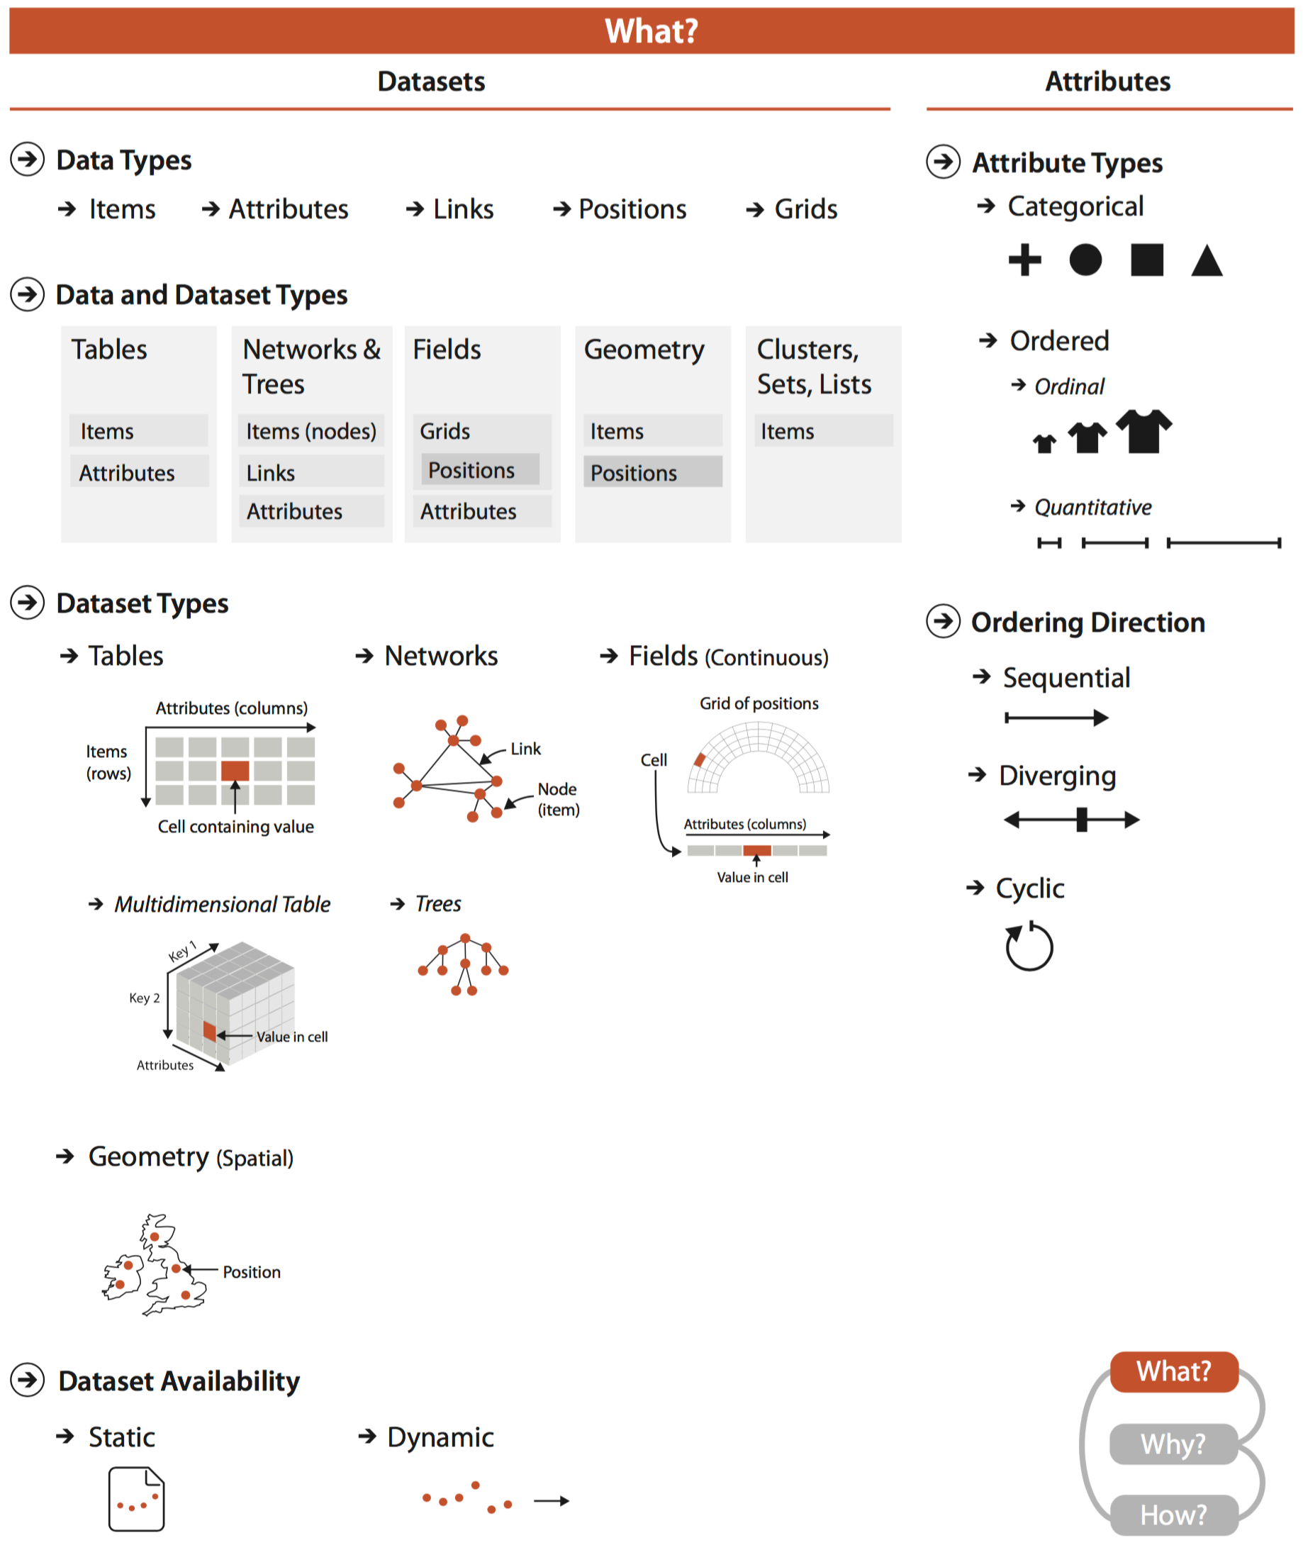
Chart types

Slide 13
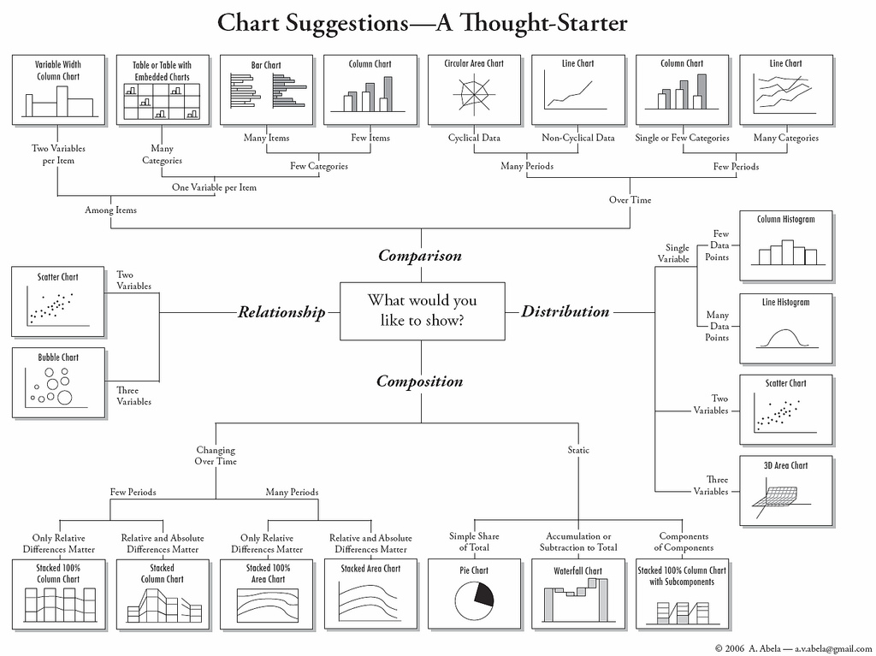

Slide 14
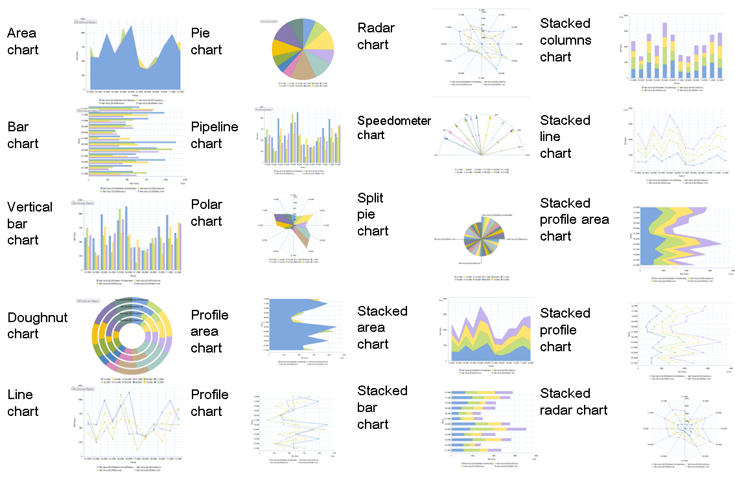
Chart types

Slide 15
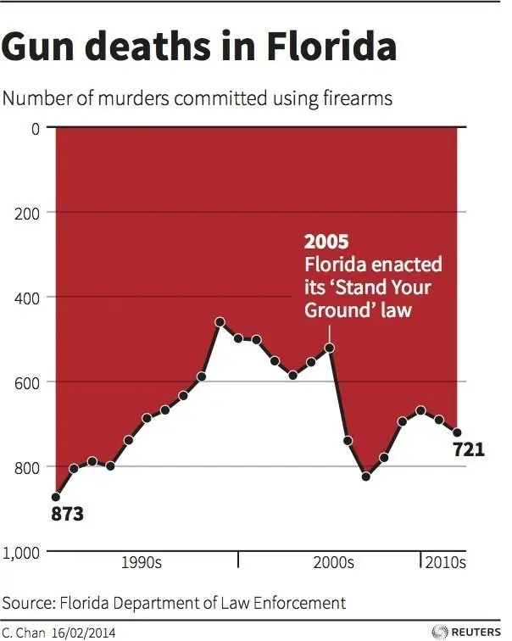
Ethics

Slide 16
Ethics
This only has one problem with it..

Slide 17
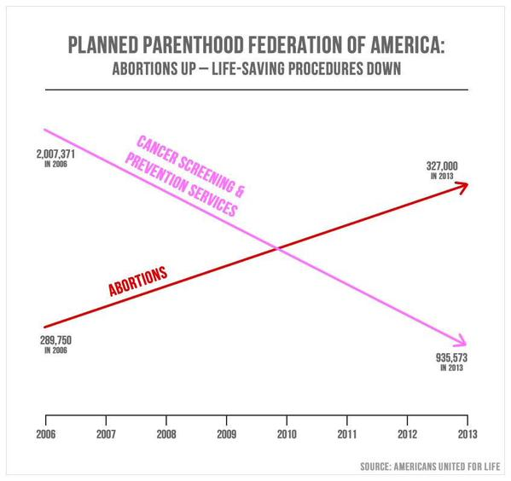
Ethics

Slide 18
Ethics
This one has more than one problem –
using visualization to obscure the truth rather than reveal it

Slide 19
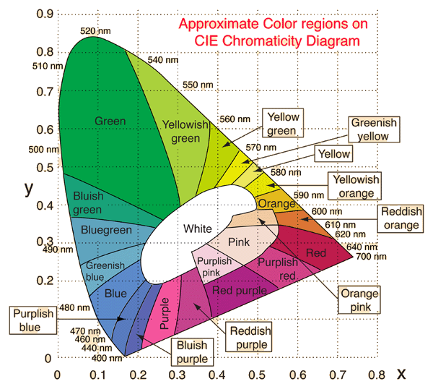
Color

Slide 20
Color

Slide 21
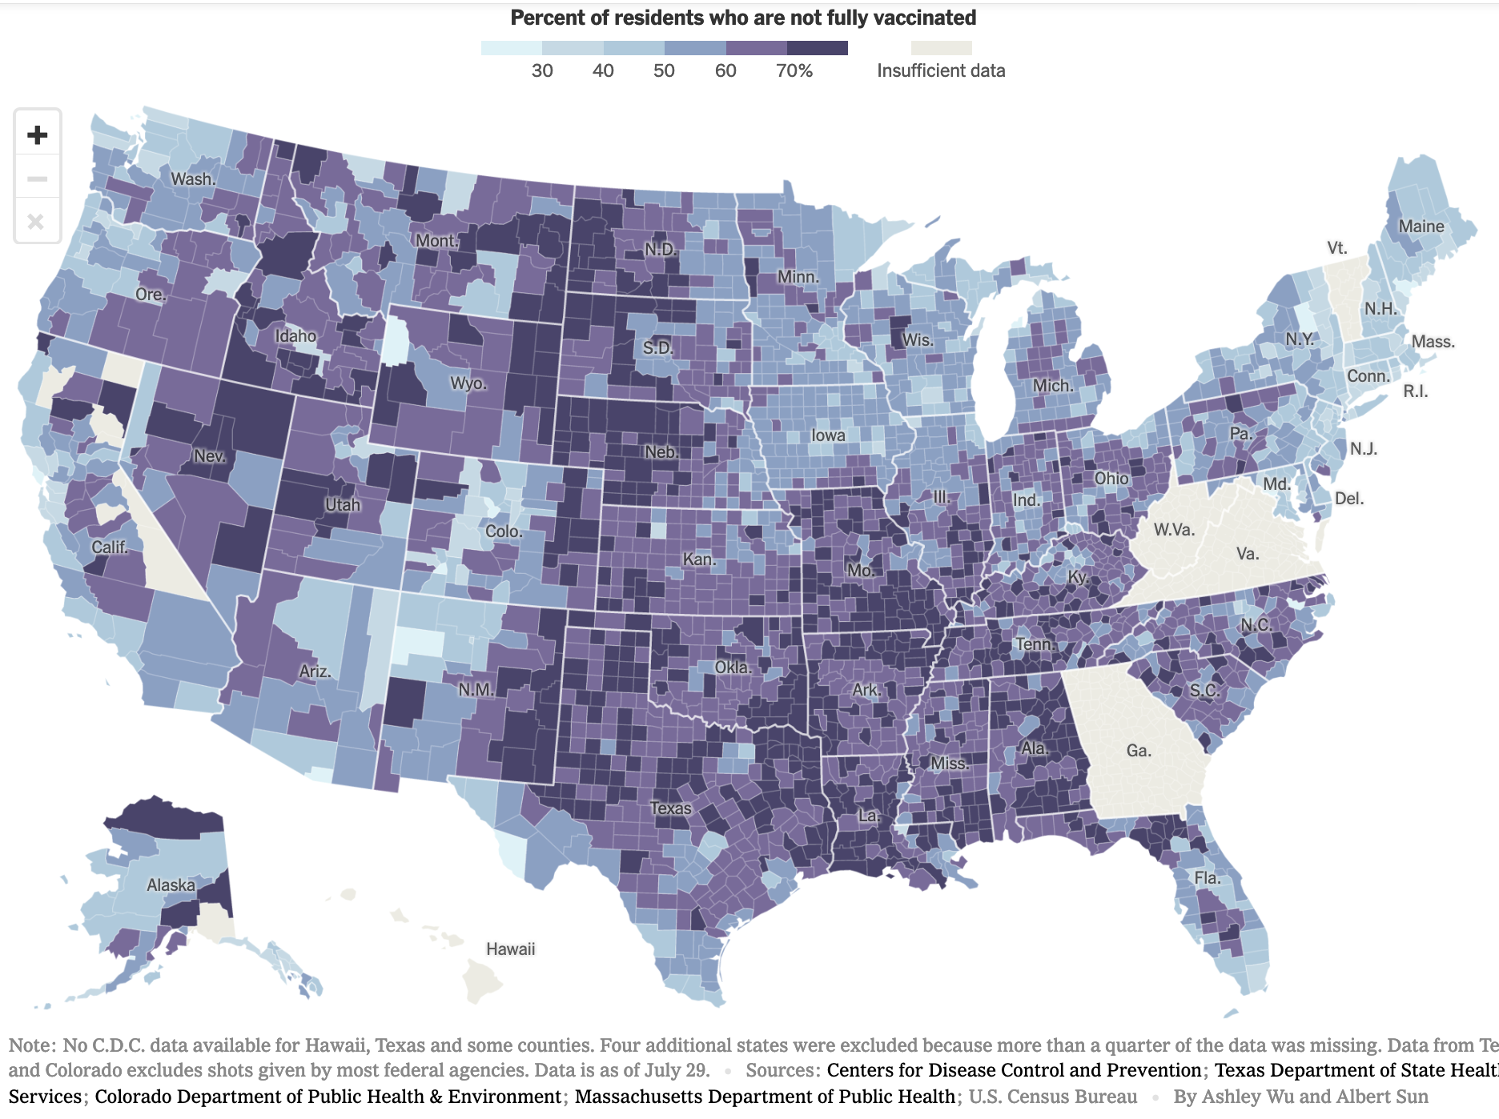
Maps

Slide 22
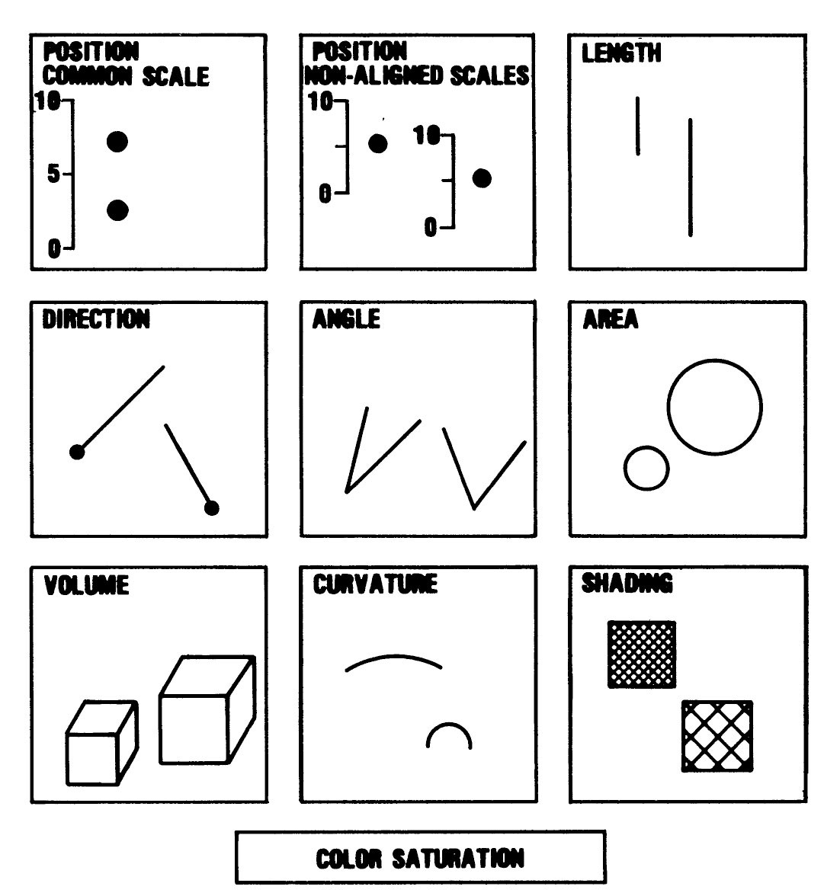
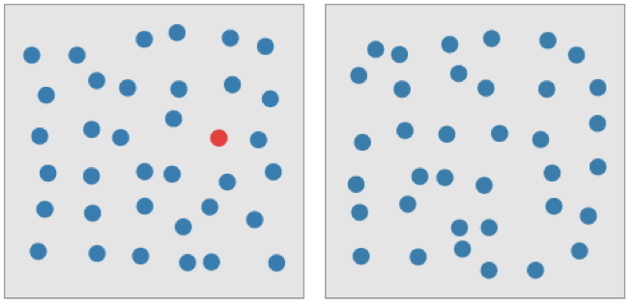
Perception

Slide 23
What is Visualization for?
Document, record, preserve
Analyze
  Tool to help us understand
    enhance memory
    take advantage of perceptual preprocessing
  Reveal peculiarities, limitations of data
Communicate
  Inform, persuade
  Make decisions

Slide 24
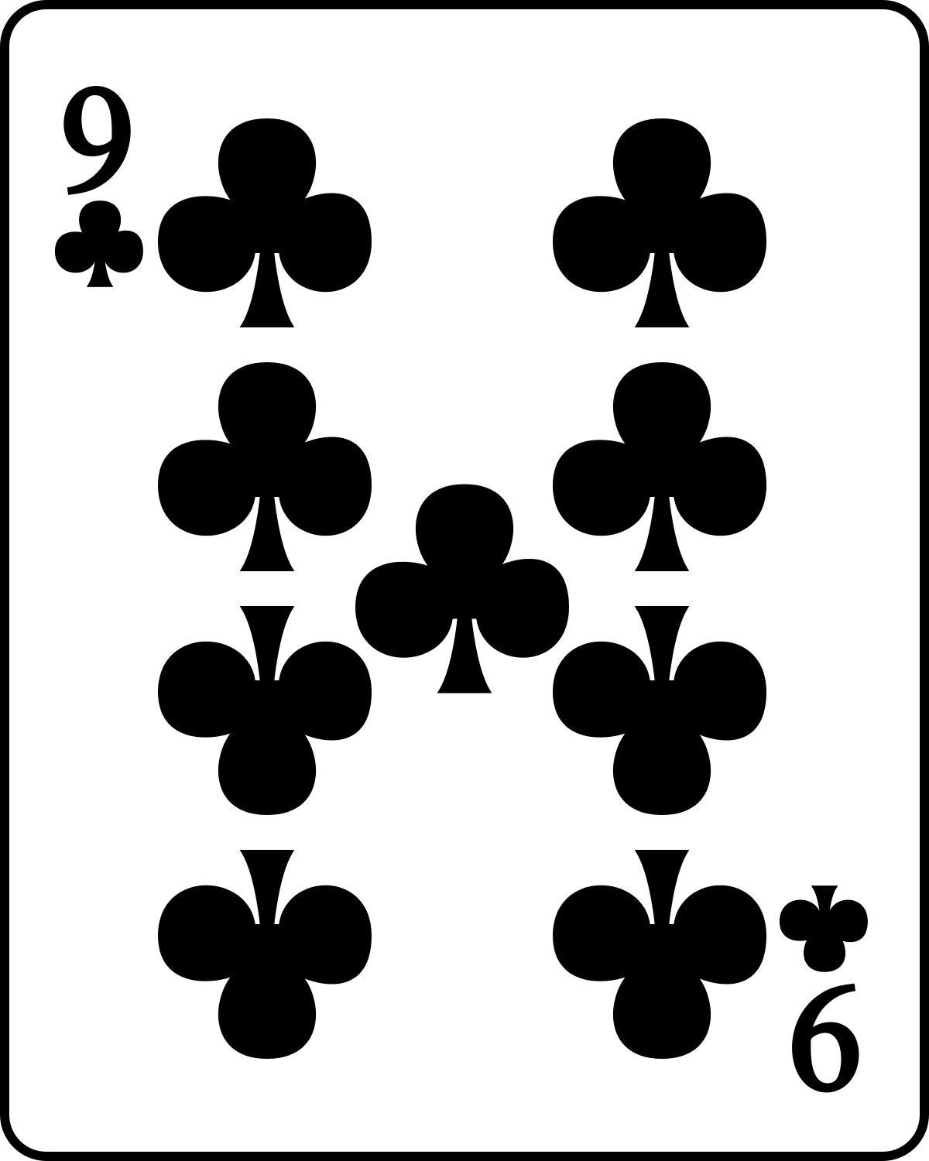
Activity: Number Scrabble
Two-player game played with cards A-9
Players alternately choose one card
First player to collect any three cards which sum to 15 wins
If all cards are exhausted and no three cards held by one player sum to 15, game ends in a draw.
Herbert Simon, The Sciences of the Artificial, 1969

Slide 25
Number Scrabble example game
Player A takes 8
Player B takes 2
Player A takes 4
Player B takes 3
Player A takes 5
B to move?

Slide 26
Number Scrabble example game
Player A takes 8
Player B takes 2
Player A takes 4
Player B takes 3
Player A takes 5
B to move?
How much do you know about arithmetic?

Slide 27
Number Scrabble example game
Player A takes 8
Player B takes 2
Player A takes 4
Player B takes 3
Player A takes 5
B to move?
Unclaimed: 1,6,7,9
A: 8, 4, 5
B: 2, 3

Slide 28
Number Scrabble example game
B: 2, 3
Unclaimed: 1,6,7,9
A: 8, 4, 5
3 choose 2 = 3 pairs
A can try to play next

Slide 29
Number Scrabble example game
B: 2, 3
Unclaimed: 1,6,7,9
A: 8, 4, 5
8 + 4 + 3 = 15
8 + 5 + 2 = 15
4 + 5 + 6 = 15

Slide 30
Number Scrabble example game
A: 8, 4, 5
B: 2, 3
Unclaimed: 1,6,7,9
8 + 4 + 3 = 15
8 + 5 + 2 = 15
4 + 5 + 6 = 15

Slide 31
Number Scrabble example game
A: 8, 4, 5
B: 2, 3
Unclaimed: 1,6,7,9
8 + 4 + 3 = 15
8 + 5 + 2 = 15
4 + 5 + 6 = 15
If I color them, B's only non-losing move is evident.

Slide 32
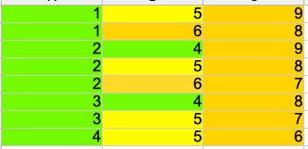
Activity: Number Scrabble
There are eight triplets of distinct natural numbers between 1 and 9...
There are eight triplets of distinct natural numbers between 1 and 9 that sum to 15.
Four solutions involve 5, and four solutions are imbalanced around 5
Herbert Simon, The Sciences of the Artificial, 1969

Slide 33
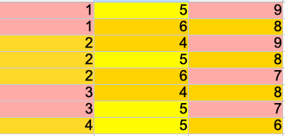
Activity: Number Scrabble
There are eight triplets of distinct natural numbers between 1 and 9...
1, 3, 9, 7 have only two paths to victory
2, 4, 6, 8 have three each
5 is in four of the solutions
Herbert Simon, The Sciences of the Artificial, 1969

Slide 34
Activity: Number Scrabble
There are eight triplets of distinct natural numbers between 1 and 9...
1, 3, 9, 7 have only two paths to victory
2, 4, 6, 8 have three each
5 is in four of the solutions
Herbert Simon, The Sciences of the Artificial, 1969

Slide 35
Activity: Number Scrabble
1, 3, 9, 7 have only two paths to victory
2, 4, 6, 8 have three each
5 is in four of the solutions
Herbert Simon, The Sciences of the Artificial, 1969

Slide 36
Number Scrabble example game
A: 8, 4, 5
B: 2, 3
Unclaimed: 1,6,7,9
6 | 7 | 2
1 | 5 | 9
8 | 3 | 4
8 + 4 + 3 = 15
8 + 5 + 2 = 15
4 + 5 + 6 = 15

Slide 37
Activity: Number Scrabble
6 | 7 | 2
1 | 5 | 9
8 | 3 | 4
Writing down the cards helped us see what was done, what was missing
Coloring the numbers helped us see some group theory properties
The tic-tac-toe representation turns the problem into a solved one.

Slide 38



Visualization tools
Ubiquitous, limited to keypresses and mouse clicks
Excellent for interacting with primates / getting data and judgements out of your head
Commercial, free license for students, entirely graphical and purported to be easy to use.
Browser-based free data wrangling power tool; find outliers, perform transforms on columns. Won't need for this class

Slide 39







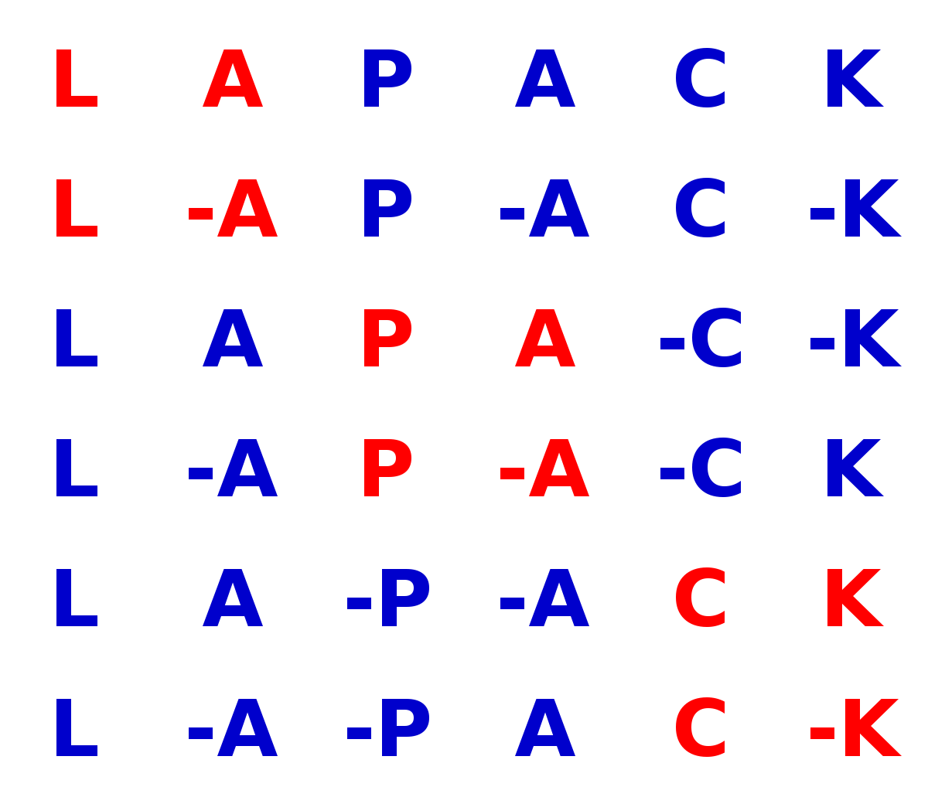
The stack
Stratiographic layers -- lower layers are older, will likely last longer into the future.
Python

Slide 40
The stack
Python

Slide 41
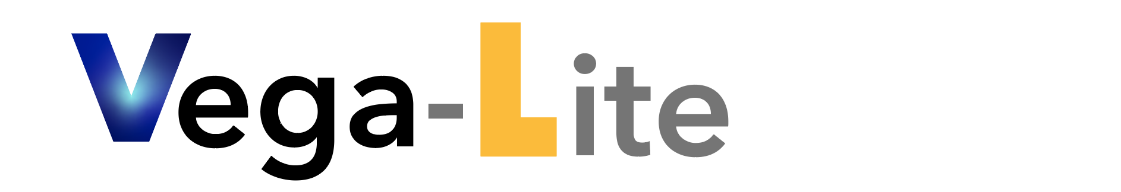



The stack
ega
Python

Slide 42
<!doctype html>
<html>
<head>
<style>
.bar {
fill: steelblue;
}
</style>
<script src="https://d3js.org/d3.v4.min.js"></script>
<body>
<svg width="600" height="500"></svg>
<script>
var svg = d3.select("svg"),
margin = 200,
width = svg.attr("width") - margin,
height = svg.attr("height") - margin
svg.append("text")
.attr("transform", "translate(100,0)")
.attr("x", 50)
.attr("y", 50)
.attr("font-size", "24px")
.text("XYZ Foods Stock Price")
var xScale = d3.scaleBand().range([0, width]).padding(0.4),
yScale = d3.scaleLinear().range([height, 0]);
var g = svg.append("g")
.attr("transform", "translate(" + 100 + "," + 100 + ")");
d3.csv("XYZ.csv", function(error, data) {
if (error) {
throw error;
}
xScale.domain(data.map(function(d) { return d.year; }));
yScale.domain([0, d3.max(data, function(d) { return d.value; })]);
g.append("g")
.attr("transform", "translate(0," + height + ")")
.call(d3.axisBottom(xScale))
.append("text")
.attr("y", height - 250)
.attr("x", width - 100)
.attr("text-anchor", "end")
.attr("stroke", "black")
.text("Year");
g.append("g")
.call(d3.axisLeft(yScale).tickFormat(function(d){
return "$" + d;
})
.ticks(10))
.append("text")
.attr("transform", "rotate(-90)")
.attr("y", 6)
.attr("dy", "-5.1em")
.attr("text-anchor", "end")
.attr("stroke", "black")
.text("Stock Price");
g.selectAll(".bar")
.data(data)
.enter().append("rect")
.attr("class", "bar")
.attr("x", function(d) { return xScale(d.year); })
.attr("y", function(d) { return yScale(d.value); })
.attr("width", xScale.bandwidth())
.attr("height", function(d) { return height - yScale(d.value); });
});
</script>
</body>
</html>
This is the sample code for a bar graph

Slide 43
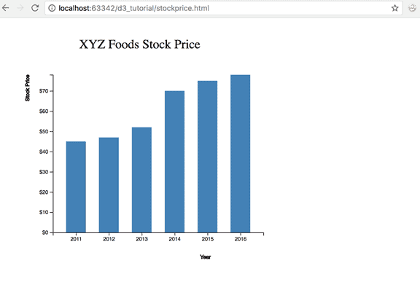
<!doctype html>
<html>
<head>
<style>
.bar {
fill: steelblue;
}
</style>
<script src="https://d3js.org/d3.v4.min.js"></script>
<body>
<svg width="600" height="500"></svg>
<script>
var svg = d3.select("svg"),
margin = 200,
width = svg.attr("width") - margin,
height = svg.attr("height") - margin
svg.append("text")
.attr("transform", "translate(100,0)")
.attr("x", 50)
.attr("y", 50)
.attr("font-size", "24px")
.text("XYZ Foods Stock Price")
var xScale = d3.scaleBand().range([0, width]).padding(0.4),
yScale = d3.scaleLinear().range([height, 0]);
var g = svg.append("g")
.attr("transform", "translate(" + 100 + "," + 100 + ")");
d3.csv("XYZ.csv", function(error, data) {
if (error) {
throw error;
}
xScale.domain(data.map(function(d) { return d.year; }));
yScale.domain([0, d3.max(data, function(d) { return d.value; })]);
g.append("g")
.attr("transform", "translate(0," + height + ")")
.call(d3.axisBottom(xScale))
.append("text")
.attr("y", height - 250)
.attr("x", width - 100)
.attr("text-anchor", "end")
.attr("stroke", "black")
.text("Year");
g.append("g")
.call(d3.axisLeft(yScale).tickFormat(function(d){
return "$" + d;
})
.ticks(10))
.append("text")
.attr("transform", "rotate(-90)")
.attr("y", 6)
.attr("dy", "-5.1em")
.attr("text-anchor", "end")
.attr("stroke", "black")
.text("Stock Price");
g.selectAll(".bar")
.data(data)
.enter().append("rect")
.attr("class", "bar")
.attr("x", function(d) { return xScale(d.year); })
.attr("y", function(d) { return yScale(d.value); })
.attr("width", xScale.bandwidth())
.attr("height", function(d) { return height - yScale(d.value); });
});
</script>
</body>
</html>

Slide 44
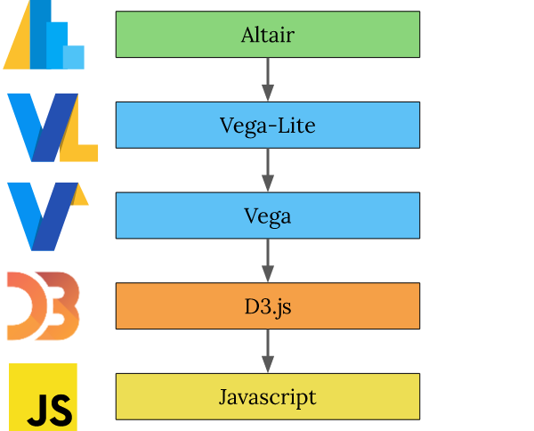
FacetedEncoding({
x: X({
field: 'Year',
type: 'temporal'
}),
y: Y({
aggregate: 'count',
type: 'quantitative'
})
})
This is a specification for a bar graph in Vega-lite
https://eitanlees.github.io/altair-stack/

Slide 45
alt.Chart(cars).mark_bar().encode(
alt.X('Year'),
alt.Y('count()'))
And here is the specification in altair (python wrapper for vega-lite)
And here is the specification in altair (python wrapper for vega-lite)
https://eitanlees.github.io/altair-stack/

Slide 46
If I find out that altair/vega-lite really isn't working out by 2nd week we can move back to pure python.
If I find out that altair/vega-lite really isn't working out by 2nd week we can move back to pure python.
https://eitanlees.github.io/altair-stack/

Slide 47
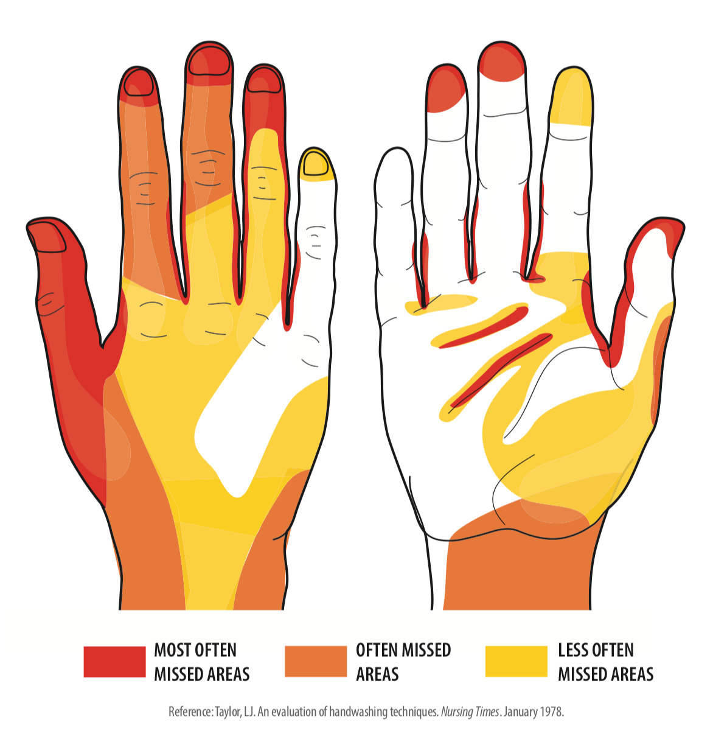
Beautiful, easy-to-understand graphic for these interesting times.

Slide 48
Administrivia
Office hours
  WT: 1-2:30 Wednesday,
  WT: 11-12 Thursday, Friday; other times by appointment
  AM:
  AS:
7 homeworks, due on Friday 11:59 pm. First one friday of 2nd week.

Slide 49



Teaching Staff
Teaching Assistants
Professor
Will Trimble
Instructor, Data Science
W 1-2:30
Th 11-212
F 11-12
Anna Moise
Abby Star

Slide 50
This and that
TAs:
Abby Starr <abigailstarr@uchicago.edu>
Anna Moise <amoise@uchicago.edu>
10 minutes to pandas which takes way more than 10 minutes:
https://pandas.pydata.org/pandas-docs/stable/user_guide/10min.html

