Slide 1

Data 227
Data Visualization & Communication
Autumn, 2021

Slide 2
Week 3 readings
D3: Data-Driven Documents. Michael Bostock, Vadim Ogievetsky & Jeffrey Heer. InfoVis 2011.
Chapter 3: Sources of Graphical Integrity, In The Visual Display of Quantitative Information. Tufte. (easy)

Slide 3

Logarithmic scales: why?
Compress wide range of values onto one graph [Dynamic Range: the ratio of the largest to the smallest values a tool of yours can handle]
Convention (Earthquake, RF signal power, sound level, information theory)
When net effect is the result of small multiplicative effects (microbiology, finance) = sum of log-effects
Diligence: Log scales should usually be marked with the numbers, not their logarithms. Otherwise, base of logarithm must be specified (2, e, 10, and are common, field-specific choices)

Slide 4
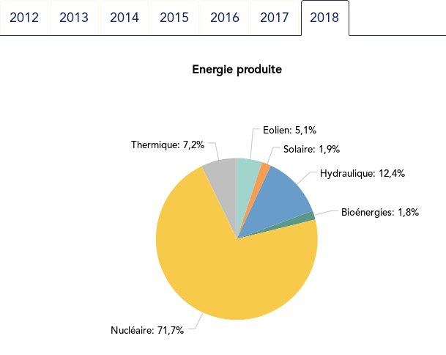
https://pierreh.eu/pie-vs-dots-powersystem/

Slide 5
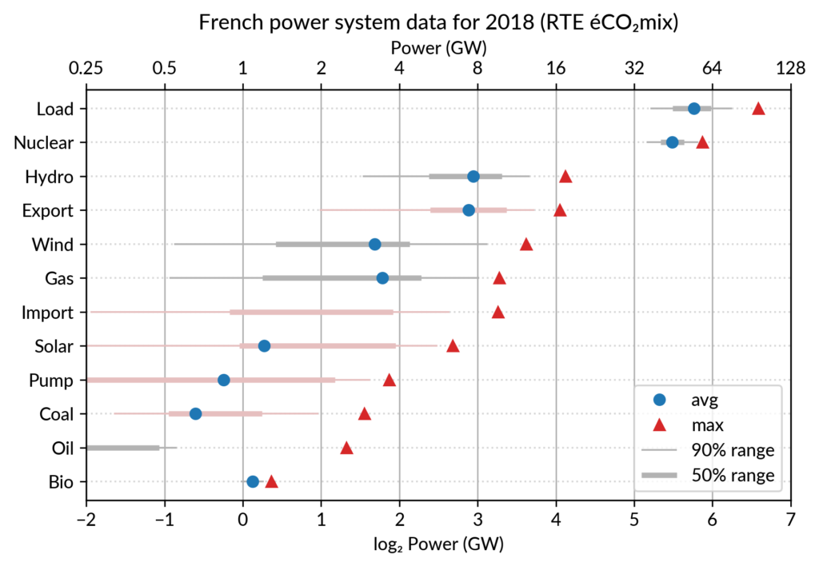
https://pierreh.eu/pie-vs-dots-powersystem/

Slide 6
But this visualization obscures the fact that the largest component is 71% of the total
https://pierreh.eu/pie-vs-dots-powersystem/

Slide 7
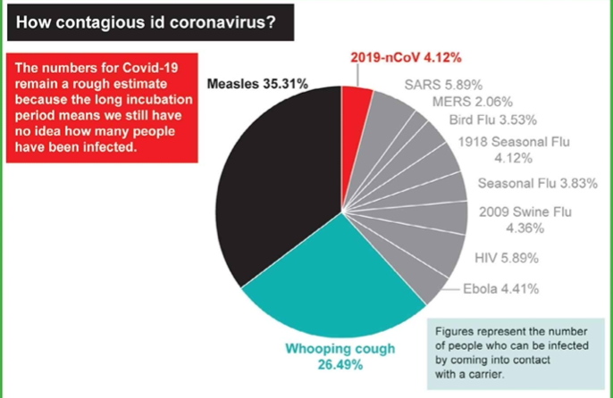
The Bad
Jonathan Schwabish, redrawn from The Australian March 2020

Slide 8
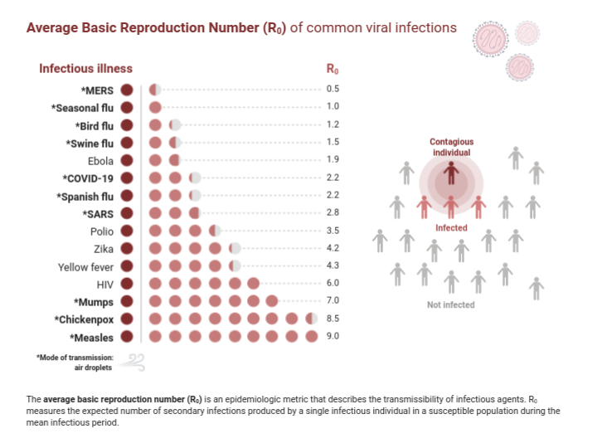
BioRender (2021). Average Basic Reproduction Number (R0) of Common Viral Infections. Retrieved from https://app.biorender.com/biorender-templates/t-5e820384a3f45b00ae3fd002-average-basic-reproduction-number-r0-of-common-viral-infecti

Slide 9
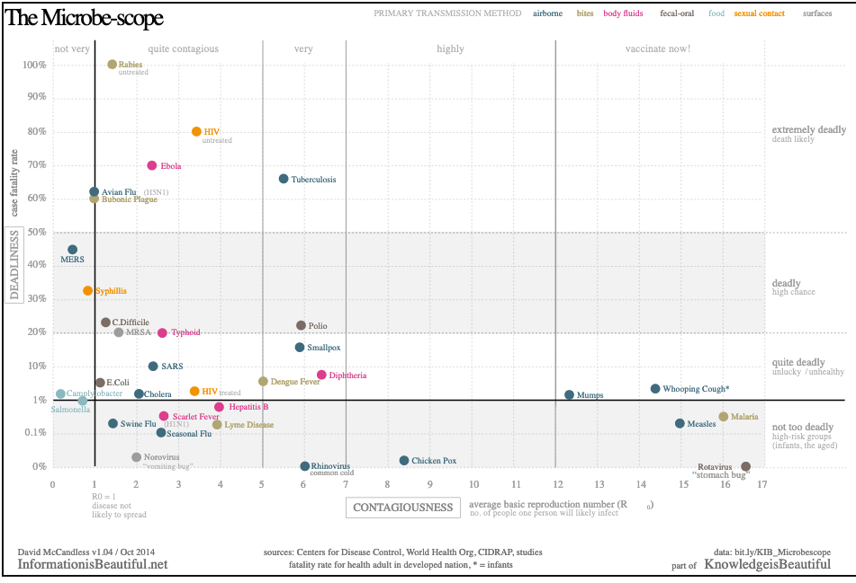
https://www.informationisbeautiful.net/visualizations/the-microbescope-infectious-diseases-in-context/

Slide 10
This is lovely! Descriptive labels on the right.
Unusual but effective mixture of logarithmic and linear scale for y.
This is actually interactive on the website.
https://www.informationisbeautiful.net/visualizations/the-microbescope-infectious-diseases-in-context/

Slide 11
Steven Few, Show me the Data

Slide 12
Playfair
Bretin
Tufte
Cleveland
Munzner
Playfair
Descartes
ISU
Tukey
Apple
Computer
Steven Few, Show me the Data

Slide 13
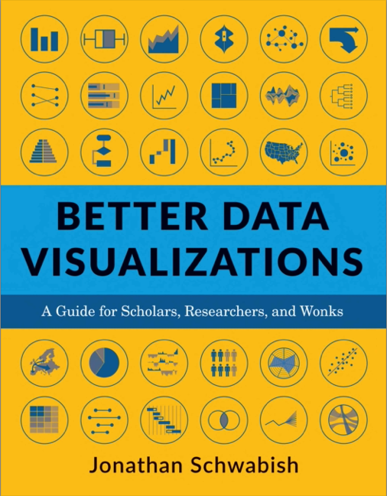
From a political/policy perspective, this is a pretty good nuts-and-bolts book on making pretty good graphs.

Slide 14
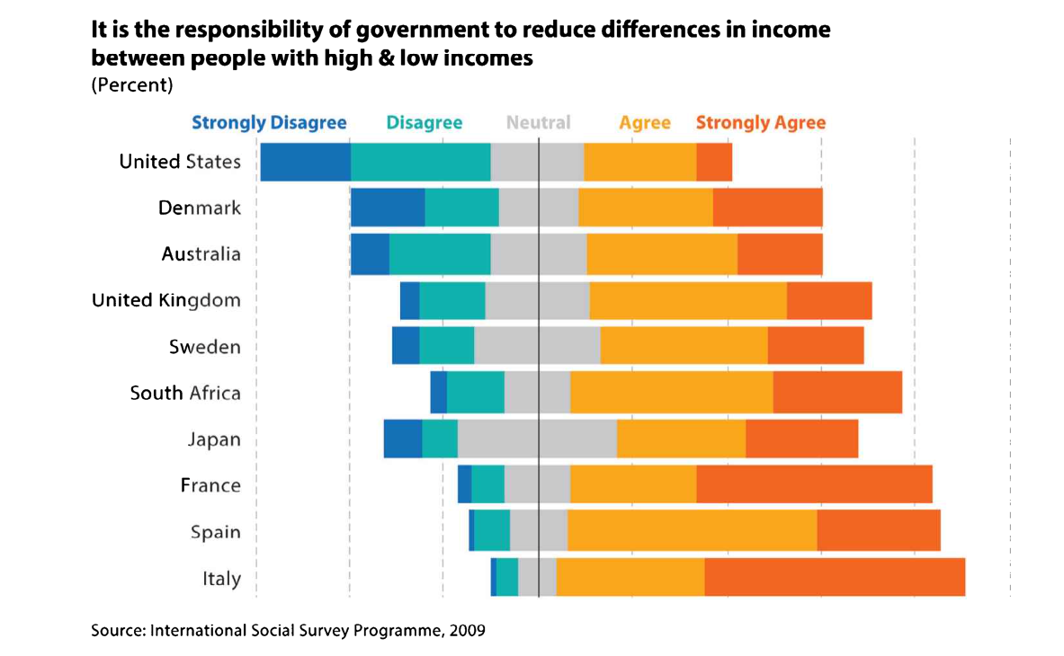
Likert scale -- diverging bar chart
Jonathan Schwabish, Better Data Visualizations

Slide 15
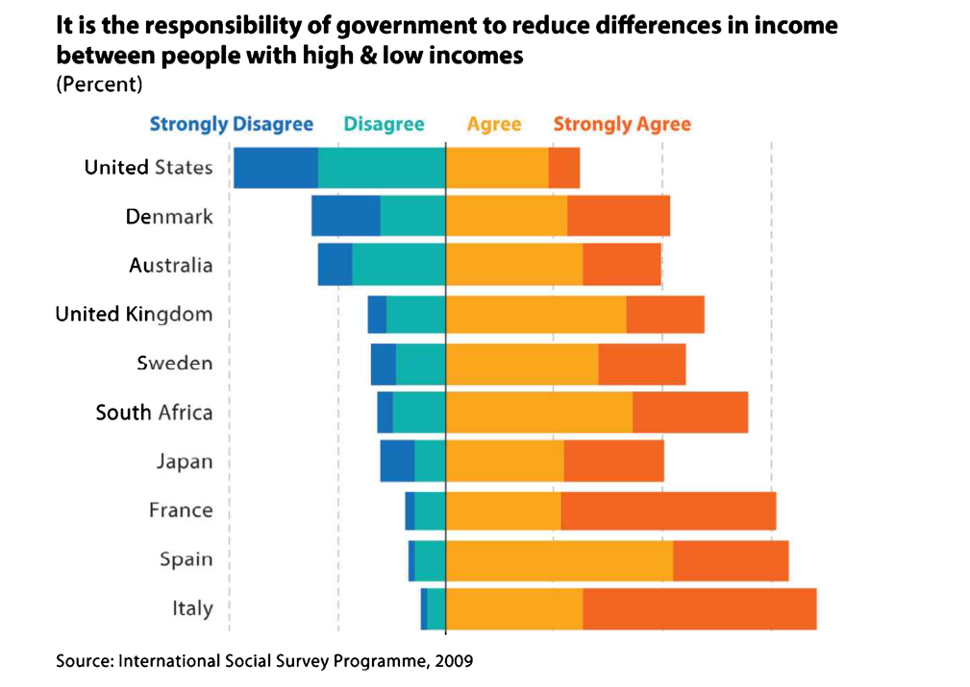
Likert scale -- diverging bar chart
Neutral has not been plotted.
Jonathan Schwabish, Better Data Visualizations

Slide 16
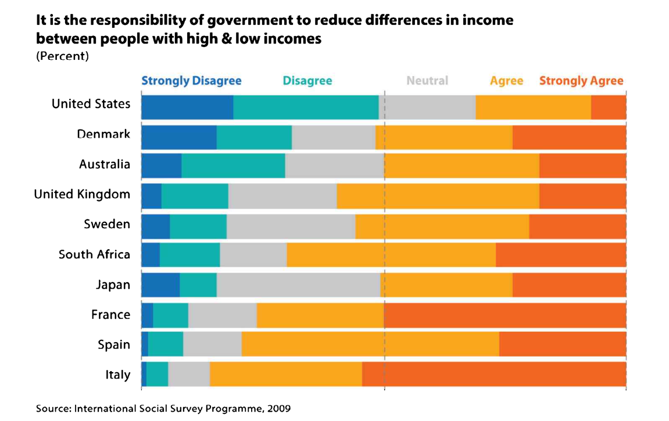
Likert scale -- stacked bar
Jonathan Schwabish, Better Data Visualizations

Slide 17
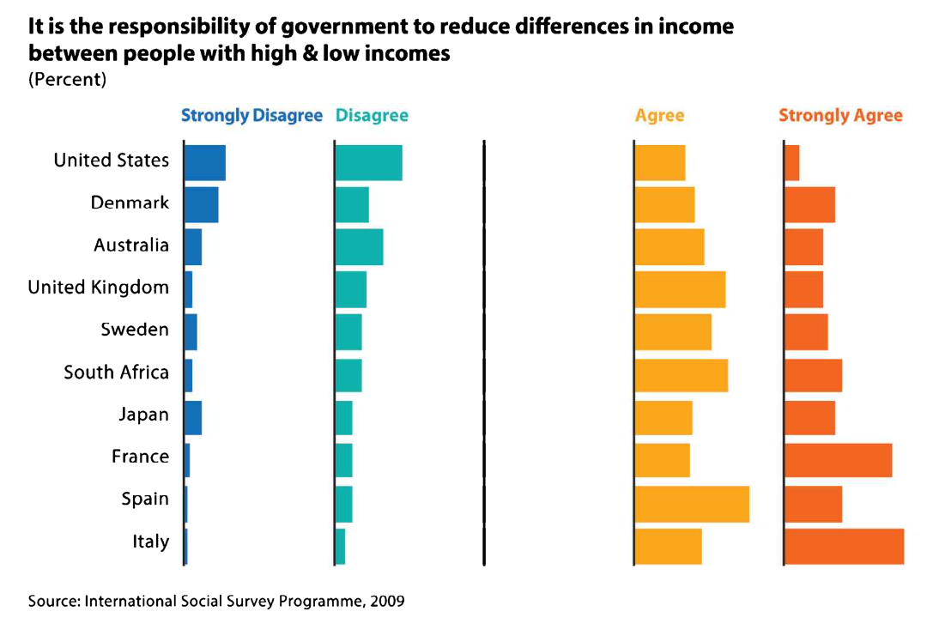
Likert scale - small multiples
Jonathan Schwabish, Better Data Visualizations

Slide 18
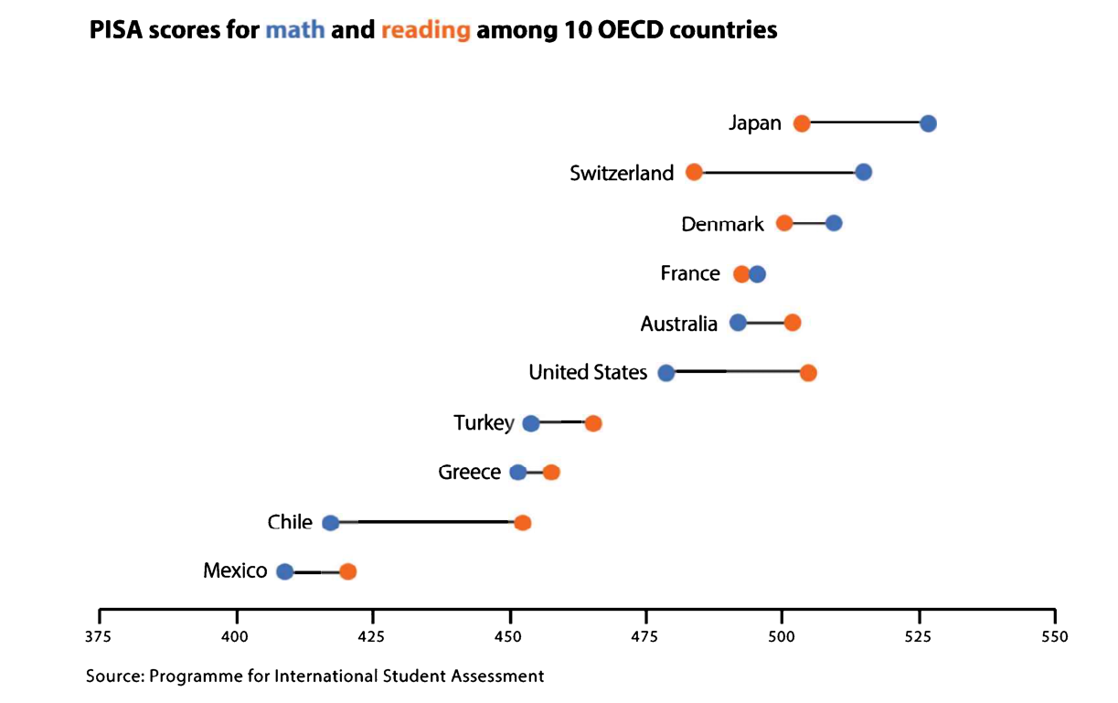
“Dot plot”

Slide 19
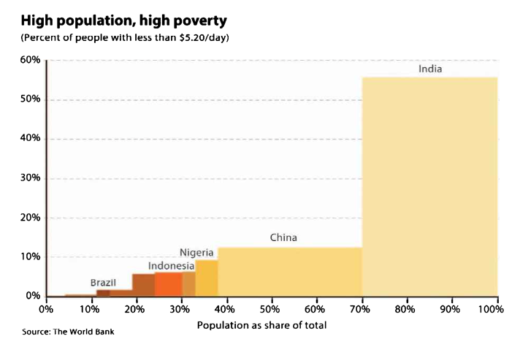
Marimekko graphs:
Bar Charts with more variables

Slide 20
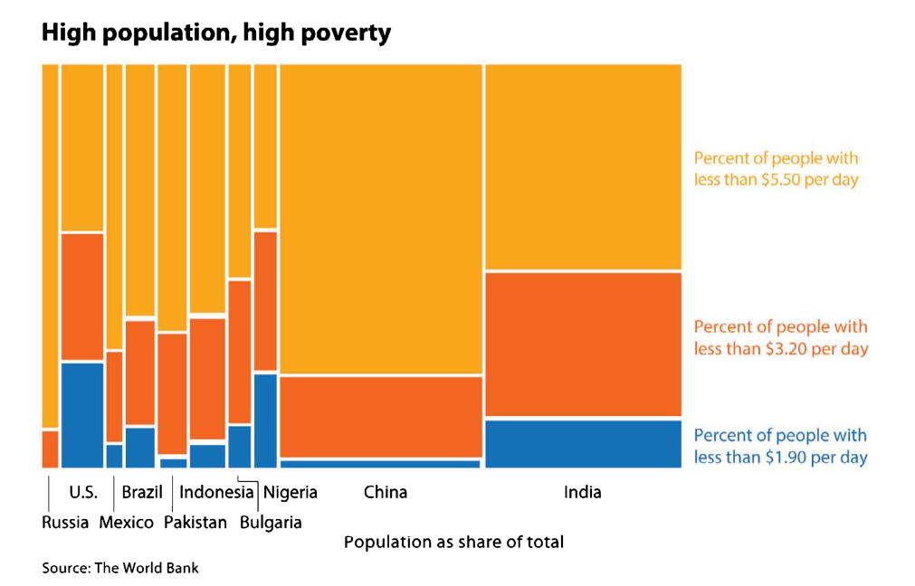
Marimekko graphs

Slide 21
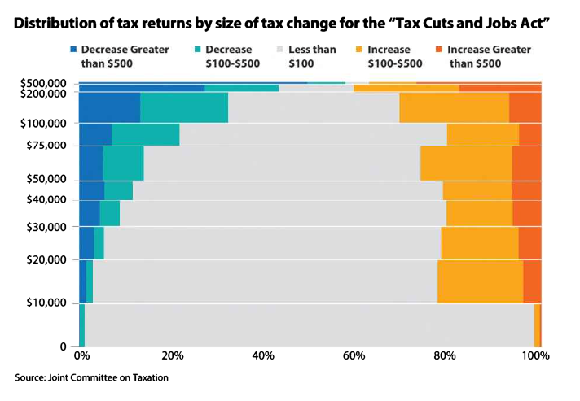
Marimekko graphs

Slide 22
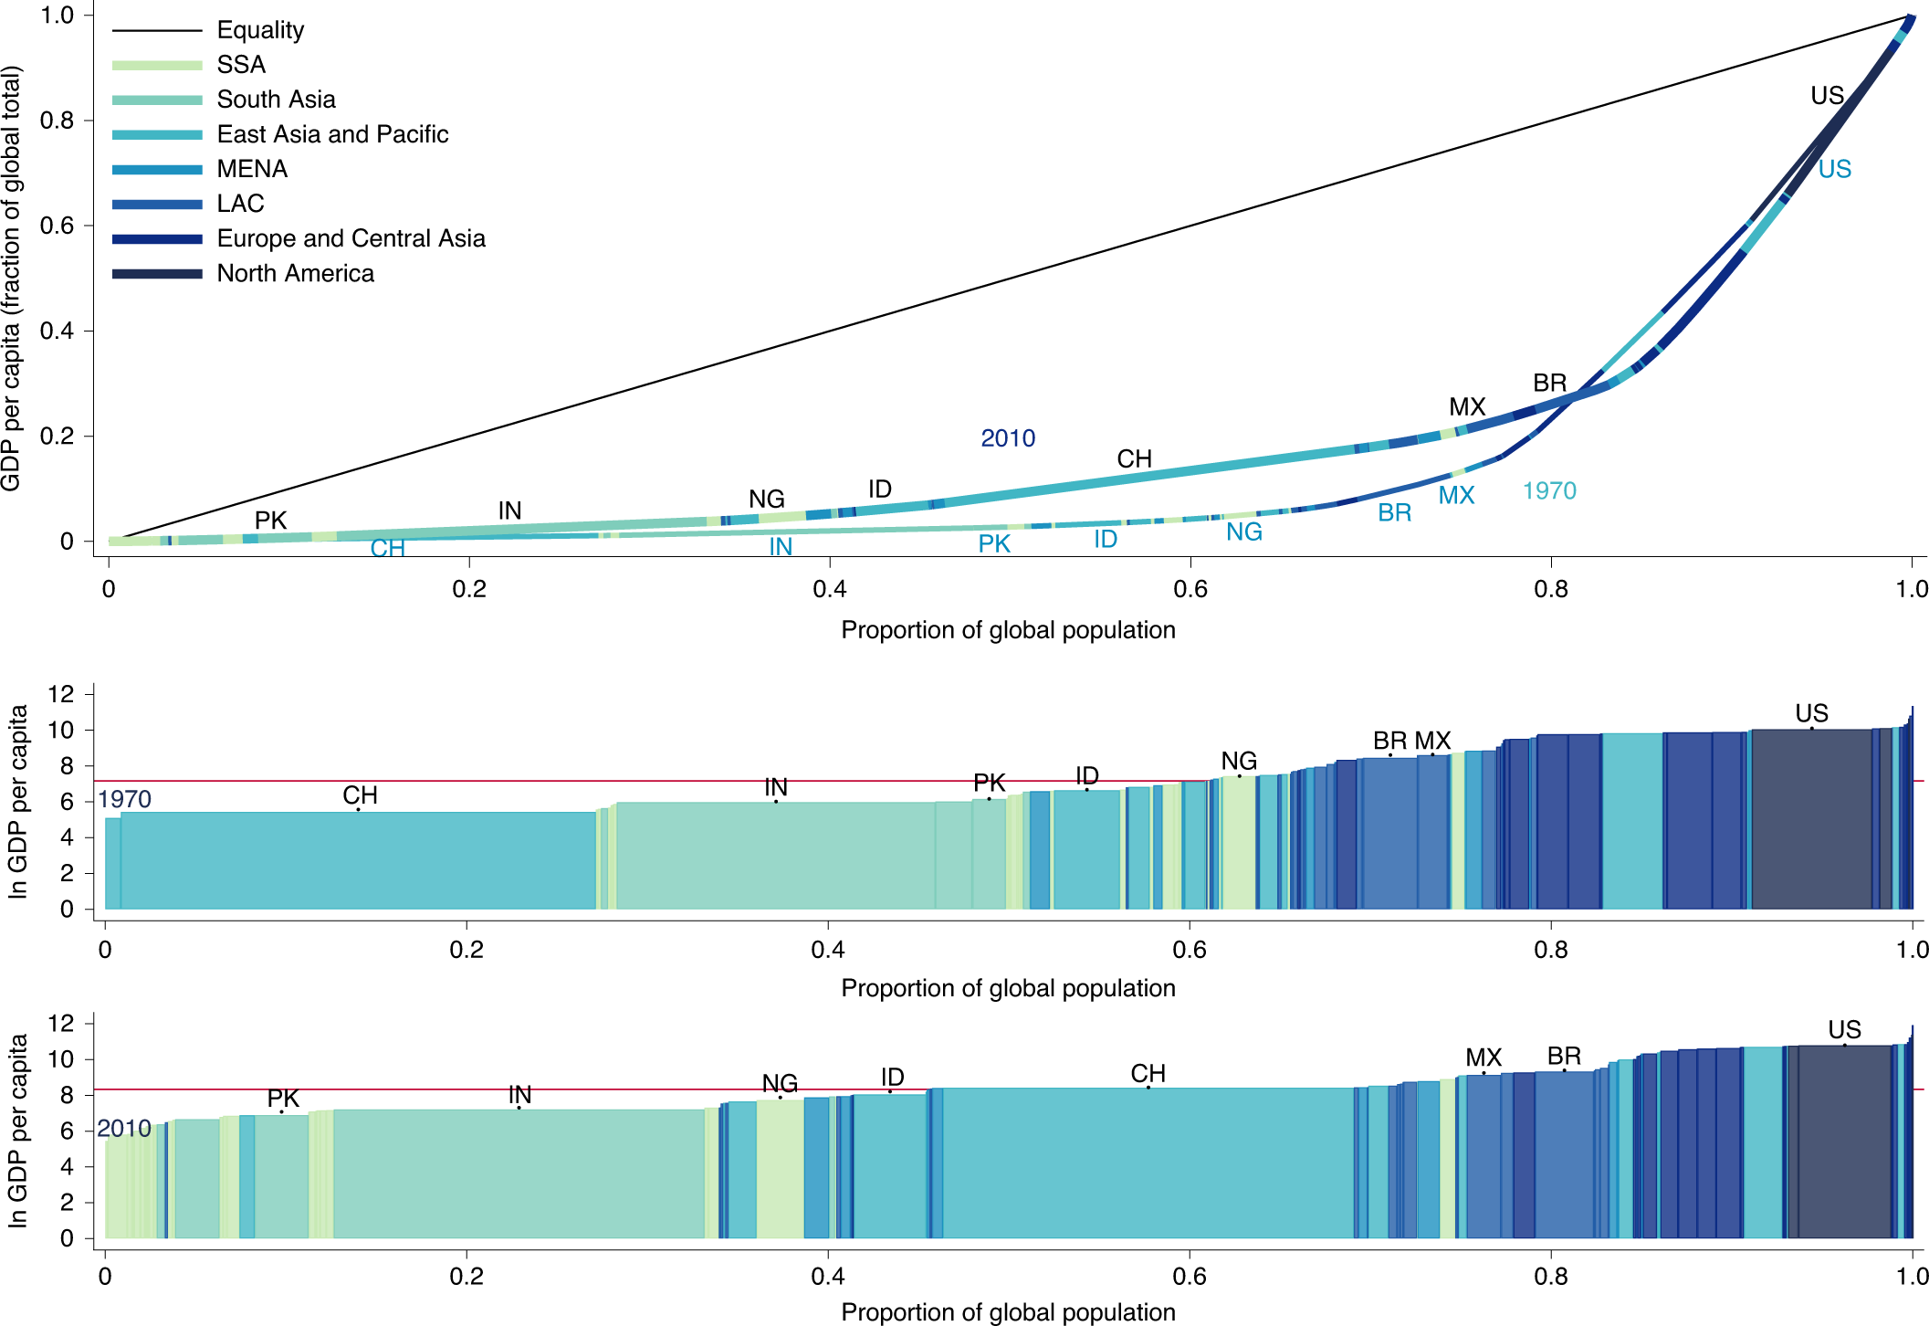
Bell, W., Lividini, K. & Masters, W.A. Global dietary convergence from 1970 to 2010 altered inequality in agriculture, nutrition and health. Nat Food 2, 156–165 (2021). doi: 10.1038/s43016-021-00241-9

Slide 23
Back to the notebook
I have a notebook that plots a toy data bar chart using
  altair
  matplotlib (basic functionality, lots of hard-to-find-knobs)
  seaborn (prettifed matplotlib) and
  plotnine (an adaptation of R's ggplot, steep learning curve for ggplot2's data visualization grammar)
Then it loads in the Chicago salary database, makes a histogram with matplotlib, and makes a somewhat nicer-looking histogram with altair

