Slide 1

Data 227
Data Visualization & Communication
Autumn, 2022
Deception

Slide 2
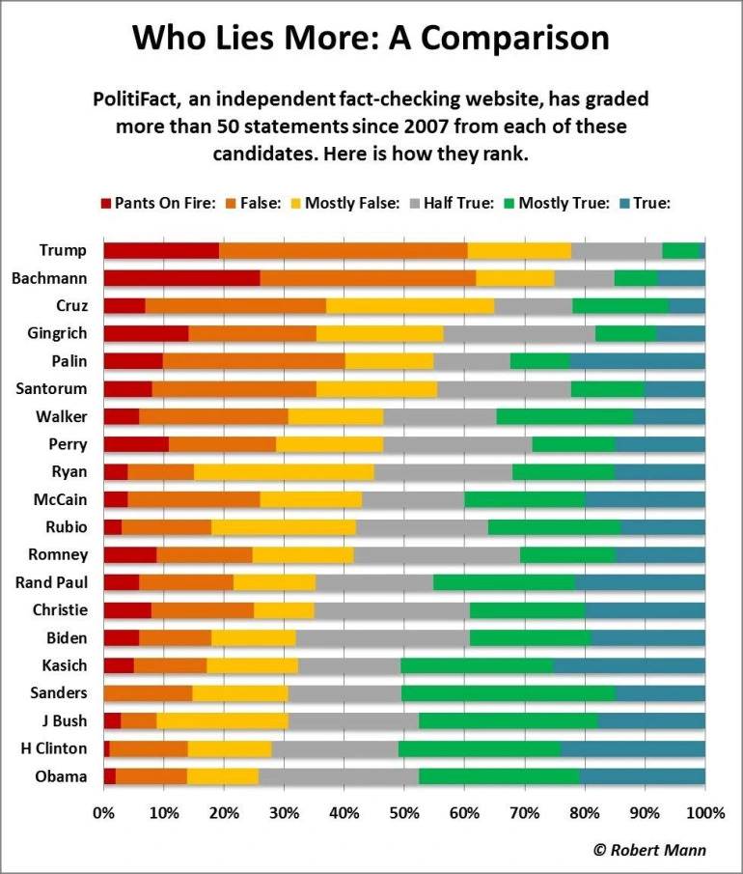
https://datavizblog.com/2016/07/26/politifacts-methodology-who-lies-more-a-comparison-robert-mann/

Slide 3
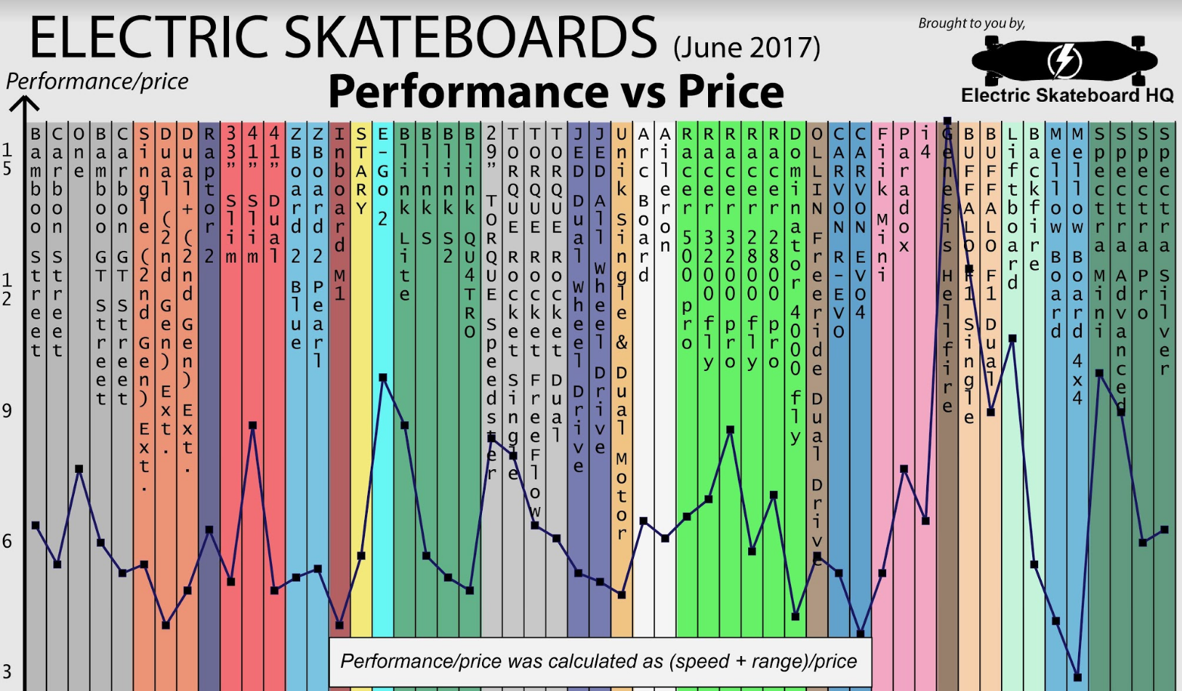
https://www.electricskateboardhq.com/electric-skateboard-comparison-chart-june-2017/

Slide 4
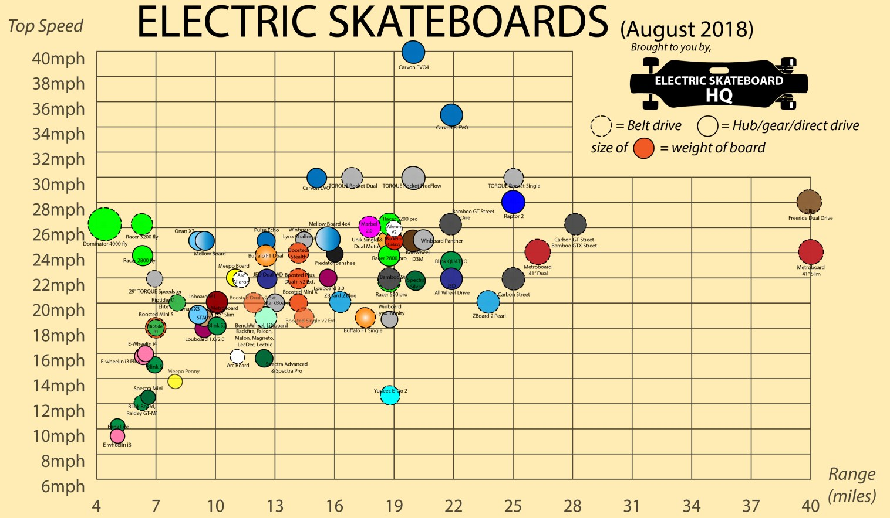
https://www.electricskateboardhq.com/electric-skateboard-comparison-chart-june-2017/

Slide 5
Who, me, ethics?
I'm just here for the health insurance
The existence of data is not politically neutral
Design decisions in visualization matter; can be used to obscure
Humanistic obligations on viz practitioners
Michael Correll CHI 2019 Ethical Dimensions of Visualization Research
https://doi.org/10.475/123_4

Slide 6
Obligations
Visualize hidden labor
Visualize hidden uncertainty
Collect data with empathy
anthropomorphize data
obfuscate data to protect privacy
provide context and analytical power
slow unethical analytical behavior
Michael Correll CHI 2019 Ethical Dimensions of Visualization Research
https://doi.org/10.475/123_4

Slide 7
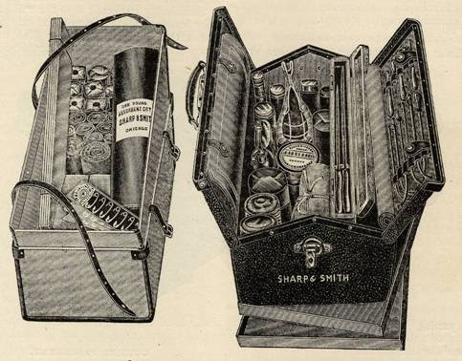
What's in the toolbox?
Hundreds of design variables when selecting, transforming, and encoding the data. Rich sample space for malfeasance

Slide 8
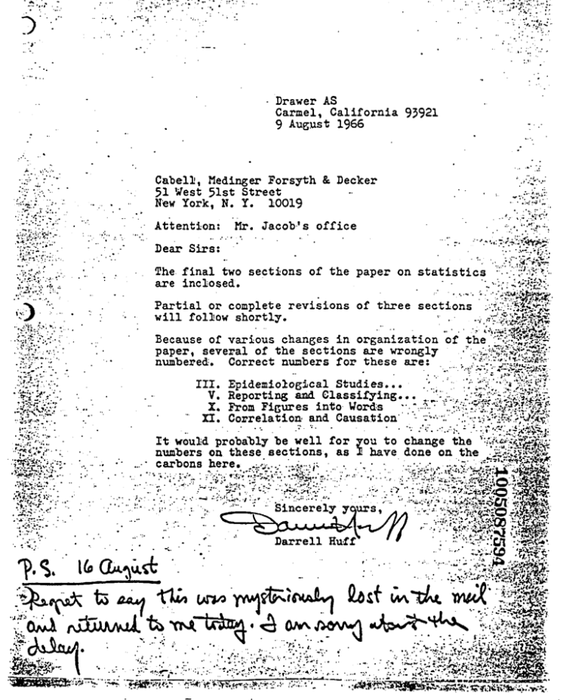
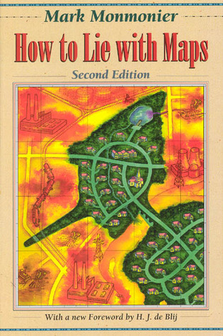
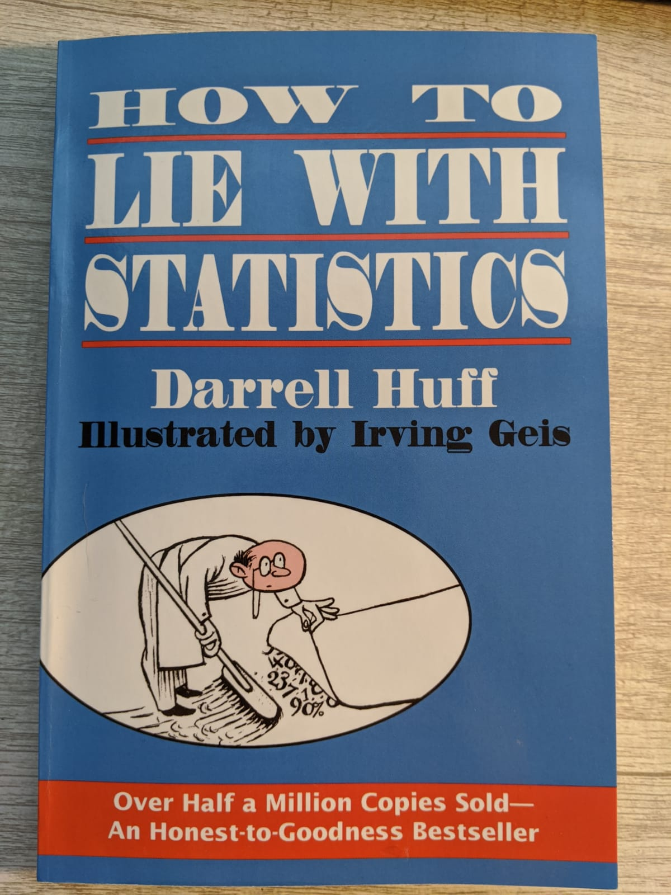
What's in the toolbox?
Darrell Huff, How to lie with smoking statistics draft, 1966

Slide 9
What's in the toolbox?
Choices when designing scale. Includes suppressing zero, breaking scale. (one reason dual-axis-scale charts are generally poor choices.)

Slide 10
What's in the toolbox?
Choices when designing scale. Includes suppressing zero, breaking scale. (one reason dual-axis-scale charts are generally poor choices.)
Violating conventions:
  left/right old/new
  up/down big/small
  dark/light dense/thin
  axes are regular, linear without good signage

Slide 11
What's in the toolbox?
Choices when designing scale. Includes suppressing zero, breaking scale. (one reason dual-axis-scale charts are generally poor choices.)
Violating conventions (left/right old/new, up/down big/small, regularity of axis; dark/light dense/thin)
Deliberately restricted scope (subset of data so narrow as to lose context or to highlight victory)

Slide 12
What's in the toolbox?
Choices when designing scale. Includes suppressing zero, breaking scale. (one reason dual-axis-scale charts are generally poor choices.)
Violating conventions (left/right old/new, up/down big/small, regularity of axis; dark/light dense/thin)
Deliberately restricted scope (subset of data so narrow as to lose context or to highlight victory)
Carefully expanded scope to force favorable comparisons

Slide 13
What's in the toolbox?
Careful choice of category boundaries, aggregation level (rigged histograms are possible)

Slide 14
What's in the toolbox?
Careful choice of category boundaries, aggregation level (rigged histograms are possible)
Exaggerated representations (areas grow as length², grotesquely scaled pictograms, illustrative decorations)

Slide 15
What's in the toolbox?
Careful choice of category boundaries, aggregation level (rigged histograms are possible)
Exaggerated representations (areas grow as length², grotesquely scaled pictograms, illustrative decorations)
Push less-flattering data into low-saliency channels

Slide 16
What's in the toolbox?
Careful choice of category boundaries, aggregation level (rigged histograms are possible)
Exaggerated representations (areas grow as length², grotesquely scaled pictograms, illustrative decorations)
Push less-flattering data into low-saliency channels
Count the wrong things (ignoring weights; counts like “number of countries;” fail to correct for inflation or population growth; plot rank)

Slide 17

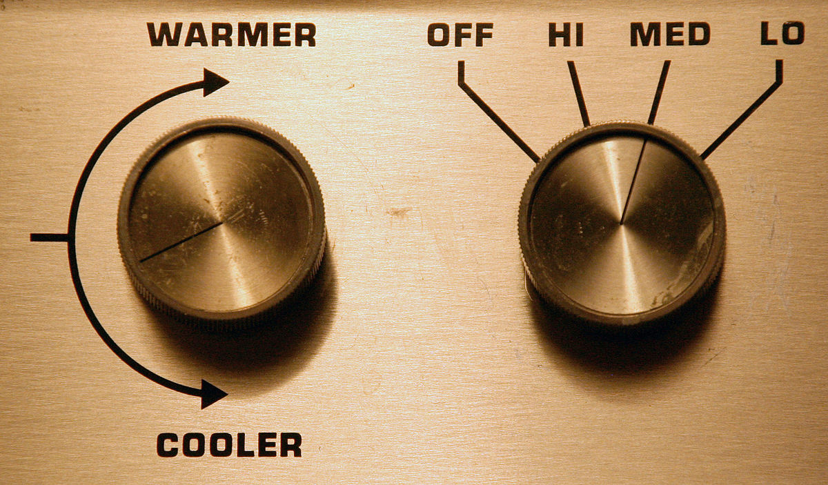
Parameters are your friends
Linear dual-axis graph has four free parameters:

Slide 18
Parameters are your friends
Linear dual-axis graph has four free parameters:
The space of possible competitors to compare against my lackluster client may be large (veering in the direction of strawman here)

Slide 19
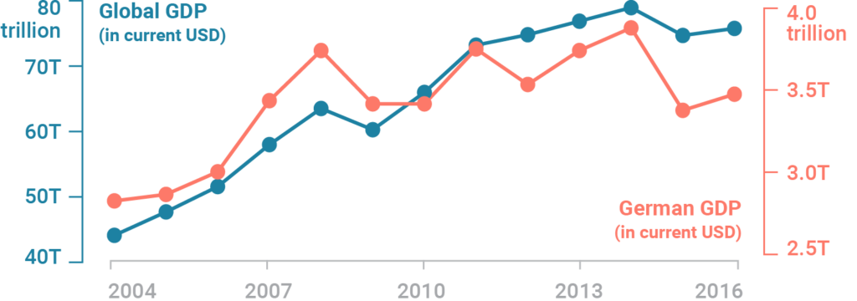
Scale

Slide 20
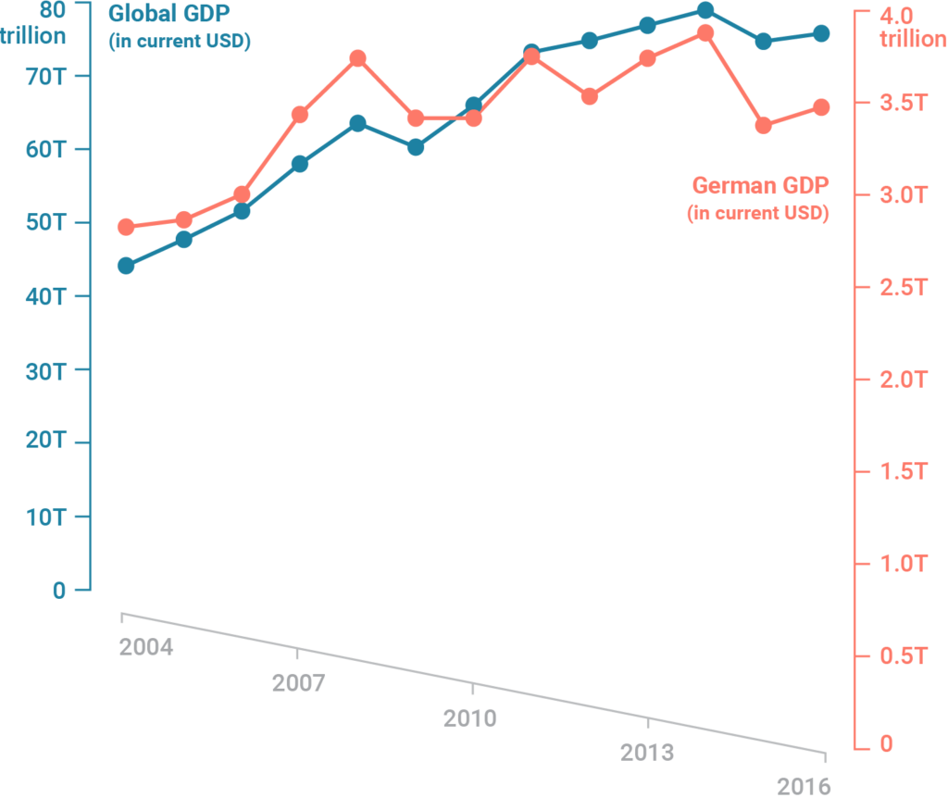
Scale

Slide 21
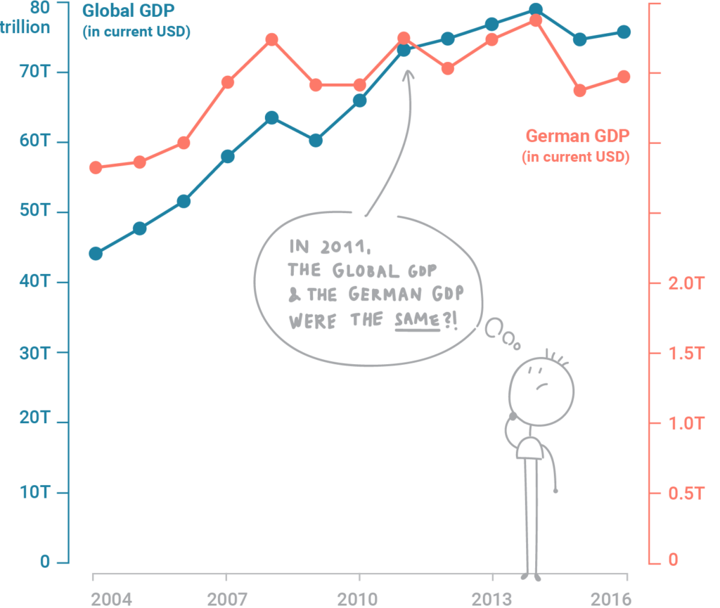
Scale

Slide 22
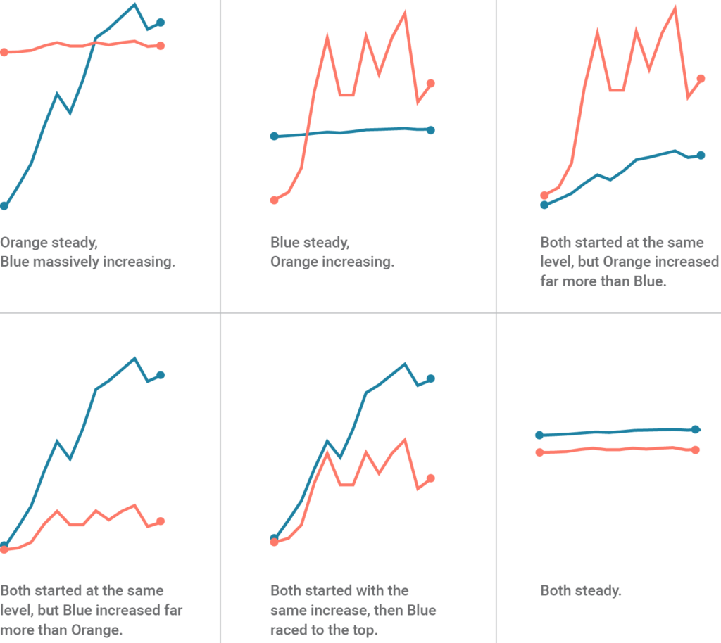

Slide 23
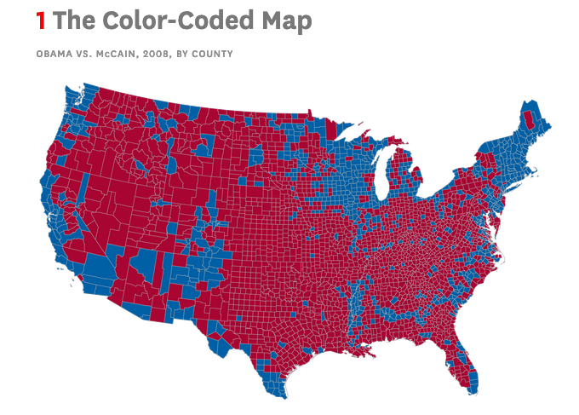
Set threshold, use wrong weights
https://hbr.org/2014/12/vision-statement-how-to-lie-with-charts

Slide 24
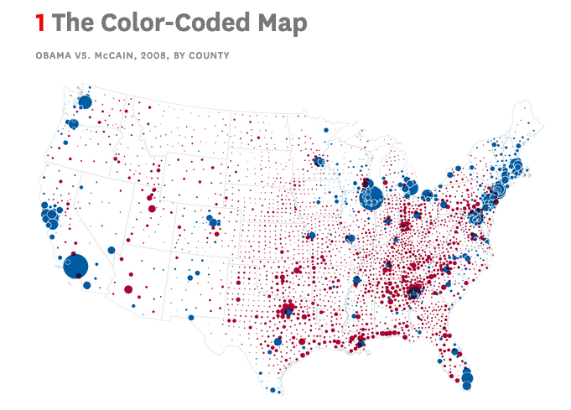
Use weights
https://hbr.org/2014/12/vision-statement-how-to-lie-with-charts

Slide 25
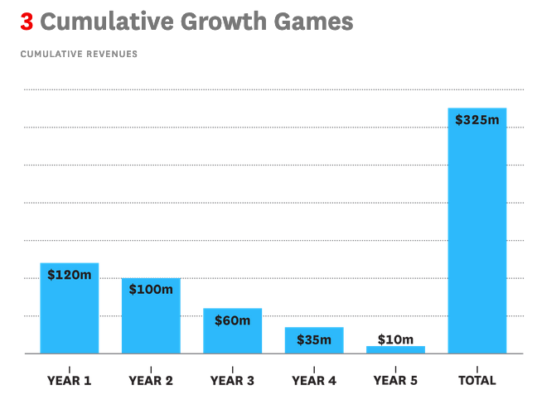
Use calculus
https://hbr.org/2014/12/vision-statement-how-to-lie-with-charts

Slide 26
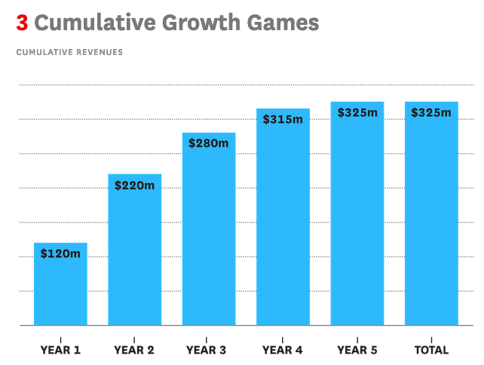
Use calculus
https://hbr.org/2014/12/vision-statement-how-to-lie-with-charts

Slide 27
Use calculus
Want to make things look smooth and monotonic? Use cumulative sum.
Want to make things look noisy, dramatic, and obscure the big picture? Use finite differences.
https://hbr.org/2014/12/vision-statement-how-to-lie-with-charts

Slide 28
Count the wrong things weighting by individuals, not importance
...fraction of departments that have a median salary above...
...fraction of retailers that implement loss-prevention strategy...
...fraction of colleges that accept ACT scores...
...fraction of employers with drug testing policies...
...fraction of landlords that include heating cost.
...fraction of countries with visa requirements for US nationals...

Slide 29
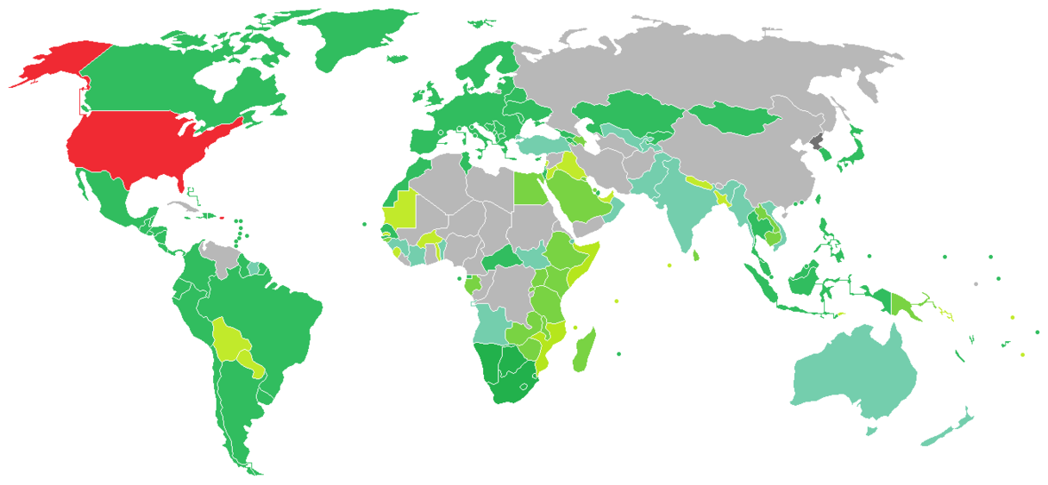
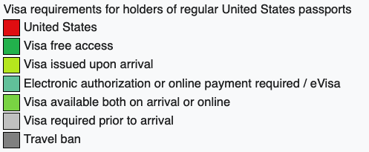
wikipedia: Visa_requirements_for_United_States_citizens.png

Slide 30
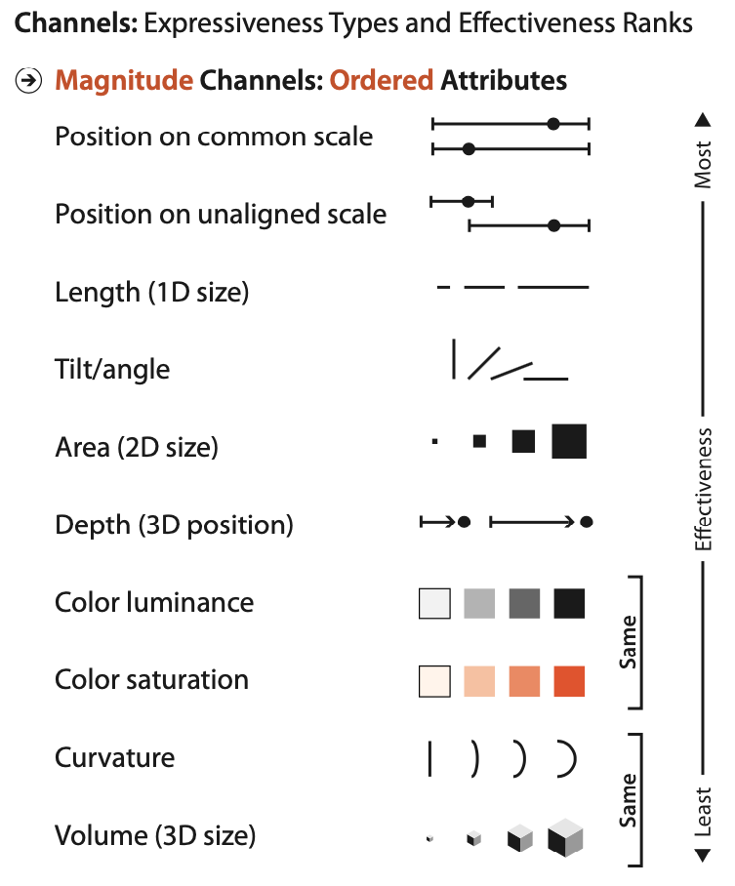
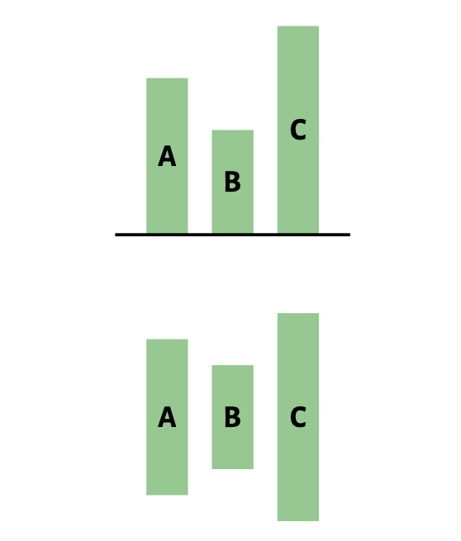
Mute saliency
Munzner, 2017

Slide 31
Mute saliency
Munzner, 2017

Slide 32
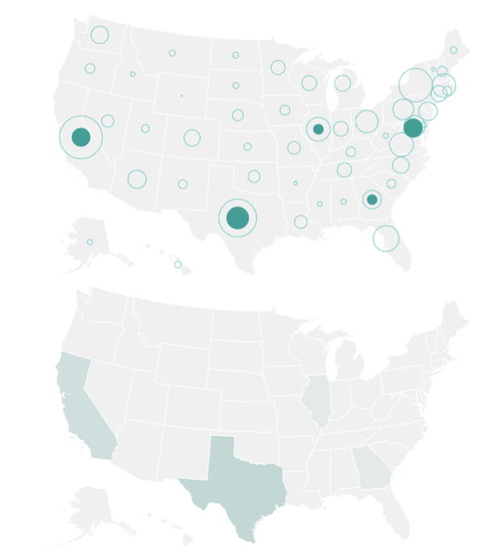
Mute saliency
Munzner, 2017

Slide 33
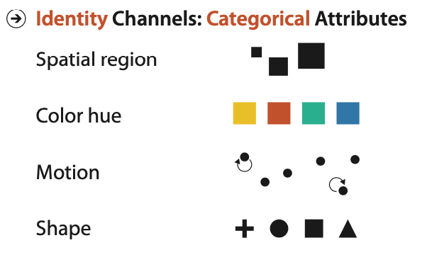
Inappropriate encoding: put quantitative data into categorical attributes
Munzner, 2017

