Slide 1

Color I
Data 227
Data Visualization & Communication
Autumn, 2022

Slide 2
HW3
Provenance: minimum “CDC, year”
Be expressive
  No particular graph types are bad, but some types make for low-expressiveness choices for some data types.
2d-histograms (with color or marker size) were popular for this maddeningly categorical data.

Slide 3
HW3
Try not to be wrong:
  Check scale of axis and rough area-under-the-graph for numbers that make sense.
  single-word errors (-1)
  wrong numbers on axis (-2)
  numbers in data not close to real numbers (-3)

Slide 4
HW3
  ~40,000 traffic fatalities per year
  ~4M births per year
  ~40,000 infant deaths per year (1%)
  ~330M total U.S. population 2020
  How many deaths per year?

Slide 5
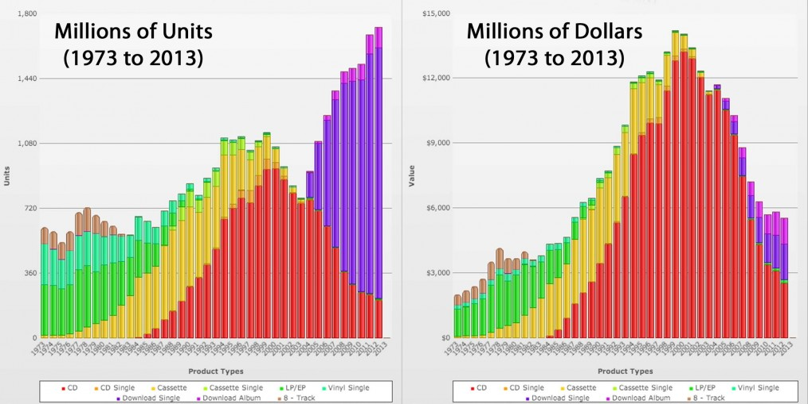

Slide 6
  Comparing these, you can see that the red format get a high price, and that the purple format was really cheap..

Slide 7
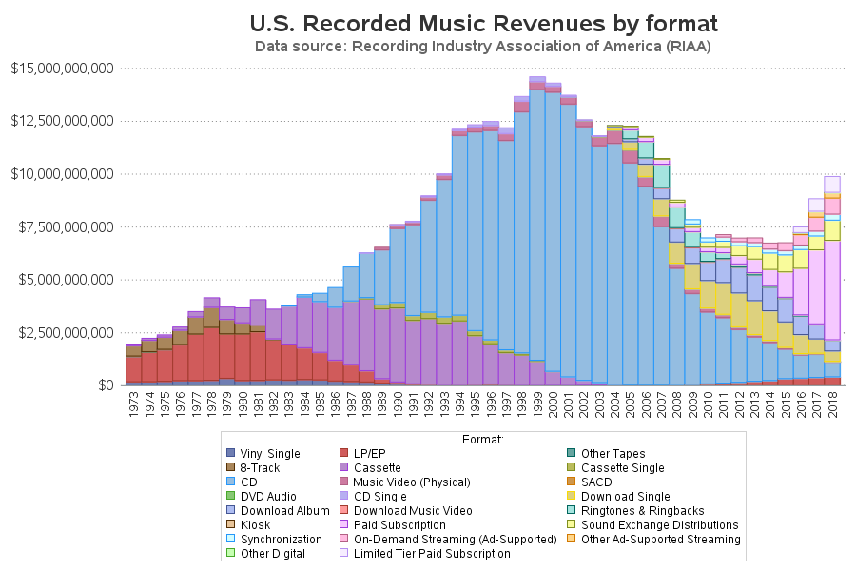

Slide 8
  Note the artful ordering of the bars: the older bars (which drop to zero) are plotted on the bottom of the stack.

Slide 9
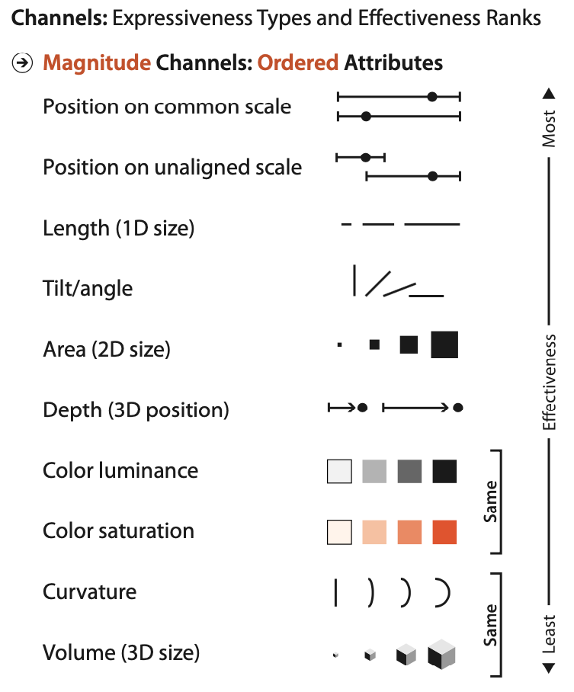
Scatter: usually best choice
Bar, line: usually good choices
Stacked-bar: good for understanding proportions; category distributions (race, cigarettes, Likert scale)
Usually not the best choice for time series.

Slide 10

How to encode color?

Slide 11
How to encode color?

Slide 12
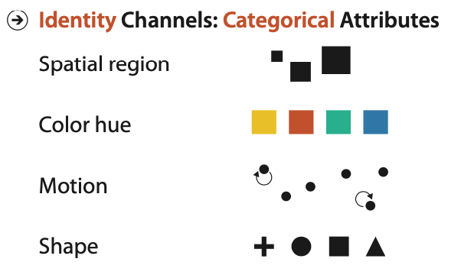
We have two tasks for color:
Marking nominal categories (legend)

Slide 13
We have two tasks for color
Painting quantitative values (colormap)

Slide 14
We have two tasks for color
Painting quantitative values (colormap)
Accept that putting quantitative data in the color channel is carrying flowers in a duffelbag.

Slide 15
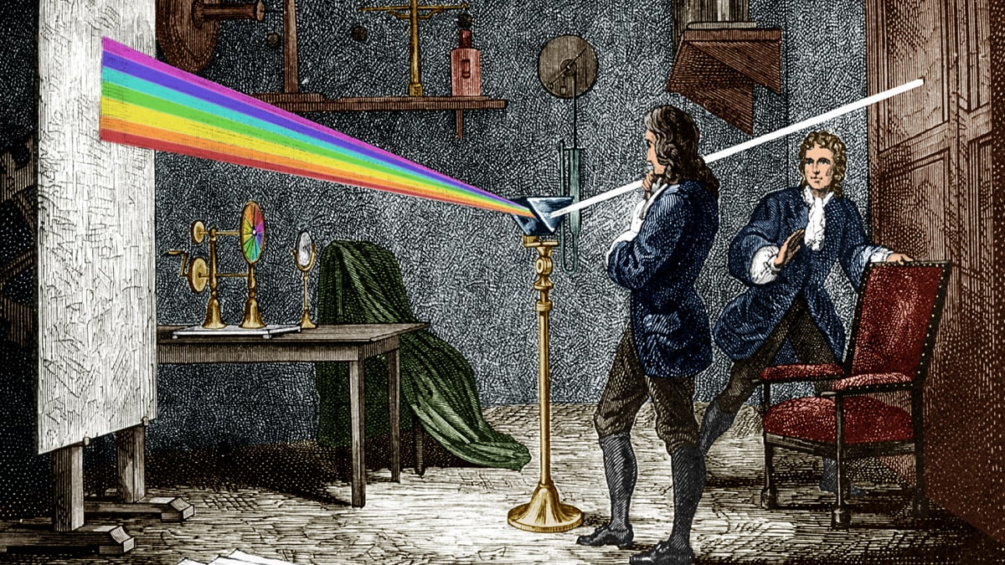
Ask a physicist. Physicists think they know everything.

Slide 16
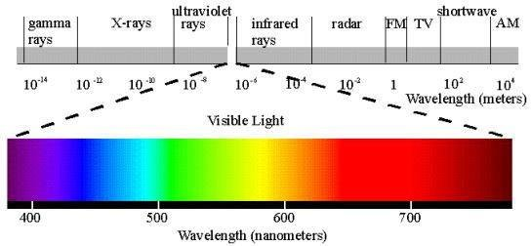
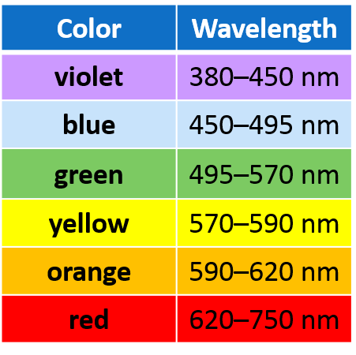

Slide 17
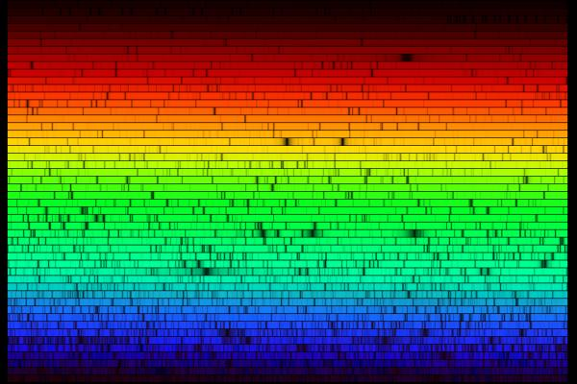
This is the spectrum of the sun.

Slide 18
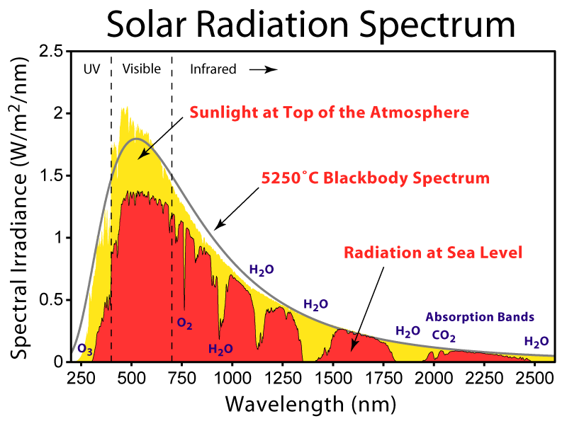

Slide 19
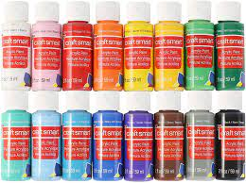
But this is closer to what we experience...

Slide 20
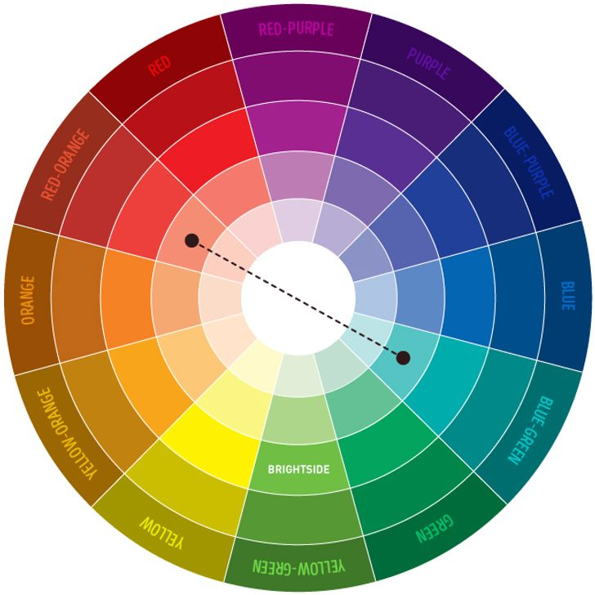

Slide 21
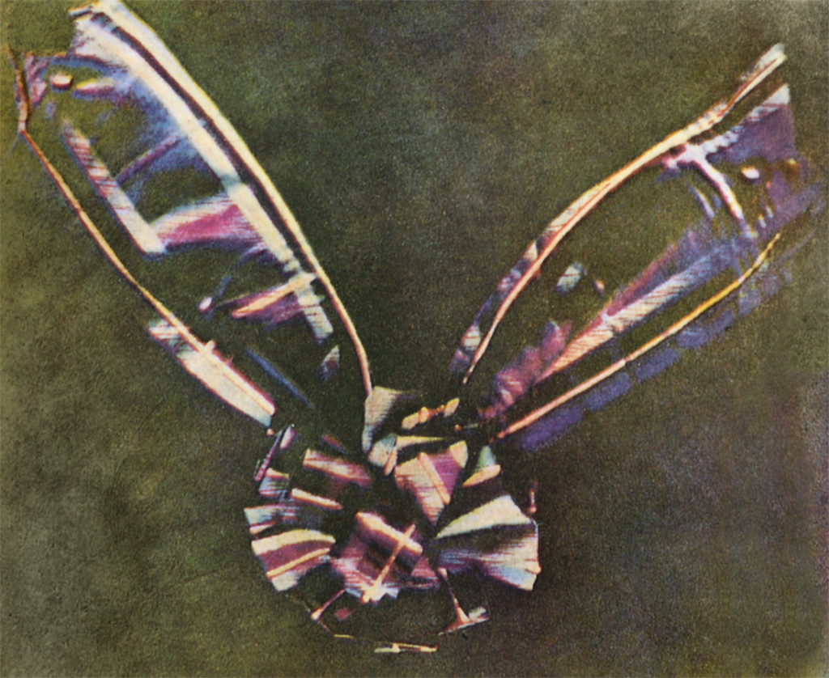
Maybe it's time to ask an engineer.
Photography, cinema, television, printing..
1861, Thomas Sutton, first color photograph

Slide 22
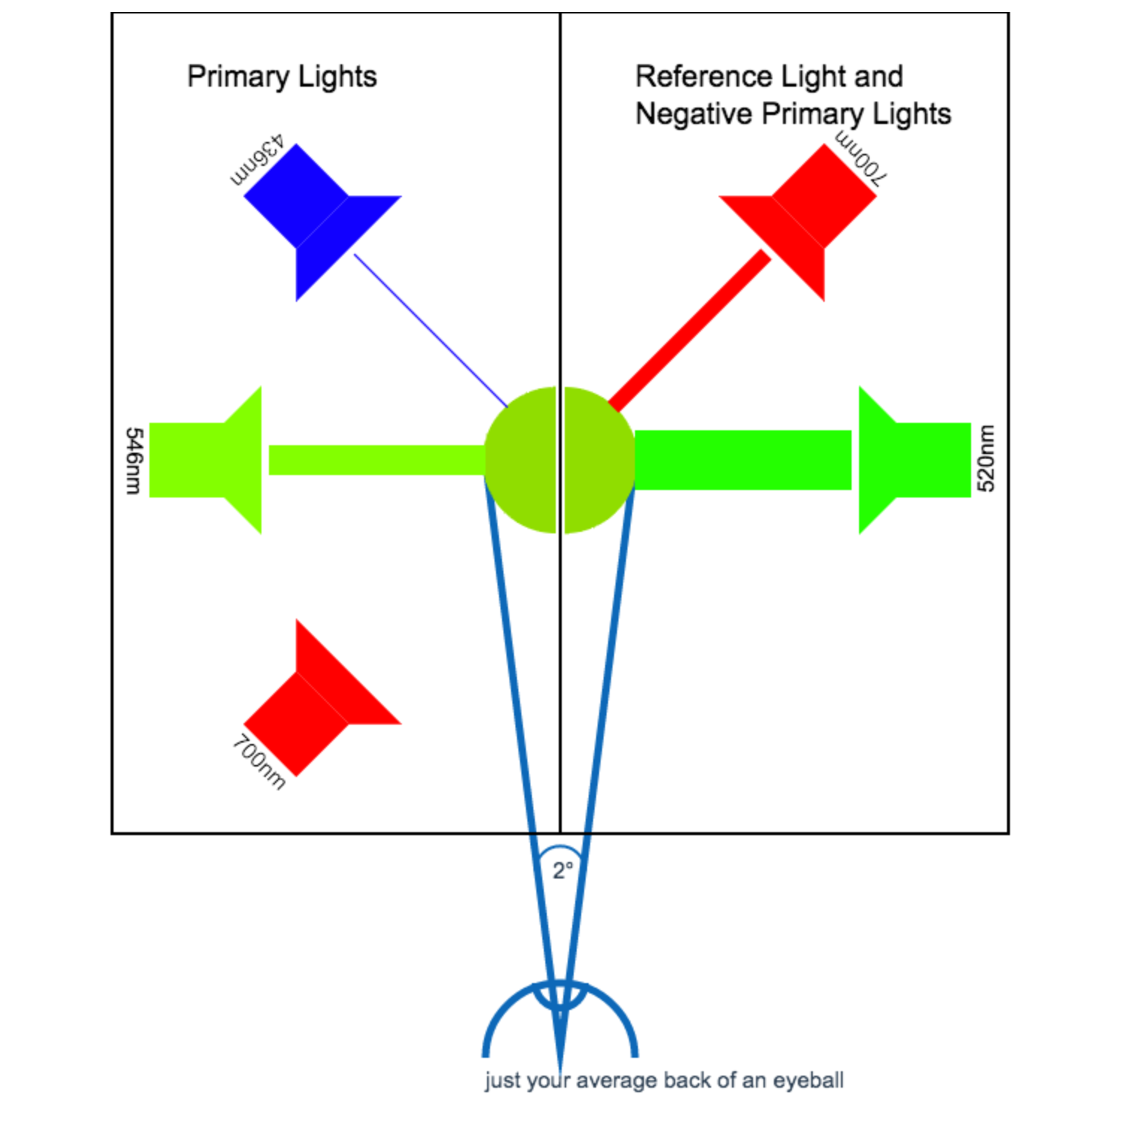
Pure single-wavelength
color

Slide 23
“I can't match it”

Slide 25
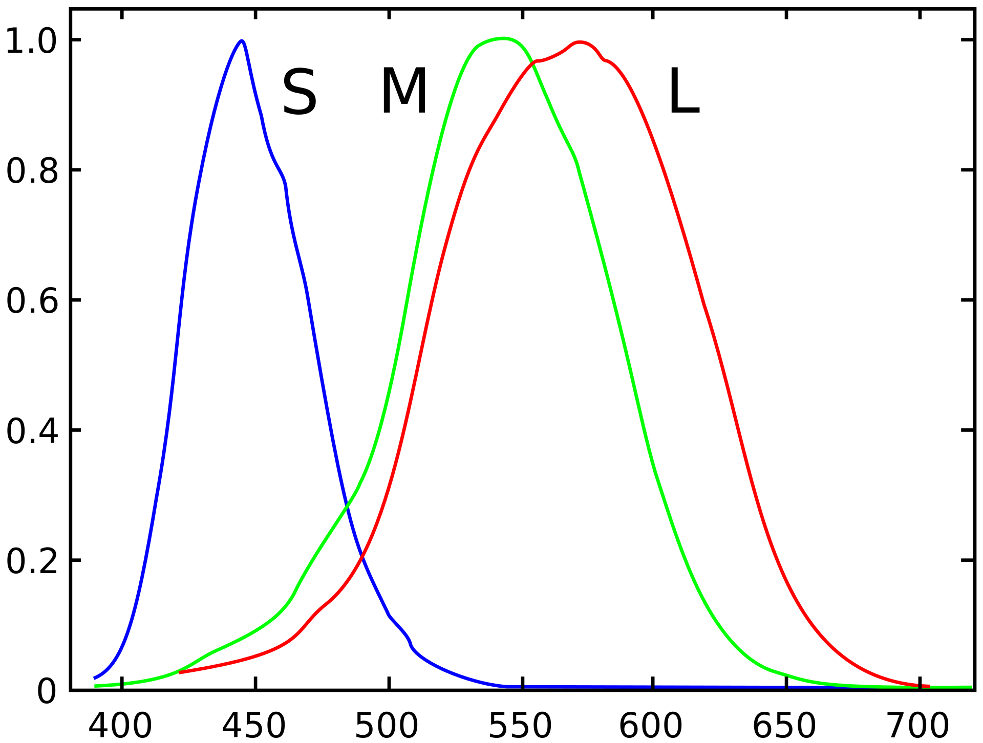
3 kinds of
cone responses:
“Short”
“Medium”
“Long”
Relative sensitivity
Wavelength (nm)

Slide 26
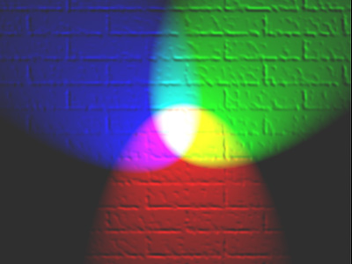

Slide 27
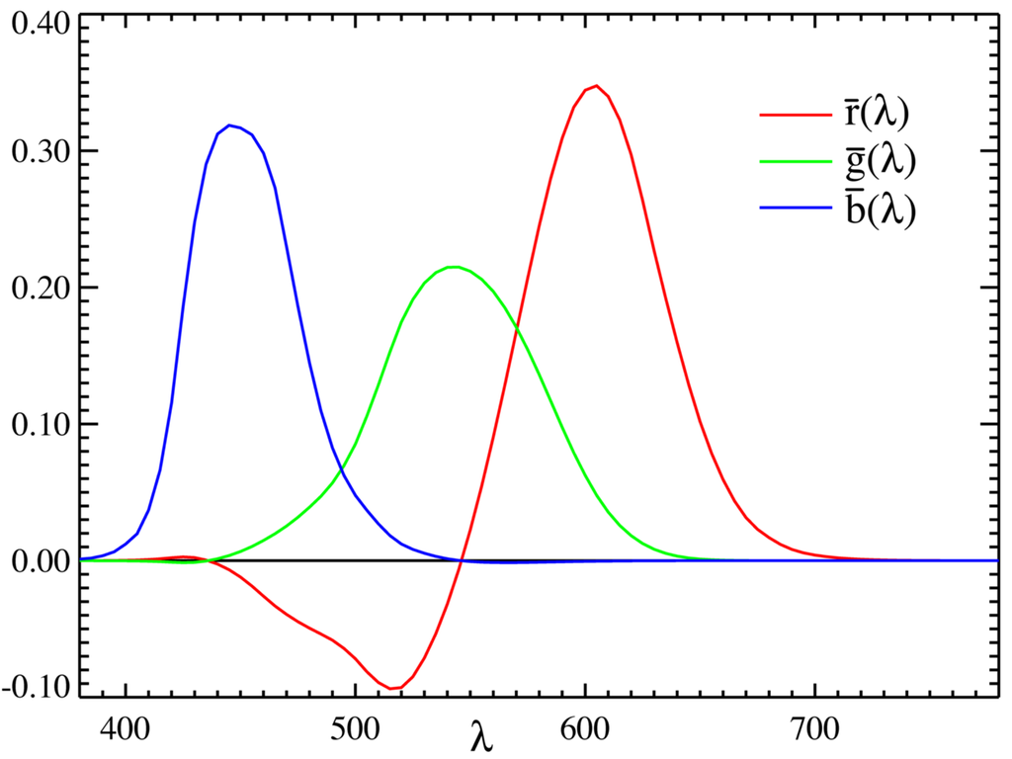
CIE RGB model

Slide 28
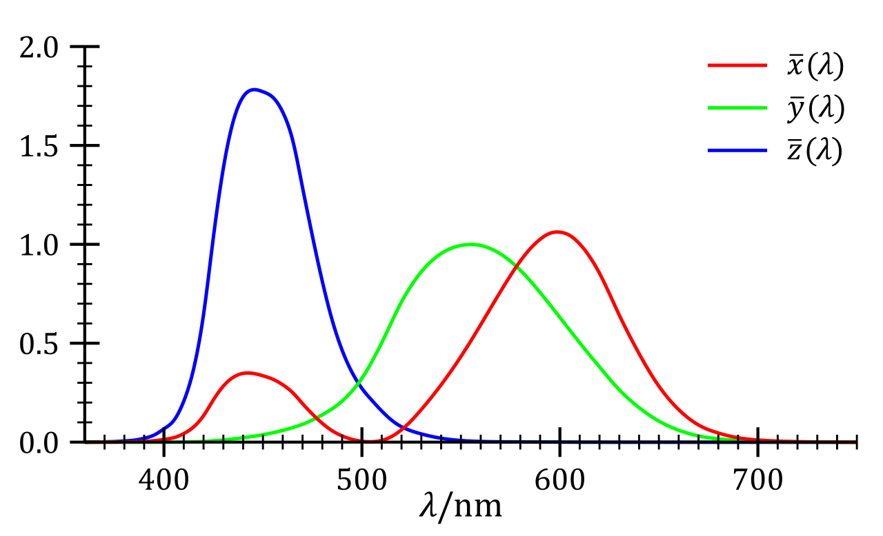
CIE 1931 XYZ color space

Slide 29
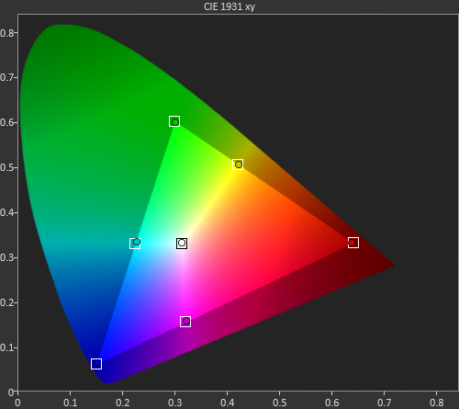
Chromacity -- pair of coordinates that specifies color
Luminance --single coordinate, quasi-objective measure of brightness
y
x

Slide 30
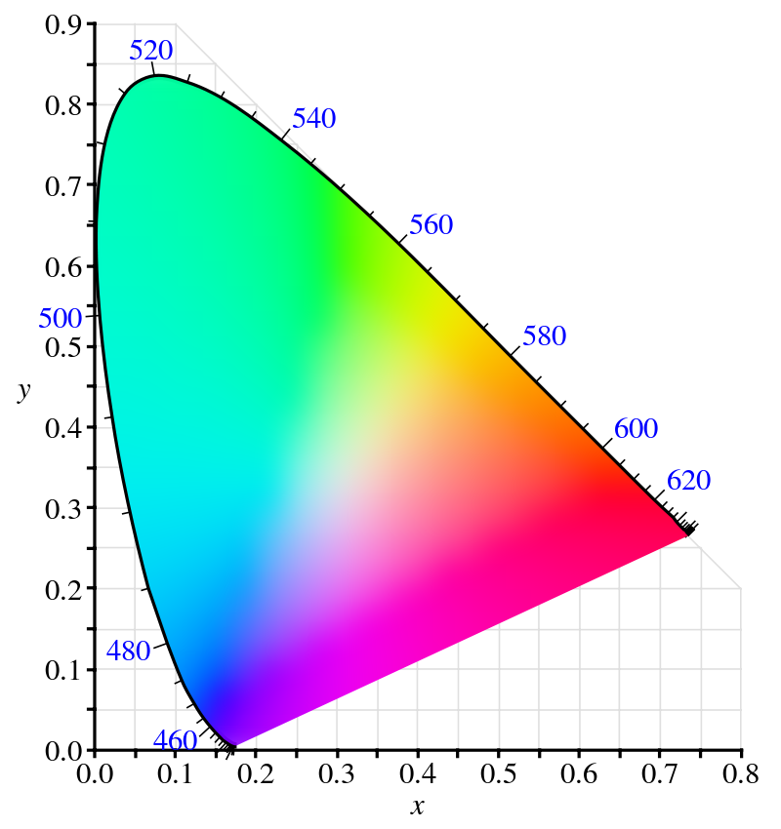

Slide 32
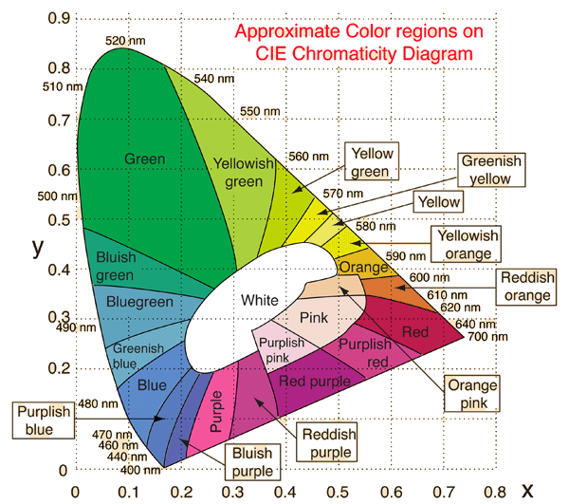

Slide 33
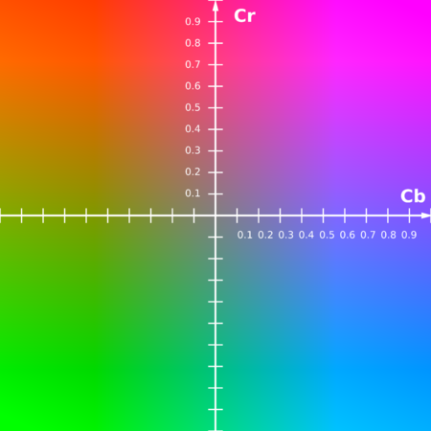
Y' Cb Cr (sYCC) colorspace
This color space has been designed to create planes of equal luminance.

Slide 34
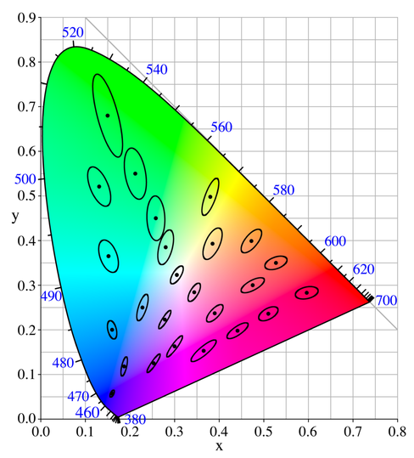

Slide 35
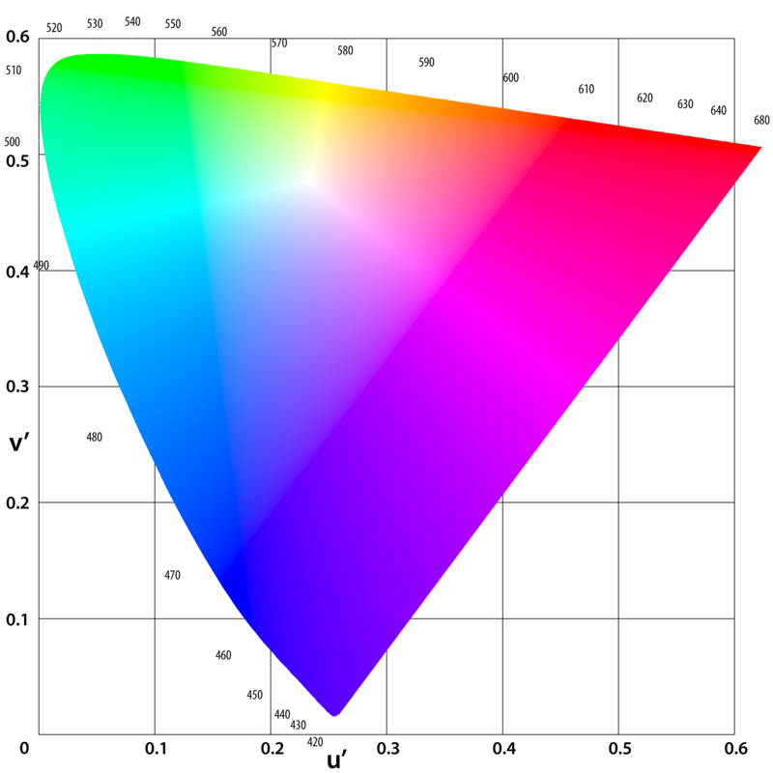
CIE L u* v* (1976)
Intended to be more perceptually uniform (confusion ovals have smaller size difference)

Slide 36
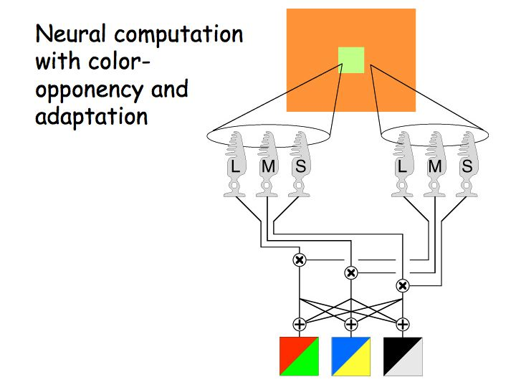
Opponent color theory

Slide 37
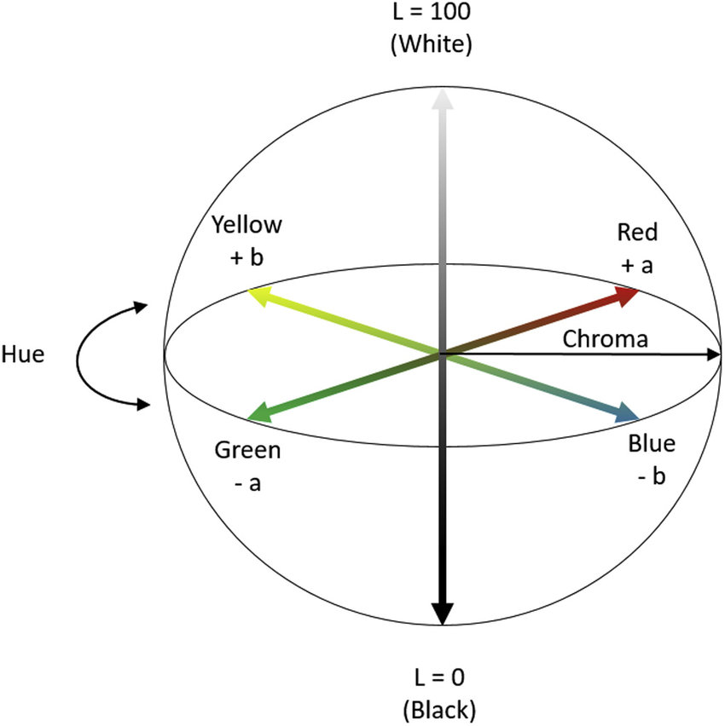
CIE L*a*b* colorspace (1976)
L* perceptual lightness
a* Red-Green axis
b* Yellow-Blue axis

Slide 38
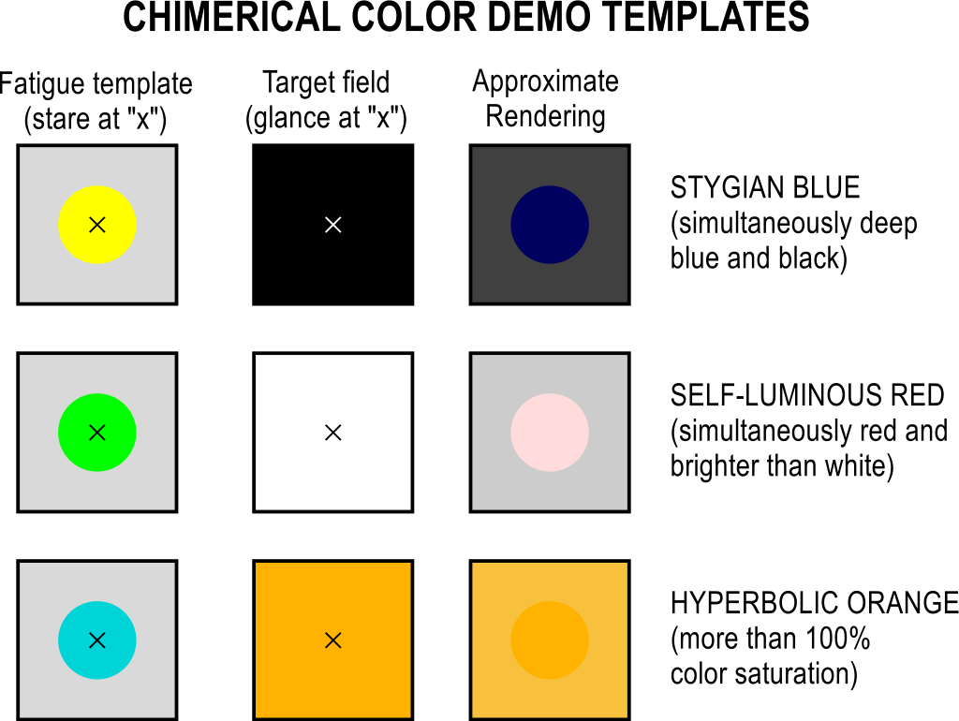
Afterimage parlor trick:
Blacker than black, oranger than orange...
https://en.wikipedia.org/wiki/Impossible_color#/media/File:Chimerical-color-demo.svg

Slide 39
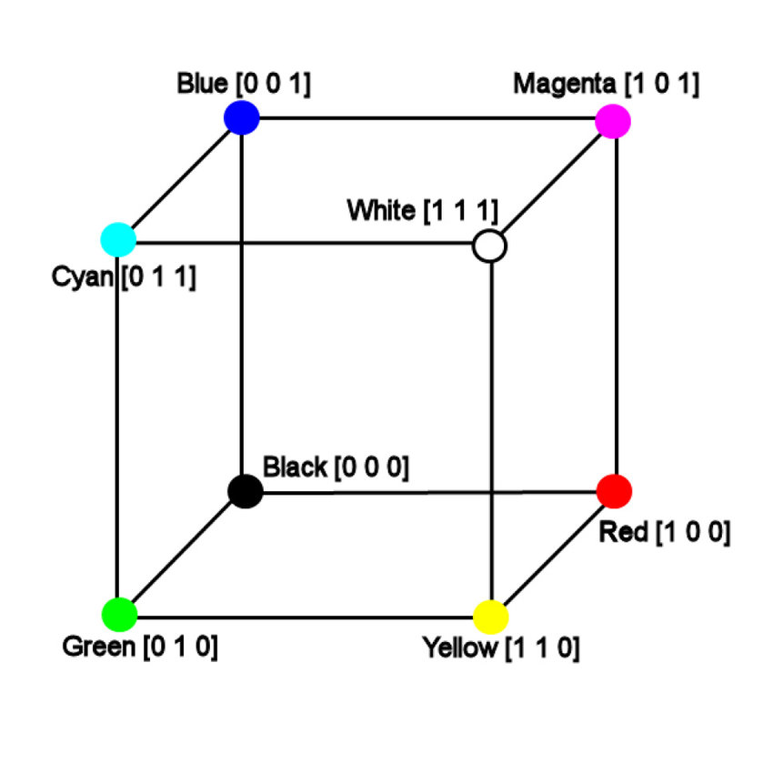
sRGB colorspace
How bad can RGB be?

Slide 40

What could go wrong with
3 primary, 3 secondary colors?
https://www.vis4.net/blog/2011/12/avoid-equidistant-hsv-colors/

Slide 41

What could go wrong with
3 primary, 3 secondary colors?
Seriously uneven luminance.
https://www.vis4.net/blog/2011/12/avoid-equidistant-hsv-colors/

Slide 42


Sadly
Even steps in saturation have different subjective brightness for different hues. Our eyes are apparently differently nonlinear for red and for blue. (That's why we have so many color spaces, each one corrects for a different aspect of our visual peculiarities.)
https://www.vis4.net/blog/2011/12/avoid-equidistant-hsv-colors/

Slide 43
If we just pretend that sRGB is good...

Slide 44
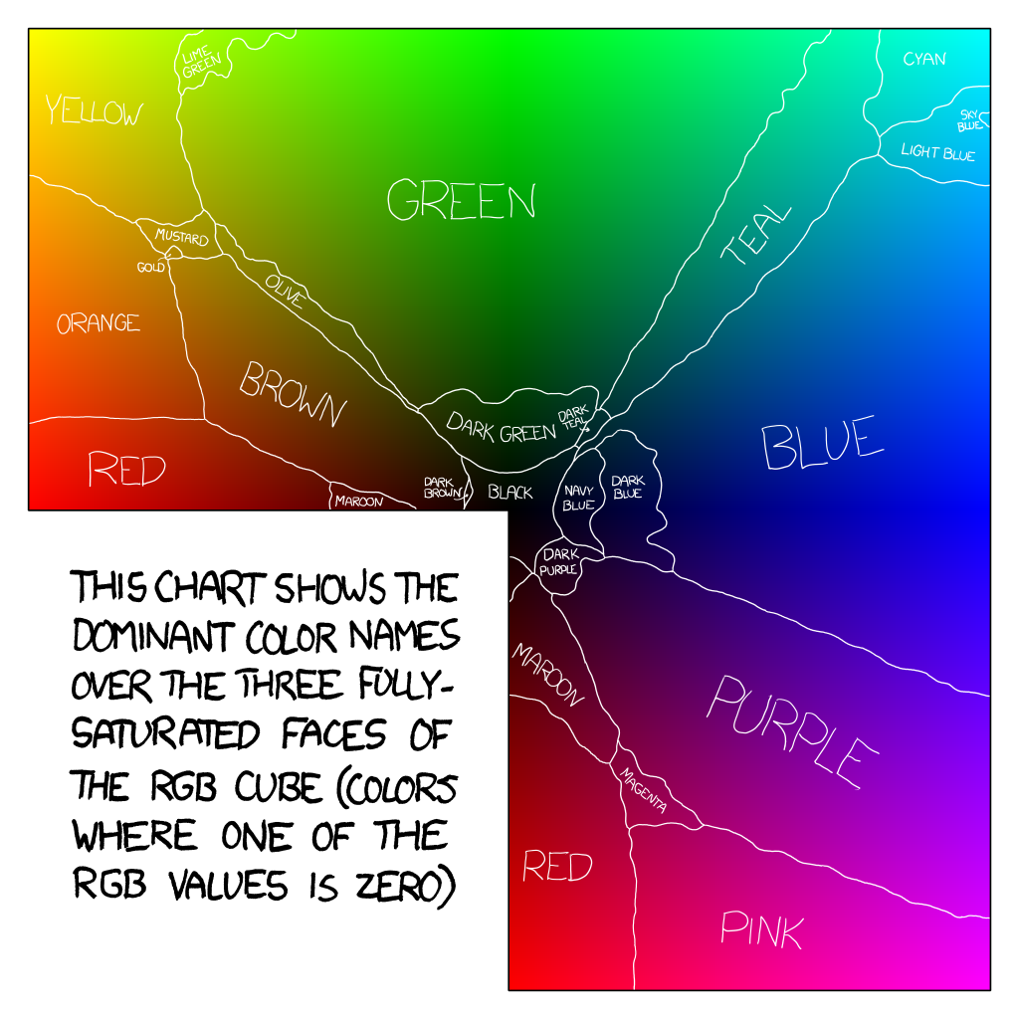

Slide 45
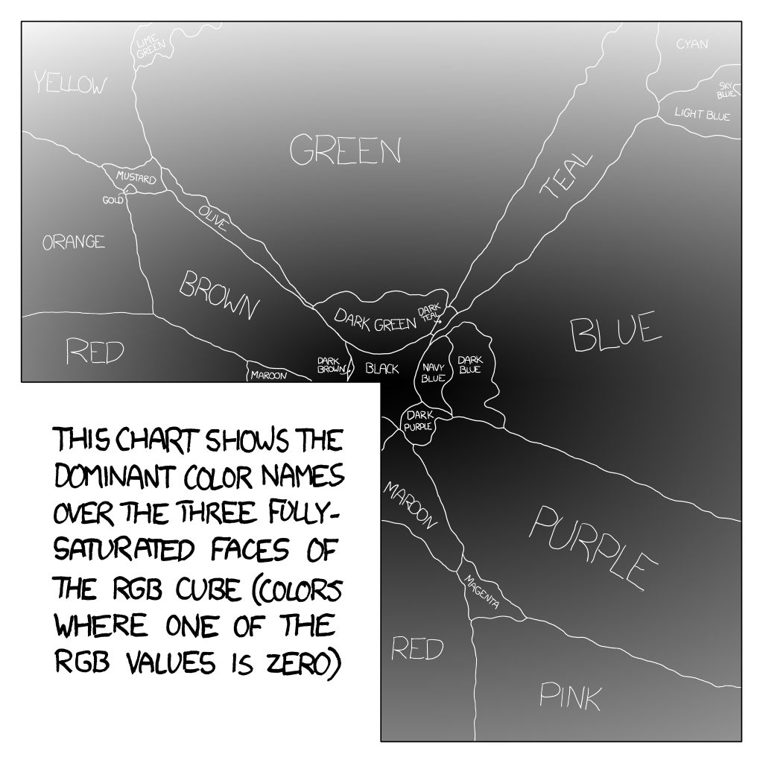

Slide 46
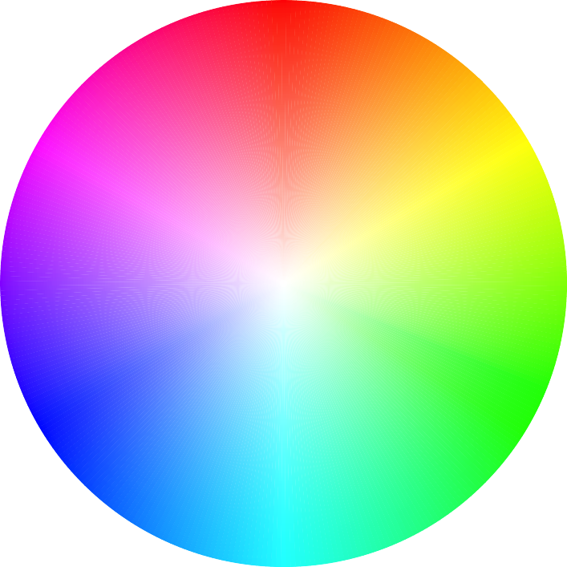

Slide 47
R
M
Y
B
R
C

Slide 48
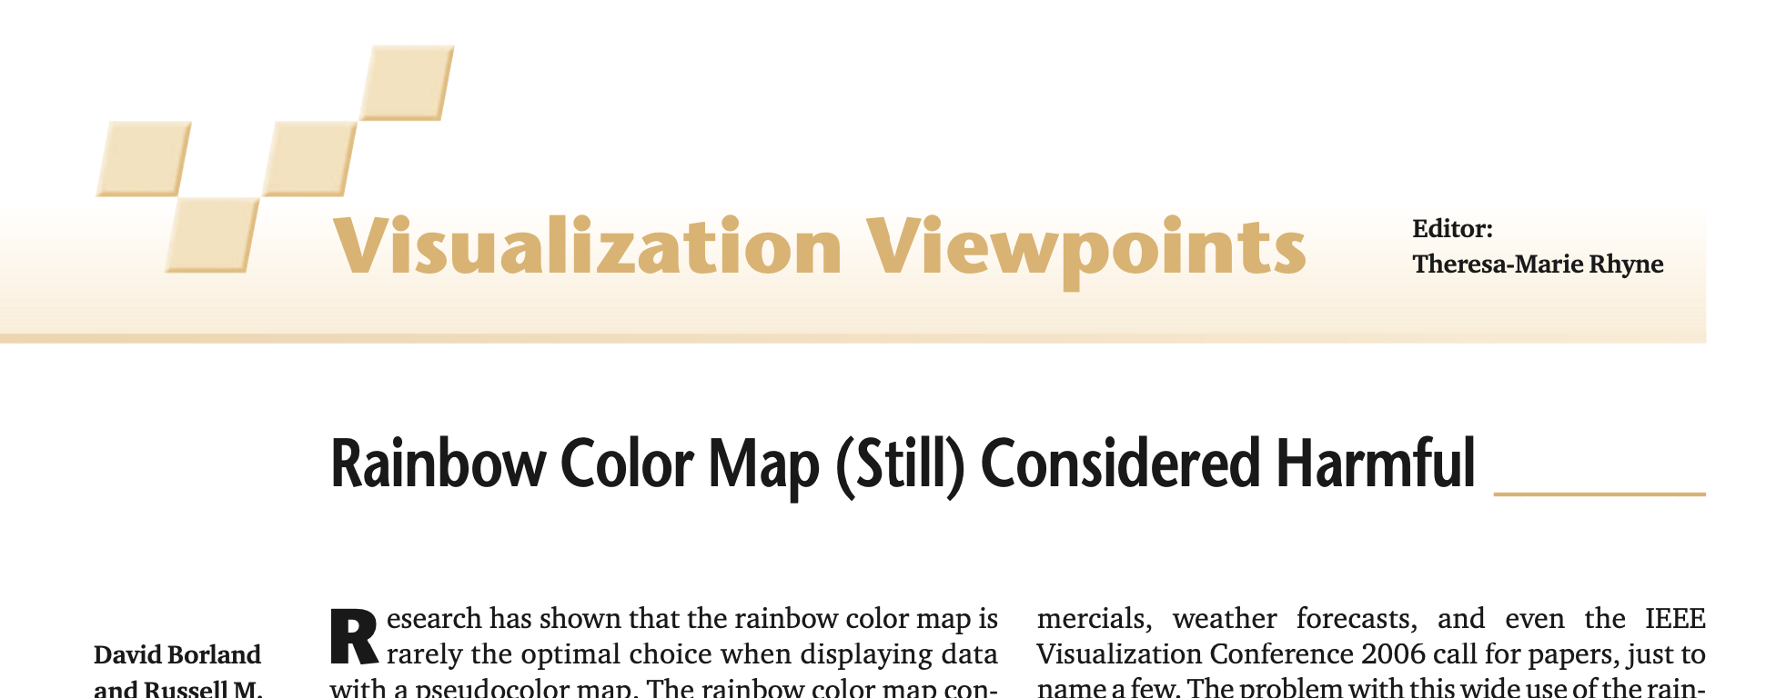

Slide 49
Desiderata
Discriminability
Ordering
Association
Do not modulate luminance as a side effect

Slide 50
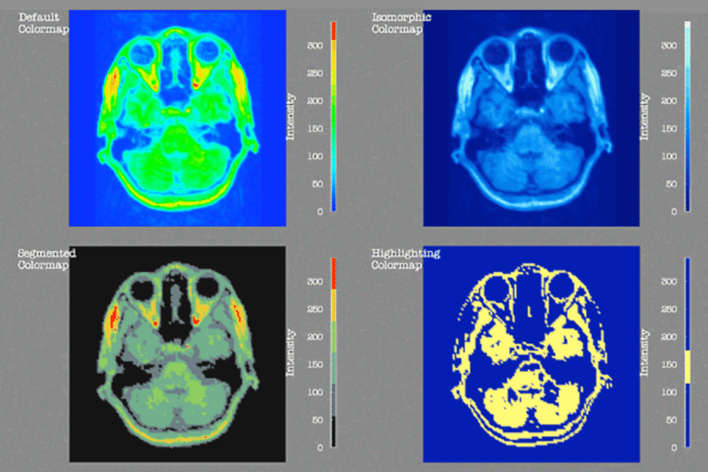
Rogowitz & Treinish, How Not to Lie with Visualization (1996)

