Slide 1

Data 227
Data Visualization & Communication
Autumn, 2021
Deception II
(Deceptive filename)

Slide 2
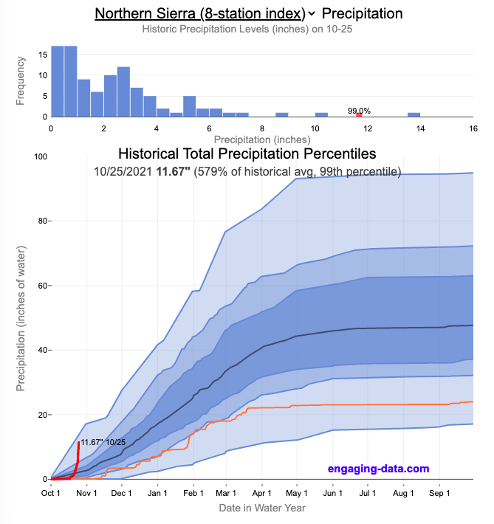
https://engaging-data.com/california-precipitation-levels/

Slide 3
https://engaging-data.com/california-precipitation-levels/
Comparing current cumulative rainfall to distribution over many past years clearly shows anamolies.

Slide 4
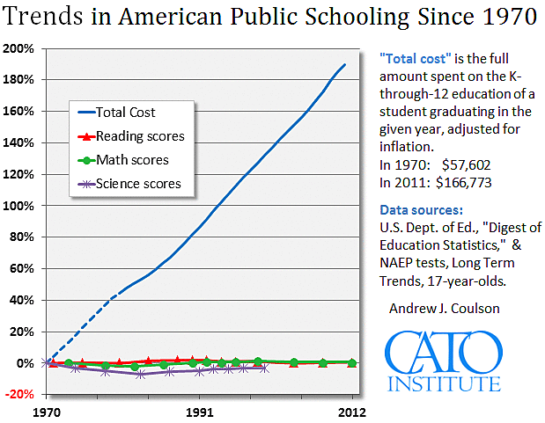
https://www.cato.org/blog/addressing-critics-purportedly-no-good-very-bad-chart

Slide 5
Comparing apples and oranges
Inflation-adjusted cost and test scores live in vector spaces with different symmetries--no quotient comparison for qualitative test scores!
https://www.cato.org/blog/addressing-critics-purportedly-no-good-very-bad-chart

Slide 6
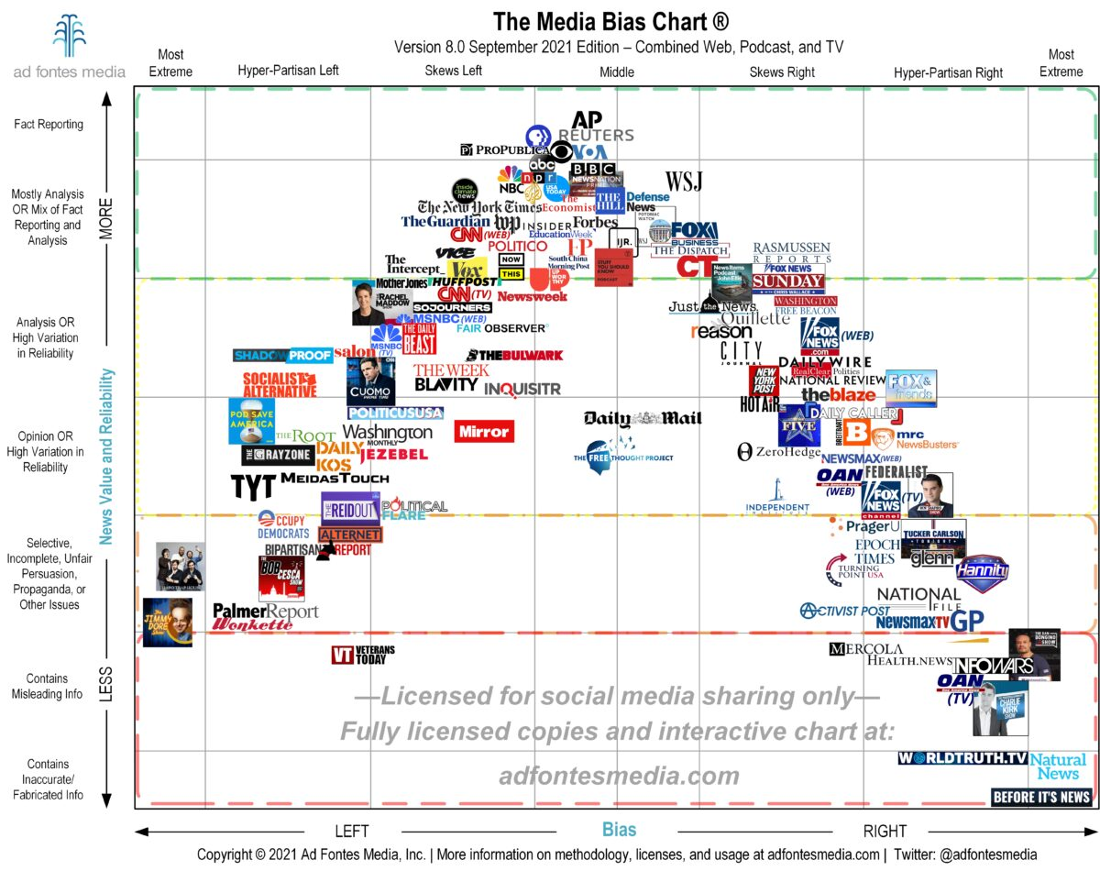

Slide 7
I dunno, go to some think tank website and look for bad viz...

Slide 8
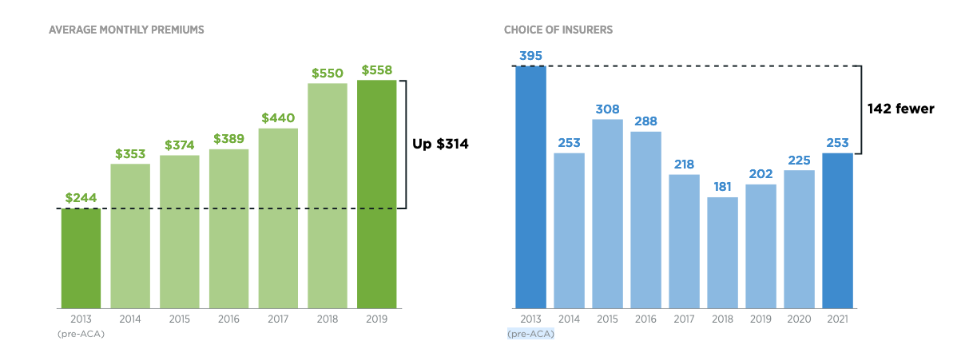
https://datavisualizations.heritage.org/public-health/health-care-choices-and-premiums-under-obamacare-whats-going-on-in-the-states/

Slide 9
WT: Annotations comparing beginning to end
help focus reader's attention (good)
https://datavisualizations.heritage.org/public-health/health-care-choices-and-premiums-under-obamacare-whats-going-on-in-the-states/

Slide 10
WT: Annotations comparing beginning to end
help focus reader's attention (good)
DB: Averages?!? You know the're lying to you
when they use averages! What about the large,
positive change in the number of people insured?
WT: Annotations comparing beginning to end
help focus reader's attention (good)
DB: Averages?!? You know they're lying to you
when they use averages! What about the large,
positive change in the number of people insured?
https://datavisualizations.heritage.org/public-health/health-care-choices-and-premiums-under-obamacare-whats-going-on-in-the-states/

Slide 11
WT: Annotations comparing beginning to end
help focus reader's attention (good)
DB: Averages?!? You know the're lying to you
when they use averages! What about the large,
positive change in the number of people insured?
WT: Annotations comparing beginning to end
help focus reader's attention (good)
DB: Averages?!? You know they're lying to you
when they use averages! What about the large,
positive change in the number of people insured?
WT: Counting the wrong things.
https://datavisualizations.heritage.org/public-health/health-care-choices-and-premiums-under-obamacare-whats-going-on-in-the-states/

Slide 12
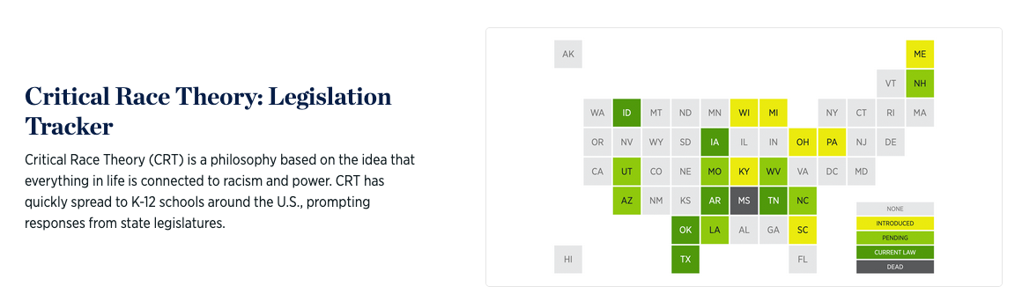
https://datavisualizations.heritage.org/education/critical-race-theory-legislation-tracker/

Slide 13
The Viz is effective, but the caption contains strange definitions and expansive framing of this front in the culture wars.
I guess the lesson is don't be afraid to put bold, false statements in your deceptive-visualization titles and captions.
https://datavisualizations.heritage.org/education/critical-race-theory-legislation-tracker/

Slide 14
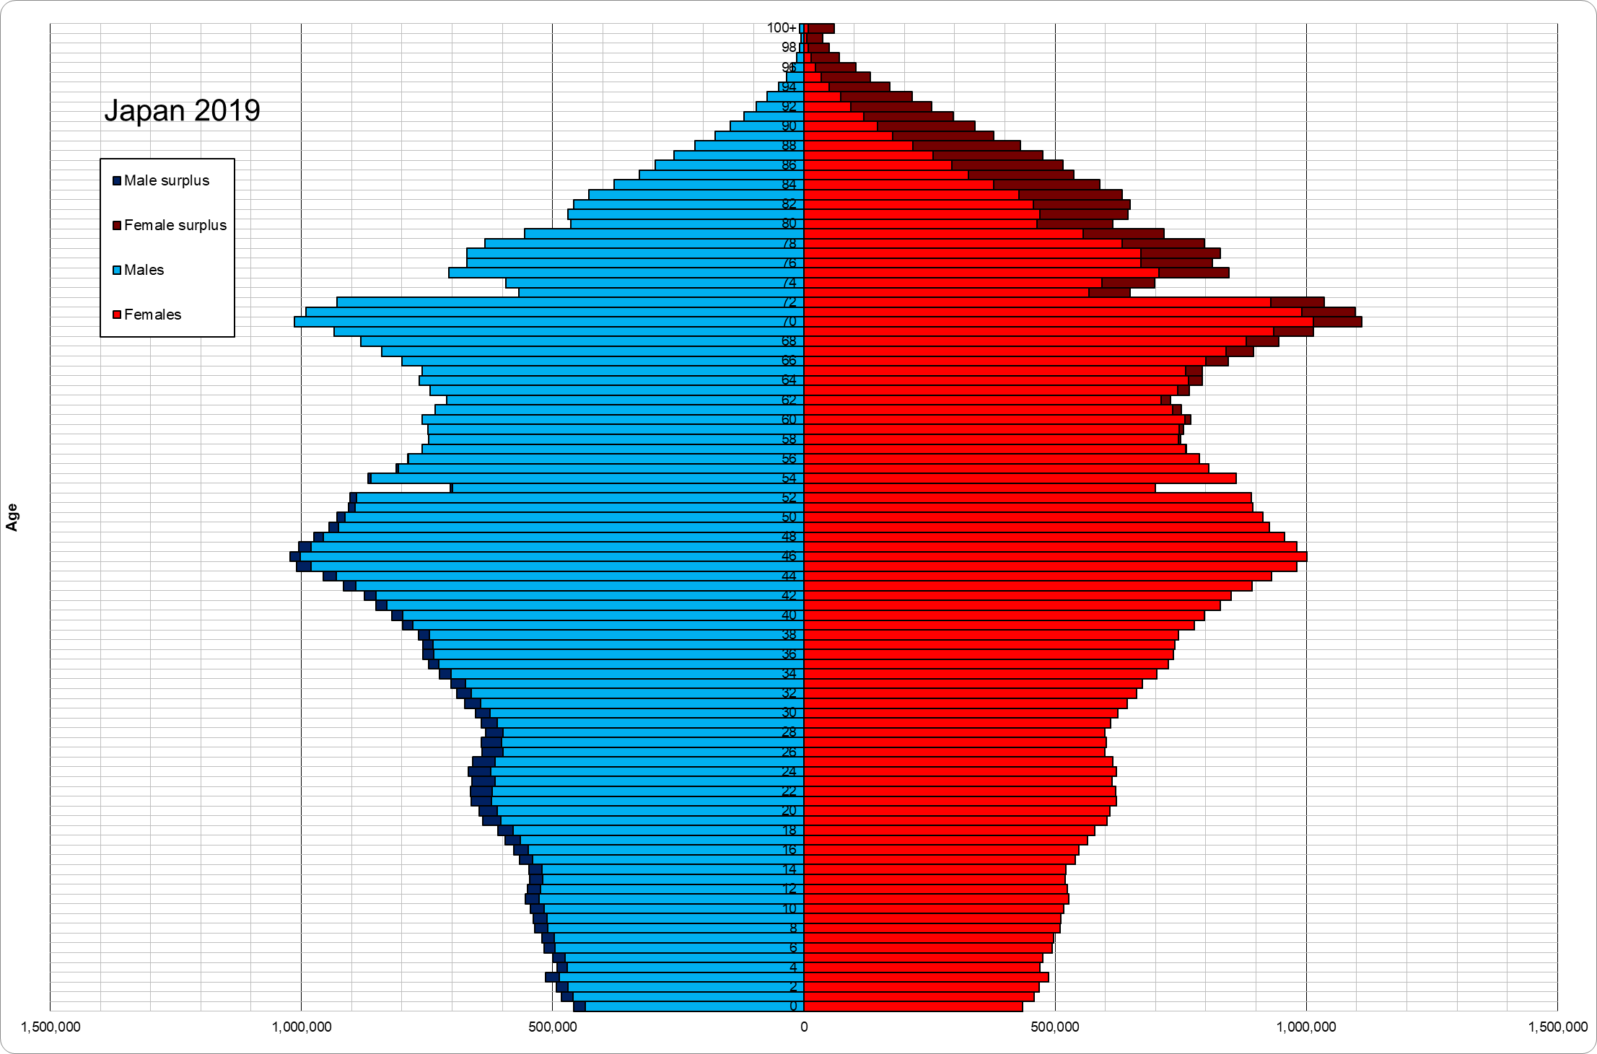
https://upload.wikimedia.org/wikipedia/commons/7/71/Japan_population_pyramid_10.01.2019.png

Slide 15
1920
1920
1930
1940
1950
1960
1970
1980
1990
2000
2010

Slide 16
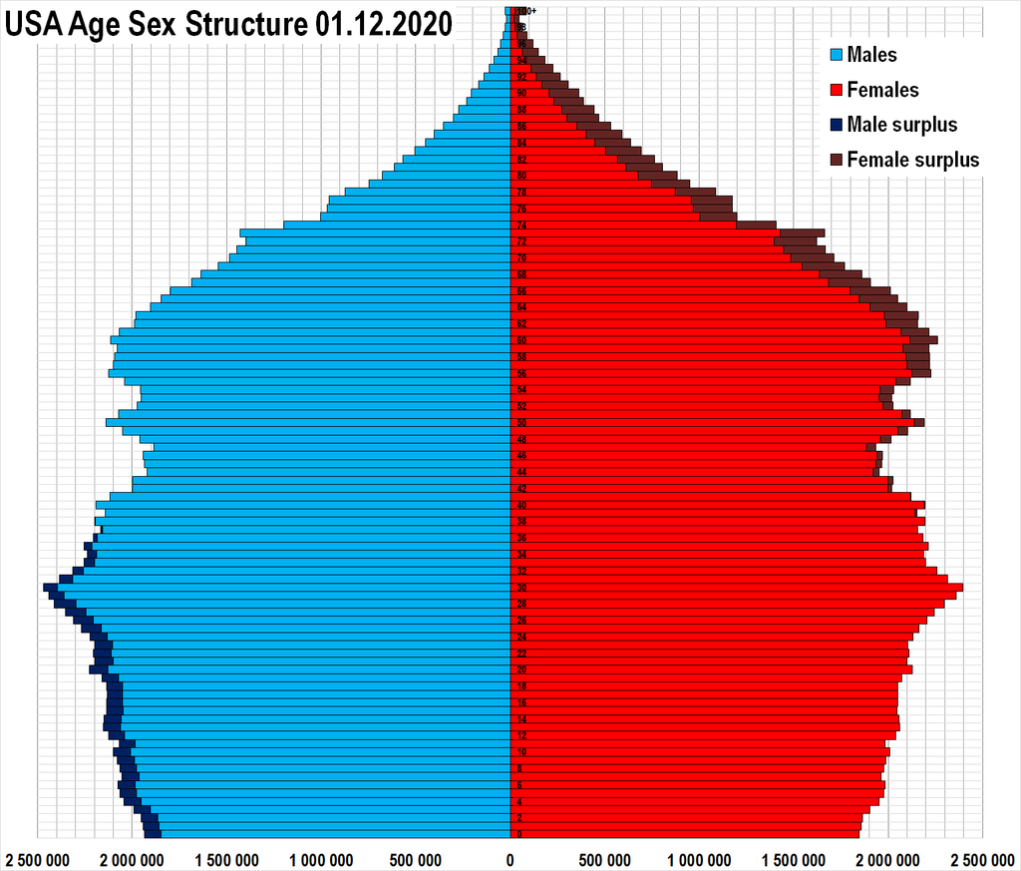
1920
1930
1940
1950
1960
1970
1980
1990
2000
2010

Slide 17
1920
Japan (2019)
1920
1930
1940
1950
1960
1970
1980
1990
2000
2010

Slide 18
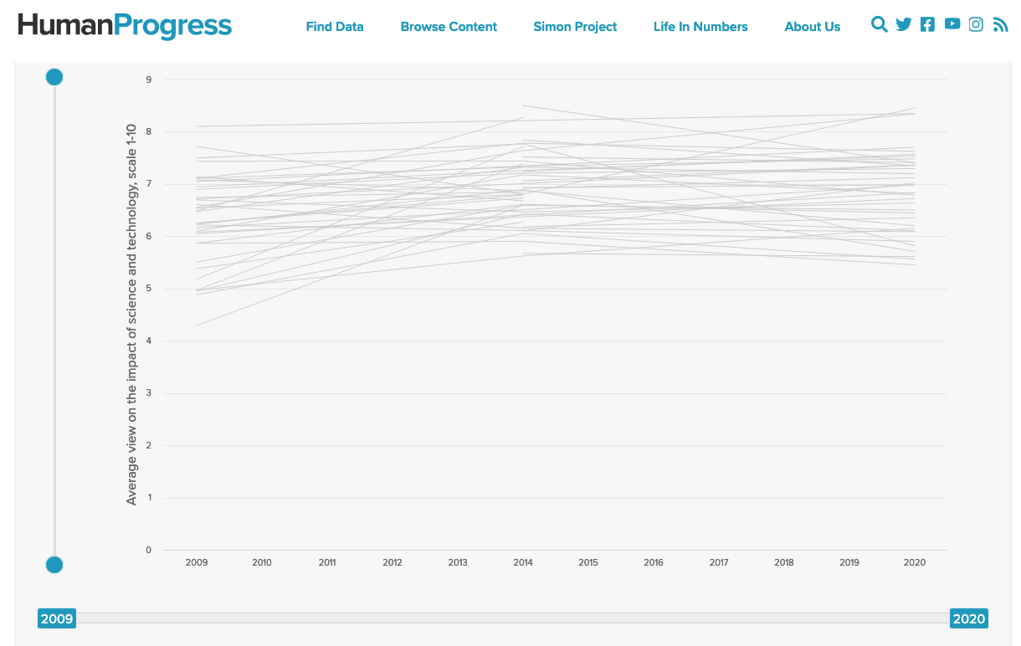
https://www.humanprogress.org/dataset/average-view-on-the-impact-of-science-and-technology/

Slide 19
This is mostly awful for being data-thin and ugly; it earns my wrath further because it interpolates between thin data with inappropriate precision
Interactive bells and whistles can't rescue sad data.
This would be better as a dot plot (intersections of lines on an only semiquantitative scale aren't important)
https://www.humanprogress.org/dataset/average-view-on-the-impact-of-science-and-technology/

Slide 20
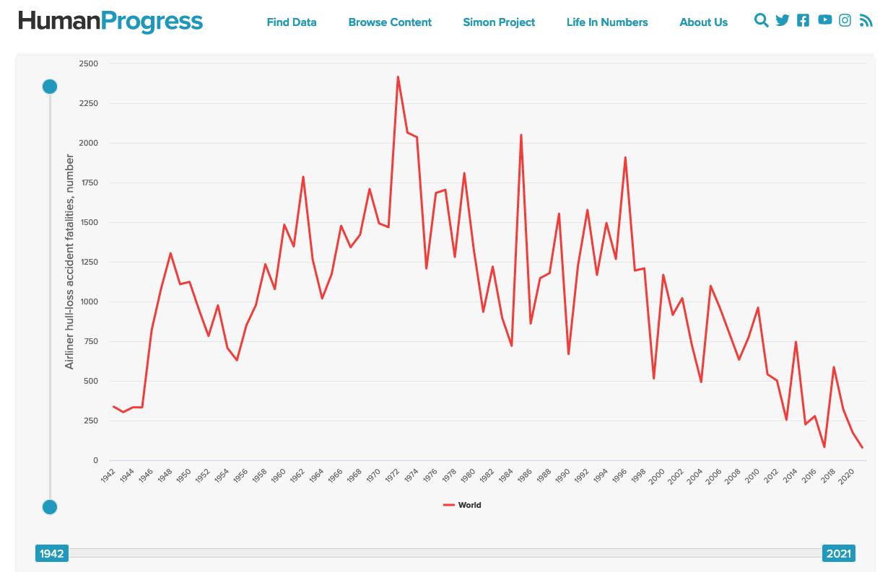
Airplane crash fatalities by year

Slide 21
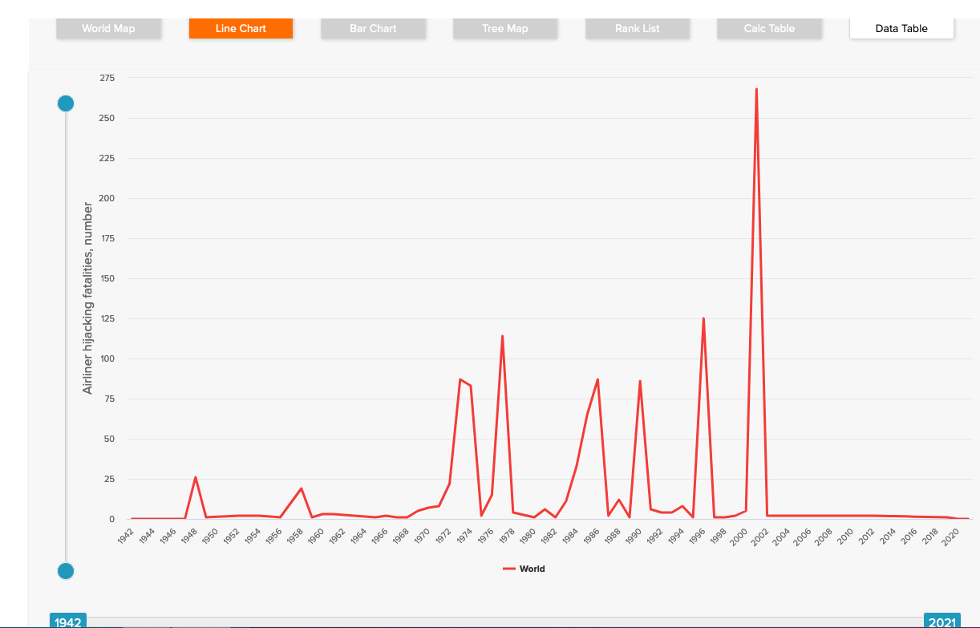
Aviation hijacking fatalities by year

Slide 22
Aviation hijacking fatalities by year
What is the word for paying attention to the wrong things, or paying attention to things that are not important?
Misdirection?

Slide 23
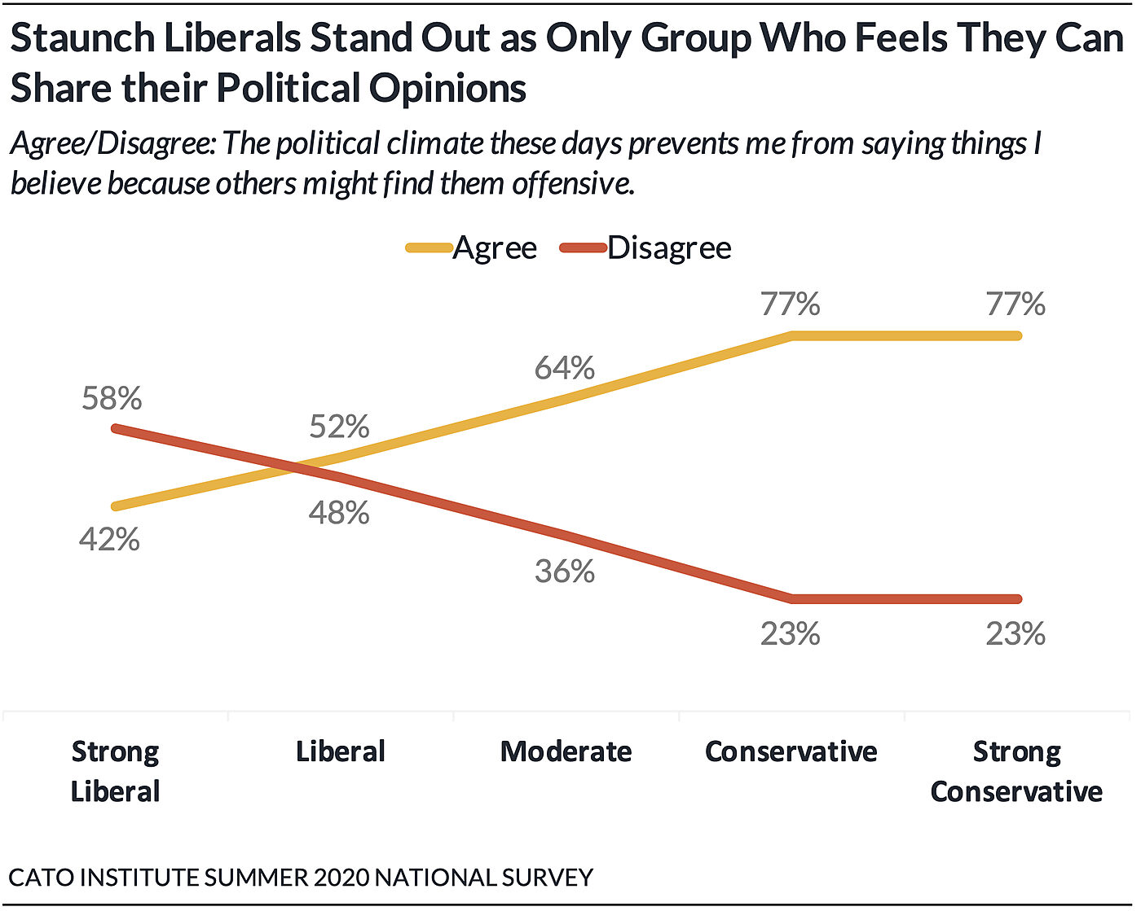
https://www.cato.org/survey-reports/poll-62-americans-say-they-have-political-views-theyre-afraid-share#introduction

Slide 24
Anything funny here?
https://www.cato.org/survey-reports/poll-62-americans-say-they-have-political-views-theyre-afraid-share#introduction

Slide 25
Yellow and red plots are mirror images.
You need a good reason to plot mirror images.
https://www.cato.org/survey-reports/poll-62-americans-say-they-have-political-views-theyre-afraid-share#introduction

Slide 26
Yellow and red plots are mirror images.
You need a good reason to plot mirror images.

Slide 27
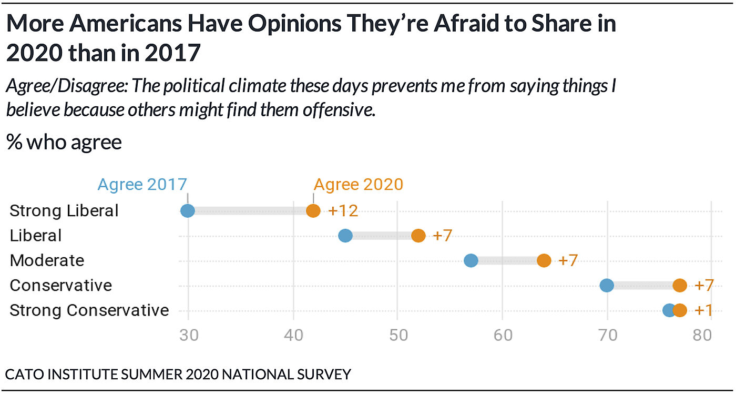
Same data, but much more effective as a dot plot
https://www.cato.org/survey-reports/poll-62-americans-say-they-have-political-views-theyre-afraid-share#introduction

Slide 28
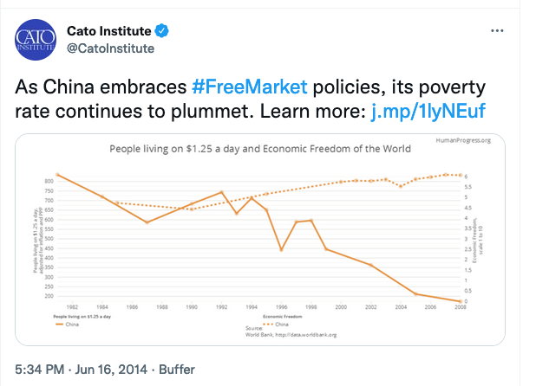
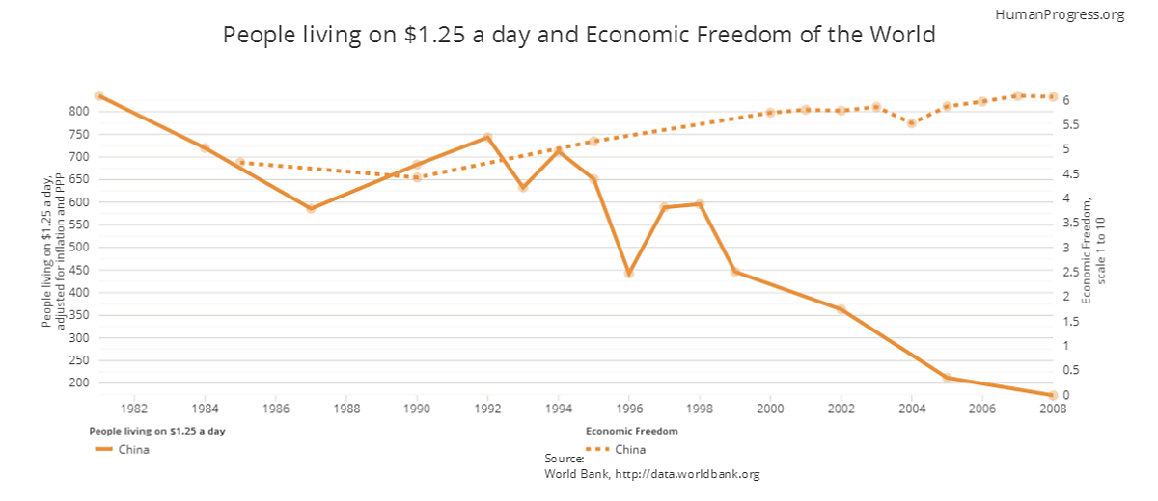
Wild-caught dual-axis graph
https://www.cato.org/blog/obama-understands-improving-state-humanity

Slide 29
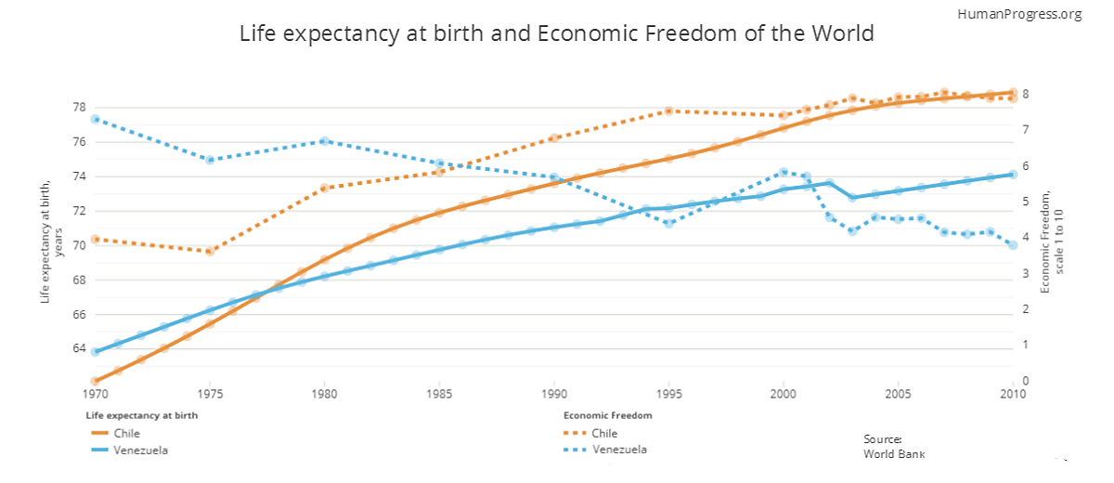
And another
https://www.cato.org/blog/obama-understands-improving-state-humanity

Slide 30


https://www.heritage.org/education/report/diversity-university-dei-bloat-the-academy

Slide 31
https://www.heritage.org/education/report/diversity-university-dei-bloat-the-academy
Visualization reports rankings among 65 large universities examined;
act of summarizing staffing levels for DEI is political in its bringing attention to one class of university staffing.
Why aren't they picking on the Music department?

Slide 32
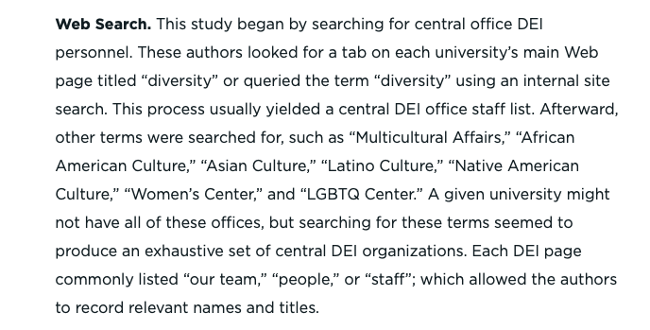
https://www.heritage.org/education/report/diversity-university-dei-bloat-the-academy
Methodology:
Searched university's websites, counted people.
Just remember, somebody got paid to do this.

Slide 33
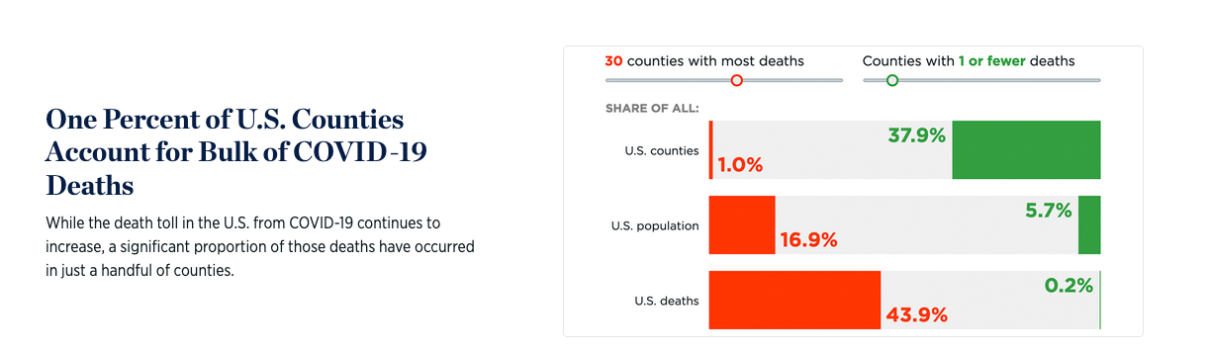
This is from February 2021, when there were 433,000 cumulative deaths from COVID-19 in the US.
https://datavisualizations.heritage.org/public-health/one-percent-of-us-counties-account-for-bulk-of-covid-19-deaths/

Slide 34
This is from February 2021, when there were 433,000 cumulative deaths from COVID-19 in the US.
There are several things wrong here.
https://datavisualizations.heritage.org/public-health/one-percent-of-us-counties-account-for-bulk-of-covid-19-deaths/

Slide 35
This is from February 2021, when there were 433,000 cumulative deaths from COVID-19 in the US.
There are two things wrong here.
There are several things wrong here.
First, we're counting the wrong things. Fraction of counties is what you need when you're ordering T-shirts for the county commissioners' convention.
https://datavisualizations.heritage.org/public-health/one-percent-of-us-counties-account-for-bulk-of-covid-19-deaths/

Slide 36
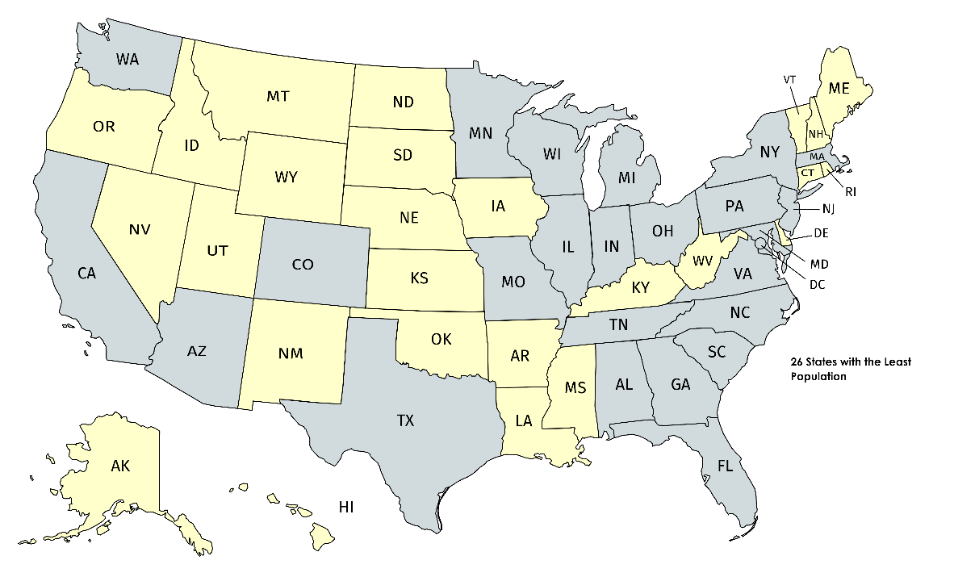
The 26 least populous states (in the 2010 census) have 17% of the U.S. population but control 52/101 votes in the Senate.

Slide 37
Programming interlude making this graph in altair.

Slide 38
This is from February 2021, when there were 433,000 cumulative deaths from COVID-19 in the US.
More importantly, this is reporting on how extreme are the extreme values of a random process after the fact; explicitly sorting the data and plotting it from worst to best.
This is intellectually dishonest.
https://datavisualizations.heritage.org/public-health/one-percent-of-us-counties-account-for-bulk-of-covid-19-deaths/

Slide 39
This is from February 2021, when there were 433,000 cumulative deaths from COVID-19 in the US.
Unless extreme events are your object of study (earthquakes, hurricanes, billionaires), these extreme events are an accounting artifact, not the right object of study.
https://datavisualizations.heritage.org/public-health/one-percent-of-us-counties-account-for-bulk-of-covid-19-deaths/

Slide 40
This is from February 2021, when there were 433,000 cumulative deaths from COVID-19 in the US.
There was no essay attached to this visualization.
There are more expressive ways of communicating the joint distribution of population and body count. (x and y ?!)
https://datavisualizations.heritage.org/public-health/one-percent-of-us-counties-account-for-bulk-of-covid-19-deaths/

Slide 41
This is from February 2021, when there were 433,000 cumulative deaths from COVID-19 in the US.
This is one death per 750 US. population, and most counties are larger than 1000 people.
I wonder if the death rate is the same for all counties?
https://datavisualizations.heritage.org/public-health/one-percent-of-us-counties-account-for-bulk-of-covid-19-deaths/

Slide 42
This is from February 2021, when there were 433,000 cumulative deaths from COVID-19 in the US.
This is one death per 750 US. population, and most counties are larger than 1000 people.
I wonder if the death rate is the same for all counties?
Don't spend too much time wondering.
https://datavisualizations.heritage.org/public-health/one-percent-of-us-counties-account-for-bulk-of-covid-19-deaths/

