Slide 1

Networks
Data 227
Data Visualization & Communication
Autumn, 2021

Slide 2
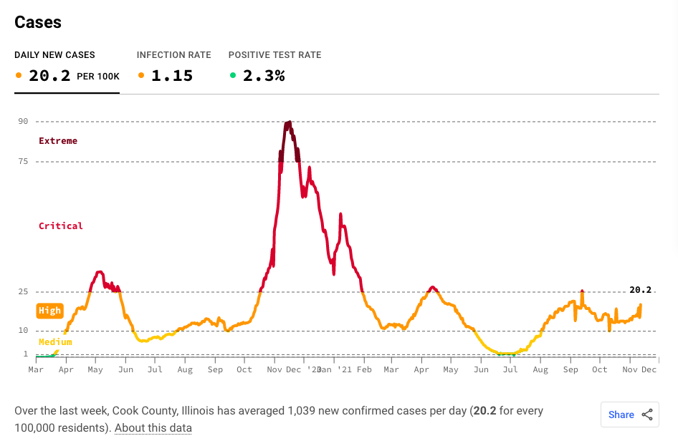
Here, the most striking design choice is the horizontal banding and color coding.
It is both visually striking and effective.

Slide 3
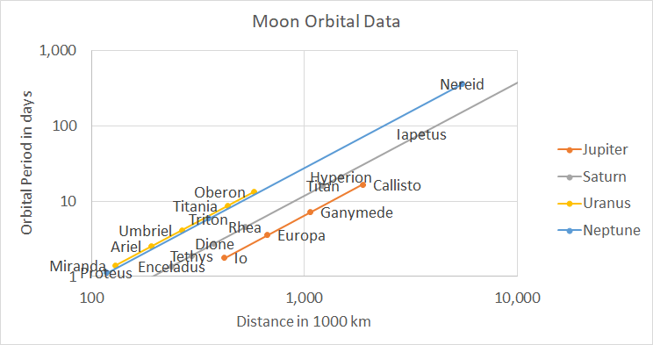
Kepler's third law

Slide 4
Kepler's third law
If we were testing Kepler's third law,
we would put all of the points in a one-dimensional Kepler-goodness variable

Slide 5
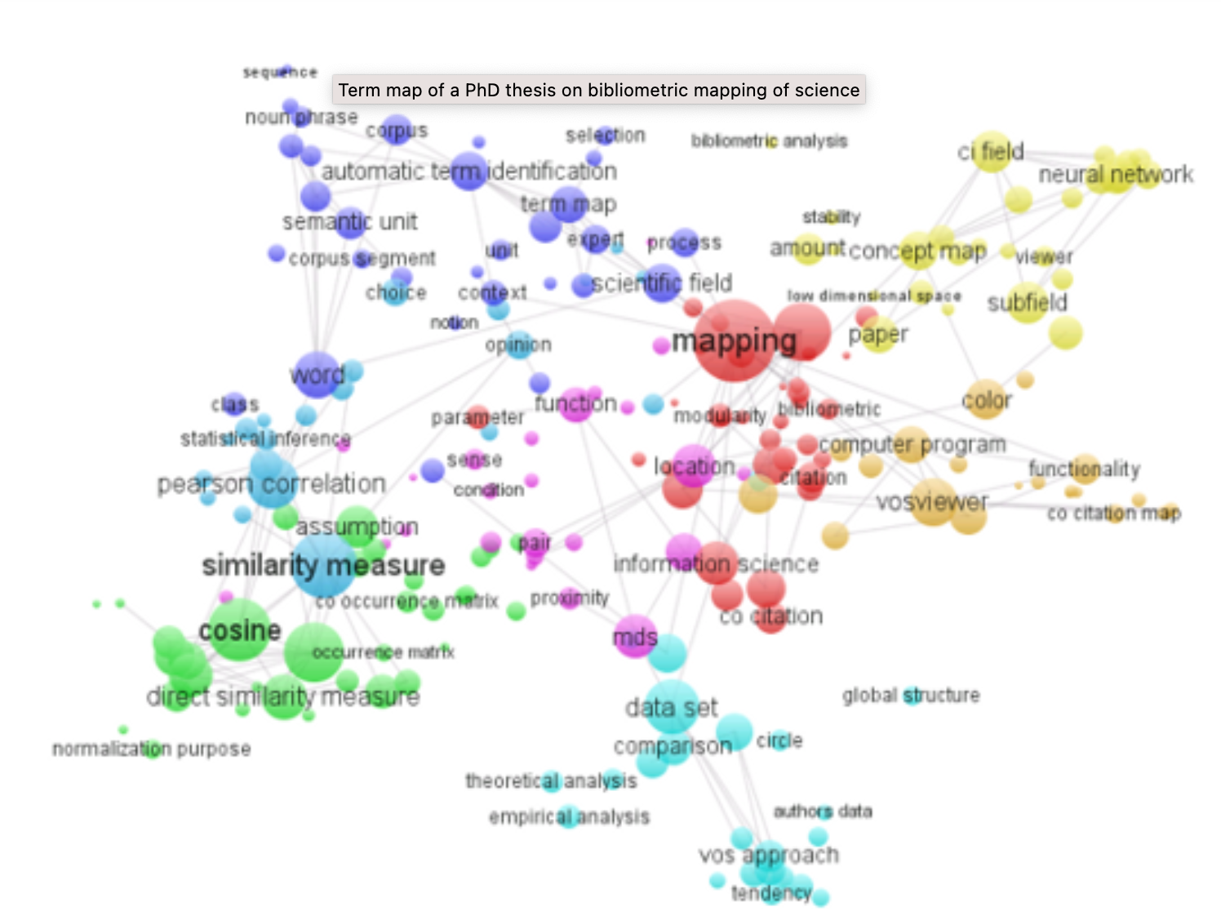
cccc
https://www.vosviewer.com/text-mining-and-visualization-using-vosviewer

Slide 6
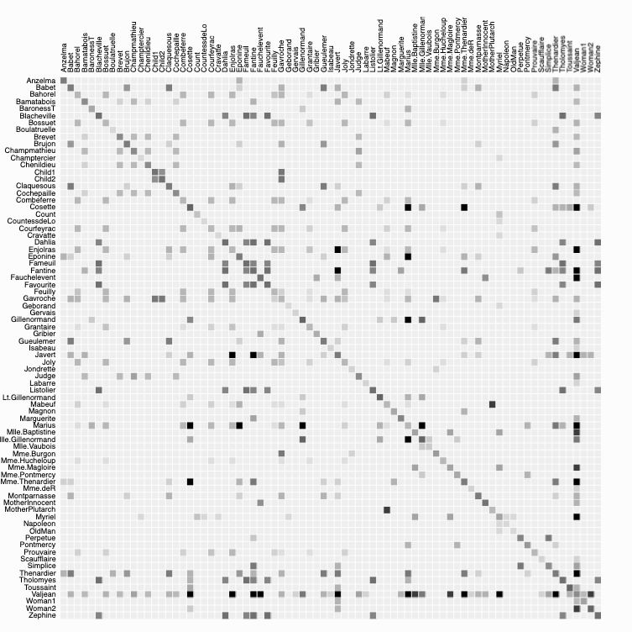
Character interactions in Les Miserables
https://bost.ocks.org/mike/miserables/

Slide 7
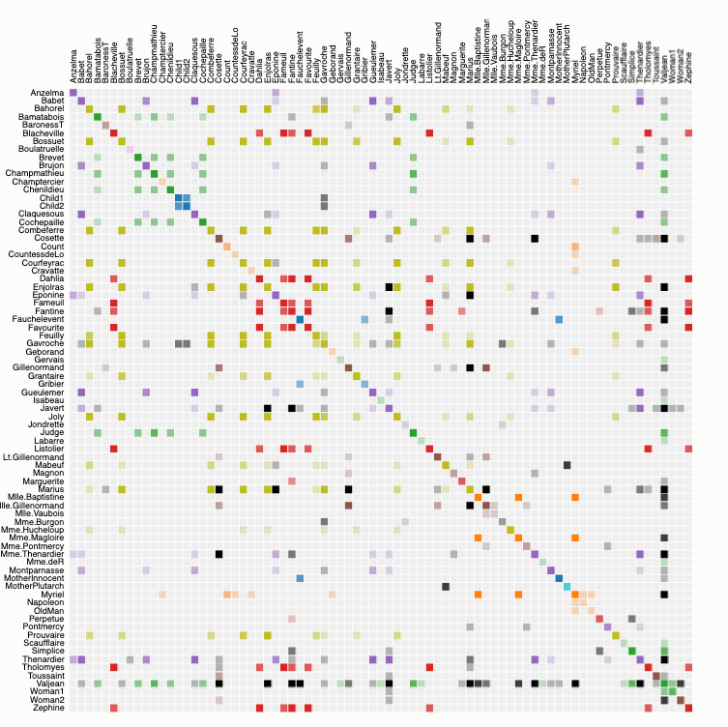
Alphabetical order
https://bost.ocks.org/mike/miserables/

Slide 8
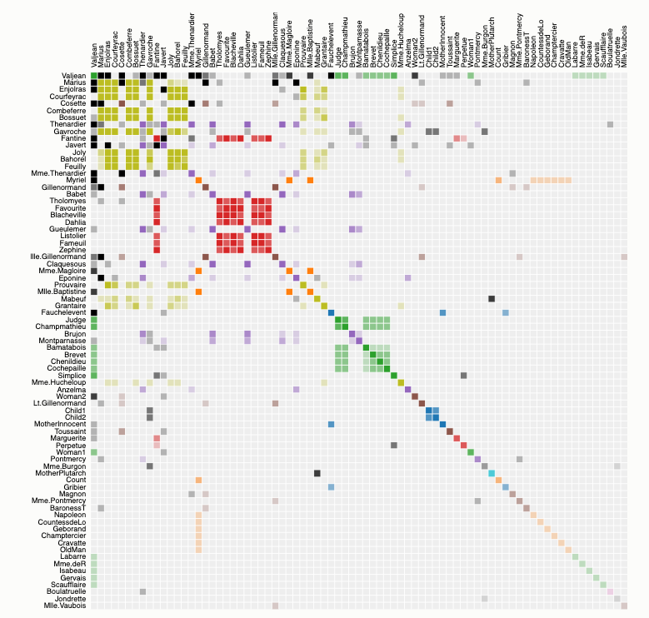
Ordered by occurrence
https://bost.ocks.org/mike/miserables/

Slide 9
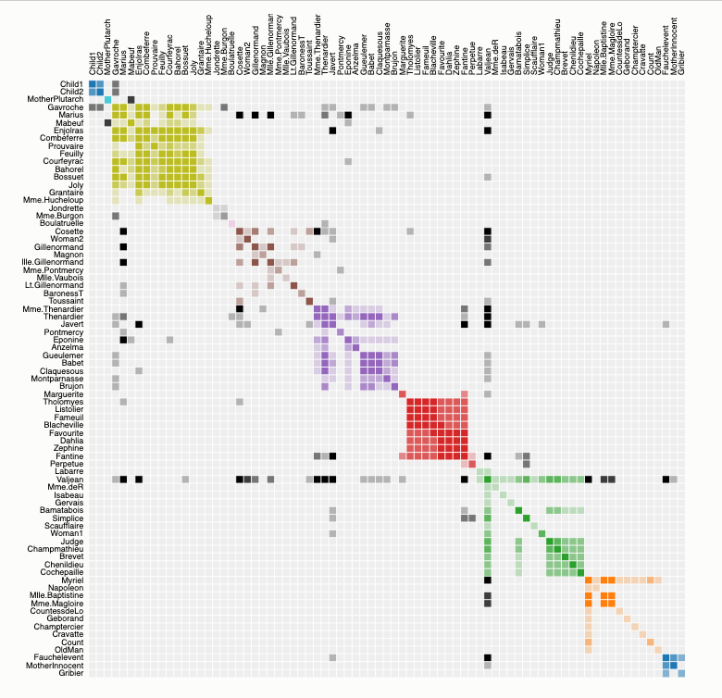
Ordered by cluster
How can we find these clusters, reorder the data?
https://bost.ocks.org/mike/miserables/

Slide 10
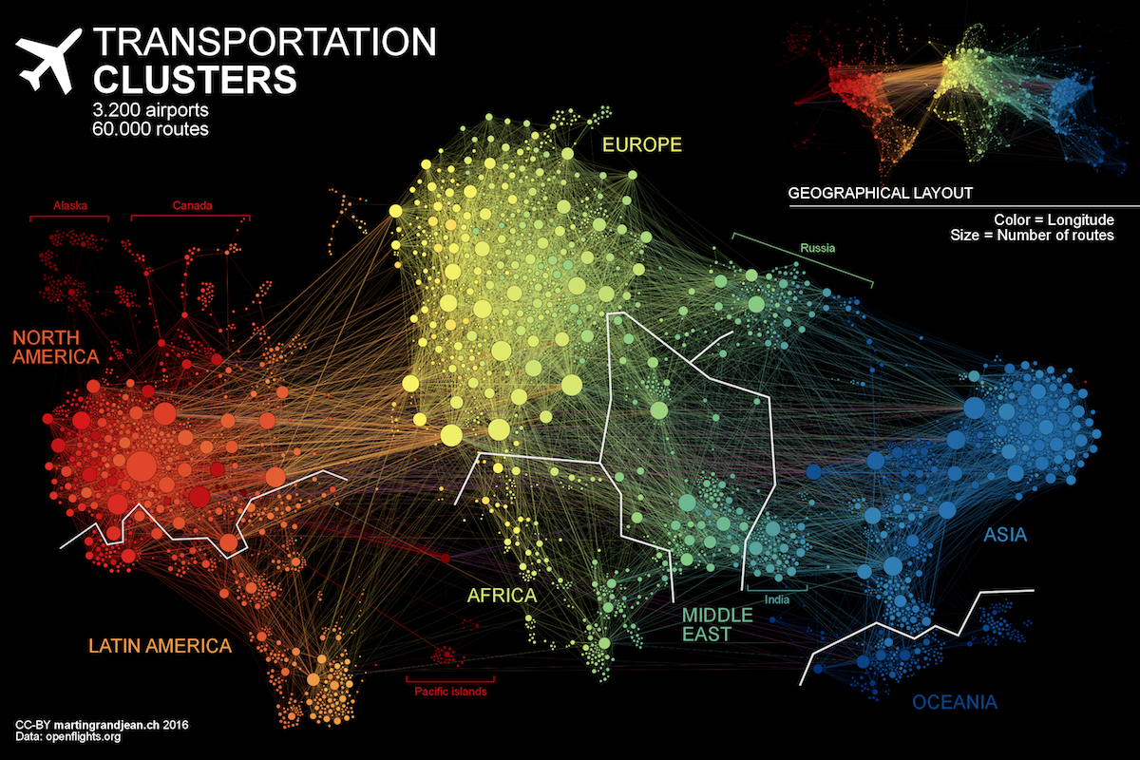
http://www.martingrandjean.ch/connected-world-air-traffic-network/

Slide 11
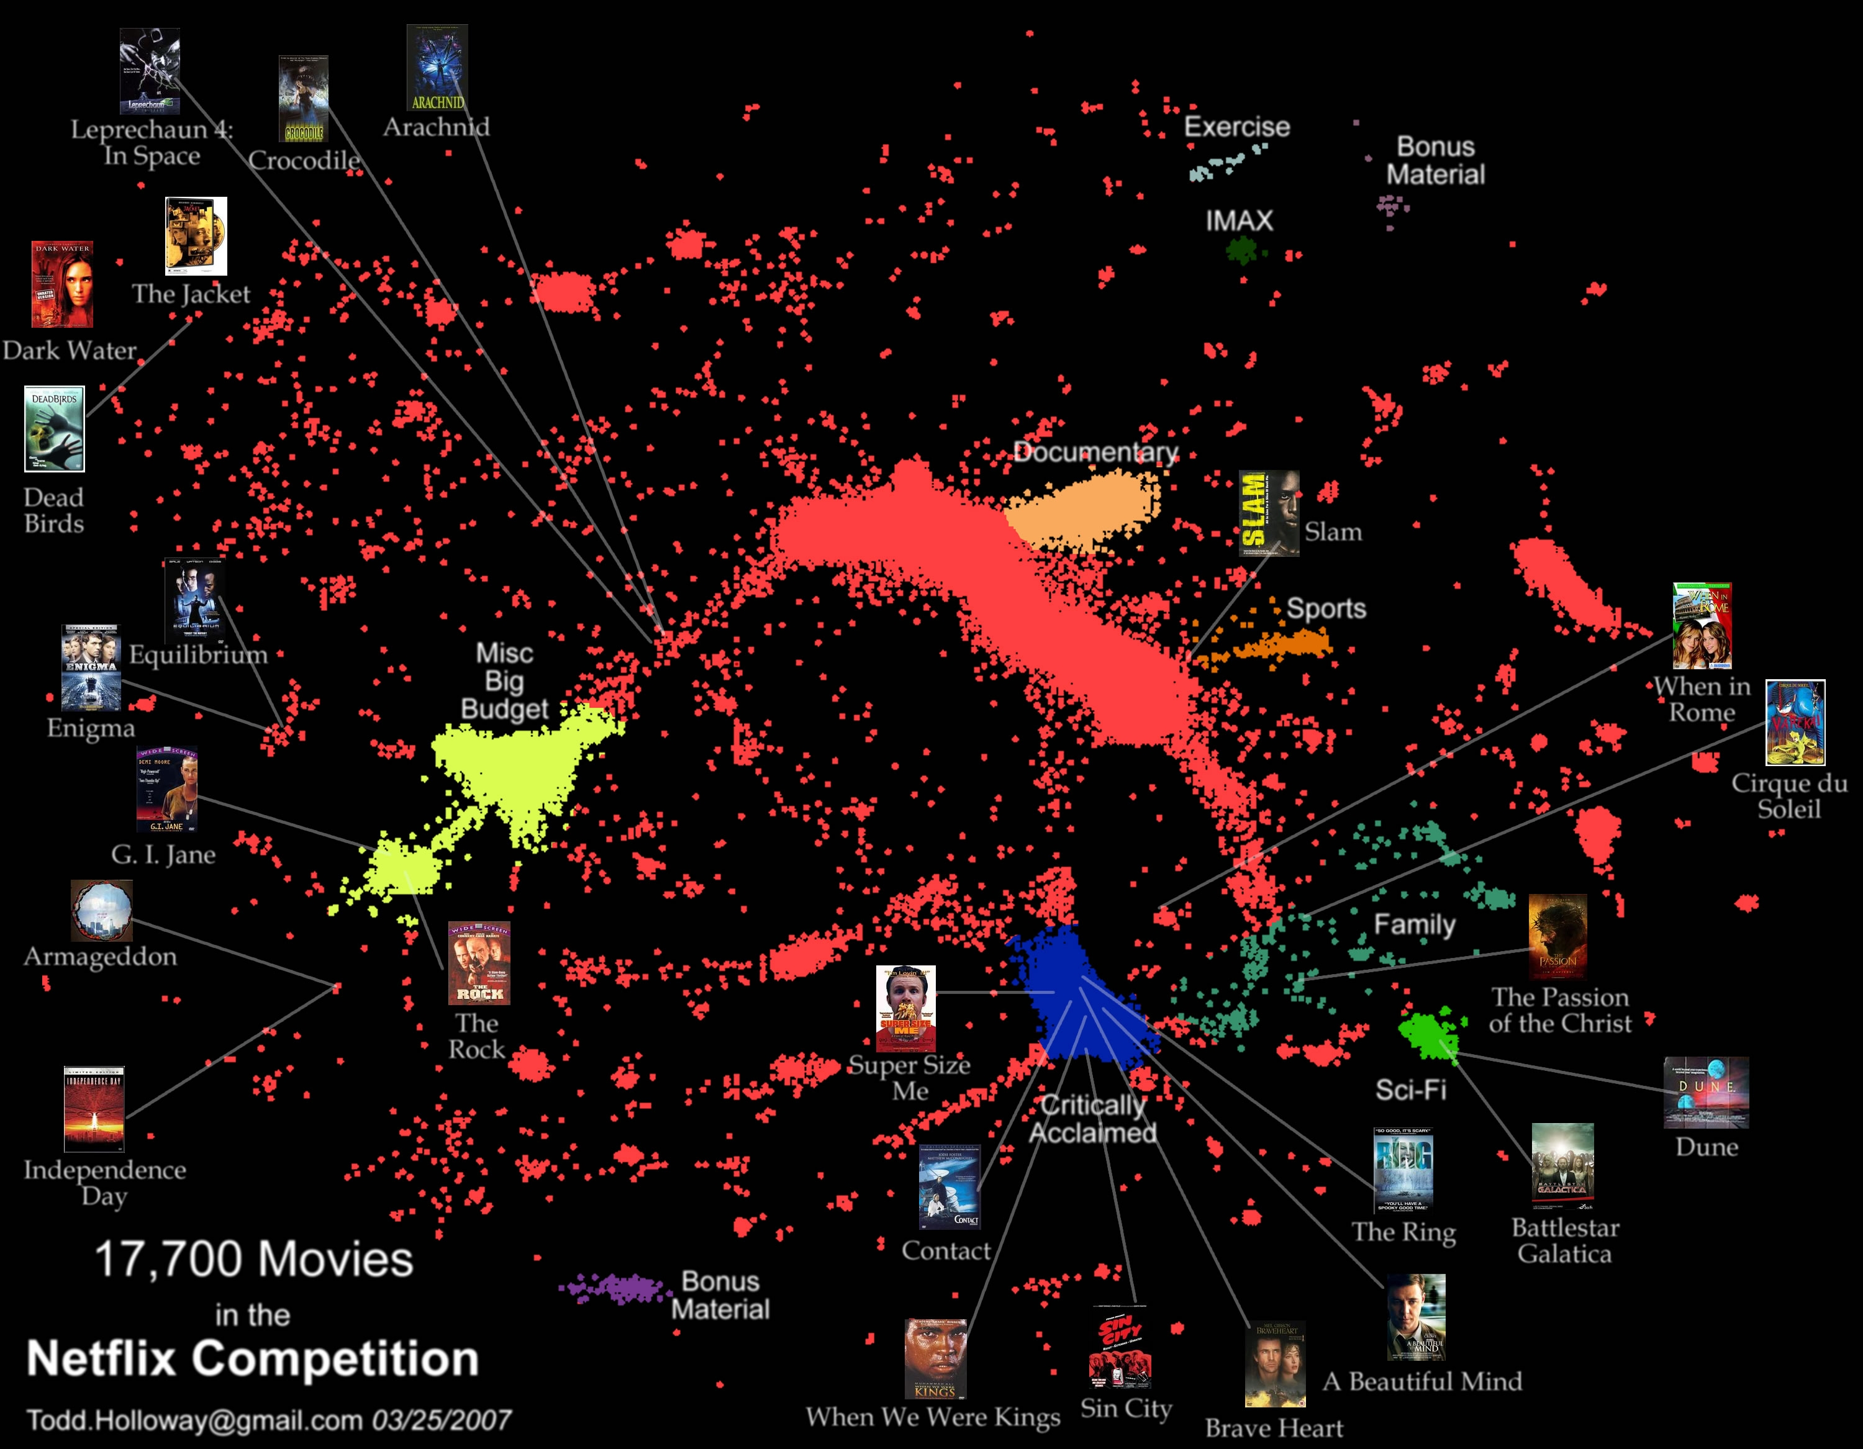
https://web.archive.org/web/20141004205326/http://abeautifulwww.com/2007/04/03/another-visualization-of-the-netflix-prize-dataset/

Slide 12
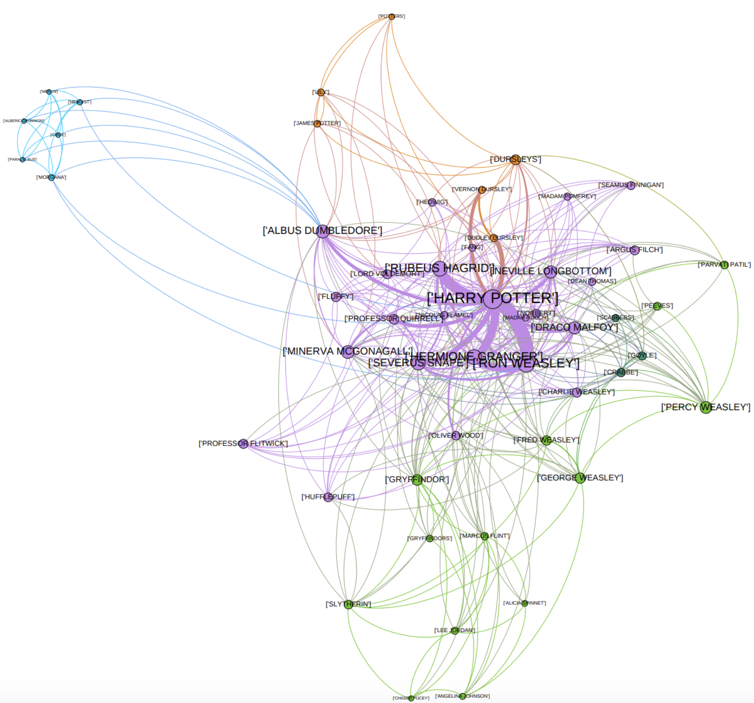
Harry Potter and the Sorcerer's Stone
https://towardsdatascience.com/explore-harry-potter-via-a-dynamic-social-network-of-characters-f5bed9a39f01

Slide 13
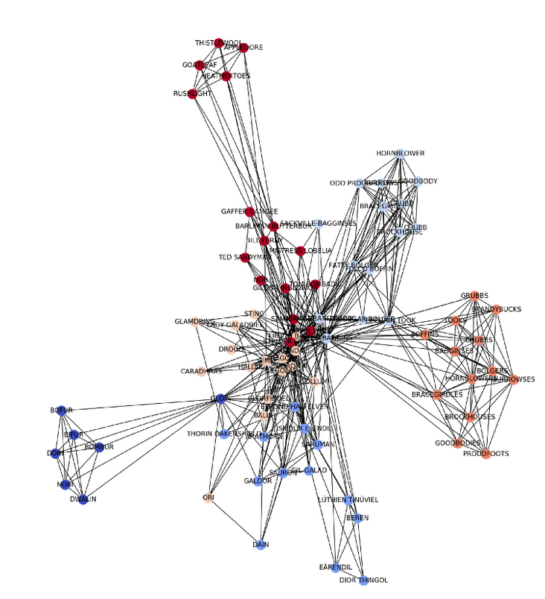
Lord of the Rings
https://towardsdatascience.com/explore-harry-potter-via-a-dynamic-social-network-of-characters-f5bed9a39f01

Slide 14
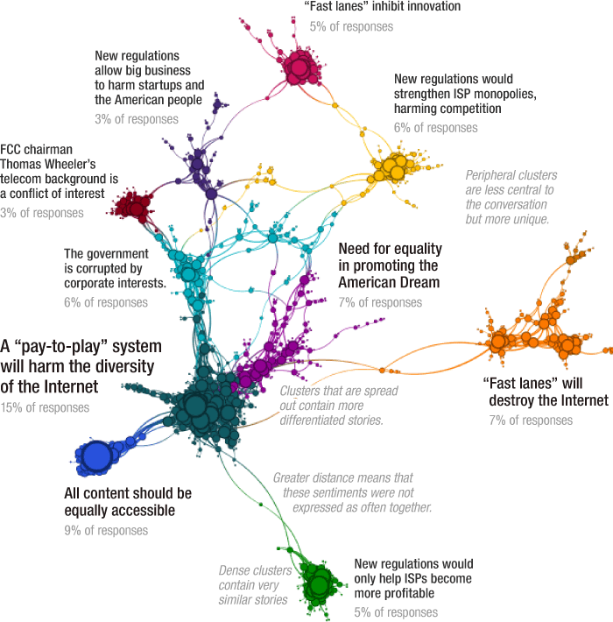
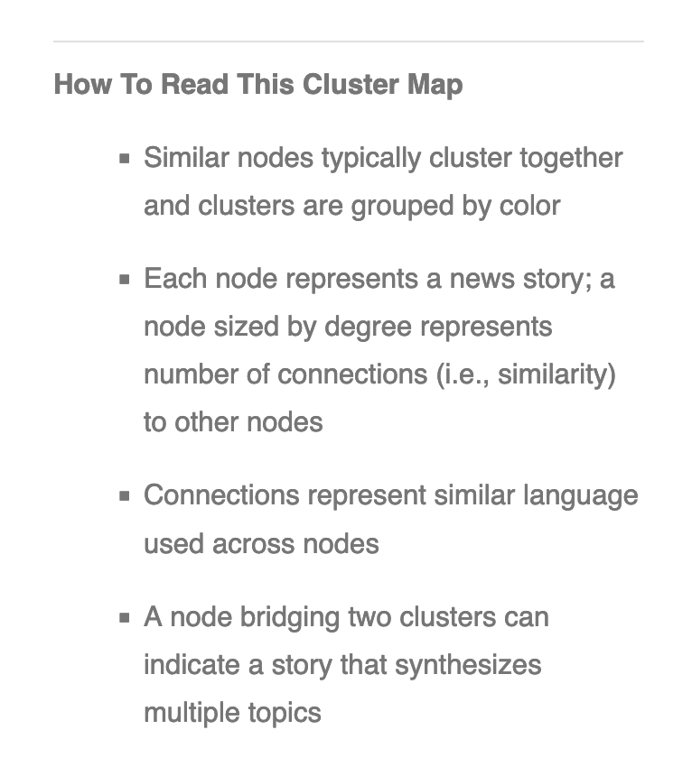
https://www.npr.org/sections/alltechconsidered/2014/08/12/339710293/a-fascinating-look-inside-those-1-1-million-open-internet-comments

Slide 15
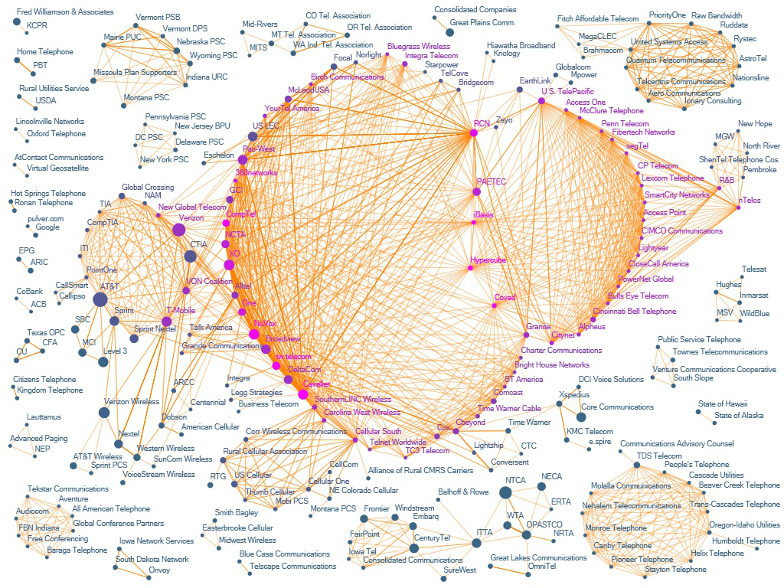
https://www.cmu.edu/joss/content/issues/2010jossviz/5_deVries.htm

