Slide 1

Animation
Data 227
Data Visualization & Communication
Autumn, 2021

Slide 2
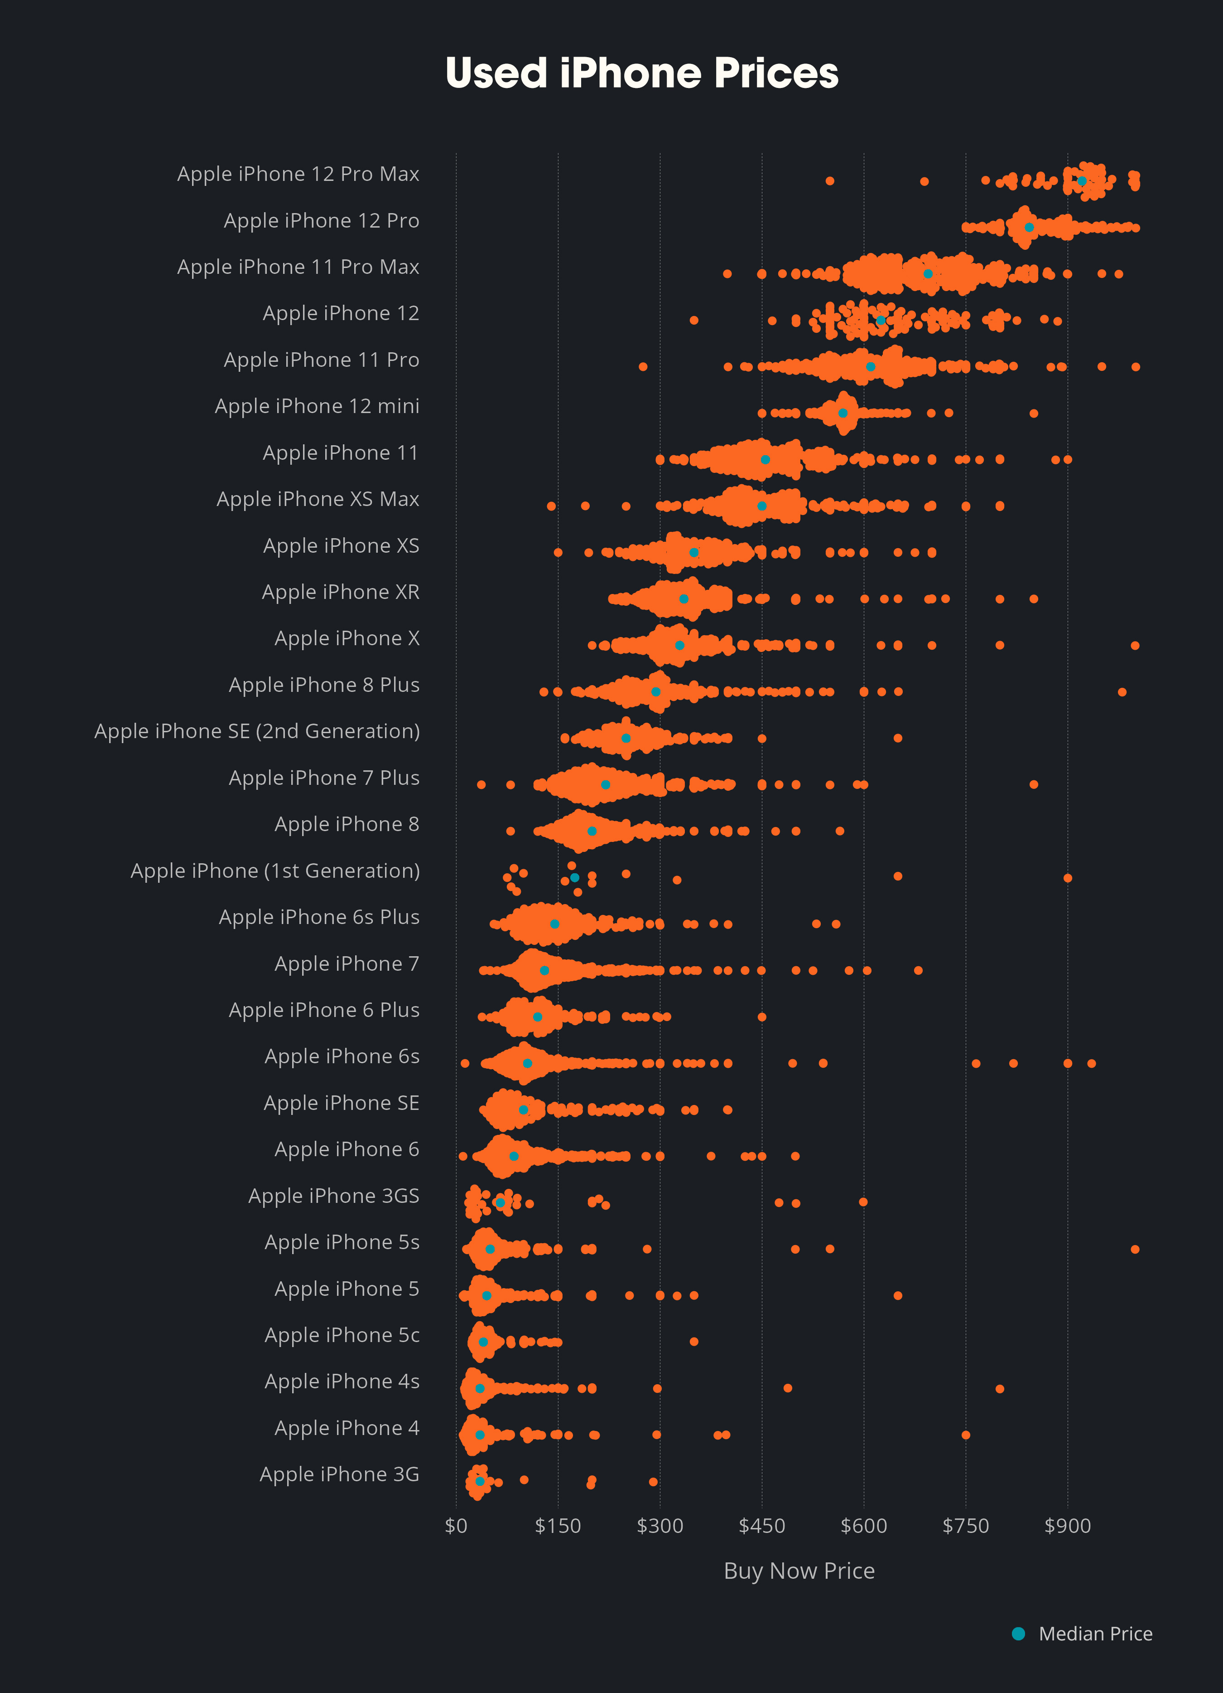

Slide 3
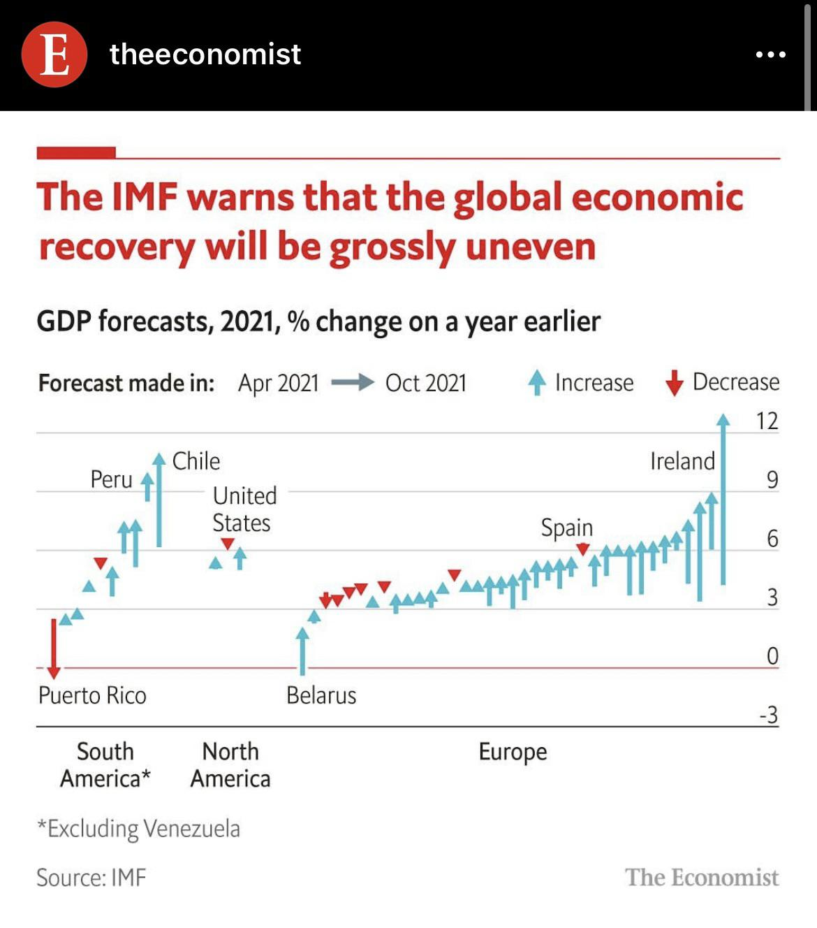

Slide 4
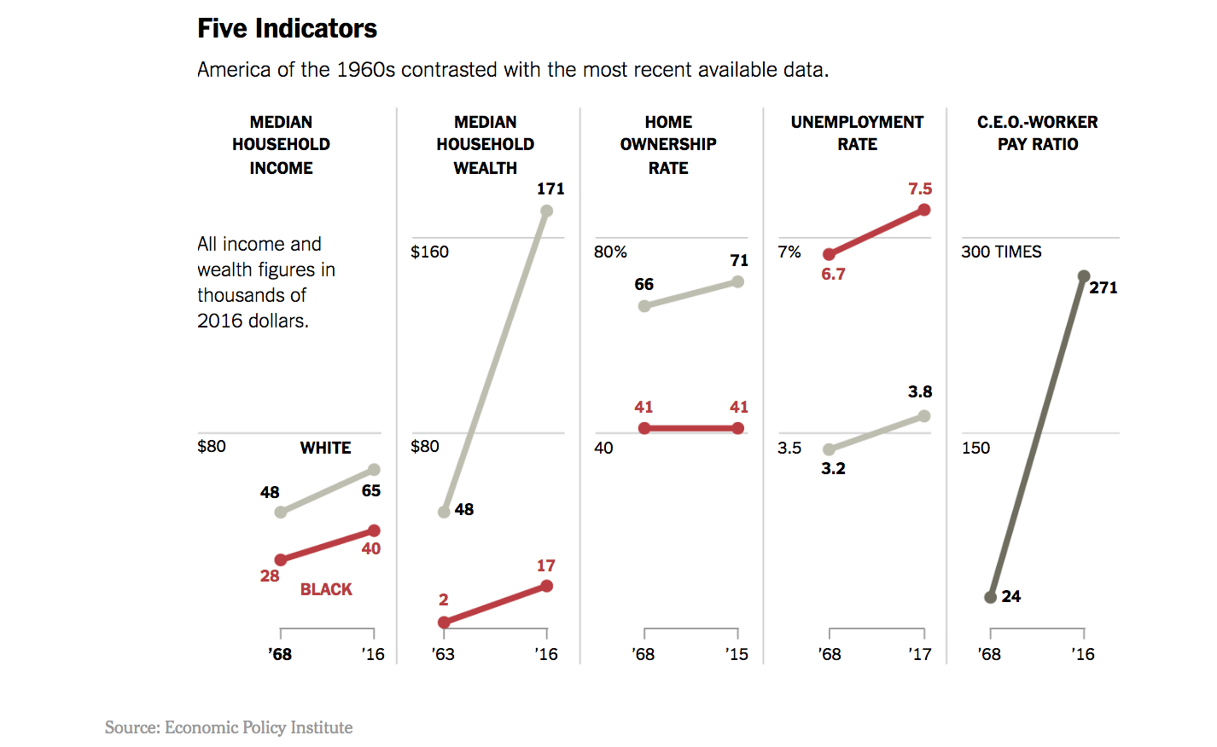
https://www.nytimes.com/interactive/2018/02/28/opinion/the-unmet-promise-of-equality.html

Slide 5
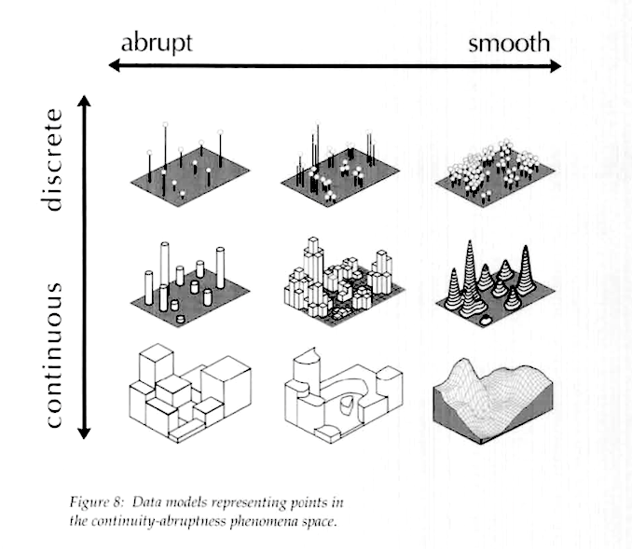
MacEachren, Visualizing Uncertain Information 1992

Slide 6
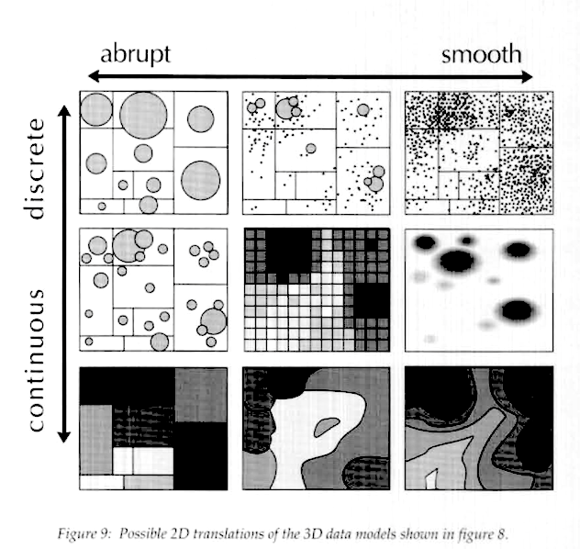
MacEachren, Visualizing Uncertain Information 1992

Slide 7
Why Animate?
Ornamentation?
Direct reader attention--focus and highlight
Filler for transitions between slides, pages, visualizations
Additional dimension for multiplexing data:
  show 3d data that do not project nicely
  show aspects of time series data (or another additional dimension) when x and y are already busy

Slide 8
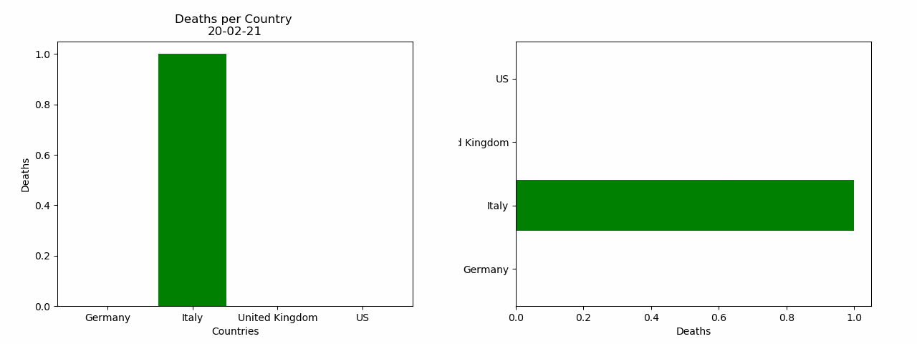
https://towardsdatascience.com/learn-how-to-create-animated-graphs-in-python-fce780421afe

Slide 9
How Animate?
Draw every frame.
Draw “key” frames and allow libraries to interpolate

Slide 10
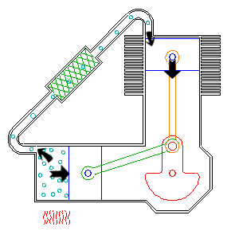
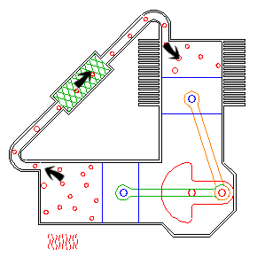
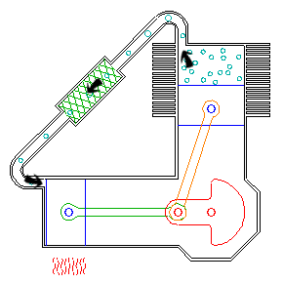
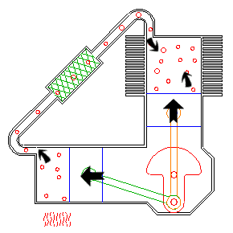
http://animatedengines.com/vstirling.html

Slide 11
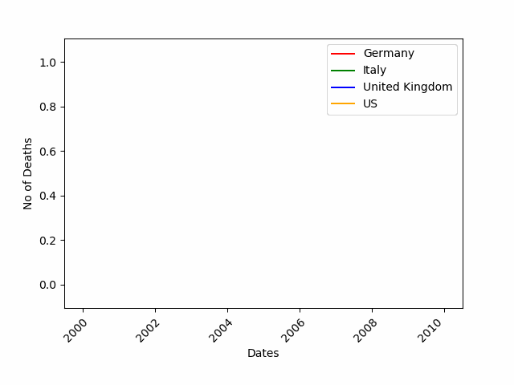
https://towardsdatascience.com/learn-how-to-create-animated-graphs-in-python-fce780421afe

Slide 12
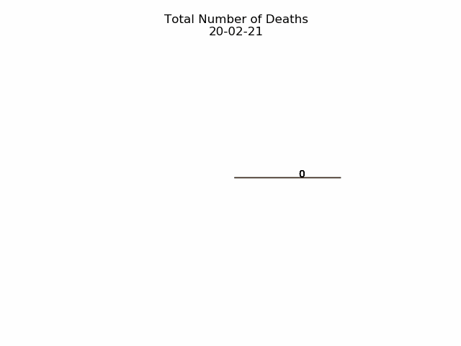
https://towardsdatascience.com/learn-how-to-create-animated-graphs-in-python-fce780421afe

Slide 13
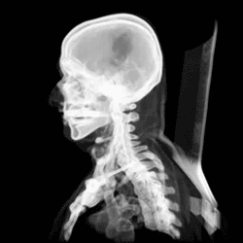

Slide 14
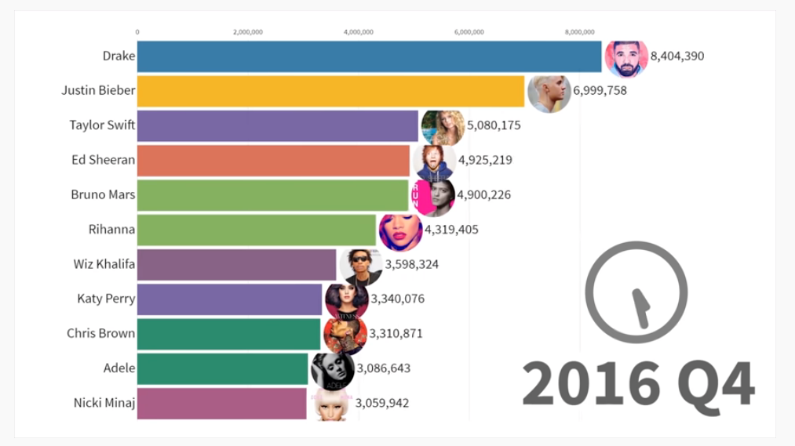
Barchart Races
Easy -- just feed dataframe into bar chart races
https://www.youtube.com/watch?v=a3w8I8boc_I

