Slide 1

Networks
Data 227
Data Visualization & Communication
Autumn, 2021

Slide 2
Reminder: data provenance
Name of dataset
Author or publisher
version of dataset or distributor of dataset (datasets change with time!)

Slide 3
Administrivia
HW5 Dec 6, but if you want feedback before end-of-term, you can submit earlier.
final Dec 7
Graduating this term? HW5 and final Dec 1.
Resubmit 2 homeworks with leniency tokens for re-grading, if you are inclined.

Slide 4
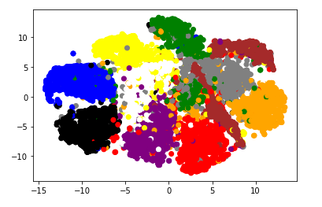
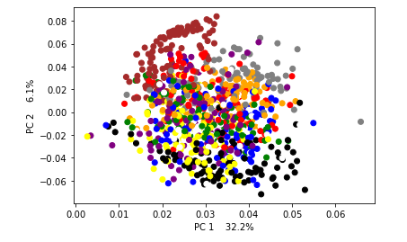
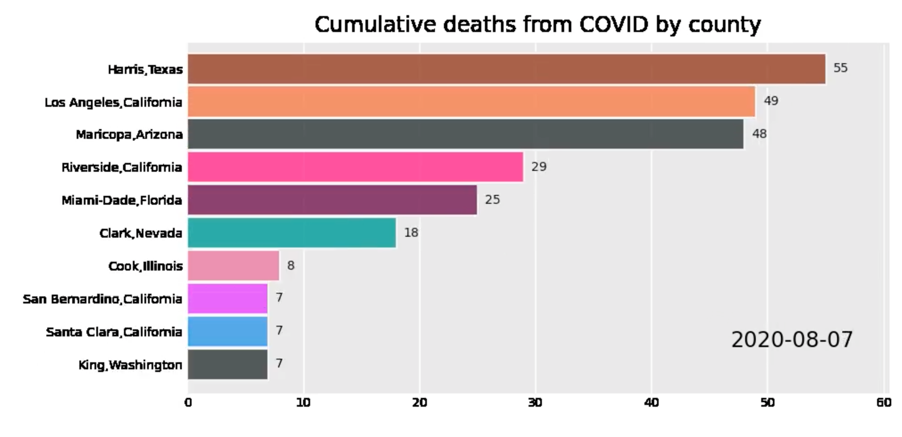

Slide 5
Networks + Trees
Trees
  graph with strict hierarchy
  each node is subordinate to the root and zero or more other nodes
  root, parent, children are the terms
Graph
  nodes: objects that can be connected
  edges: connections representing relationships between nodes; can be qualitative, binary, or numerical
  set of V, E defines the graph, our task is display

Slide 6
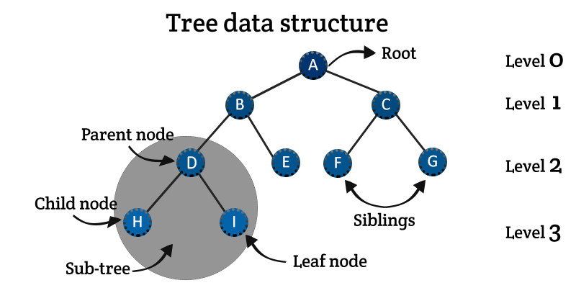
Trees
  graph with strict hierarchy
  each node is subordinate to the root and zero or more other nodes
  root, parent, children are the terms
  each node has a “level” in the hierarchy

Slide 7
Trees
somewhat common: computing, organizations, evolutionary biology, ancestry

Slide 8

Indentation
https://www.ncbi.nlm.nih.gov/Taxonomy/Browser/wwwtax.cgi?name=domestic+cat
cellular organisms;
  Eukaryota;
    Metazoa;
      Chordata;
        Craniata;
          Vertebrata;
            Euteleostomi;
              Mammalia;
                Eutheria;
                Laurasiatheria;
                Carnivora;
                Feliformia;
                Felidae;
                Felinae;
                Felis

Slide 9
Indentation
https://www.ncbi.nlm.nih.gov/Taxonomy/Browser/wwwtax.cgi?name=Severe+acute+respiratory+syndrome+coronavirus+2
Viruses; Riboviria; Orthornavirae; Pisuviricota; Pisoniviricetes; Nidovirales; Cornidovirineae; Coronaviridae; Orthocoronavirinae; Betacoronavirus; Sarbecovirus
Viruses;
  Riboviria;
    Orthornavirae;
      Pisuviricota;
        Pisoniviricetes;
          Nidovirales;
            Cornidovirineae;
              Coronaviridae;
                Orthocoronavirinae;
                Betacoronavirus;
                Sarbecovirus

Slide 10
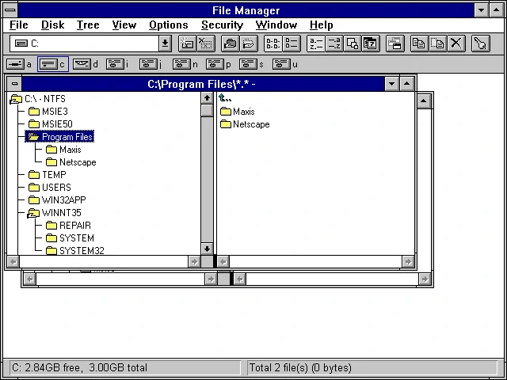
Indentation
Indentation
Can be used with only text
Runs out of space, mapping entire dataset onto 1d.
Indentation

Slide 11
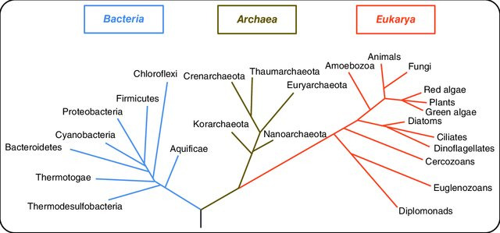
Tree of life

Slide 12
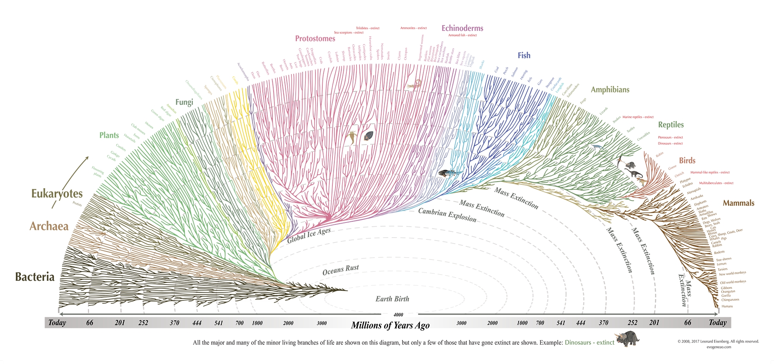

Slide 13
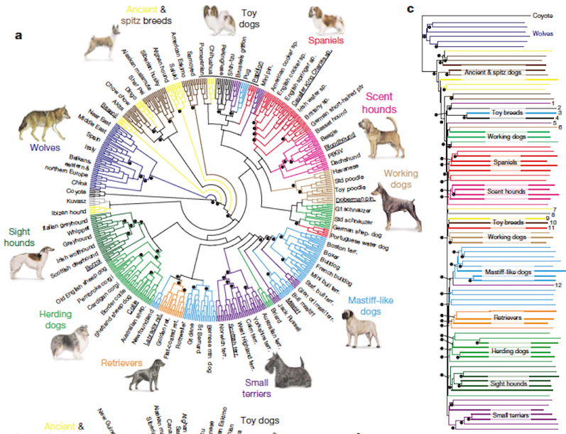
https://www.instituteofcaninebiology.org/how-to-read-a-dendrogram.html

Slide 14
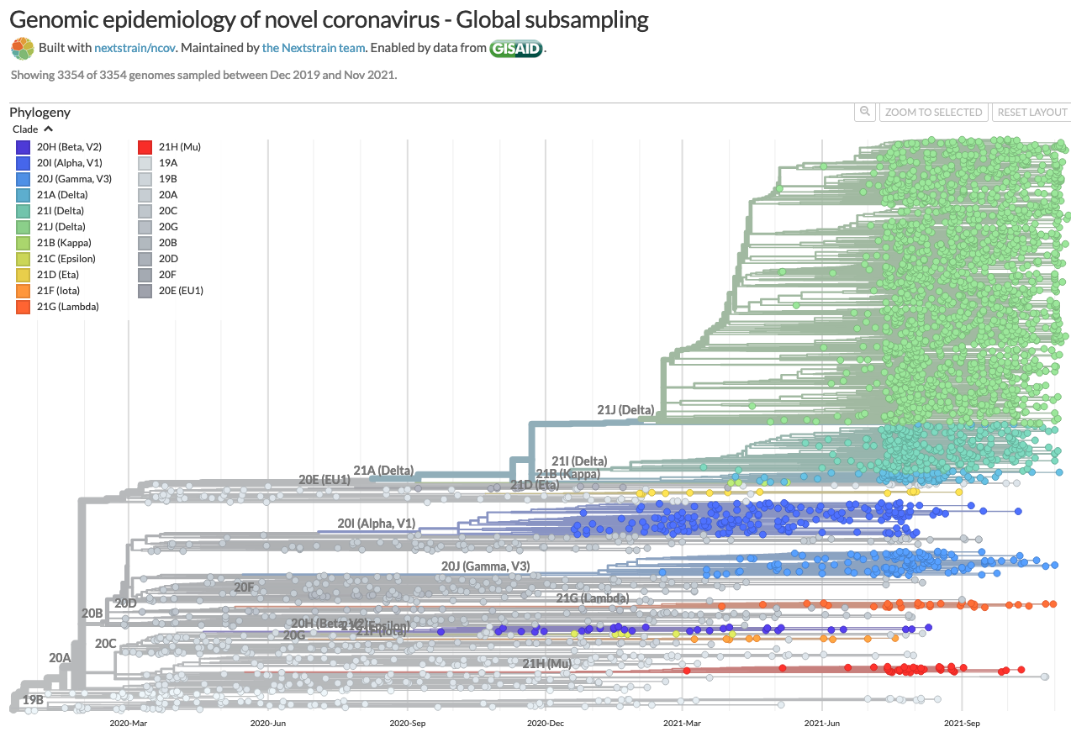
https://nextstrain.org/ncov/gisaid/global

Slide 15
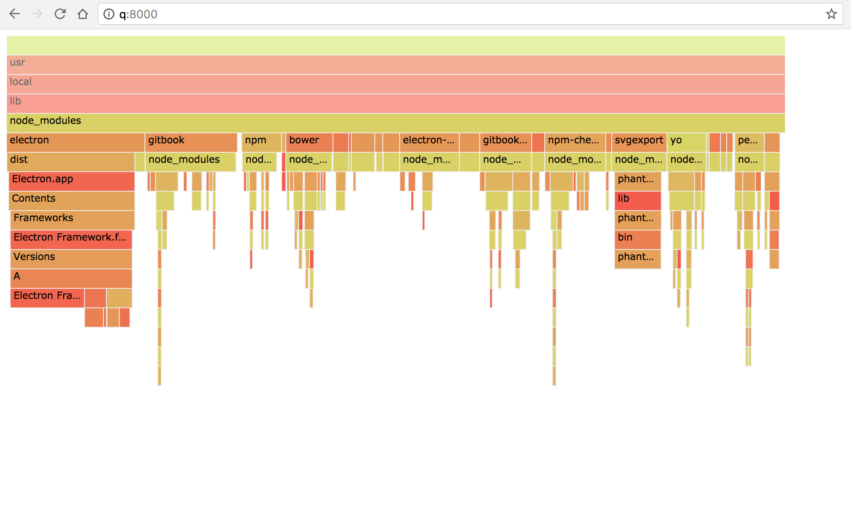
Icicle chart -- popular in computer profiling
https://github.com/spiermar/d3-flame-graph/issues/73

Slide 16
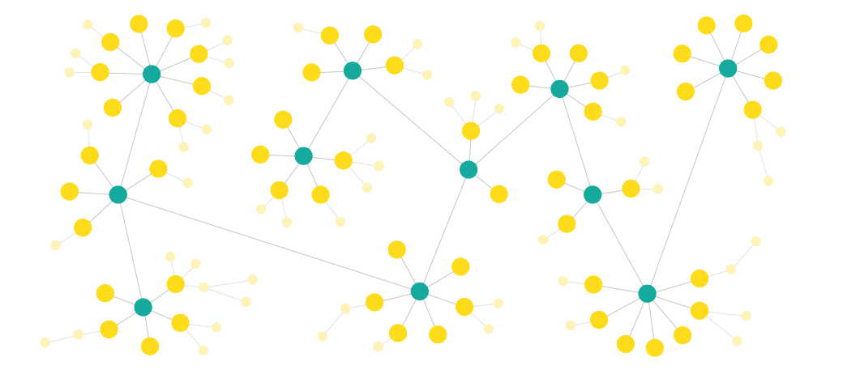
Graphs
Graph
  nodes: objects that can be connected
  edges: connections representing relationships between nodes; can be qualitative, binary, or numerical; can convey direction or not.
  set of V, E defines the graph
  our task is display

Slide 17
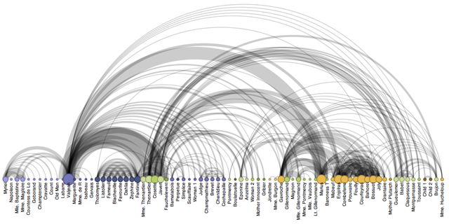
  low bandwidth
  sensitive to row ordering

Slide 18
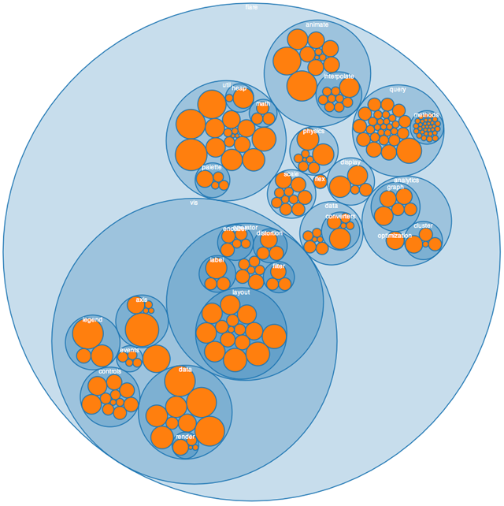
  hard to accurately read

Slide 19
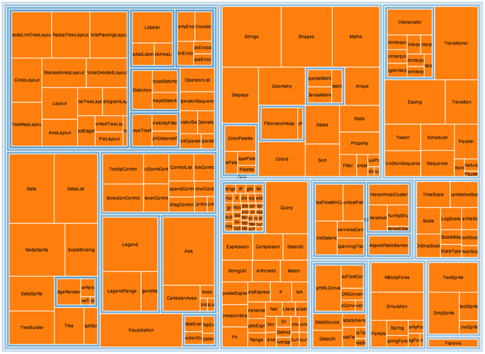
  hard to accurately read sizes, hierarchy
  good for overall picture

Slide 20
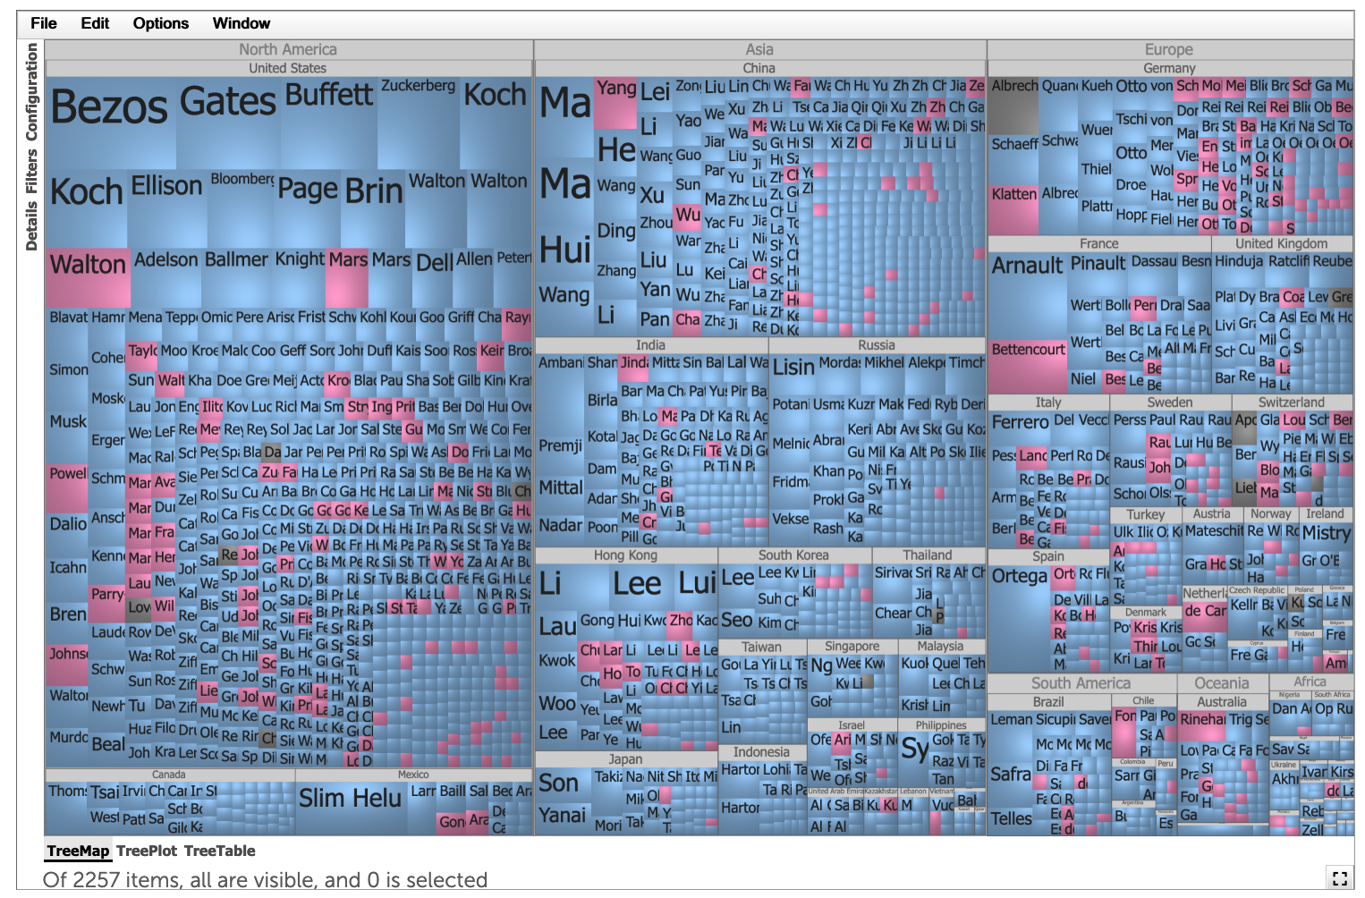
https://www.treemap.com/datasets/billionaires/
https://www.treemap.com/datasets/billionaires/

Slide 21
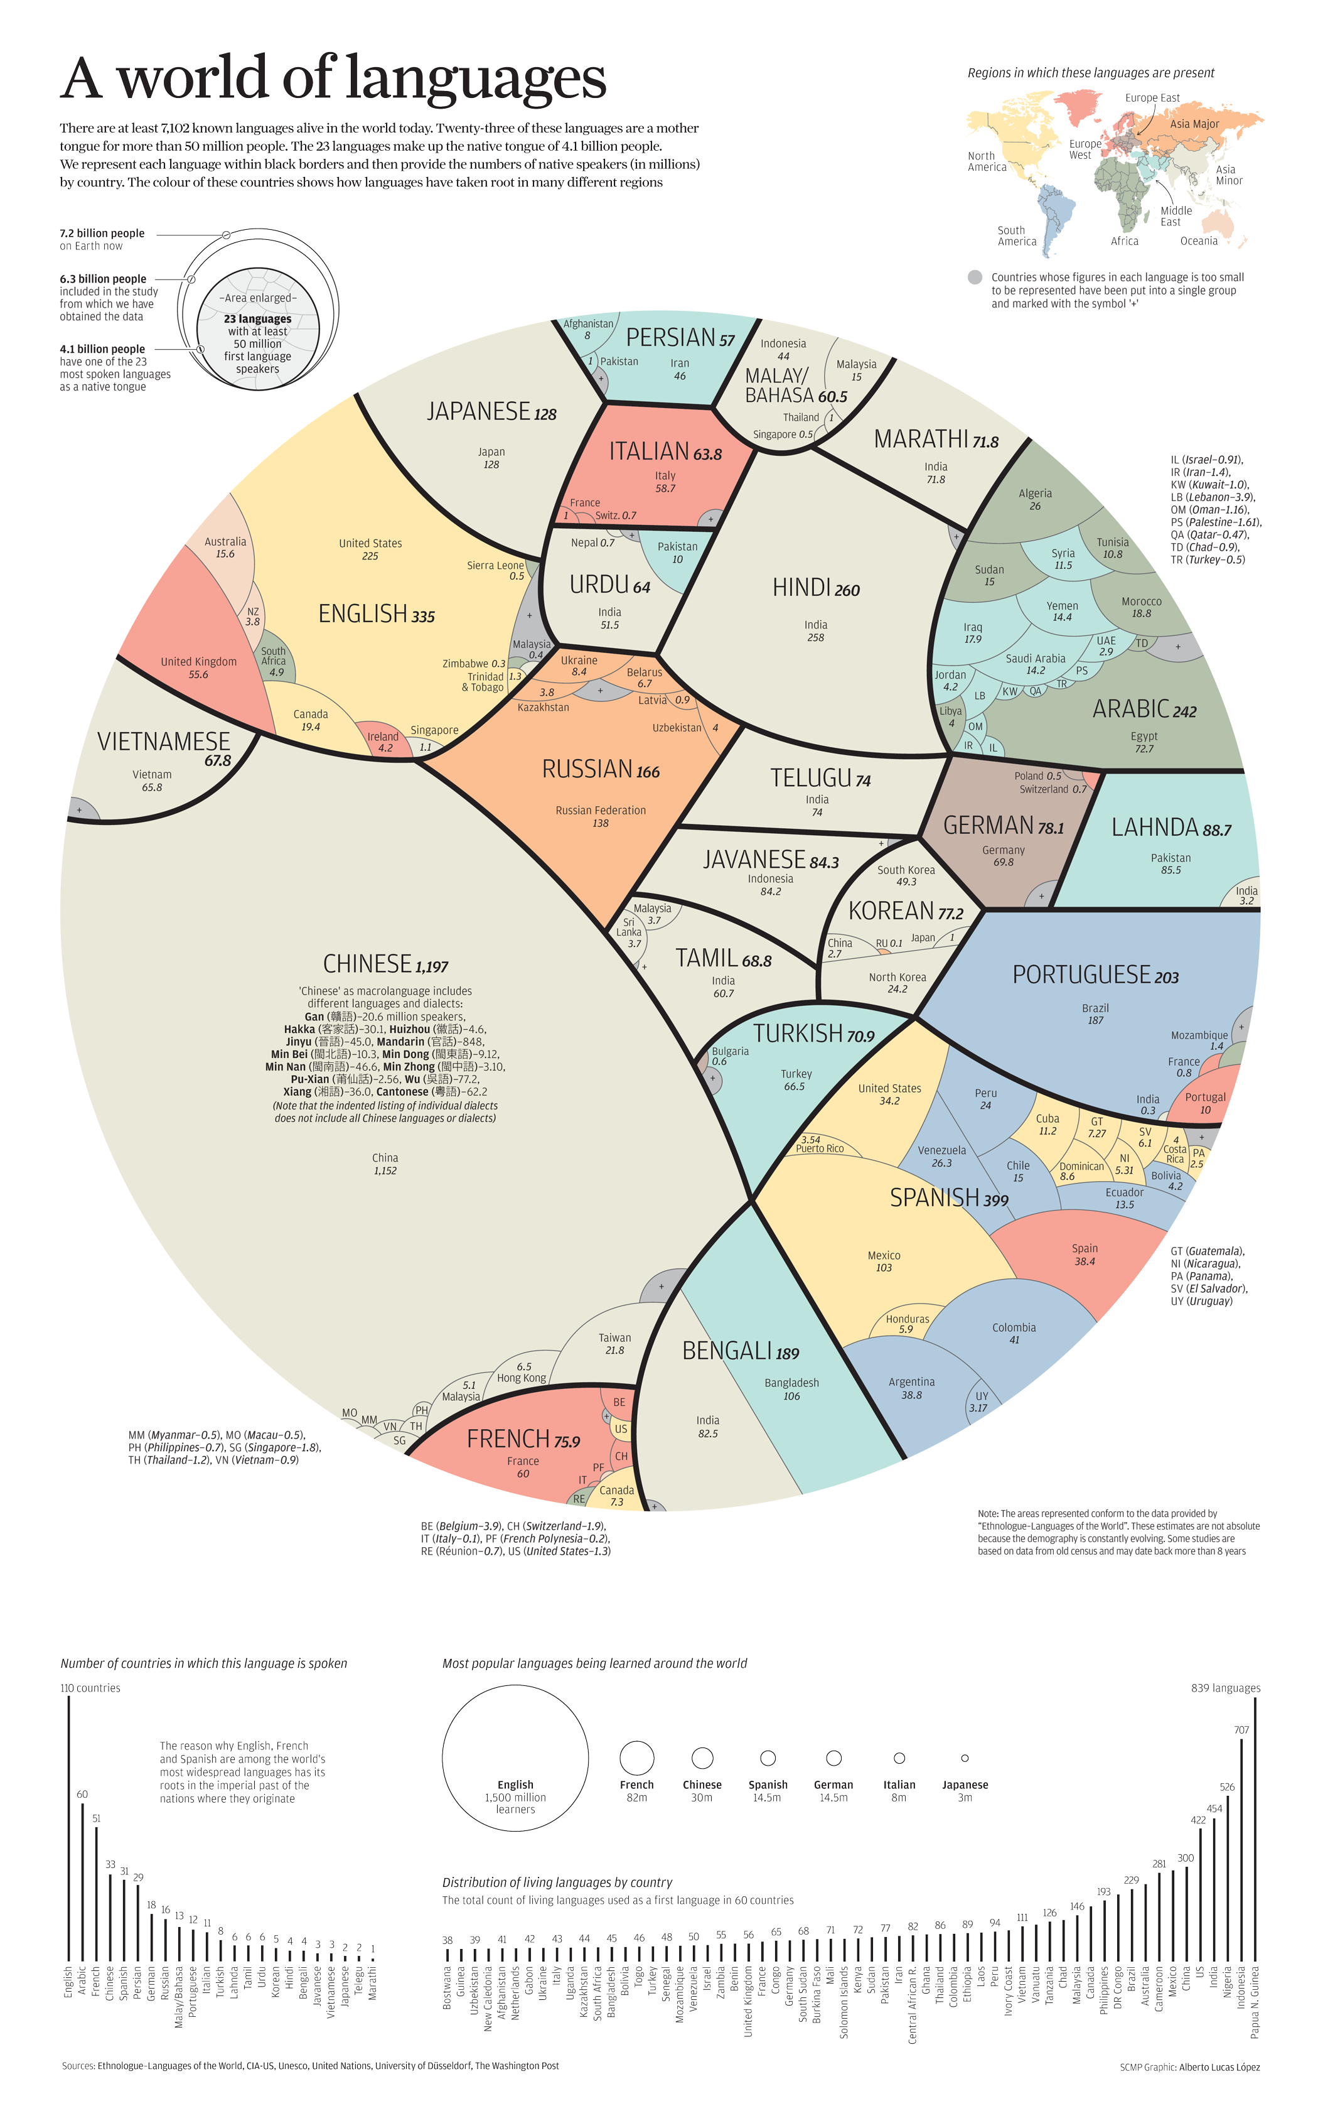
https://coolinfographics.com/blog/2015/6/1/a-world-of-languages.html

Slide 22
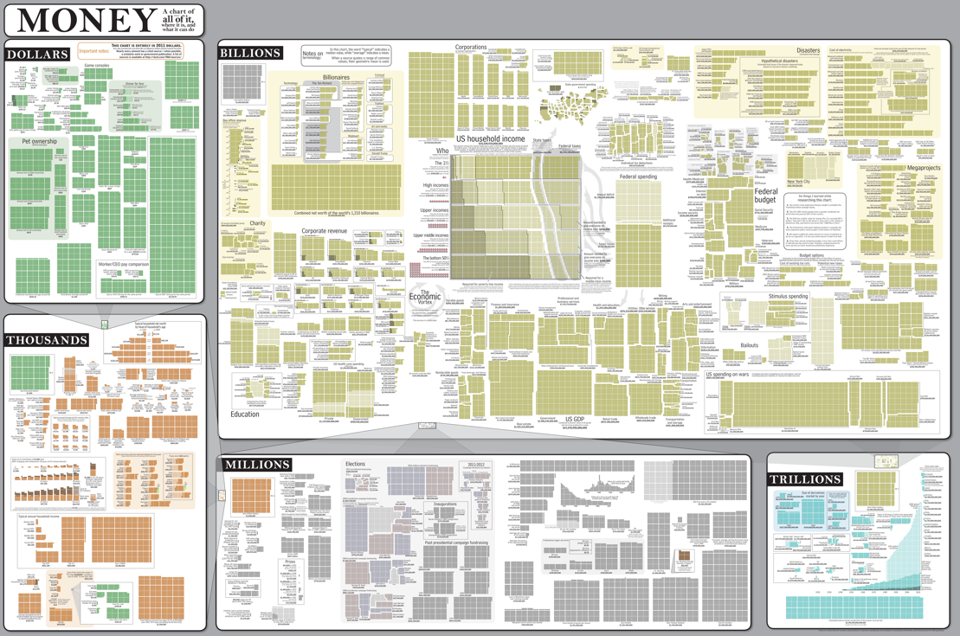
http://imgs.xkcd.com/comics/money_huge.png

Slide 23
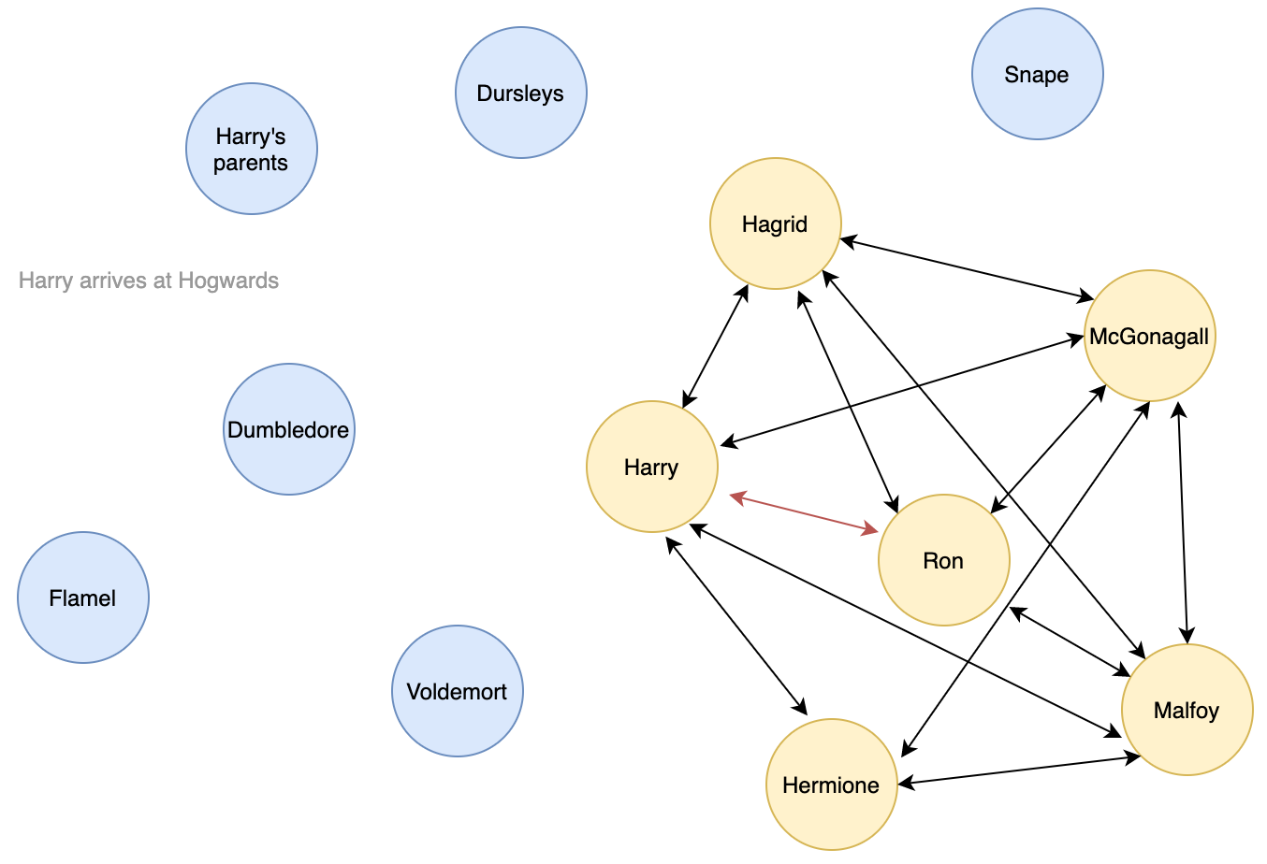

Slide 24
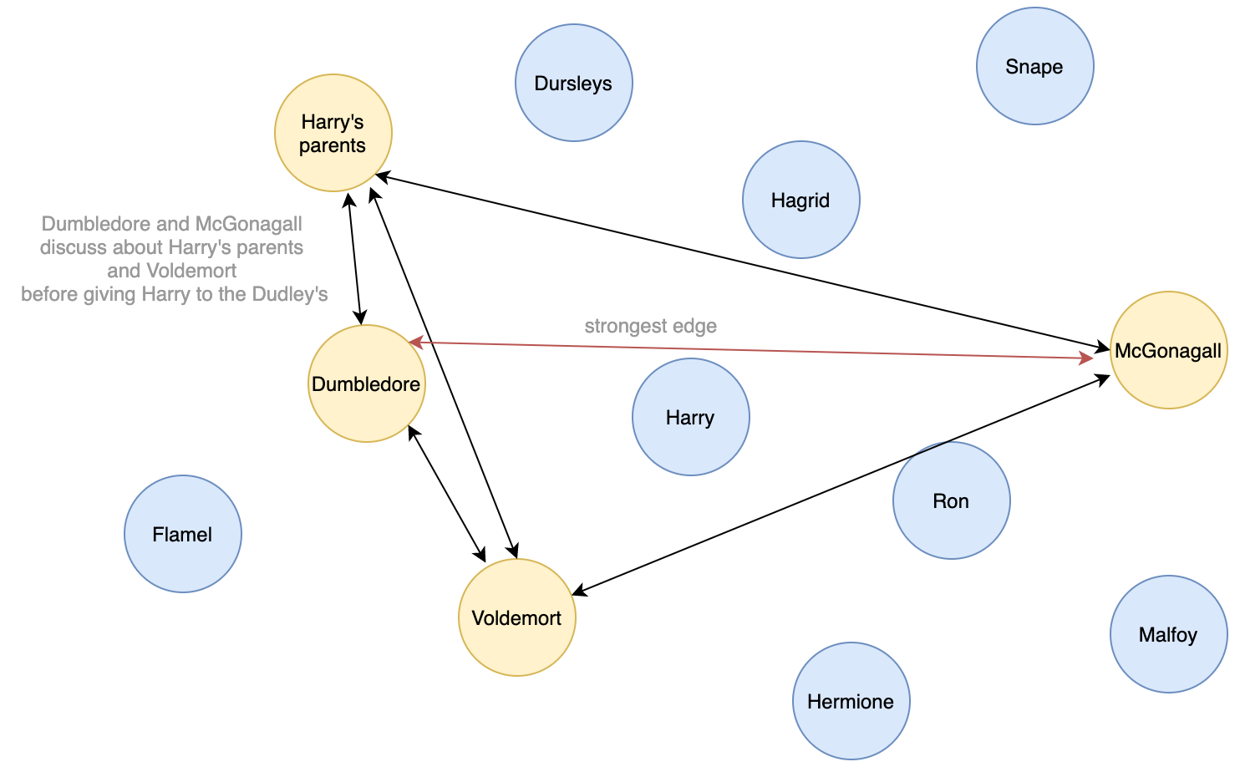

Slide 25

The Enron Corpus
Collected by law enforcement (FERC) in May 2002; by 2005 was published for CS students to write papers on.
http://www.cs.cmu.edu/~enron/
~619k emails for 150 people in Enron management
Need to parse 1.7Gb compressed text emails to make visualization.
https://www.kaggle.com/jamestollefson/enron-network-analysis/notebook

Slide 26
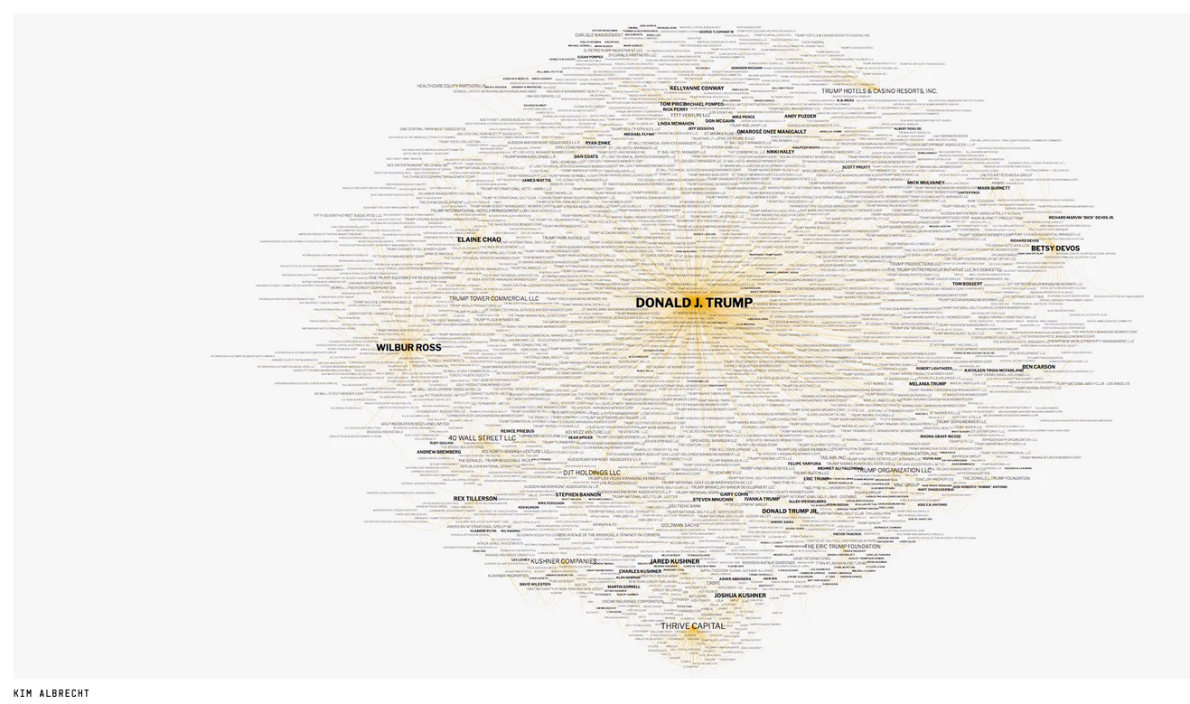
KIM ALBRECHT
https://www.buzzfeednews.com/article/johntemplon/help-us-map-trumpworld
Help Us Map TrumpWorld, Jan 15, 2017 John Templon, Buzzfeed News

Slide 27
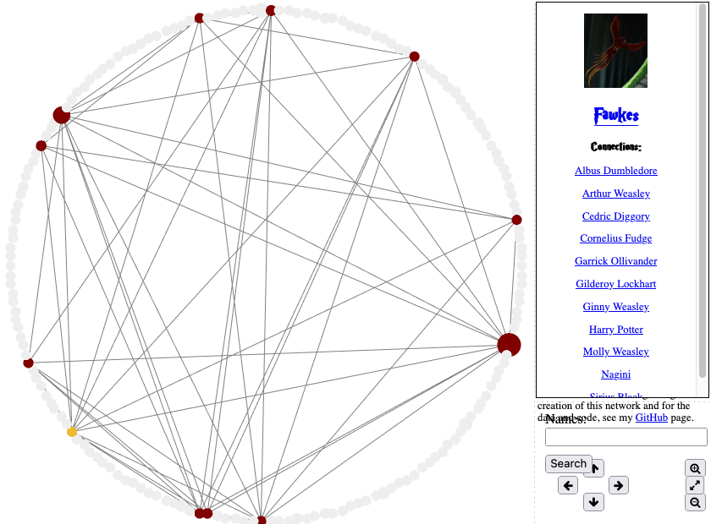
https://dpmartin42.github.io/projects/Harry_Potter/Harry_Potter_Network.html

Slide 28
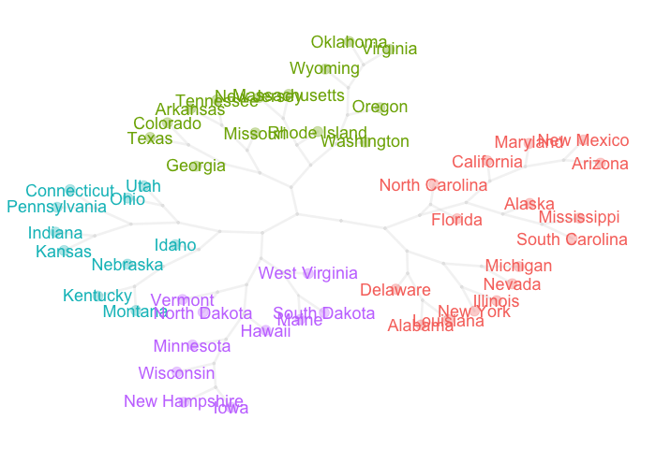
Node-link diagrams
2 dimensions! Thank goodness.
Example that draws this graph in R
https://www.gastonsanchez.com/visually-enforced/resources/2014/07/05/Pretty-tree-graph/

Slide 29

Tooling
Interactive (GUI), possibly abandoned by developers
Tutorial at https://gephi.org/users/quick-start/

Slide 30


Tooling
networkx
pyvis
https://towardsdatascience.com/visualizing-networks-in-python-d70f4cbeb259

