Slide 1

Data 227
Data Visualization & Communication
Autumn, 2021
Perception
Nov 2

Slide 2
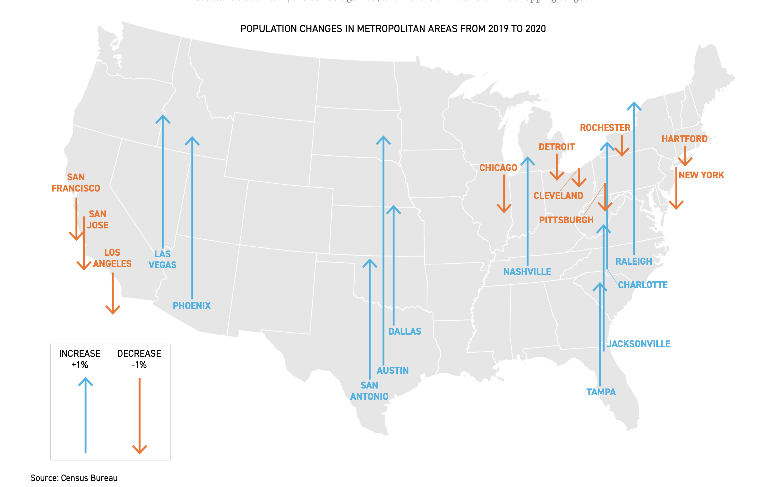
https://www.politico.com/news/2021/10/21/covid-american-cities-charts-516295

Slide 3
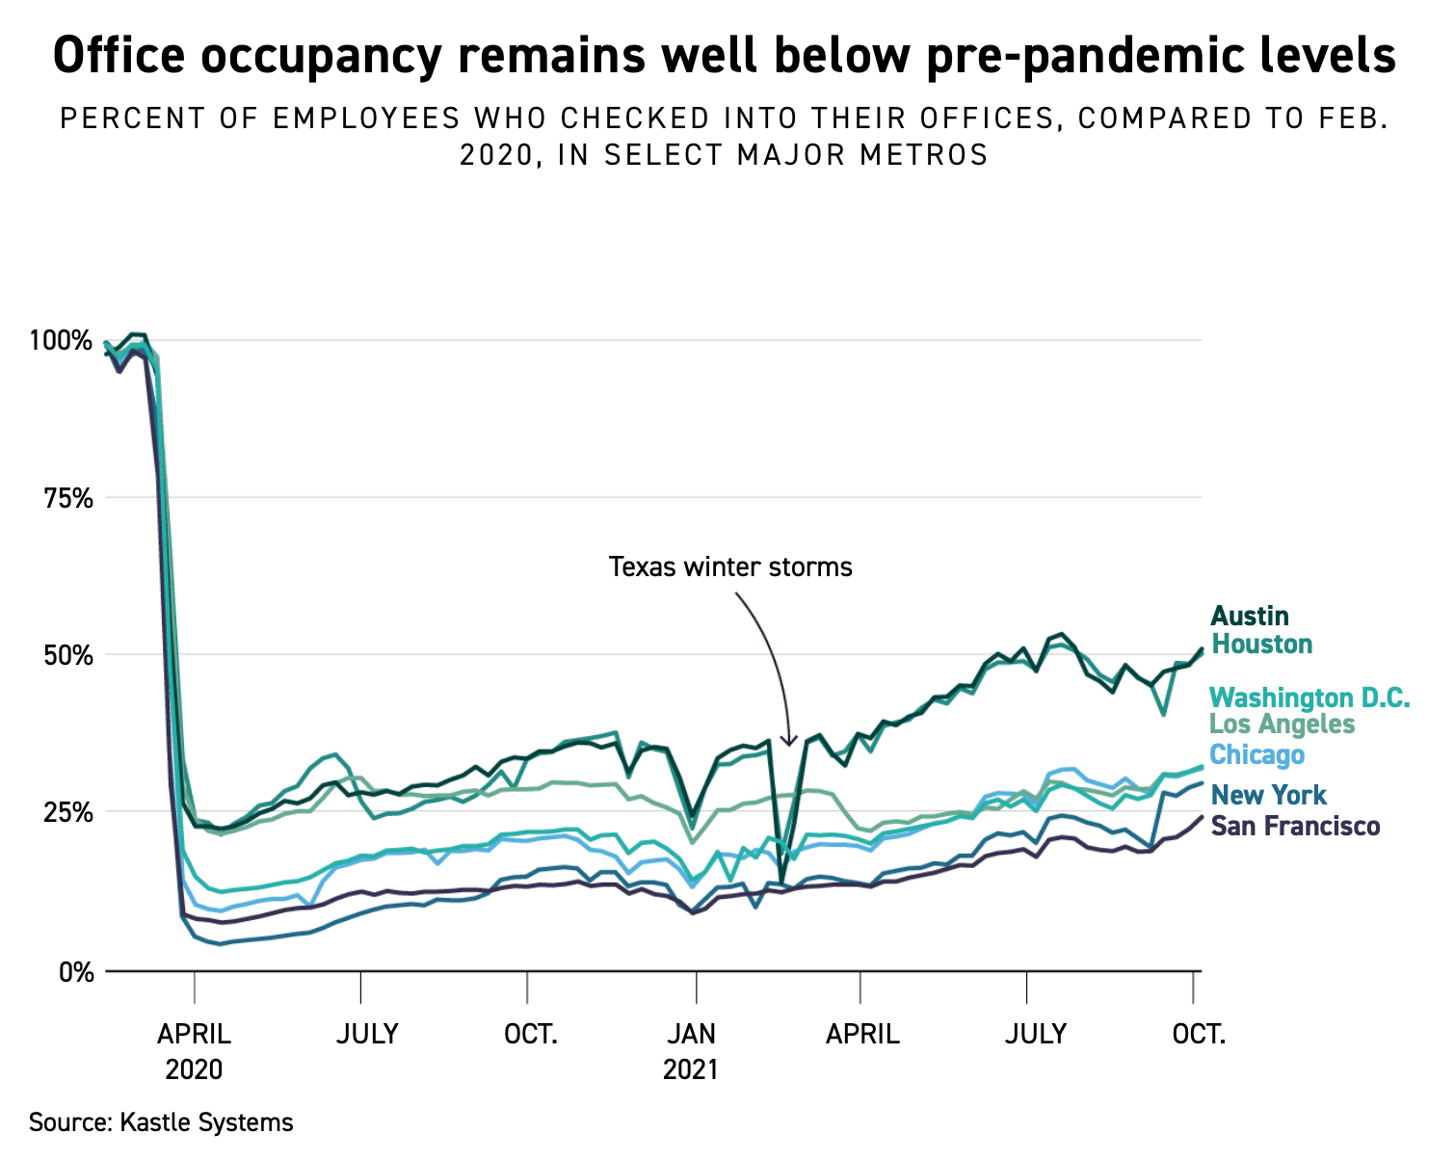
https://www.politico.com/news/2021/10/21/covid-american-cities-charts-516295

Slide 4
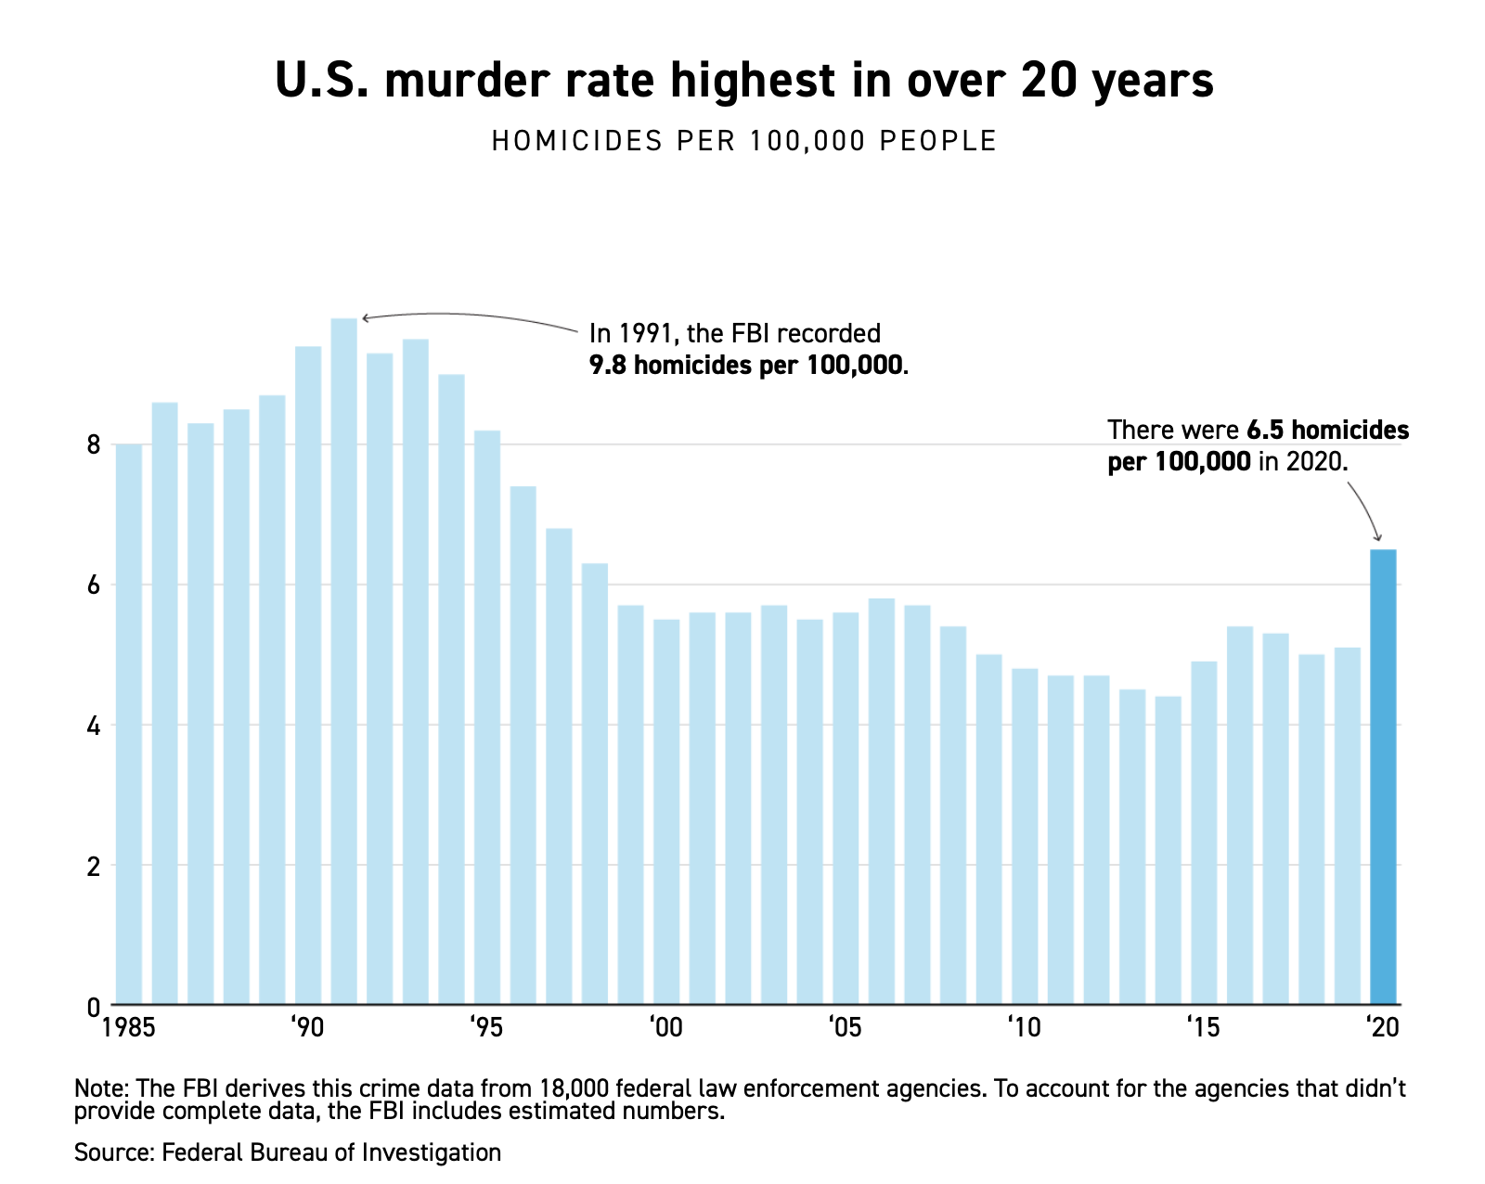
https://www.politico.com/news/2021/10/21/covid-american-cities-charts-516295

Slide 5
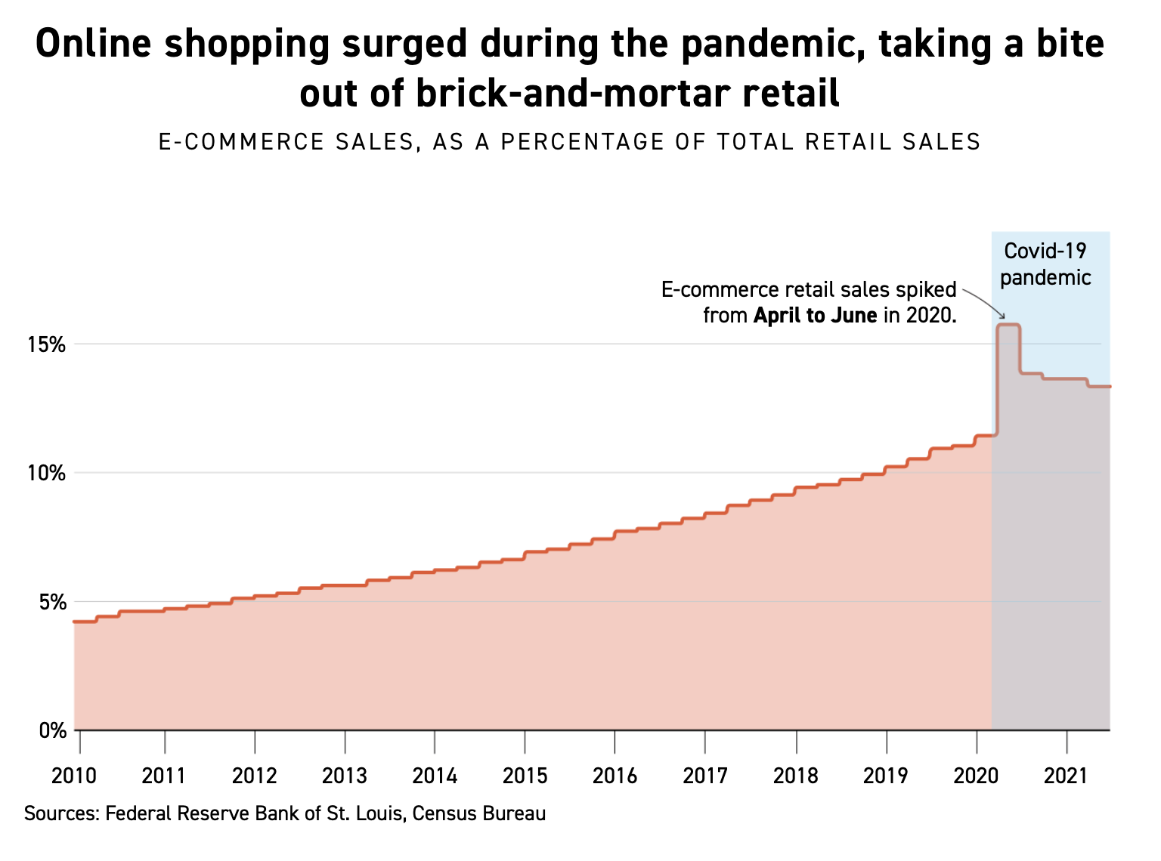
https://www.politico.com/news/2021/10/21/covid-american-cities-charts-516295

Slide 6
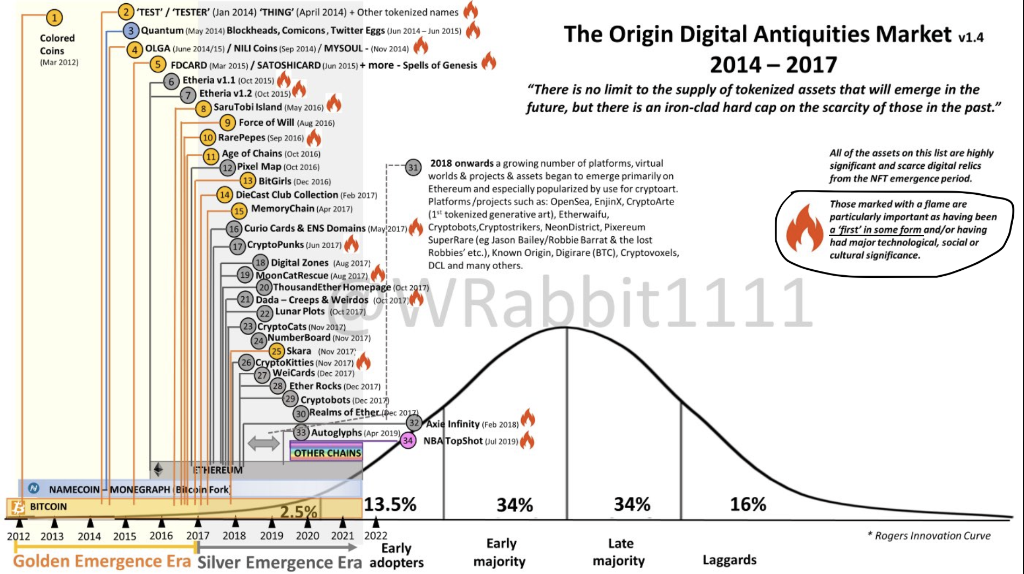

Slide 7
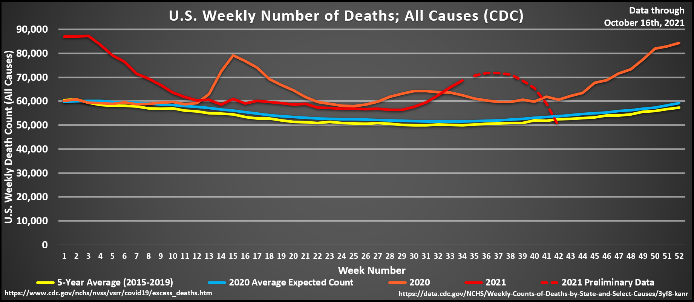

Slide 8
Expresiveness and effectiveness:
Show what is there (and not other things)
Use effective encodings (lower the cost of extracting knowledge)
Let us appraise our [visual] communication channels..

Slide 9
Weber's Law -> Stevens' Power Law -> gamma correction -> crispening
Color constancy
Edge effects
Preattentive features

Slide 10
Weber's law
Sensitivity to differences seems to depend on proportions more than on magnitudes.
Loudness, brightness, weight...
Why? Apparently our senses use logarithmic encoding, a trick that increases their dynamic range.
Can we use this? Not really, it's just that things we wish were linear are nonlinear.

Slide 11
Weber's law
Sensitivity to differences seems to depend on proportions more than on magnitudes.
Loudness, brightness, weight...
JND for weights ~2.5% of weight
Loudness.. neighborhood of 0.5 dB
Light intensity..

Slide 12
Brain tries to correct for illumination color; some sort of subtraction of color of surroundings.
Great for everyday life, terrible for linearity of perception

Slide 13
Weber's law
Just noticeable difference in stimulus dS
Overall size of stimulus S
For measuring weights by hand, k is about 2.5%

Slide 14
Stevens' power law
Power law coefficient
Subjective perceived
intensity of stimulus

Slide 15
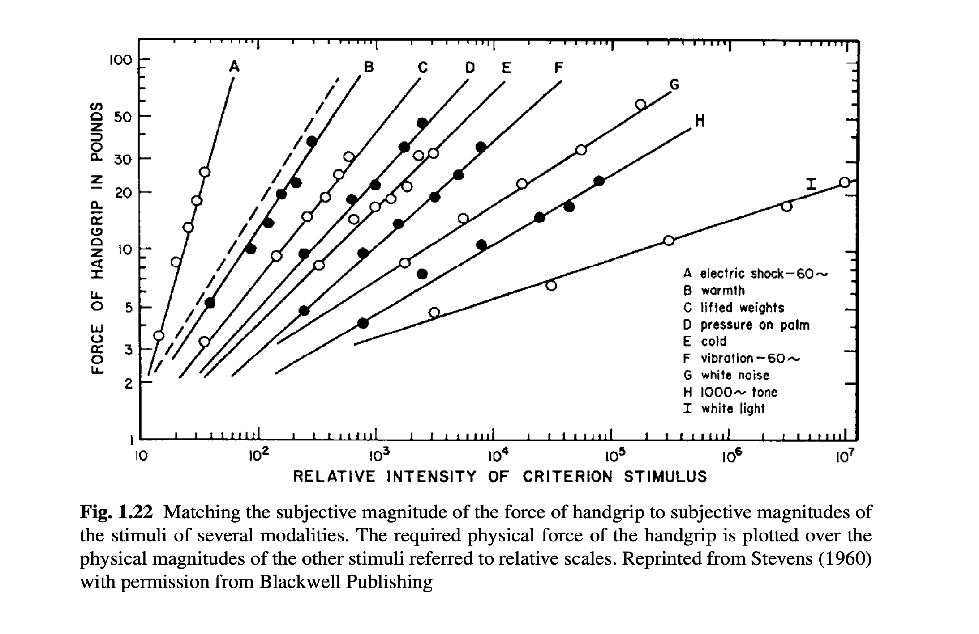
Zwislocki, Sensory Neuroscience, 2009

Slide 16
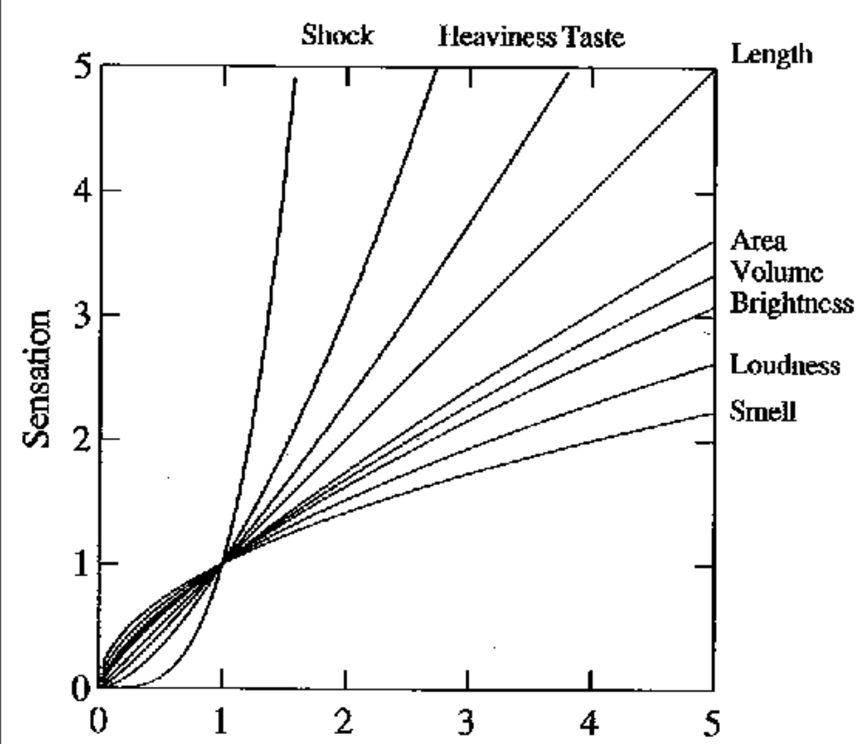

Stevens' power law
Intensity of stimulus

Slide 17
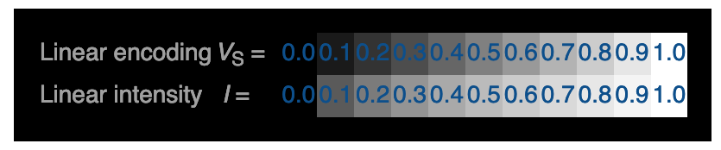
Gamma correction -- because linear intensity looks bad
https://en.wikipedia.org/wiki/Gamma_correction

Slide 18


Slide 19
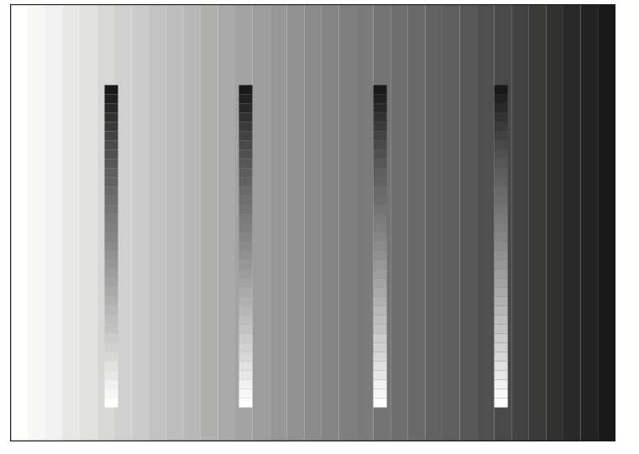

Slide 20
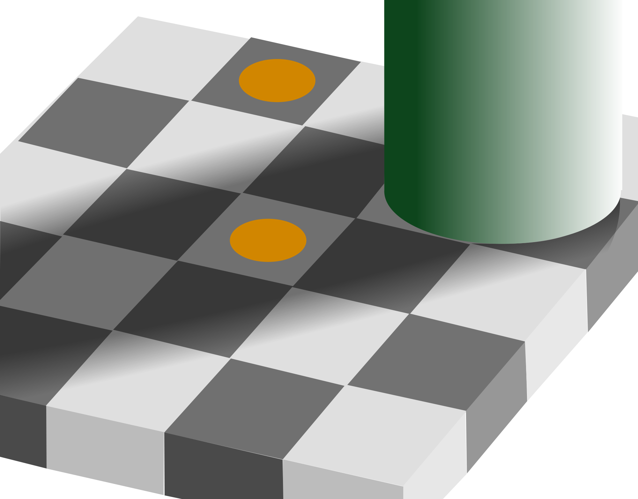

Slide 21


Slide 22
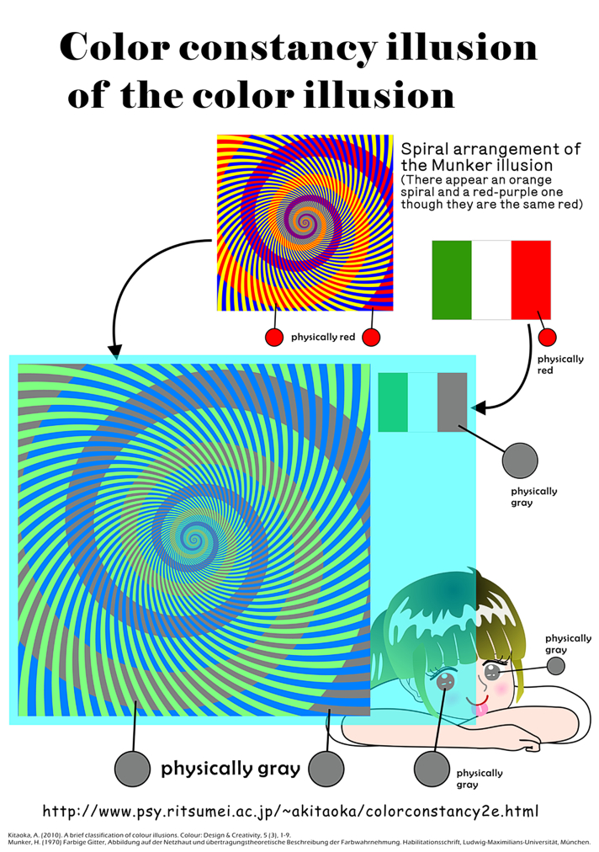

Slide 23
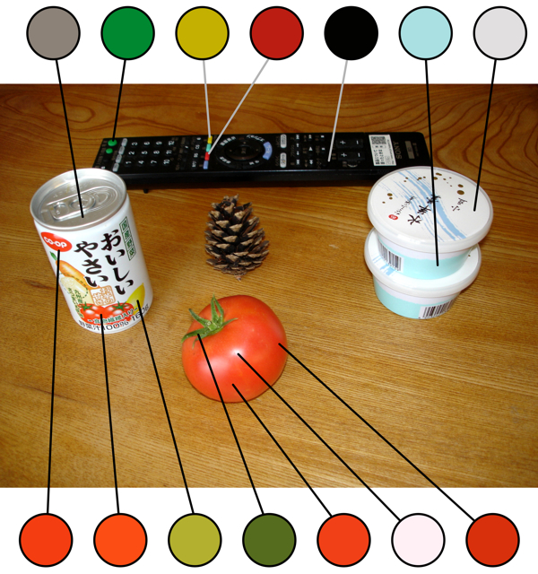
http://www.psy.ritsumei.ac.jp/~akitaoka/colorconstancy2e.html

Slide 24
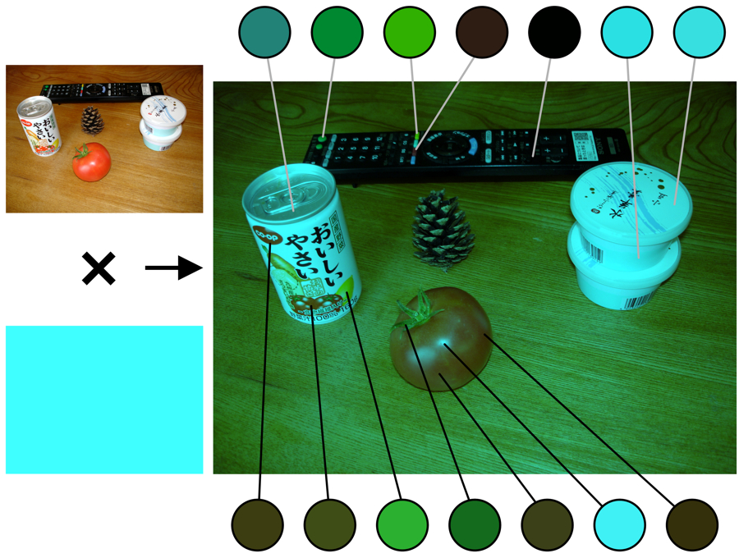
http://www.psy.ritsumei.ac.jp/~akitaoka/colorconstancy2e.html

Slide 25
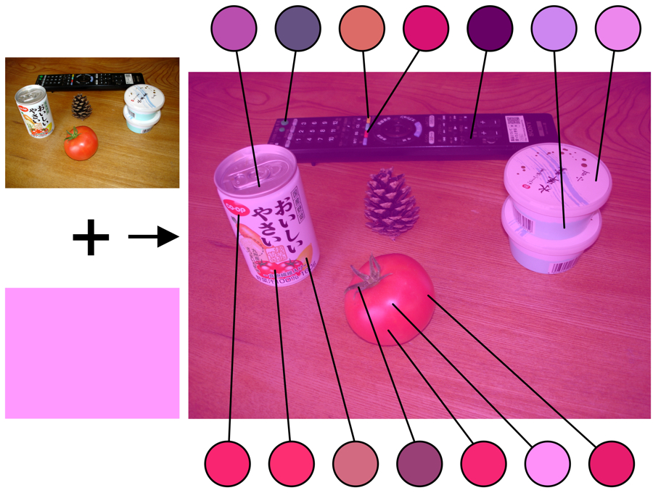
http://www.psy.ritsumei.ac.jp/~akitaoka/colorconstancy2e.html

Slide 26
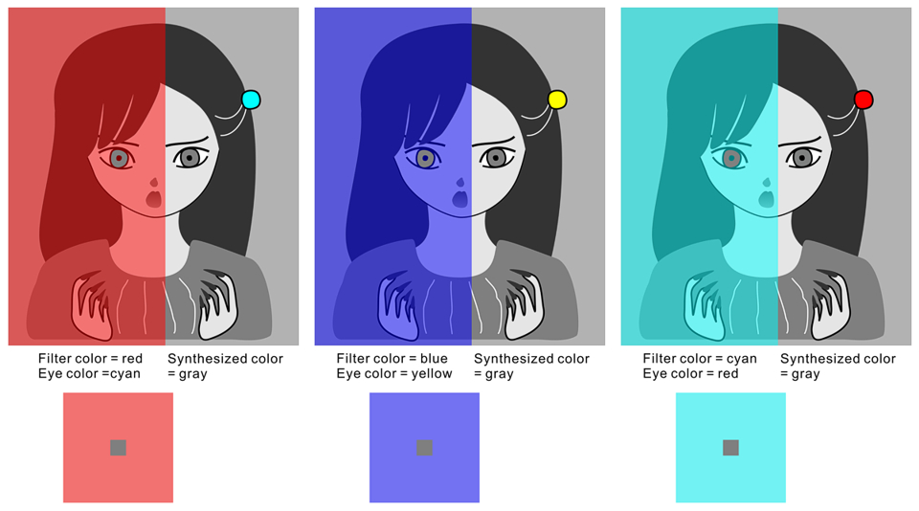

Slide 27
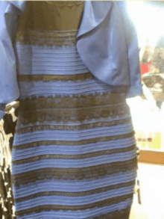

Slide 28
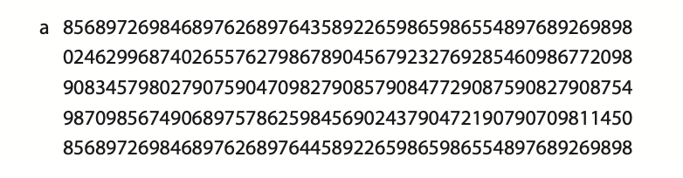
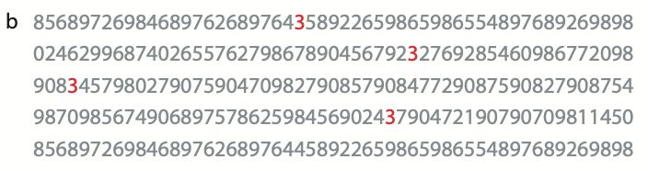

Slide 29
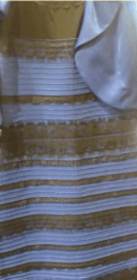

Slide 31
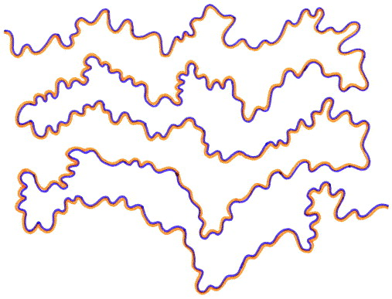
Watercolor illusion

Slide 32
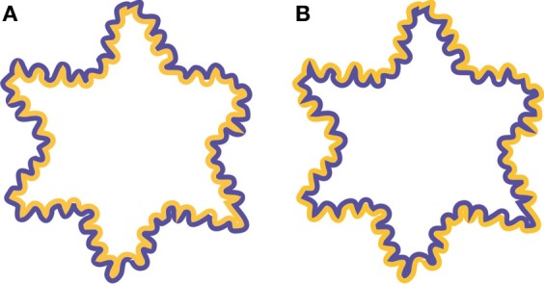
Watercolor illusion

Slide 33
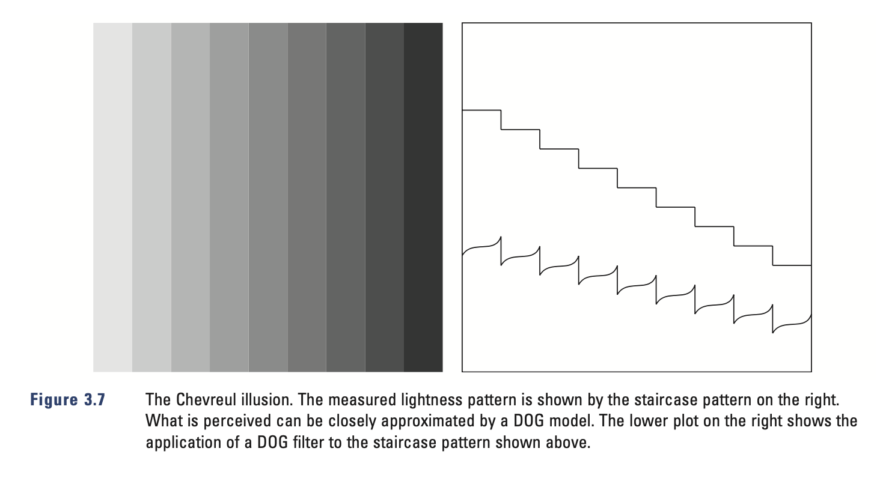

Slide 34
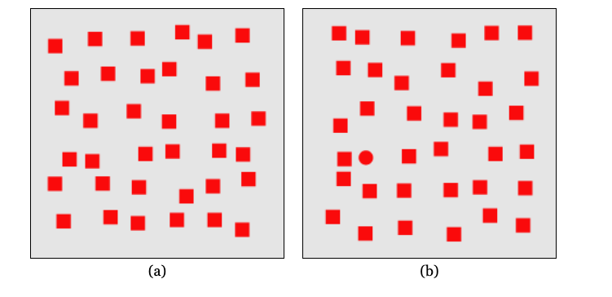

Slide 35
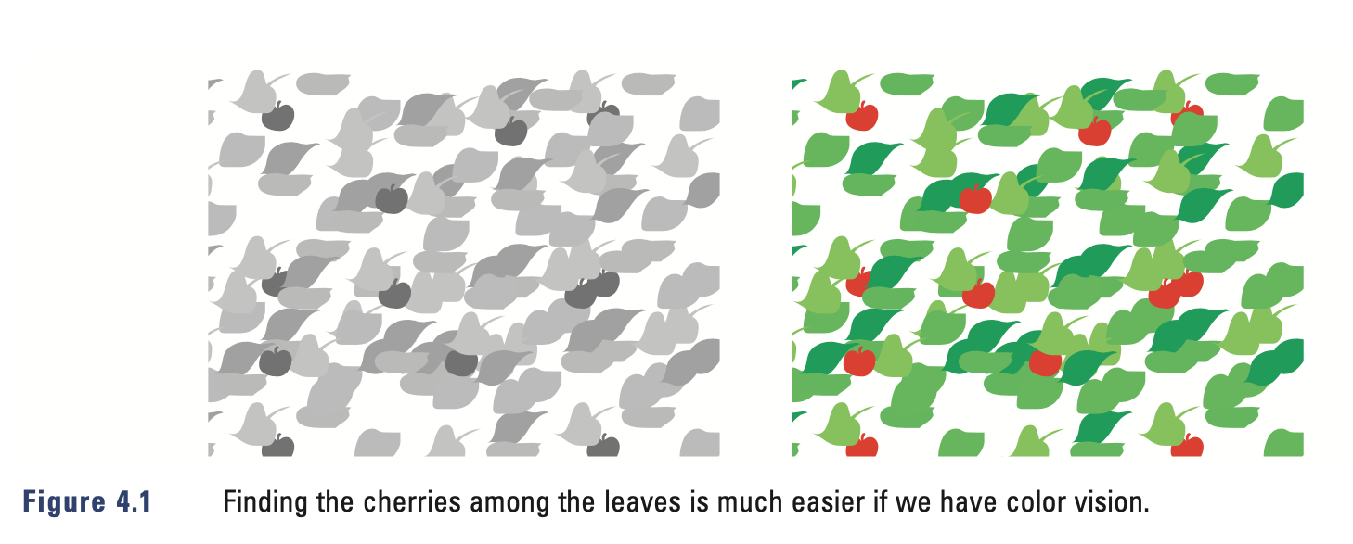

Slide 37
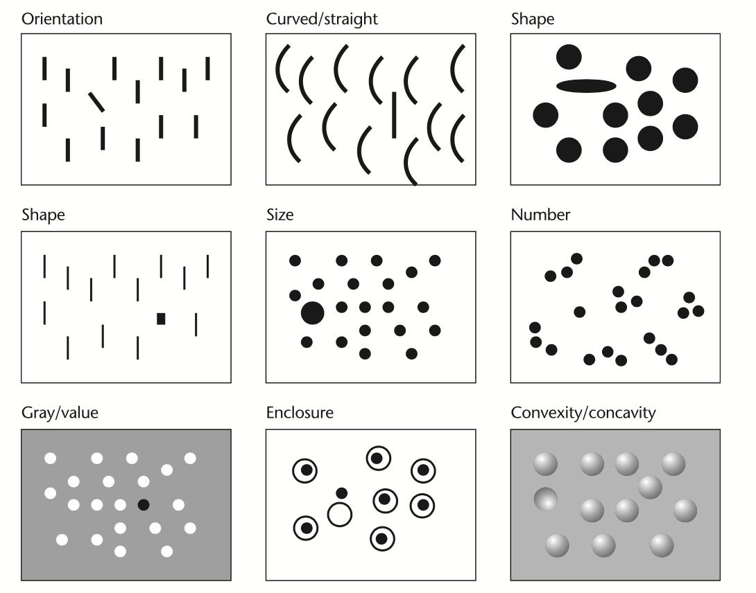

Slide 38
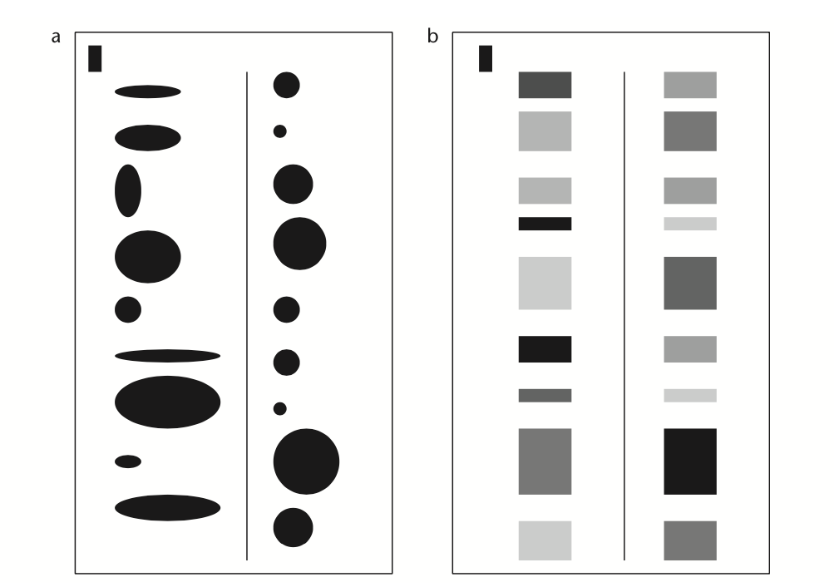

Slide 39
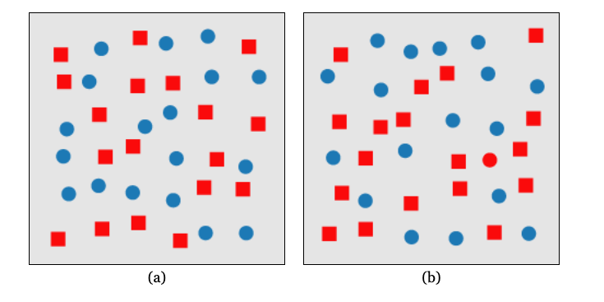

Slide 40
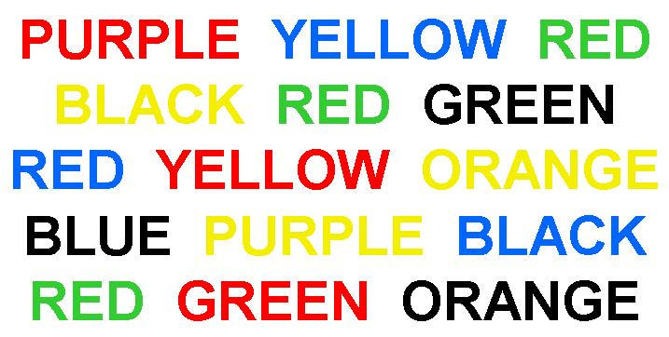
Stroop effect

Slide 41
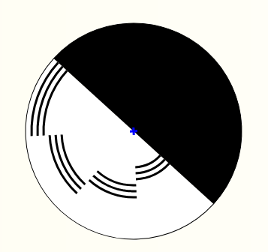
Benham's top
https://michaelbach.de/ot/col-Benham/index.html

