Slide 1

Data 227
Data Visualization & Communication
Autumn, 2021

Slide 2
Week 2 readings
A Tour through the Visualization Zoo. Jeffrey Heer, Michael Bostock, and Vadim Ogievetsky. ACM Queue, 8(5). 2010.
Chapter 1: Information Visualization, in Readings in Information Visualization. Stuart Card, Jock Mackinlay, and Ben Shneiderman. 1999. (light, uneven, some interesting points)
Enterprise Data Analysis and Visualization: An Interview Study. Sean Kandel, Andreas Paepcke, Joseph M. Hellerstein, and Jeffrey Heer. IEEE InfoVis. 2012. (result of interviews w/ data workers)
Chapter 5: Chartjunk, In The Visual Display of Quantitative Information. Tufte. (light, entertaining)

Slide 3
Kandel, Enteprise Data Analysis and Visualization: An Interview Study
5 tasks:
Discovery
Wrangling
Profiling
Modeling
Reporting

Slide 4
Kandel, Enteprise Data Analysis and Visualization: An Interview Study
5 tasks:
Discovery
Wrangling
Profiling
Modeling
Reporting
3 roles:
Hacker
Scripter
Application User

Slide 5


Slide 6
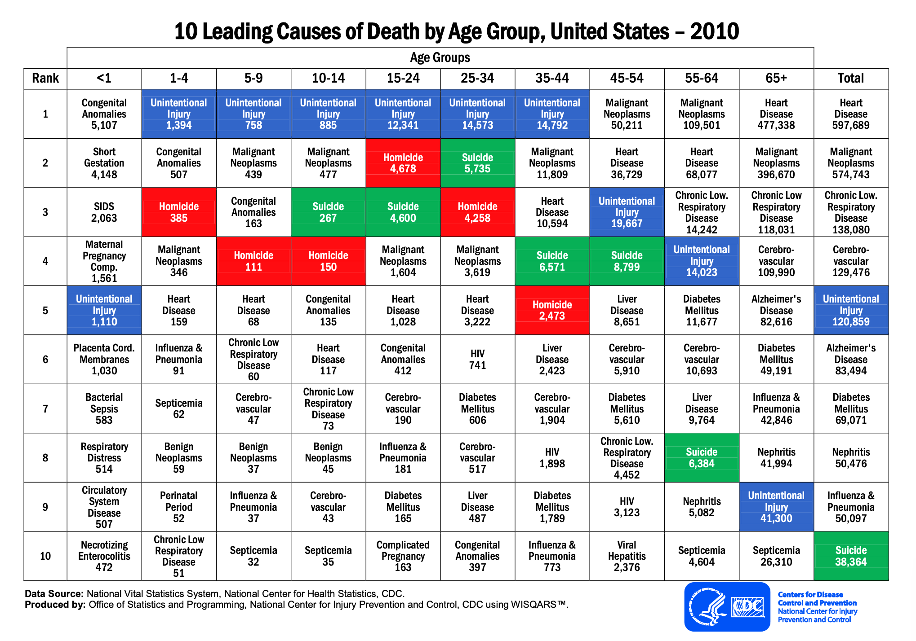

Slide 8
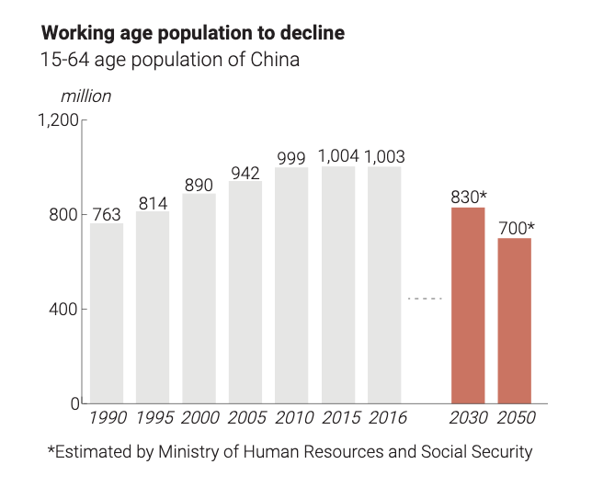
What's wrong here?
Why ‘Made in China 2025’ triggered the wrath of President Trump,
Alice Tse and Julianna Wu South China Morning Post 2018-09-11
https://multimedia.scmp.com/news/china/article/made-in-China-2025/index.html

Slide 9
What's wrong here?
Extremely irregular x-axis
Why ‘Made in China 2025’ triggered the wrath of President Trump,
Alice Tse and Julianna Wu South China Morning Post 2018-09-11
https://multimedia.scmp.com/news/china/article/made-in-China-2025/index.html

Slide 10
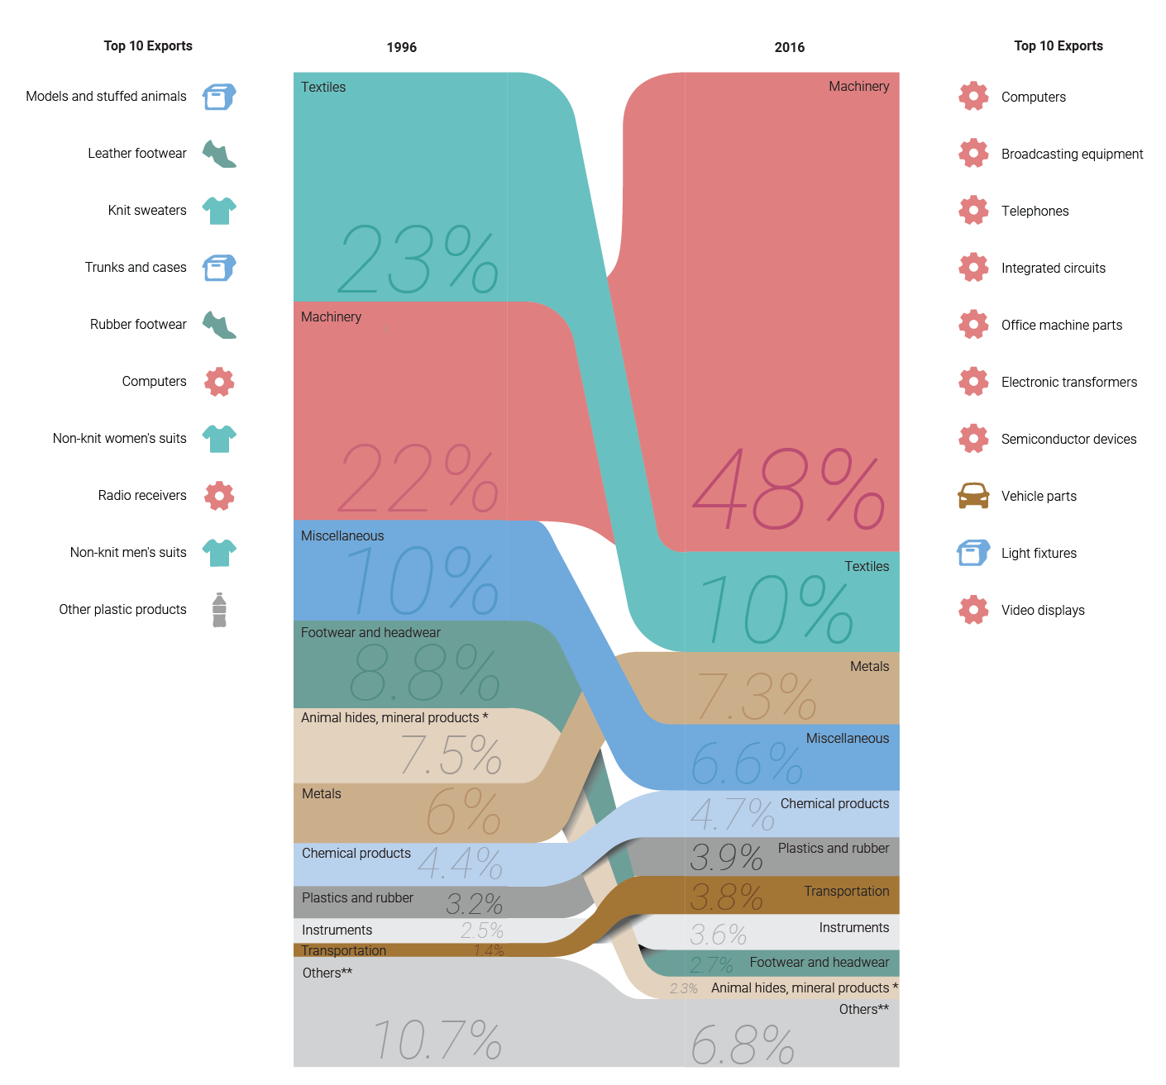
Why ‘Made in China 2025’ triggered the wrath of President Trump,
Alice Tse and Julianna Wu South China Morning Post 2018-09-11
https://multimedia.scmp.com/news/china/article/made-in-China-2025/index.html

Slide 11
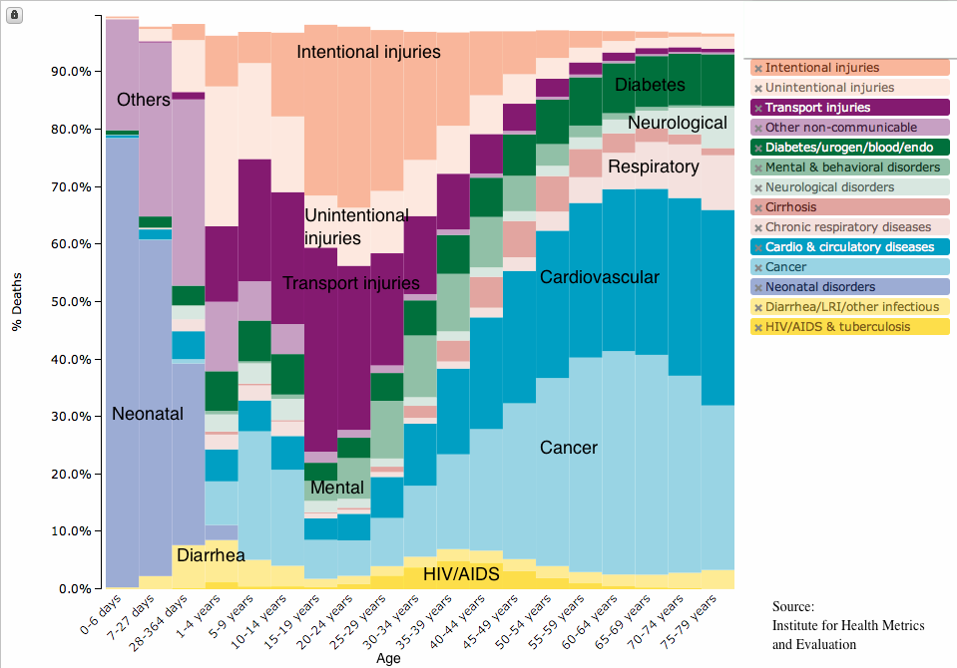
Unlike CDC data, suicide and homicide are combined here under Intentional Injuries.

Slide 12
Stacked bar graph--stairsteps bring group boundaries to mind
Order of stacking matches order in legend
On-data labels ease understanding
Uneven x-axis before age 5

Slide 13
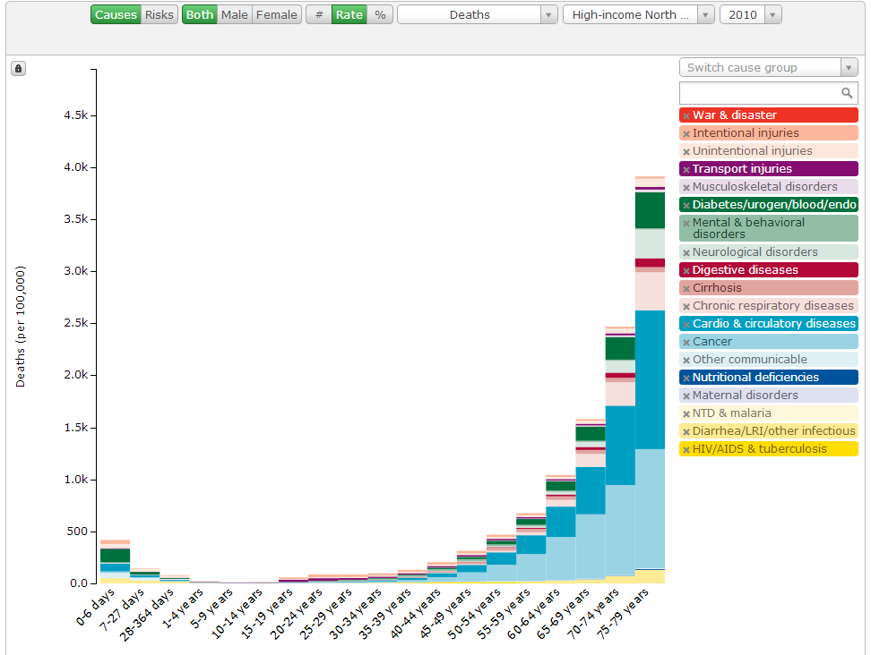
https://vizhub.healthdata.org/gbd-compare/

Slide 14
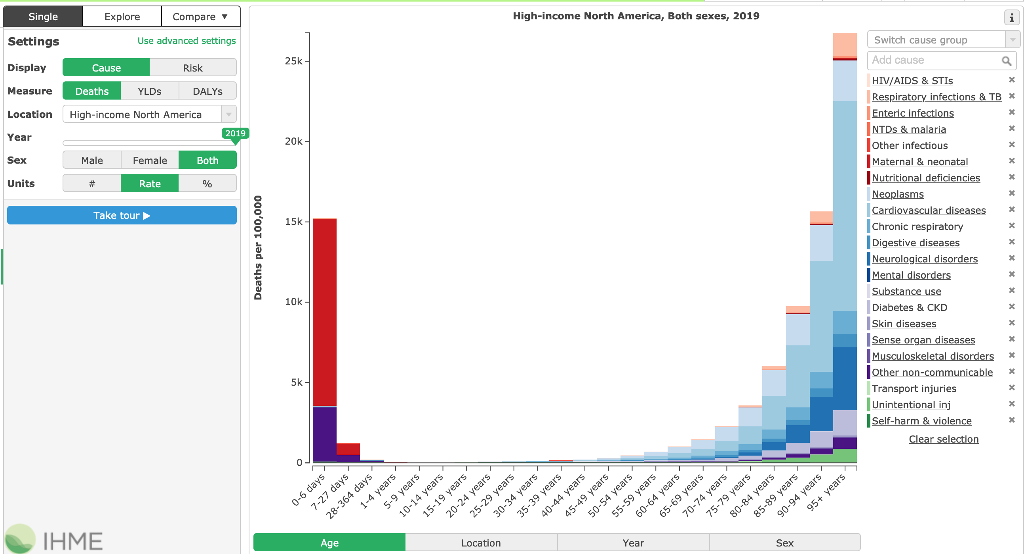
This graph shows the (browser) control panel
This graph goes out to age = 95
Note the colors for the categories --shades of red, blue, purple...

Slide 15
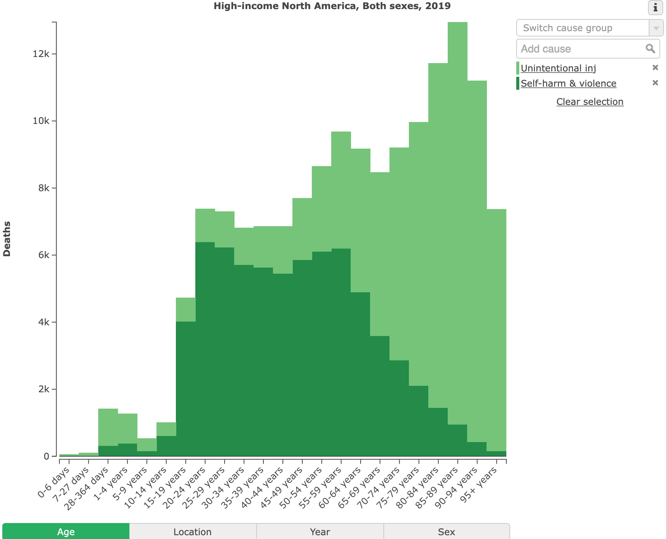
Units: #

Slide 16
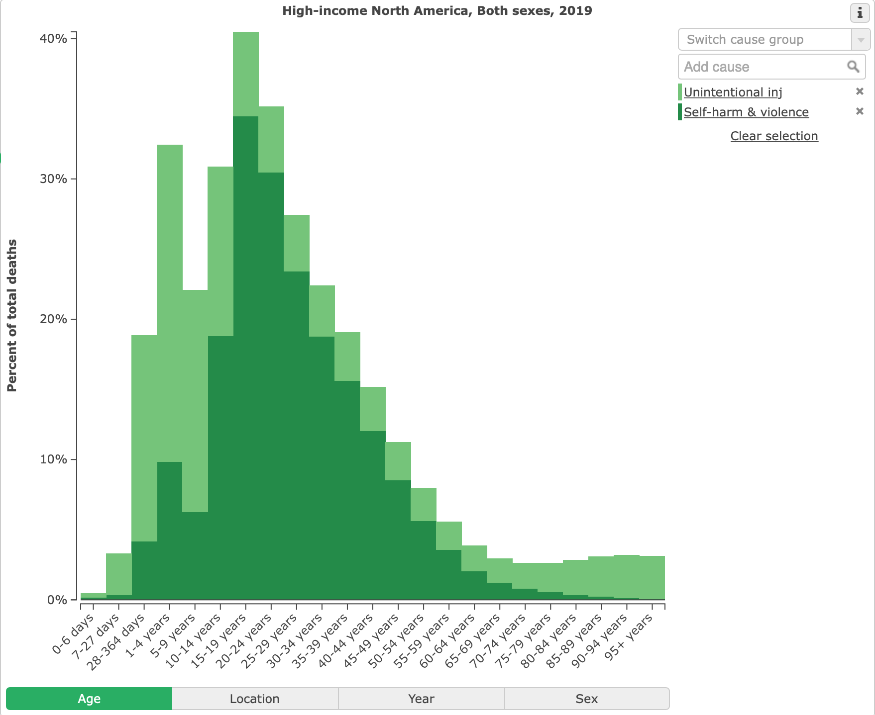
Units: %

Slide 17
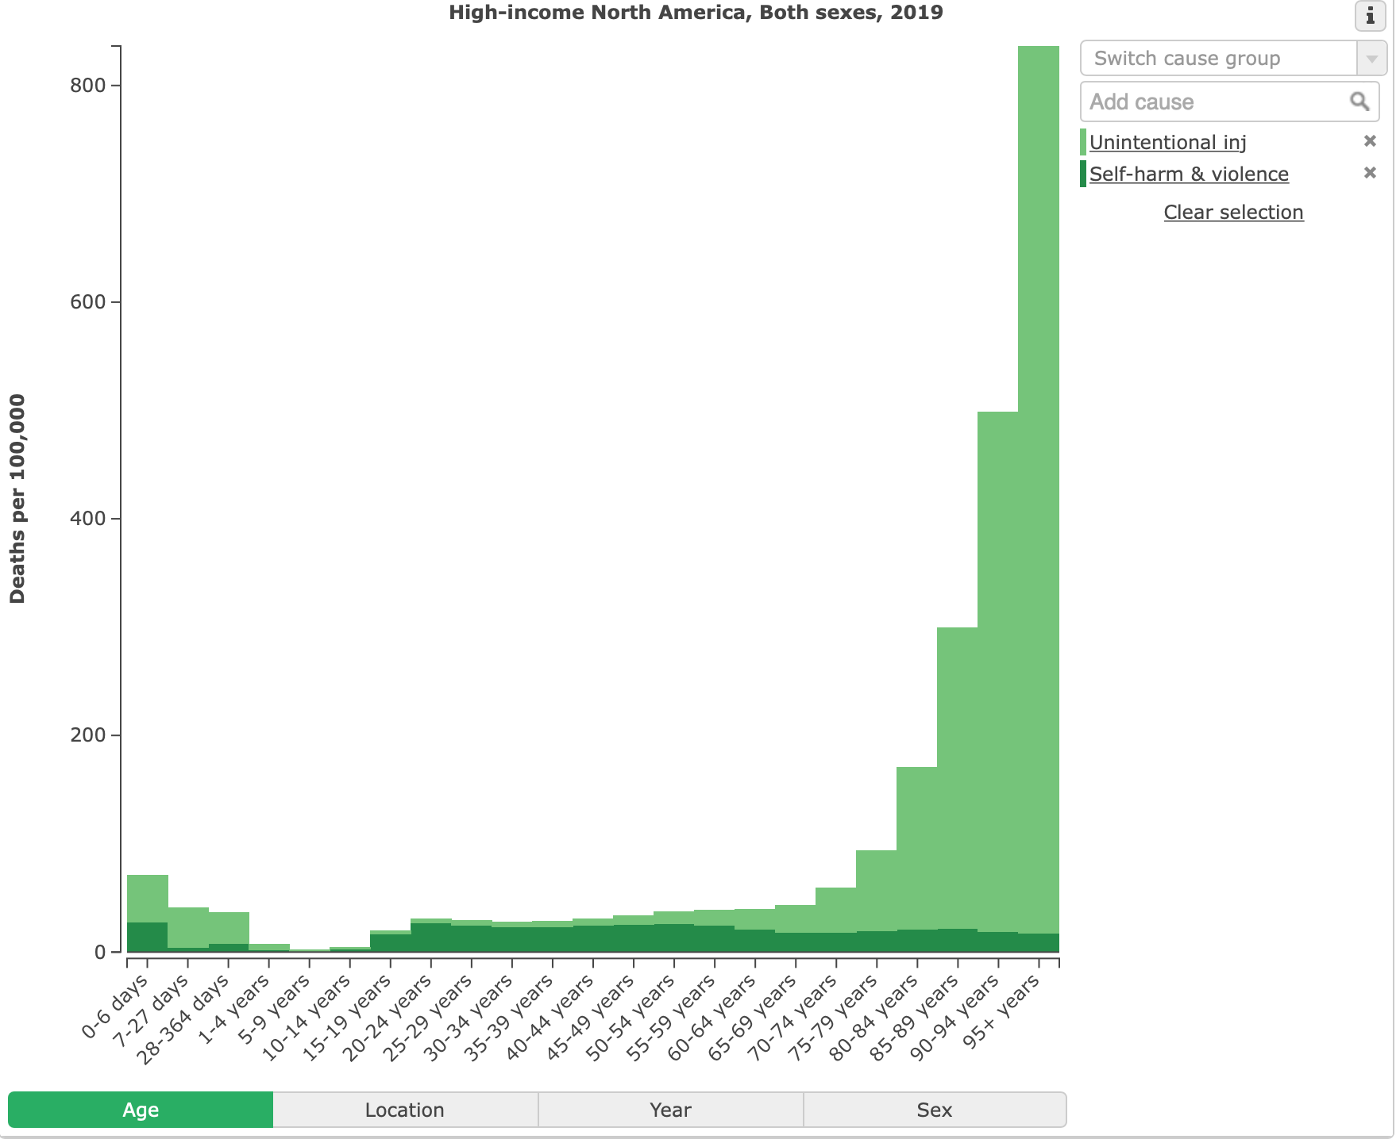
Units: per 100,000
We really do need different views of the data to understand it.

Slide 18
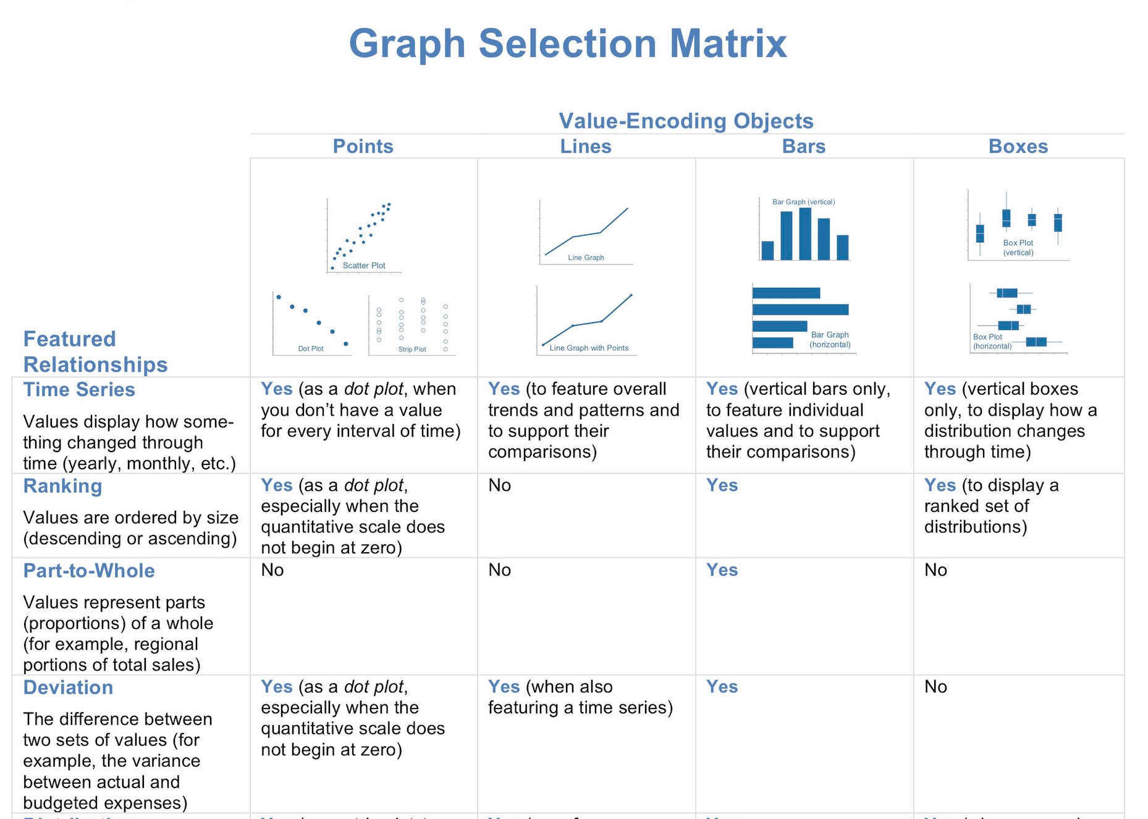
Steven Few, Show Me the Numbers 2004

Slide 19
Steven Few, Show Me the Numbers 2004

Slide 20
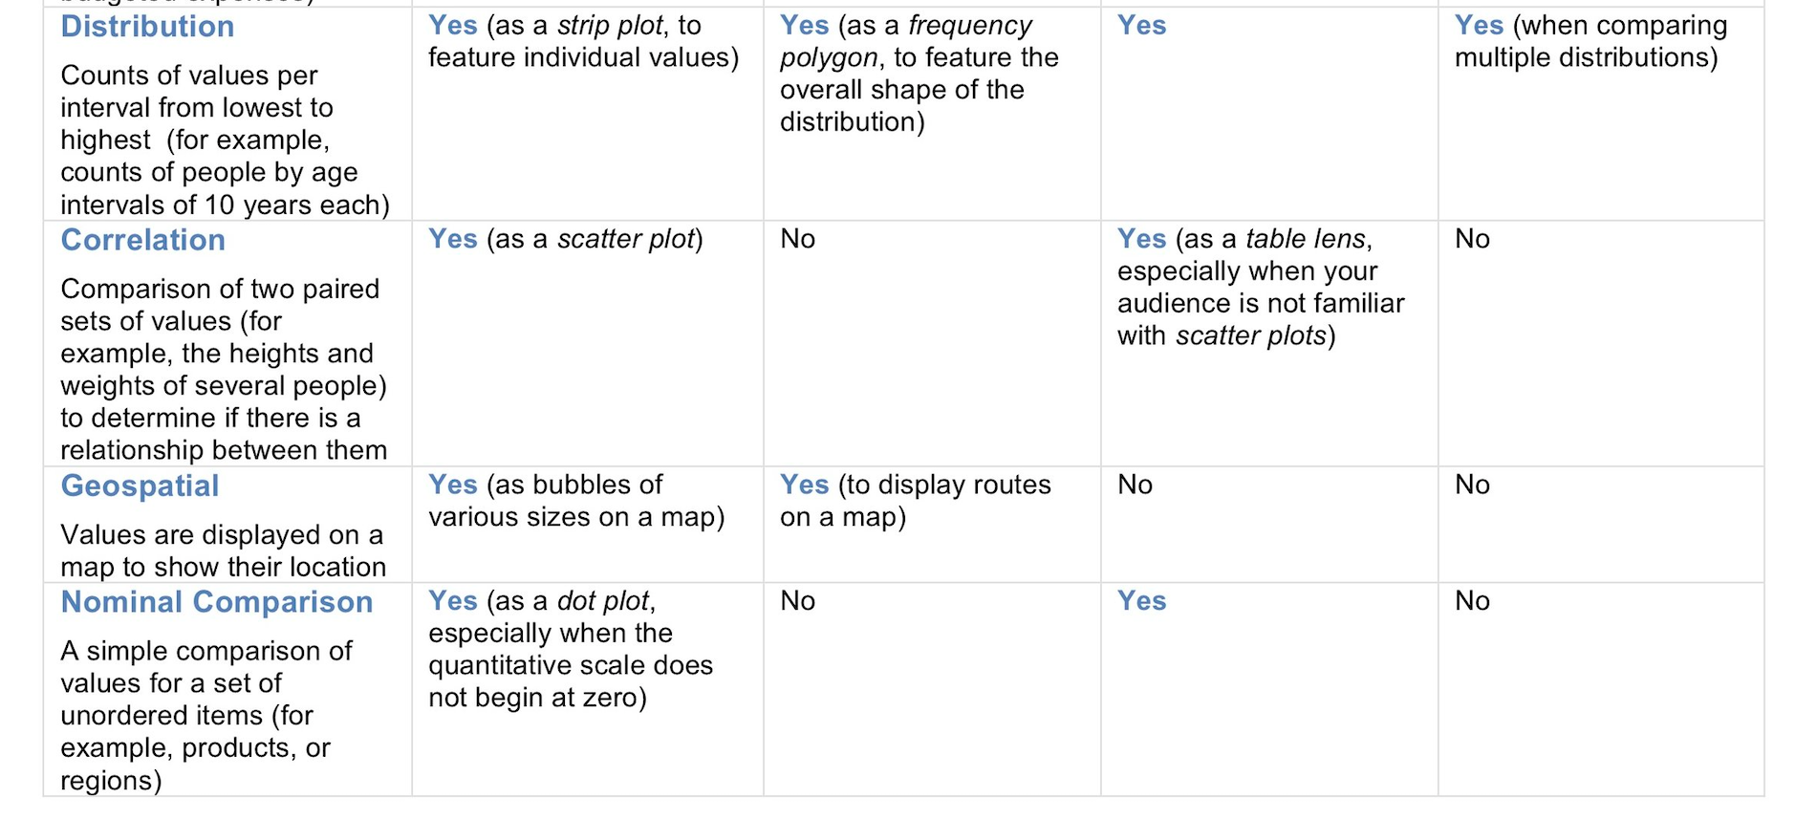

Slide 21
Toy categorical data
Days City Inches Mm
113 Atlanta, Georgia 49.7 1263
88 Austin, Texas 34.2 870
116 Baltimore, Maryland 41.9 1064
117 Birmingham, Alabama 53.7 1364
126 Boston, Massachusetts 43.8 1112
167 Buffalo, New York 40.5 1028
110 Charlotte, North Carolina 41.6 1057
124 Chicago, Illinois 36.9 937
137 Cincinnati, Ohio 41.9 1065
155 Cleveland, Ohio 39.1 994
139 Columbus, Ohio 39.3 998
81 Dallas, Texas 37.6 954
87 Denver, Colorado 15.6 396
135 Detroit, Michigan 33.5 850
130 Hartford, Connecticut 45.9 1165
104 Houston, Texas 49.8 1264
129 Indianapolis, Indiana 42.4 1078

Slide 22
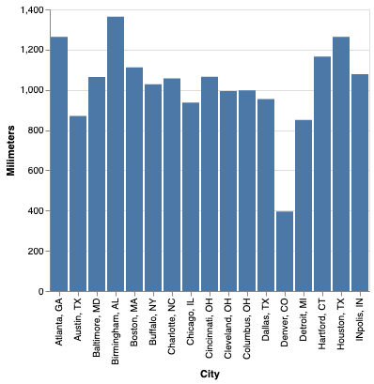
Toy data, bar charts
Nominal (city name) => x
Quantitative (Annual precipitation) => y
Mark: bar

Slide 23
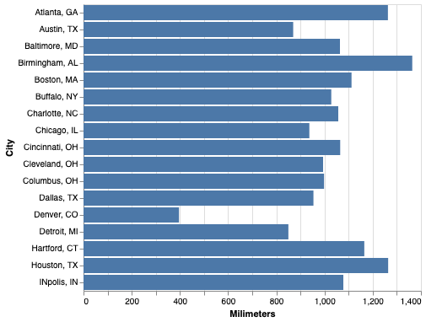
Toy data, bar charts
Mark: bar
Nominal (city name) => x
Quantitative (Annual precipitation) => y
Nominal (city name) => y
Quantitative (Annual precipitation) => x

Slide 24
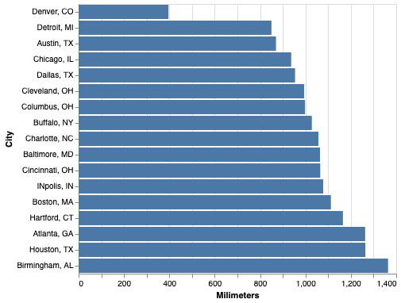
Toy data, bar charts
Nominal (city name) => y
Quantitative (Annual precipitation) => x
Mark: bar

Slide 25
Toy data, bar charts
Nominal (city name) => x
Quantitative (Annual precipitation) => y
Mark: bar

Slide 26
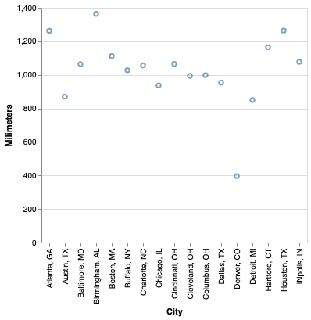
Mark types
Nominal (city name) => x
Quantitative (Annual precipitation) => y
Mark: bar
Mark: point

Slide 27
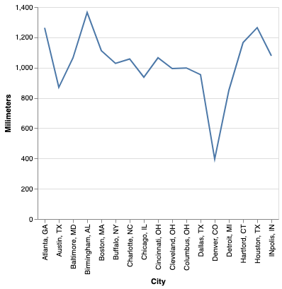
Mark types
Nominal (city name) => x
Quantitative (Annual precipitation) => y
Mark: bar
Mark: point
Mark: line

Slide 28
Mark types
Nominal (city name) => x
Quantitative (Annual precipitation) => y
Mark: bar
Mark: point
Mark: line

Slide 29
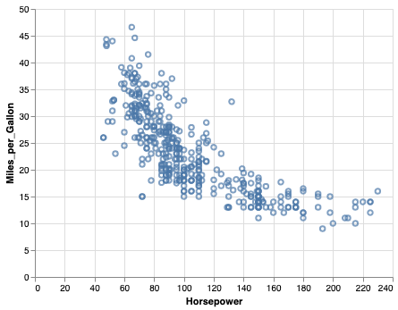
Scatterplot
Quantitative (Horsepower) => x
Quantitative (Miles_per_Gallon) => y

Slide 30
Scatterplot
Quantitative (Horsepower) => x
Quantitative (Miles_per_Gallon) => y

Slide 31
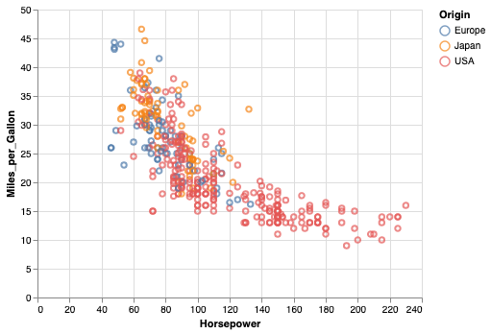
Scatterplot with nominal color
Nominal (city name) => x
Quantitative (Annual precipitation) => y
Nominal (Origin) => color

Slide 32
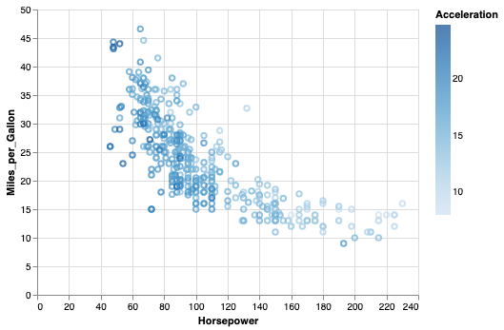
Scatterplot with quantitative color
Nominal (city name) => x
Quantitative (Annual precipitation) => y
Quantitative (Acceleration) => color
We'll make these
graphs on Thursday.

