Slide 1

Data 227
Transformation

Slide 2
HW1
Data transformation / encoding issues:
Raw differences ( population increase)
Cohort ratios (dividing by small numbers)
Lines connecting cohorts (discouraged but tolerable)

Slide 3
HW1
Presentation flaws:
ineffective use of plot real estate
color contrast that impairs legibility
color legend missing when needed
symbols too small to easily make out their color
can't see color if too many overlapping bars
fonts too small
bad typesetting of scientific notation “1e7”
legend alignment issues, “90+” bin
percentages larger than 300%, axis labels with more than 4 consecutive zeros
inaccurate legends

Slide 4
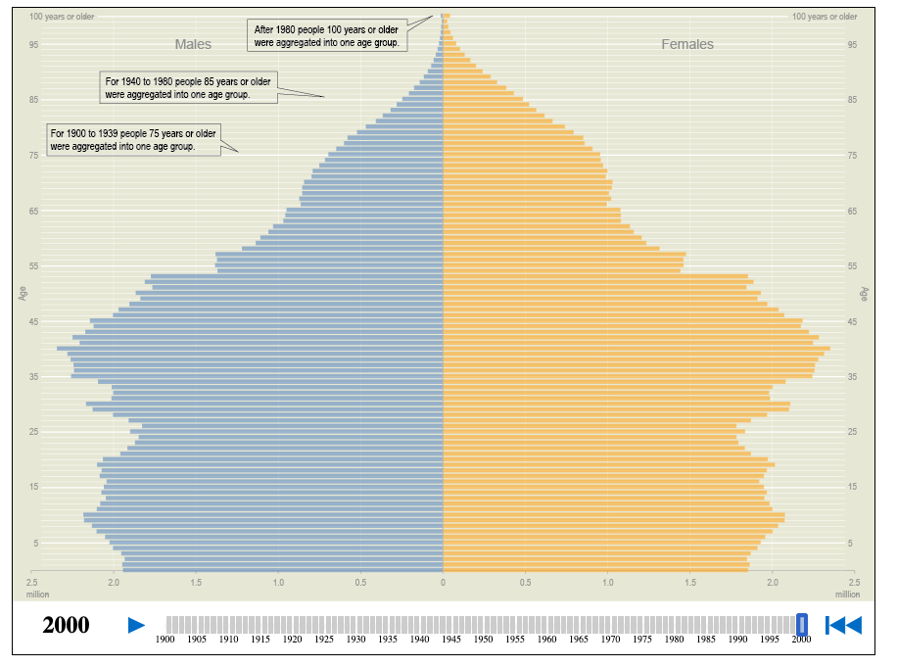
https://www.census.gov/dataviz/visualizations/055/

Slide 5
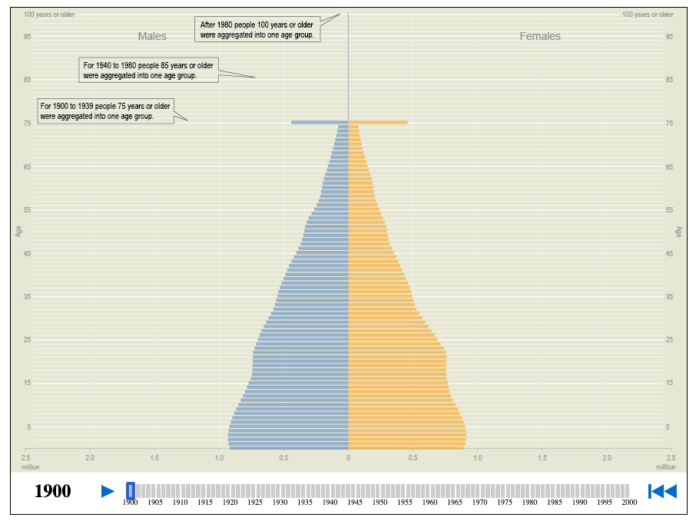
https://www.census.gov/dataviz/visualizations/055/

Slide 6
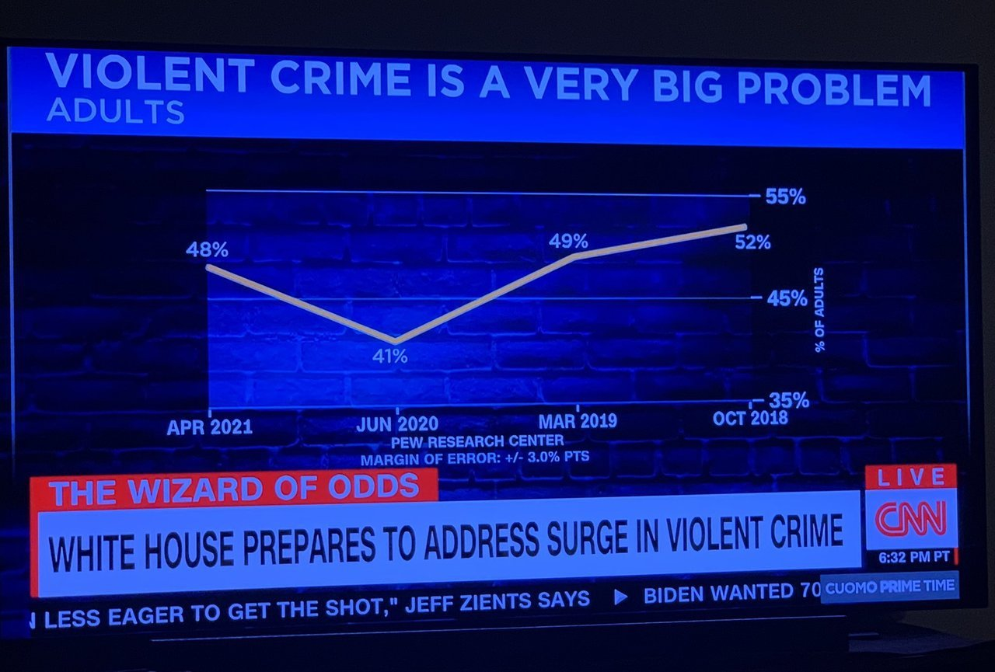

Slide 7
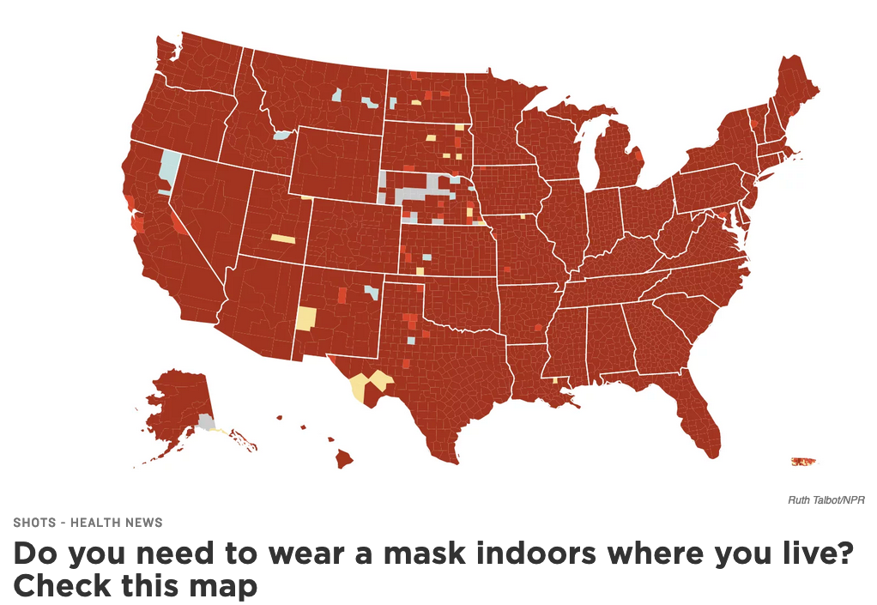

Slide 8
Data Provenance
Who collected the data?
For what purpose?
Is this combination trustworthy?

Slide 9
Data transformations
Rarely does the data that we have access to drop into the graphing library without modification.
The design decisions to adjust the data to make it more suitable to display are important!

Slide 10
Data transformations
Rarely does the data that we have access to drop into the graphing library without modification.
The design decisions to adjust the data to make it more suitable to display are important!
number -> distance
category-> color
number -> color

Slide 11
This film has been modified from its original version. It has been formatted to fit this screen.

Slide 12
This data has been modified from its original version. It has been edited to remove uninteresting content and aggregated to fit this screen.

Slide 13
Data transformations
Monotonic transforms (adjust the scale of the data to the scale of the visualization)
Aggregation (level of aggregation, exceptions, granularity)
Treatment of central tendency measures, outliers
Handling of missing data
On-chart annotation, legends, explainers

Slide 14
Data Wrangling
Preparing data
  acquiring data (downloading, scraping, purchasing)
  formatting
  handling groups, hierarchies, merging data sources
  handling missing data, divide-by-zero
  quality assessment, determining data subset to be used

Slide 15
Data Provenance
When was the data collected? (Have coding standards, collection protocols, data quality changed?)
Where was the data collected? (Are there likely geographic effects in data consistency?)

Slide 16
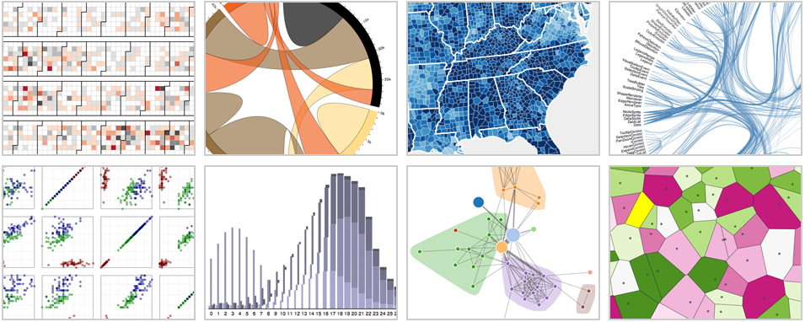
Chart Types
Interactive visualizations built with D3, running inside Google Chrome. From left to right: calendar view, chord diagram, choropleth map, hierarchical edge bundling, scatterplot matrix, grouped & stacked bars, force-directed graph clusters, Voronoi tessellation.
Bostock, 2011, D3

Slide 17
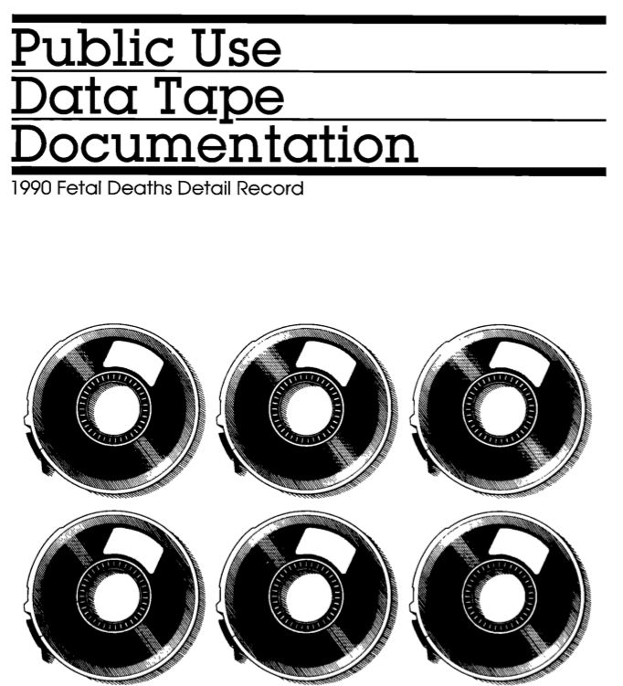
HW3

