Slide 1

Data 227
Data Visualization & Communication

Slide 2
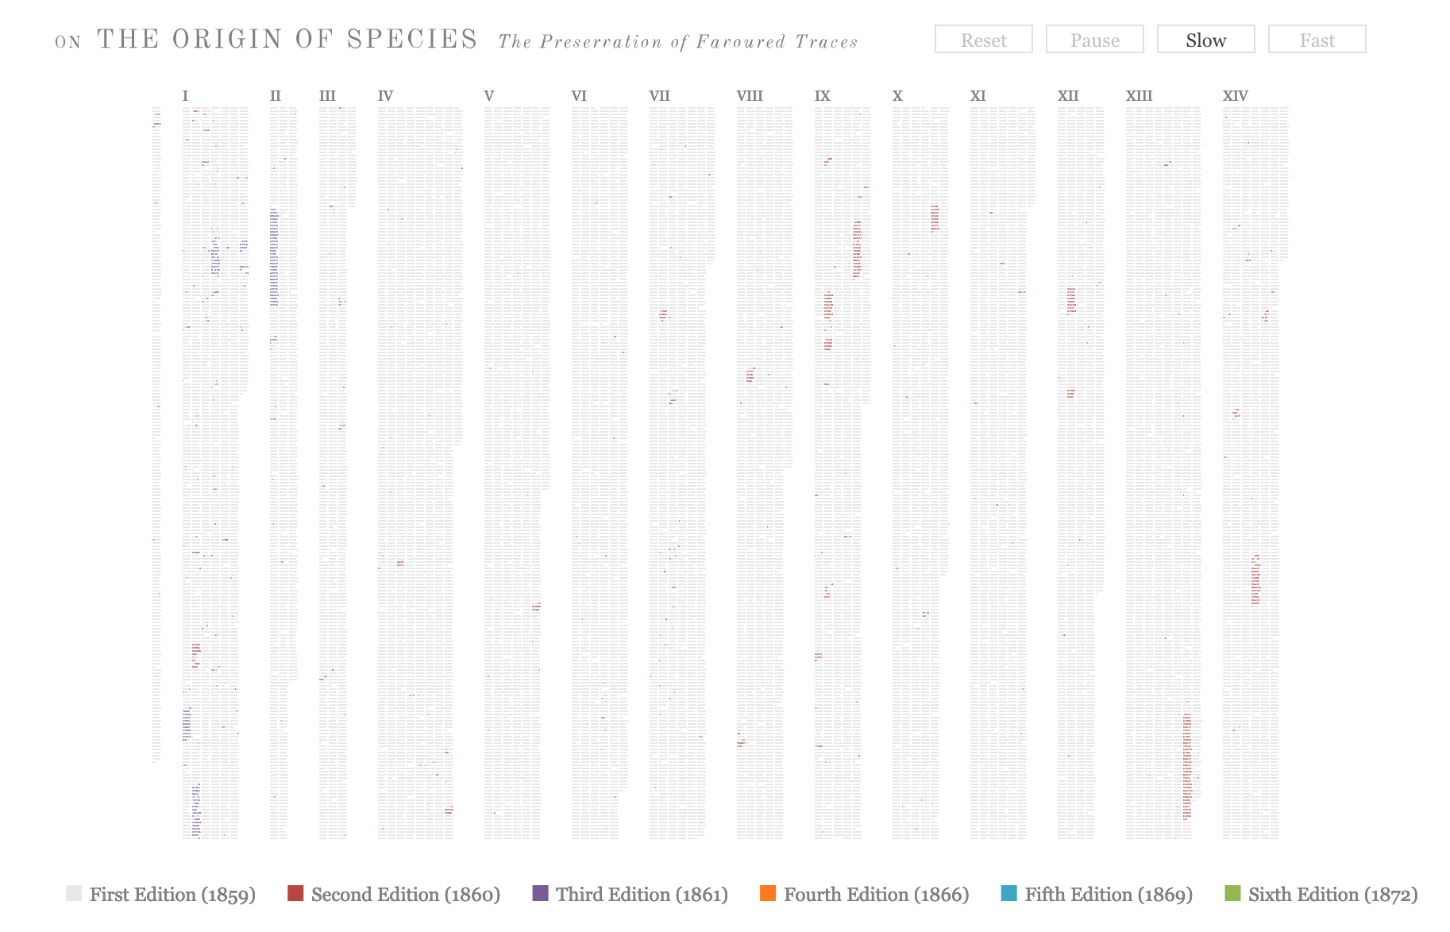
https://benfry.com/traces/

Slide 3
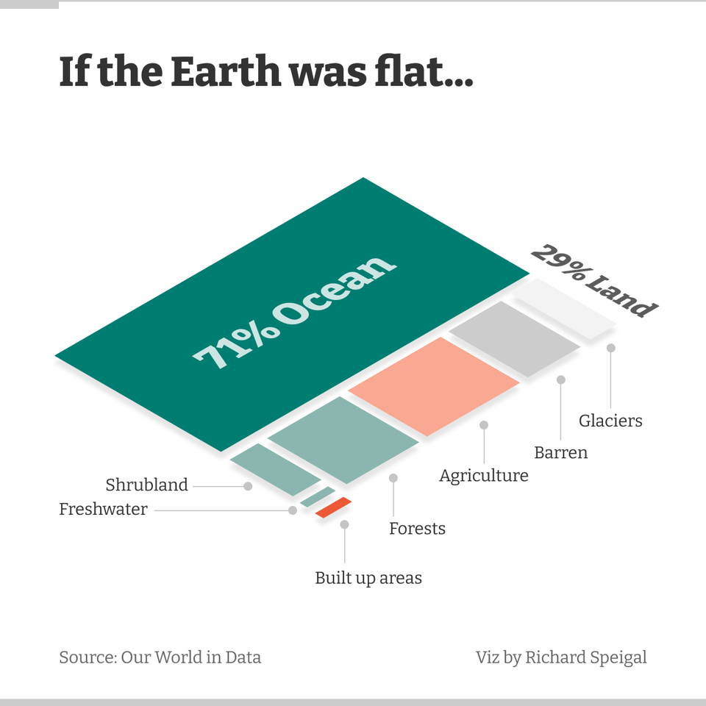

Slide 4
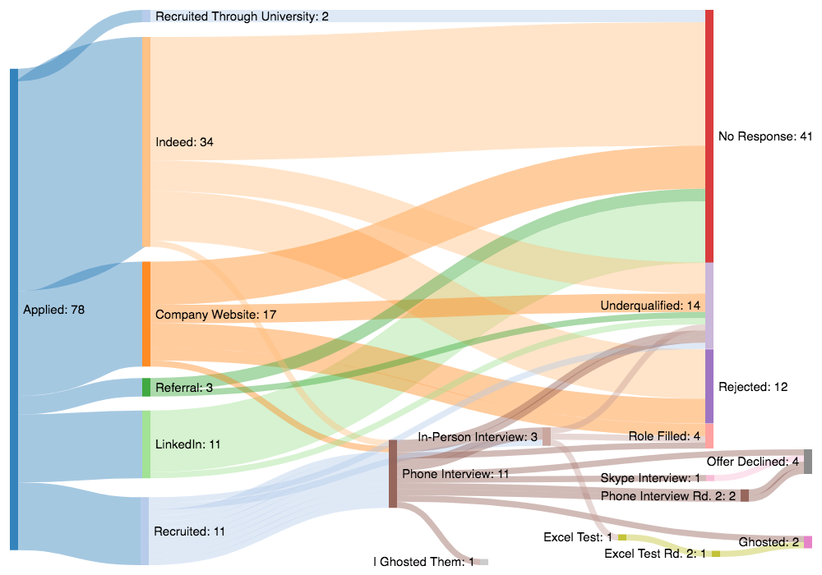
Sankey charts
redditn.com//u/itsjfin v

Slide 5
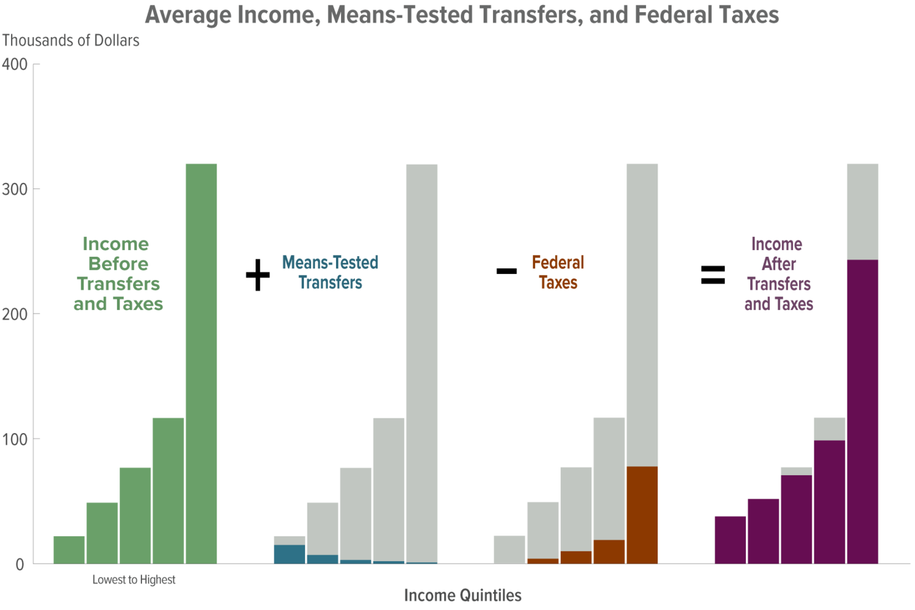
https://www.cbo.gov/publication/57061

Slide 6

1. Show the data
Jonathan Schwabish, Better Data Visualizations 2020

Slide 7
1. Show the data
2. Reduce the clutter
Jonathan Schwabish, Better Data Visualizations 2020

Slide 8
1. Show the data
2. Reduce the clutter
3. Integrate the graphics and text
Jonathan Schwabish, Better Data Visualizations 2020

Slide 9
1. Show the data
2. Reduce the clutter
3. Integrate the graphics and text
4. Avoid the spaghetti chart
Jonathan Schwabish, Better Data Visualizations 2020

Slide 10
1. Show the data
2. Reduce the clutter
3. Integrate the graphics and text
4. Avoid the spaghetti chart
5. Start with gray
Jonathan Schwabish, Better Data Visualizations 2020

Slide 11
Schwabish's principle
1. Show the data (Munzner's expressiveness principle)
2. Reduce the clutter (Tufte's avoid chartjunk principle)
3. Integrate the graphics and text (Schwabish's principle)
4. Avoid the spaghetti chart
5. Start with gray (Get it right in black and white)
Jonathan Schwabish, Better Data Visualizations 2020

Slide 12
Schwabish's principle
3. Integrate the graphics and text
Remove legends when possible and label data directly
Write the title like a newspaper headline
Add explainers
Jonathan Schwabish, Better Data Visualizations 2020

Slide 13
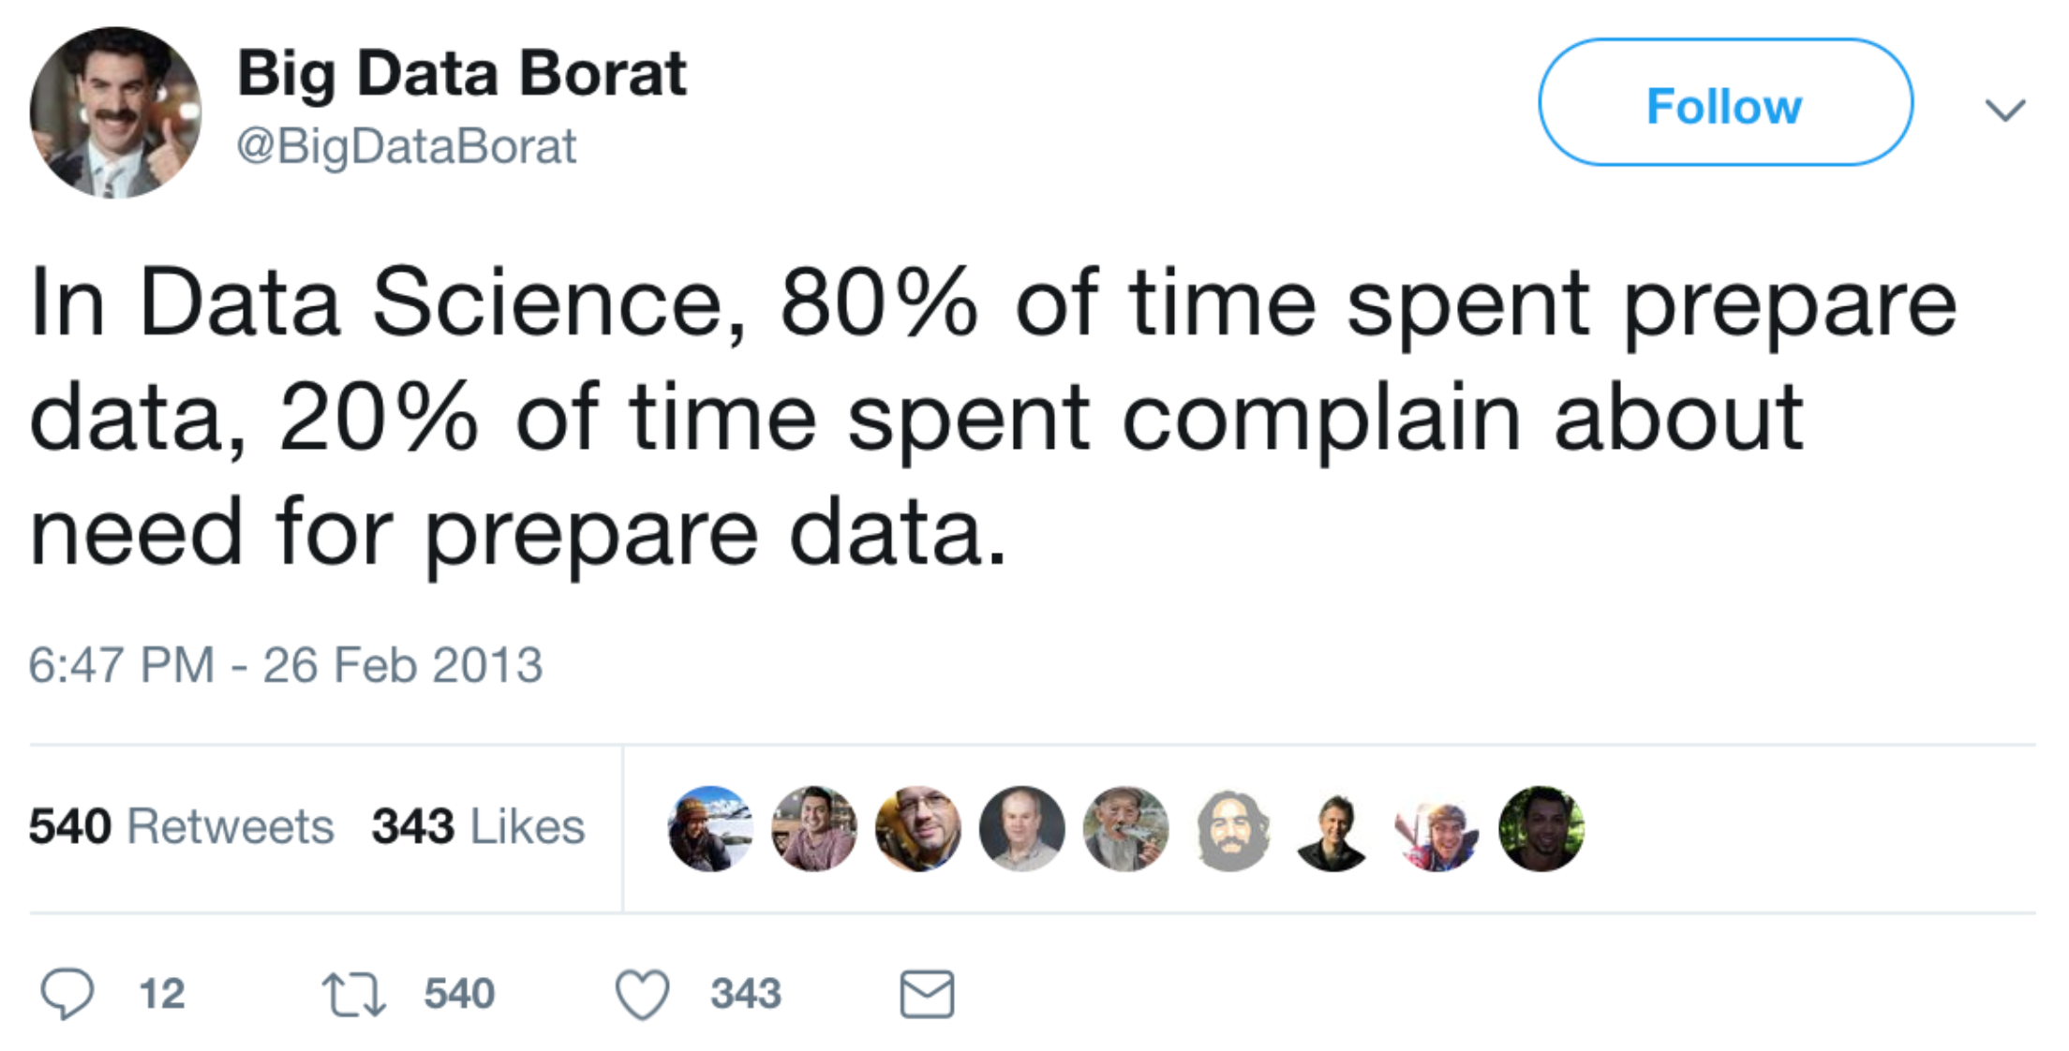

Slide 14

~4 million births in the US per year
~40,000 deaths of children before age 1
Extensive coded data for all births

Slide 15
11988 1136301010373630101037008 23199100245011199990021705996101002999999999699055033112
11988 1136301010373630101037999 11219010250011101010013511165101001381602801105033011111
11988 2236301010373630101999999 11224020280011203030012108144101001331411104305022022111
11988 1136301019993630101999999 23220020284011301010022509175101002291311102106022022112
11988 1136301010493630101049999 23221020290011101010021705102101002401202502101022011112
31988 1136301019993630101999999 23121020292011101010023210134201999999902902110022011112
11988 2236301010373630101999999 82226020300011107080582709154259999999902903206022011118
11988 2236301010373630101999999 11199100300011100010012809144101001251302900500033011111
11988 2236301010373630101999999 23127020310011202070022709123201999999951603211055055112
11988 1136301010373630101037008 23199100310011101010022008092201999999969999699055022112
11988 1136301019993630101999999 23220020312011301010022509175101002291300002106011011112
11988 1136301010493630101049999 23130030312011101000022408123201999999900006304011011112
11988 2236301010493630101999999 23222020320011102010024012144101002391202201110022011112
11988 1136301010373630101037999 23222020322011102020022308123201999999971802103022022112
11988 2236301010373630101999999 11127020326011105090012909123101001271461802107022022111
11988 1136301019993630101999999 23220020340011301010022509175101002291311102106033033112
11988 1136301010373630101037008 11129030340011302020012609165101001291711102109033033111
11988 2236301019993630101999999 11120020340011300000012909996199001999902802104022011111
11988 1136301010493630101049999 23121020340011102000021806112101002261602200500022011112
11988 1136301019993630101999999 23224020342011101010021806123201999999900002104011011112
11988 1136301010373630101037008 23299100350011201010021907996299999999999900500999999112
11988 1136301010373630101037008 23199100353011199990022108123201999999941500500022022132
11988 1136301019993630101999999 11220020356011101010013010154125001341602301106022011111
11988 1136301019993630101999999 11221020388011101010014412165236999999900001106011011111
11988 2236301010373630101999999 11120020392011299990012509134105001281511103203055055111
11988 2236301019993630101999999 11222020397011102020012709102101001331249902103066044111
11988 1136301019993630101999999 23222020397011101010023410165101002401471802110055022112
11988 1136301010493630101049999 23223020400011103010022008123201999999902401105022011112
11988 1136301010493630101049999 23120020400011101010023310112201999999972401106055033112
31988 2236301010373630101999999 11220020400011101020012709102101001330971801104033033111
11988 2236301010373630101999999 23225020400011101010022909123201999999931304302022022112
11988 1136301019993630101999999 11223020400011101000013511134201999999962402199033022111
11988 1136301010373630101037008 11129030410011302020012609165101001291711102109022022111
11988 2236301010373630101999999 11221020410011201010013110165115001321611102105022022111
11988 1136301019993630101999999 23223020411011101010021705112201999999900099601011011112
31988 1136301019993630101999999 23222020413011101000012108123101002231202905313022011111
11988 2236301019993630101999999 11122020420011203050012909996101001229911101105022022111
11988 1136301010373630101037008 23222020420011101010023110144123002351272902109077044112

Slide 16
11988 1136301010373630101037008 23199100245011199990021705996101002999999999699055033112
11988 1136301010373630101037999 11219010250011101010013511165101001381602801105033011111
11988 2236301010373630101999999 11224020280011203030012108144101001331411104305022022111
11988 1136301019993630101999999 23220020284011301010022509175101002291311102106022022112
11988 1136301010493630101049999 23221020290011101010021705102101002401202502101022011112
31988 1136301019993630101999999 23121020292011101010023210134201999999902902110022011112
11988 2236301010373630101999999 82226020300011107080582709154259999999902903206022011118
11988 2236301010373630101999999 11199100300011100010012809144101001251302900500033011111
11988 2236301010373630101999999 23127020310011202070022709123201999999951603211055055112
11988 1136301010373630101037008 23199100310011101010022008092201999999969999699055022112
11988 1136301019993630101999999 23220020312011301010022509175101002291300002106011011112
11988 1136301010493630101049999 23130030312011101000022408123201999999900006304011011112
11988 2236301010493630101999999 23222020320011102010024012144101002391202201110022011112
11988 1136301010373630101037999 23222020322011102020022308123201999999971802103022022112
11988 2236301010373630101999999 11127020326011105090012909123101001271461802107022022111
11988 1136301019993630101999999 23220020340011301010022509175101002291311102106033033112
11988 1136301010373630101037008 11129030340011302020012609165101001291711102109033033111
11988 2236301019993630101999999 11120020340011300000012909996199001999902802104022011111
11988 1136301010493630101049999 23121020340011102000021806112101002261602200500022011112
11988 1136301019993630101999999 23224020342011101010021806123201999999900002104011011112
11988 1136301010373630101037008 23299100350011201010021907996299999999999900500999999112
11988 1136301010373630101037008 23199100353011199990022108123201999999941500500022022132
11988 1136301019993630101999999 11220020356011101010013010154125001341602301106022011111
11988 1136301019993630101999999 11221020388011101010014412165236999999900001106011011111
11988 2236301010373630101999999 11120020392011299990012509134105001281511103203055055111
11988 2236301019993630101999999 11222020397011102020012709102101001331249902103066044111
11988 1136301019993630101999999 23222020397011101010023410165101002401471802110055022112
11988 1136301010493630101049999 23223020400011103010022008123201999999902401105022011112
11988 1136301010493630101049999 23120020400011101010023310112201999999972401106055033112
31988 2236301010373630101999999 11220020400011101020012709102101001330971801104033033111
11988 2236301010373630101999999 23225020400011101010022909123201999999931304302022022112
11988 1136301019993630101999999 11223020400011101000013511134201999999962402199033022111
11988 1136301010373630101037008 11129030410011302020012609165101001291711102109022022111
11988 2236301010373630101999999 11221020410011201010013110165115001321611102105022022111
11988 1136301019993630101999999 23223020411011101010021705112201999999900099601011011112
31988 1136301019993630101999999 23222020413011101000012108123101002231202905313022011111
11988 2236301019993630101999999 11122020420011203050012909996101001229911101105022022111
11988 1136301010373630101037008 23222020420011101010023110144123002351272902109077044112
Fail early, fail often
Invest in faster feedback
    Hack at code with data subset
Specify what you want to do before you do it
Get it right first, make it fast later
Usually better to use pandas/numpy than do it yourself

