Slide 1

Data 227
Data Visualization & Communication
Autumn, 2021

Slide 2
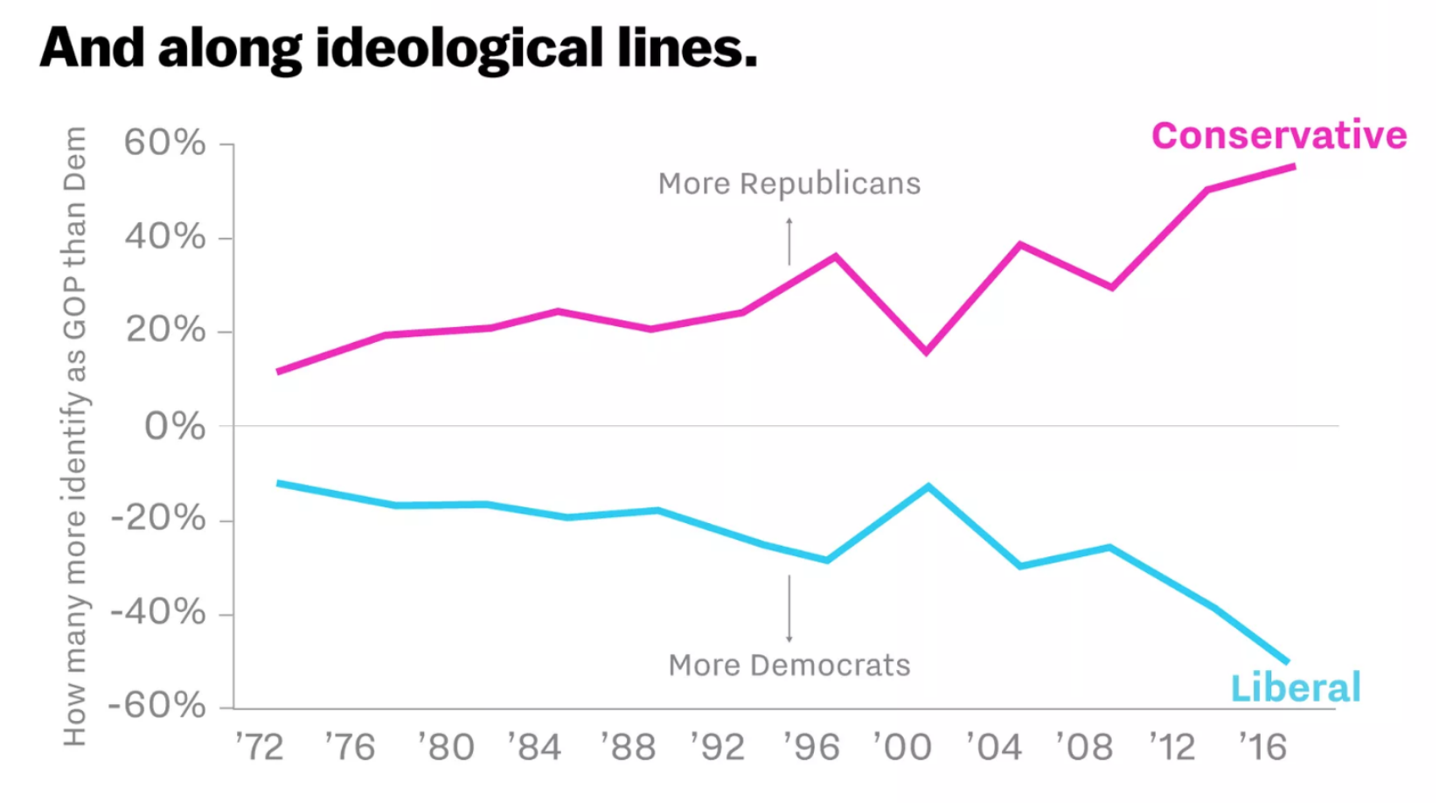
https://getdolphins.com/blog/worst-graphs-of-2018/

Slide 3
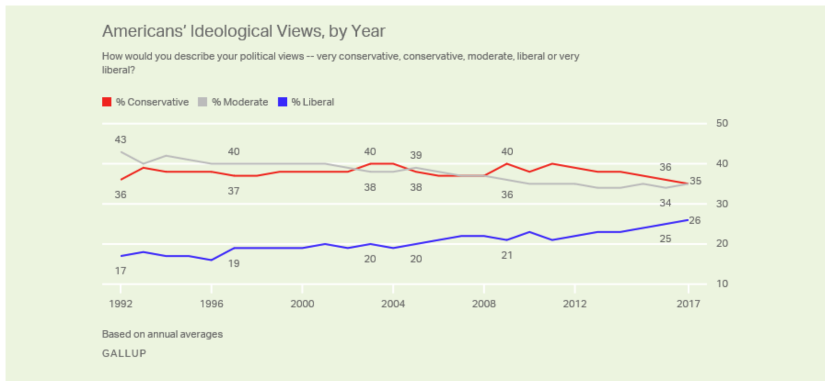
https://getdolphins.com/blog/worst-graphs-of-2018/

Slide 4
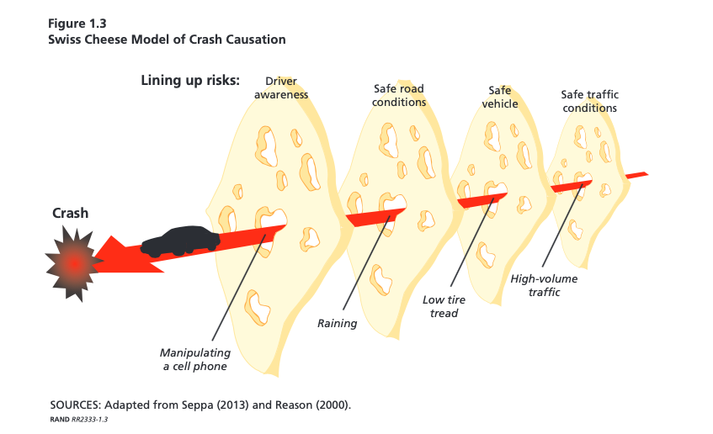

Slide 5
HW2
Provenance: City and Year MUST be in caption, legend, or title.
Currency symbol needs to be in the graphic (USD or $)
Text should not be more than a factor of 2 smaller than normal text in notebook.
Some visualizations are exactly as good as tables.

Slide 6
HW2
Don't need (but didn't lose points for) pairs of numbers that add up to 100%.
Appropriate axis labels (salaries are in money per unit time -- need time units on legends)
Exporting 7pt fonts as bitmaps results in crummy, not-publication-ready graphics in PDFs.

Slide 7
HW3
Due Thursday, Oct 21.
1d marginal distributions won't get you full credit, so find at least two fields, or a single field across years, and communicate the interaction

Slide 8
HW3
Due Thursday, Oct 21.
1d marginal distributions won't get you full credit, so find at least two fields, or a single field across years, and communicate the interaction

Slide 9
Enrico Bertini's visualization guidelines:
Not an absolutist: “bad” designs like pie charts and dual-axis graphs aren't necessarily always bad.

Slide 10
Enrico Bertini's visualization guidelines:
What is it for?
  What knowledge / fact will reader get from it?

Slide 11
Enrico Bertini's visualization guidelines:
What is it for?
  What knowledge / fact will reader get from it?
What can I see here?
  How much effort to extract?
  How much confidence in results?

Slide 12
Enrico Bertini's visualization guidelines:
What is it for?
  What knowledge / fact will reader get from it?
What can I see here?
  How much effort to extract?
  How much confidence in results?
What are alternative solutions?

Slide 13

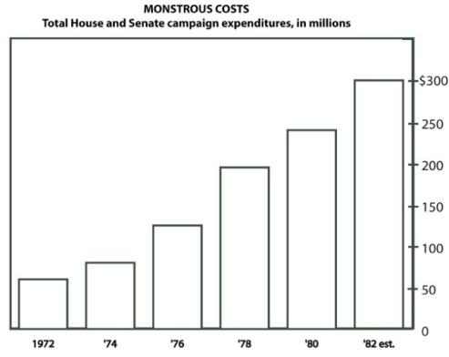
Distractions
Bateman, CHI 2010 doi: 10.1145/1753326.1753716

Slide 14
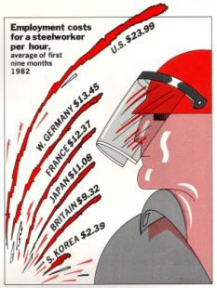
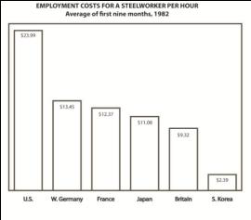
Distractions
Bateman, CHI 2010 doi: 10.1145/1753326.1753716

Slide 15
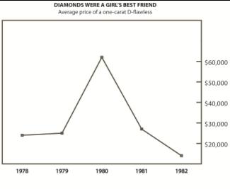
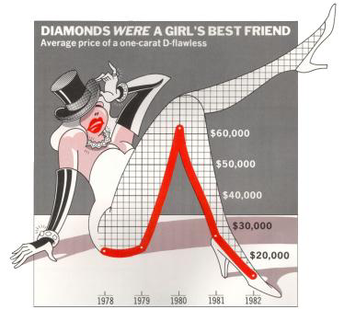
Distractions
Bateman, CHI 2010 doi: 10.1145/1753326.1753716

Slide 16
“The world does not spontaneously quantify, curate, or data-mine itself. Rather, the process of observing the world and quantifying it is a political act, and deserves ethical consideration” - Michael Correll
Michael Correll, https://doi.org/10.475/123_4 CHI 2019

Slide 17
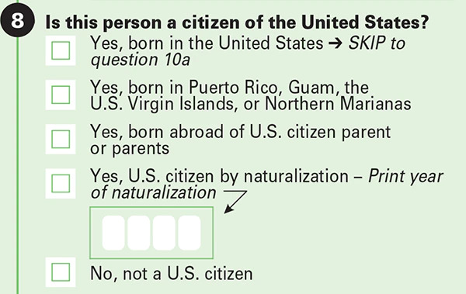
Questions of scope confer power

Slide 18
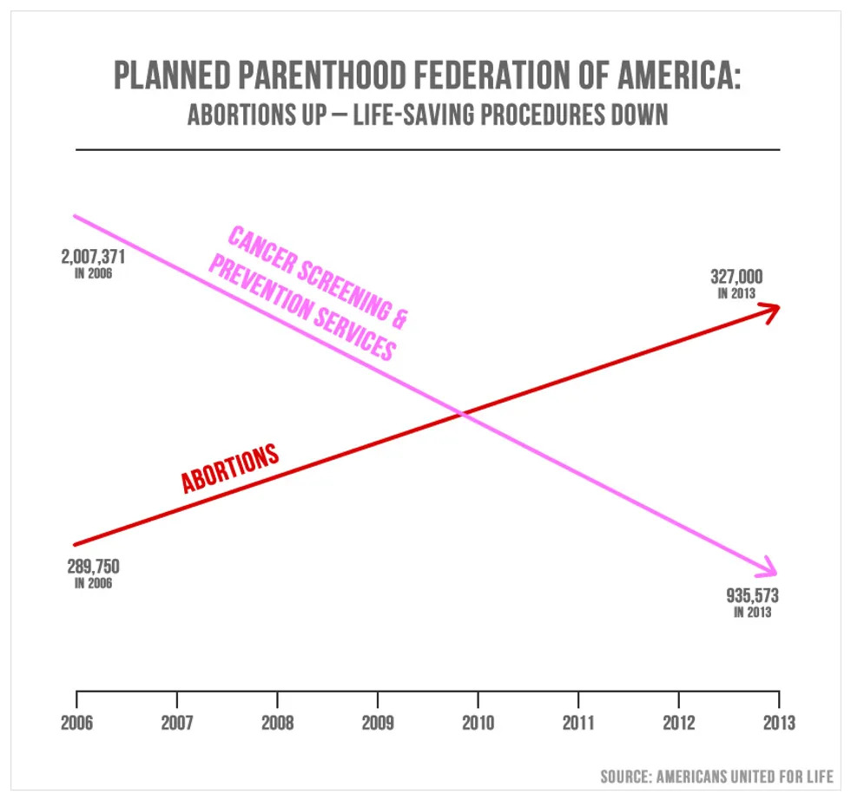

Slide 19


Slide 20
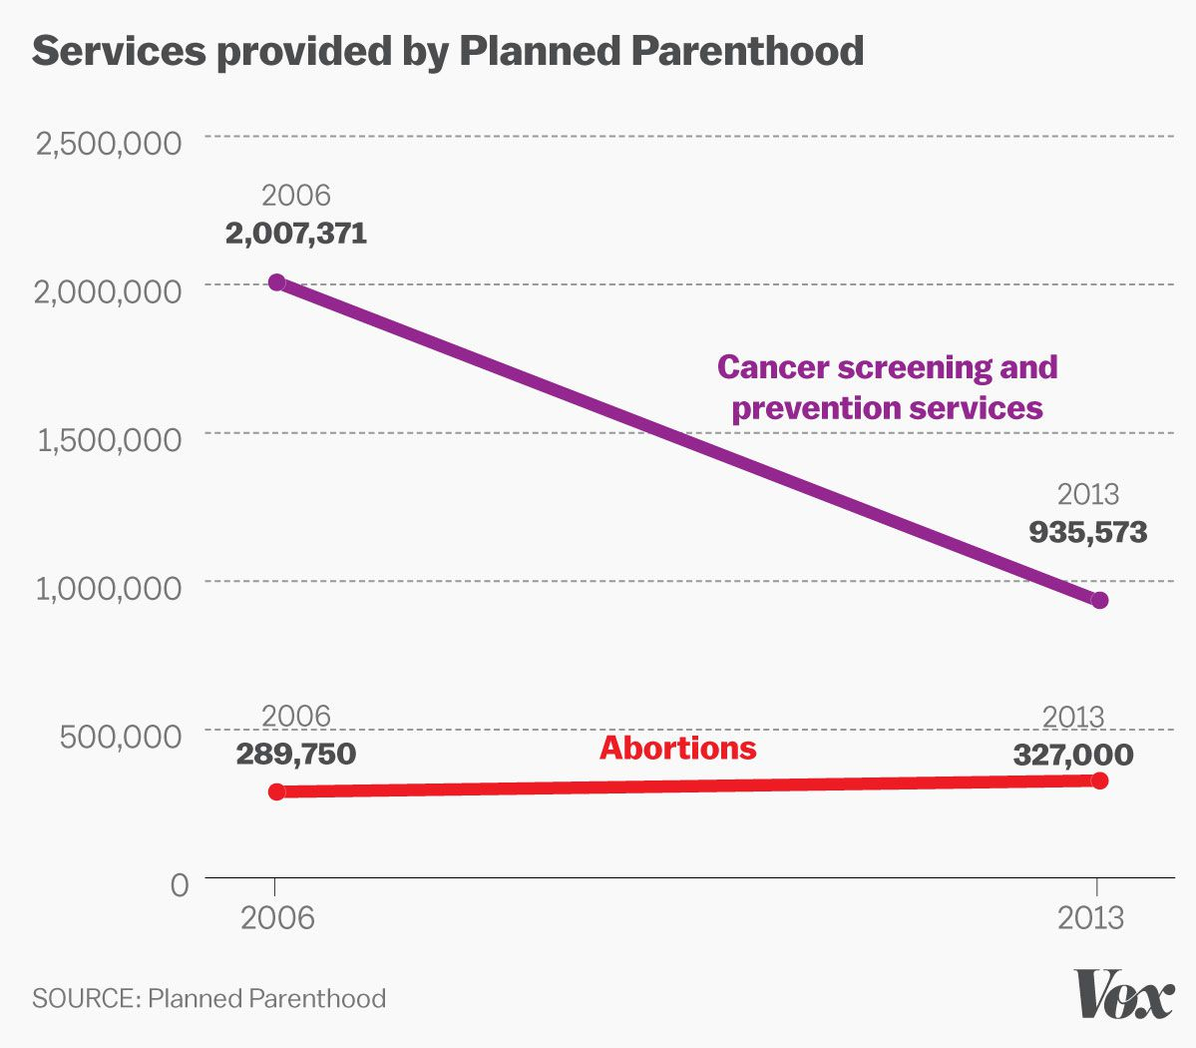
Scales corrected

Slide 21
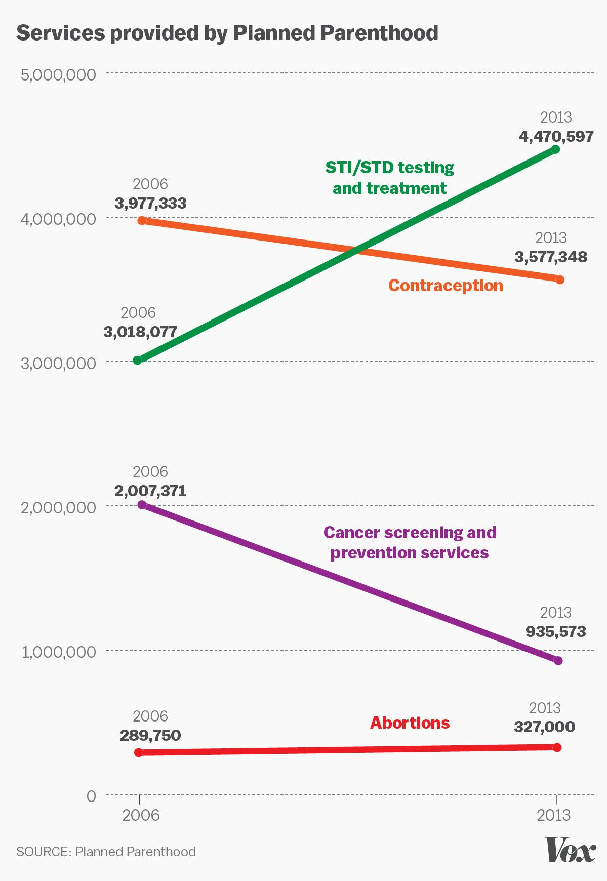
Insufficient
context

Slide 22
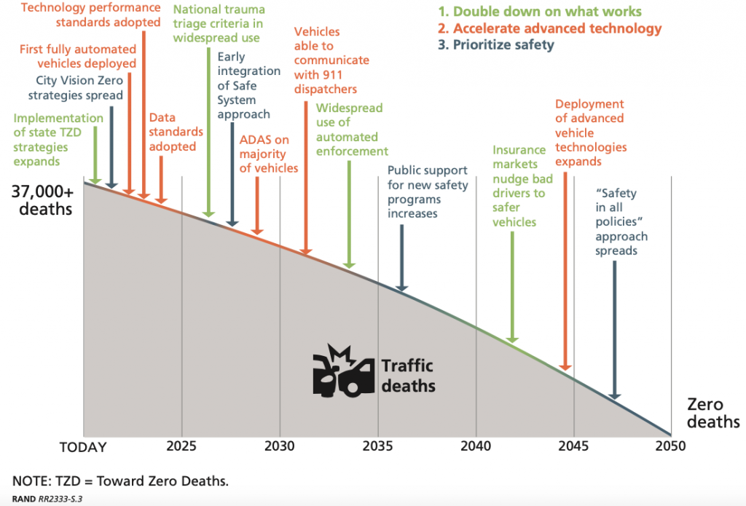

Slide 23
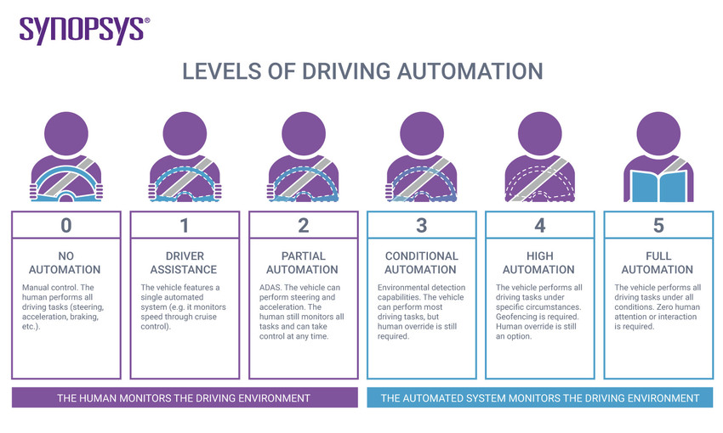

Slide 24
How safe are driverless cars?
Q2 2021 1 crash / 4.41M miles driven
Q1 2021 1 crash / 4.19M miles driven
Q4 2021 1 crash / 3.45M miles driven
Q3 2020 1 crash / 4.59M miles driven
Q2 2020 1 crash / 4.53M miles driven
Q1 2020 1 crash / 4.68M miles driven
“By comparison, NHTSA’s most recent data shows that in the United States there is an automobile crash every 436,000 miles”
https://www.tesla.com/VehicleSafetyReport

Slide 25
How safe are driverless cars?
Q2 2021 1 crash / 4.41M miles driven
Q1 2021 1 crash / 4.19M miles driven
Q4 2021 1 crash / 3.45M miles driven
Q3 2020 1 crash / 4.59M miles driven
Q2 2020 1 crash / 4.53M miles driven
Q1 2020 1 crash / 4.68M miles driven
“By comparison, NHTSA’s most recent data shows that in the United States there is an automobile crash every 436,000 miles”
1 crash / 4 M miles is
25 crashes / 100 M miles.
Reciporical units, so larger
numbers are better.
https://www.tesla.com/VehicleSafetyReport

Slide 26
How safe are driverless cars?
Q2 2021 1 crash / 4.41M miles driven
Q1 2021 1 crash / 4.19M miles driven
Q4 2021 1 crash / 3.45M miles driven
Q3 2020 1 crash / 4.59M miles driven
Q2 2020 1 crash / 4.53M miles driven
Q1 2020 1 crash / 4.68M miles driven
“By comparison, NHTSA’s most recent data shows that in the United States there is an automobile crash every 436,000 miles”
Can't find any visualizations worth printing.
https://www.tesla.com/VehicleSafetyReport

Slide 27
Expert commentary on safety reports
“Then, you have to make sure you’re comparing your apple to another apple. This week, Musk tweeted that Tesla only saw one death per 320 million miles, compared to one death per 86 million miles for the average car. The problem is that latter figure is includes all road deaths involving all vehicles—those killed in motorcycles (which are way more dangerous than cars), clunkers built in the late ‘80s, and tractor trailers, as well as those killed while biking or walking.”
https://www.wired.com/story/tesla-autopilot-crash-safety/

Slide 28
How safe are driverless cars?
Q2 2021 1 crash / 4.41M miles driven
Q1 2021 1 crash / 4.19M miles driven
Q4 2021 1 crash / 3.45M miles driven
Q3 2020 1 crash / 4.59M miles driven
Q2 2020 1 crash / 4.53M miles driven
Q1 2020 1 crash / 4.68M miles driven
“By comparison, NHTSA’s most recent data shows that in the United States there is an automobile crash every 436,000 miles”
“Autonomous Vehicles (AVs) got into more crashes overall: 9.1 crashes per million miles driven, compared with 4.1 crashes per million miles for conventional vehicles.” ( Govtech, citing Schoettle & Sivak technical report from October 2015)
https://www.tesla.com/VehicleSafetyReport

Slide 29
What about fatal crashes?
1.1 fatal crashes per 100 million VMT overall (3.2B VMT annually ~2019 )
April 2020 Tesla claims 3 Billion VMT on autopilot
11 cumulative deaths by that point.. 1 death per 270M VMT?
https://www.nytimes.com/2021/07/05/business/tesla-autopilot-lawsuits-safety.html
-- people sue self-driving car manufacturers when they crash
https://www.natlawreview.com/article/dangers-driverless-cars (May 2021)
-- lawyers don't quote the manufacturer's data, they quote six-year-old statistics.
I'm ready to give up when I find dishonorable sources claiming
410 crashes / 100M VMT (2015) and
25 crashes / 100M VMT (2021)

Slide 30
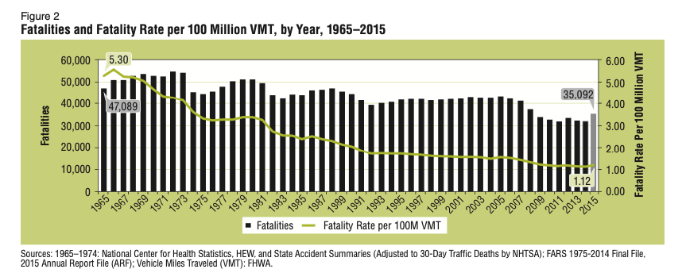
The perils of the private auto are well understood

Slide 31
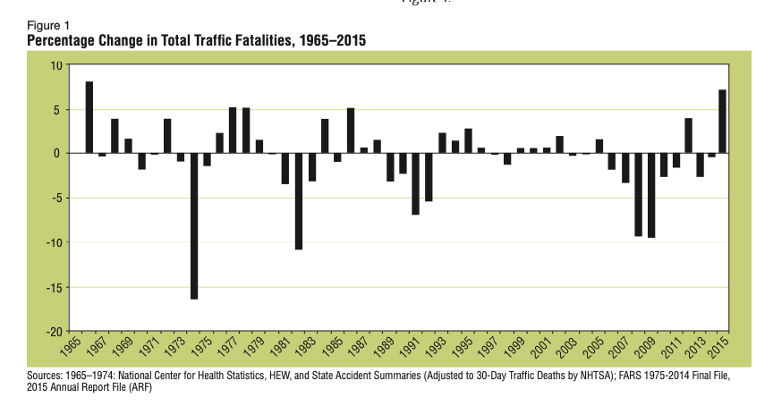
The perils of the private auto are well understood
Here, the use of finite differences (well, ratios)
obscures the overall picture and overall values (!!!)
increases the “noise” in the graphic

Slide 32
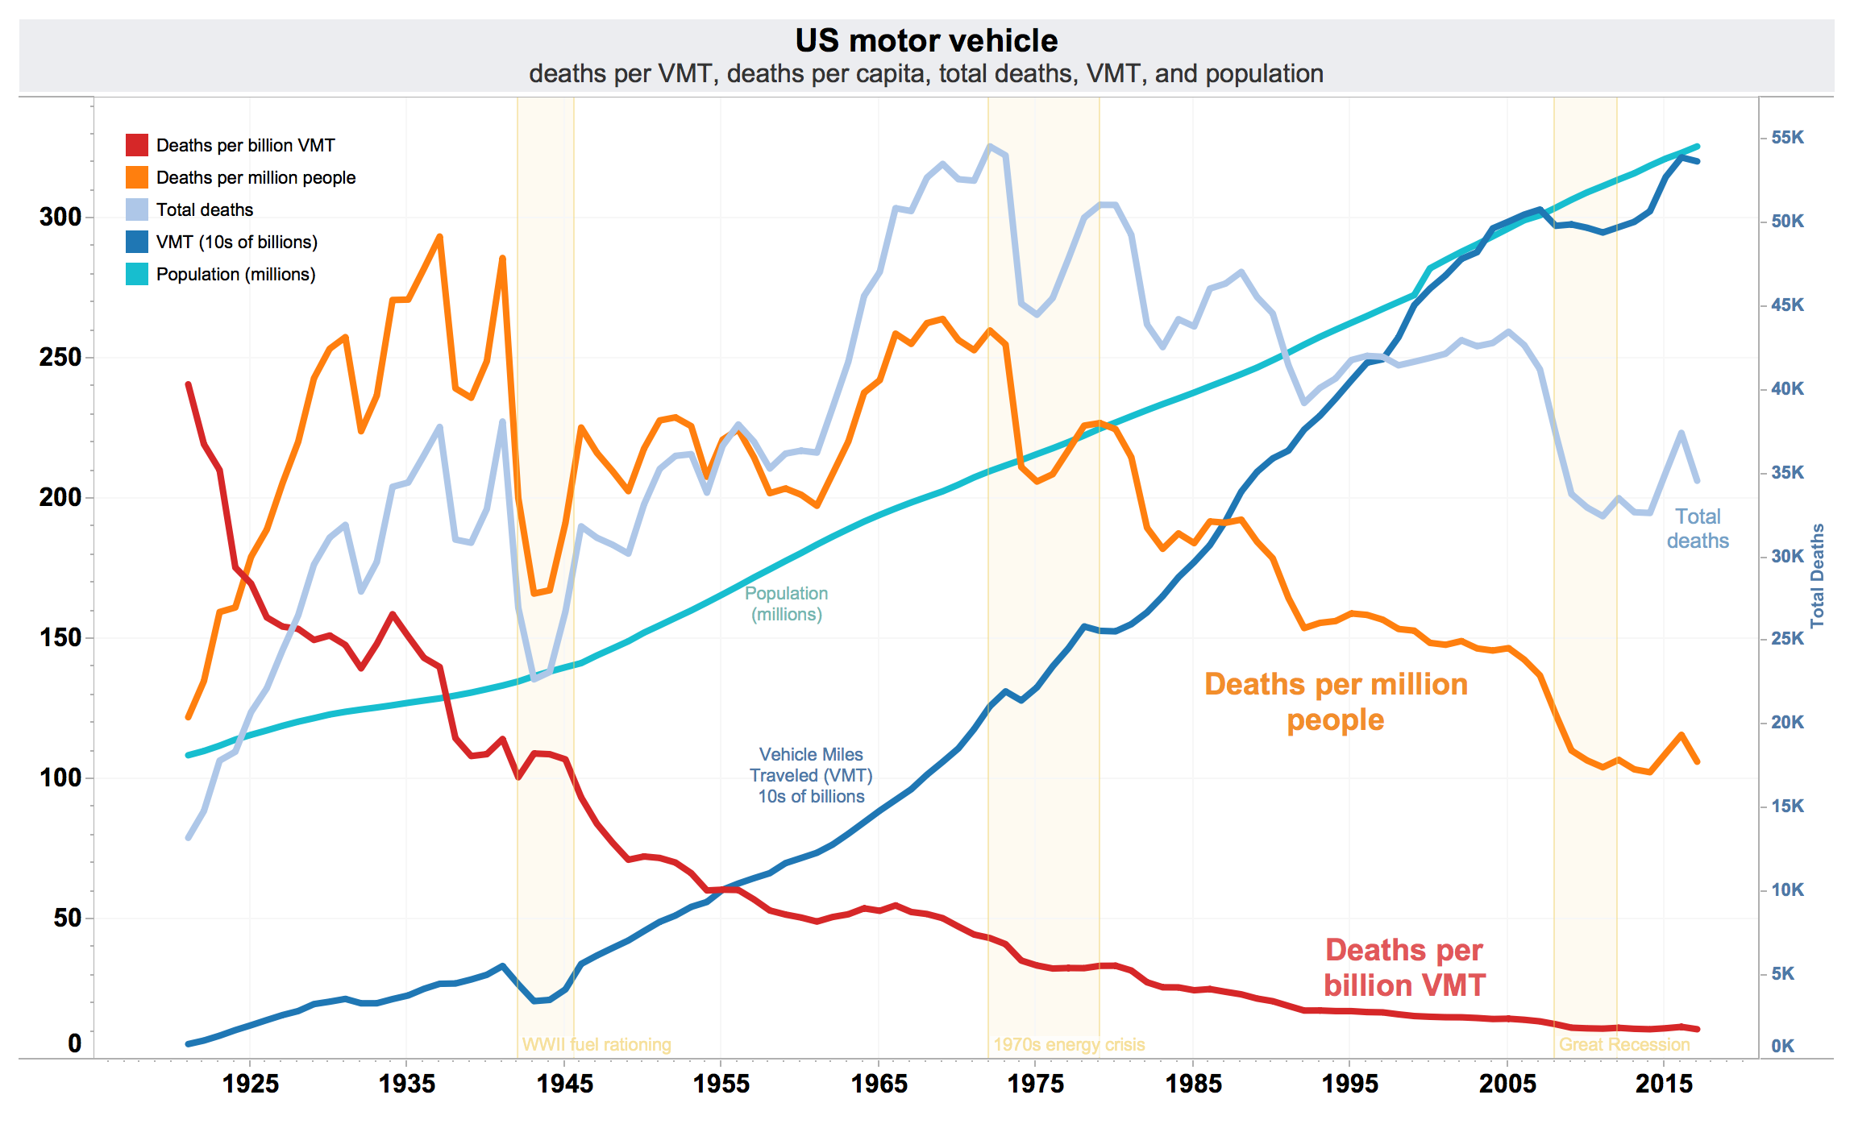
This graphic, from wikipedia, is lovely, but hard to interpret.
Seat belts were mandated by 1983, and airbags have been getting better.

Slide 33

Project 1
Thursday, November 4 (Two full weeks from HW3, sorry for the error earlier)
Design two visualizations of the same facet of a dataset
Rich enough (> 10 numbers!)
One graph should be designed to mislead, one should be comparatively honest.

Slide 34
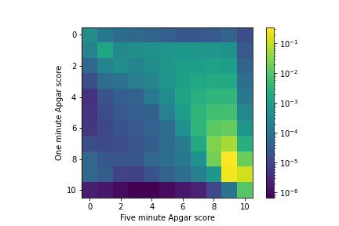

Slide 35
Text with perceptible pixels is not good enough for professional presentations; it's the graphical design equivalent of errors in speling.

Slide 36
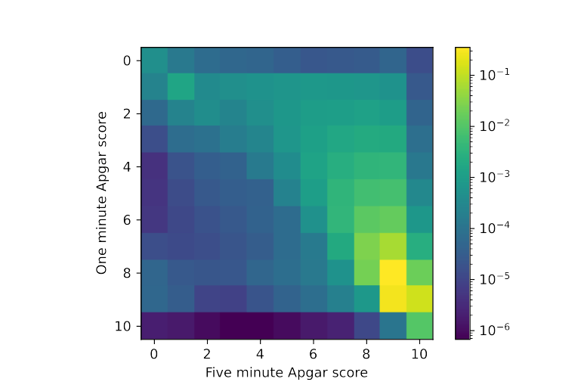

Slide 37


Slide 38
If you can export/import in vector graphics format (EPS, PDF, EPDF, SVG) do so.
If you can't, get higher-resolution (200, 300 dpi) bitmaps (PNG, WEBP, JPG)
PNG handles lossless compression and transparency; JPG uses lossy compression and is bad for text.
See BetterResolution.ipynb

