Slide 1

Data 227
Data Visualization & Communication
Autumn, 2021
Deception II

Slide 2
Some deceptive strategies
Inappropriate juxtaposition [dual-axis graph]
Count the wrong things [swap numbers that matter for numbers that are easy to obtain]
Encourage bad comparisons [take numbers out-of-context]
Post-hoc reporting about the extremity of the extremes
Study and report on the wrong things. Report audience-engaging matters that are irrelevant for decisionmaking. (moral panics?)

Slide 3

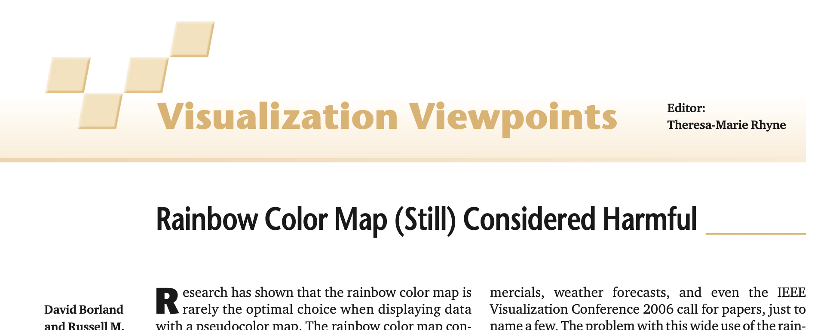

Slide 4
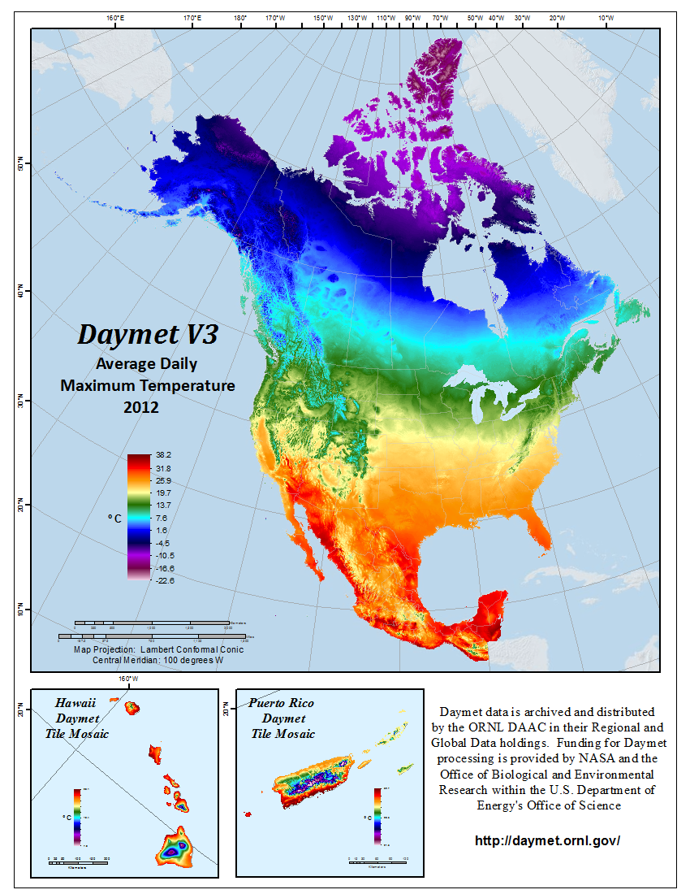

Slide 5
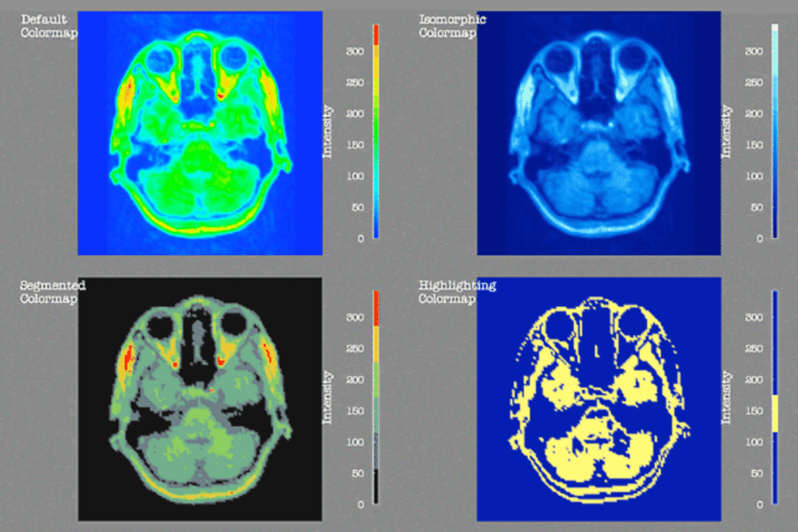
Rogowitz & Treinish, How Not to Lie with Visualization (1996)

Slide 6


Slide 7
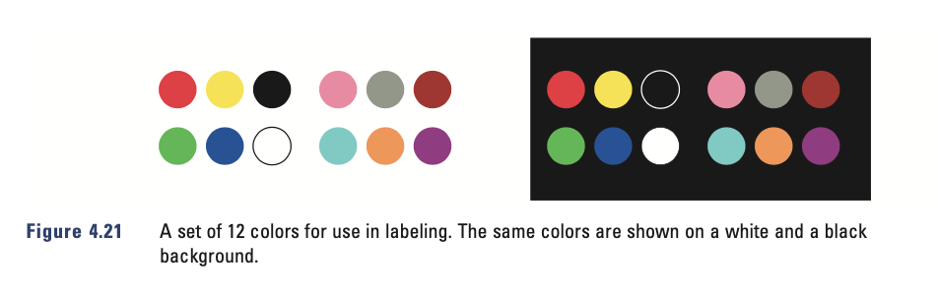
1920

Slide 8
