Slide 1

Color I
Data 227
Data Visualization & Communication
Autumn, 2021

Slide 2
HW3
Provenance: minimum “CDC, year”
Be expressive
  No particular graph types are bad, but some types make for low-expressiveness choices for some data types.
2d-histograms (with color or marker size) were popular for this maddeningly categorical data.

Slide 3
HW3
Try not to be wrong:
  Check scale of axis and rough area-under-the-graph for numbers that make sense.
  single-word errors (-1)
  wrong numbers on axis (-2)
  numbers in data not close to real numbers (-3)

Slide 4
HW3
  ~40,000 traffic fatalities per year
  ~4M births per year
  ~40,000 infant deaths per year (1%)
  ~330M total U.S. population 2020
  How many deaths per year?

Slide 5
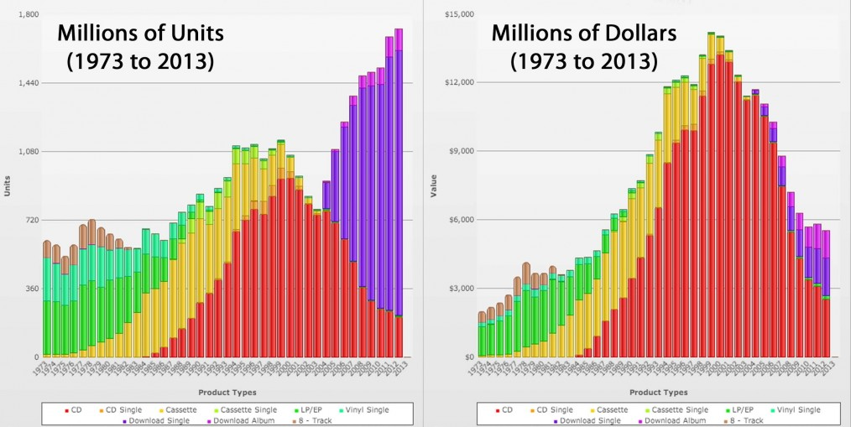

Slide 6
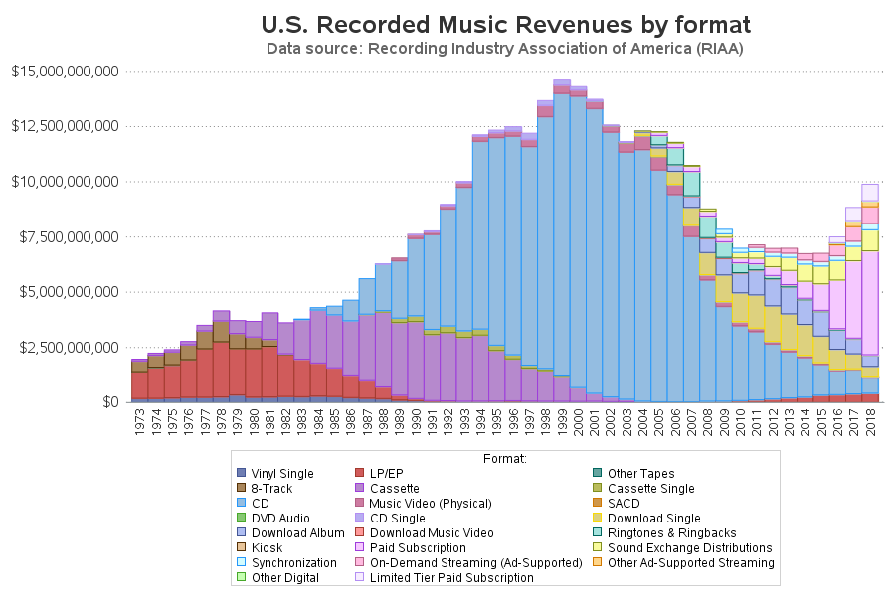

Slide 7
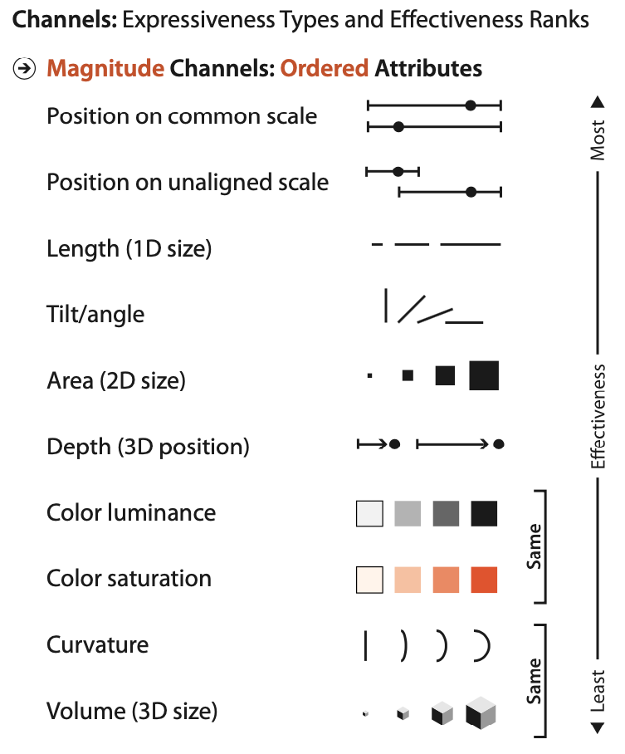
Scatter: usually best choice
Bar, line: usually good choices
Stacked-bar: good for understanding proportions; category distributions (race, cigarettes, Likert scale)
Usually not the best choice for time series.

Slide 8

How to encode color?

Slide 9
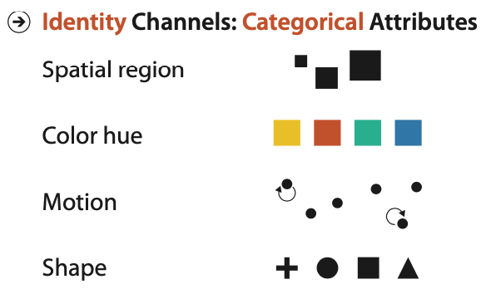
We have two tasks for color:
Marking nominal categories (legend)

Slide 10
We have two tasks for color
Painting quantitative values (colormap)

Slide 11
We have two tasks for color
Painting quantitative values (colormap)
Accept that putting quantitative data in the color channel is carrying flowers in a duffelbag.

Slide 12
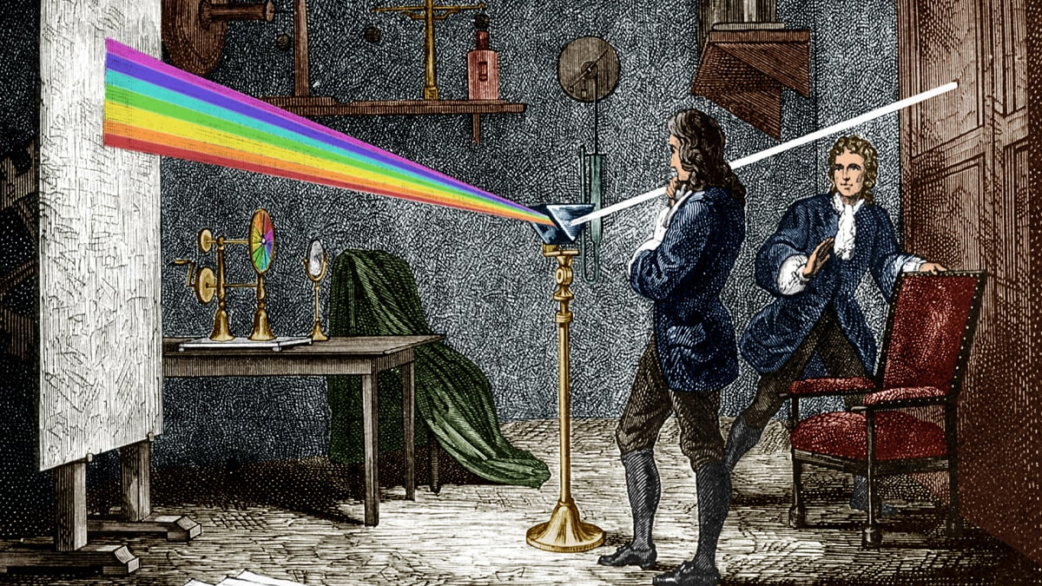
Ask a physicist. Physicists think they know everything.

Slide 13
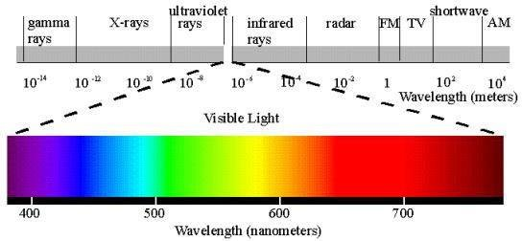
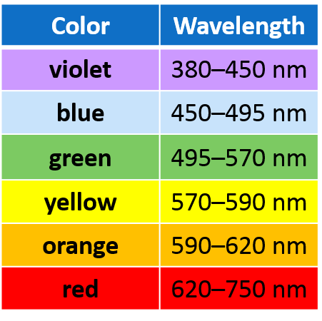

Slide 14
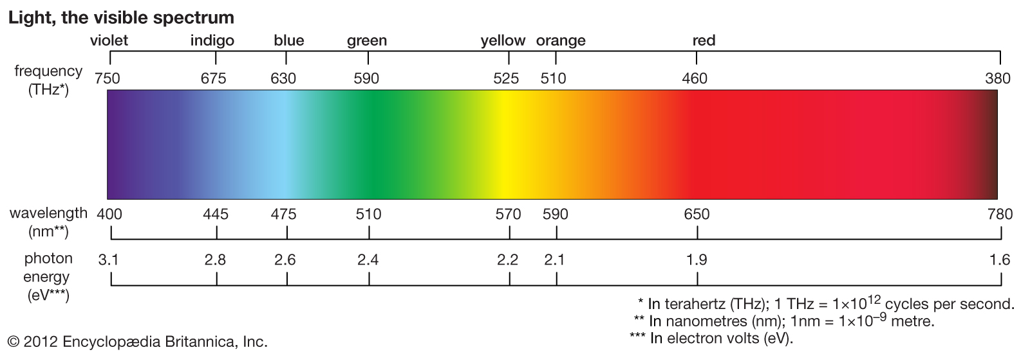

Slide 15
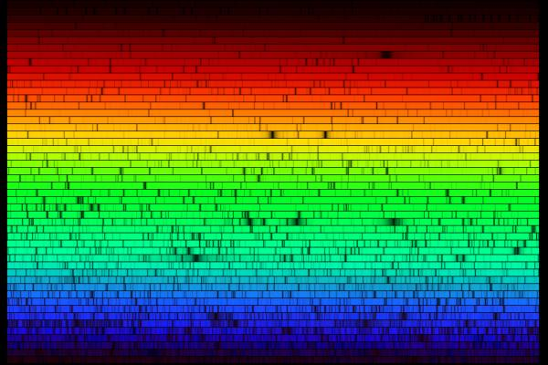
This is the spectrum of the sun.

Slide 16
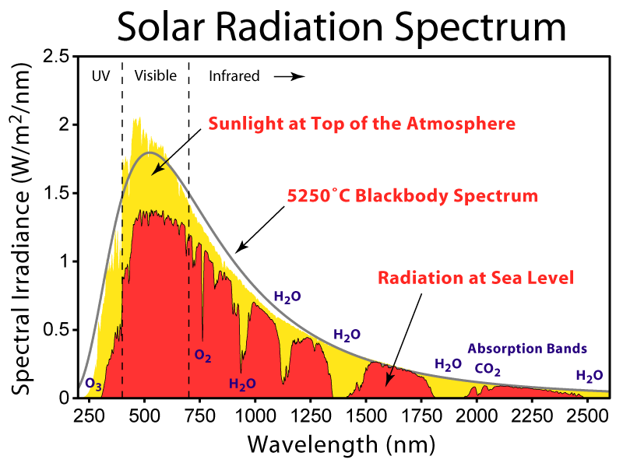

Slide 17
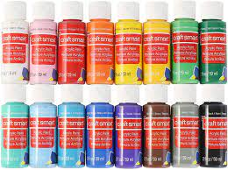
But this is closer to what we experience...

Slide 18
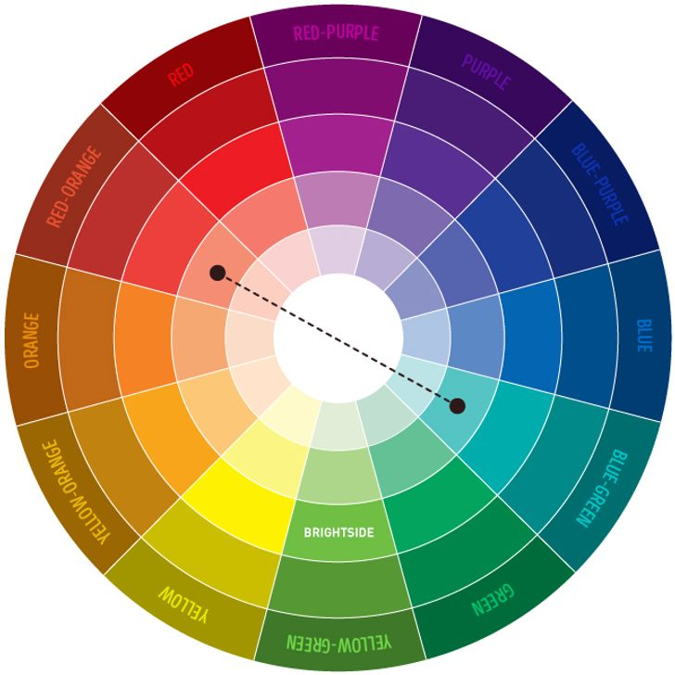

Slide 19
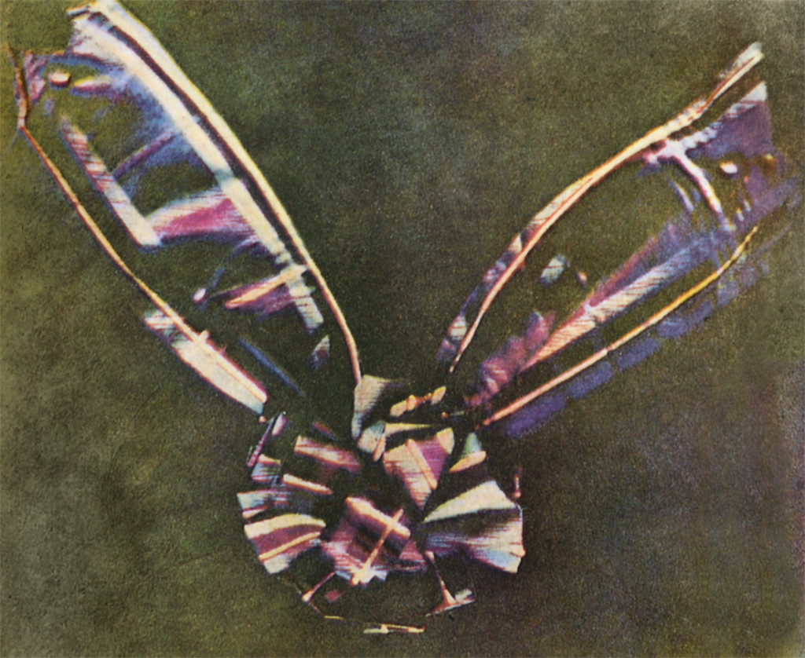
Maybe it's time to ask an engineer.
Photography, cinema, television, printing..
1861, Thomas Sutton, first color photograph

Slide 20
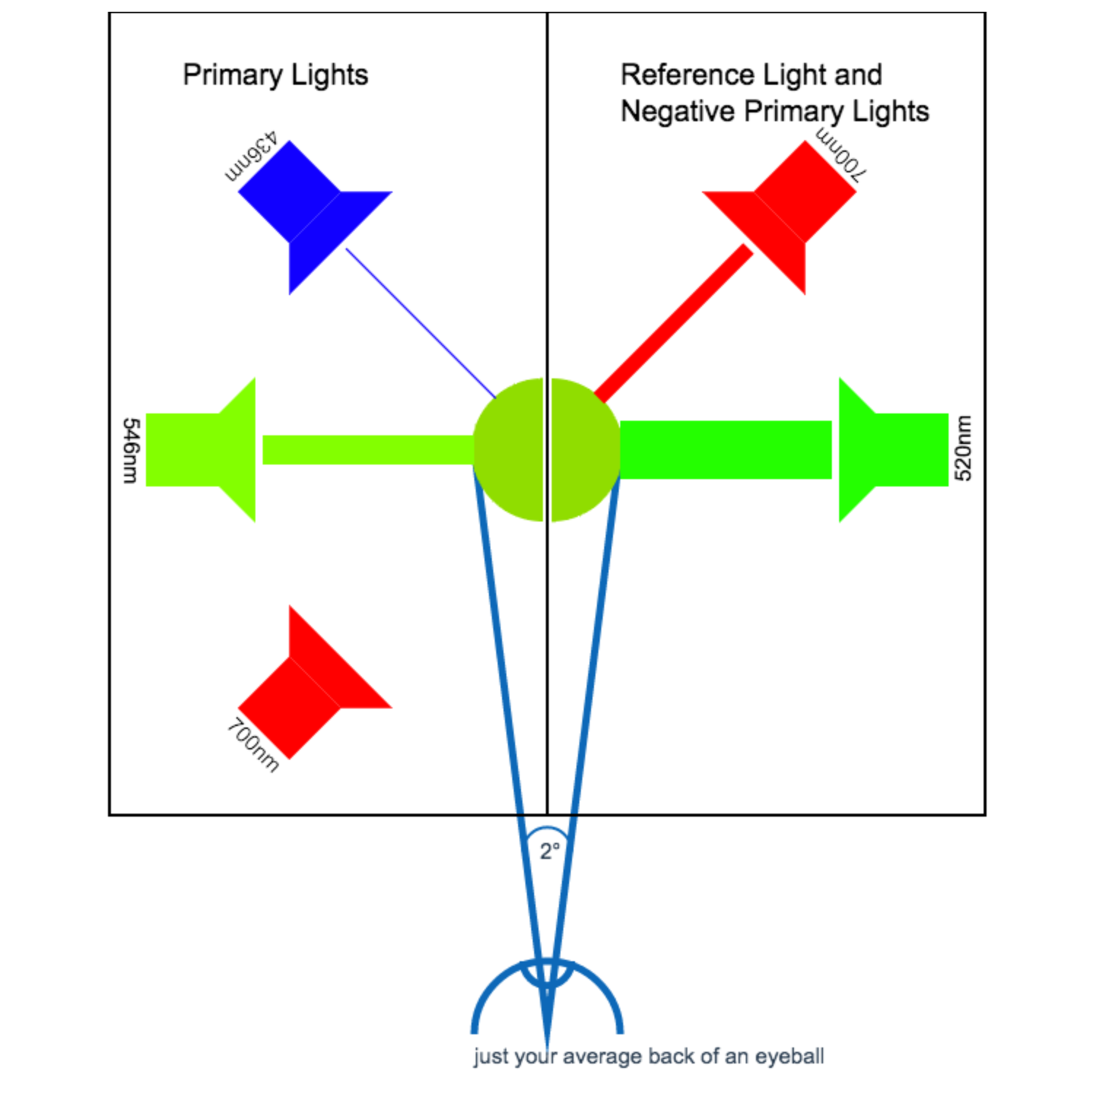

Slide 23
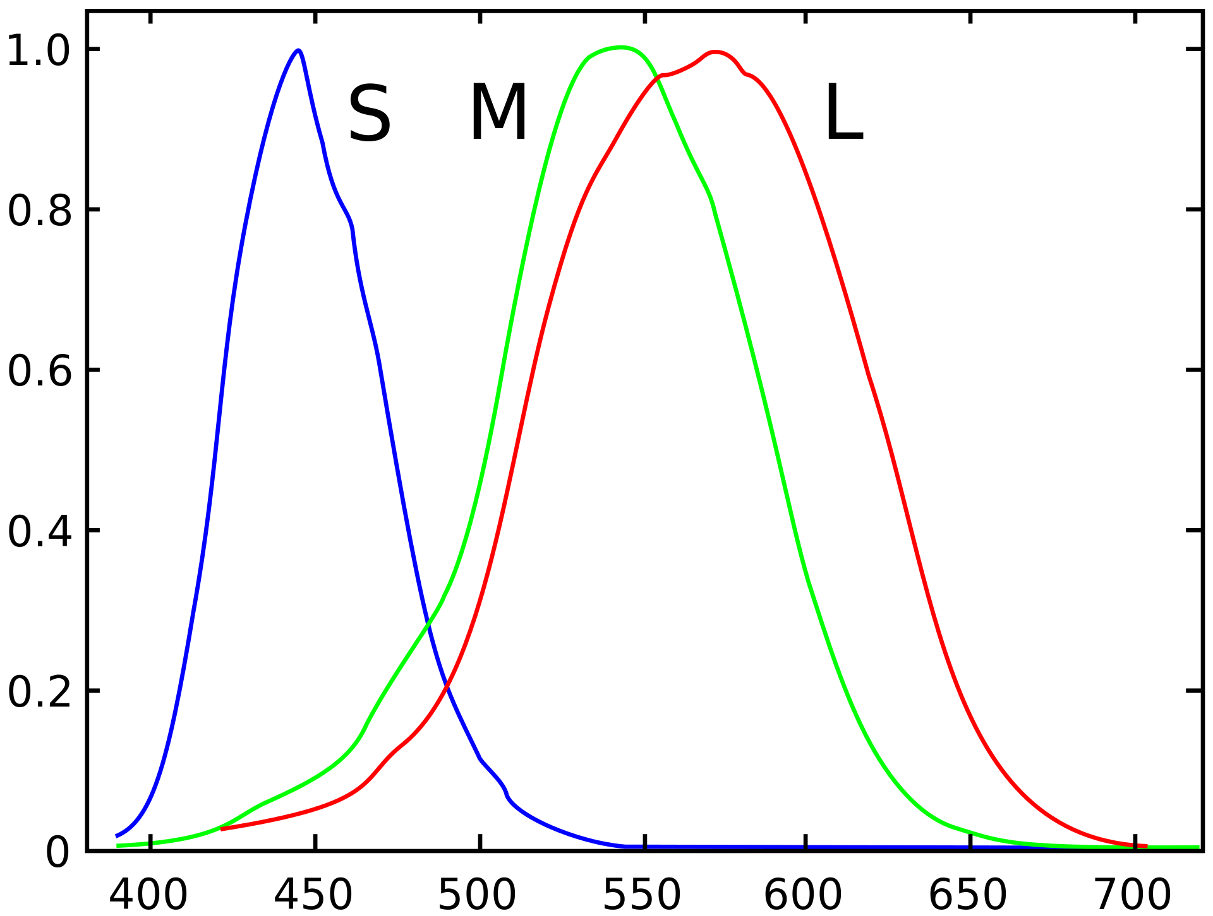
Relative sensitivity
Wavelength (nm)

Slide 24
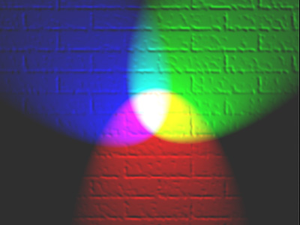

Slide 25
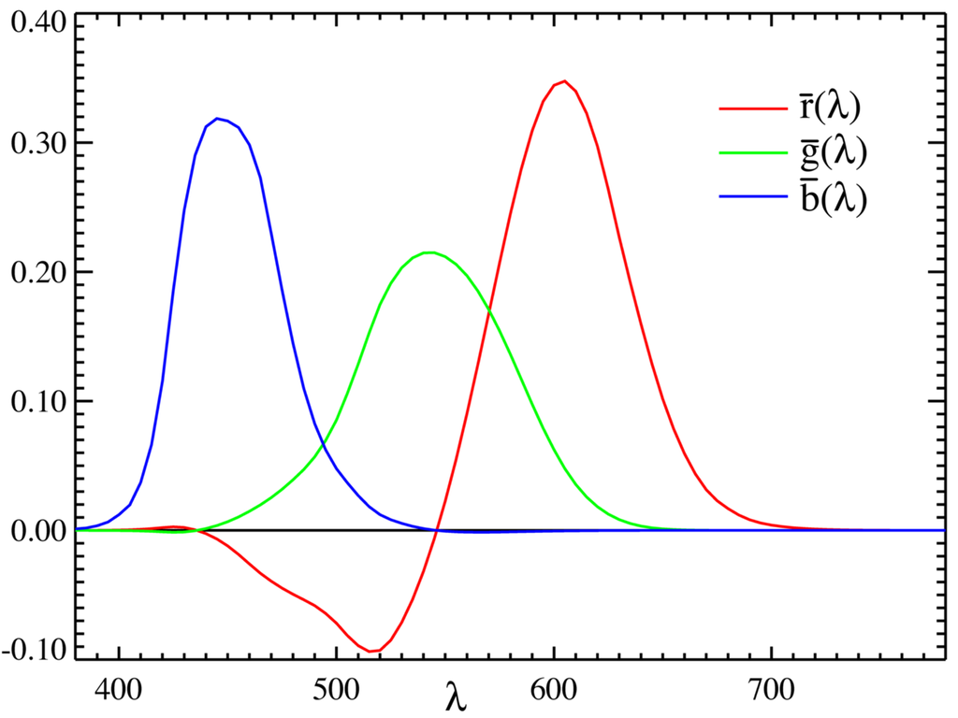
CIE RGB model

Slide 26
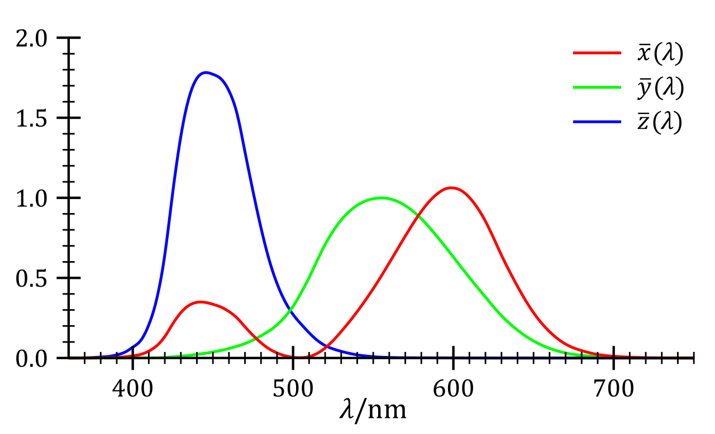
CIE 1931 XYZ color space

Slide 27
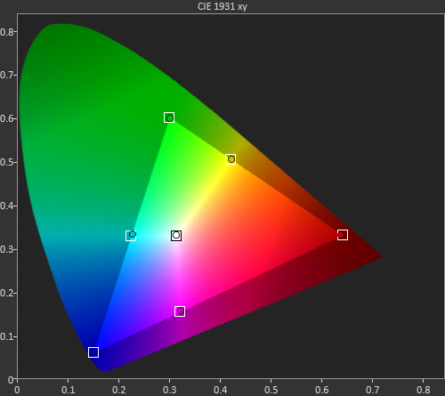
Chromacity -- pair of coordinates that specifies color
Luminance --single coordinate, quasi-objective measure of brightness
y
x

Slide 28
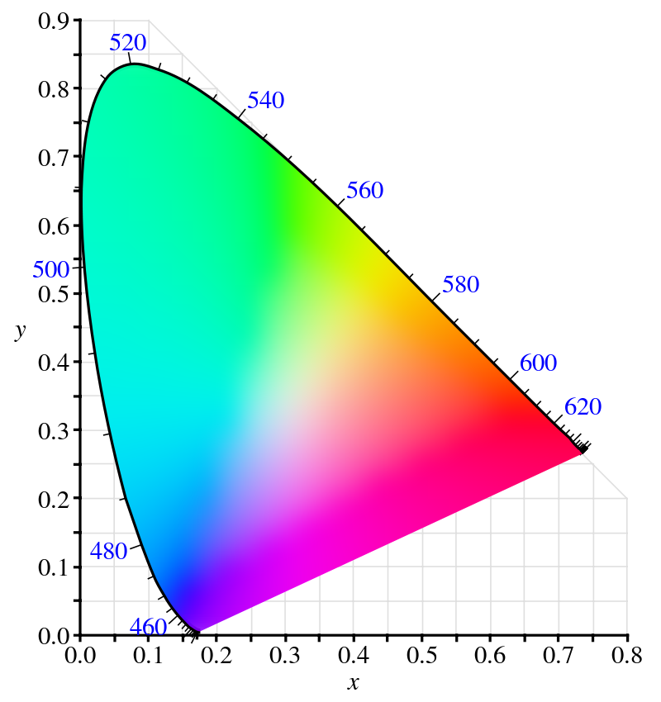

Slide 30
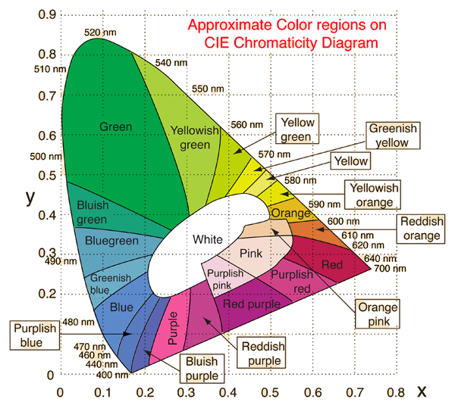

Slide 31
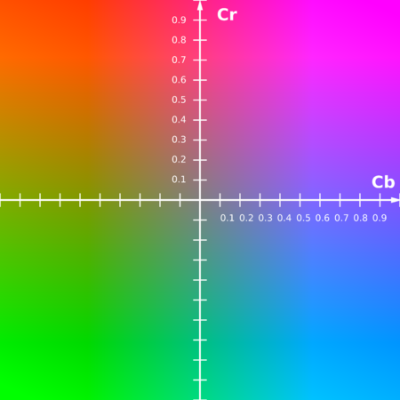
Y' Cb Cr (sYCC) colorspace
This color space has been designed to create planes of equal luminance.

Slide 32
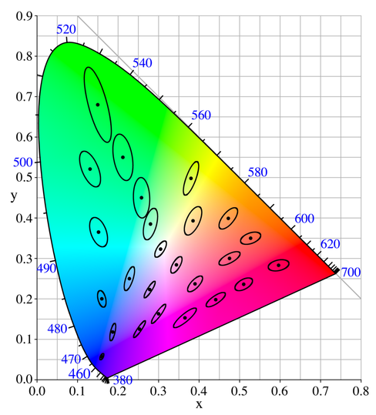

Slide 33
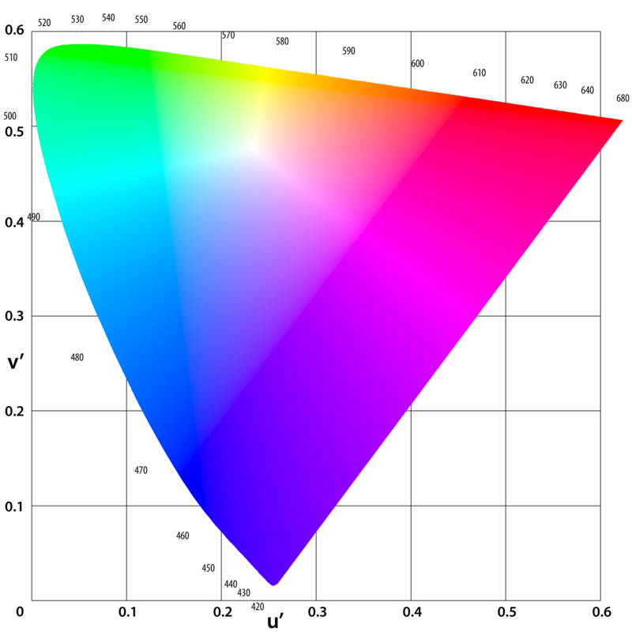
CIE L u* v* (1976)
Intended to be more perceptually uniform (confusion ovals have smaller size difference)

Slide 34
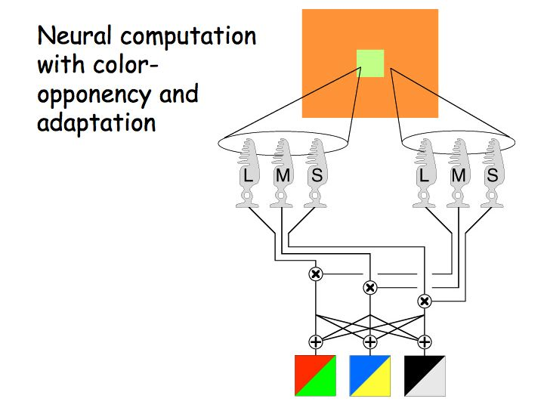
Opponent color theory

Slide 35
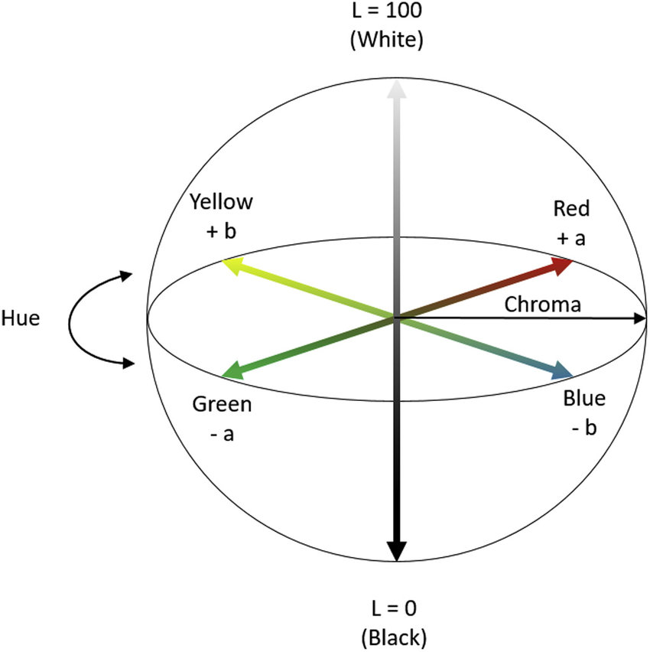
CIE L*a*b* colorspace (1976)
L* perceptual lightness
a* Red-Green axis
b* Yellow-Blue axis

Slide 36
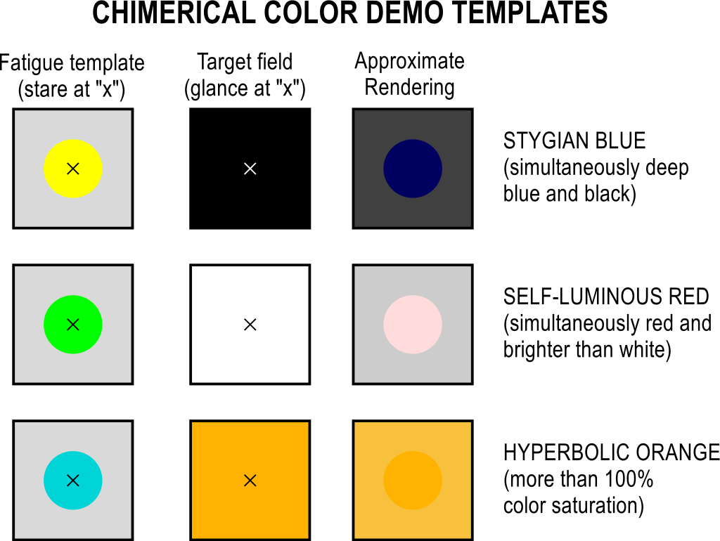
https://en.wikipedia.org/wiki/Impossible_color#/media/File:Chimerical-color-demo.svg

Slide 37
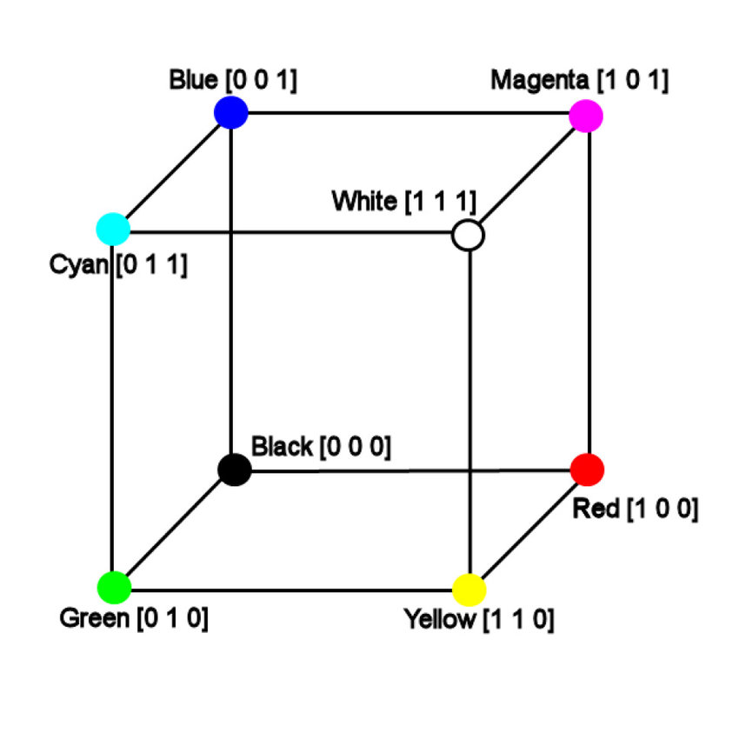
sRGB colorspace
How bad can RGB be?

Slide 38

https://www.vis4.net/blog/2011/12/avoid-equidistant-hsv-colors/

Slide 39


https://www.vis4.net/blog/2011/12/avoid-equidistant-hsv-colors/

Slide 40
If we just pretend that sRGB is good...

Slide 41
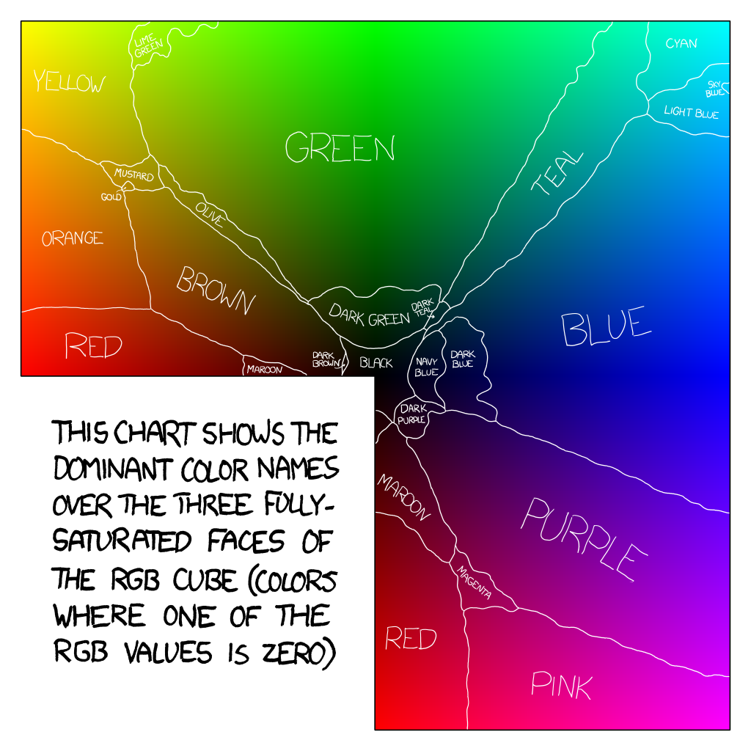

Slide 43
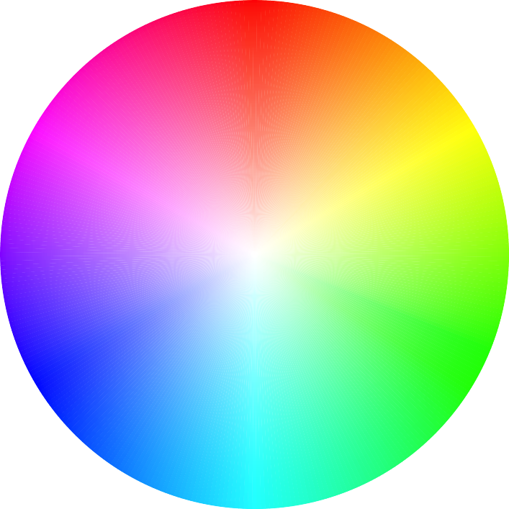

Slide 44
R
M
Y
B
R
C

Slide 45
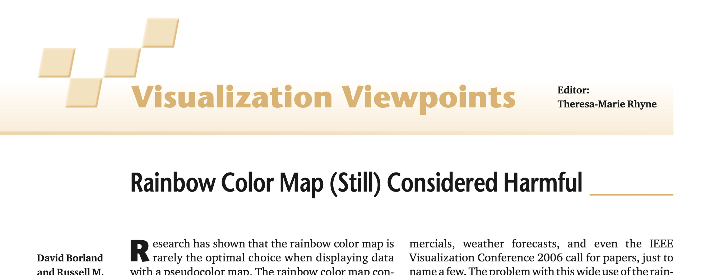

Slide 46
Desiderata
Discriminability
Ordering
Association
Do not modulate luminance as a side effect

Slide 47
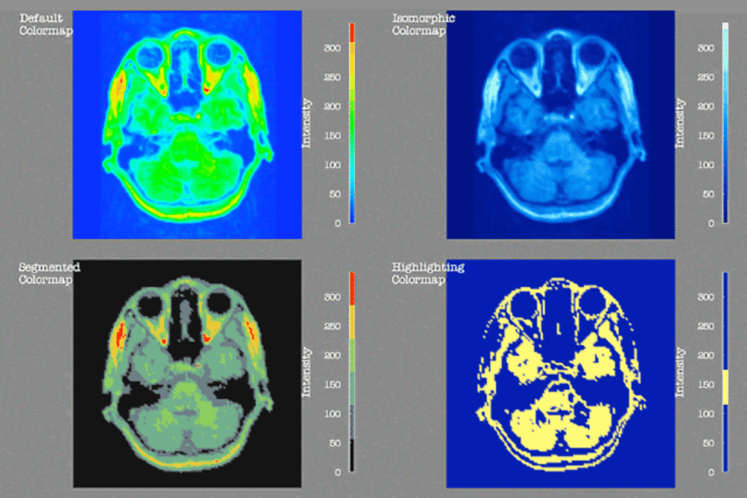
Rogowitz & Treinish, How Not to Lie with Visualization (1996)

Slide 48
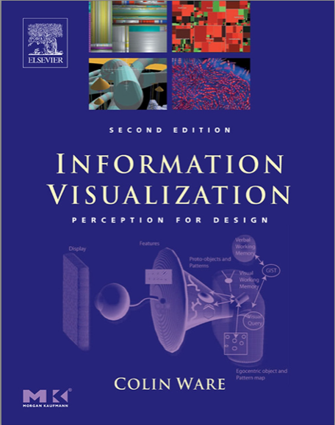

Slide 49
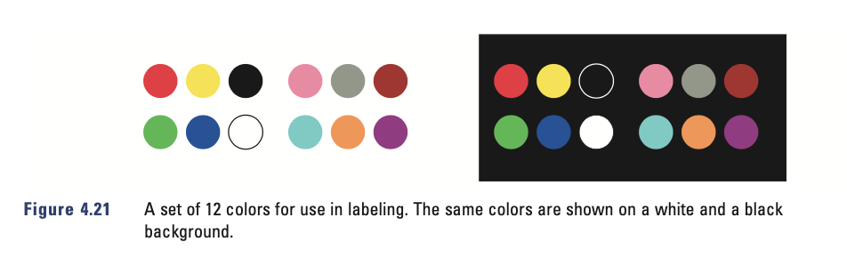

Slide 50


