Slide 1

Maps I
Data 227
Data Visualization & Communication
Autumn, 2021

Slide 2
When maps?
Data contain geographical or location information
Spatial relationships are relevant

Slide 3

https://www.businessinsider.com/etf-stock-best-performing-fund-in-2017-2017-7

Slide 4
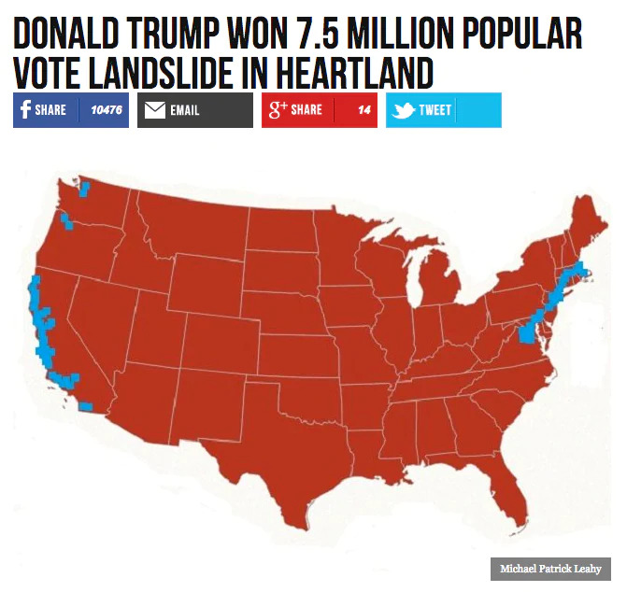
https://www.washingtonpost.com/news/the-fix/wp/2016/11/15/thanks-to-a-bad-map-and-bizarre-math-breitbart-can-report-that-trump-won-the-real-popular-vote/
https://www.washingtonpost.com/news/the-fix/wp/2016/11/15/thanks-to-a-bad-map-and-bizarre-math-breitbart-can-report-that-trump-won-the-real-popular-vote/

Slide 5
“Donald Trump won an overwhelming 7.5 million popular vote victory in 3,084 of the country’s 3,141 counties or county equivalents in America’s heartland.”
https://www.washingtonpost.com/news/the-fix/wp/2016/11/15/thanks-to-a-bad-map-and-bizarre-math-breitbart-can-report-that-trump-won-the-real-popular-vote/
https://www.washingtonpost.com/news/the-fix/wp/2016/11/15/thanks-to-a-bad-map-and-bizarre-math-breitbart-can-report-that-trump-won-the-real-popular-vote/

Slide 6
“Donald Trump won an overwhelming 7.5 million popular vote victory in 3,084 of the country’s 3,141 counties or county equivalents in America’s heartland.”
The popular vote would have gone the other way if it weren't for 50-100 counties that favored Clinton.
https://www.washingtonpost.com/news/the-fix/wp/2016/11/15/thanks-to-a-bad-map-and-bizarre-math-breitbart-can-report-that-trump-won-the-real-popular-vote/
https://www.washingtonpost.com/news/the-fix/wp/2016/11/15/thanks-to-a-bad-map-and-bizarre-math-breitbart-can-report-that-trump-won-the-real-popular-vote/

Slide 7
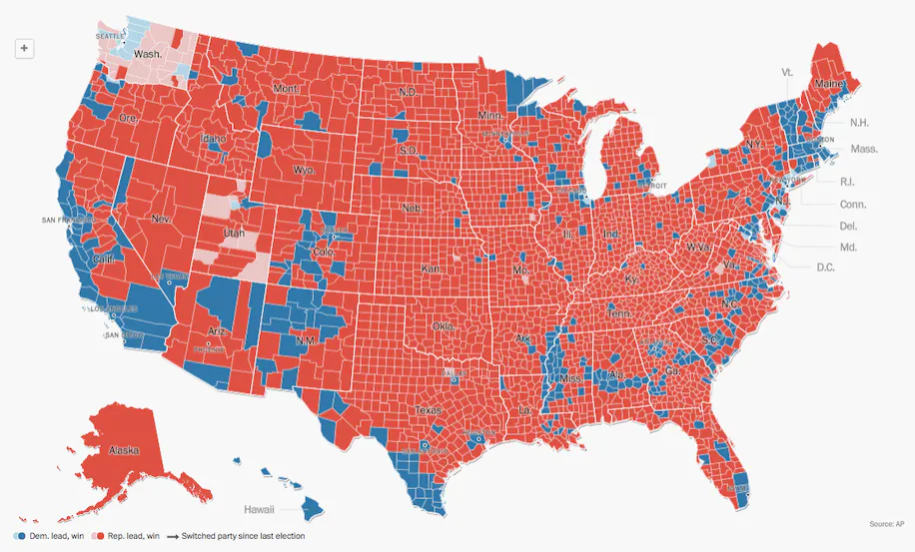
https://www.washingtonpost.com/news/the-fix/wp/2016/11/15/thanks-to-a-bad-map-and-bizarre-math-breitbart-can-report-that-trump-won-the-real-popular-vote/

Slide 8
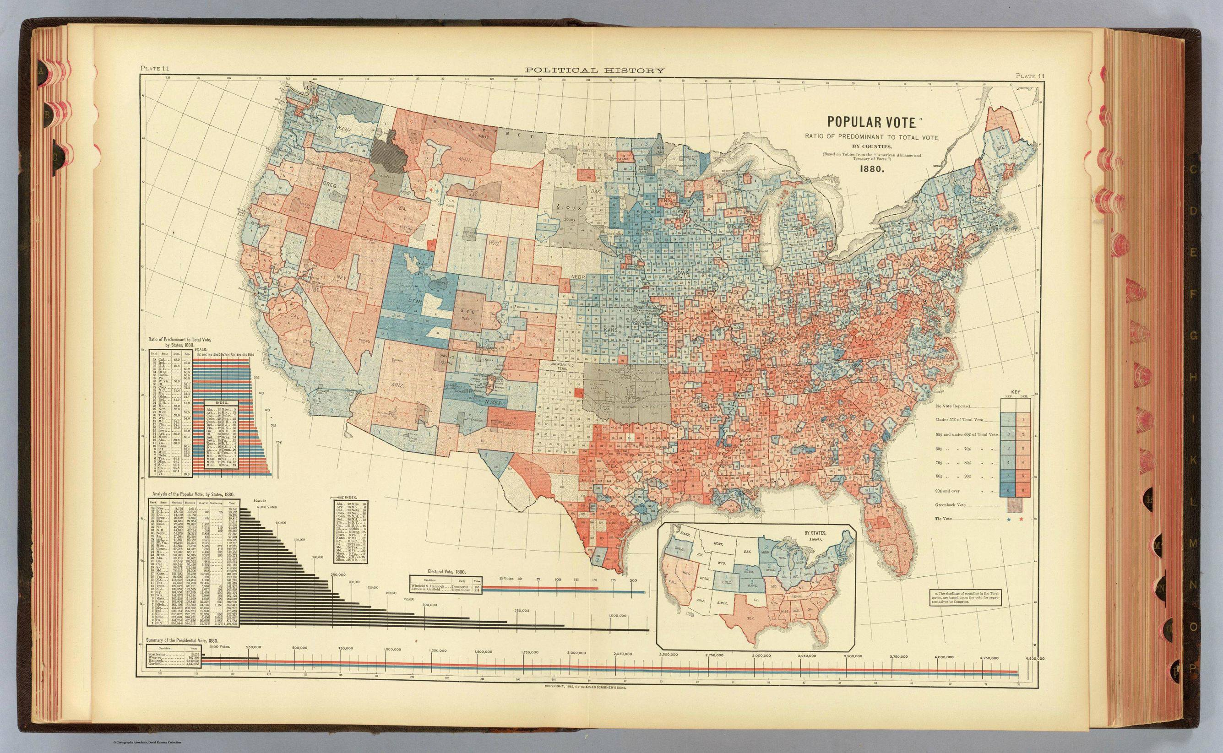
Fletcher W. Hewes and Henry Gannett, Scribner’s Statistical Atlas of the United States, 1883.

Slide 9
Fletcher W. Hewes and Henry Gannett, Scribner’s Statistical Atlas of the United States, 1883.

Slide 10
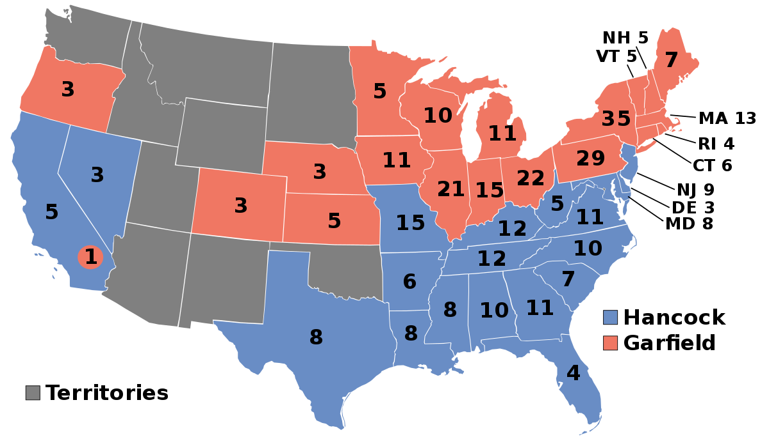
Popular vote: 1880
Fletcher W. Hewes and Henry Gannett, Scribner’s Statistical Atlas of the United States, 1883.

Slide 11
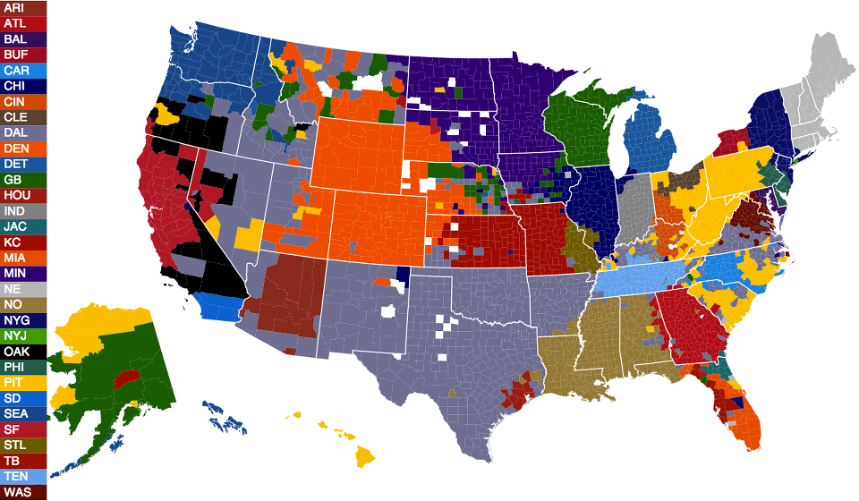
NFL playoffs - 32
League has 32 teams;
Facebook identifies 35 million accounts that have
“liked” one of those teams during the playoff season.
Facebook Data Science, NFL fans on Facebook, 2021-03-13
https://www.facebook.com/notes/10158927994943415/

Slide 12
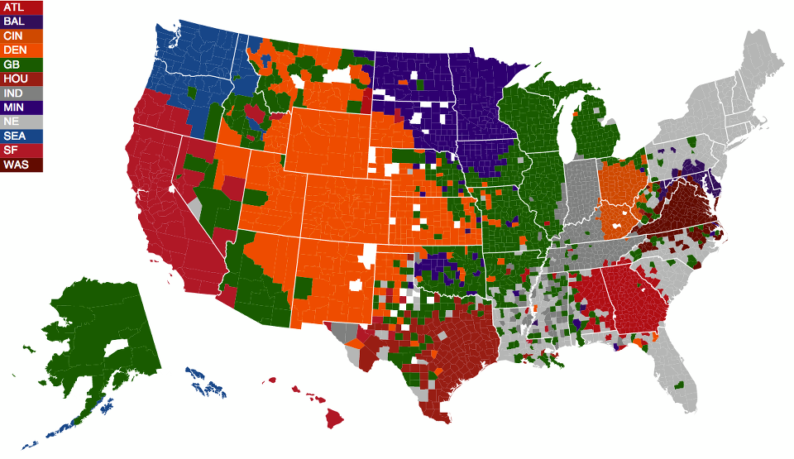
NFL playoffs - 12
Ignoring the likes for teams that do not continue, and taking the maximum of those that remain...
https://www.facebook.com/notes/10158927994943415/

Slide 13
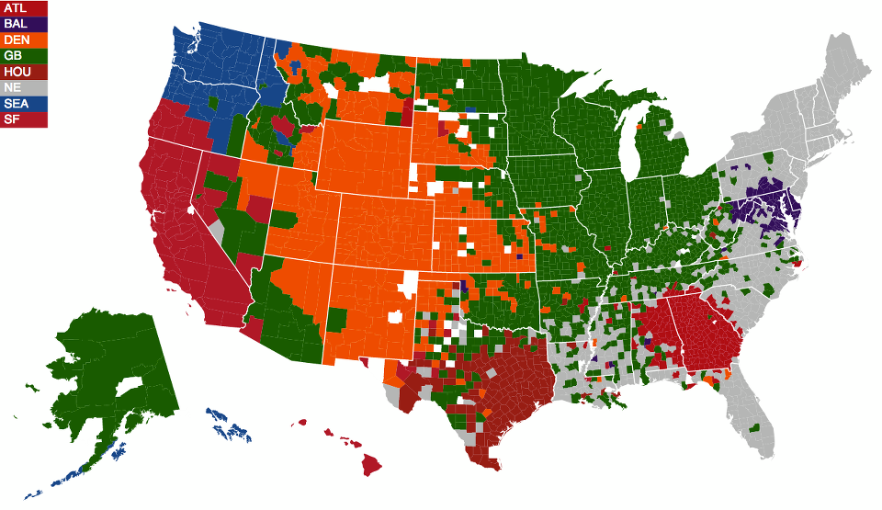
NFL playoffs - 8
https://www.facebook.com/notes/10158927994943415/

Slide 14
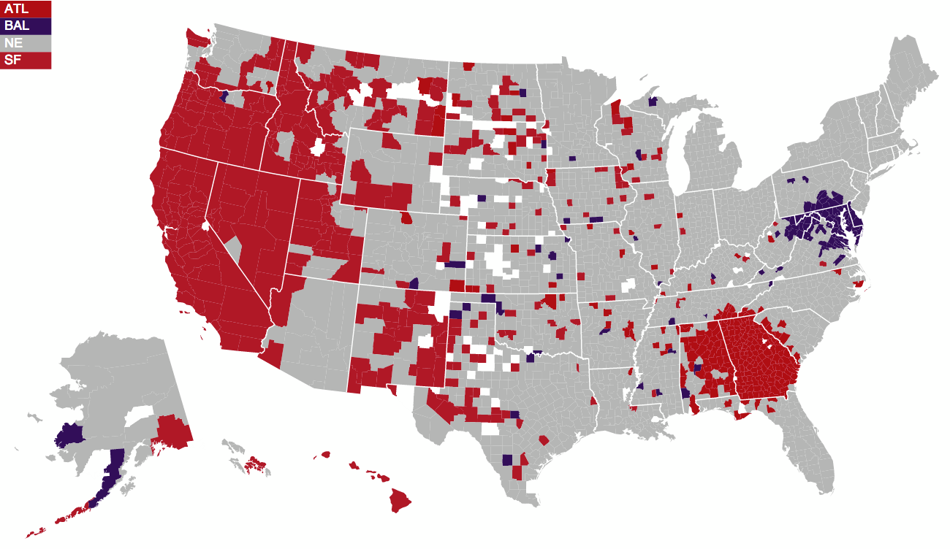
NFL playoffs - 4
https://www.facebook.com/notes/10158927994943415/

Slide 15
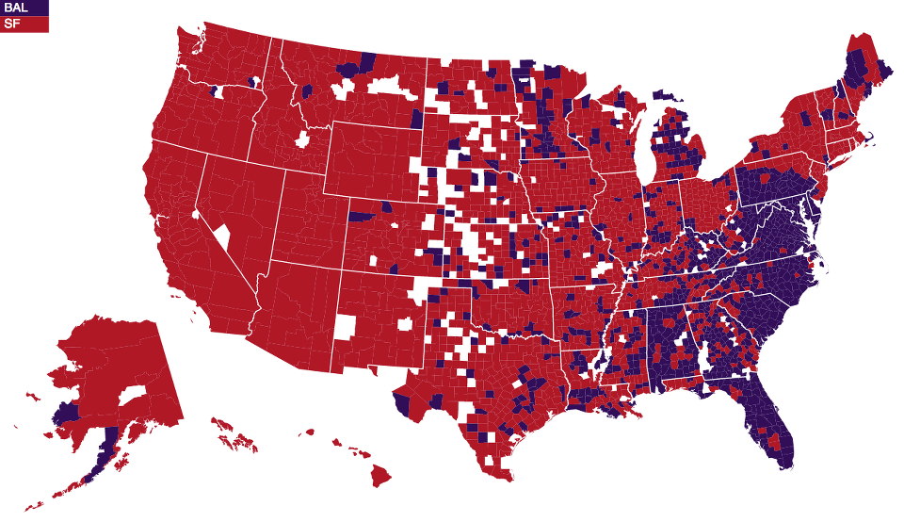
NFL playoffs - 2
https://www.facebook.com/notes/10158927994943415/

Slide 16
This graphic is beautiful! (Probably why it got published)
What is the most serious flaw here?

Slide 17
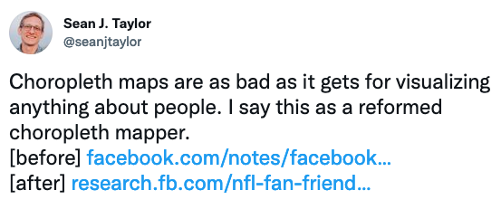
https://twitter.com/seanjtaylor/status/1061849248419835904

Slide 18
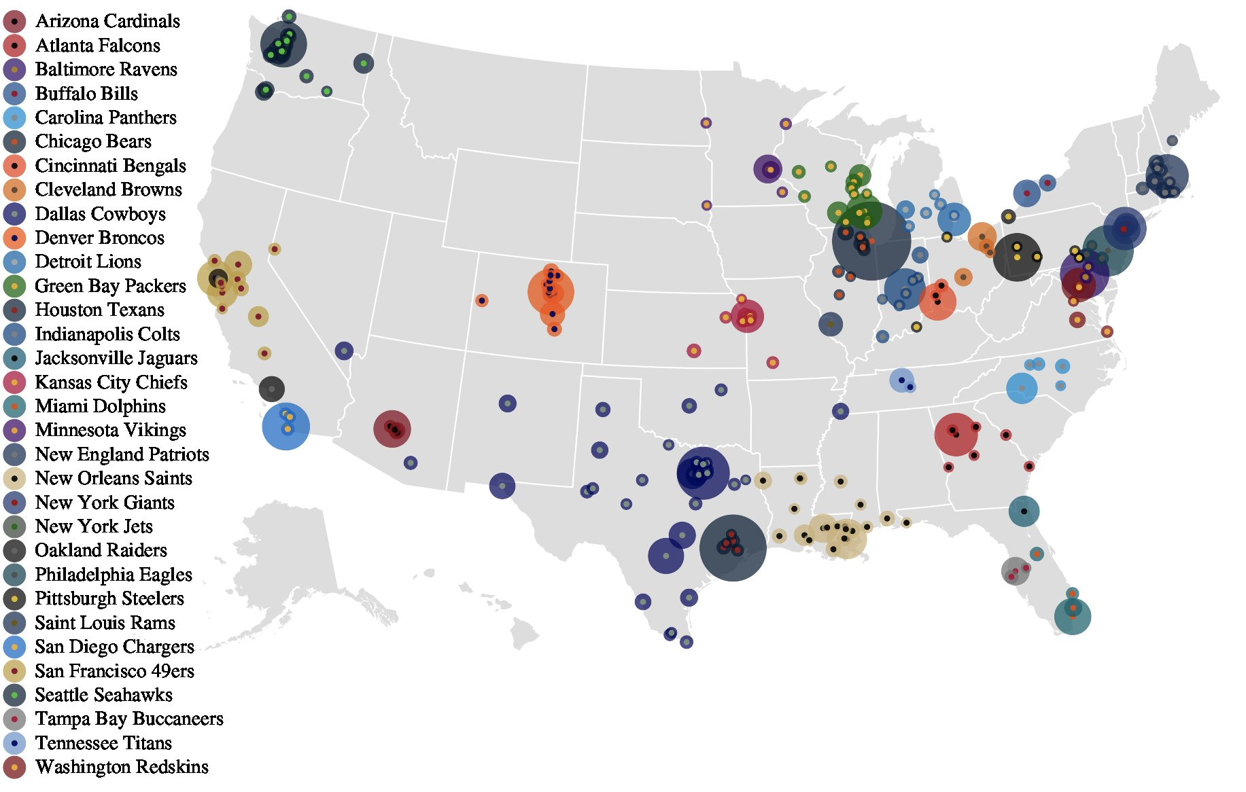
Weights, weights, weights
https://twitter.com/seanjtaylor/status/1061849248419835904

Slide 19
This graphic is beautiful! (Probably why it got published)
What is the most serious flaw here?

Slide 20
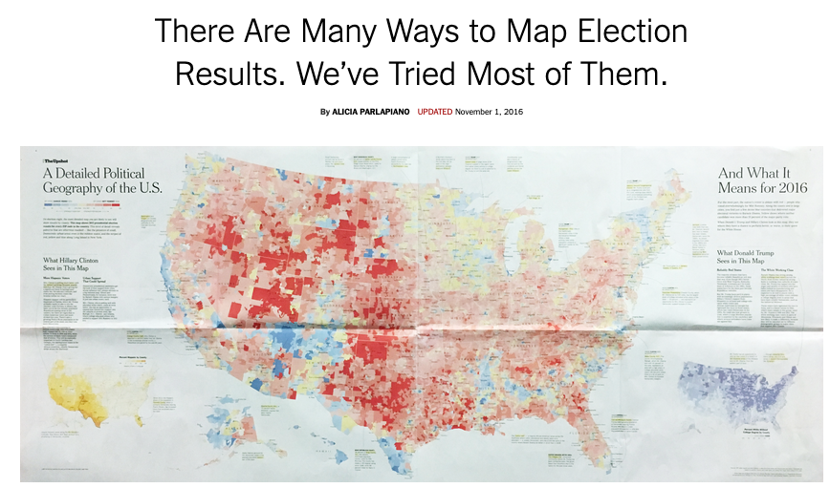
https://www.nytimes.com/interactive/2016/11/01/upshot/many-ways-to-map-election-results.html

Slide 21
Who is winning / has won in my district?
Was it a landslide?
https://www.nytimes.com/interactive/2016/11/01/upshot/many-ways-to-map-election-results.html

Slide 22
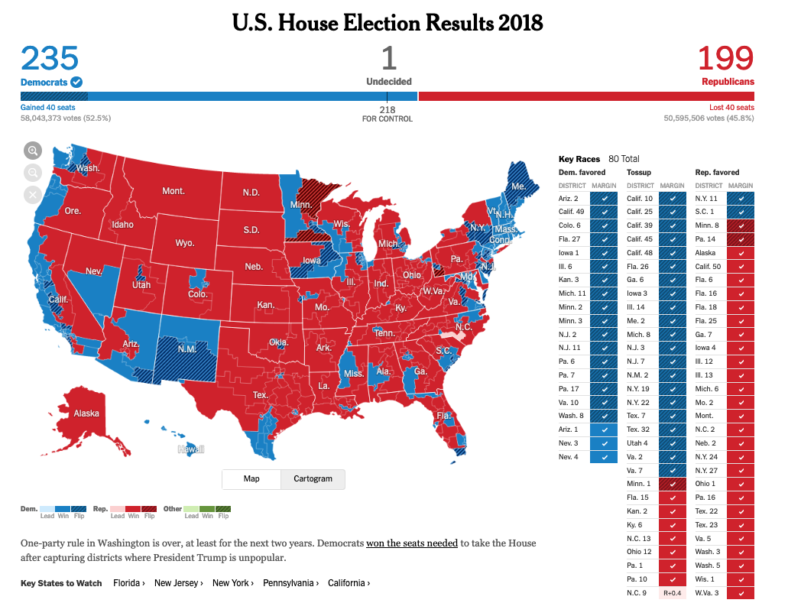
NYT, Nov 11, 2018

Slide 23
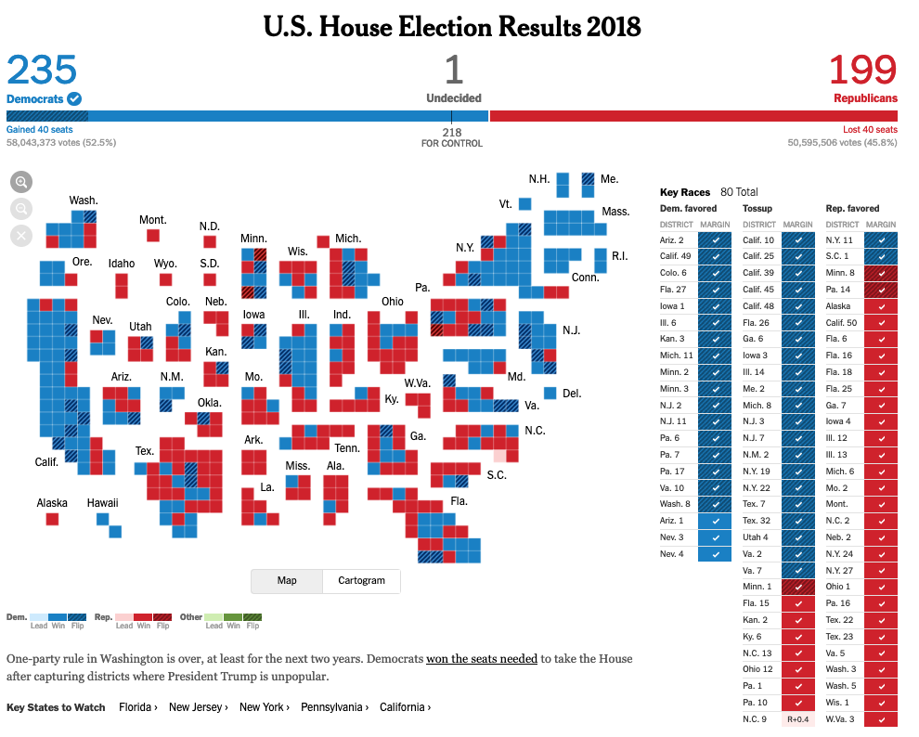
NYT, Nov 11, 2018

Slide 24
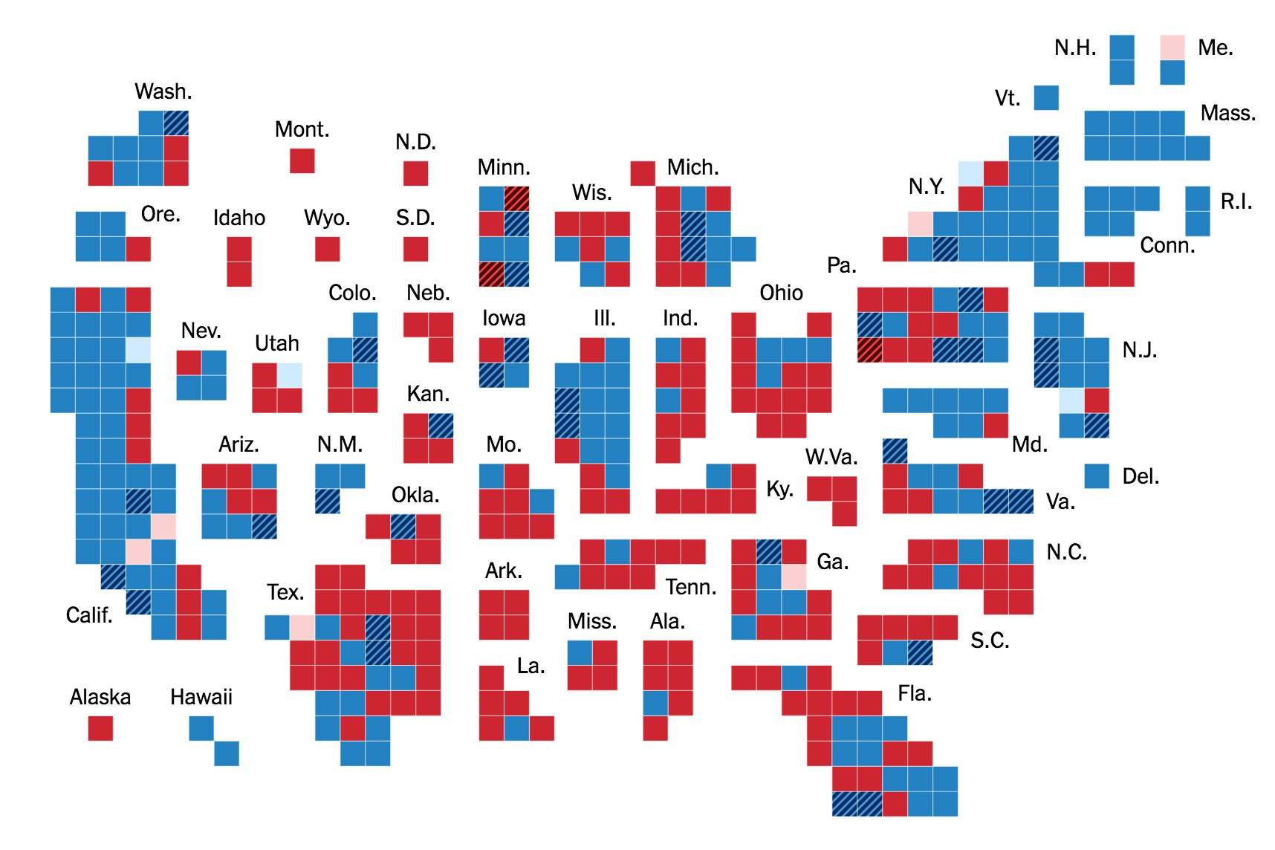
2018 House midterm results

Slide 25
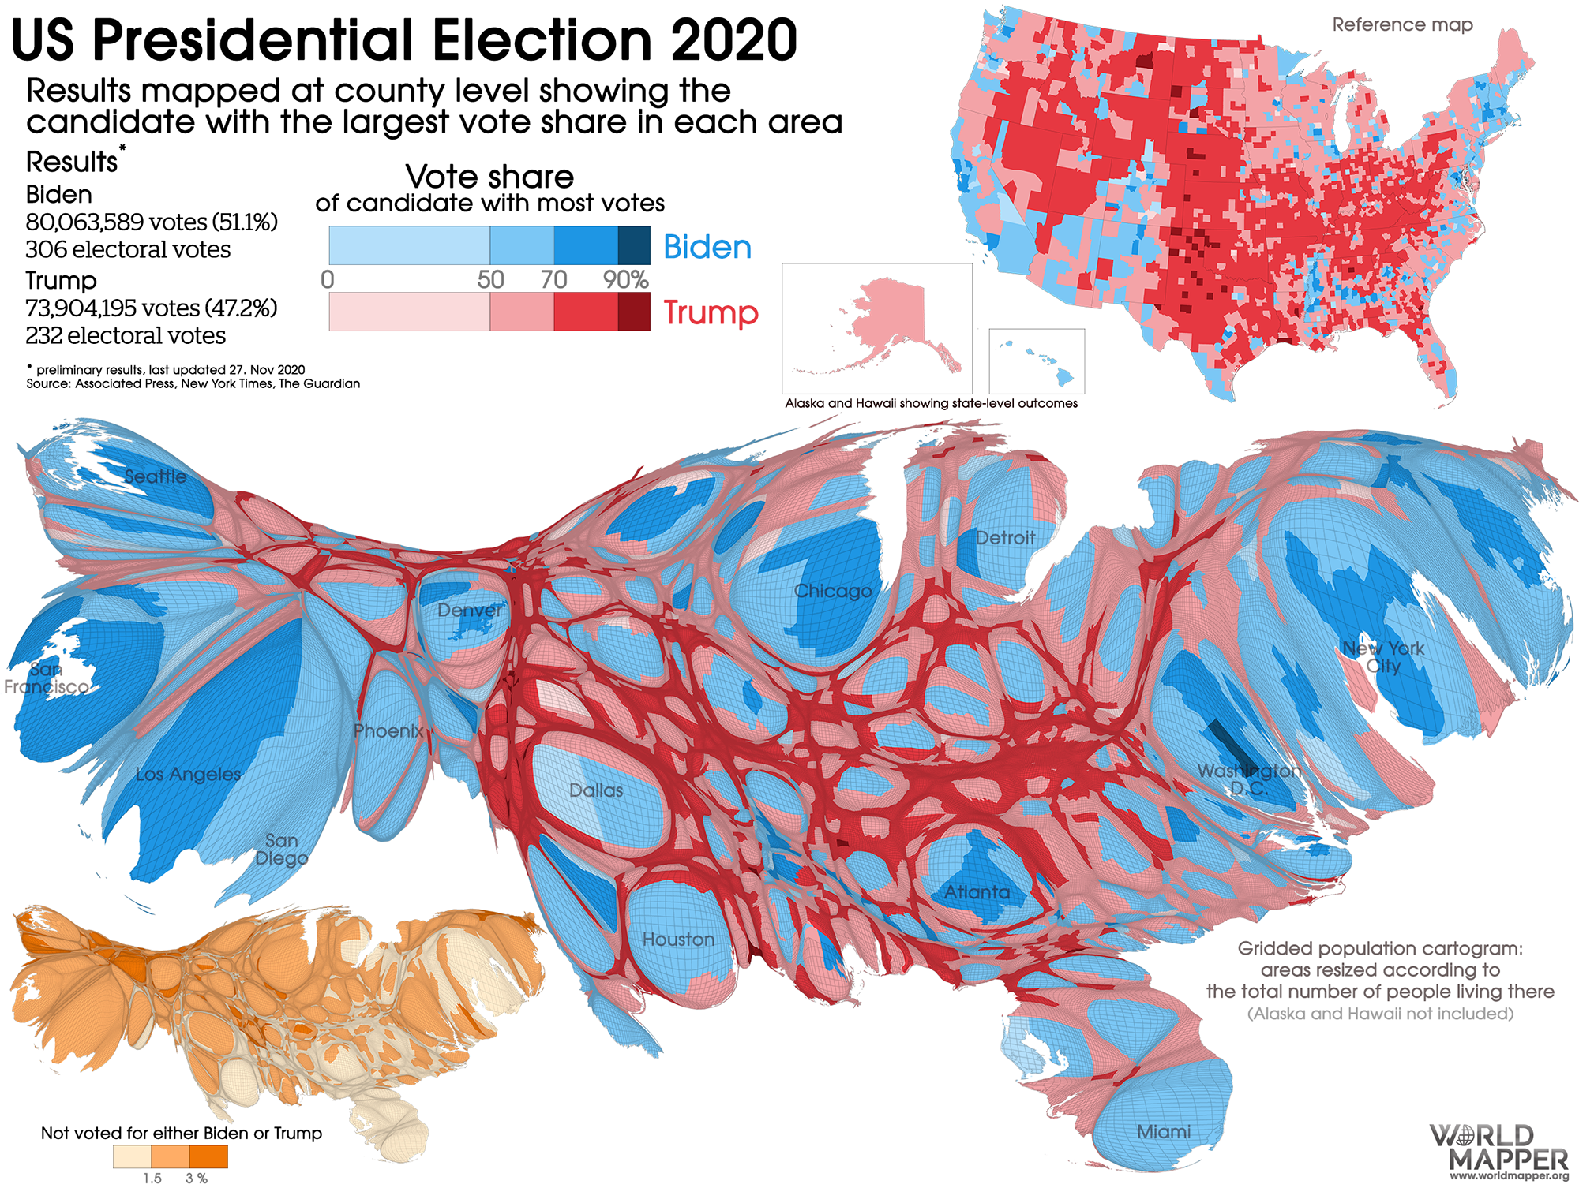
Some approaches look weirder than others.

Slide 26
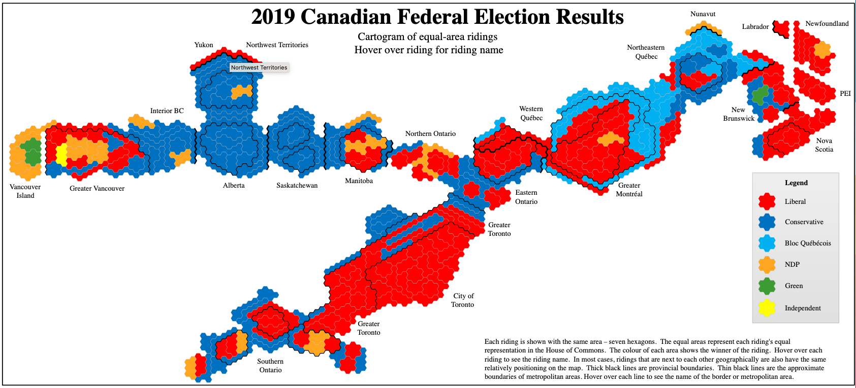
Cartograms always look weird.

Slide 27
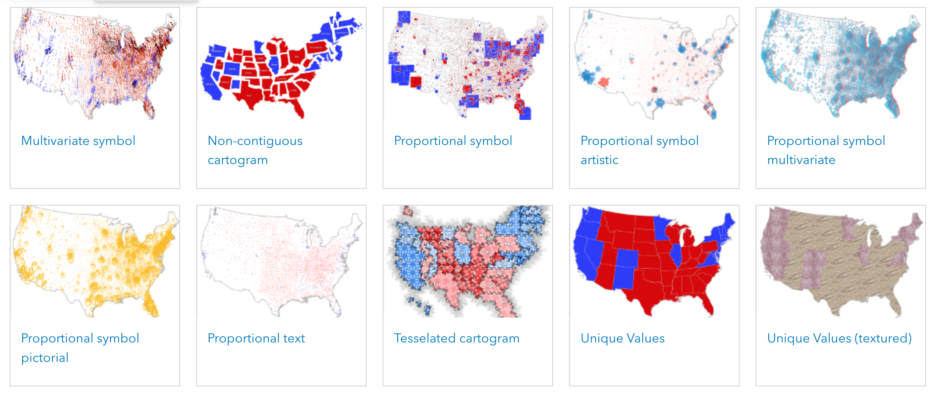
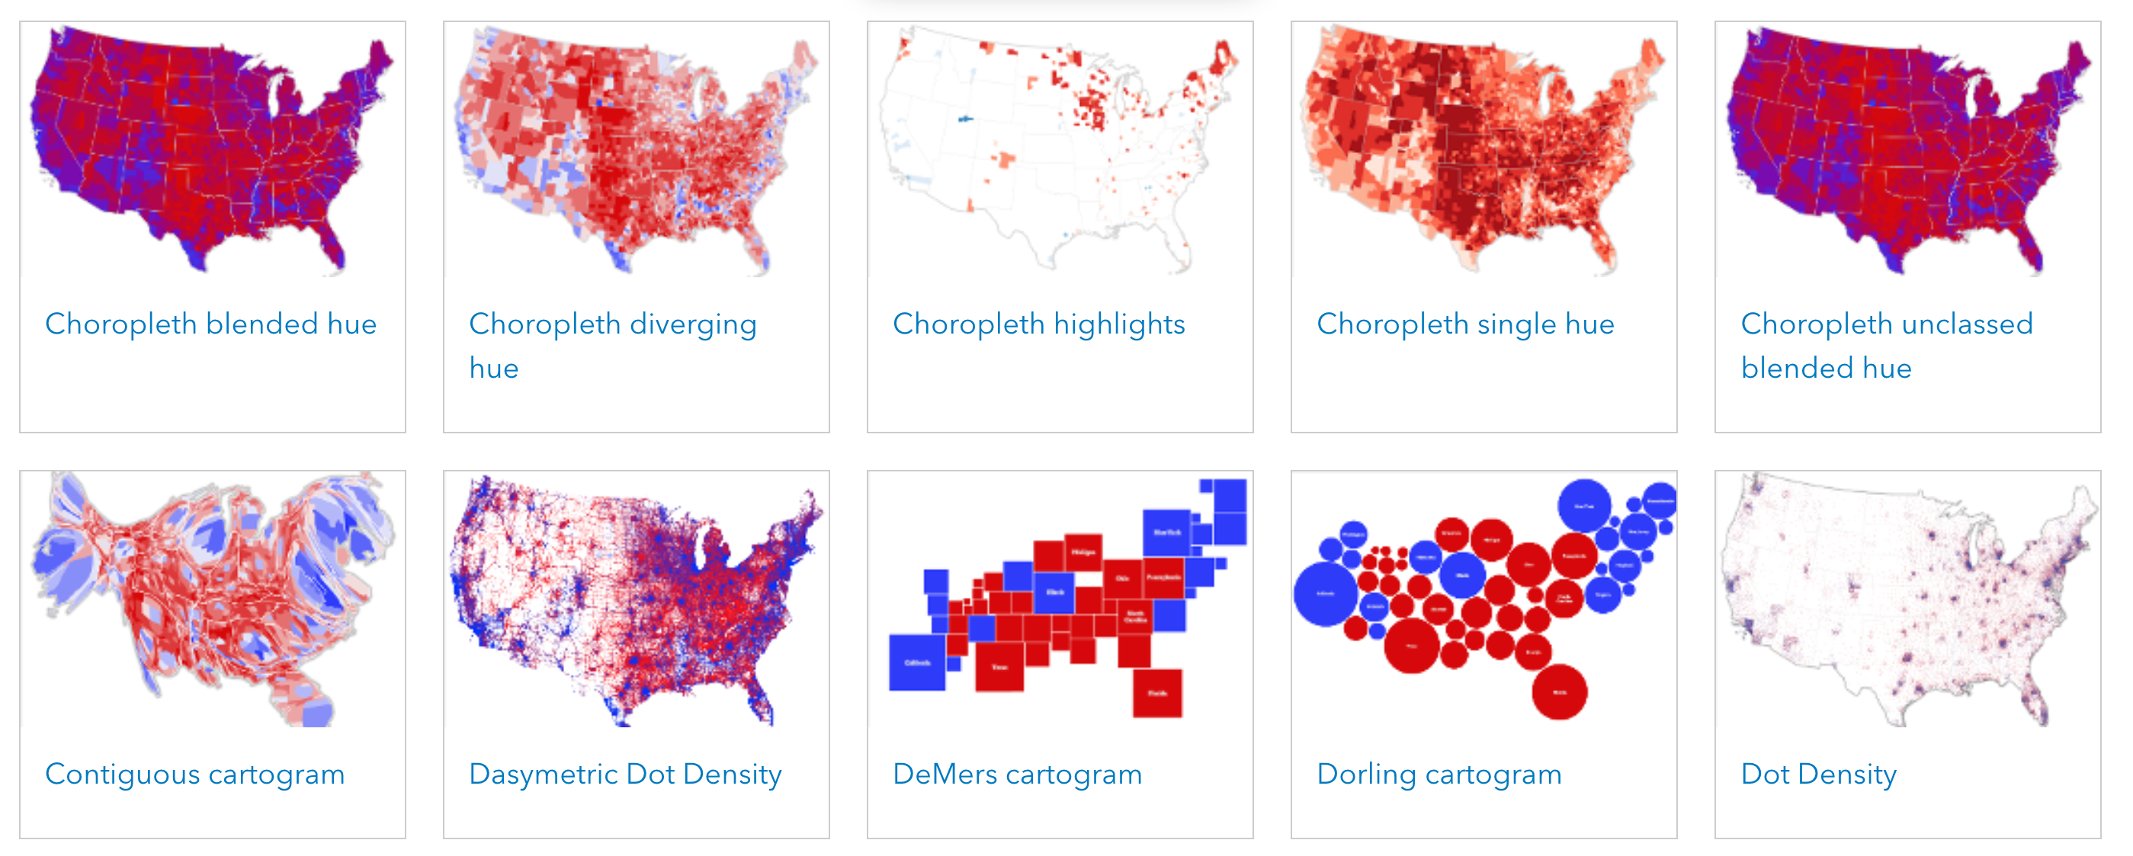
https://carto.maps.arcgis.com/apps/MinimalGallery/index.html

Slide 28
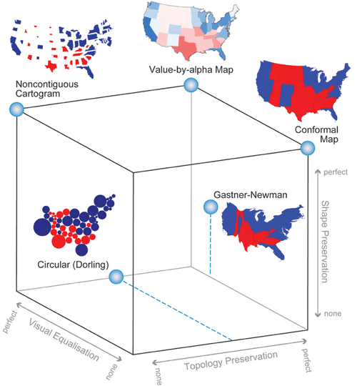
http://www.cartogrammar.com/blog/value-by-alpha-maps/

Slide 29
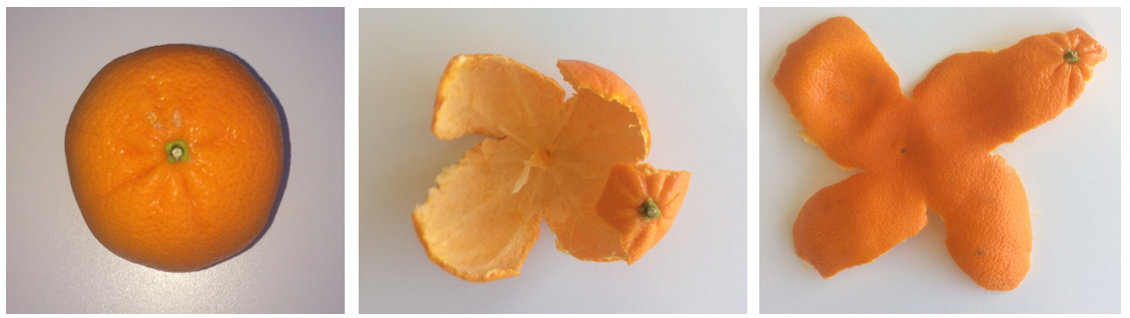
Projections
You have to choose a projection when your areas are large
Can't map the surface of a sphere onto flat paper without either tearing it or distorting it severely.

Slide 30
Projections
projection( params)
data lat, lon
visualization x,y

Slide 31
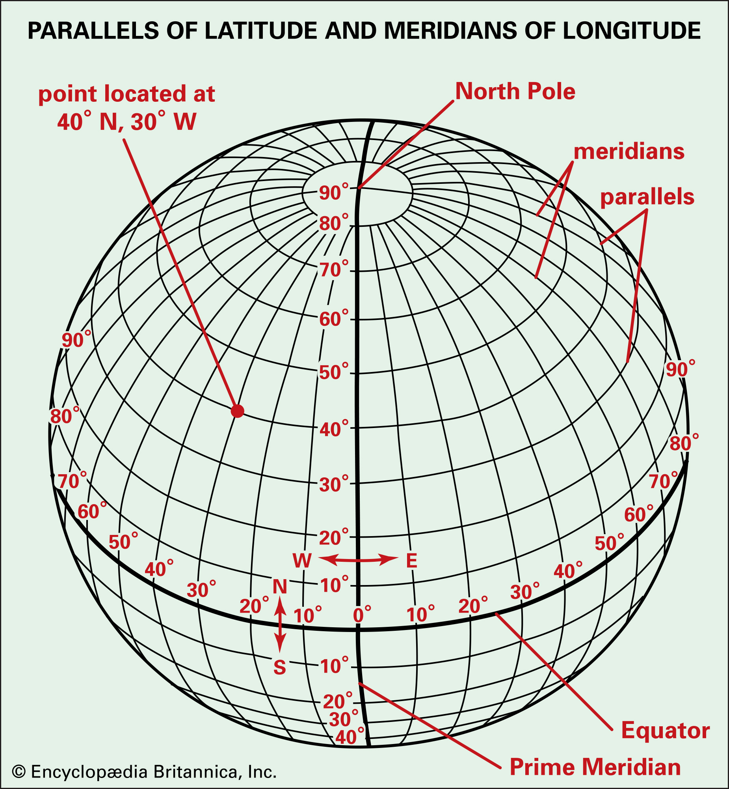

Slide 32
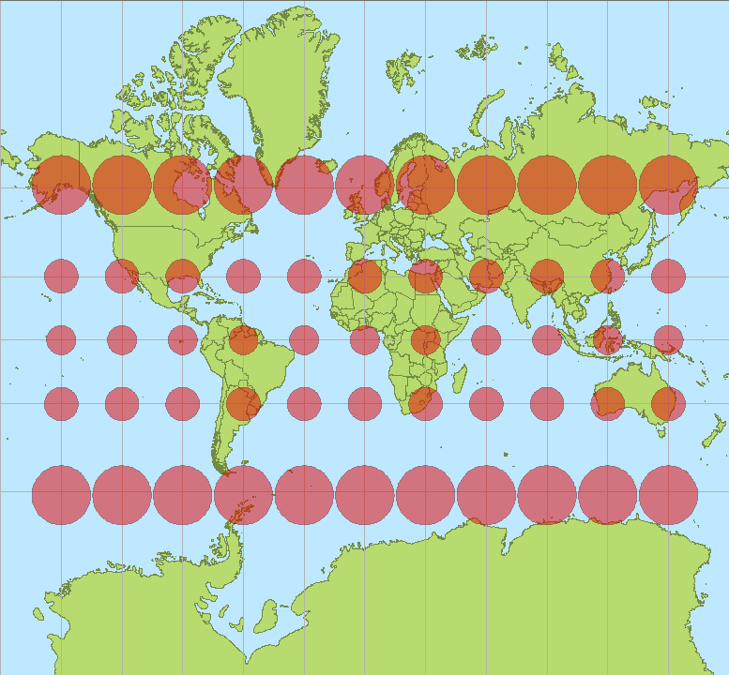

Slide 33
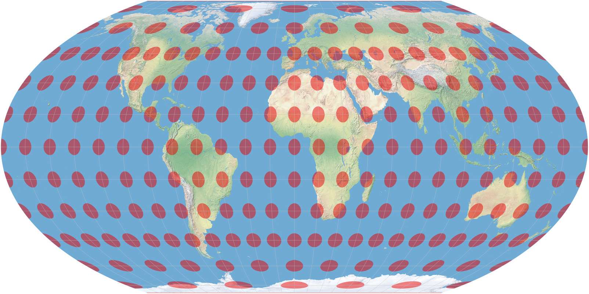

Slide 34
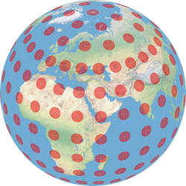
Tissot's indicatrix

Slide 35
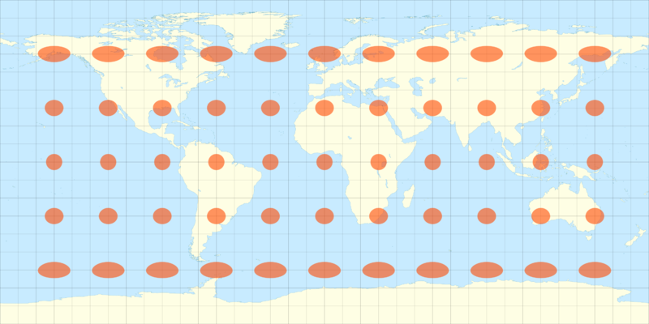

Slide 36
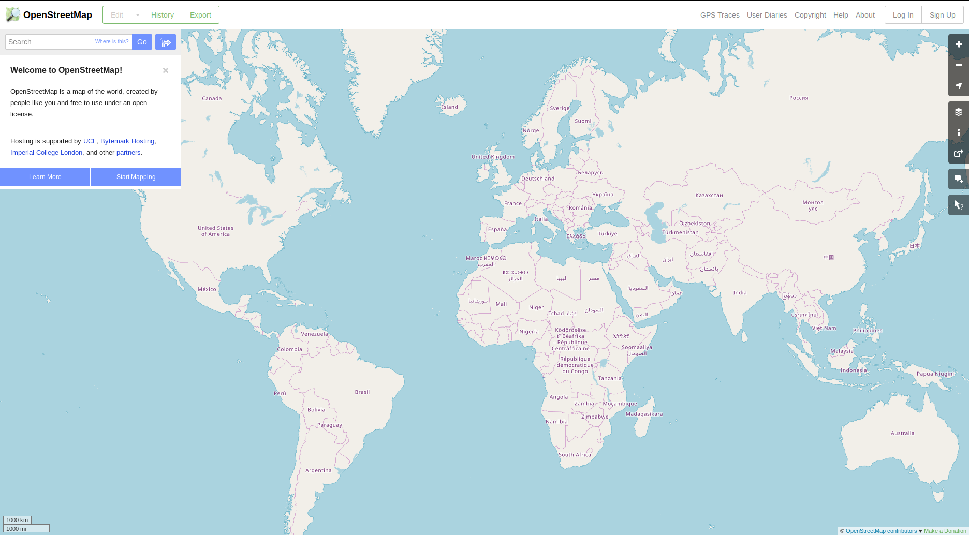
Web Mercator

