Slide 1

Data 227
Data Visualization & Communication
Autumn, 2021
Week 9

Slide 2
Administrivia
HW5 Dec 6 (graduating this quarter Dec 1)
Final project Dec 7
Resubmitted homeworks / projects same end-of-quarter deadline

Slide 3
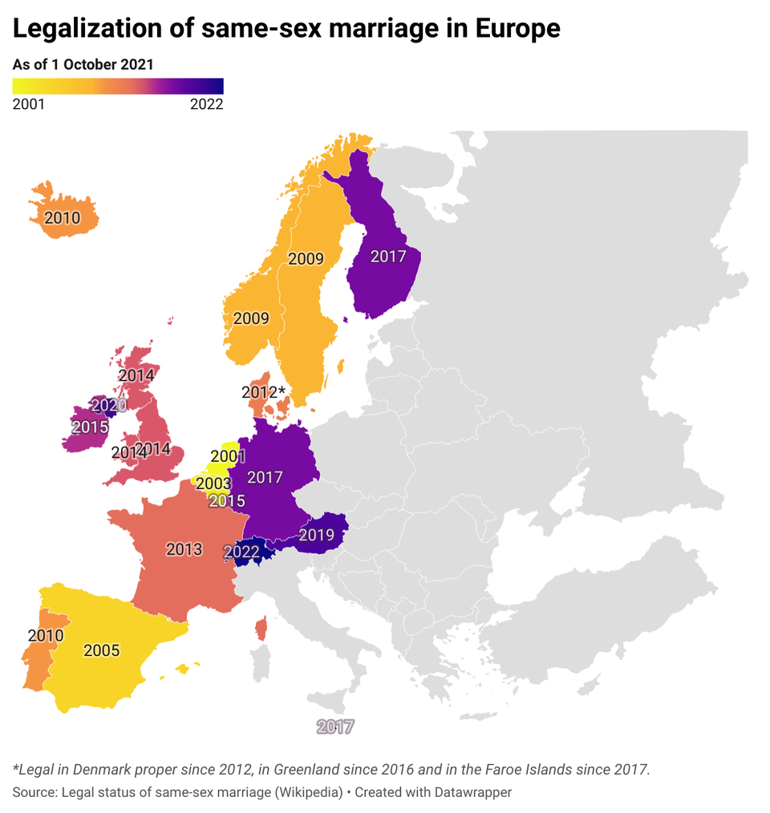

Slide 4
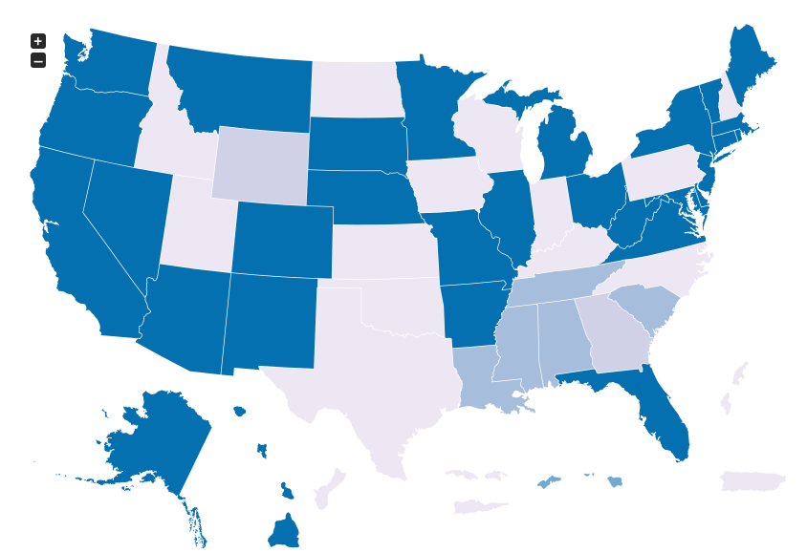
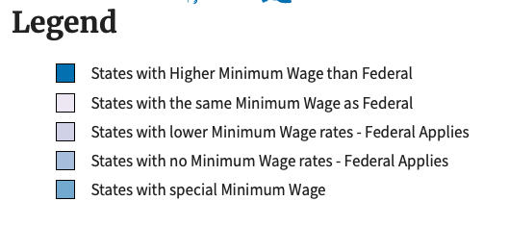
https://www.dol.gov/agencies/whd/minimum-wage/state

Slide 5
The colors make no sense!
https://www.dol.gov/agencies/whd/minimum-wage/state

Slide 6
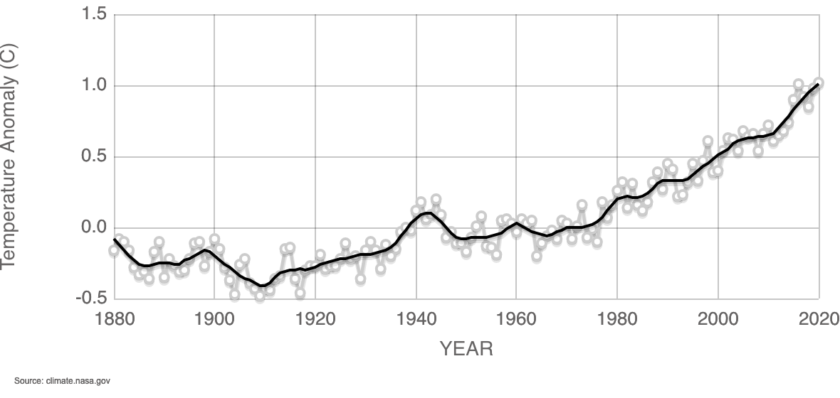
GLOBAL LAND-OCEAN TEMPERATURE INDEX
Data source: NASA's Goddard Institute for Space Studies (GISS).
Credit: NASA/GISS

Slide 7
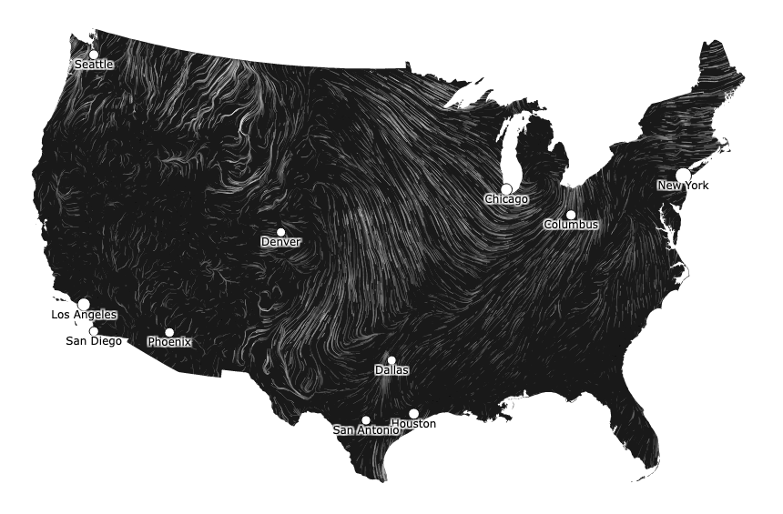
http://hint.fm/wind/

Slide 8








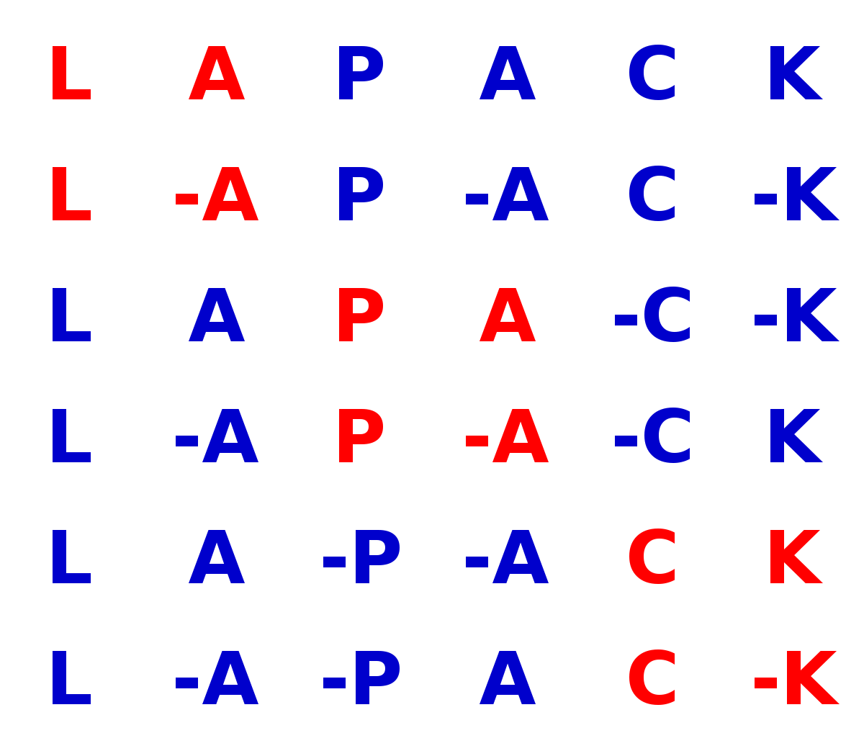
The stack
Stratiographic layers -- lower layers are older, will likely last longer into the future.
Python

Slide 9
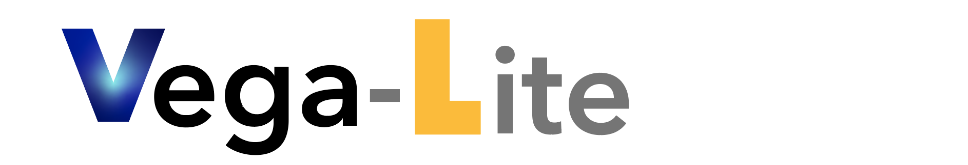



The stack
ega
Python

Slide 10
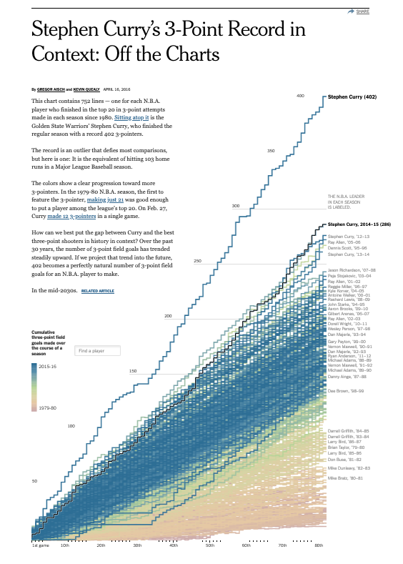
https://www.nytimes.com/interactive/2016/04/16/upshot/stephen-curry-golden-state-warriors-3-pointers.html

Slide 11
Interaction
User does not know what data visualizations are going to do.
It is only after a few moments playing with the interface that its functionality becomes apparent.

Slide 12
Schneiderman mantra
Overview first, zoom and filter, details on demand.
Overview first, zoom and filter, details on demand.
Overview first, zoom and filter, details on demand.
Overview first, zoom and filter, details on demand.
Overview first, zoom and filter, details on demand.
Overview first, zoom and filter, details on demand.
Overview first, zoom and filter, details on demand.
Overview first, zoom and filter, details on demand.

Slide 13
Schneiderman's seven information-seeking tasks
Overview: present all the elements at once
Zoom: show items of interest
Filter: remove uninteresting items
Details-on-demand: user-selection-dependent details
Relate: get relationships between items
History: keep a history of actions, alloing undo, replay, and progressive refinement
Extract: Allow extraction of data subsets and creation of queries

Slide 14
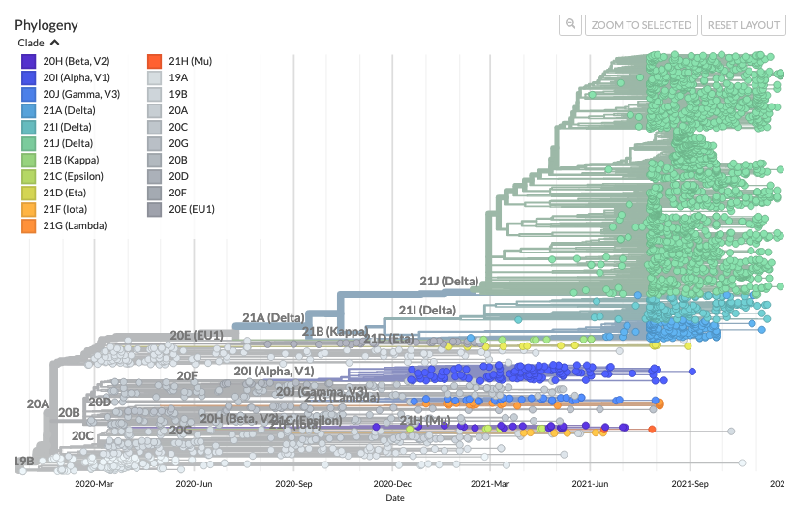
Nextstrain, so much to admire

Slide 15
Nextstrain, so much to admire
Nextstrain is excellent at
overview
filter
details-on-demand

Slide 16
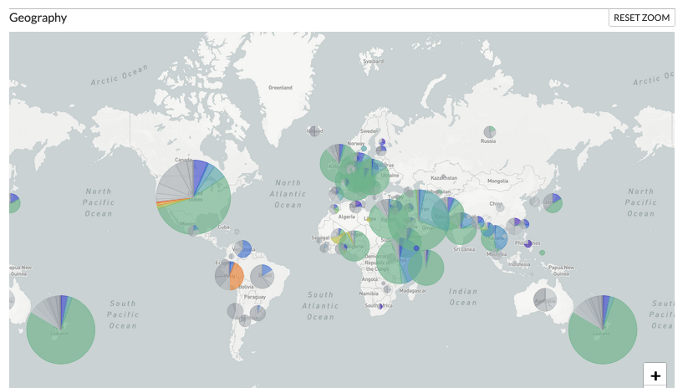
Nextstrain, so much to admire

Slide 17
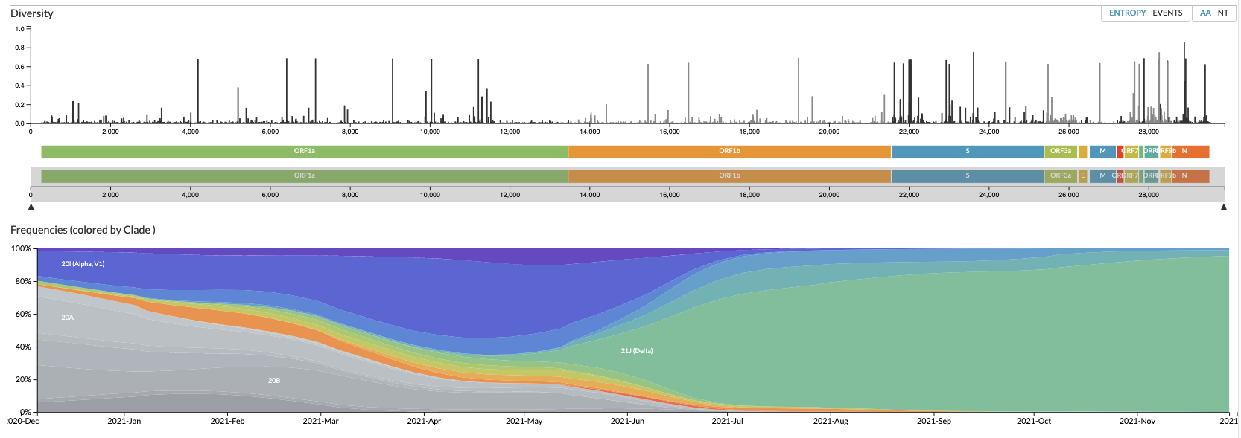
Nextstrain, so much to admire

Slide 18
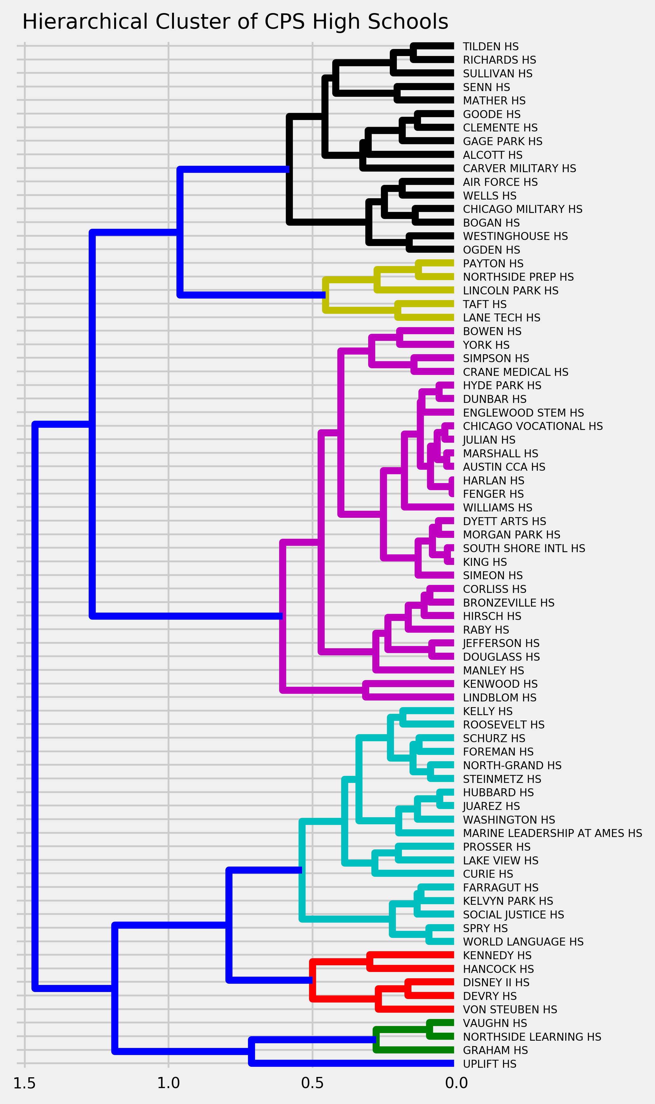
School name
Bilingual fraction
Free/reduced lunch
Special education
merged with racial composition
feed into clustering / treemaking algorithm
School name
Bilingual fraction
Free/reduced lunch
Special education
merged with racial composition
feed into clustering / treemaking algorithm
School name
Bilingual fraction
Free/reduced lunch
Special education
merged with racial composition
feed into clustering / treemaking algorithm
School name
Bilingual fraction
Free/reduced lunch
Special education
merged with racial composition
feed into clustering / treemaking algorithm
Victoria Kielb

Slide 19
School name
Bilingual fraction
Free/reduced lunch
Special education
merged with racial composition
feed into clustering / treemaking algorithm
School name
Bilingual fraction
Free/reduced lunch
Special education
merged with racial composition
feed into clustering / treemaking algorithm
School name
Bilingual fraction
Free/reduced lunch
Special education
merged with racial composition
feed into clustering / treemaking algorithm
School name
Bilingual fraction
Free/reduced lunch
Special education
merged with racial composition
feed into clustering / treemaking algorithm
Begs the question:
What do the clusters mean?
Victoria Kielb

Slide 20
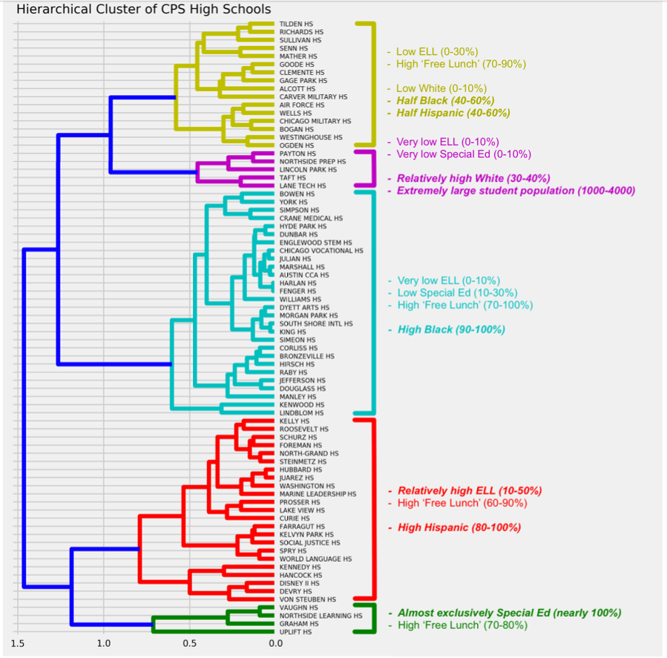
This dendrogram above displays the 5 clusters (the optimal k according to the Elbow method) that were created via K-means clustering for 76 Chicago Public School high schools. To the right of the dendrogram are common characteristics between each of the schools in their respective cluster, as seen by the corresponding cluster-to-text colors.
The ones in bold and italics represent the most prominent/distinctive characteristic(s). Percentage ranges are given for each characteristic to provide a more quantifiable picture of how the student populations are composed for every cluster.
Information to create the clusters are derived from two datasets from the Chicago Public Schools website. The first is the 2021-2022 “Limited English Proficiency, Special Ed, Low Income, IEP Report” dataset (.xls), which contains information like the percentages of English Language Learning (ELL), Special Ed, and Free/Reduced Lunch (i.e. families whose income is within 18.5% of the federal poverty line) students for each CPS high school. The second is the 2021-2022 “Racial/Ethnnic Report” dataset (.xls), which contains the racial demographic breakdown for each high school.
Victoria Kielb

Slide 21
This dendrogram above displays the 5 clusters (the optimal k according to the Elbow method) that were created via K-means clustering for 76 Chicago Public School high schools. To the right of the dendrogram are common characteristics between each of the schools in their respective cluster, as seen by the corresponding cluster-to-text colors.
The ones in bold and italics represent the most prominent/distinctive characteristic(s). Percentage ranges are given for each characteristic to provide a more quantifiable picture of how the student populations are composed for every cluster.
Information to create the clusters are derived from two datasets from the Chicago Public Schools website. The first is the 2021-2022 “Limited English Proficiency, Special Ed, Low Income, IEP Report” dataset (.xls), which contains information like the percentages of English Language Learning (ELL), Special Ed, and Free/Reduced Lunch (i.e. families whose income is within 18.5% of the federal poverty line) students for each CPS high school. The second is the 2021-2022 “Racial/Ethnnic Report” dataset (.xls), which contains the racial demographic breakdown for each high school.
Clusters on their own may be meaningless computational artifacts; if we can articulate what they mean, however, we think we learned something.
Victoria Kielb

