Slide 1

Data 227
Data Visualization & Communication
Autumn, 2021
Week 9

Slide 2
What have we done?
Why visualization? Good viz makes us smarter

Slide 3
What have we done?
Why visualization? Good viz makes us smarter
How? Chart Types, Encodings and Channels

Slide 4
What have we done?
Why visualization? Good viz makes us smarter
How? Chart Types, Encodings and Channels
Data transformations; redundant encoding

Slide 5
What have we done?
Why visualization? Good viz makes us smarter
How? Chart Types, Encodings and Channels
Data transformations; redundant encoding
Deception and misdirection

Slide 6
What have we done?
Why visualization? Good viz makes us smarter
How? Chart Types, Encodings and Channels
Data transformations; redundant encoding
Deception and misdirection
Color (Do it right in black and white!)

Slide 7
What have we done?
Why visualization? Good viz makes us smarter
How? Chart Types, Encodings and Channels
Data transformations; redundant encoding
Deception and misdirection
Color (Do it right in black and white!)
Maps
Interaction (Overview, zoom, details on demand)

Slide 8
What have we done?
Why visualization? Good viz makes us smarter
How? Chart Types, Encodings and Channels
Data transformations; redundant encoding
Deception and misdirection
Color (Do it right in black and white!)
Maps
Interaction (Overview, zoom, details on demand)
Dimension reduction, ordination (PCA, tSNE)

Slide 9
Make life easy for your audience!
Words are good; words are easier to interpret than flags and icons.

Slide 10
Make life easy for your audience!
Words are good; words are easier to interpret than flags and icons.
Annotations are almost always good; the creator of the graph can put knowledge on the graph.

Slide 11
Make life easy for your audience!
Words are good; words are easier to interpret than flags and icons.
Annotations are almost always good; the creator of the graph can put knowledge on the graph.
Numbers are good; numbers on top of graphs or maps make presentation more precise and can improve data density.

Slide 12
Make life easy for your audience!
Words are good; words are easier to interpret than flags and icons.
Annotations are almost always good; the creator of the graph can put knowledge on the graph.
Numbers are good; numbers on top of graphs or maps make presentation more precise and can improve data density.
Interaction is possible! html / javascript is preferred.

Slide 13
Make life easy for your audience!
Words are good; words are easier to interpret than flags and icons.
Annotations are almost always good; the creator of the graph can put knowledge on the graph.
Numbers are good; numbers on top of graphs or maps make presentation more precise and can improve data density.
Interaction is possible! html / javascript is preferred.
Some graphs would be better as tables.

Slide 14
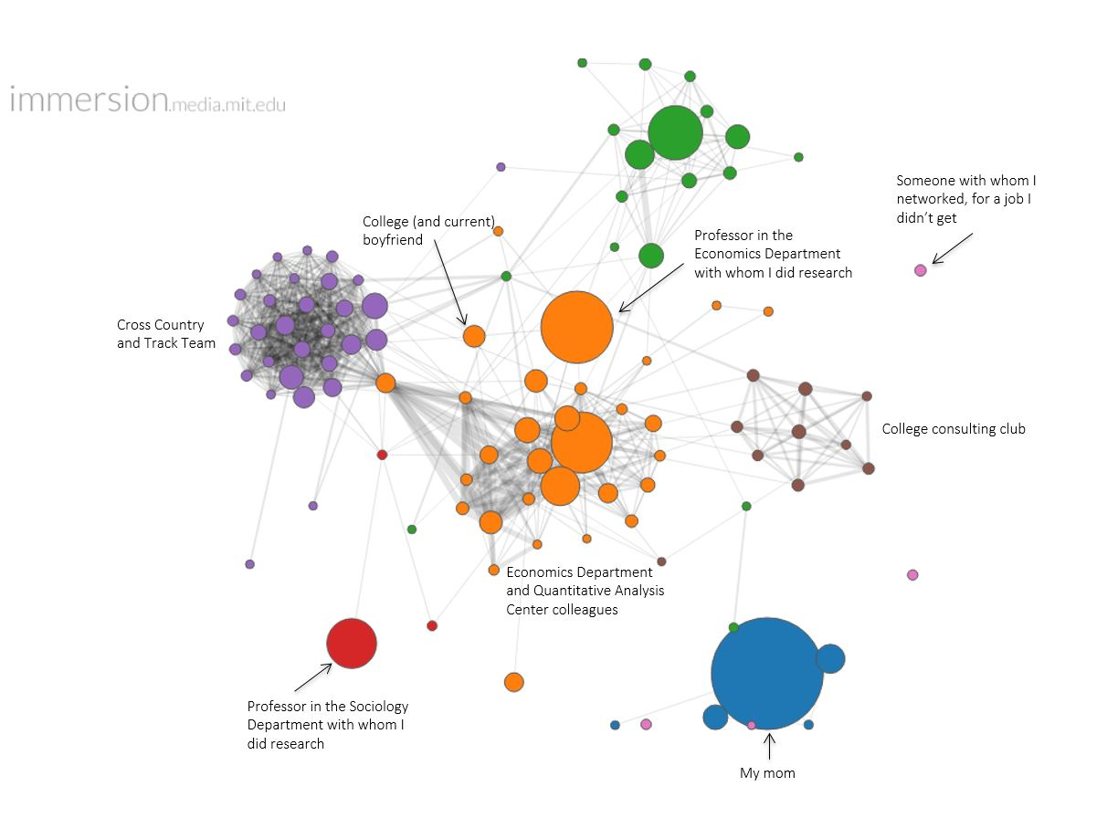
https://www.danalouie-apartmentart.com/blog/2018/6/6/data-visualization-visualizing-my-network-via-gmail

Slide 15
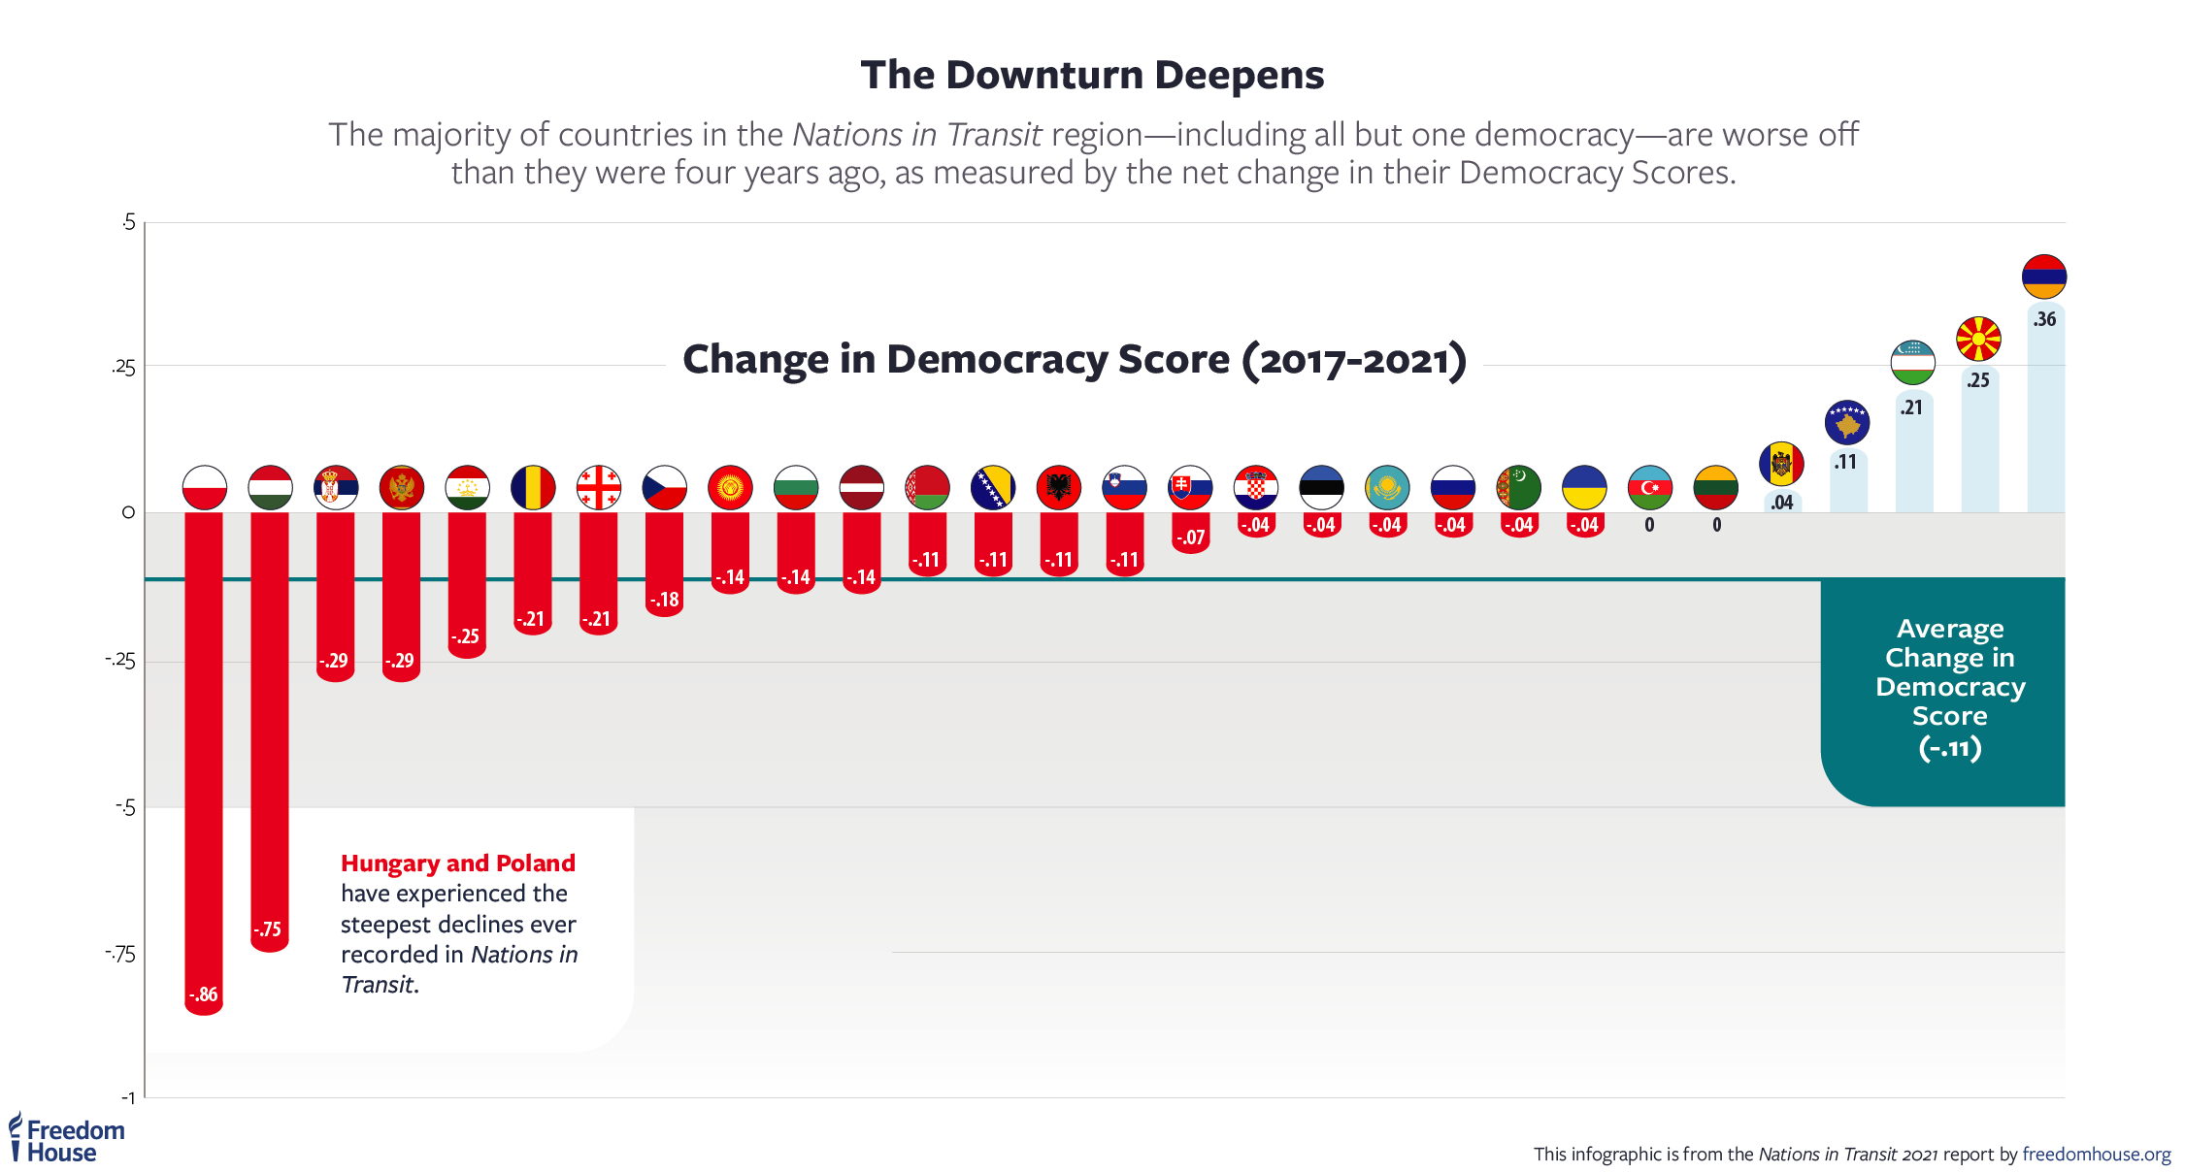

Slide 16
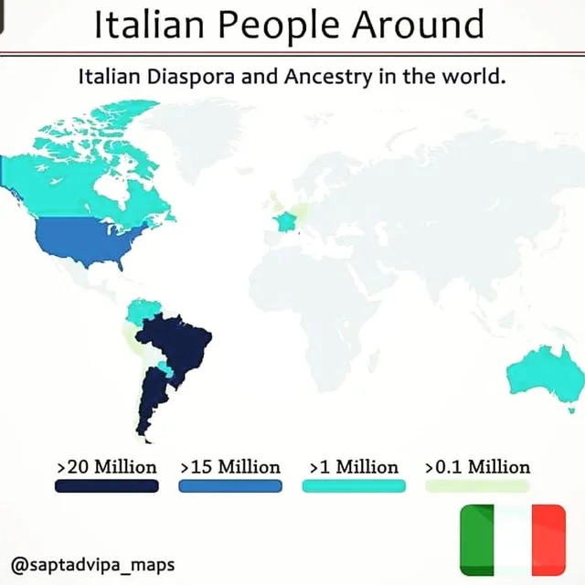

Slide 17
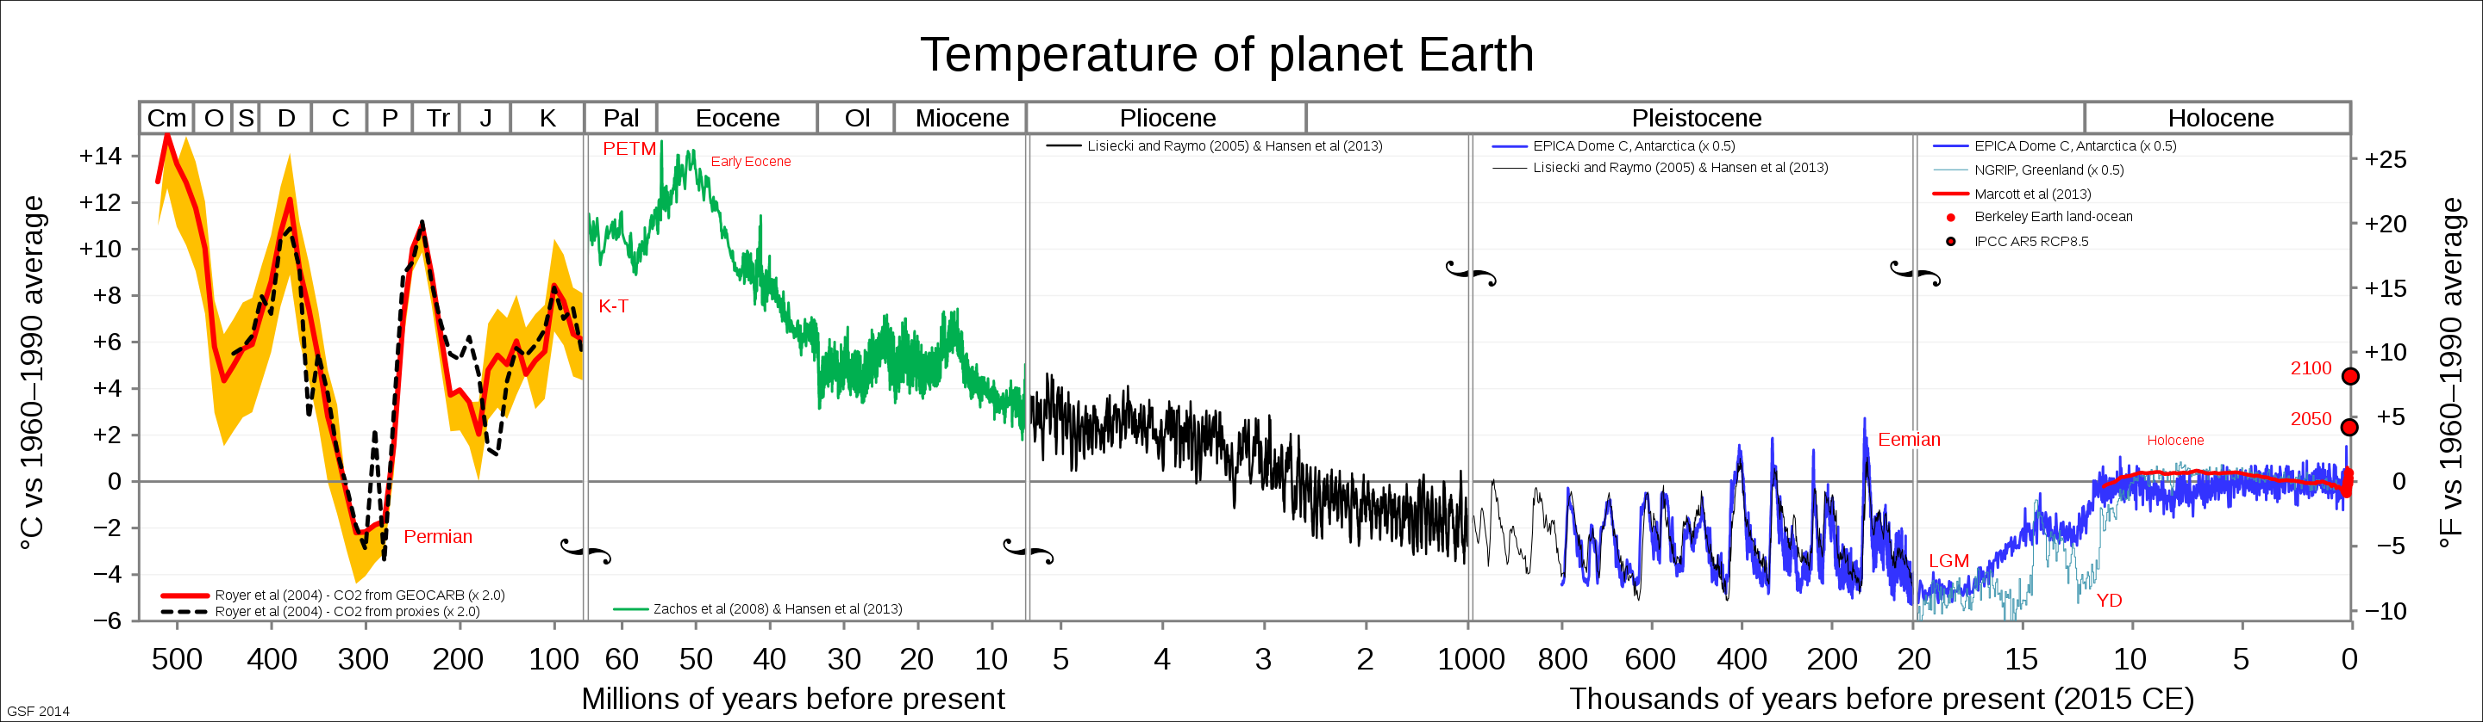
Glen Fergus https://commons.wikimedia.org/wiki/File:All_palaeotemps.svg

Slide 18
Dark Patterns
You've seen these. Maybe every day.
You can spend an hour looking into examples and typologies; these are deceptive design practices intended to manipulate behavior
After manipulation, publishers of evil content have legal cover. Users agreed to the terms!
Default basket can include optional extras, website won't accept the (advertised) cheapest option; unsubscribe buttons in a muted or white-on-white font. Consent forms that are hard to understand. Pretty clear why they aren't easy to understand.

Slide 19
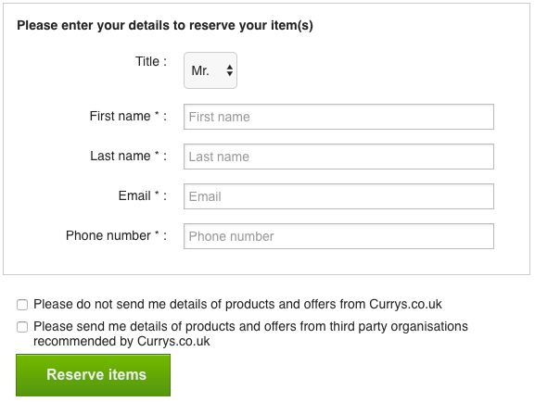

Slide 20
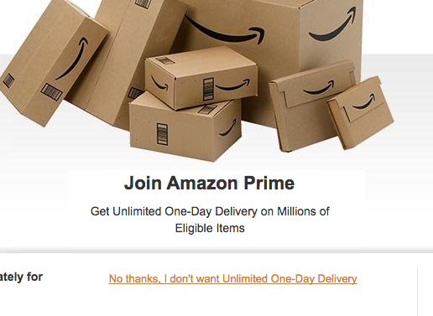

Slide 21
Next year?
Better editing of readings?
Better integration of readings?
Prompt discussion?
Sharing submissions / consent for sharing?
Communication of Uncertainty; Interaction; construction of Narrative

Slide 22
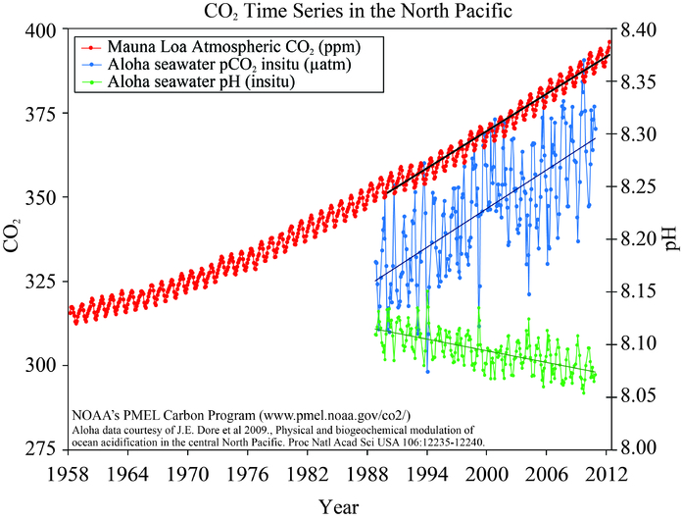
https://pmel.noaa.gov/co2/file/CO2+time+series

