Slide 1

Data 227
Data Visualization & Communication

Slide 2
Readings
Boreland, Taylor (2007) Rainbow Colormap (Still) Considered Harmful IEEE Computer Graphics and Applications 10.1109/MCG.2007.323435
Segel & Heer (2010) Narrative Visualization: Telling Stories with Data doi:10.1109/TVCG.2010.179
Liu (2018) Somewhere Over the Rainbow: An Empirical Assessment of Quantitative Colormaps doi:10.1145/3173574.3174172

Slide 3
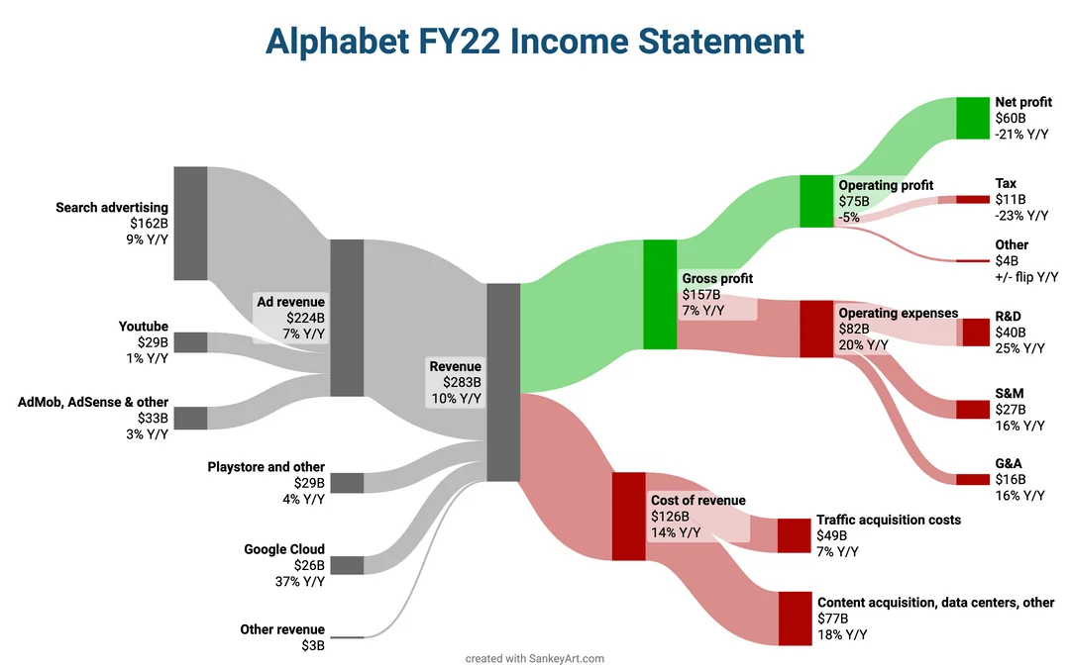

Slide 4
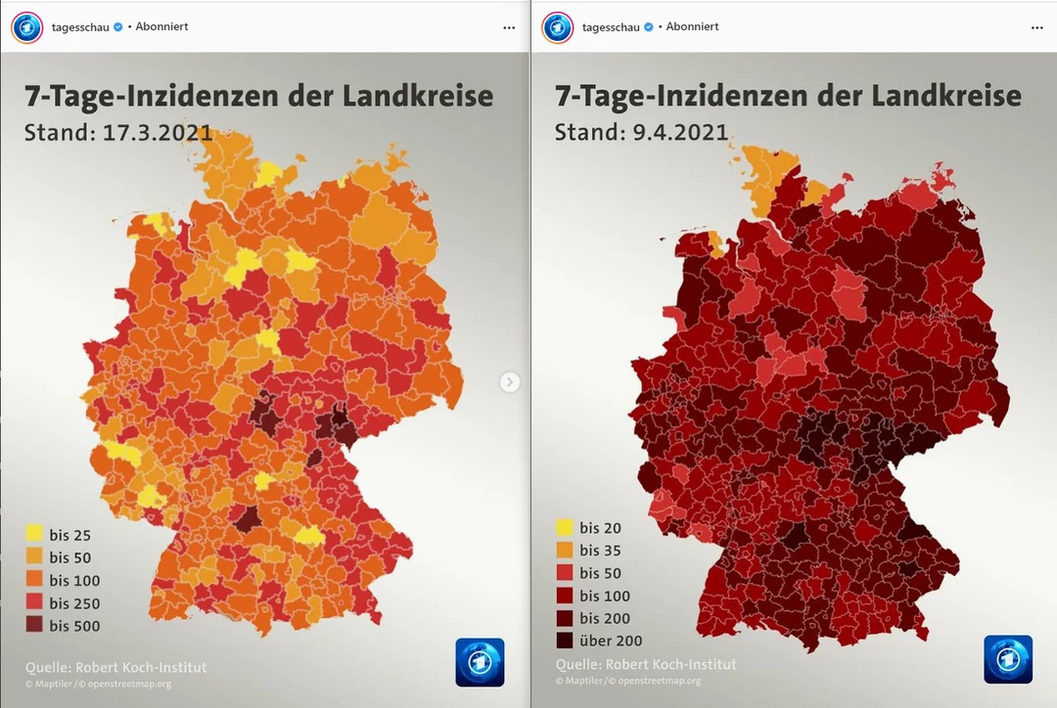
New Covid cases in 7 days per 100.000 people
https://www.instagram.com/p/CMh7JXuKRxX/
https://www.instagram.com/p/CNc5ooWIO8u/

Slide 5
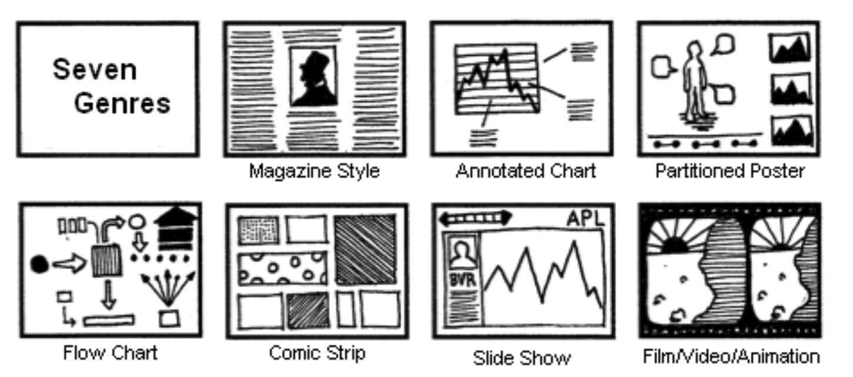
Narrative Visualization
(case studies+ some theory)

Slide 6
Some deceptive strategies
Inappropriate juxtaposition [dual-axis graph]
Count the wrong things [swap numbers that matter for numbers that are easy to obtain]
Encourage bad comparisons [take numbers out-of-context, provide bad context]
Post-hoc reporting about the extremity of the extremes
Study and report on the wrong things. Report audience-engaging matters that are irrelevant for decisionmaking. (moral panics?)

Slide 7
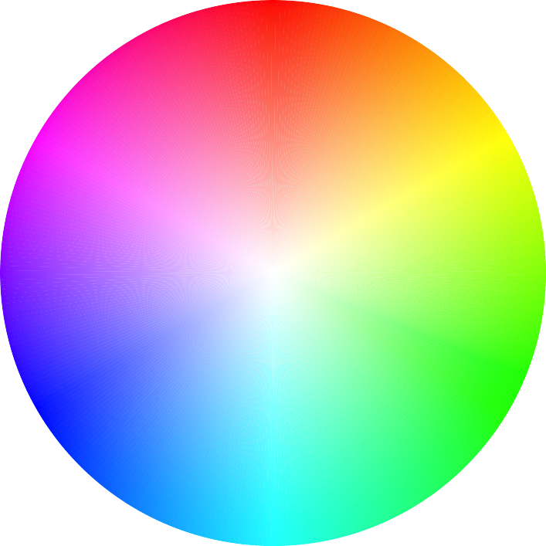
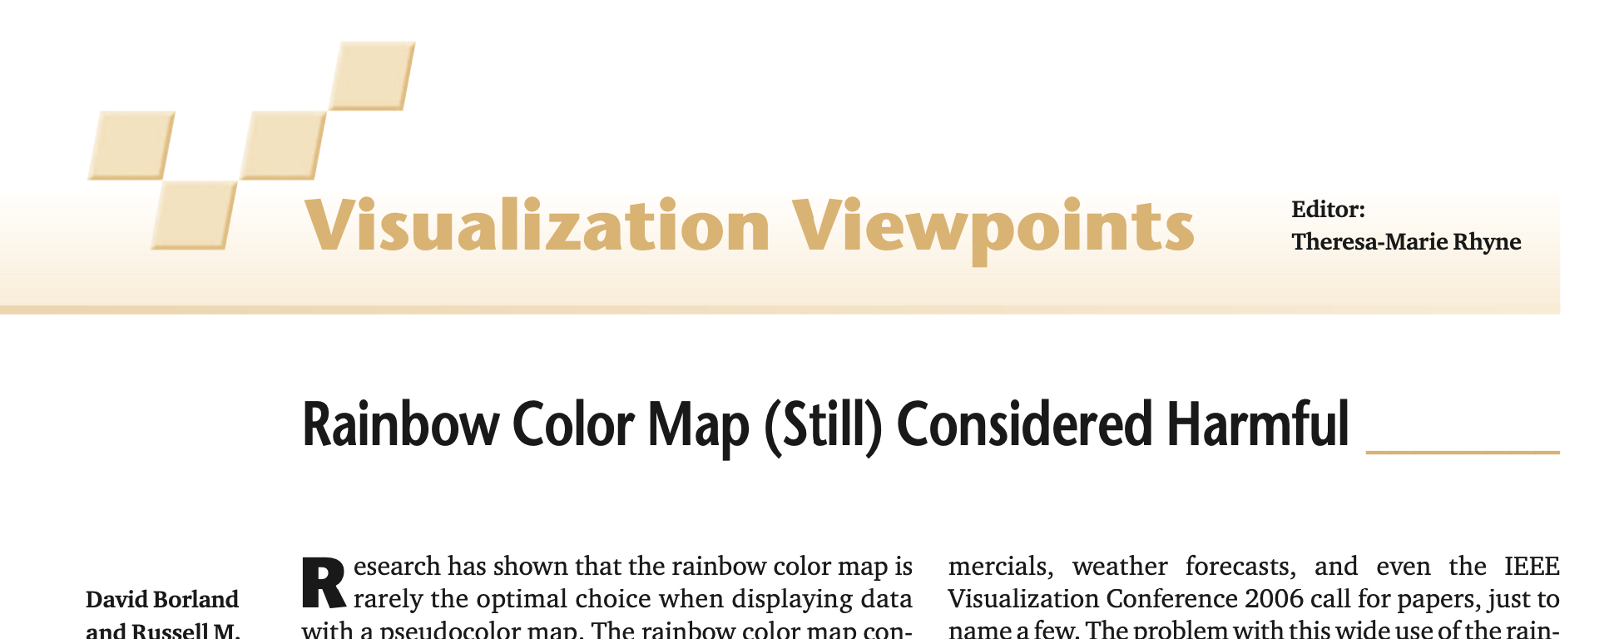

Slide 8
Rainbow is not perceptually ordered: the ordering is not completely universal or obvious. (empirical)
Luminance varies up and down in response to data.
Hues lead to perception of bands of color with sharp boundaries (not in the data)
For historical reasons, "jet" is a popular default rainbow colormap.

Slide 9
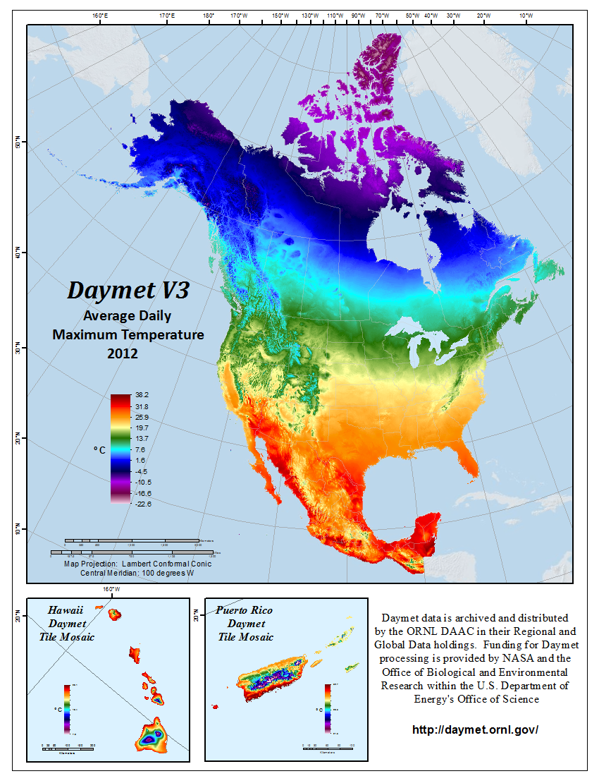

Slide 10
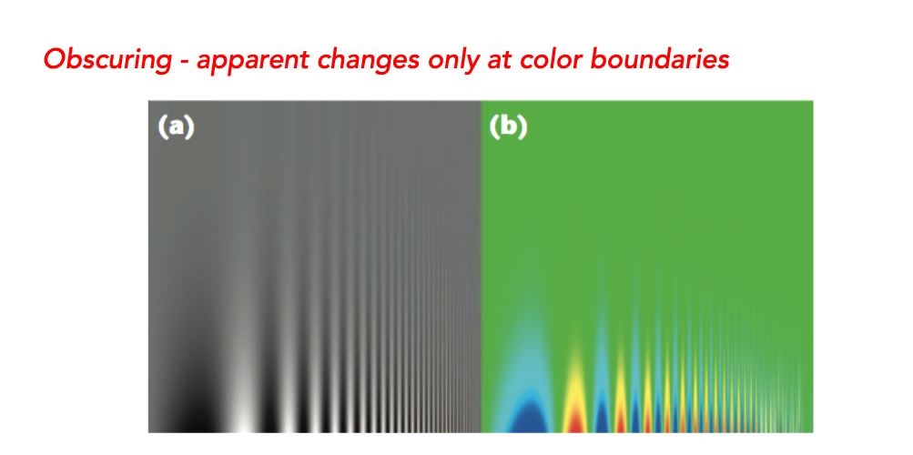

Slide 11
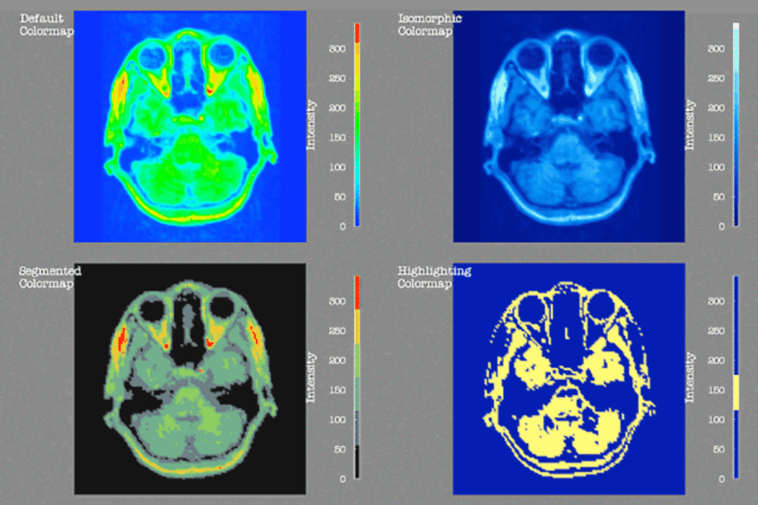
Rogowitz & Treinish, How Not to Lie with Visualization (1996)

Slide 12
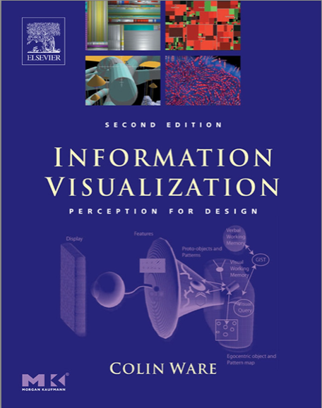

Slide 13
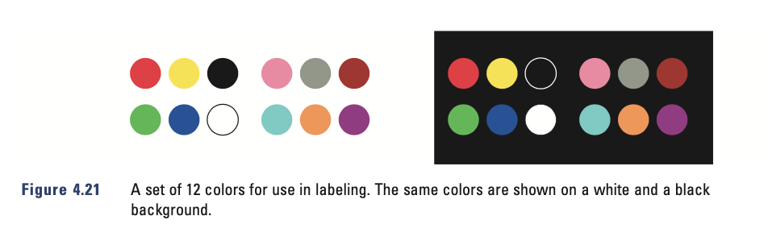
Ware, Information Visualization, Perception for Design 2004

Slide 14
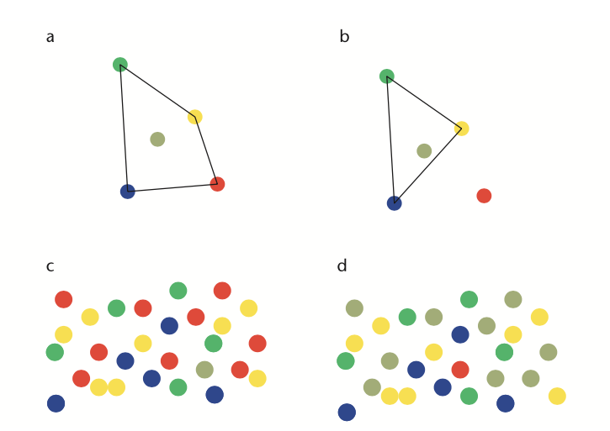
In principle, the CIE luv and lab color spaces estimate how discriminable color pairs are;
in practice, discriminability can be thwarted by collections of nearby colors:
Ware, Information Visualization, Perception for Design 2004

Slide 15
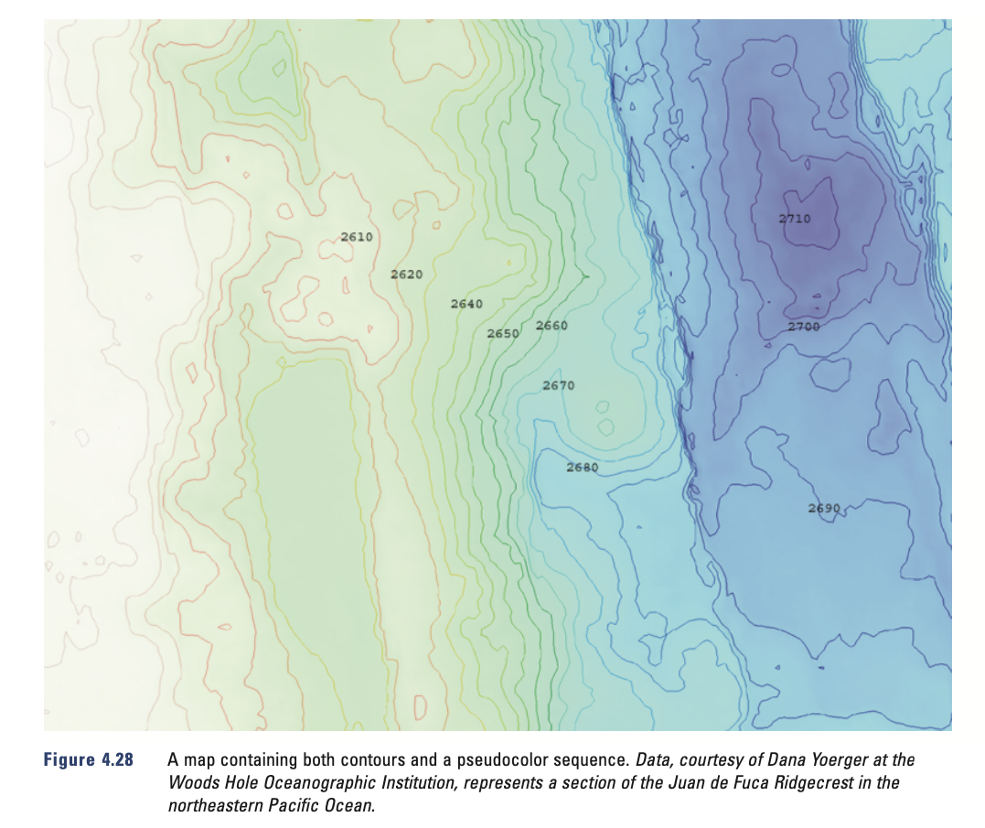

Slide 16
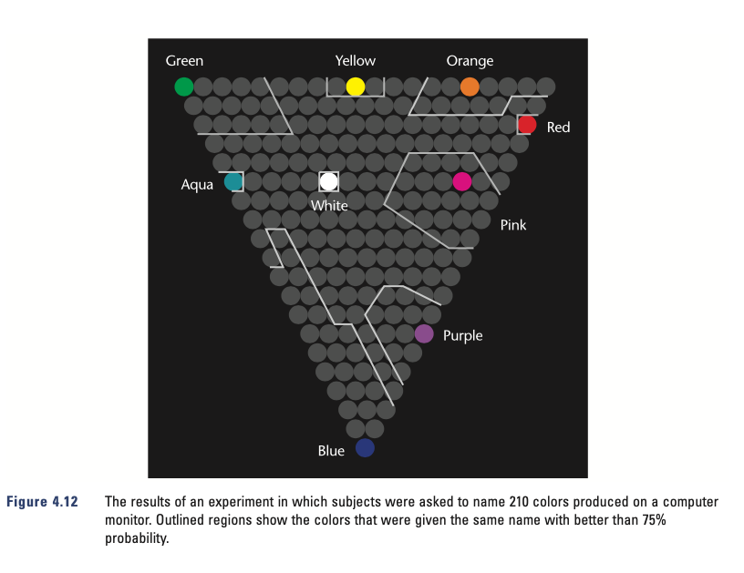

Slide 17
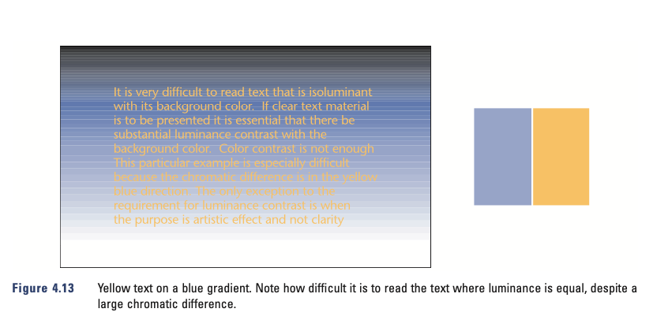

Slide 18
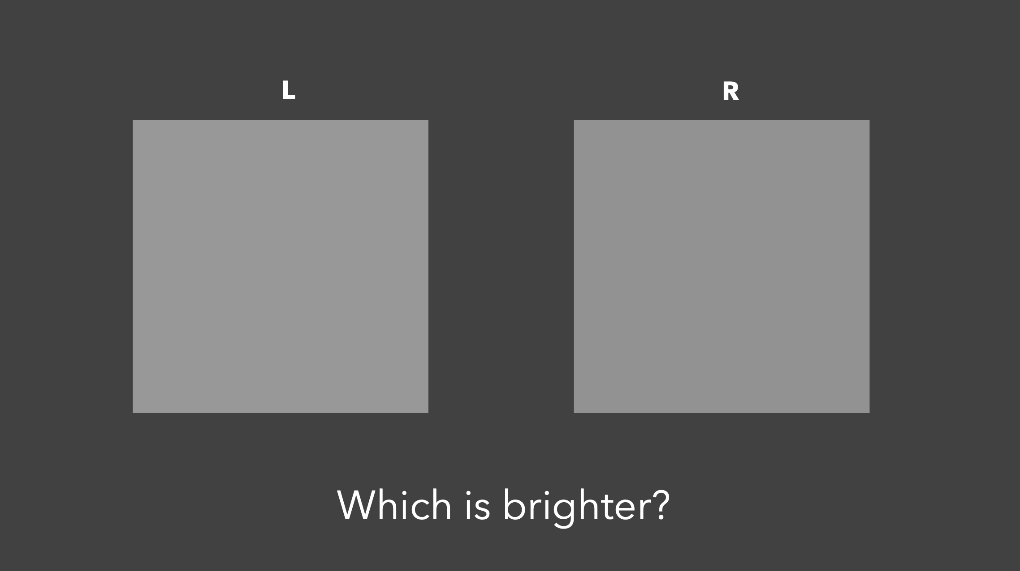

Slide 19
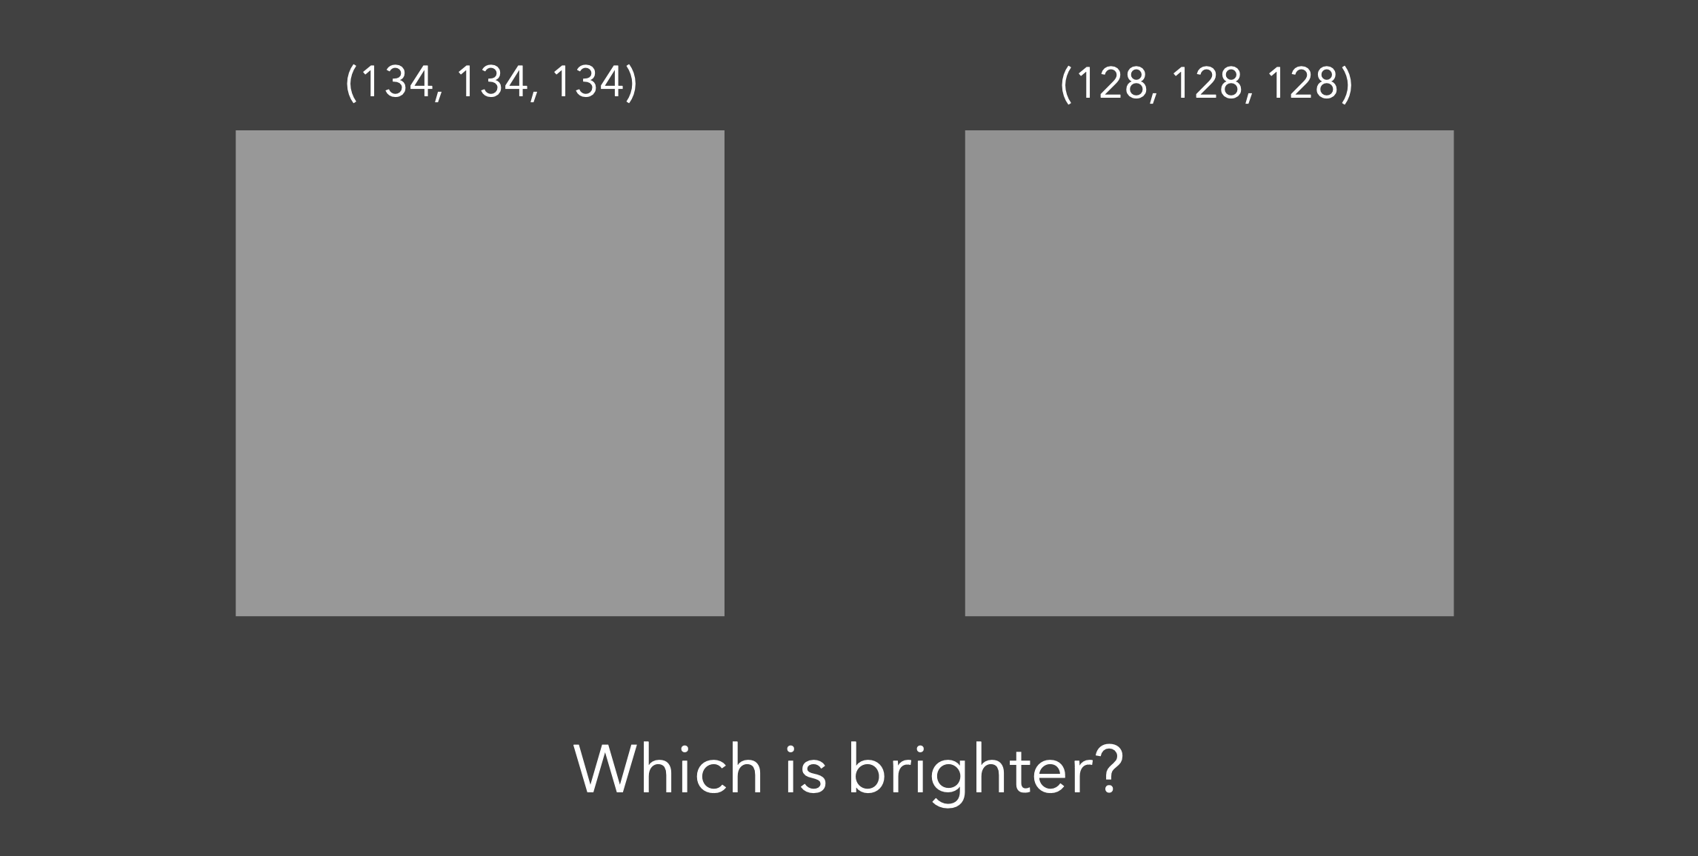

Slide 20
Luminance channel dominates
Better resolution for fine detail in luminance channel than in red-green and blue-yellow
Stereoscopic vision locks onto luminance
Always separate foreground from background by luminance, never just by color
Small symbols should have saturated colors; large areas of fill should have desaturated colors.
Use diverging colormaps where appropriate

Slide 21
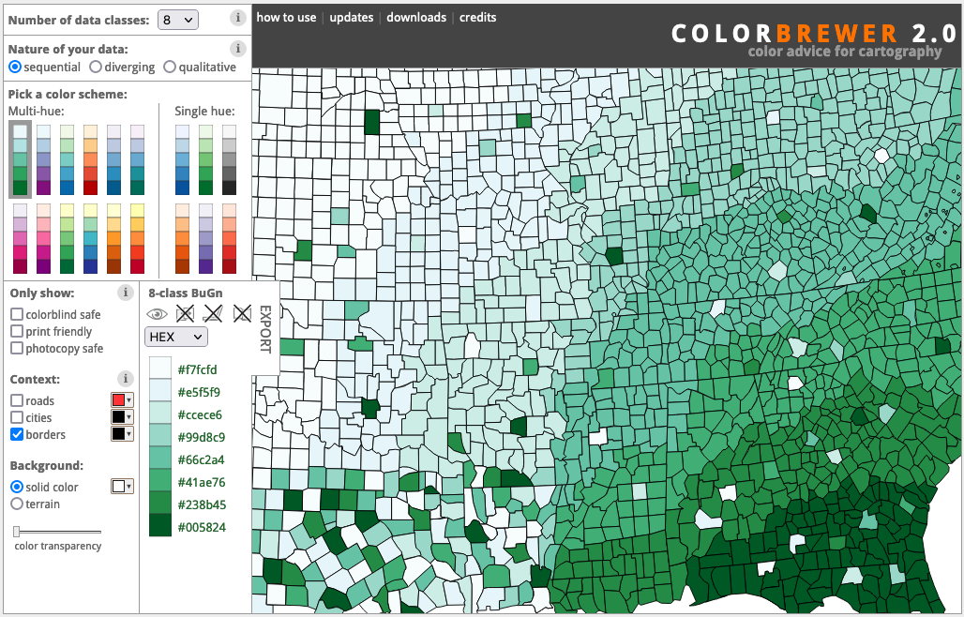

Slide 22
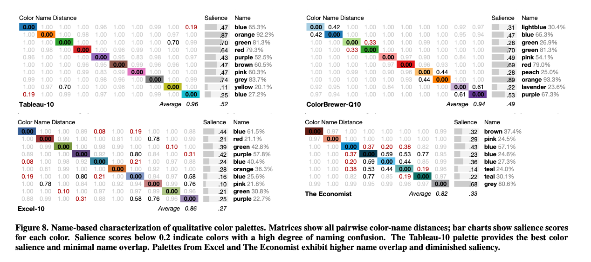
Color Naming Models for Color Selection, Image Editing and Palette Design
Heer, J. and Stone, M. CHI 2012

Slide 23
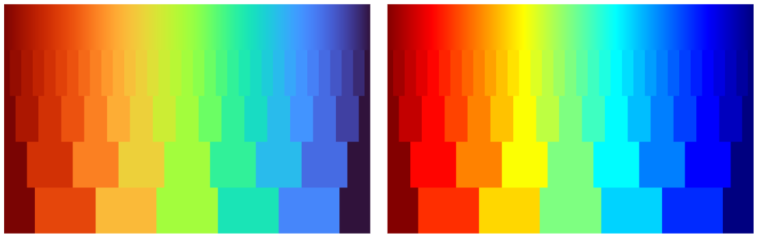
https://ai.googleblog.com/2019/08/turbo-improved-rainbow-colormap-for.html
Google “Turbo” colormap
Matlab “jet” colormap

Slide 24
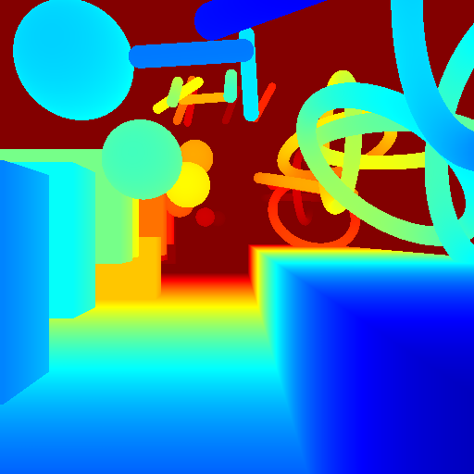
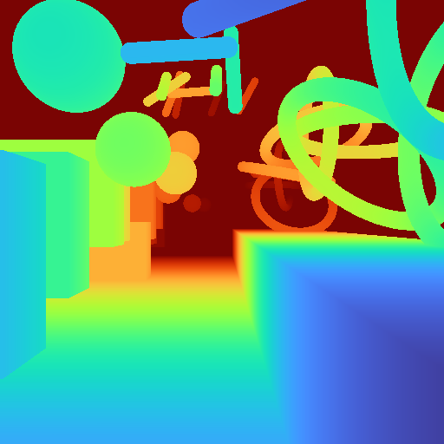
https://ai.googleblog.com/2019/08/turbo-improved-rainbow-colormap-for.html

Slide 25
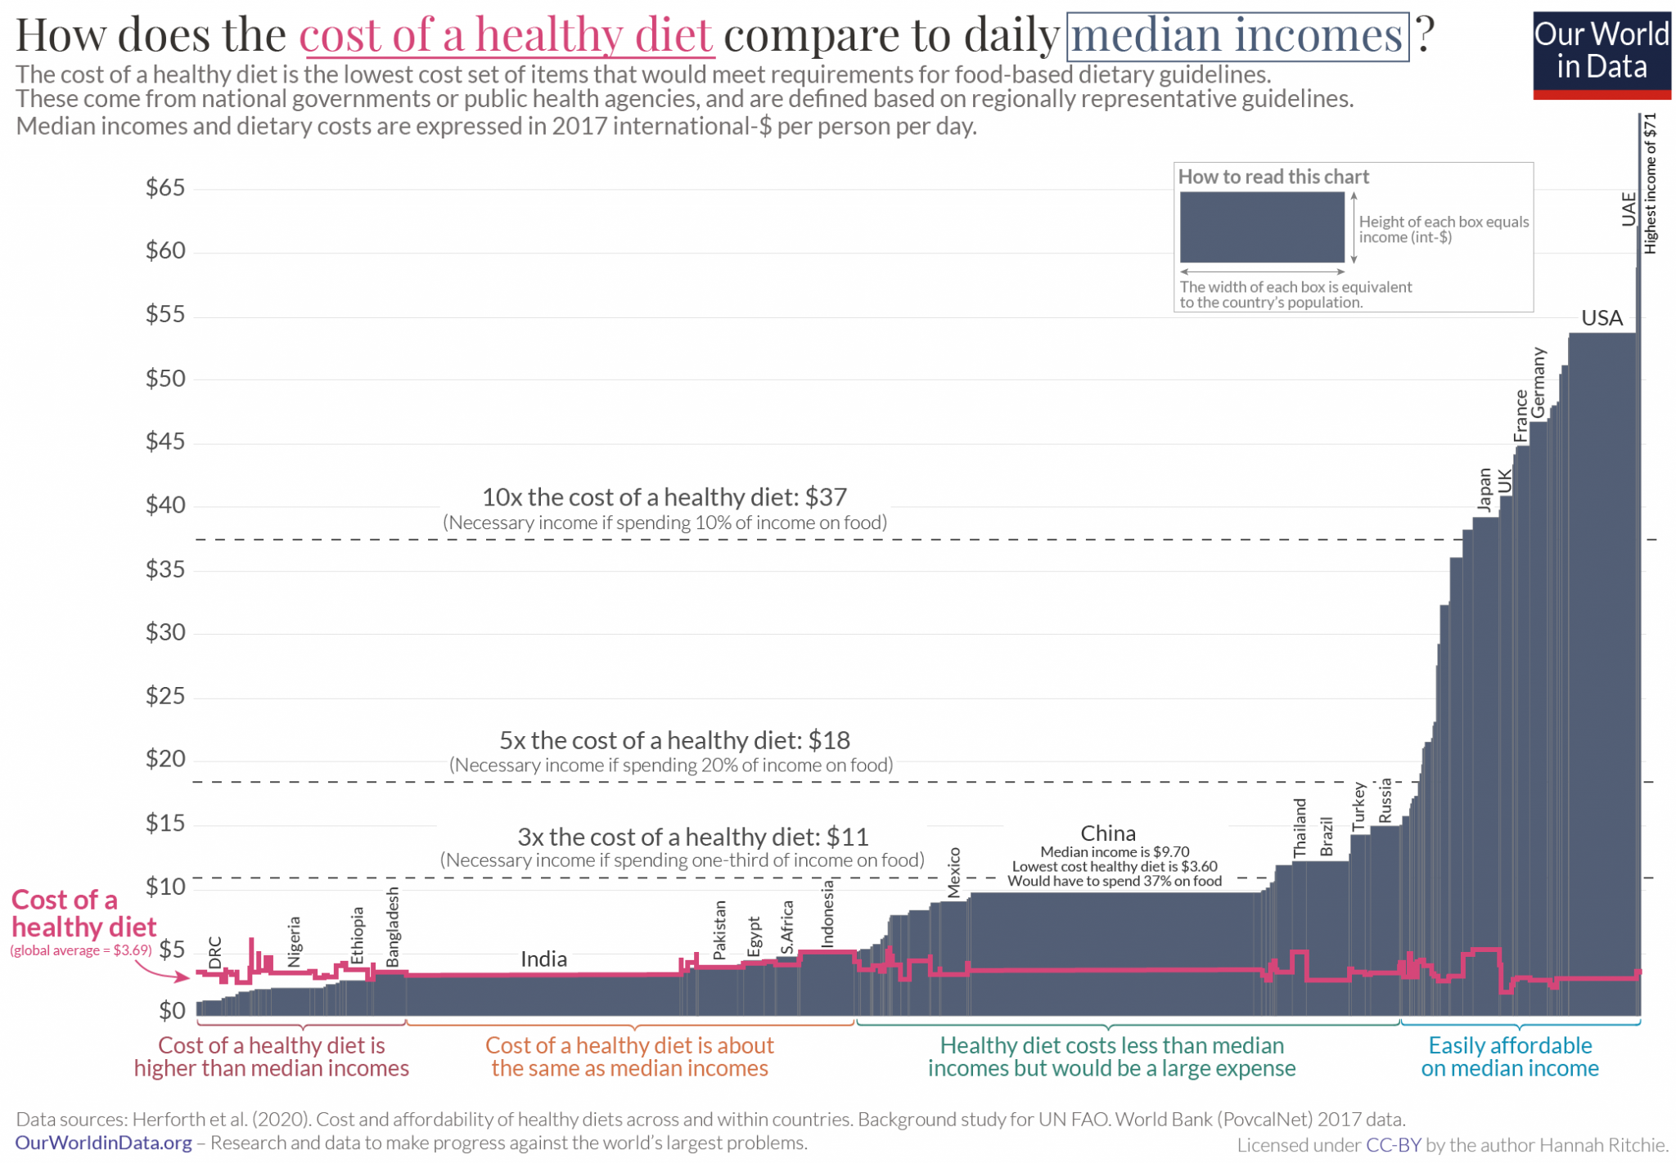

Slide 26
Writing captions/titles:
"This is a scatterplot" -- This is the alt text. Caption / title does not need to tell us the graph type.
WHAT is being plotted? "Weights"?
What is the scope of the thing being plotted? Geographical, temporal constraints. "Birth weight? of whom?" For CDC, that means YEAR and US.
Data source statement.
Captions can (optionally) include interpretation; the publisher's tradition will tell you whether to write 500 word captions or 50 word captions.

Slide 27
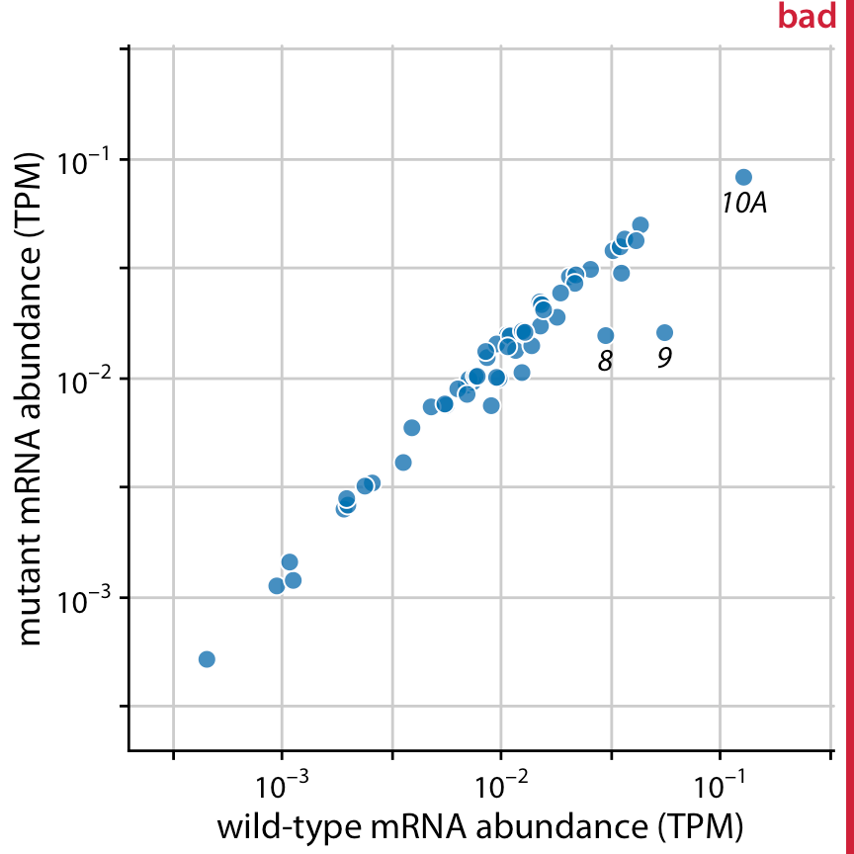
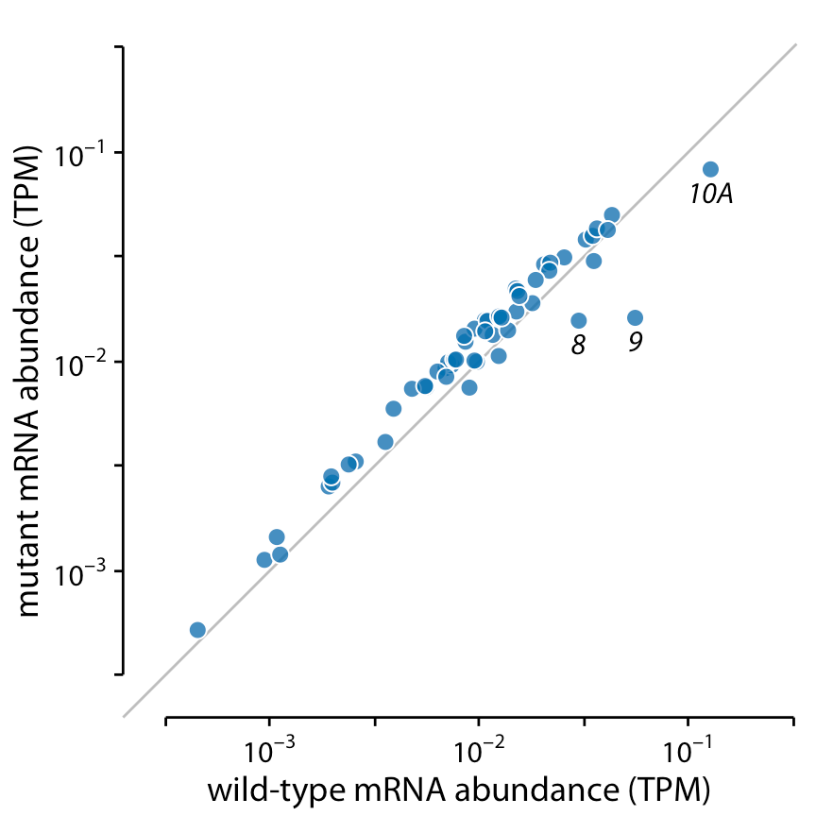
Provide context
https://clauswilke.com/dataviz/balance-data-context.html

Slide 28
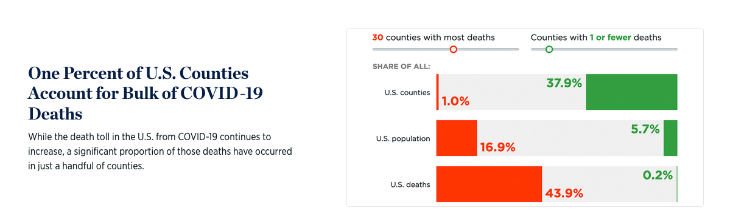
One percent of US Counties...
https://datavisualizations.heritage.org/public-health/one-percent-of-us-counties-account-for-bulk-of-covid-19-deaths/

