Slide 1
(My audio recording wasn’t working! But the information on these slides is what I was preparing to present. Thanks!)

Slide 2
Demographics of the Uninsured Population of Wake County, NC (2019)
Using the Census Bureau’s 2019 American Community Survey
As presented to the CDC judging team
October 2021

Slide 3
Contents
01. Overview
02. Gender & Age
Wake County’s population and amount of uninsured, compared to NC at large
Uninsured population of Wake County broken down by categorical variables
03. Race, Education, Employment
04. HIU Income
05. Implications
Uninsured population of Wake County, broken down by socioeconomic variables
Discussion of potential QHP-eligible uninsured adults in Wake County
Suggestions for NC health insurance policy

Slide 4
Overview
Wake County (% of NC)
North Carolina
Total Non-Elderly Population (Excluding Undocumented): 924,700 (11%)
Uninsured Population (Excluding Undocumented): 80,400 (8%)
Percent Uninsured: 9%
Total Non-Elderly Population (Excluding Undocumented): 8,417,500
Uninsured Population (Excluding Undocumented): 996,500
Percent Uninsured: 12%
Overall, Wake County has a lower percentage of uninsured individuals (9%) when compared to the state at large (12%).

Slide 5
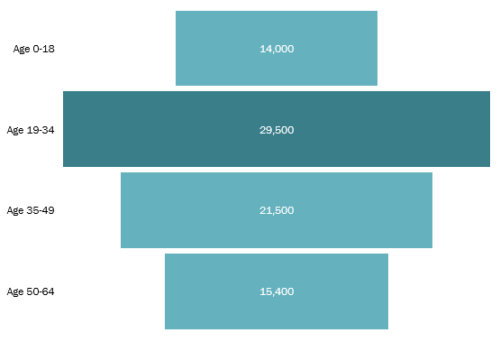
Gender & Age
The ratio of uninsured males to females in Wake County is 1.1 to 1.
Adults aged 19-34 make up the largest cohort.

Slide 6
Race, Education, Employment
White and Black Non-Latinos make up the largest proportions of the uninsured population, at 44% and 28% respectively.
Over half (56%) of uninsured individuals have a high school diploma.
Although there is no employment information for 26% of the uninsured population, most individuals work in info/finance or trade industries.

Slide 7
HIU Income vs Federal Poverty Level
According to the HHS, Qualified Health Plan (QHP) eligible uninsured adults are aged 19-24 and have a Health Insurance Unit (HIU) income > 138% of the Federal Poverty Level (FPL) in Medicaid expansion states.
North Carolina is not covered under this expansion, in which case the cutoff for eligibility is HIU income above 100% of FPL.
While this data set does not provide individual level information, estimating from the total numbers show that around 67% of the uninsured population in Wake County may qualify for QHPs, assuming the numbers are taken from adults 19-64.

Slide 8
Implications
Based on the data provided for Wake County, policymakers in health should focus on providing insurance to young adults (ages 19-34), which is the largest proportion of the current uninsured population. This follows the national trend, based on census data from 2019. However, policies like the Affordable Care Act have already taken steps to ensure that more young people have opportunities to become insured.
Additionally, seeking to find the relationships between socioeconomic factors and insurance coverage will uncover systemic issues with the way American health insurance is provided. This will need in depth review, such as through cross-sectional studies and checking trends over time.

