Slide 1
Spring Cloud Data Flow
Architecture
Wayne Lund
Notes:
In this section we will cover
The major components of Spring Cloud Data Flow
Go into some detail of each and a quick overview of what they do.
Registering apps

Slide 2


Spring Cloud Data Flow
DSL/Shell
REST-API/Dashboard
Flo Visual Designer
Spring Cloud Stream
Spring Cloud Task
Spring Integration
Spring Boot
Spring Batch

Slide 3
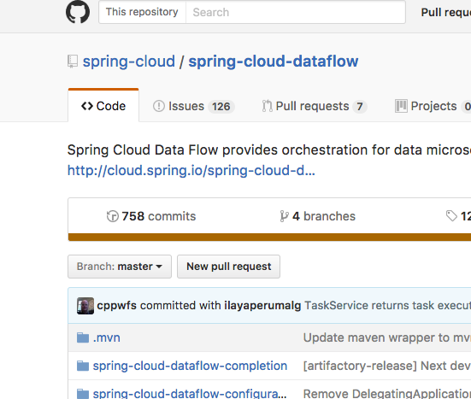

CODE IS ON GITHUB
https://github.com/spring-cloud/spring-cloud-dataflow

Slide 4

JAR LINK
http://repo.spring.io/release/org/springframework/cloud/spring-cloud-dataflow-server-local/1.2.0.RELEASE/spring-cloud-dataflow-server-local-1.2.0.RELEASE.jar
Notes:
https://flic.kr/p/9Bkxjo

Slide 5

Reference Docs
http://docs.spring.io/spring-cloud-dataflow/docs/1.2.0.RELEASE/reference/htmlsingle/
Notes:
https://flic.kr/p/8MVYfc

Slide 6
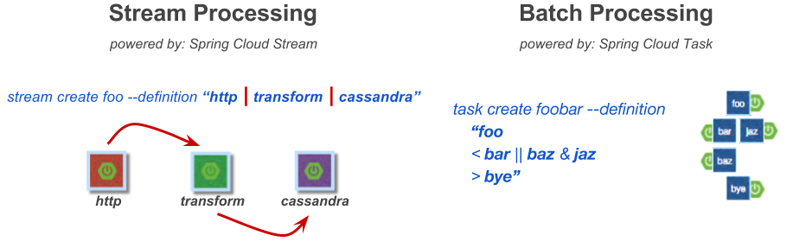
Spring Cloud Data Flow is
an orchestration service for composable microservice
applications on modern runtimes
Notes:
foo && < bar &&baz ||jaz> && bye
So as we’ve discussed SCDF orchestrates the creation of composable microservice applications
Streams and tasks are composed of applications that are deployed on the platform

Slide 7
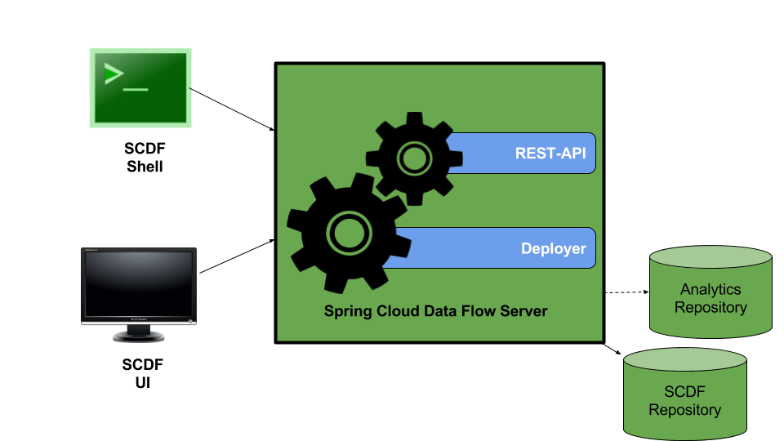
Notes:
Spring BOOT App
**** ADD BOOT LOGO****
7 Components of the Spring Cloud Data Flow Server
Server -
REST-API
Deployer
SCDF-UI
SCDF Shell
SCDF Repository
Analytics Repository

Slide 8
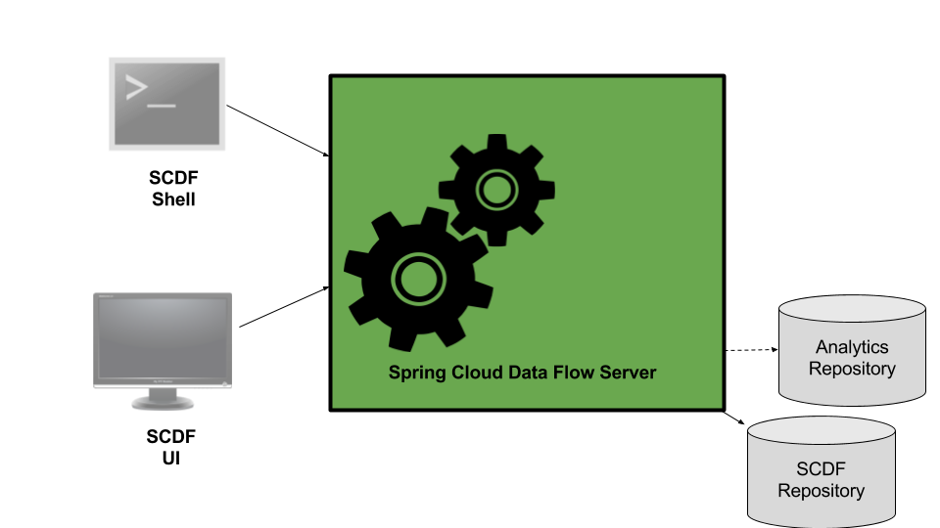
Notes:
What is the Data Flow Server
The Data Flow Server uses an embedded servlet container and exposes REST endpoints for creating, deploying, undeploying, and destroying streams and tasks, querying runtime state, analytics, and the like.
Allows us to deploy the applications that compose a stream. Or an launch application(s) for a task
Via a restful-API or UI allows users to retrieve the state of the apps of a stream or task.
Offers the ability to view the current values of the analytics
Stores the the URI’s of where to obtain the application.
Stores the definitions for all the tasks and streams

Slide 9
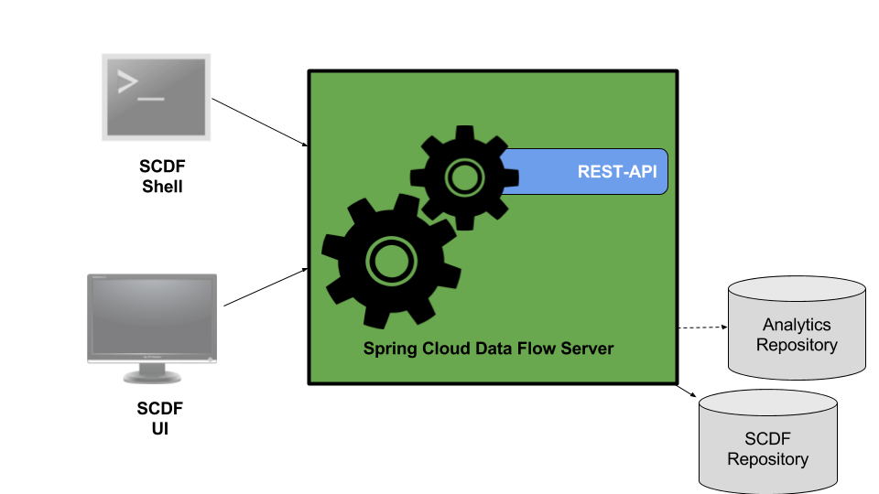
Streams
Runtime
Tasks
Jobs
Metrics
Notes:
Restful interface is offered from the SPI and thus all implementations support it.
This is good for CI implementations
Is build on Spring HATEOAS so it supports HATEOAS principles
Client doesn’t have to have prior knowledge of the server
The endpoints are broken down into the following categories:
Streams
Runtime
Tasks
Jobs
Metrics

Slide 10
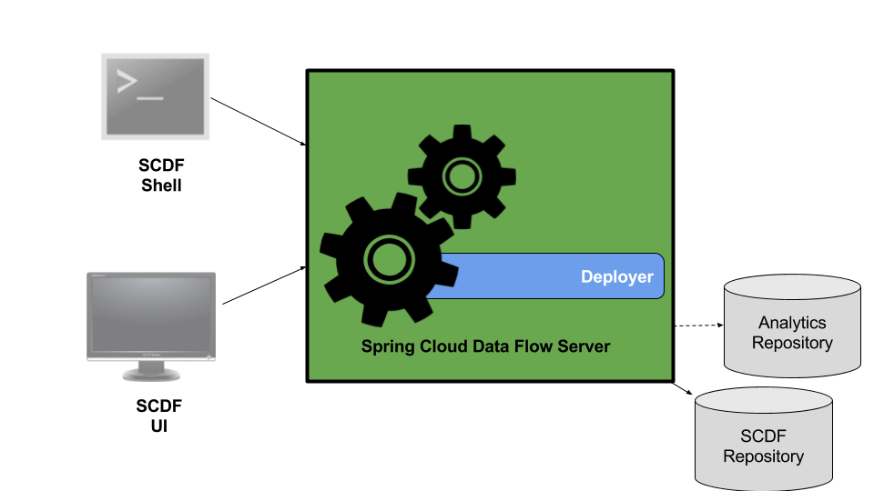
CF
Mesos
Kubernetes
Yarn
Local
Others have been added by the community
Notes:
Spring Cloud Deployer
Provides a common means to deploy applications to a platform
Based on the Spring Cloud Deployer project https://github.com/spring-cloud/spring-cloud-deployer
Each Spring Cloud Data Flow Server implementation uses one deployer. The current deployers that we support are:
CF
Mesos
Kubernetes
Yarn
Local
Others have been added by the community

Slide 11
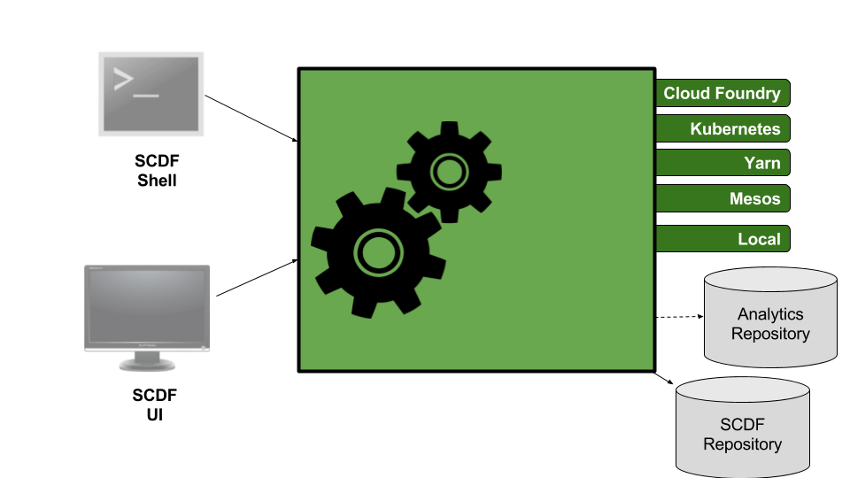
Notes:
SCDF Server Types
Spring Cloud Dataflow has a separate server for each deployment type.
Cloud Foundry - https://github.com/spring-cloud/spring-cloud-dataflow-server-cloudfoundry
Mesos - https://github.com/spring-cloud/spring-cloud-dataflow-server-mesos
Yarn - https://github.com/spring-cloud/spring-cloud-dataflow-server-yarn
Kubernetes - https://github.com/spring-cloud/spring-cloud-dataflow-server-kubernetes
Local -SPI
But all are based on the Spring Cloud Data Flow SPI - https://github.com/spring-cloud/spring-cloud-dataflow
Can you support multiple platforms on a single SCDF instance?
The answer is no. Each server supports only one platform.
Why we are using Local
Meant for development purposes
Wanted to run it locally on your Machines
Wanted fast deployment to speed up labs
Wanted simple install (Yarn isn’t easy to install)

Slide 12
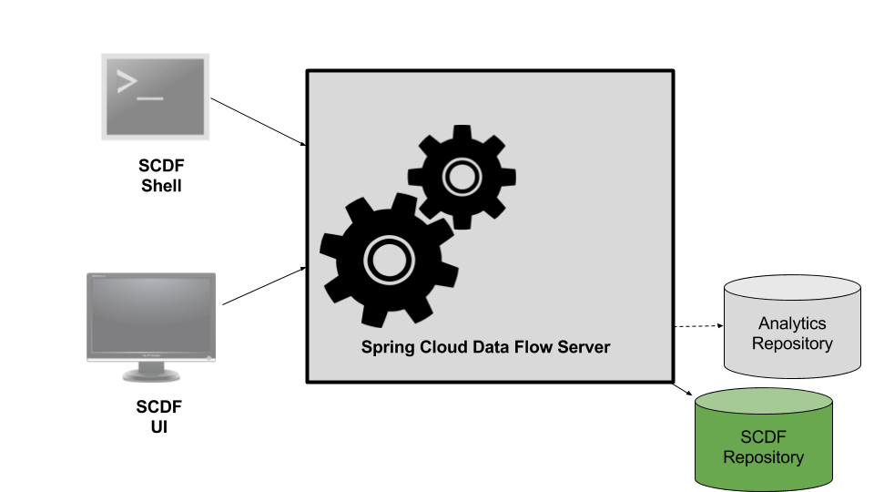
Notes:
SCDF Repository
Is an external relational database that stores:
Stream Definitions
Task Definitions
URI’s to the apps
Task Execution Statuses
Job Statuses
By default Local uses an embedded H2 database
Currently supported (out of the box) H2, HSQLDB, MySQL, POSTGRESQL

Slide 13
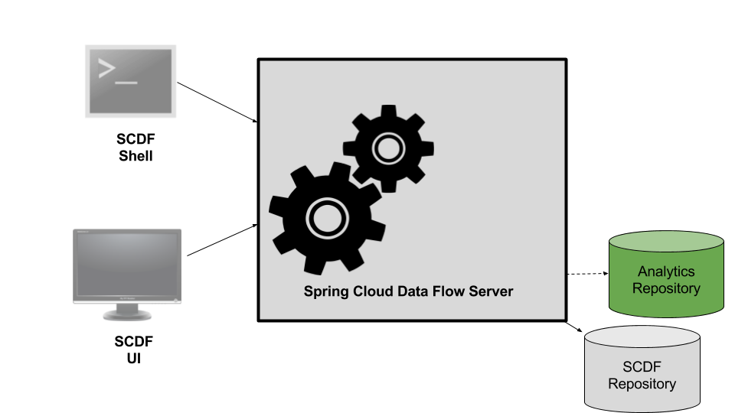
Notes:
Analytics Repository
Is an external Redis database that stores:
Counts
Aggregate-Counters
Field Value Counters

Slide 14
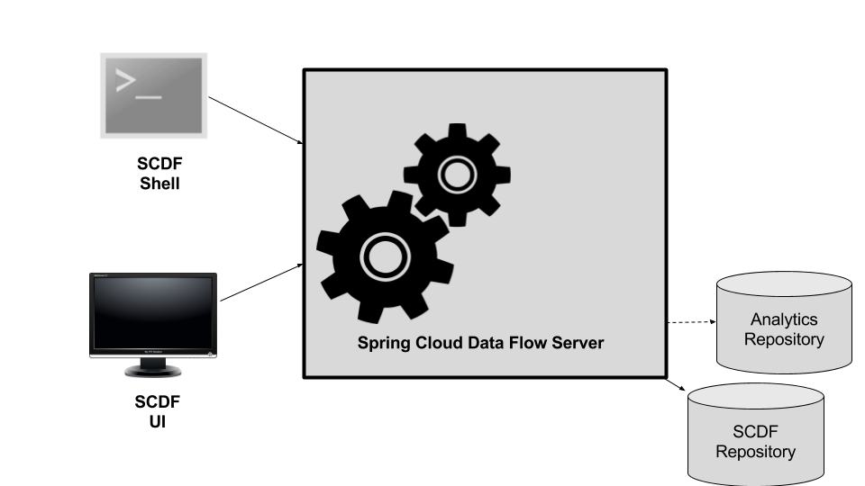
Notes:
SCDF UI
Offers an UI interface to the features offered by the RestfulAPI
Accessible via the /dashboard endpoint ie. localhost:9393/dashboard
Stream Creation, destruction and monitoring
Task Creation, destruction and monitoring
App registration
Metrics montoring
Job Monitoring

Slide 15
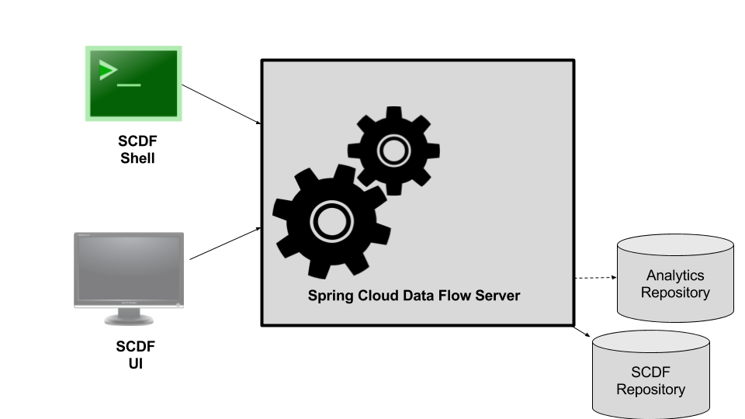
Notes:
SCDF Shell
Offers a command line interface to interface with the Restful API
The shell has no real knowledge of the SCDF except what it gets from the Spring Cloud Data Flow Server
Since it is a stand-alone app it can connect to any SCDF server that has its Restful API available for access
By default it looks at localhost:9393/

Slide 16

Notes:
Now we have the basic components that makeup a SCDF Server.

Slide 17

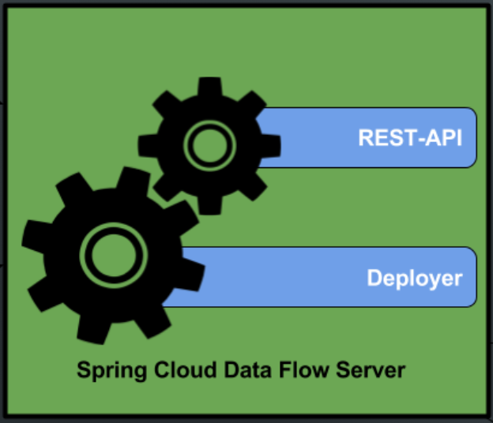
http | log
time | log
foo | bar | bar
Notes:
Deployment Strategy 1 Run SCDF externally to the platform

Slide 18
http | log
time | log
foo | bar | bar
Your
Preference
Notes:
Deployment Strategy 1 Run SCDF on the platform

Slide 19
Demo: Starting up Data Flow
Notes:
Startup Data Flow Server
Startup Shell
Startup Rabbit

Slide 20

Security!
Notes:
Https
Basic Authentication via LDAP or File based
Single Sign On OAuth
Authorization will be added on 1.2
https://flic.kr/p/igAH3a

Slide 21

Configuration
Notes:
Setup using typical Boot properties
Environment
command line
yaml
set location of yams file by using the following config: spring.config.location=<wherever>/application.yml
etc
https://flic.kr/p/oEFEGs

Slide 22

But, where are my apps?
Notes:
We invision using apps from a market place for apps.
You may have special team that generates a specific type of apps and then you can re-use those apps.
i.e. DataScience Apps
As we just discovered there are no apps
Spring Cloud Data Flow out of the box does not have a default set of apps that are available.
You can register the apps that you want or
You can import from our Spring Cloud App Starters if you wish to have a base set
app import --uri http://bit.ly/Bacon-RELEASE-stream-applications-rabbit-maven
Now you can list the apps by executing an app list
Get the details about a specific app i.e. app info <apptype>:appName
Unregister the app. App unregister --name appName --type apptype
App registration does not mean that the app has been pulled down to your server(when using https or maven).
It is only pulled into the maven repo or to file system when you deploy a stream, launch a task or execute app info
https://flic.kr/p/9zUCyn

Slide 23

app register --name http
--type source
--uri maven://org.springframework.cloud.stream.app:http-source-rabbit:1.1.1.RELEASE
Notes:
Registration sample
The registration command looks like the following: app register --name <yourappname> --type=<task,source,sink,processor> --uri=<thelocationofyourapp>
We currently support the following URI resources for looking up the app
File
Http
Maven
Docker
https://flic.kr/p/9YxwXp

Slide 24

To Download or not to download?
Notes:
Not yet.
If the jar uses a maven resource it will not pull down that jar (if it is not already in the repo) until:
deploy a stream that uses it
Execute an app info

Slide 25
app import
--uri file:///tmp/my-apps.properties
task.foo=file:///tmp/foo.jar
task.bar=file:///tmp/bar.jar
Notes:
I can register one app at a time or I can import them from a flat file or via http:
For example you can download our Spring Cloud App stream Starters app definitions for a basic set of apps from the shell:
app import --uri file:///tmp/my-apps.properties

Slide 26
app list
app info --id source:http
app unregister --name http --type source
Notes:
Once apps are registered we can exercise them a little bit.
app list - obtain a list of the available apps
app info - get detailed information about your application.
What properties does the app support
What is the apps resource location
Note: the first time the app is access either by deployment or app info, it will take longer if it has to pull it from a remote location.
Finally Remove the app from the registry

Slide 27
Demo: App Registration
Notes:
Import apps
App list
App info
Create basic stream
Deploy stream
Show where results go

Slide 28

The
Comparison
Notes:
Differences between SCDF and other platforms
Apache Spark, Apache Flink, and Google Cloud Dataflow run on a dedicated compute engine cluster.
Compute engines gives these platforms a richer environment for performing complex calculations
But it introduces complexity of another execution environment that is often not needed when creating data centric applications.
You can real time data computations when using Spring Cloud Data Flow.
Refer to the analytics section in our docs.
Counting based use-cases
RxJava integration for functional API driven analytics use-cases, such as time-sliding-window and moving-average among others
Each of these require a application execution cluster (like XD).
Often, framework specific interfaces are required to be used in order to correctly “plug in” to the cluster’s execution framework.
As we discovered during the evolution of Spring XD, the rise of multiple container frameworks in 2015 made creating our own runtime a duplication of efforts. When there are multiple runtime platforms that offer this functionality already.

Slide 29
Lab 3 - Install Data Flow
DNDataFlow/labs/lab3/Lab3-InstallDataFlow.pdf

