Slide 1
Spring Cloud Stream

Slide 2


Spring Cloud Data Flow
DSL/Shell
REST-API/Dashboard
Flo Visual Designer
Spring Cloud Stream
Spring Cloud Task
Spring Integration
Spring Boot
Spring Batch
Notes:
Here’s the workshop roadmap again. In this session, we are going to review Spring Cloud Stream and the projects that it builds on.

Slide 3
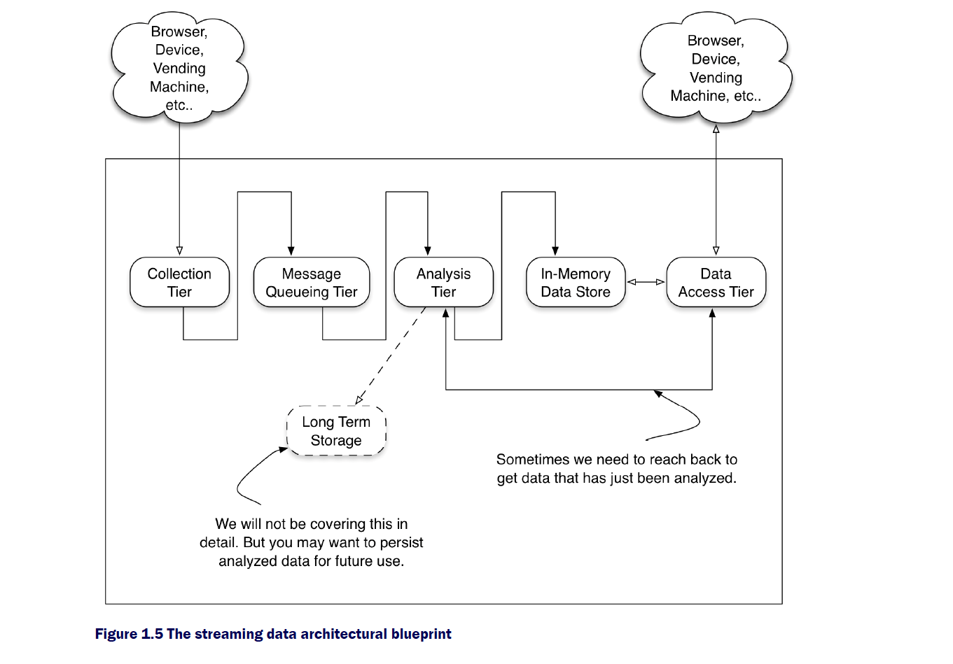
Streaming data architectural blueprint

Slide 4
Streaming data architectural blueprint
_{rabbitmq}
_{Kafka}
_{gemfire}
_{mongo}
_{cassandra}
_{Etc.}
_{redis}
_{src}
_{processor}
_{sinks}
_{hdfs}
_{greenplum}

Slide 5


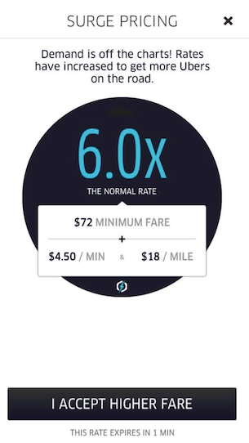



Data Insights
Recommendation
Insights
Performance
Insights
Strategic
Insights
ms —> s
s —> hrs
hrs —> wks
Notes:
In an enterprise setting, there is requirement to process data at various stages. Some require sub-second processing and there are cases for weeks to sometimes years worth of data that needs collected for larger strategic reasons.
To simplify this, let’s review this chart.
ms -> s processing requires insights right when the event occurred; users need immediate actionable insights to make decision. For example, think of amazon carts - you get recommendations such as “users who have bought this also bought 1, 2, 3 …”
At times we would need some data collection to make decisions such as optimizing your recommendation engine or for that matter think of a email marketing campaign - whether it works or not, you wouldn’t know until you’ve had some provable data points to back it. The optimizations on such campaigns can be incremental from then on.
The historical data along with real-time events tell a different story. A story that could relate to strategic decisions at the enterprise. Examples include “acquisition of a company to fill the growing demands”, “expanding line of products to be more lucrative” etc.

Slide 6
Requirements for Real-time Insights
Real-time Data Processing | High Throughput | Grouping | Async Interaction
Heterogeneous Data Processing | Low Latency | Ordering | Command Query Responsibility Seggregation
 | Resiliency | Partitioning | Event Sourcing
 |  | Windowing
Notes:
Now that we have a general idea about enterprise data and the various stages they add value to the business, let’s review what streaming data requirements are. The business requirements that need sub-second to seconds decisions.

Slide 7



Streaming = Long Running
Spring Integration
enables lightweight messaging within Spring-based applications and supports integration with external systems
Spring Cloud Stream
enables you to create powerful event-driven streaming data applications with a minimal amount of coding

Slide 8

Programming Model
Source
Processor
Sink
@EnableBinding(Source.class)
@SpringBootApplication
public class SourceApplication {
..
..
}
@EnableBinding(Processor.class)
@SpringBootApplication
public class ProcessorApplication {
..
..
}
@EnableBinding(Sink.class)
@SpringBootApplication
public class SinkApplication {
..
..
}
Discover
Output
Channel
Discover Input and Output
Channels
Discover
Input
Channel
Auto
Configure
Discover
Binder
Bind
Producer
Auto
Configure
Discover
Binder
Bind
Producer and Consumer
Auto
Configure
Discover
Binder
Bind
Consumer
Discover
Type
Converter
Discover
Type
Converter
Discover
Type
Converter
@Poller
@Transformer
@ServiceActivator
@ServiceActivator
@StreamListener/ @SendTo
@StreamListener/ @SendTo
Notes:
A quick glance at 3 OOTB types of applications in SCSt. This is extendable; you can write your own interface with multiple channels in it, too. In other words, these 3 OOTB types aren’t the only ones possible via SCSt.
Since SCSt builds upon SI at its foundation, all that applies in SI can be leveraged here as well.
High-level annotations to interact with the payload offered by SI:
http://docs.spring.io/spring-integration/api/org/springframework/integration/annotation/package-summary.html

Slide 9
Programming Model Contd.
package org.springframework.cloud.stream.messaging; public interface Processor {
String INPUT = "input";
String OUTPUT = “output";
@Input(Sink.INPUT) SubscribableChannel input();
@Output(Source.OUTPUT) MessageChannel output();
}
@EnableBinding(Processor.class)
@SpringBootApplication public class UpperCase { @ServiceActivator(inputChannel = Processor.INPUT, outputChannel = Processor.OUTPUT) public Object uppercase(Object incomingPayload) { return incomingPayload.toString().toUpperCase(); }
}
Notes:
A deep-dive into the programming model. You’ll be doing this in the lab momentarily.
The Processor interface.
SCSt is backed by generic abstraction called “channels”. It is the channel through which the bindings to a topic/queue that occurs. The data flows through these channels backed by the messaging middleware.

Slide 10



Spring Cloud Stream Application
Input Messaging Channel
Messaging
Middleware
B
I
N
D
E
R
payload = foo
E
V
E
N
T
S
payload = FOO
upperCase()
Output Messaging Channel
Notes:
Read this visual from left -> right.
A lot of real-time events are happening; think of sensor data or the website clicks etc.
All of those events are reaching the messaging middleware and a SCSt application is subscribed to the topic where the messages land.
Being an event-driven application, the messages are continuously consumed by the applications through the automation of configuration and connection provided by SCSt framework.
Messages received by the applications are consumed by the “INPUT” channel and the business logic can be applied at this layer. The transformed payload is now pushed back to the messaging middleware via the “OUTPUT” channel for downstream processing.
In this example, we are seeing a simplistic use-case of payload transformation. A simple “upperCase()” example.

Slide 11
Demo: upperCase()

Slide 12
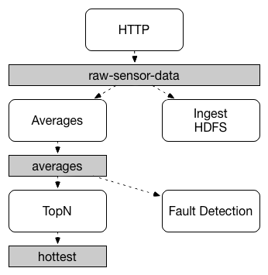
Concepts: Persistent Pub/Sub
Semantics
Primitives for streaming and event-driven
data processing
Notes:
With SCSt, you can build both streaming and event-driven applications.
A streaming pipeline to ingest, process and write data fragments as quickly as possible (eg., etl, streaming analytics)
An event-driven pipeline that kicks-off downstream processing (eg., event sourcing; async interaction)

Slide 13
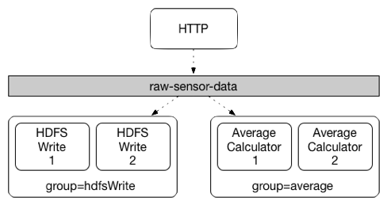
Concepts: Consumer Groups
Groups of competing
consumers within
the pub-sub
destination
Notes:
Inspired from Apache Kafka’s “consumer group” functionality, SCSt provides a similar capability at the binding mechanism.
When doing this, different instances of an application are placed in a competing consumer relationship, where only one of the instances is expected to handle a given message.

Slide 14
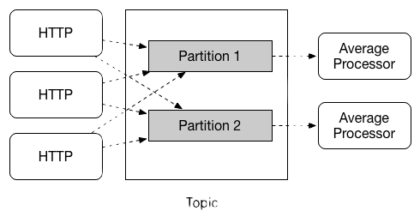
Concepts: Partitioning
Primitives for stateful stream processing
Notes:
When publishing a keyed message, the SCSt’s binding mechanism deterministically maps the message to a partition based on the hash of the key. This provides a guarantee that messages with the same key are always routed to the same partition.
Grouping/ordering is important when doing stateful stream processing.
Imagine an IoT use-case where there are millions of sensor devices are in the grid. The streaming pipeline should be in a situation to process the data that belong to each device/sensor correctly. You don’t want to process wrong sensor data and end up with wrong calculations, which of course would trigger wrong predictions - wrong insights - wrong business decisions.

Slide 15
Demo: Partitions & Consumer Groups

Slide 16







Binder Abstraction
Development
Experimental
Production
TEST BINDER
(only for dev)
Notes:
Lastly SCSt is built with binding mechanism at its core and there’s an abstraction put in place at this level.
Today, we recommend Apache Kafka or RabbitMQ as the messaging middleware for production setting. However, there’s few other options in various stages of release cadence.
Test binder is something you’d use in DEV. This is super easy for unit/integration testing
Experimental binders are in the process of graduating to a production quality binder
Of course, kafka and rabbit are ready to use in production

Slide 17
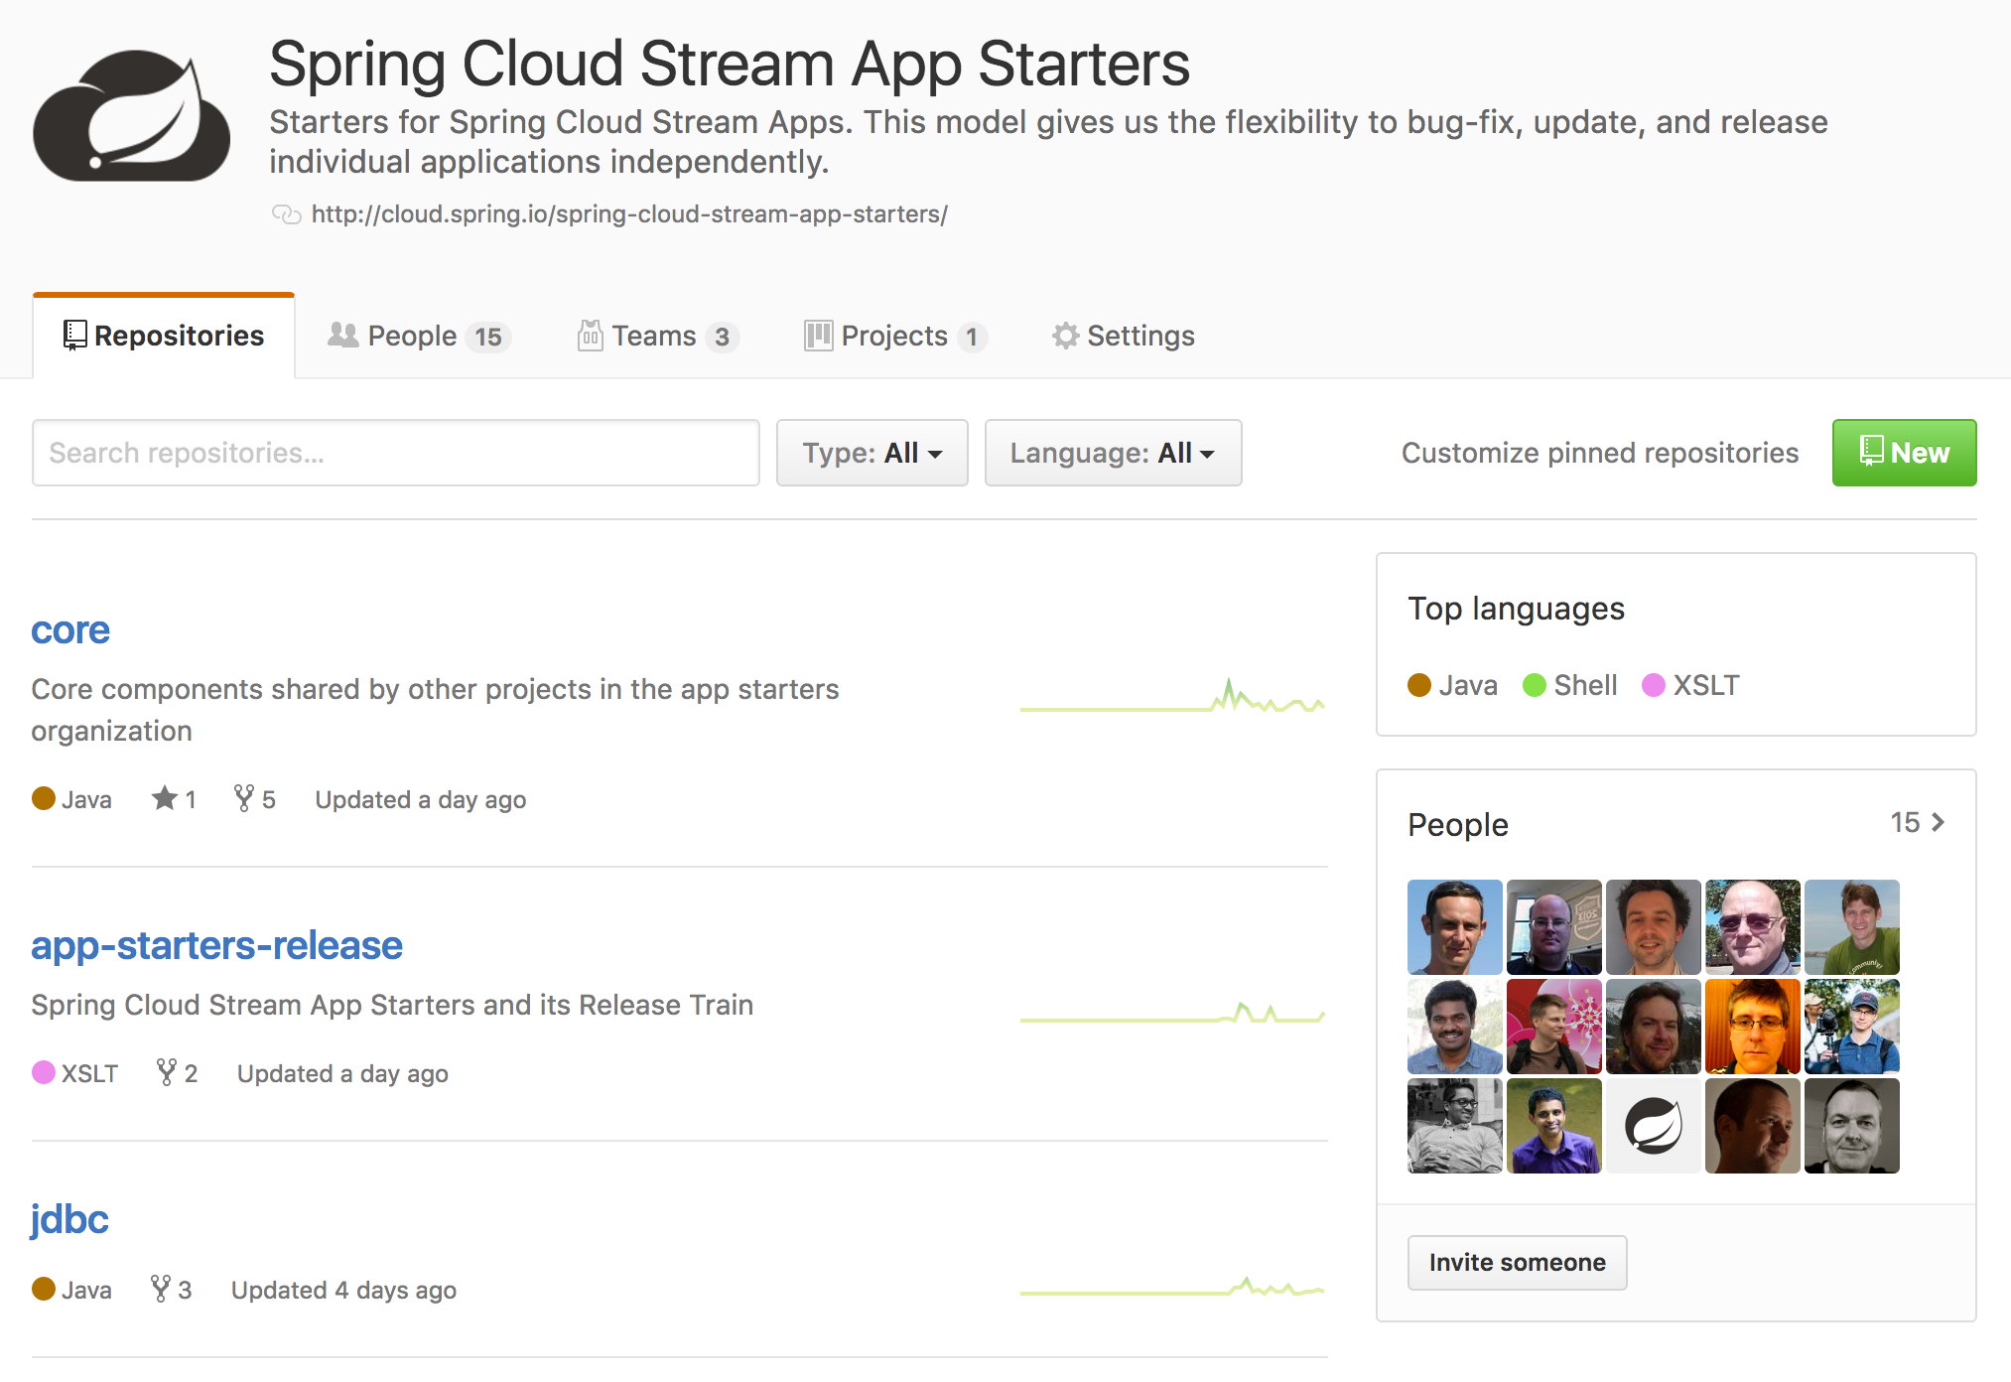
52 Application Starters & Counting!
https://github.com/spring-cloud-stream-app-starters

