Slide 1
Tasks

Slide 2


Spring Cloud Data Flow
DSL/Shell
REST-API/Dashboard
Flo Visual Designer
Spring Cloud Stream
Spring Cloud Task
Spring Integration
Spring Boot
Spring Batch

Slide 3

What is a Task?
Notes:
In SCSt what we see are LRP or long running processes
If they fail what they get restarted
And they run till they are shut down
Tasks are ephemeral
Once complete they stop.
The framework does not restart them.
Good when you need perform a certain amount of work then terminate
Reduced cost - Only charged for the run time they are up
Reduced need for resources.
https://flic.kr/p/8HDJ5B

Slide 4
What is
Spring Cloud Task?
Notes:
Spring Cloud Task is a Ephemeral microservice framework
Built on Spring stack:
Spring Boot: full-stack standalone apps, configuration
Provides features required for a task in a cloud environment
Common abstractions
Records the task state information in a datastore
Emits Task Event at start and stop of task
Job events as well
Provides listeners for before, failed, and after events for a task
https://flic.kr/p/8HDJ5B

Slide 5
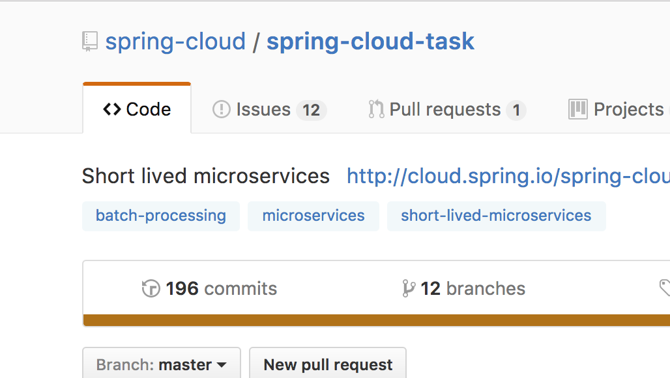

CODE IS ON GITHUB
https://github.com/spring-cloud/spring-cloud-task

Slide 6

Reference Docs
http://docs.spring.io/spring-cloud-task/docs/1.2.0.RELEASE/reference/htmlsingle/
Notes:
https://flic.kr/p/8MVYfc

Slide 7

Persists
Task Execution
Notes:
Persist Task Execution
Persists the TaskExecution event to RDBMS data store or in memory at
Task Start
Task End
To Enable:
spring-cloud-starter-task
Add boot-starter-jdbc dependency
Add database dependency
Creates TaskExecution on start
Updates TaskExecution entry upon completion
End Time
Exit Code
Exit Message
Error Message
https://flic.kr/p/7DUk5

Slide 8
@SpringBootApplication
@EnableTask
public class TaskApplication {
public static void main(String[] args) {
SpringApplication.run(TaskApplication.class, args);
}
public class TimestampTask implements
CommandLineRunner {
public void run(String... strings) throws Exception {
...
}
}
}
Notes:
So what we see is that it is a core Spring boot application that is using a CommandLineRunner.
The primary differentiator is that we have the annotation @EnableTask

Slide 9
<dependency>
<groupId>org.springframework.cloud</groupId>
<artifactId>spring-cloud-starter-task</artifactId>
</dependency>
<dependency>
<groupId>org.springframework.boot</groupId>
<artifactId>spring-boot-starter-jdbc</artifactId>
</dependency>
<dependency>
<groupId>org.mariadb.jdbc</groupId>
<artifactId>mariadb-java-client</artifactId>
</dependency>
Notes:
The dependencies above provide the following:
spring-cloud-starter-task Auto configures the boot application to be a task
spring-boot-starter-jdbc Auto configures a datasource for the application and by default task will use it as well.
mariadb-java-client Establishes what database driver to use for your application. In this example we are using the opensource driver for mysql.

Slide 10

Emits Task Events
to a Stream
Notes:
Task Events
Emit TaskEvent via Spring Cloud Stream channel
Task Start
Task End
Automatically enabled when SCSt dependency is added for example
https://flic.kr/p/oHpnei

Slide 11
<dependency>
<groupId>org.springframework.cloud</groupId>
<artifactId>spring-cloud-starter-stream-rabbit
</artifactId>
</dependency>
Notes:
As we discussed earlier Spring Cloud Task can emit task events (Task Execution Start and End)
In those cases where we want our task to emit events I can add a starter stream to dependencies. And in that case we can emit the events to Rabbit, Kafka etc. In the case above it will be to Rabbit.

Slide 12

Emits Batch Events
to a Stream
Notes:
Batch Events
Emit BatchEvents via Spring Cloud Stream channel
job-execution-events
step-execution-events
chunk-events
item-read-events
item-process-events
item-write-events
skip-events
https://flic.kr/p/82tvyd

Slide 13

Remote
Partitioning
Notes:
Remote Partitioning
Spring Batch provides an SPI for partitioning a Step execution and executing it remotely.
Spring Cloud Task provides the infrastructure to allow a user to execute Batch Partitions on most cloud platforms.
This is done using Spring Cloud Deployer.
An example of this can be seen here: https://github.com/spring-cloud/spring-cloud-task/tree/master/spring-cloud-task-samples/partitioned-batch-job
https://flic.kr/p/dHH8ui

Slide 14
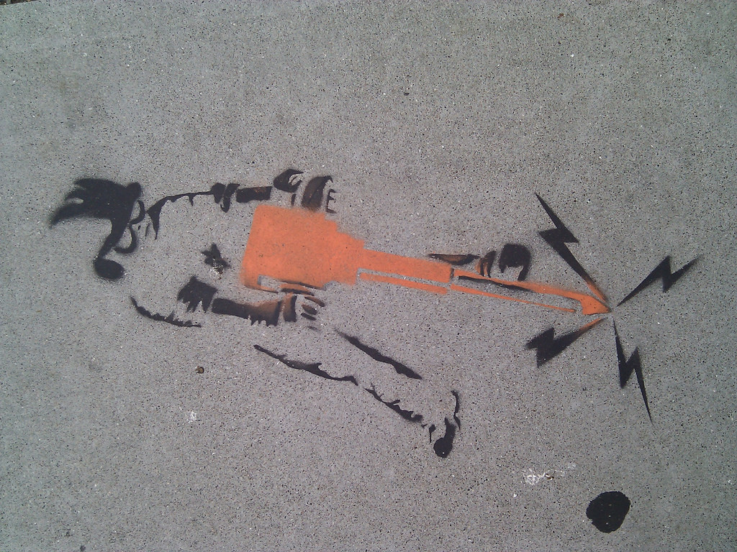
Cool,
but how do you
make it work?
Notes:
https://flic.kr/p/8stahR

Slide 15
@BeforeTask
public static void beforeTask(TaskExecution) {
...
}
@AfterTask
public static void afterTask(TaskExecution) {
...
}
@FailedTask
public static void failedTask(TaskExecution, Throwable) {
...
}
Notes:
As we discussed earlier you can register listeners for the following events:
beforeTask
afterTask
failedTask
This can be done by 2 methods
Create a class that implements the TaskExecutionListener
or (as shown above) use the @BeforeTask, @AfterTask, or @FailedTask

Slide 16
Or just use the Spring Initializer… ;-)
Notes:
Just remember in your tests add the following line below your @SpringBootTest
@TestPropertySource(properties = {"spring.cloud.task.closecontext_enable=false"})

Slide 17
Demo Time!

Slide 18
Lab 2 - Spring Cloud Task
DNDataFlow/labs/lab2/Lab2-SpringCloudTask.pdf

