Slide 1
Stream Processing
+
Spring Cloud Data Flow

Slide 2


Spring Cloud Data Flow
DSL/Shell
REST-API/Dashboard
Flo Visual Designer
Spring Cloud Stream
Spring Cloud Task
Spring Integration
Spring Boot
Spring Batch
Notes:
We are going to revisit stream processing in the context of SCDF. The benefits of orchestration aspects of SCDF is what we are going to cover.

Slide 3


Stream Processing in Spring Cloud Data Flow
dataflow:>stream create foo --definition "http --port=9001 | uppercase | log" --deploy
1
3
http
B
I
N
D
E
R
B
I
N
D
E
R
log
2
4
upperCase()
Notes:
This is the same example that we saw in Streams labs. Let’s revisit it in the context of SCDF.
First and foremost, the DSL. This is where the power is. Inspired by UNIX’s pipes and filter syntaxes, the SCDF DSL includes a powerful representation of both linear and complex streaming pipeline topologies.
The same uppercase() can be defined multiple ways. We are all about options.
you can register the same application that you had developed in the lab and reuse it here
you can use SpEL expressions to compute simple to a complex transformations
“Easy to build or customize; fast you can build topologies; quick you can promote to production”
Same as:
dataflow:> stream create --definition "http | transform --expression=payload.toUpperCase() | log" --name mystream --deploy

Slide 4
Demo: upperCase()

Slide 5
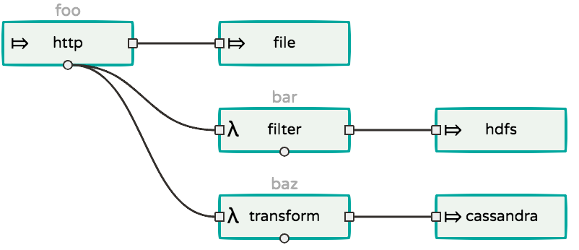
Wiretaps in Streams
dataflow:>stream create foo --definition "http --port=9001 | file”
dataflow:>stream create bar --definition “:foo.http > filter | hdfs”
dataflow:>stream create baz --definition “:foo.http > transform | cassandra”
Notes:
There are some responsibilities for primary data pipeline. The pipeline that writes RAW data to a master dataset; something like hadoop or s3 for example.
While that’s happening, if you’d want to fork and get a copy of same data and do some ad-hoc analytics or some other downstream processing, yes, you can in SCDF.
We call it TAPing the stream. Again, the DSL provides easy to use syntaxes to TAP a copy of data.
stream foo - Data from http port=9001 written to S3.
stream bar - TAPs data from the producer on foo stream and the copy of data is then sent to “hdfs” after some cleansing through “filter” processor.
stream baz - TAPs data from the producer on foo stream and the copy of data is now sent to “cassandra" after some transformation through “transform” processor.
Below you’d see the flo representation of this complex topology. It is easy to read and understand.

Slide 6
Demo: TAPs

Slide 7
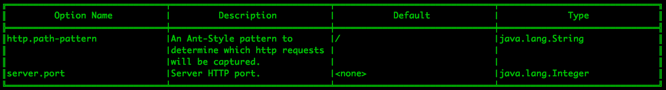
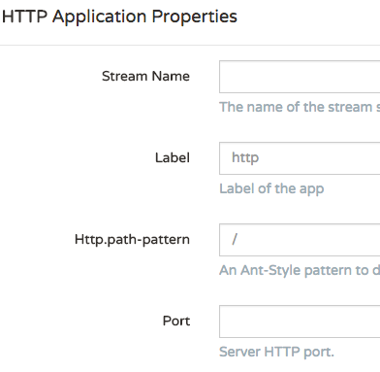
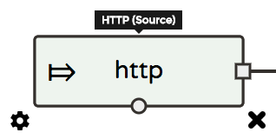
Application Properties
dataflow:>app info source:http
Notes:
Fundamentally, everything in the pipeline is a Spring Boot application. All Boot goodies apply to these applications, too.
Specifically, the properties are a powerful feature in Boot; with that, we could override the application behavior at runtime.
There are multiple ways one can enable such properties and likewise, there are plenty of ways to override them in Boot. Refer to Boot’s ref. guide for more details: https://docs.spring.io/spring-boot/docs/current/reference/html/common-application-properties.html
Building upon this, SCDF and the ecosystem of projects provide similar support, too. From SCDF perspective, the DSL lends easy to use method of overriding application properties.
In this example, you are seeing all the overridable properties for “http-source” application. The same can be overridden when you create pipelines via Flo.

Slide 8
Deployment Properties
Simple Stream
dataflow:>stream create foo --definition “http --port=9001 | log”
Scale-out Deployment
dataflow:>stream deploy foo --properties “app.log.count=2”
Partitioned Stream
dataflow:>stream deploy foo --properties “app.http.producer.partitionKeyExpression=payload”
Stream Binding Overrides
dataflow:>stream deploy foo --properties ”app.http.spring.cloud.stream.bindings.output.destination=bar,
app.log.spring.cloud.stream.bindings.input.destination=bar”
Notes:
We reviewed application properties.
When deploying the stream, properties that control the deployment of the apps into the target platform are known as deployment properties. SCDF provides easy method to override them as well.
Imagine a simple stream “http | log”
Now, if you’d want to deploy 2-instances of log-sink, you’d do that via “app.log.count=2”
If you’d want to supply a partitioning method for the producer (http-source), you’d do that via: “app.http.producer.partitionKeyExpression=payload”
If you’d want to override the default destinations (generated by SCDF = <server-name>.<stream-name>.<app-name>) for your producer and consumer applications to connect, you’d do that via ”app.http.spring.cloud.stream.bindings.output.destination=bar,app.log.spring.cloud.stream.bindings.input.destination=bar”
http://docs.spring.io/spring-cloud-stream/docs/Chelsea.M1/reference/htmlsingle/#_configuration_options

Slide 9
Properties via Reference File
app.http.producer.partitionKeyExpression=payload app.http.spring.cloud.stream.bindings.output.destination=bar app.log.spring.cloud.stream.bindings.input.destination=bar app.log.count=2
Properties File
dataflow:>stream deploy foo --propertiesFile myprops.properties
YAML File
dataflow:>stream deploy foo --propertiesFile myprops.yml
app: http: producer: partitionKeyExpression: payload spring: cloud: stream: bindings: output: destination: bar .... .... ....
Notes:
Properties can be provided as plain “.properties” or as “.yml” artifacts.

Slide 10
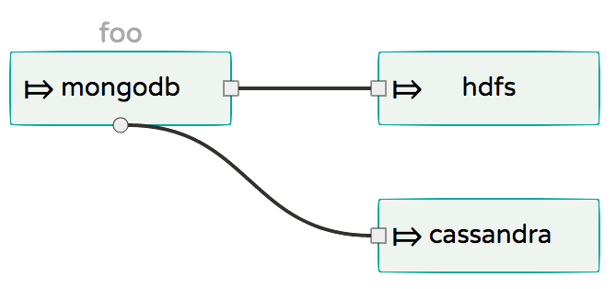


Properties via Reference File
Config
Server
app.mongodb.producer.partitionKeyExpression=payload app.mongodb.spring.cloud.stream.bindings.output.destination=bar app.hdfs.spring.cloud.stream.bindings.input.destination=bar app.cassandra.spring.cloud.stream.bindings.input.destination=bar app.cassandra.count=2
Notes:
Alternatively, you can also use config-server backed by a centralized GIT to resolve properties more dynamically via “profiles” at the runtime.

Slide 11
Demo: All Things Properties

Slide 12
Explicit Broker Destinations
Destination as a Source
dataflow:>stream create foo --definition “:myFancySourceDestination > log”
Destination as a Sink
dataflow:>stream create foo --definition “http > :myFancySourceDestination”
Notes:
You can connect directly to a queue/topic and the DSL for doing that is what you’re seeing in this slide.
You don’t need an explicit application as source/sink is the point. This method is more flexible and it eliminates the requirement to code, test and build producers from scratch.

Slide 13


Advanced Broker Interactions
http
transform
log
Stream Definition
dataflow:>stream create foo --definition “http | transform --expression=payload.toUpperCase() | log”
Stream Deployment
dataflow:>stream deployment foo --properties
"app.http.spring.cloud.stream.bindings.output.binder=rabbitBinder,
app.transform.spring.cloud.stream.bindings.input.binder=rabbitBinder,
app.transform.spring.cloud.stream.bindings.output.binder=kafkaBinder,
app.log.spring.cloud.stream.bindings.input.binder=kafkaBinder"
Notes:
GLOBAL configurations provided at the SERVER level:
spring.cloud.dataflow.applicationProperties.stream.spring.cloud.stream.binders.rabbitBinder.type=rabbit
spring.cloud.dataflow.applicationProperties.stream.spring.cloud.stream.binders.rabbitBinder.environment.spring.rabbitmq.host=awesome1.dev
spring.cloud.dataflow.applicationProperties.stream.spring.cloud.stream.binders.rabbitBinder.environment.spring.rabbitmq.port=90000
spring.cloud.dataflow.applicationProperties.stream.spring.cloud.stream.binders.kafkaBinder.type=kafka
spring.cloud.dataflow.applicationProperties.stream.spring.cloud.stream.binders.kafkaBinder.environment.spring.cloud.stream.kafka.binder.brokers=awesome2.dev:9092
spring.cloud.dataflow.applicationProperties.stream.spring.cloud.stream.binders.kafkaBinder.environment.spring.cloud.stream.kafka.binder.zkNodes=awesome2.dev:2181
It is easy to build complex pipelines that interact with multiple binder implementations.
Imagine a requirement that is strictly only requires RabbitMQ for some processing - perhaps something to do with Rabbit’s powerful security features.
At the same time, a team would like to use Kafka for some high throughput / low-latency downstream processing.
Both of these requirements are legit and in SCDF, we provide easy options to plug different binding implementation between producers and consumers. This visual represents that.

Slide 14
Demo: All Things Destination

Slide 15
Reactive Stream Processing
@SpringBootApplication @EnableBinding(Processor.class) public class SensorAverageApplication {
@StreamListener @Output(Processor.OUTPUT) public Flux<AverageData> calculateAverage(@Input(Processor.INPUT) Flux<ReceivedSensorData> data) { return data.window(Duration.ofSeconds(20), Duration.ofSeconds(10)) .flatMap(window -> window.groupBy(sensorData -> sensorData.getId()) .flatMap(group -> calculateAverage(group))); } ... ...
}
@EnableRxJavaProcessor public class RxJavaTransformer {
@Bean public RxJavaProcessor<String,String> processor() { return inputStream -> inputStream.map(data -> { return data; }).buffer(5).map(data -> String.valueOf(avg(data))); } ... ...
}
i0
..
10
11
12
13
14
15
16
17
18
19
..
12
i1
..
10
11
12
13
14
15
16
17
18
19
..
17
Notes:
Spring Cloud Stream also supports the use of reactive APIs where incoming and outgoing data is handled as continuous data flows.
Instead of specifying how each individual message should be handled, you can use operators that describe functional transformations from inbound to outbound data flows.
Project Reactor and RxJava APIs are more natively supported at the programming model.
With this, you can build complex computation business logic in your applications. Examples include “moving-average”, “time-windowing”, “aggregations” — all this can be easily done in the application itself. They can be registered in SCDF to build complex streaming topologies using the DSL/Flo.
A moving-average example is shown in this slide. For every 5-entries coming from the upstream application, the average is calculated and the outcome is sent to downstream app for processing/persistence.
http://docs.spring.io/spring-cloud-stream/docs/Chelsea.M1/reference/htmlsingle/#_reactive_programming_support

Slide 16
Demo: Moving Average

