Slide 1
Price Strategies for Big Mountain Resort
Livi Wang

Slide 2
Problem Identification
Context:
Big Mountain Resort is a ski resort located in Montana
an additional chair is installed which increases the distribution of visitors across the mountain but increases the operating costs by $1,540,000 this season.
Goal:
cut costs without undermining the ticket price or supports an even higher ticket price
Notes:
Problem identification (1-2 slides)

Slide 3
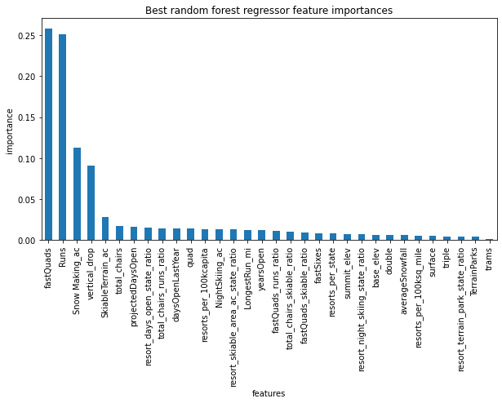
Recommendation and Key Findings
dominant top four features:
The number of fast 4 person chairs
Count of the number of runs on the resort
Total area covered by snow making machines in acres
Vertical change in evaluation from the summit to the base in feet
Notes:
Recommendation and key findings (1 slide)
Selected features and meaning of those features

Slide 4
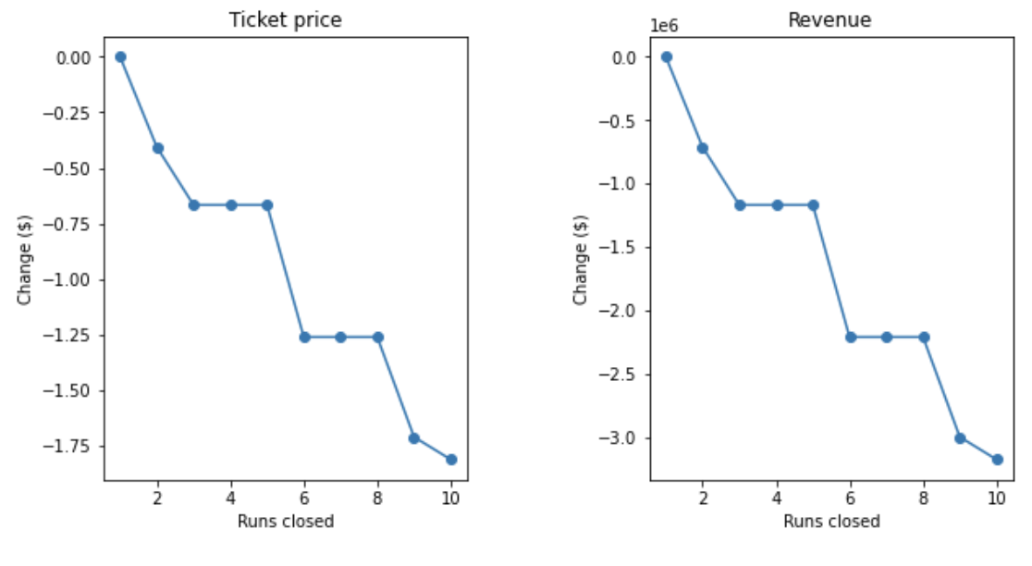
Modeling Results and Analysis
1. Permanently closing down up to 10 of the least used runs. This doesn't impact any other resort statistics.
Notes:
Modeling results and analysis (3-4 slides)
The model says closing 1 run makes no difference.
Closing 2 and 3 successively reduces support for ticket price and so revenue.
If Big Mountain closes down 3 runs, it seems they may as well close down 4 or 5 as there's no further loss in ticket price. Increasing the closures down to 6 or more leads to a large drop.

Slide 5
Modeling Results and Analysis
2. Increase the vertical drop by adding a run to a point 150 feet lower down but requiring the installation of an additional chair lift to bring skiers back up, without additional snow making coverage
This scenario increases support for ticket price by $1.99
Over the season, this could be expected to amount to $3474638
Notes:
Modeling results and analysis (3-4 slides)

Slide 6
Modeling Results and Analysis
3. Same as number 2, but adding 2 acres of snow making cover
This scenario increases support for ticket price by $1.99
Over the season, this could be expected to amount to $3474638
Notes:
Modeling results and analysis (3-4 slides)

Slide 7
Modeling Results and Analysis
4. Increase the longest run by 0.2 mile to boast 3.5 miles length, requiring an additional snow making coverage of 4 acres
No difference. Although the longest run feature was used in the linear model, the random forest model (the one we chose because of its better performance) only has longest run way down in the feature importance list.

Slide 8
Summary and Conclusion
Best Business Option:
Increase the vertical drop by adding a run to a point 150 feet lower down but requiring the installation of an additional chair lift to bring skiers back up, without additional snow making coverage.
Test Other Options:
Model Learning Model Interactive Dashboard - https://github.com/wlwlct/DataScienceGuidedCapstone/blob/master/Notebooks/DP.py
Notes:
Summary and conclusion (1 slide)

