Slide 1
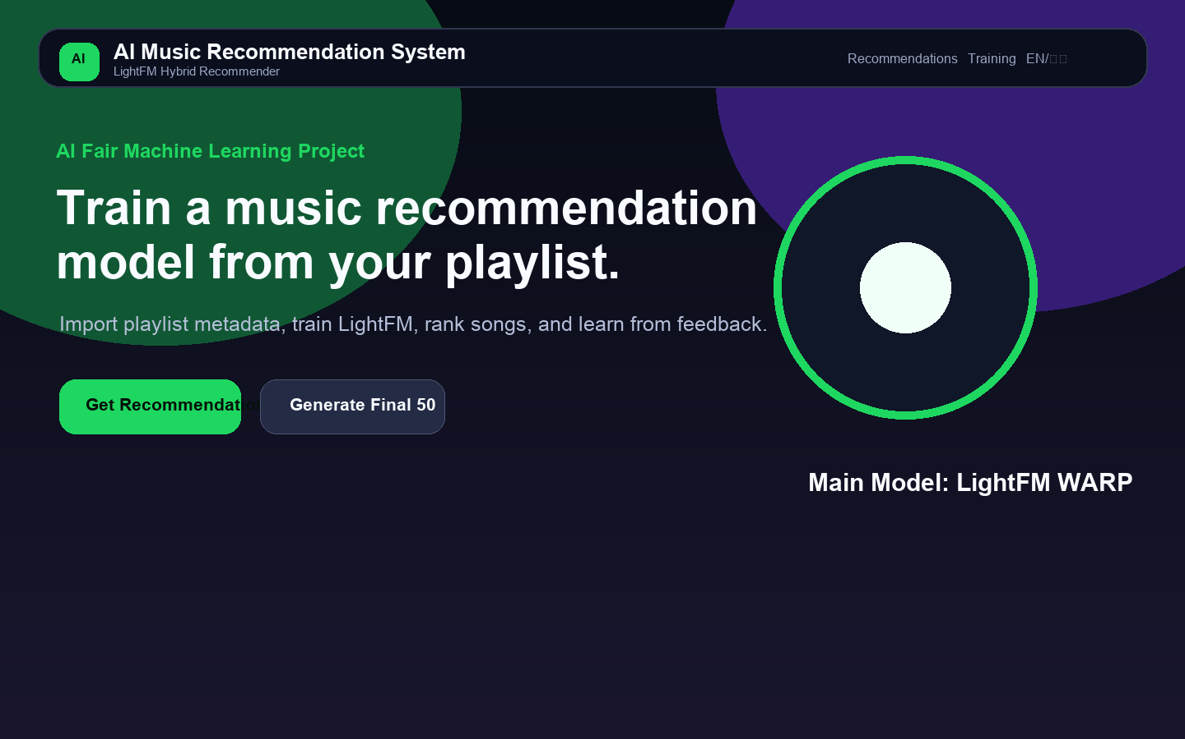
AI FAIR 2026 · MACHINE LEARNING TRACK
AI Music Recommendation System
Training a hybrid recommendation model from playlists, song features, and user feedback.
Main Model
Output
Data
LightFM WARP
Daily 50
CSV + APIs
Presenter: AI Fair Project Team

Slide 2
PROJECT OVERVIEW
The project solves a real recommendation problem: finding songs that match a listener’s taste.
Real-world problem
Target users
Why it matters
Music libraries are too large to browse manually. A recommender must learn from what the user already likes.
Students, music listeners, and AI Fair visitors who want to see how playlist data becomes a trained model.
It connects a familiar product experience with core machine learning ideas: data, features, training, prediction, and feedback.
Thesis: this is not just a search page. It creates training data, trains a hybrid model, and updates recommendations after feedback.

Slide 3
SYSTEM ARCHITECTURE
A local Flask app turns playlist metadata and user actions into machine learning training data.
Playlist Import
Song Search
CSV Store
Training
Ranking
→
→
→
→
QQ Music metadata
Local + public APIs
songs / interactions / feedback
LightFM WARP
Daily 50 recommendations
All data is stored locally in CSV files. Online services are used only for public song metadata; no music audio is downloaded.

Slide 4
DATASET AND FEATURES
The dataset is simple enough to inspect, but structured enough to train a model.
songs.csv
Song metadata + audio features
track, artist, genre, energy, tempo, popularity
interactions.csv
Training signals
playlist_import, manual_add, like, dislike
feedback.csv
Explicit feedback
Like = 1, Dislike = 0
playlists.csv
Import history
source, song_count, created_at

Slide 5
PLAYLIST IMPORT
QQ Music links are parsed safely, then the app imports metadata only.
Supports playlist/{id}, taoge.html?id=, disstid=, tid=, and pure numeric IDs.
Tries multiple metadata endpoints: qzone, v8 playlist, and musicu.fcg.
Never downloads music, never bypasses copyright, and never accesses paid audio.
If QQ fails, the user gets a friendly fallback: manual playlist or song search.
URL extraction logic
https://y.qq.com/n/ryqq/playlist/12345 → extract_qq_playlist_id() → playlist_id = 12345 → fetch metadata → normalize songs → create playlist_import interactions

Slide 6
MUSIC SEARCH APIS
The app searches local data first, then public metadata APIs when more results are needed.
1
Local CSV
2
Deezer
Fast, stable, includes training features
Clean public metadata for mainstream songs
3
MusicBrainz
4
Last.fm
Open music knowledge base, 1 request/sec
Optional API key; skipped if missing
Every request uses timeout=8 and try/except, so API failure never crashes the Flask app.

Slide 7
FEATURE ENGINEERING
Songs become item feature tokens that LightFM can learn from.
genre:pop
artist:the_weeknd
tag:dance
source:qq
energy:high
tempo:fast
valence:positive
danceability:high
popularity:high
Instead of only using numeric similarity, the model learns embeddings for interpretable feature buckets such as high energy, fast tempo, genre, artist, and source.

Slide 8
TRAINING DATA
Playlist actions and feedback become a user–song interaction matrix.
playlist_import
manual_add
like
dislike
+1.0
+1.0
+2.0
-1.0
LightFM WARP trains from positive ranking examples. Dislikes are saved, then used during re-ranking to lower scores.

Slide 9
MODEL AND METHOD
LightFM is the main machine learning model because it supports hybrid recommendation.
Open-source recommender library
Learns from implicit and explicit feedback
Uses WARP ranking loss for Top-N recommendation
Combines user–song interactions with item features
Works well for small educational datasets
Training object
model = LightFM(loss="warp") model.fit(interactions, item_features, sample_weight, epochs=30)

Slide 10
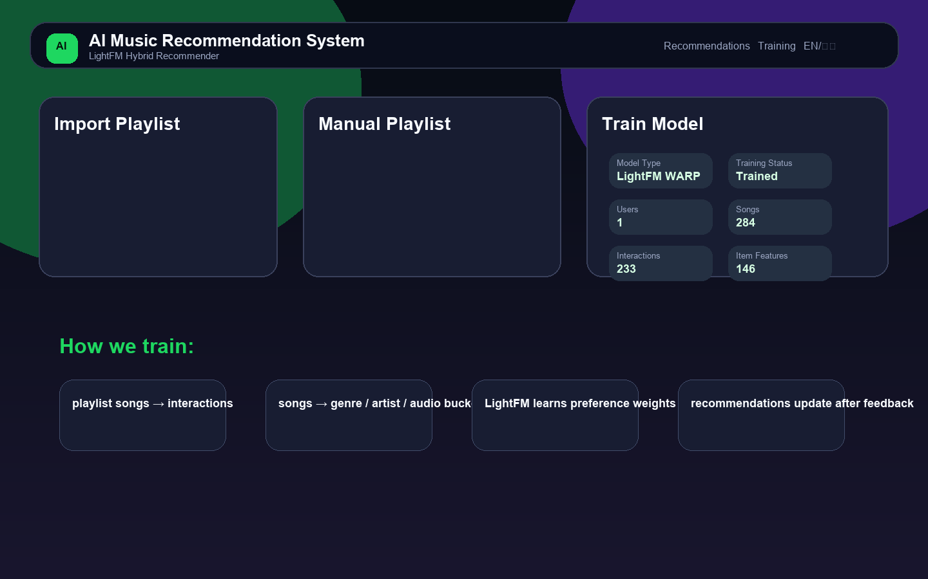
TRAINING WORKFLOW
The UI exposes every training step so the audience can see the machine learning pipeline.
Import or manually add songs
Write interactions.csv rows
Build item feature tokens
Train LightFM WARP
Save lightfm_model.pkl
Show model status in the UI

Slide 11
RECOMMENDATION RANKING
Final recommendations blend learned preference and content similarity.
final_score = 0.7 × LightFM model_score + 0.3 × content_similarity_score
model_score
content_similarity
rule explanation
The trained LightFM model predicts how much the user may like each candidate song.
Cosine similarity compares audio features such as energy, tempo, danceability, and mood.
Reasons are generated deterministically, not by an LLM.

Slide 12
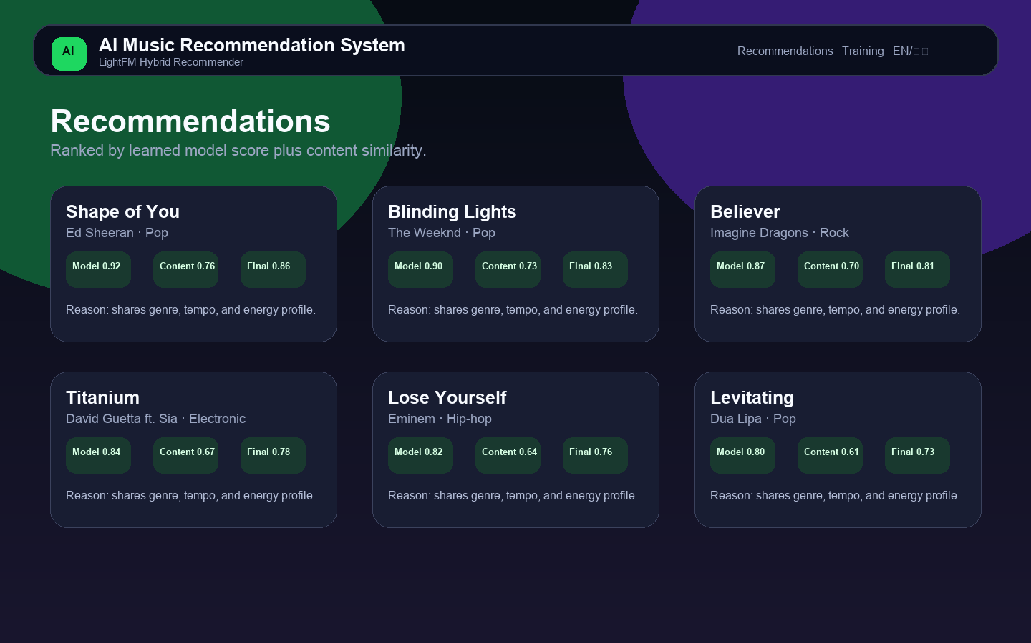
SOFTWARE EXPERIENCE
The app feels like a modern music recommendation dashboard, not a plain form.
Bilingual UI, playlist import, manual songs, model status, recommendation cards, Like/Dislike, and Daily 50 output.

Slide 13
RESULTS AND EVALUATION
The system produces ranked songs, explanations, and a final 50-song daily mix.
Recommendation Cards
Final Playlist
Top 10
50 songs
Explanation Type
Feedback Loop
Rules
Retrain
Evaluation demo: after Like/Dislike feedback, interactions.csv changes, model retrains, and future rankings shift.

Slide 14
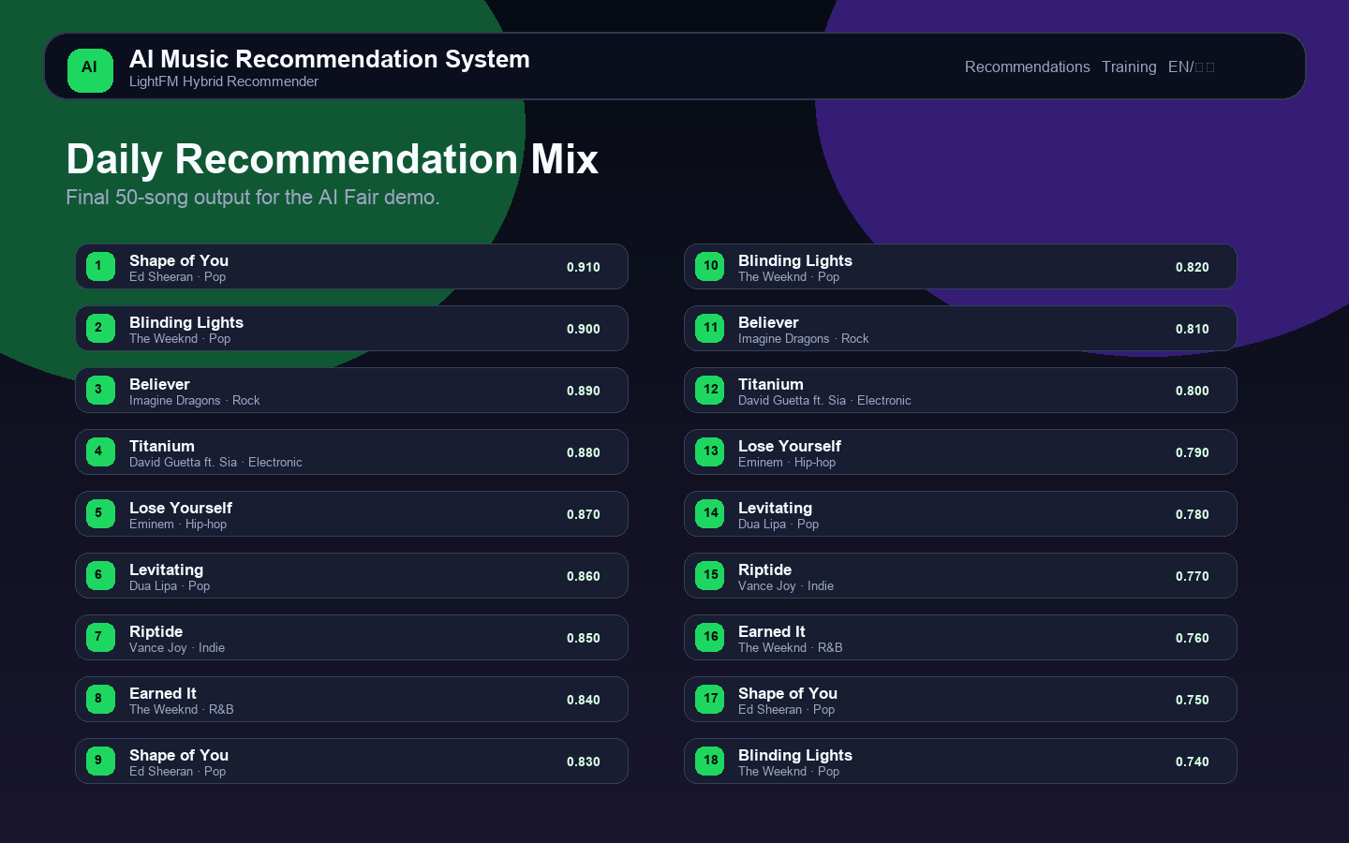
FINAL OUTPUT
Daily Recommendation Mix turns model scores into a show-ready playlist.
Generates up to 50 songs
Filters songs already used for training
Reduces repeated artists and genres
Can be copied as a playlist text output

Slide 15
REAL-WORLD USE
The same pipeline can support real school or personal music discovery.
For students
For music apps
For future work
Learn ML from a product everyone understands: playlists and song recommendations.
Convert playlist behavior and feedback into a continuously improving recommendation loop.
Add richer audio analysis, more users, offline evaluation metrics, and stronger diversity controls.
Most useful improvement: collect more feedback over time and evaluate precision@k / recall@k.

Slide 16
ETHICAL AI DISCLOSURE
The project uses AI help responsibly and avoids copyright risks.
AI assistance was used for coding, debugging, UI writing, and documentation support.
The model and code were checked and understood by the student.
No local LLM, LM Studio, Ollama, or OpenAI API is used for recommendation explanations.
QQ Music import uses metadata only; no audio download or unauthorized playback.
Risk controls
Timeouts for API requests
Friendly error fallback
Local CSV storage
Rule-based explanations
No private audio scraping

Slide 17
LIMITATIONS
The model is real, but the dataset size and public metadata sources limit accuracy.
Small dataset
Estimated features
Unstable APIs
A single demo user means rankings are useful for demonstration, not production-scale personalization.
Some online results do not provide true audio features, so the app estimates features from metadata.
QQ Music public endpoints may change, so the app includes fallback and manual input.
Future improvements: real audio-feature sources, multi-user data, train/test evaluation, precision@k, recall@k, and stronger diversity re-ranking.

Slide 18
HOW TO USE
Quick start: open the app, import music taste data, then train the model.
1
Start the app
Run python app.py, then open the local URL printed in the terminal.
2
Import or add songs
Paste a QQ Music playlist link, or type songs manually in Song - Artist format.
3
Check the dataset
The app saves songs, playlists, interactions, and feedback into local CSV files.
4
Train the model
Click Train Model to build a LightFM hybrid recommendation model.
For the AI Fair booth, prepare a short playlist first so the model has training data before visitors test recommendations.

Slide 19
DEMO TUTORIAL
A simple live demo can show the complete machine learning loop in under three minutes.
Step 1
Search or import
Step 2
Create interactions
Search for familiar songs such as Shape of You, Blinding Lights, Believer, or Levitating.
Add songs to the training playlist. These actions become positive training examples.
Step 3
Train LightFM
Step 4
Generate recommendations
Click Train Model and point out the model type, number of interactions, and item features.
Click Get Recommendations to show Top 10 ranked songs with model/content/final scores.
Step 5
Give feedback
Step 6
Generate Final 50
Click Like or Dislike. The app saves feedback and retrains so future recommendations change.
Click Generate Final 50 to output a Daily Recommendation Mix that can be copied.
Presentation line: The important part is not the button click. It is that every click creates data that changes the trained model.

Slide 20
USAGE NOTES
If an online service fails, the system still works through local data and manual input.
If QQ import fails
If API search is slow
If LightFM is unavailable
Use manual playlist input or Search Songs. QQ public metadata endpoints can change or block some playlists.
The app uses timeouts and skips failed providers, so Flask stays running instead of crashing.
The app falls back to content similarity and a logistic-regression feedback model.
Teacher-facing explanation
The project is designed to keep running during a live demo: public API errors become friendly messages, while the local CSV dataset and trained recommender still provide recommendations.

Slide 21
CLOSING
This project shows the full ML loop: data → features → training → ranking → feedback.
Playlist import creates implicit feedback. Like/Dislike creates explicit feedback. LightFM learns preferences and ranks songs the user is likely to enjoy.
Thank you · Questions?

