Slide 1
Introduction to Principal Component Analysis
2017.03.21

Slide 2
Why Factor or Component Analysis?
We study phenomena that can not be directly observed
Underlying factors that govern the observed data
We want to identify and operate with underlying latent factors rather than the observed data
E.g. topics in news articles
We want to discover and exploit hidden relationships
“beautiful car” and “gorgeous automobile” are closely related
But does your search engine know this?
Reduces noise and error in results

Slide 3
Why Factor or Component Analysis?
We have too many observations and dimensions
To reason about or obtain insights from
To visualize
Too much noise in the data
Need to “reduce” them to a smaller set of factors
Better representation of data without losing much information
Can build more effective data analyses on the reduced-dimensional space: classification, clustering, pattern recognition
Combinations of observed variables may be more effective bases for insights, even if physical meaning is obscure

Slide 4
Factor or Component Analysis
Discover a new set of factors/dimensions/axes against which to represent, describe or evaluate the data
For more effective reasoning, insights, or better visualization
Reduce noise in the data
Typically a smaller set of factors: dimension reduction
Better representation of data without losing much information
Can build more effective data analyses on the reduced-dimensional space: classification, clustering, pattern recognition
Factors are combinations of observed variables
May be more effective bases for insights, even if physical meaning is obscure
Observed data are described in terms of these factors rather than in terms of original variables/dimensions

Slide 5
Basic Concept
Areas of variance in data are where items can be best discriminated and key underlying phenomena observed
Areas of greatest “signal” in the data
If two items or dimensions are highly correlated or dependent
They are likely to represent highly related phenomena
So we want to combine related variables, and focus on uncorrelated or independent ones, especially those along which the observations have high variance
We want a smaller set of variables that explain most of the variance in the original data, in more compact and insightful form

Slide 6
Basic Concept
What if the dependences and correlations are not so strong or direct?
And suppose you have 3 variables, or 4, or 5, or 10000?
Look for the phenomena underlying the observed covariance/co-dependence in a set of variables
Once again, phenomena that are uncorrelated or independent, and especially those along which the data show high variance
These phenomena are called “factors” or “principal components” or “independent components,” depending on the methods used
Factor analysis: based on variance/covariance/correlation
Independent Component Analysis: based on independence

Slide 7
Principal Component Analysis
Most common form of factor analysis
The new variables/dimensions
Are linear combinations of the original ones
Are uncorrelated with one another
Orthogonal in original dimension space
Capture as much of the original variance in the data as possible
Are called Principal Components

Slide 8
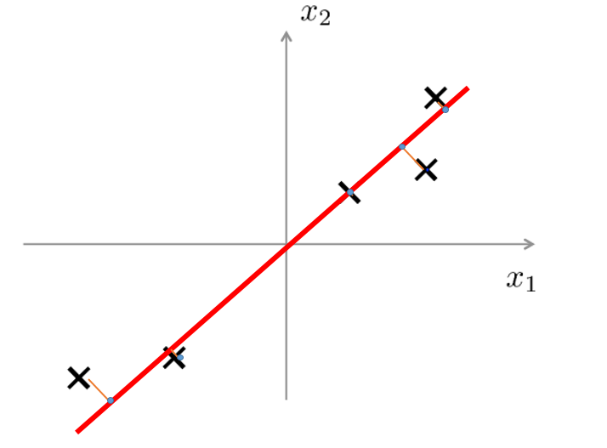
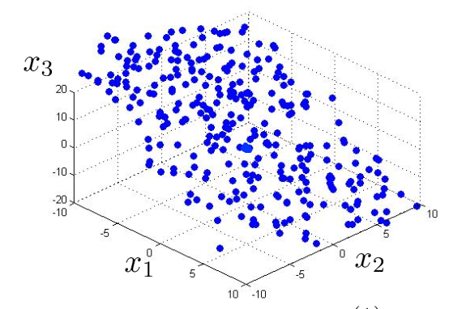
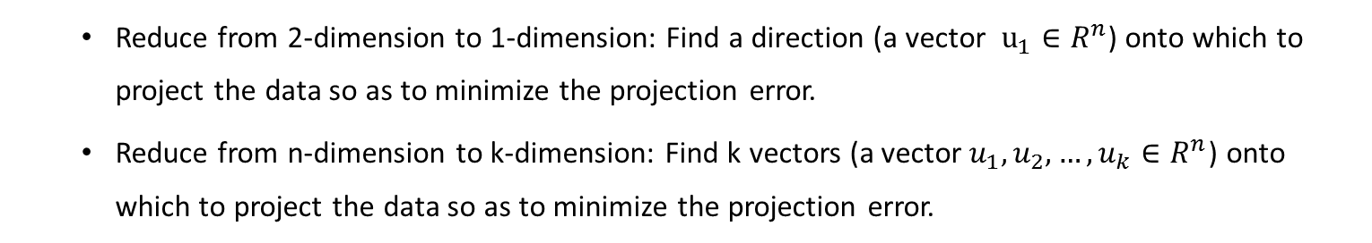
Principal Component Analysis (PCA) problem formulation
Reduce from 2-dimension to 1-dimension: Find a direction (a vector $u_{1}∈R^{n}$) onto which to project the data so as to minimize the projection error.
Reduce from n-dimension to k-dimension: Find k vectors (a vector${ u}_{1},u_{2},…,u_{k}∈R^{n}$) onto which to project the data so as to minimize the projection error.

Slide 9
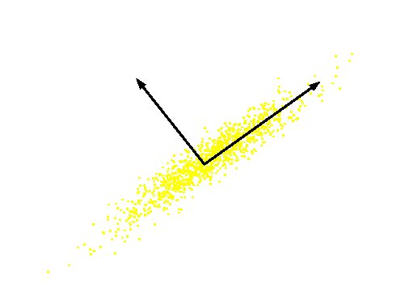
What are the new axes?
Original Variable B
PC 2
PC 1
Original Variable A
Orthogonal directions of greatest variance in data
Projections along PC1 discriminate the data most along any one axis

Slide 10
Principal Components
First principal component is the direction of greatest variability (covariance) in the data
Second is the next orthogonal (uncorrelated) direction of greatest variability
So first remove all the variability along the first component, and then find the next direction of greatest variability
And so on …

Slide 11
Principal Components Analysis (PCA)
Principle
Linear projection method to reduce the number of parameters
Transfer a set of correlated variables into a new set of uncorrelated variables
Map the data into a space of lower dimensionality
Form of unsupervised learning
Properties
It can be viewed as a rotation of the existing axes to new positions in the space defined by original variables
New axes are orthogonal and represent the directions with maximum variability

Slide 12
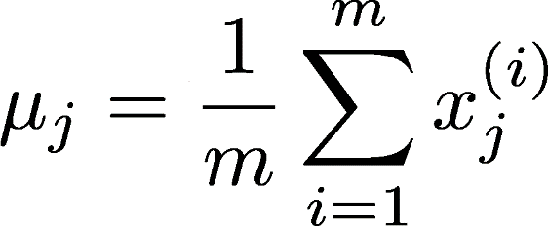
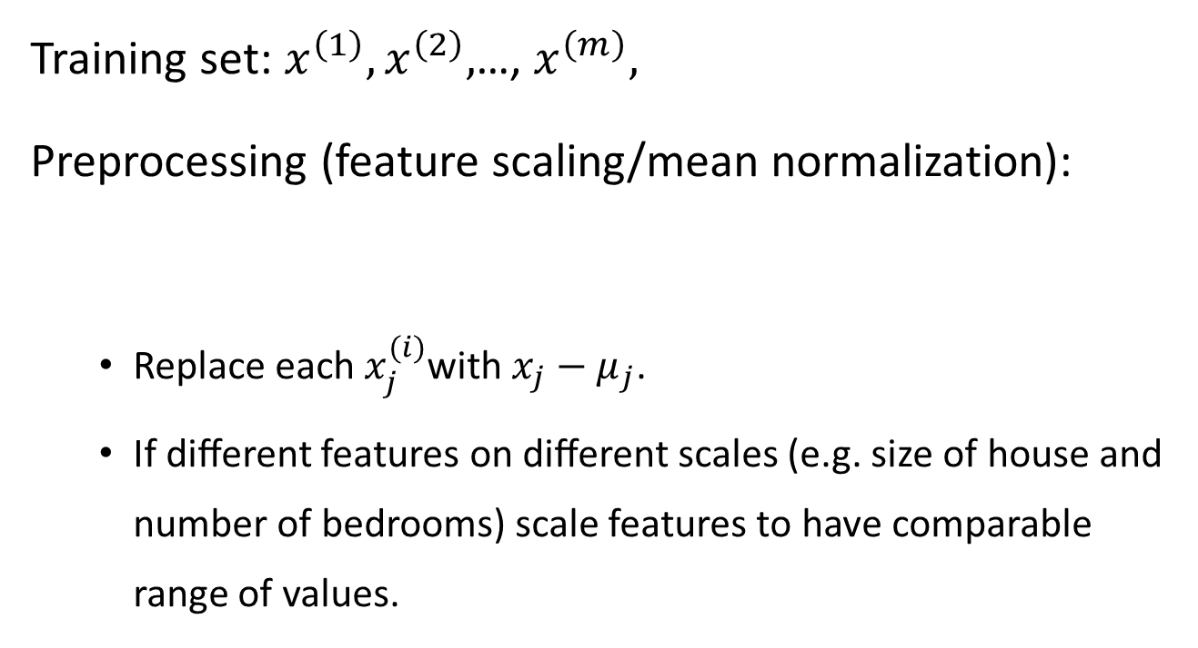
Data preprocessing
Training set: $x^{\left(1\right)},x^{\left(2\right)},$…, $x^{\left(m\right)},$
Preprocessing (feature scaling/mean normalization):
Replace each $x_{j}^{(i)}$with $x_{j}−μ_{j}$.
If diﬀerent features on diﬀerent scales (e.g. size of house and number of bedrooms) scale features to have comparable range of values.

Slide 13
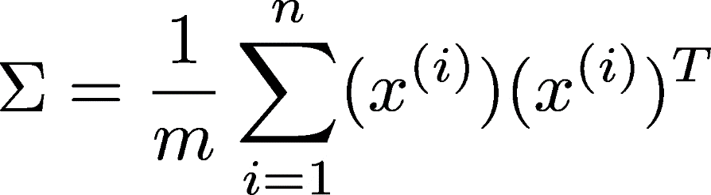
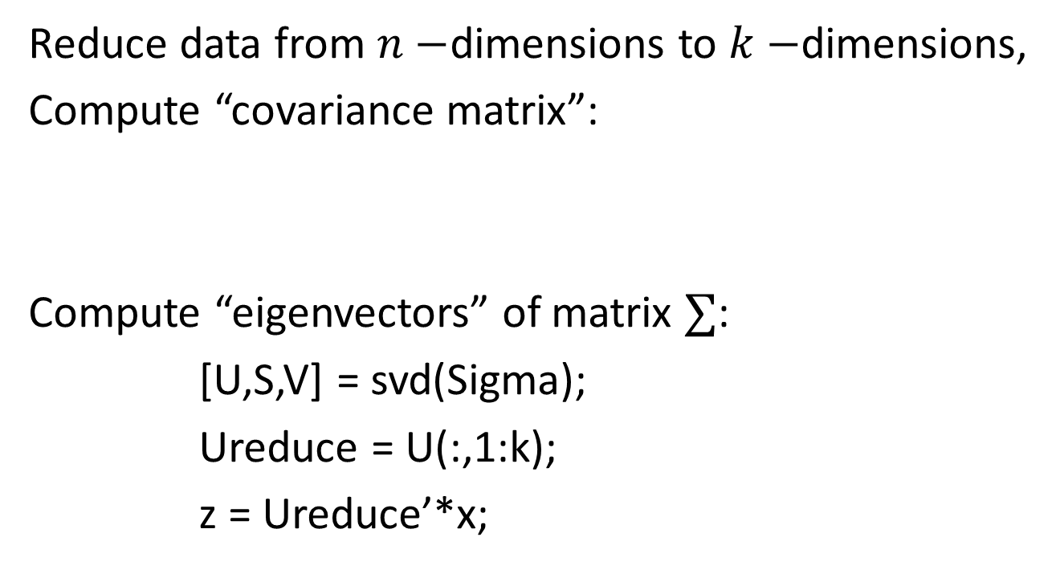
PCA algorithm
Reduce data from $n−$dimensions to $k−$dimensions,
Compute “covariance matrix”:
Compute “eigenvectors” of matrix $∑$:
[U,S,V] = svd(Sigma);
Ureduce = U(:,1:k);
z = Ureduce’*x;
Notes:
均值归一

Slide 14
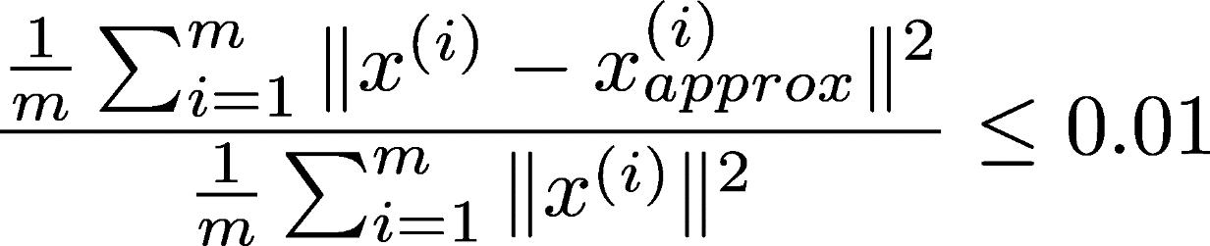
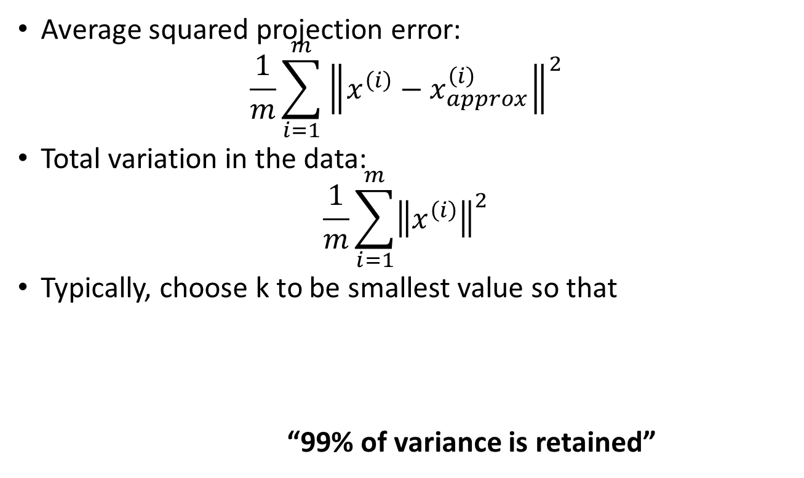
Choosing k(number of PCA)
Average squared projection error:
$$\frac{1}{m}\sum_{i=1}^{m}{{\left\|x^{\left(i\right)}−x_{approx}^{\left(i\right)}\right\|}^{2}}$$
Total variation in the data:
$$\frac{1}{m}\sum_{i=1}^{m}{{\left\|x^{\left(i\right)}\right\|}^{2}}$$
Typically, choose k to be smallest value so that
“99% of variance is retained”

Slide 15
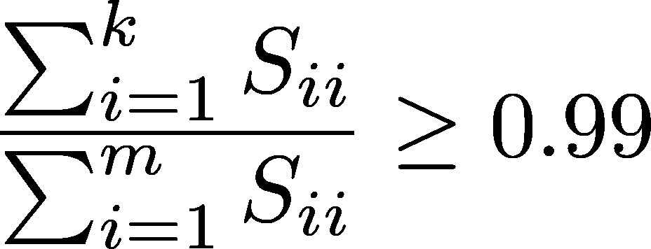

Choosing k(number of PCA)
[U,S,V] = svd(Sigma)
Pick smallest value of $k$ for which

Slide 16
Application of PCA
Compression
Reduce memory/disk needed to store data,
Speed up learning algorithm
Visualization
Notes:
Variance retain
K=2 or k =3

Slide 17
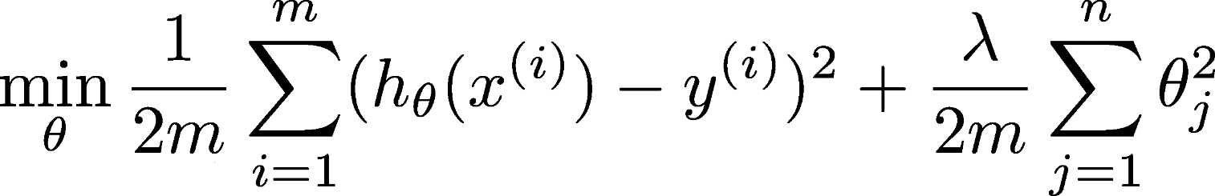
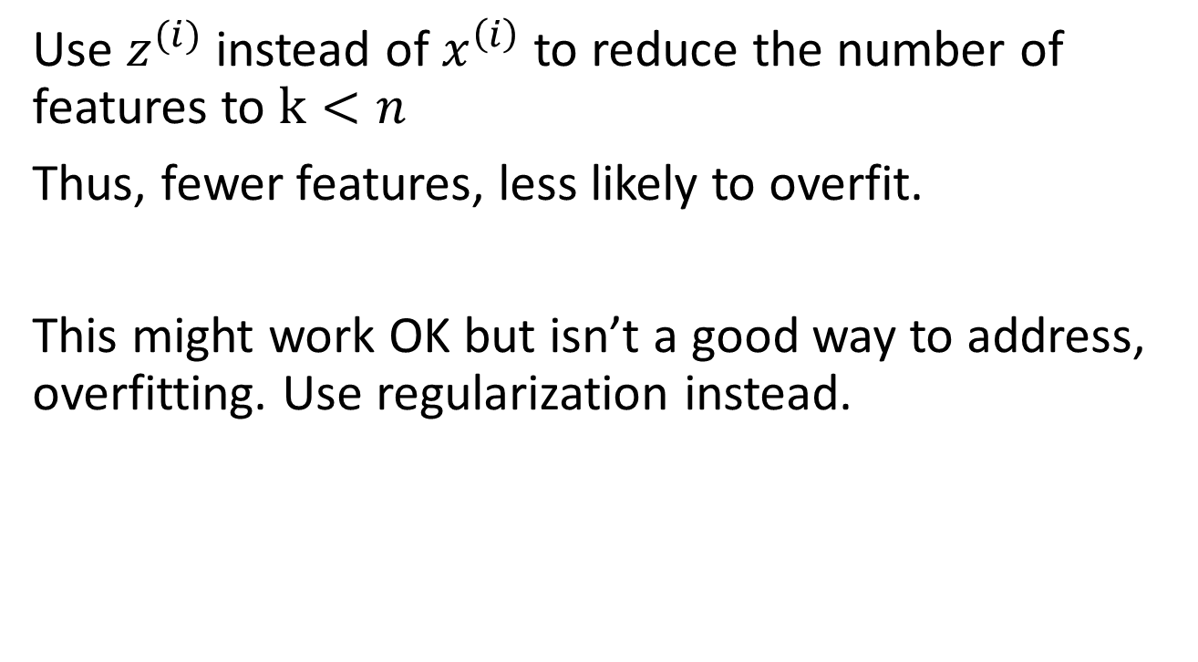
Bad use of PCA: To prevent overﬁtting
Use $z^{(i)}$ instead of $x^{\left(i\right)}$ to reduce the number of features to $k<n$
Thus, fewer features, less likely to overfit.
This might work OK but isn’t a good way to address, overfitting. Use regularization instead.
Notes:
Bad!
不使用数据的标签，某些数据去掉了，PCA是一种无监督学习，其存在的假设是：方差越大信息量越多。但是信息（方差）小的特征并不代表表对于分类没有意义，可能正是某些方差小的特征直接决定了分类结果，而PCA在降维过程中完全不考虑目标变量的做法会导致一些关键但方差小的分类信息被过滤掉。

