Slide 1
Word2vec推导
北京大学
苑斌

Slide 2
Guideline
1 What is Word2vec?
2 Hierarchy Softmax
3 Negative Sampling

Slide 3
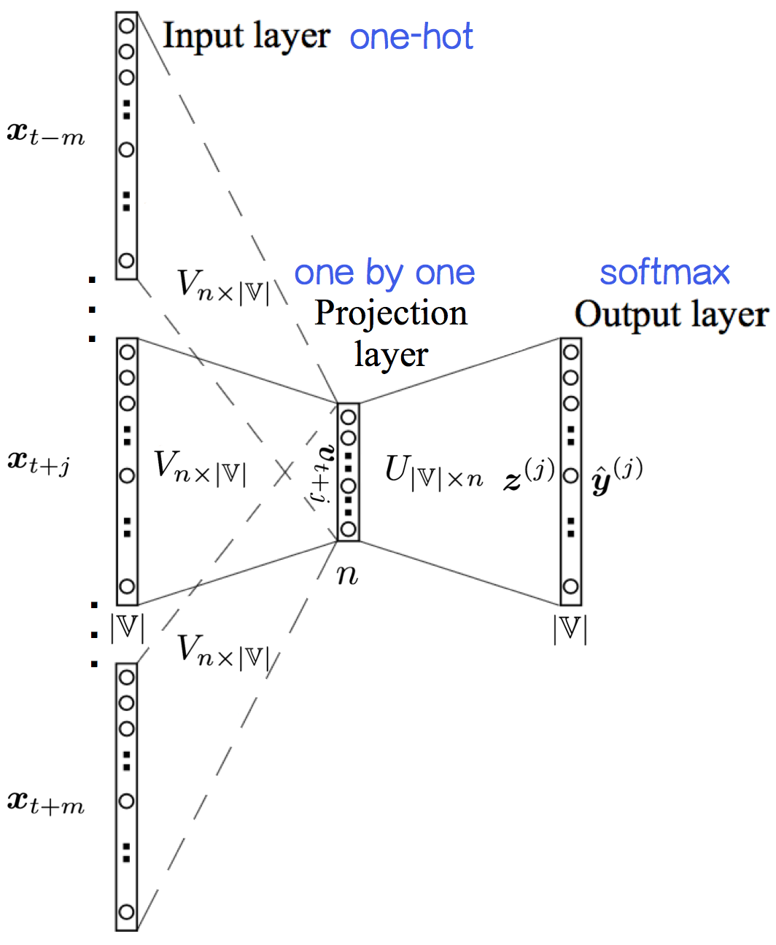
What is word2vec
Skip-gram:

Slide 4
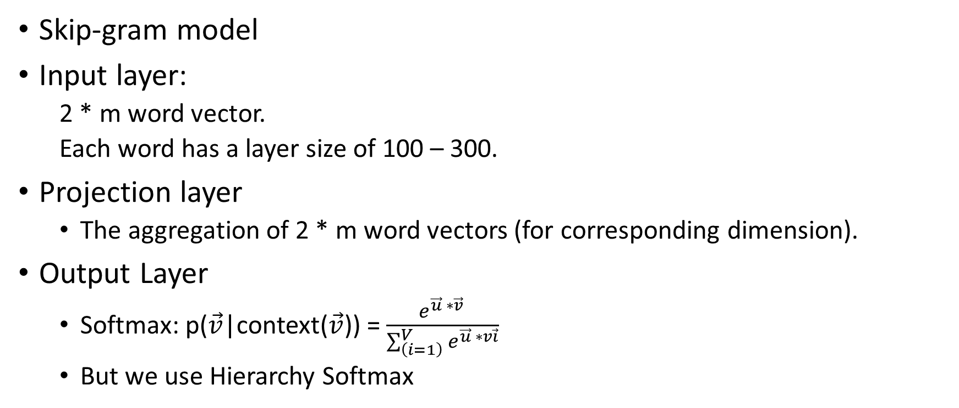
What is word2vec?
Skip-gram model
Input layer:
2 * m word vector.
Each word has a layer size of 100 – 300.
Projection layer
The aggregation of 2 * m word vectors (for corresponding dimension).
Output Layer
Softmax: p($\vec{v}$|context($\vec{v}$)) = $\frac{e^{\vec{u} ∗\vec{v} }}{\sum_{\left(i=1\right)}^{V}{e^{\vec{u} ∗v\vec{i}}}}$
But we use Hierarchy Softmax

Slide 5

Why do we use Hierarchy Softmax
t$he cost of computing \sum_{\left(i=1\right)}^{V}{e^{\vec{u} ∗\vec{v_{i}}}}$ is very expansive.
We use it to backpropagation.
We need to reduce this cost.

Slide 6
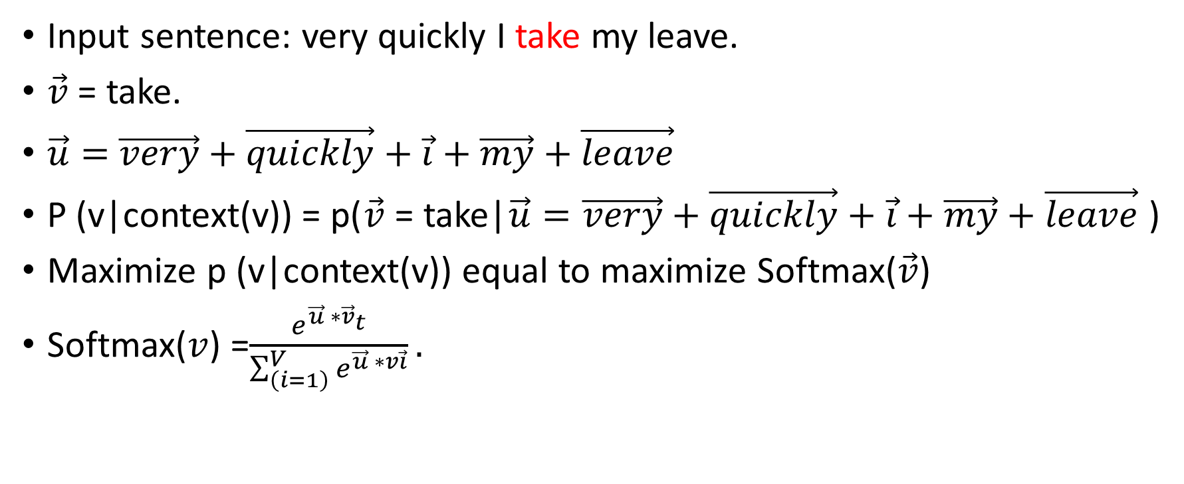
Softmax
Input sentence: very quickly I take my leave.
$\vec{v}$ = take.
$\vec{u}=$ $\vec{very}+\vec{quickly}+\vec{i}+\vec{my}+\vec{leave}$
P (v|context(v)) = p($\vec{v}$ = take|$\vec{u}=$ $\vec{very}+\vec{quickly}+\vec{i}+\vec{my}+\vec{leave}$)
Maximize p (v|context(v)) equal to maximize Softmax($\vec{v}$)
Softmax($v$) =$\frac{e^{\vec{u} ∗{\vec{v}}_{t}}}{\sum_{\left(i=1\right)}^{V}{e^{\vec{u} ∗v\vec{i}}}}.$

Slide 7
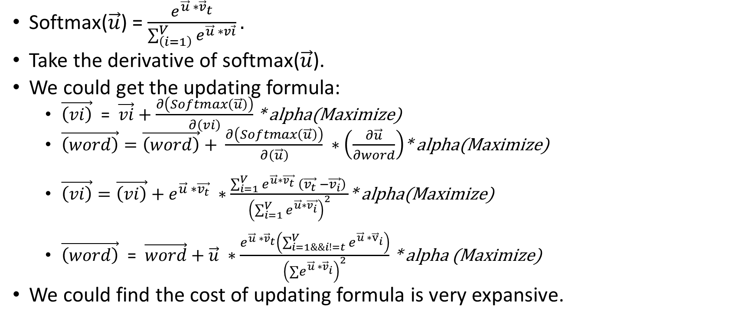
Softmax
Softmax($\vec{u}$) = $\frac{e^{\vec{u} ∗{\vec{v}}_{t}}}{\sum_{\left(i=1\right)}^{V}{e^{\vec{u} ∗v\vec{i}}}}.$
Take the derivative of softmax($\vec{u}$).
We could get the updating formula:
$\vec{\left(vi\right)}$ = $\vec{vi}+\frac{∂\left(Softmax\left(\vec{u}\right)\right)}{∂\left(vi\right)}$* alpha(Maximize)
$\vec{\left(word\right)}=\vec{\left(word\right)}+ \frac{∂\left(Softmax\left(\vec{u}\right)\right)}{∂\left(\vec{u}\right)} ∗\left(\frac{∂\vec{u}}{∂word}\right)$* alpha(Maximize)
$\vec{\left(vi\right)}=\vec{\left(vi\right)}+e^{\vec{u} ∗\vec{v_{t}}} ∗\frac{\sum_{i=1}^{V}{e^{\vec{u}∗\vec{v_{t}}} \left(\vec{v_{t}} −\vec{v_{i}}\right)} }{{\left(\sum_{i=1}^{V}{e^{\vec{u}∗\vec{v_{i}}}}\right)}^{2}}$* alpha(Maximize)
$\vec{\left(word\right)}$ = $\vec{word}+$ $\vec{u} ∗\frac{e^{\vec{u} ∗{\vec{v}}_{t}}\left(\sum_{i=1\&\&i!=t}^{V}{e^{\vec{u} ∗{\vec{v}}_{i}}}\right)}{{\left(∑e^{\vec{u} ∗{\vec{v}}_{i}}\right)}^{2}}$ * alpha (Maximize)
We could find the cost of updating formula is very expansive.

Slide 8






Hierarchy Softmax
Softmax: p($\vec{v_{t}}$|$\vec{u}=$context(${\vec{v}}_{t}$)) =$\frac{e^{\vec{u} ∗{\vec{v}}_{t}}}{\sum_{\left(i=1\right)}^{V}{e^{\vec{u} ∗v\vec{i}}}}.$
Hierarchy softmax:
$v_{t}=take$
Code[1] = 1
Code[2] = 0
Code[3] = 0
Code[4] = 1
$$θ1$$
$$θ2$$
leave
$$θ3$$
$$θ4$$
$$θ5$$
very
quickly
I
take
my

Slide 9
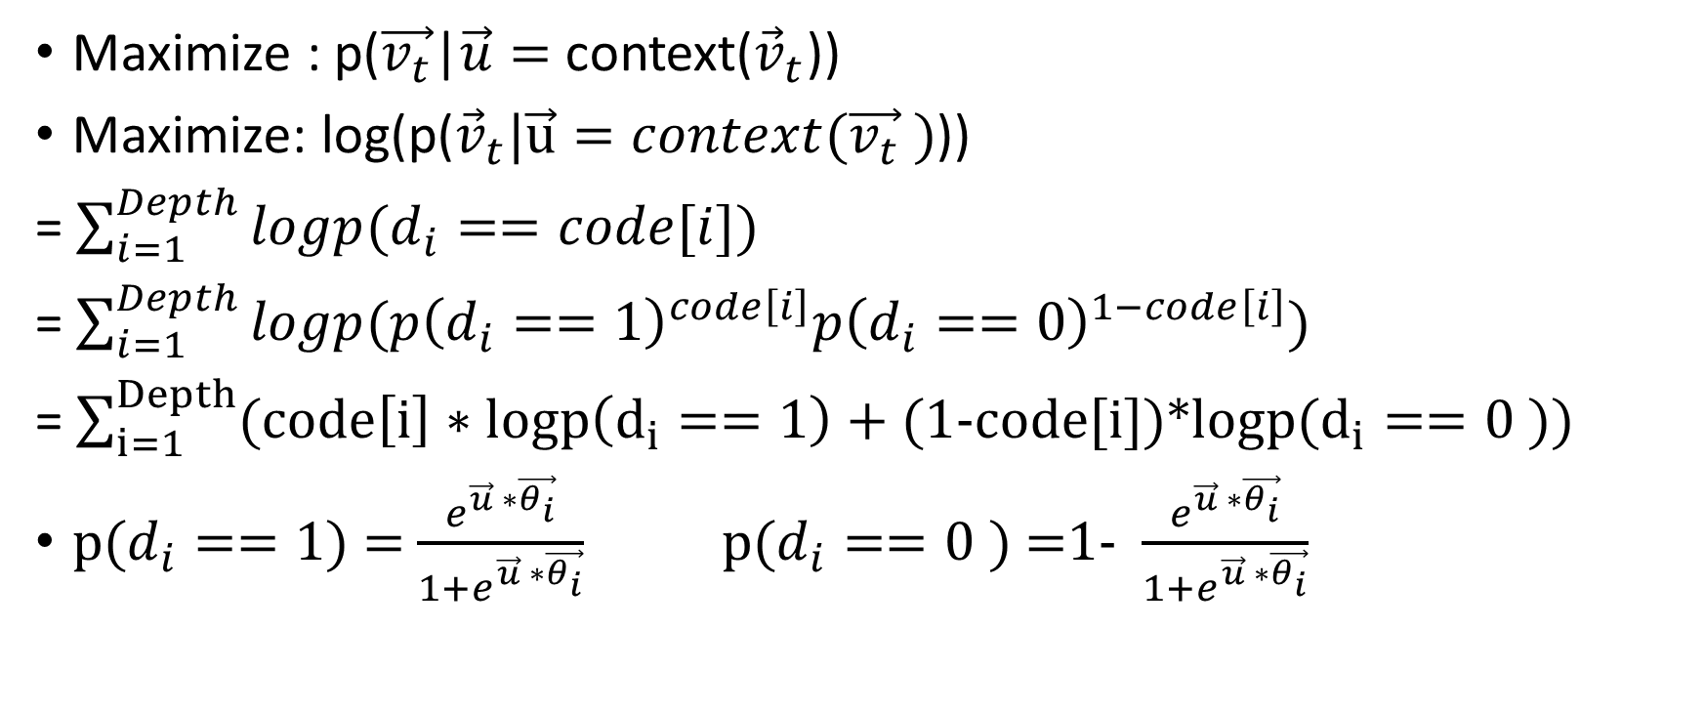
Hierarchy Softmax
Maximize : p($\vec{v_{t}}$|$\vec{u}=$context(${\vec{v}}_{t}$))
Maximize: log(p(${\vec{v}}_{t}|\vec{u}=context(\vec{v_{t}} )$))
= $\sum_{i=1}^{Depth}{logp(d_{i}==code[i])}$
= $\sum_{i=1}^{Depth}{logp(p{\left(d_{i}==1\right)}^{code\left[i\right]}p{\left(d_{i}==0\right)}^{1−code\left[i\right]})}$
= $\sum_{i=1}^{Depth}{(code\left[i\right]∗logp\left(d_{i}==1\right)+ }$(1-code[i])*logp($d_{i}==0$))
p($d_{i}==1$) = $\frac{e^{\vec{u} ∗\vec{θ_{i}}}}{1+e^{\vec{u} ∗\vec{θ_{i}}}}$ p($d_{i}==0$ ) =1- $\frac{e^{\vec{u} ∗\vec{θ_{i}}}}{1+e^{\vec{u} ∗\vec{θ_{i}}}}$

Slide 10
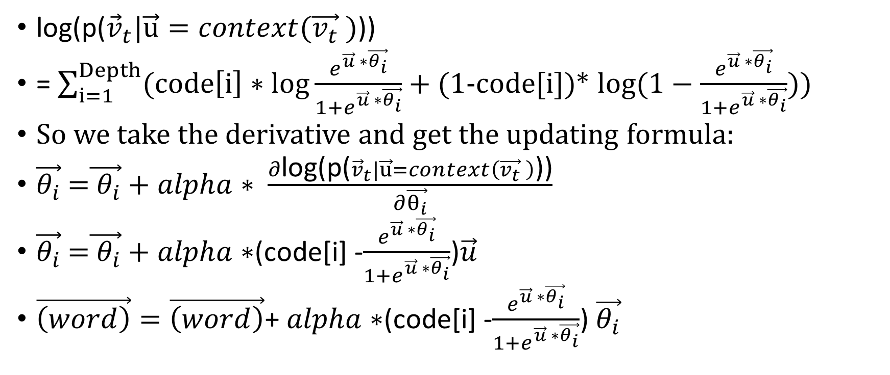
Hierarchy Softmax
log(p(${\vec{v}}_{t}|\vec{u}=context(\vec{v_{t}} )$))
= $\sum_{i=1}^{Depth}{(code\left[i\right]∗log\frac{e^{\vec{u} ∗\vec{θ_{i}}}}{1+e^{\vec{u} ∗\vec{θ_{i}}}}+ }$(1-code[i])* $log(1−\frac{e^{\vec{u} ∗\vec{θ_{i}}}}{1+e^{\vec{u} ∗\vec{θ_{i}}}})$)
So we take the derivative and get the updating formula:
$\vec{θ_{i}}$ =$\vec{{ θ}_{i}}+alpha∗ \frac{∂\text{log}\text{(}\text{p}\text{(}{\vec{v}}_{t}|\vec{u}=context\left(\vec{v_{t}} \right)\text{))}}{∂\vec{θ_{i}}}$
$\vec{θ_{i}}$ =$\vec{{ θ}_{i}}+alpha∗$(code[i] -$\frac{e^{\vec{u} ∗\vec{θ_{i}}}}{1+e^{\vec{u} ∗\vec{θ_{i}}}}$)$\vec{u}$
$\vec{\left(word\right)}=\vec{\left(word\right)}$+ $alpha∗$(code[i] -$\frac{e^{\vec{u} ∗\vec{θ_{i}}}}{1+e^{\vec{u} ∗\vec{θ_{i}}}}$)$\vec{θ_{i}}$

Slide 11
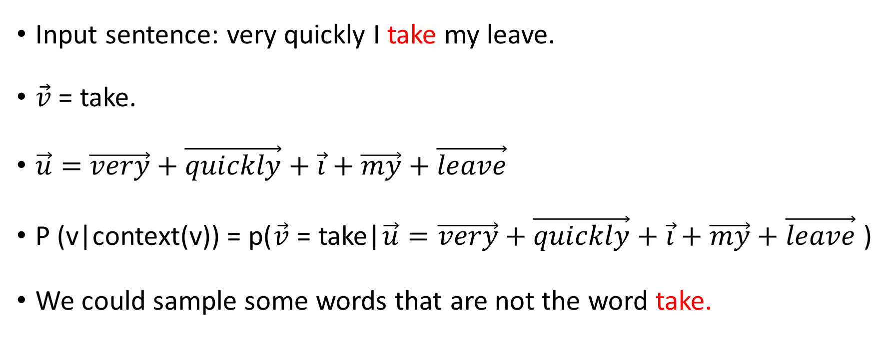
Negative sampling
Input sentence: very quickly I take my leave.
$\vec{v}$ = take.
$\vec{u}=$ $\vec{very}+\vec{quickly}+\vec{i}+\vec{my}+\vec{leave}$
P (v|context(v)) = p($\vec{v}$ = take|$\vec{u}=$ $\vec{very}+\vec{quickly}+\vec{i}+\vec{my}+\vec{leave}$)
We could sample some words that are not the word take.

Slide 12
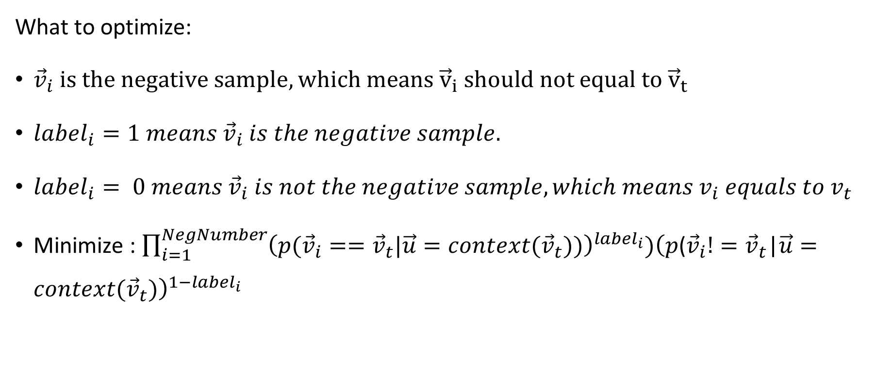
Negative sampling
What to optimize:
${\vec{v}}_{i} is the negative sample, which means {\vec{v}}_{i} should not equal to {\vec{v}}_{t}$
$label_{i}=1 means {\vec{v}}_{i} is the negative sample.$
$label_{i}= 0 means {\vec{v}}_{i} is not the negative sample, which means v_{i} equals to v_{t}$
Minimize : $\prod_{i=1}^{NegNumber}{{\left(p({\vec{v}}_{i}=={\vec{v}}_{t}|\vec{u}=context({\vec{v}}_{t}))\right)}^{label_{i}}){\left(p\text{(}{\vec{v}}_{i}!={\vec{v}}_{t}\text{|}\vec{u}=context({\vec{v}}_{t})\right)}^{1−label_{i}}}$

Slide 13
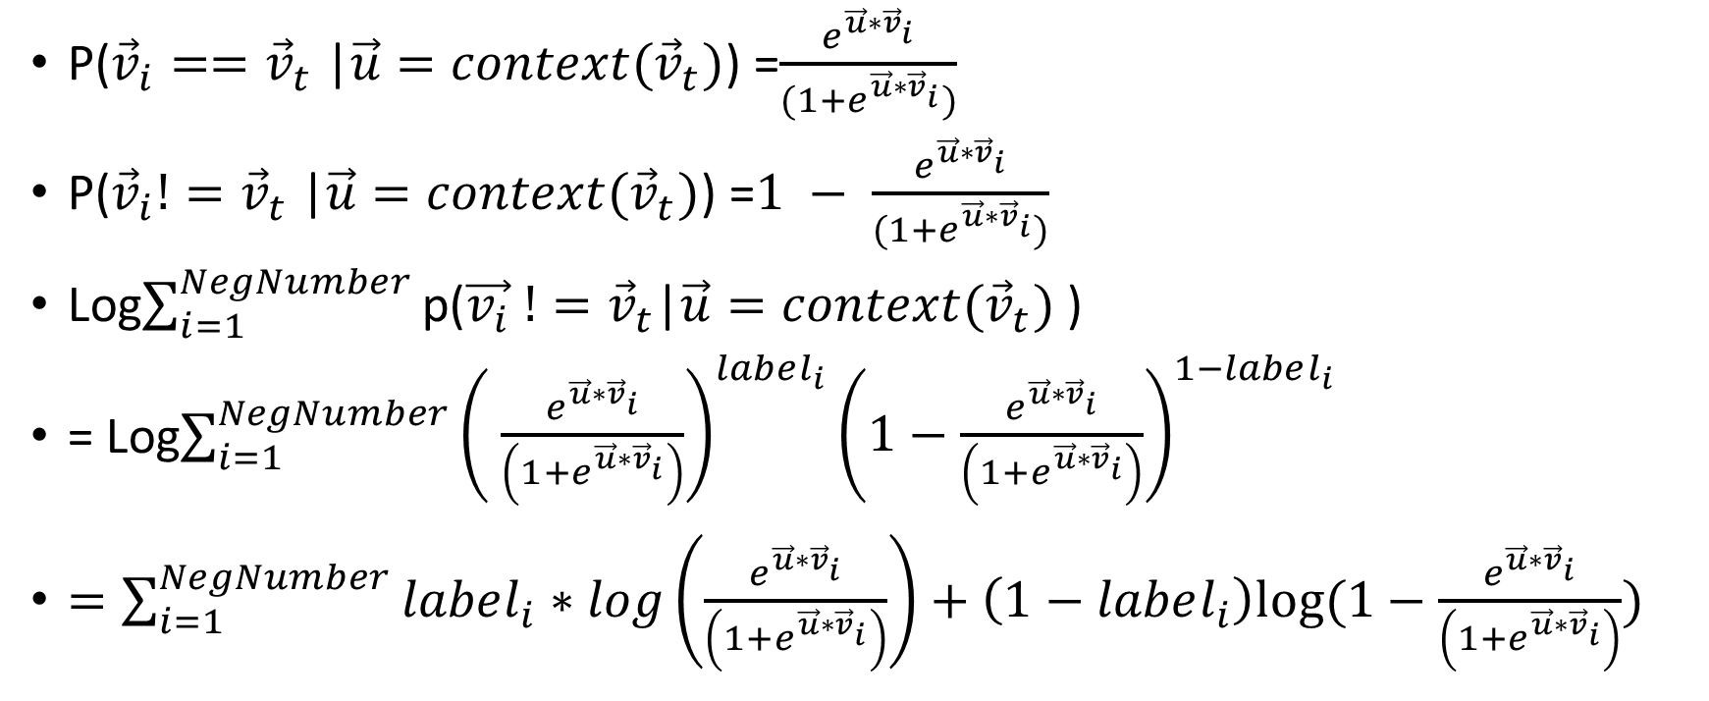
Negative sampling
P(${\vec{v}}_{i}=={\vec{v}}_{t}$|$\vec{u}=context({\vec{v}}_{t})$) =$\frac{e^{\vec{u}∗{\vec{v}}_{i}}}{(1+e^{\vec{u}∗{\vec{v}}_{i}})}$
P(${\vec{v}}_{i}!={\vec{v}}_{t}$|$\vec{u}=context({\vec{v}}_{t})$) =$1 − \frac{e^{\vec{u}∗{\vec{v}}_{i}}}{(1+e^{\vec{u}∗{\vec{v}}_{i}})}$
Log$\sum_{i=1}^{NegNumber}{\text{p}\text{(}\vec{v_{i}} !={\vec{v}}_{t}\text{|}\vec{u}=context({\vec{v}}_{t})\text{ ) }}$
= Log$\sum_{i=1}^{NegNumber}{\begin{aligned}{\left( \frac{e^{\vec{u}∗{\vec{v}}_{i}}}{\left(1+e^{\vec{u}∗{\vec{v}}_{i}}\right)}\right)}^{label_{i}}{\left(1−\frac{e^{\vec{u}∗{\vec{v}}_{i}}}{\left(1+e^{\vec{u}∗{\vec{v}}_{i}}\right)}\right)}^{1−label_{i}} \\ \end{aligned}}$
$=\sum_{i=1}^{NegNumber}{label_{i}∗log\left(\frac{e^{\vec{u}∗{\vec{v}}_{i}}}{\left(1+e^{\vec{u}∗{\vec{v}}_{i}}\right)}\right)+\left(1−label_{i}\right)log⁡(1−\frac{e^{\vec{u}∗{\vec{v}}_{i}}}{\left(1+e^{\vec{u}∗{\vec{v}}_{i}}\right)})}$

Slide 14
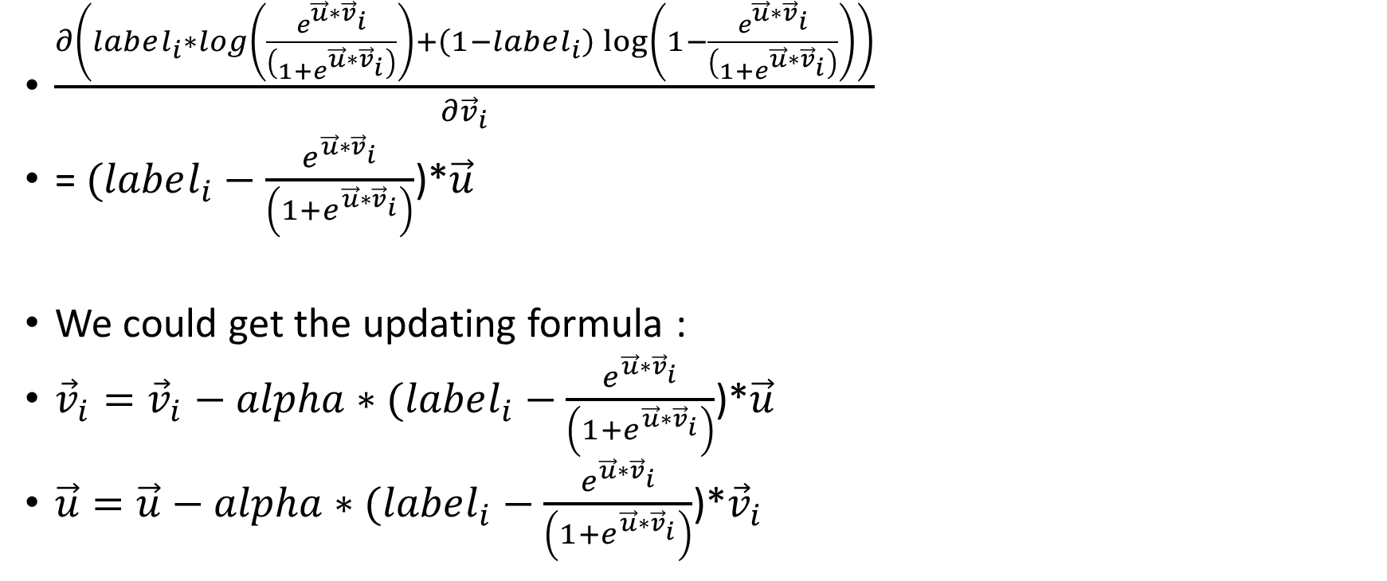
Negative sampling
$\frac{∂\left(label_{i}∗log\left(\frac{e^{\vec{u}∗{\vec{v}}_{i}}}{\left(1+e^{\vec{u}∗{\vec{v}}_{i}}\right)}\right)+\left(1−label_{i}\right)\log\left(1−\frac{e^{\vec{u}∗{\vec{v}}_{i}}}{\left(1+e^{\vec{u}∗{\vec{v}}_{i}}\right)}\right)\right)}{∂{\vec{v}}_{i}}$
= $(label_{i}−\frac{e^{\vec{u}∗{\vec{v}}_{i}}}{\left(1+e^{\vec{u}∗{\vec{v}}_{i}}\right)}$)*$\vec{u}$
We could get the updating formula :
${\vec{v}}_{i}={\vec{v}}_{i}−alpha∗(label_{i}−\frac{e^{\vec{u}∗{\vec{v}}_{i}}}{\left(1+e^{\vec{u}∗{\vec{v}}_{i}}\right)}$)*$\vec{u}$
$\vec{u}=\vec{u}−alpha∗(label_{i}−\frac{e^{\vec{u}∗{\vec{v}}_{i}}}{\left(1+e^{\vec{u}∗{\vec{v}}_{i}}\right)}$)*${\vec{v}}_{i}$

Slide 15
Thank you!

