Slide 1
Exploration of an IoT Solution for
Predictive Maintenance of
Residential Furnaces
SEIS-744 Project
Wade Lykkehoy
5/4/2020

Slide 2
Introduction and Motivation
Last December I thought my furnace was sounding “different”
Short time later, total failure
4 days until a service tech could come out (it was cold!!)
Root cause: A blower used during startup
Luckily there 1 in Mpls / St Paul; else would have taken 1-2 weeks to get
Couldn’t this issue have been detected prior to total failure?

Slide 3
Objective & Scope
Measure furnace vibration to determine
Furnace state; on/off
Abnormal condition
Proactive notification when an “abnormal” condition occurs
Mashup of vibration data with other data
Retain data for longer-term analysis (a “someday” personal project)
Justify purchasing a Raspberry Pi to play experiment and learn with

Slide 4
Prototype Architecture
Overall perspective
Drill Down per 7-Layer IoT Tech Stack
Things
Connectivity / Edge Computing
Global Infrastructure
Platforms Data Ingestion
Data Analysis
Applications
People & Process

Slide 5
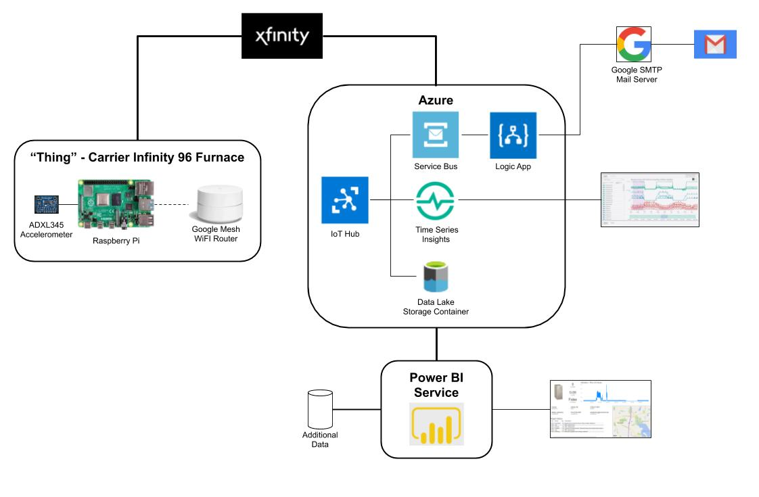

Slide 6
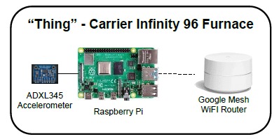
Thing
My furnace - Carrier Infinity 96
Adafruit ADXL345 accelerometer
Raspberry Pi 4
Adafruit Python library
Azure IoT Python library
Google Mesh WiFi Router

Slide 7
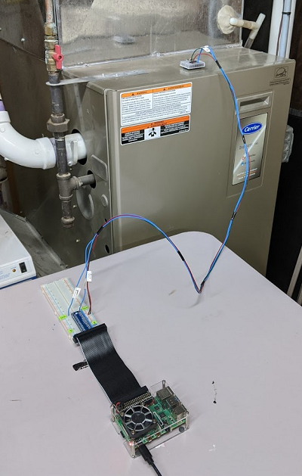
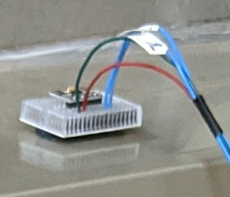
Thing

Slide 8
Connectivity / Edge Computing
Connectivity is via my home network WiFi => Xfinity to internet
5 Edge computing tasks
Accelerometer => vibration
Simple method: change in acceleration = vibration
Smoothing readings
Moving average
Determine on/off state
ML model (classification tree)
Tracking how many seconds the furnace has been in the current state
Determining “abnormal” vibration event
Simple rule based

Slide 9
Connectivity / Edge Computing
Message is packaged and sent to Azure cloud
{
"body": {
"dev_id": "RazPi",
"ts": "2020-04-17T18:28:13z",
"vib": 0.07649187,
"state": 0,
"sis": 17146,
"vibalert": "False"
},
"enqueuedTime": "2020-04-17T18:28:13.701Z",
"properties": {
"vibrationAlert": "False"
}
}

Slide 10
Global Infrastructure
AWS or Azure?
Chose Azure
Not used before, thus opportunity to learn
Good press on IoT capabilities

Slide 11
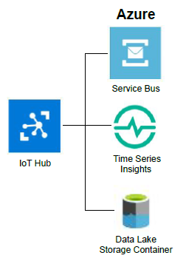
Platforms Data Ingestion
Device messages come into Azure IoT Hub
IoT Hub sends messages on to
Service Bus (only messages indicating an unusual vibration event)
Time Series Insights
Data Lake Storage

Slide 12
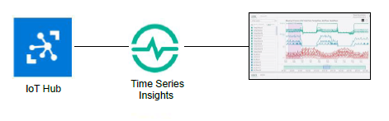
Data Analysis
Time Series Insights
Tool specifically for IoT time series data visualization and exploration

Slide 13
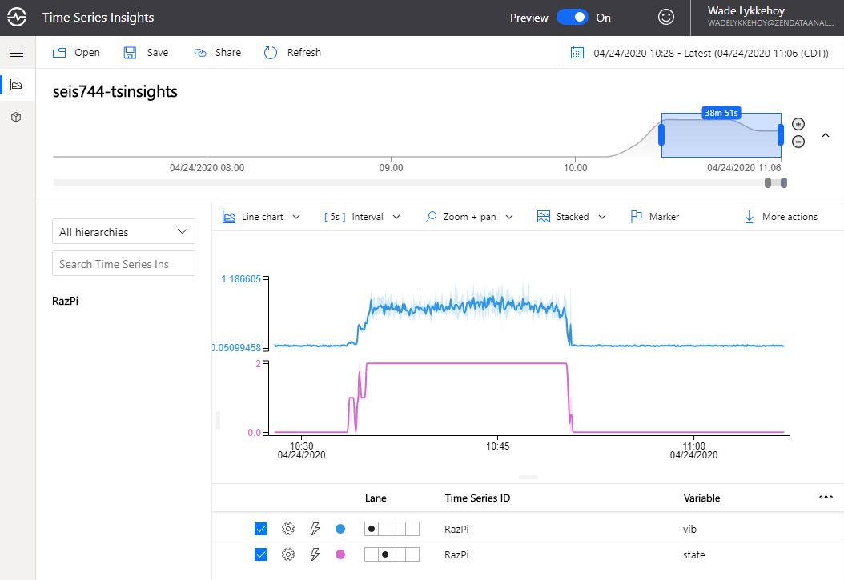

Slide 14
Applications
Send email when “unusual” vibration event detected
Dashboard with mash-up of data

Slide 15
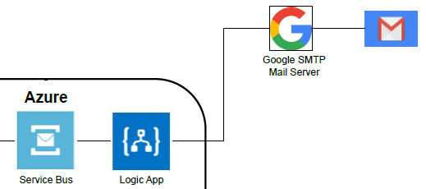
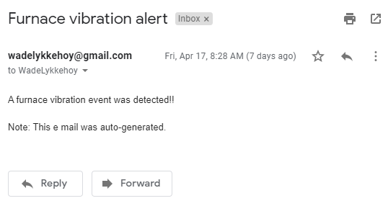
Applications - email
Logic App
Retrieves message from Service Bus (“abnormal” vibration messages)
Sends email via Google’s SMTP mail server

Slide 16
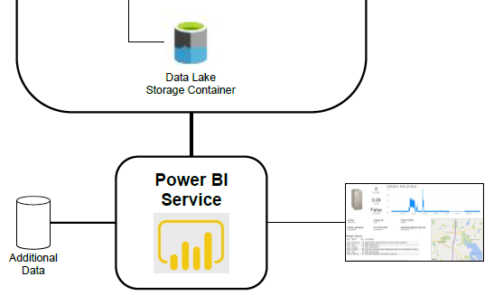
Applications - Dashboard
Power BI
“Thing” data from the Data Lake
Additional data from “other” data source (CSV files)

Slide 17
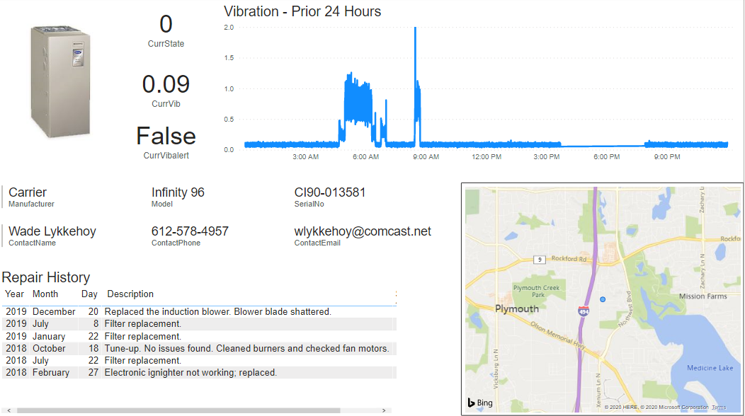

Slide 18
People & Processes
Speculative
Home owner
Enables seeking maintenance prior to total failure
A “when needed” tune-up program => $$ savings
Furnace repair provider
Enables early action when an issue is developing
Knowing cause prior to repair visit => time and $$ savings plus customer satisfaction
Regular maintenance when needed vs calendar basis => $$ savings
Enabler of an as-a-service model

Slide 19
Challenges & Lessons Learned
Tech stack complexity
25 apps / tools / libraries used
This was a simpler tech stack due to smaller scope
Azure ecosystem is large, complex, and rapidly evolving/changing
Lack of or out of date documentation
Furnace is not simply on or off (domain knowledge!)
Amount of data adds up quickly!
1 message per second => approx 55 meg per day

Slide 20
Challenges & Lessons Learned
Measuring vibration is not as simple as I originally (naively) thought
Sensor produces acceleration in X / Y / Z directions
Must turn that into a measure of vibration
Determining vibration thresholds; lack of baseline data
Azure “surprises”
Adds overhead to messages => increased data storage needs
Base64 encoding of message data/payload when stored in Data Lake
Data Lake forces storage hierarchy with 1 file per minute

Slide 21
Q & A

