Slide 1
Chapter 7 Objects and Classes

Slide 2
OO Programming Concepts
Object-oriented programming (OOP) involves programming using objects. An object represents an entity in the real world that can be distinctly identified. For example, a student, a desk, a circle, a button, and even a loan can all be viewed as objects. An object has a unique identity, state, and behaviors. The state of an object consists of a set of data fields (also known as properties) with their current values. The behavior of an object is defined by a set of methods.

Slide 3
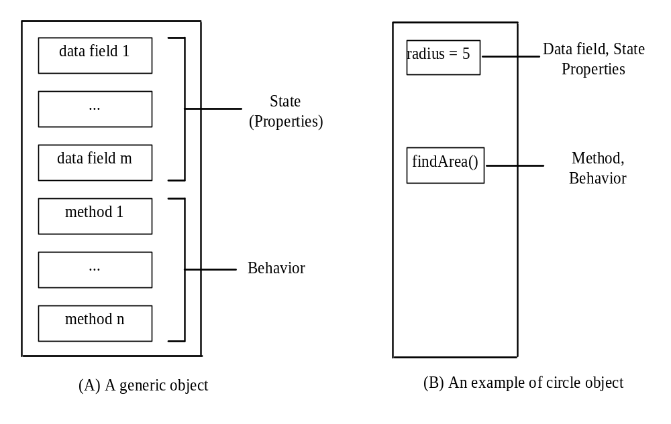
An object has unique identity
state
behaviors
State(attributes) consists of a set of data fields (properties) with their current values.
Behavior(operations) of an object is defined by a set of methods.

Slide 4
Classes:
  People,books,dogs,cats,cars,airplanes,trains,etc.
Instance of a class
  You, your parents, the book you are reading, the car you drive
Example: Car class
  Property names Method Names
  model startEngine
  year stopEngine
  Color accelerate

Slide 5
public class Student {
private String name;
private String studentID;
private String surname;
private Course[] takenCourses;
private int state;
public void takeCourse(Course course) {
.
.
.
}
public void payTuition() {
.
.
.
}
}

Slide 6
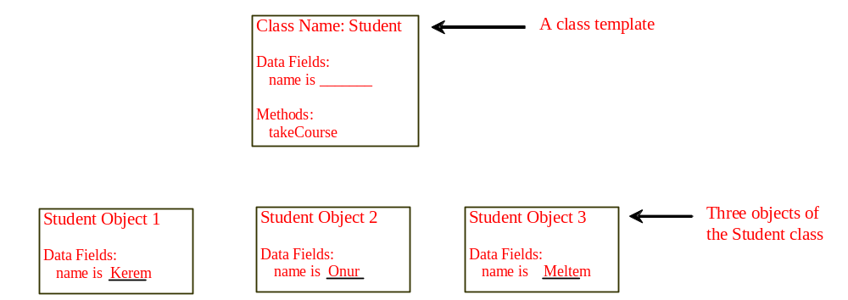
Objects
An object has both a state and behavior. The state defines the object, and the behavior defines what the object does.

Slide 7
class Planet
{
public double radius;
public String name;
public static final long g = 10;
public void display()
{
System.out.println("Radius "+ radius);
System.out.println("Name " + name);
System.out.println("Long "+ g);
}
public void initialize()
{
radius = 10; //usage
name = "Dunya"; //usage
}
}
class ExPlanet
{
public static void main(String [] args)
{
Planet p = new Planet(); // creation
p. initialize(); //usage
p.display(); //usage
}
}

Slide 8
Classes
Classes are constructs that define objects of the same type. (Building plan of similar objects)
A Java class uses variables to define data fields and methods to define behaviors.
A class provides a special type of methods, known as constructors, which are invoked to construct objects from the class.

Slide 9
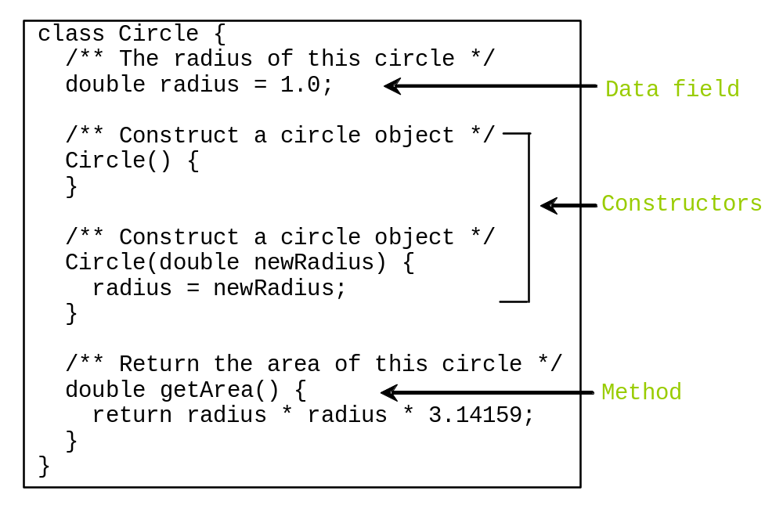
Classes

Slide 10
Constructors
Constructors are a special kind of methods that are invoked to perform initializing actions.
Circle() {
}
Circle(double newRadius) {
radius = newRadius;
}

Slide 11
Constructors, cont.
A constructor with no parameters is referred to as a no-arg constructor.
· Constructors must have the same name as the class itself.
· Constructors do not have a return type—not even void.
· Constructors are invoked using the new operator when an object is created. Constructors play the role of initializing objects.

Slide 12
class Emp
{
private String name;
private String id;
private int salary;
Emp() // default constructor. No argument list
{
name = “Ahmet";
id = "1234";
salary = 100;
}
public Emp(String n, String i, int s) // non-default constructor
{
name = n;
id = i;
salary = s;
}
void display()
{
System.out.println("\nEmploye Info ");
System.out.println("Name "+ name);
System.out.println("ID "+ id);
System.out.println("Salary "+ salary);
}
}

Slide 13
class ExEmp
{
public static void main(String [] args)
{
Emp e1 = new Emp();
e1.display();
Emp e4 = new Emp("Ali","98745", 400);
e4.display();
}
}

Slide 14
Creating Objects Using Constructors
new ClassName();
Example:
new Circle();
new Circle(5.0);

Slide 15
Default Constructor
A class may be declared without constructors. In this case, a no-arg constructor with an empty body is implicitly declared in the class. This constructor, called a default constructor, is provided automatically only if no constructors are explicitly declared in the class.

Slide 16
public class Student {
private String name;
private String studentID;
private String surname;
private Course[] takenCourses;
private int state;
public Student(String nameParam,String surnameParam) {
name=nameParam;
surname=surnameParam;
}
public static void main(String[] args) {
Student s1 = new Student(“Onur”,”Saran”);
}
}

Slide 17
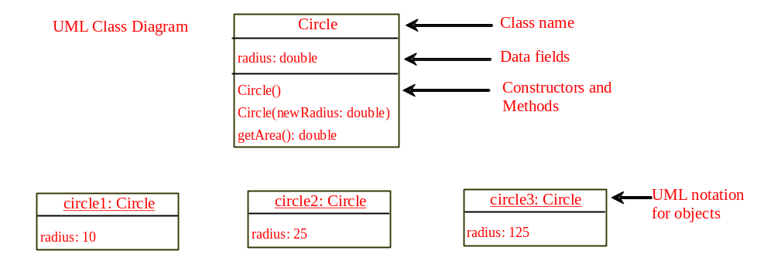
UML Class Diagram(Unified Modeling Languauge)

Slide 18
Declaring/Creating Objects in a Single Step
ClassName objectRefVar = new ClassName();
Example:
Circle myCircle = new Circle();

Slide 19
Accessing Objects
Referencing the object’s data:
objectRefVar.data
e.g., myCircle.radius
Invoking the object’s method:
objectRefVar.methodName(arguments)
e.g., myCircle.getArea()

Slide 20
// Define the circle class with two constructors
class Circle1 {
double radius;
/** Construct a circle with radius 1 */
Circle1() {
radius = 1.0;
}
/** Construct a circle with a specified radius */
Circle1(double newRadius) {
radius = newRadius;
}
/** Return the area of this circle */
double getArea() {
return radius * radius * Math.PI;
}
}
public class TestCircle1 {
public static void main(String[] args) {
// Create a circle with radius 5.0
Circle1 myCircle = new Circle1(5.0);
System.out.println("The area of the circle of radius " + myCircle.radius + " is " + myCircle.getArea());
// Create a circle with radius 1
Circle1 yourCircle = new Circle1();
System.out.println("The area of the circle of radius " + yourCircle.radius + " is " + yourCircle.getArea());
// Modify circle radius
yourCircle.radius = 100;
System.out.println("The area of the circle of radius " + yourCircle.radius + " is " + yourCircle.getArea());
}
}

Slide 21
Caution
Recall that you use
  Math.methodName(arguments) (e.g., Math.pow(3, 2.5))
to invoke a method in the Math class. Can you invoke getArea() using Circle1.getArea()? The answer is no. All the methods used before this chapter are static methods, which are defined using the static keyword. However, getArea() is non-static. It must be invoked from an object using
  objectRefVar.methodName(arguments) (e.g., myCircle.getArea()).

Slide 22
Reference Data Fields
The data fields can be of reference types. For example, the following Student class contains a data field name of the String type.
public class Student {
String name; // name has default value null
int age; // age has default value 0
boolean isScienceMajor; // isScienceMajor has default value false
char gender; // c has default value '\u0000'
}

Slide 23
Default Value for a Data Field
The default value of a data field is null for a reference type, 0 for a numeric type, false for a boolean type, and '\u0000' for a char type. However, Java assigns no default value to a local variable inside a method.
public class Test {
public static void main(String[] args) {
Student student = new Student();
System.out.println("name? " + student.name);
System.out.println("age? " + student.age);
System.out.println("isScienceMajor? " + student.isScienceMajor);
System.out.println("gender? " + student.gender);
}
}

Slide 24
Example
Java assigns no default value to a local variable inside a method.
public class Test {
public static void main(String[] args) {
int x; // x has no default value
String y; // y has no default value
System.out.println("x is " + x);
System.out.println("y is " + y);
}
}
Compilation error: variables not initialized

Slide 25

Differences between Variables of
Primitive Data Types and Object Types

Slide 26

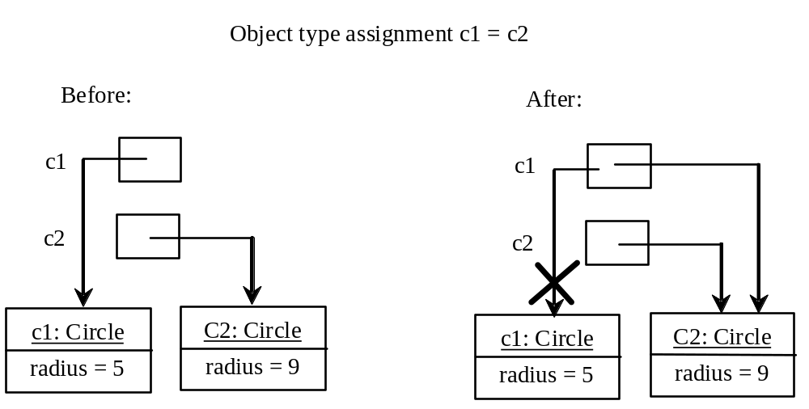
Copying Variables of Primitive Data Types and Object Types

Slide 27
Garbage Collection
As shown in the previous figure, after the assignment statement c1 = c2, c1 points to the same object referenced by c2. The object previously referenced by c1 is no longer referenced. This object is known as garbage. Garbage is automatically collected by JVM.

Slide 28

The Date Class
Java provides a system-independent encapsulation of date and time in the java.util.Date class. You can use the Date class to create an instance for the current date and time and use its toString method to return the date and time as a string.

Slide 29
The Date Class Example
For example, the following code
  java.util.Date date = new java.util.Date();
  System.out.println(date.toString());
displays a string like Sun Mar 09 13:50:19 EST 2003.

Slide 30

The Random Class
You have used Math.random() to obtain a random double value between 0.0 and 1.0 (excluding 1.0). A more useful random number generator is provided in the java.util.Random class.

Slide 31
The Random Class Example
If two Random objects have the same seed, they will generate identical sequences of numbers. For example, the following code creates two Random objects with the same seed 3.
Random random1 = new Random(3);
System.out.print("From random1: ");
for (int i = 0; i < 10; i++)
System.out.print(random1.nextInt(1000) + " ");
Random random2 = new Random(3);
System.out.print("\nFrom random2: ");
for (int i = 0; i < 10; i++)
System.out.print(random2.nextInt(1000) + " ");
From random1: 734 660 210 581 128 202 549 564 459 961
From random2: 734 660 210 581 128 202 549 564 459 961

Slide 32
Instance
Variables, and Methods
Instance variables belong to a specific instance.
Instance methods are invoked by an instance of the class.

Slide 33
Static Variables, Constants, and Methods
Static variables are shared by all the instances of the class.
Static methods are not tied to a specific object.
Static constants are final variables shared by all the instances of the class.

Slide 34
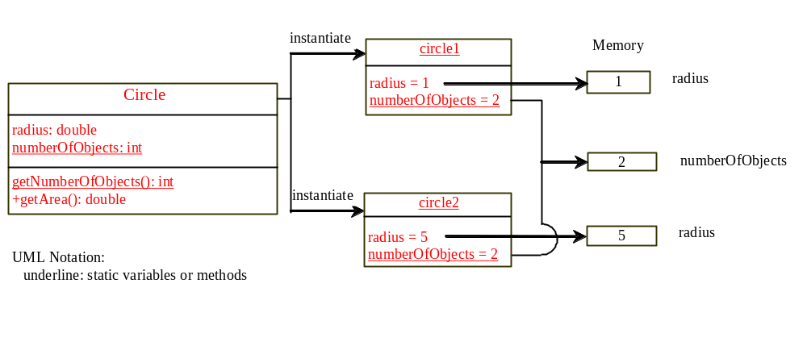
Static Variables, Constants, and Methods, cont.

Slide 35
public class TestCircle2 {
/** Main method */
public static void main(String[] args) {
// Create c1
Circle2 c1 = new Circle2();
// Display c1 BEFORE c2 is created
System.out.println("Before creating c2");
System.out.println("c1 is : radius (" + c1.radius +
") and number of Circle objects (" +
c1.numberOfObjects + ")");
// Create c2
Circle2 c2 = new Circle2(5);
// Change the radius in c1
c1.radius = 9;
// Display c1 and c2 AFTER c2 was created
System.out.println("\nAfter creating c2 and modifying " +
"c1's radius to 9");
System.out.println("c1 is : radius (" + c1.radius +
") and number of Circle objects (" +
c1.numberOfObjects + ")");
System.out.println("c2 is : radius (" + c2.radius +
") and number of Circle objects (" +
c2.numberOfObjects + ")");
}
}
public class Circle2 {
/** The radius of the circle */
double radius;
/** The number of the objects created */
static int numberOfObjects = 0;
/** Construct a circle with radius 1 */
Circle2() {
radius = 1.0;
numberOfObjects++;
}
/** Construct a circle with a specified radius */
Circle2(double newRadius) {
radius = newRadius;
numberOfObjects++;
}
/** Return numberOfObjects */
static int getNumberOfObjects() {
return numberOfObjects;
}
/** Return the area of this circle */
double getArea() {
return radius * radius * Math.PI;
}
}

Slide 36
Visibility Modifiers and
Accessor/Mutator Methods
public
The class, data, or method is visible to any class in any package.
private
The data or methods can be accessed only by the declaring class. The get and set methods are used to read and modify private properties.
By default, the class, variable, or method can be
accessed by any class in the same package.

Slide 37
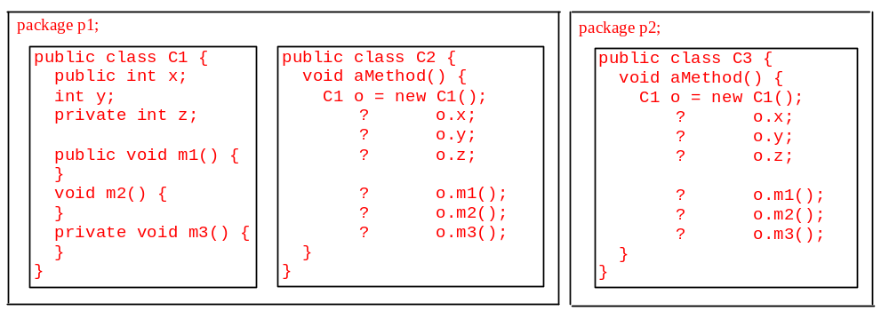
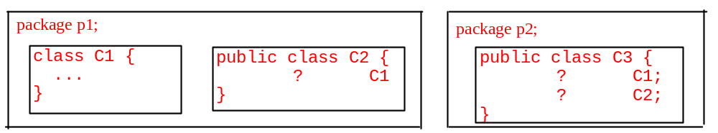
The private modifier restricts access to within a class, the default modifier restricts access to within a package, and the public modifier enables unrestricted access.

Slide 38
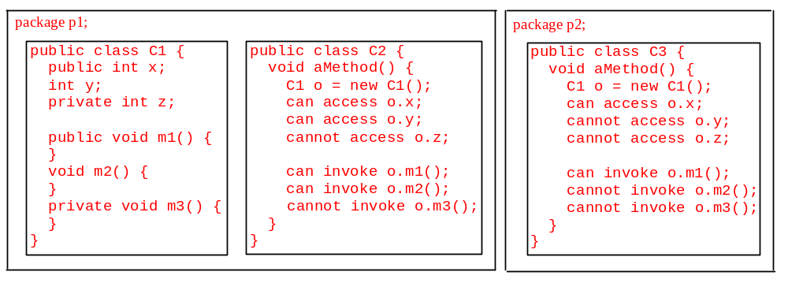
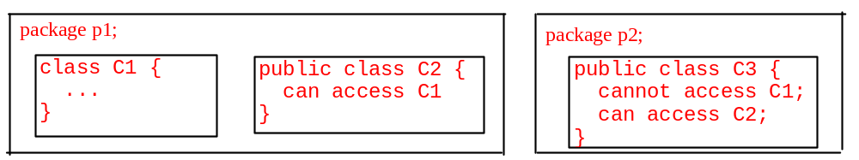
The private modifier restricts access to within a class, the default modifier restricts access to within a package, and the public modifier enables unrestricted access.

Slide 39
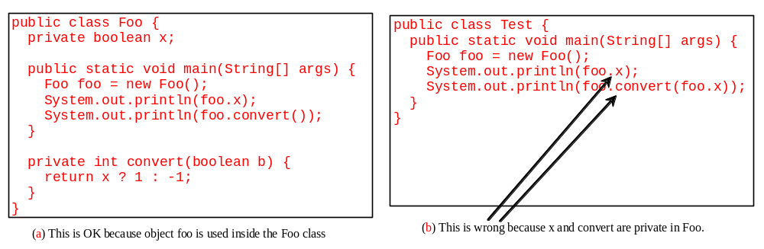
NOTE
An object cannot access its private members, as shown in (b). It is OK, however, if the object is declared in its own class, as shown in (a).

Slide 40
Why Data Fields Should Be private?
To protect data.
To make class easy to maintain.

Slide 41

Example of
Data Field Encapsulation

Slide 42
public class Circle3 {
/** The radius of the circle */
private double radius = 1;
/** Construct a circle with radius 1 */
public Circle3() {
}
/** Construct a circle with a specified radius */
public Circle3(double newRadius) {
radius = newRadius;
}
/** Return radius */
public double getRadius() {
return radius;
}
/** Set a new radius */
public void setRadius(double newRadius) {
radius = (newRadius >= 0) ? newRadius : 0;
}
/** Return the area of this circle */
public double getArea() {
return radius * radius * Math.PI;
}
}

Slide 43
Immutable Objects and Classes
If the contents of an object cannot be changed once the object is created, the object is called an immutable object and its class is called an immutable class. If you delete the set method in the Circle class in the preceding example, the class would be immutable because radius is private and cannot be changed without a set method.
A class with all private data fields and without mutators is not necessarily immutable. For example, the following class Student has all private data fields and no mutators, but it is mutable.

Slide 44
Example
public class BirthDate {
private int year;
private int month;
private int day;
public BirthDate(int newYear,
int newMonth, int newDay) {
year = newYear;
month = newMonth;
day = newDay;
}
public void setYear(int newYear) {
year = newYear;
}
}
public class Student {
private int id;
private BirthDate birthDate;
public Student(int ssn,
int year, int month, int day) {
id = ssn;
birthDate = new BirthDate(year, month, day);
}
public int getId() {
return id;
}
public BirthDate getBirthDate() {
return birthDate;
}
}
public class Test {
public static void main(String[] args) {
Student student = new Student(111223333, 1970, 5, 3);
BirthDate date = student.getBirthDate();
date.setYear(2010); // Now the student birth year is changed!
}
}

Slide 45
What Class is Immutable?
For a class to be immutable, it must mark all data fields private and provide no mutator methods and no accessor methods that would return a reference to a mutable data field object.

Slide 46
Passing Objects to Methods
Passing by value for primitive type value (the value is passed to the parameter)
Passing by value for reference type value (the value is the reference to the object)

Slide 47
public class TestPassObject {
/** Main method */
public static void main(String[] args) {
// Create a Circle object with radius 1
Circle3 myCircle = new Circle3(1);
// Print areas for radius 1, 2, 3, 4, and 5.
int n = 5;
printAreas(myCircle, n);
// See myCircle.radius and times
System.out.println("\n" + "Radius is " + myCircle.getRadius());
System.out.println("n is " + n);
}
/** Print a table of areas for radius */
public static void printAreas(Circle3 c, int times) {
System.out.println("Radius \t\tArea");
while (times >= 1) {
System.out.println(c.getRadius() + "\t\t" + c.getArea());
c.setRadius(c.getRadius() + 1);
times--;
}
}
}

